Slide 1
静态面板模型 FE v.s. RE

Slide 2
Pooled OLS
Cross-sectional: y_{i} = a + X_{i} β + ε_{i}
Panel Data: y_{it} = a + X_{it} β + ε_{it}
估计方法
OLS reg y x
局限？
不可观测的个体效应

Slide 3
Fixed Effects (FE) v.s. Random Effects (RE) models
估计方法
OLS + firm dummies GLS
Stata commands
xtreg y x, fe xtreg y x, re
reg y x i.id
areg y x, absorb(id)
FE
u_{it}
Z_{it}γ
RE

Slide 4
Fixed Effects model (FE)
(1)−(2)+(3)
Within-group Estimator, De-meaned Estimator, 组内去心
OLS regress

Slide 5
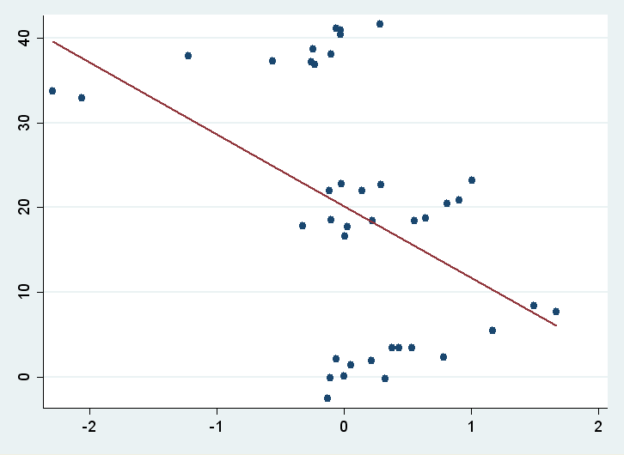
Relationship between POLS and FE
Case I

Slide 6
Relationship between POLS and FE
Case II

Slide 7
Review
Pooled OLS (POLS)
y_{it} = a + X_{it} β + ε_{it} || reg y x
Between effect model (BE)
|| xtreg y x, be
Fixed effects model (FE)
|| xtreg y x, fe
Random effects model (RE)
|| xtreg y x, re

Slide 8
over

