Slide 1
Best Stops of the Future Subway
Presented by Hello Data:
Yi Zhang
Yilun Zhang
Jiajia Yin

Slide 2

Content
Introduction
Motivation
Approach
Conclusion
Notes:
For years, many of the people of Mississauga have bemoaned the lack of a subway

Slide 3
Introduction
Mississauga might need a subway system in the future:
For convenience
For economical benefit
For stimulating growth and development
Determining where the stops go is VITAL
We propose a novel, real-time, automated technological solution
Notes:
For years, many of the people of Mississauga have bemoaned the lack of a subway

Slide 4
Motivation
Making the data as well as the solution public
Having historical trend as well as current data available
Decisions can be made collectively by Mississauga residents
Promote greater awareness and engagement with the Mississauga community
Notes:
For years, many of the people of Mississauga have bemoaned the lack of a subway

Slide 5
Approach - Data
Data we used (total of 6 data sources)
Office building data
Residence data
Eateries data
Parking ticket data
Cleaning
Used Google Map API to map street number + name / postal code to longitude and latitude values
Removed all entries with no-match/miss-match or missing data

Slide 6
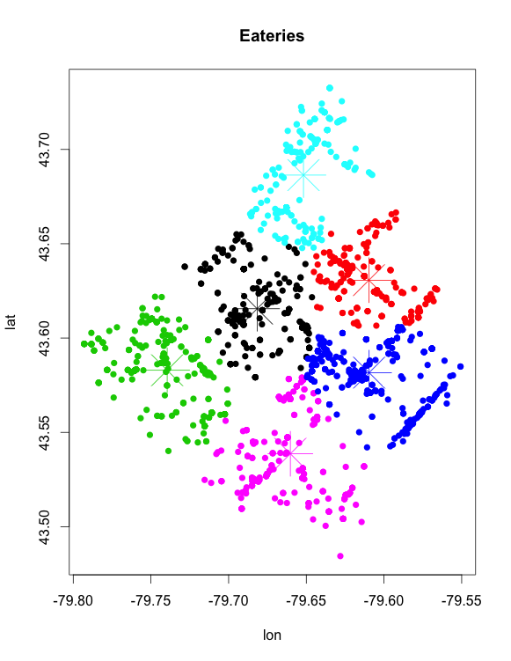
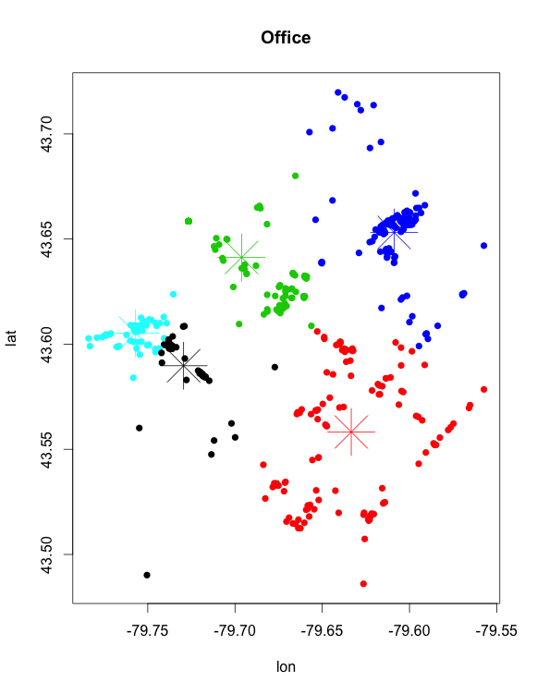
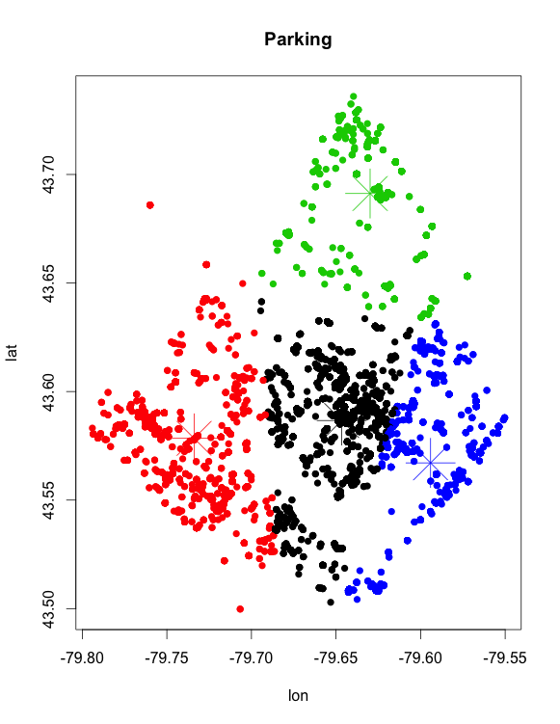
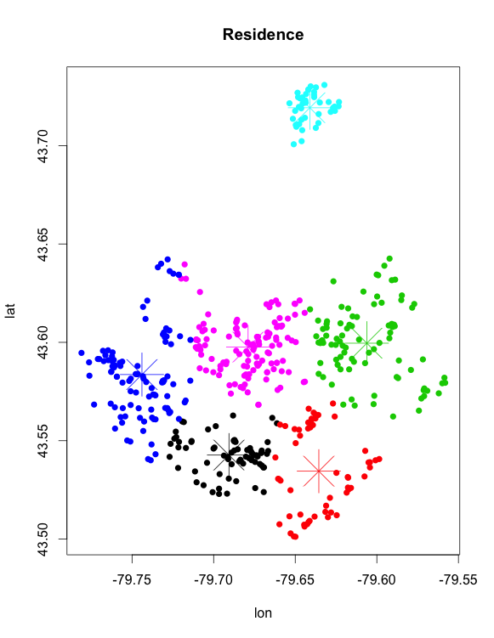
Approach - Method
K-mean clustering algorithm to find the center for each type of data

Slide 7
Approach – Score calculation
Overlay all the cluster centers
Assign importance score to each type of data
Office (8), residence (5), eateries (3), parking (2)
A density score for a point in the city is calculated by: the importance score of the center type times the distance from the point to the center
Higher score -> busier area, more population
Overlay the scores and a contour plot on the map of Mississauga

Slide 8
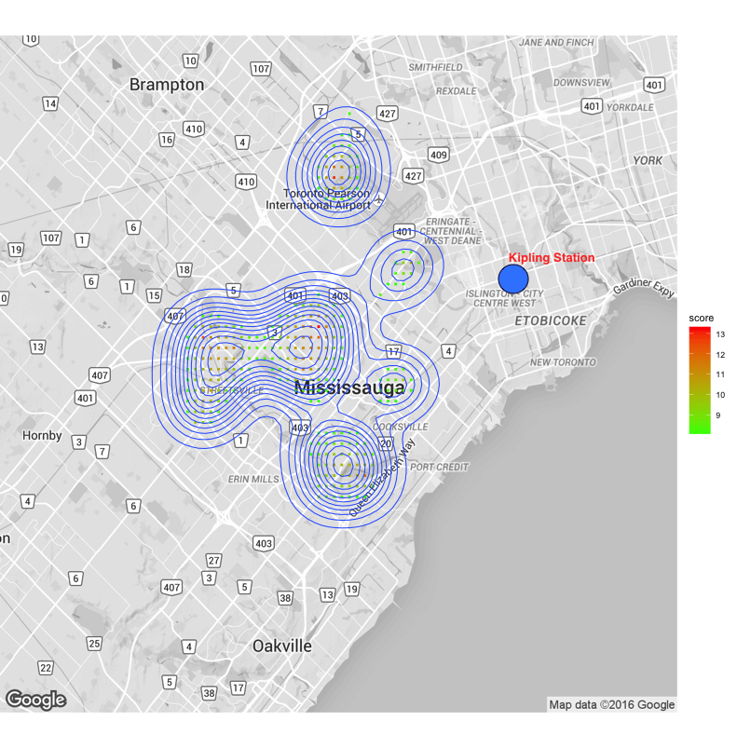
Approach – Map Visualization
With a real-time map application (web), we can monitor the changes of city density centers …
By analyzing the trend, we can also identify the movement of city centers and plan for the future …
Using Google Map API

Slide 9
Conclusion
Novel approach to subway stations
Real time update, historical trend and current data all publicly available
More involvement and engagement of residents
Can be improved with more complete census, local business, and traffic data
Notes:
For years, many of the people of Mississauga have bemoaned the lack of a subway

