Slide 1
Reduction of repeating tokens generated by encoder-decoder model
ZHANG YING
Supervisor: Okumura Manabu

Slide 2
Outline
Background
Related Research
Proposed Method
Experiment
Conclusion

Slide 3
Background
The encoder-decoder model is the model that consists of two neural networks. The past years have witnessed the rapid progress of this model. Now, this model is widely used to solve natural language processing tasks, such as
machine translation, for example, Google translation
text summarization
poetry generation
grammatical error correction
response generation
…

Slide 4
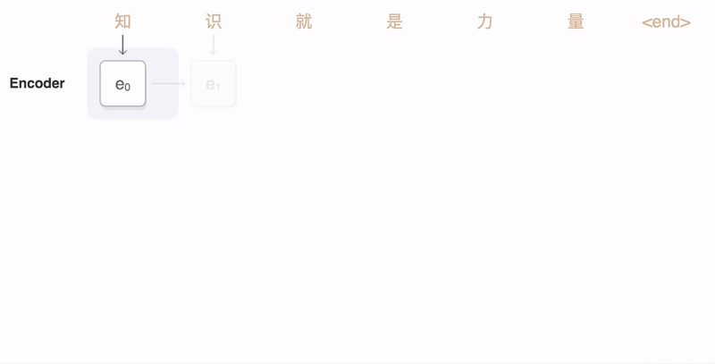
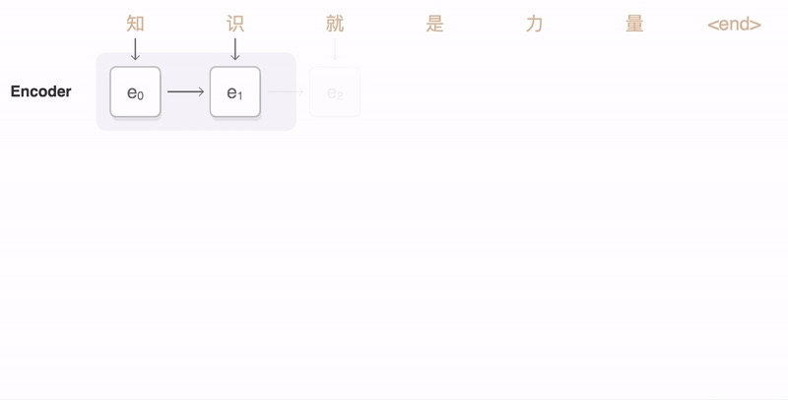
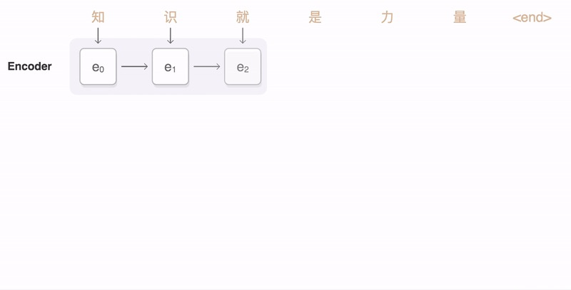
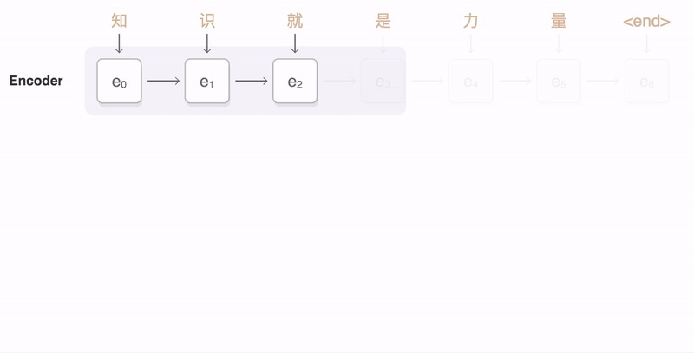
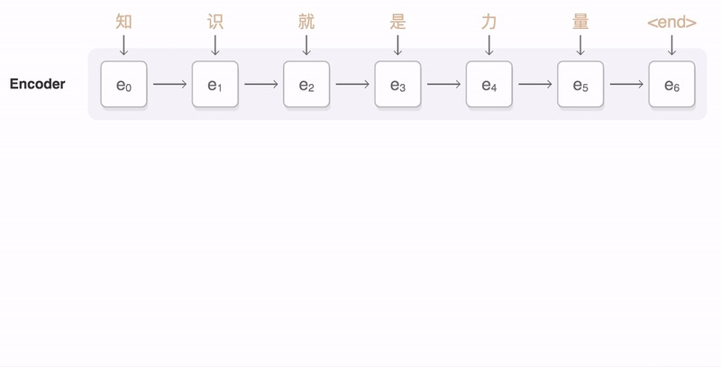
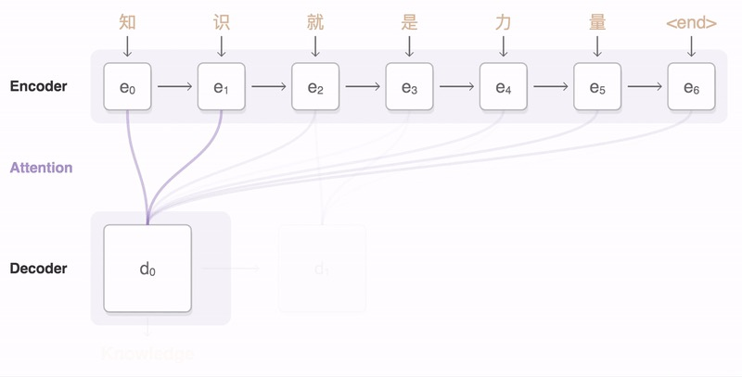
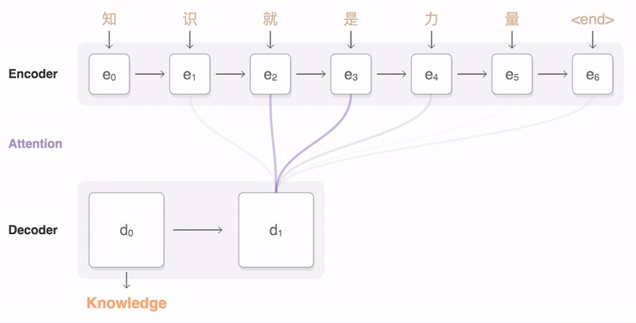
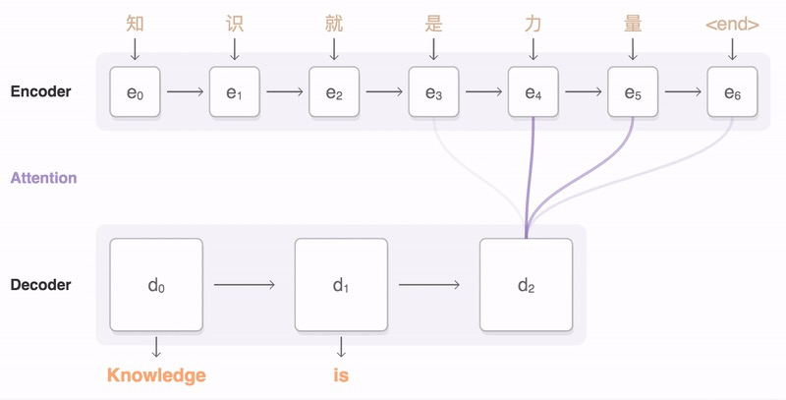
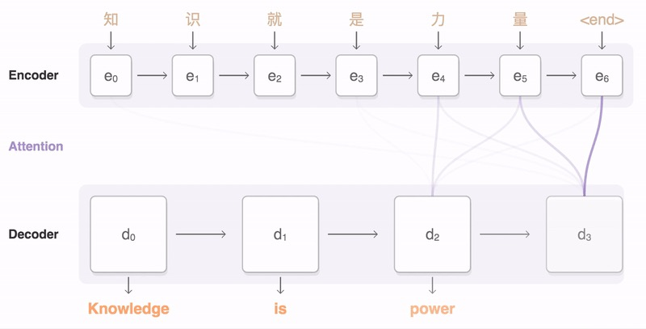
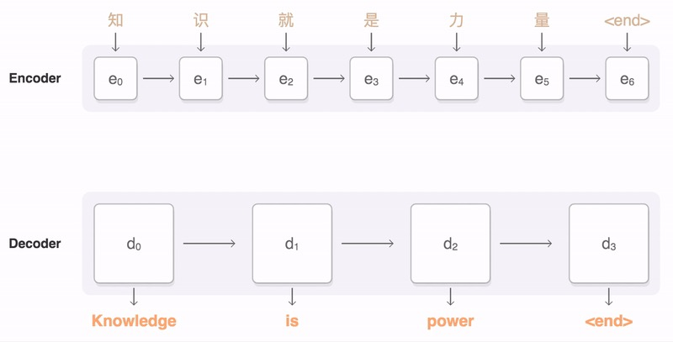
Background
Train
Select word that has highest possibility

Slide 5
Background
Test
Repeating tokens

Slide 6
Outline
Background
Related Research
Proposed Method
Experiment
Conclusion

Slide 7
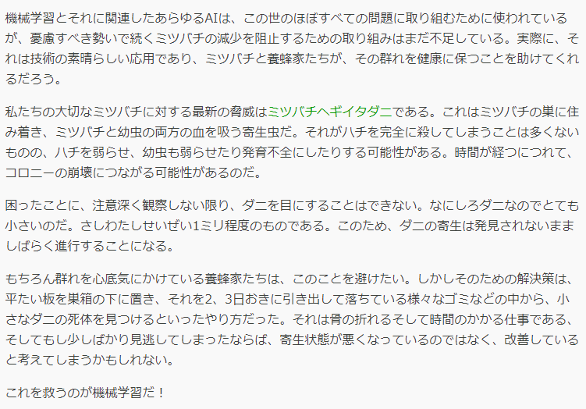

Related Research
ニューラルヘッドライン生成における誤生成問題の改善(SPM) [1]
news
headline
Enc-Dec
Example:
Input: I come from China and …
Gold: I am Chinese
<EOS>
<EOS>
<PAD> … <PAD>

Slide 8


















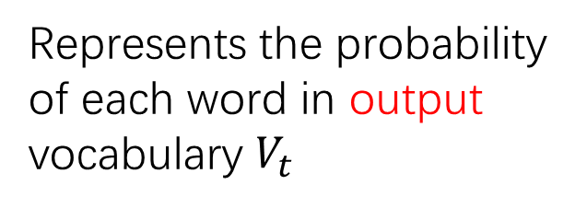





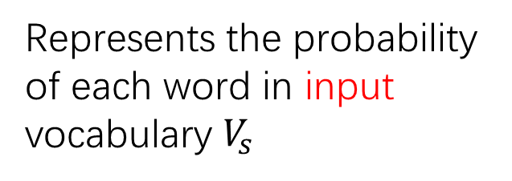




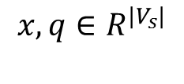

Related Research
ニューラルヘッドライン生成における誤生成問題の改善(SPM)
$${loss}_{trg}\left(Y^{′},X,θ\right)=−log\left(p\left(Y^{′} | X\right),\text{θ}\right)$$
SUM
Cross Ent.
Cross Ent.
Cross Ent.
Cross Ent.
$$x,q∈R^{{|V}_{s}|}$$
I
Chinese
<EOS>
<PAD>
$$y_{1}$$
$$y_{J}$$
$$y_{J+1}$$
$$y_{I}$$
$$o∈R^{|V_{t}|}$$
Represents the probability of each word in output vocabulary $V_{t}$
$$o_{1}$$
$$o_{J}$$
$$o_{J+1}$$
$$o_{I}$$
$o_{1}$=softmax($W_{o}{\tilde{z}}_{1}+$ $b_{o}$)
${\tilde{z}}_{j}$=AttnDec($y_{j−1}$, $h_{1:I}$)
Encoder
RNN ${\tilde{z}}_{1}$
RNN ${\tilde{z}}_{J}$
RNN ${\tilde{z}}_{J+1}$
RNN ${\tilde{z}}_{I}$
$q_{1}$=softmax($W_{q}{\tilde{z}}_{1}+$ $b_{q}$)
$$q_{1}$$
$$q_{J}$$
$$q_{J+1}$$
$$q_{I}$$
$$Χ\left\{\begin{aligned}x_{1} \\ x_{2} \\ \begin{matrix}x_{3} \\ \begin{matrix}… \\ x_{I}\end{matrix}\end{matrix}\end{aligned}\right.$$
I
come
SUM
from
Sum=1
SUM
$$…$$
$$…$$
Represents the probability of each word in input vocabulary $V_{s}$
.
$$\tilde{x}$$
$$\tilde{q}$$
One-hot
$${loss}_{src}\left(\tilde{x},X,Y^{′},γ,θ\right)=\frac{1}{C}{\left\|\tilde{q}−\tilde{x}\right\|}_{2}^{2}+log⁡(Z)$$

Slide 9
Outline
Background
Related Research
Proposed Method
Experiment
Conclusion

Slide 10








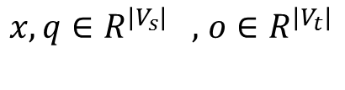

Proposed Method
ニューラルヘッドライン生成における誤生成問題の改善(SPM)
$${loss}_{trg}\left(Y^{′},X,θ\right)=−log\left(p\left(Y^{′} | X\right),\text{θ}\right)$$
SUM
Cross Ent.
Cross Ent.
Cross Ent.
Cross Ent.
$x,q∈R^{|V_{s}|} ,$ $o∈R^{|V_{t}|}$
I
Chinese
<EOS>
<PAD>
$$y_{1}$$
$$y_{J}$$
$$y_{J+1}$$
$$y_{I}$$
$$o_{1}$$
$$o_{J}$$
$$o_{J+1}$$
$$o_{I}$$
$o_{1}$=softmax($W_{o}{\tilde{z}}_{1}+$ $b_{o}$)
${\tilde{z}}_{j}$=AttnDec($y_{j−1}$, $h_{1:I}$)
Encoder
RNN ${\tilde{z}}_{1}$
RNN ${\tilde{z}}_{J}$
RNN ${\tilde{z}}_{J+1}$
RNN ${\tilde{z}}_{I}$
$q_{1}$=softmax($W_{q}{\tilde{z}}_{1}+$ $b_{q}$)
$$q_{1}$$
$$q_{J}$$
$$q_{J+1}$$
$$q_{I}$$
$$Χ\left\{\begin{aligned}x_{1} \\ x_{2} \\ \begin{matrix}x_{3} \\ \begin{matrix}… \\ x_{I}\end{matrix}\end{matrix}\end{aligned}\right.$$
I
come
SUM
from
SUM
$$…$$
$$…$$
.
$$\tilde{x}$$
$$\tilde{q}$$
One-hot
$${loss}_{src}\left(\tilde{x},X,Y^{′},γ,θ\right)=\frac{1}{C}{\left\|\tilde{q}−\tilde{x}\right\|}_{2}^{2}+log⁡(Z)$$

Slide 11





Proposed Method
Represent sum word frequency of input
Represent sum word frequency of decoded (input)
Represent average word frequency of input
Represent average word frequency of decoded(input)
Sum= $length\left(Input\right)$
Sum= $length(\text{decoded}\text{(}\text{input}\text{)})$
$$\tilde{x}$$
$$\tilde{q}$$
$$\frac{\tilde{x}}{length(Input)}$$
$$\frac{\tilde{q}}{length(Output)}$$
$${loss}_{src}\left(\tilde{x},X,Y^{′},γ,θ\right)=\frac{1}{C}{\left\|\tilde{q}−\tilde{x}\right\|}_{2}^{2}+log⁡(Z)$$
Adjust the way to compute word frequency

Slide 12

Proposed Method
$${loss}_{src}\left(\tilde{x},X,Y^{′},γ,θ\right)=\frac{1}{C}{\left\|\tilde{q}−\tilde{x}\right\|}_{2}^{2}+log⁡(Z)$$
Source: I have a puppy
Candidate 1: I have a dog
Candidate 2: I have a cat
Candidate 1 and 2 have same similarity with Source.

Slide 13
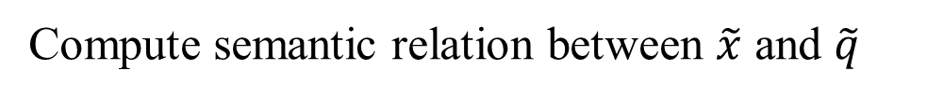
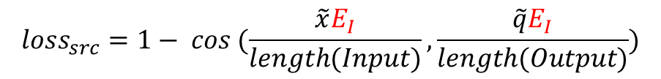




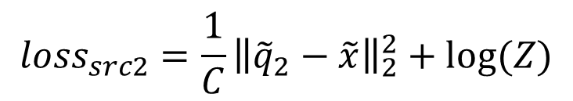

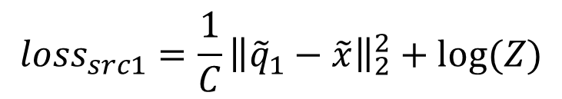
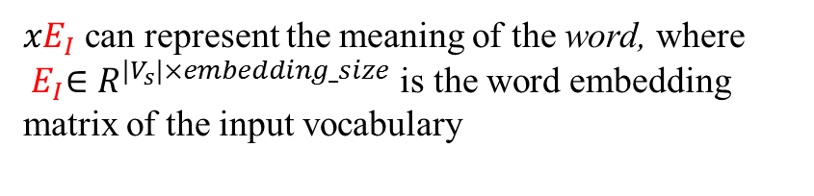

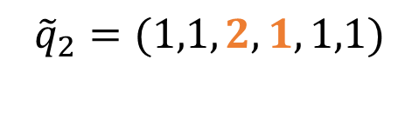

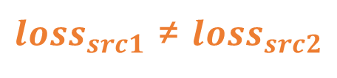
Proposed Method
$$\tilde{x}=(1,1,1,0,1,1)$$
Can I use your phone
One-hot vector $x$ represents a specific word
$$x$$
${xE}_{I}$ can represent the meaning of the word, where ${ E}_{I}∈R^{{|V}_{s}|×embedding_size}$ is the word embedding matrix of the input vocabulary
“use”
“utilize”
$${\tilde{q}}_{1}=(1,1,1,2,1,1)$$
$${\tilde{q}}_{2}=(1,1,2,1,1,1)$$
RNN ${\tilde{z}}_{j}$
$q_{j}$=softmax($W_{q}{\tilde{z}}_{j}+$ $b_{q}$)
${q_{j}E}_{I}$ can represent the meaning of $q_{j}$
$${loss}_{src1}=\frac{1}{C}{\left\|{\tilde{q}}_{1}−\tilde{x}\right\|}_{2}^{2}+log⁡(Z)$$
$$q_{j}$$
$${loss}_{src2}=\frac{1}{C}{\left\|{\tilde{q}}_{2}−\tilde{x}\right\|}_{2}^{2}+log⁡(Z)$$
$${loss}_{src}=1− cos (\frac{\tilde{x}E_{I}}{length(Input)},\frac{\tilde{q}E_{I}}{length(Output)})$$
${loss}_{src1}$ ≠ ${loss}_{src2}$
Compute semantic relation between $\tilde{x}$ and $\tilde{q}$

Slide 14


























Proposed Method
Repetition Reduction Model(RRM)
$${loss}_{trg}\left(Y,X,θ\right)$$
SUM
$$E_{I}∈R^{|V_{s}|\text{×}H}$$
Cross Ent.
Cross Ent.
Cross Ent.
Cross Ent.
私
は
中国人
<EOS>
$$y_{1}$$
$$y_{2}$$
$$y_{3}$$
$$y_{J}$$
$$o_{1}$$
$$o_{2}$$
$$o_{3}$$
$$o_{J}$$
Encoder
RNN ${\tilde{z}}_{1}$
RNN ${\tilde{z}}_{2}$
RNN ${\tilde{z}}_{3}$
RNN ${\tilde{z}}_{J}$
$q_{1}=softmax$($W_{q}{\tilde{z}}_{1}+$ $b_{q}$)
I
$$q_{1}$$
$$q_{2}$$
$$q_{3}$$
$$q_{J}$$
$$Χ\left\{\begin{aligned}x_{1} \\ x_{2} \\ \begin{matrix}x_{3} \\ \begin{matrix}… \\ \begin{matrix}x_{I} \\ \end{matrix}\end{matrix}\end{matrix}\end{aligned}\right.$$
I
$$Χ\left\{\begin{aligned}x_{1} \\ x_{2} \\ \begin{matrix}x_{3} \\ \begin{matrix}… \\ x_{I}\end{matrix}\end{matrix}\end{aligned}\right.$$
am
come
Chinese
from
$$…$$
$$…$$
SUM
$$…$$
$$…$$
SUM
<EOS>
.
$$\tilde{x}$$
$$\tilde{q}$$
One-hot
$${loss}_{src}=1−cos (\frac{\tilde{x}E_{I}}{I},\frac{\tilde{q}E_{I}}{J})$$

Slide 15
Outline
Background
Related Research
Proposed Method
Experiment
Conclusion

Slide 16
Experiment - Machine Translation
Setting
Dataset | KFTT Japanese-English dataset
Train Data | 440k → 330,202（length <= 40）
Dev Data | 1166
Test Data | 1160
Tune Data | 1235
Ja Vocab Size | 146,726→67,178 (word frequency >= 2)
En Vocab Size | 190,063→69,283 (word frequency >= 2)
Early stop | 15
Batch Size | 80
Embed Size | 300
Hidden Size | 300
Optim | Adam
Learning Rate | 1e-3
Layer | 2
Bidirectional | True
RNN | LSTM
Decode Method | Beam search

Slide 17
Experiment - Machine Translation
Comparisons
Baseline: Seq2seq with attention by Luong et al. (2015)
Coverage model by Tu et al. (2016)
Metric
Multi-BLEU
Meteor | It consists of two major components: a flexible monolingual word aligner and a scorer. For machine translation evaluation, hypothesis sentences are aligned to reference sentences. Alignments are then scored to produce sentence and corpus level scores.
AER(Alignment Error Rate) | It is commonly used metric for assessing sentence alignments. It combines precision and recall metrics together such that a perfect alignment must have all of the sure alignments and may have some possible alignments
Optimized AER
Repeat

Slide 18
Experiment - Machine Translation
Metric
GOLD : I like apple and I also like cat.
Output : I like and also like like dog fish fish.
$$Repeat\left(word\right)=max\left\{count\left(output\left(word\right)\right)−count\left(gold\left(word\right)\right), 0\right\} when count\left(output\left(word\right)\right)>1$$
 | Output | GOLD | Repeat
I | 1 | 2 | 0
like | 3 | 2 | 1
dog | 1 | 0 | 0
fish | 2 | 0 | 2
… | … | … | …
SUM | - | - | 3

Slide 19
Experiment - Machine Translation
Result
Method | Japanese-English Test data
 | Words(ratio) | Repeat(rate) | Multi-BLEU | BLEU1 | BLEU2 | BLEU3 | BLEU4 | Meteor
Gold | 26734(1.000) | - | - | - | - | - | - | -
Baseline [2] | 30578(1.144) | 17575(0.5748) | 10.37 | 30.0 | 13.3 | 7.1 | 4.1 | 14.76
+RRM | 30058(1.123) | 16932(0.5633) | 11.51 | 31.2 | 14.4 | 8.0 | 4.9 | 15.38
Coverage [3] | 24024(0.899) | 6065(0.2525) | 18.06 | 52.9 | 25.7 | 14.3 | 8.6 | 21.68
+RRM | 23648(0.885) | 5511(0.2330) | 17.85 | 53.8 | 26.0 | 14.4 | 8.5 | 21.83

Slide 20
Experiment - Machine Translation
Result
Input | 最初にモウソウチク(孟宗竹)を持ち帰ったとする説もある。
Gold | Another story has it that he was the first one to bring Moso-chiku (Moso bamboo) to Japan.
Coverage | it is said that he first brought back the first time , he brought back to the first time .
+RRM | some say that he was first , he brought back the first time .

Slide 21
Experiment - Machine Translation
Result
Method | Tune data
 | AER | AER (opt)
Baseline [2] | 0.6564 | 0.6123
+RRM | 0.6185 | 0.5775
Coverage [3] | 0.6019 | 0.5550
+RRM | 0.5934 | 0.5503
Japanese: 過去 に は 一向 宗 、 門徒 宗 と も 通称 さ れ た 。
English: It used to also be called ikko shu and monto shu .

Slide 22

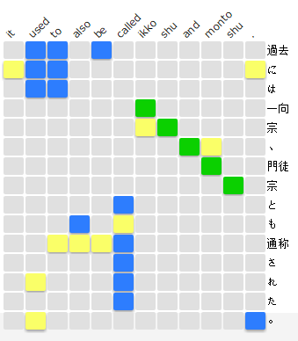
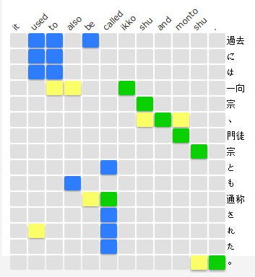

Experiment - Machine Translation
Result
Japanese: 過去 に は 一向 宗 、 門徒 宗 と も 通称 さ れ た 。
GOLD
English: It used to also be called ikko shu and monto shu .
OUTPUT
Both
Coverage
Coverage + RRM

Slide 23
Experiment - Machine Translation
Result
KFTT
Ja-En Test data

Slide 24
Experiment - Machine Translation
Result
KFTT
Ja-En Test data

Slide 25
Experiment - Machine Translation
Setting
Dataset | KFTT English-Japanese dataset
Train Data | 440k → 330,202（length <= 40）
Dev Data | 1166
Test Data | 1160
Tune Data | 1235
Ja Vocab Size | 146,726→67,178 (word frequency >= 2)
En Vocab Size | 190,063→69,283 (word frequency >= 2)
Early stop | 15
Batch Size | 80
Embed Size | 300
Hidden Size | 300
Optim | Adam
Learning Rate | 1e-3
Layer | 2
Bidirectional | True
RNN | LSTM
Decode Method | Greedy decode

Slide 26
Experiment - Machine Translation
Result
Method | English-Japanese Test data
 | Words(ratio) | Repeat(rate) | Multi-BLEU | BLEU1 | BLEU2 | BLEU3 | BLEU4 | Meteor
Gold | 28502(1.000) | - | - | - | - | - | - | -
Baseline | 34110(1.197) | 18470(0.5415) | 15.77 | 34.1 | 18.9 | 11.9 | 8.0 | 20.66
+RRM | 31933(1.120) | 16383(0.5130) | 16.57 | 36.3 | 20.1 | 12.5 | 8.3 | 20.67
Coverage[3] | 26725(0.938) | 4909(0.1837) | 22.80 | 55.1 | 30.1 | 18.1 | 11.7 | 26.93
+RRM | 25519(0.895) | 4325(0.1695) | 22.95 | 56.9 | 31.6 | 19.3 | 12.7 | 26.78

Slide 27
Experiment - Machine Translation
Result
 | Tune data
 | AER | AER(opt)
Baseline [2] | 0.6053 | 0.5437
+RRM | 0.6062 | 0.5434
Coverage [3] | 0.6220 | 0.5370
+RRM | 0.6304 | 0.5463

Slide 28
Experiment - Response Generation
Setting
Dataset | Facebook ParlAI PersonaChat dataset
Train Data | 65719
Dev Data | 7801
Test Data | 7512
Vocab Size | 19094
Early stop | 12
Pre-trained embedding | Glove
Batch Size | 64
Embed Size | 500
Hidden Size | 500
Optim | SGD
Learning Rate | 1
Layer | 2
Bidirectional | False
RNN | LSTM
Decode Method | Greedy decode

Slide 29
Experiment - Response Generation
Comparisons
Baseline: Seq2seq with attention by Luong et al. (2015)
Profile Memory model(PM) by Zhang et al. (2018)
Metric
Perplexity
F1
Hits@1 | Next utterance classification loss. It consists of choosing N random distractor responses from other dialogues and the model selecting the best response among them, resulting in a score of one if the model chooses the correct response, and zero otherwise.
Unique responses
Repeat

Slide 30
Experiment - Response Generation
Persona 1 | Persona 2
I like to ski My wife does not like me anymore I have went to Mexico 4 times this year I hate Mexican food I like to eat cheetos | I am an artist I have four children I recently got a cat I enjoy walking for exercise I love watching Game of Thrones
[PERSON 1:] Hi [PERSON 2:] Hello ! How are you today ? [PERSON 1:] I am good thank you , how are you. [PERSON 2:] Great, thanks ! My children and I were just about to watch Game of Thrones. [PERSON 1:] Nice ! How old are your children? [PERSON 2:] I have four that range in age from 10 to 21. You? [PERSON 1:] I do not have children at the moment. [PERSON 2:] That just means you get to keep all the popcorn for yourself. [PERSON 1:] And Cheetos at the moment! [PERSON 2:] Good choice. Do you watch Game of Thrones? [PERSON 1:] No, I do not have much time for TV. [PERSON 2:] I usually spend my time painting: but, I love the show.

Slide 31
Experiment - Response Generation
Original Persona | Revised Persona
I love the beach. My dad has a car dealership I just got my nails done. I am on a diet now Horses are my favorite animal | To me, there is nothing like a day at the seashore My father sales vehicles for a living. I love to pamper myself on a regular basis. I need to lose weight. I am into equestrian sports.
I play a lot of fantasy videogames I have a computer science degree. My mother is a medical doctor I am very shy. I like to build model spaceships. | RPGs are my favorite genre. I also went to school to work with technology. The woman who gave birth to me is a physician. I am not a social person. I enjoy working with my hands

Slide 32
Experiment - Response Generation
Condition | Input | Target
Self_persona | Your persona: I am an artist Your persona: I have four children Your persona: I recently got a cat Your persona: I enjoy walking for exercise Your persona: I love watching Game of Thrones Hi | Hello ! How are you today ?
Other_persona | Partner’s persona: I like to ski Partner’s persona: My wife does not like me anymore Partner’s persona: I have went to Mexico 4 times this year Partner’s persona: I hate Mexican food Partner’s persona: I like to eat cheetos Hi | Hello ! How are you today ?
:

Slide 33
Experiment - Response Generation
Condition | Input | Target
Both_persona | Your persona: I am an artist Your persona: I have four children Your persona: I recently got a cat Your persona: I enjoy walking for exercise Your persona: I love watching Game of Thrones Partner’s persona: I like to ski Partner’s persona: My wife does not like me anymore Partner’s persona: I have went to Mexico 4 times this year Partner’s persona: I hate Mexican food Partner’s persona: I like to eat cheetos Hi | Hello ! How are you today ?
No_persona | Hi | Hello ! How are you today ?

Slide 34
Experiment - Response Generation
Result
Persona | Method | Original test dataset
 |  | Perplexity |  | Hits@1 | F1 | Repeat(rate) | Unique responses | Words(ratio)
 | Gold |  |  |  |  |  |  | 89866
No Persona | Baseline/PM | 35.16 |  | 0.105 | 0.177 | 24042(0.2821) | 36.32% | 85223(0.948)
 | +RRM | 34.97 |  | 0.108 | 0.171 | 20791(0.2369) | 47.24% | 87748(0.976)
Self Persona | Baseline | 34.39 |  | 0.107 | 0.175 | 20054(0.2349) | 42.16% | 85355(0.950)
 | +RRM | 34.48 |  | 0.106 | 0.174 | 24612(0.2802) | 40.48% | 87826(0.977)
 | PM | 35.87 |  | 0.095 | 0.179 | 20225(0.2372) | 35.24% | 85257(0.949)
 | +RRM | 35.53 |  | 0.096 | 0.178 | 24247(0.2748) | 38.96% | 88231(0.982)
Their Persona | Baseline | 34.73 |  | 0.106 | 0.172 | 23090(0.2629) | 35.29% | 87824(0.977)
 | +RRM | 34.75 |  | 0.104 | 0.173 | 24180(0.2698) | 43.37% | 89629(0.997)
 | PM | 35.95 |  | 0.099 | 0.178 | 18049(0.2190) | 36.69% | 82415(0.917)
 | +RRM | 35.86 |  | 0.093 | 0.163 | 28693(0.3283) | 29.95% | 87282(0.971)
Both Persona | Baseline | 34.01 |  | 0.104 | 0.176 | 25373(0.2841) | 39.19% | 89305(0.994)
 | +RRM | 34.07 |  | 0.107 | 0.176 | 19724(0.2414) | 35.44% | 81685(0.909)
 | PM | 36.17 |  | 0.093 | 0.174 | 20925(0.2390) | 30.11% | 87561(0.974)
 | +RRM | 35.66 |  | 0.095 | 0.168 | 23808(0.2788) | 23.32% | 85393(0.950)

Slide 35
Experiment - Response Generation
Result
Persona | Method | Revised test dataset
 |  | Perplexity | Hits@1 | F1 | Repeat(rate) | Unique responses | Words(ratio)
Gold |  |  |  |  |  |  | 89866
No Persona | -
Self Persona | Baseline | 34.65 | 0.105 | 0.177 | 21523(0.2471) | 33.17% | 87104(0.969)
 | +RRM | 34.61 | 0.107 | 0.176 | 21715(0.2426) | 42.43% | 89510(0.996)
 | PM | 35.22 | 0.092 | 0.169 | 25408(0.2836) | 36.06% | 89600(0.997)
 | +RRM | 35.84 | 0.094 | 0.170 | 32353(0.3419) | 31.38% | 94617(1.086)
Their Persona | Baseline | 34.53 | 0.107 | 0.171 | 24130(0.2797) | 36.01% | 86261(0.960)
 | +RRM | 34.32 | 0.103 | 0.175 | 22694(0.2605) | 34.12% | 87126(0.970)
 | PM | 35.64 | 0.095 | 0.175 | 27306(0.2984) | 35.98% | 91521(1.018)
 | +RRM | 35.41 | 0.095 | 0.176 | 19192(0.2202) | 46.38% | 87143(0.970)
Both Persona | Baseline | 33.96 | 0.104 | 0.171 | 21719(0.2539) | 31.07% | 85550(0.952)
 | +RRM | 34.14 | 0.105 | 0.175 | 21305(0.2491) | 44.10% | 85542(0.952)
 | PM | 36.74 | 0.089 | 0.176 | 20572(0.2444) | 21.19% | 84177(0.937)
 | +RRM | 35.58 | 0.095 | 0.173 | 22211(0.2581) | 29.22% | 86049(0.958)

Slide 36
Experiment - Response Generation
Result
i would rather eat chocolate cake during this season .
what club did you go to ? me an timothy watched tv
i went to club chino . what show are you watching ?
lol oh okay kind of random
do you live in a house or apartment ?
Gold: we watched a show about animals like him
Baseline: i live in a small town with a small town .
Baseline +RRM: i am a single woman . i live in a rural area

Slide 37
Outline
Background
Related Research
Proposed Method
Experiment
Conclusion

Slide 38
Conclusion
Based on SPM model, we propose a new loss function(RRM) for the encoder-decoder model to help it reducing repeating tokens.
The experiments on two datasets show the effectiveness of RRM. RRM can not only reduce repeating tokens, but also make sure the quality of the generation.
But because RRM tends to generate shorter sentence, it may miss some important words.
As language model pre-training has been identified the effectiveness for improving many natural language processing tasks, in the future we would like to try these pre-trained models like BERT and GPT2 to fix the problems of our model.

Slide 39
Reference
[1] 清野 舜, 高瀬 翔, 鈴木 潤, 岡崎 直観, 乾 健太郎, 永田 昌明. ニューラルヘッドライン生成における誤生成問題の改善. 言語処理学会,Vol 24, 2018
[2] Luong M T, Pham H, Manning C D. Effective approaches to attention-based neural machine translation[J]. arXiv preprint arXiv:1508.04025, 2015.
[3] Tu Z, Lu Z, Liu Y, et al. Modeling coverage for neural machine translation[J]. arXiv preprint arXiv:1601.04811, 2016.

Slide 40
THANK YOU!

