Slide 1

Predicting the Students Enrollments Based on the Educational Financing
General Assembly
Yu Zhang
Seattle Public Schools
yuzhang1@seattleschools.org

Slide 2


Statement of the Problems
School district organization by strategic planning concern the elementary student attrition and retention, and student enrollment are highly related to the financing management activities;
The institutional support on the enrollment concerns that the secondary school student graduation college choice, the transition to colleges are related to the allocation of financial aid and large expenditure of awards.
Considering the state, federal revenue and spending on instruction, this research explores different factors that presumably influence the enrollment amount of the school districts.
This work intends to provide decision-makers in the enrollment management administration a better understanding of the factors that are highly correlated to the enrollment capacity.
We validate our methods using real data of NAEP (National Assessment of Educational Progress) data and Educational financing data from the National Finance Census (National Center for Educational Statistics).
Linear regression (LR) and predict the enrollment of district and K-nearest Neighbor (KNN) on cohort levels.

Slide 3
Research Questions
What are the correlations between the features of educational financing and the elementary and secondary students' enrollments of local school districts?
What is the model fit for the relevant educational financing features to predict the likelihood of enrollment in the next school year?
What is the recommendation to the stakeholders on financing management to increase the enrollment of elementary and secondary students?

Slide 4
Metrics and Feature Description
District Enrollment: overall enrollment number of elementary and secondary students aggregated in districts
Continuous: number count
Categorical: number count scale: < 50000, 50000 ~ 70000, > 70000
Features | Description | Feature Selection
Total elementary-secondary revenue | Sum of Revenue from Federal, State, Local Sources | *
Total Revenue from Federal Sources | Compensatory (Title I) federal aid | *
Total Revenue from State Sources | General formula assistance Special education programs Transportation programs ……
Total Revenue from Local Sources | All taxes Property taxes Parent government contributions Revenue from other school systems Charges | *
Total elementary-secondary expenditure | Sum of current spending, payment to the government, total capitals. | *
Total Current Spending for Instruction | Total salaries and wages Total employee benefit payments | *
Other Current Spending | Salaries and wages for instruction Employee benefits for instruction | *
Total Capital Outlay Expenditure

Slide 5
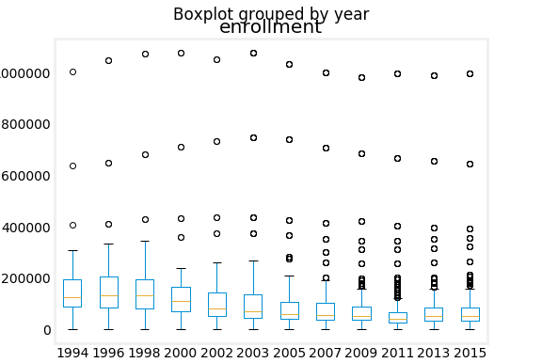
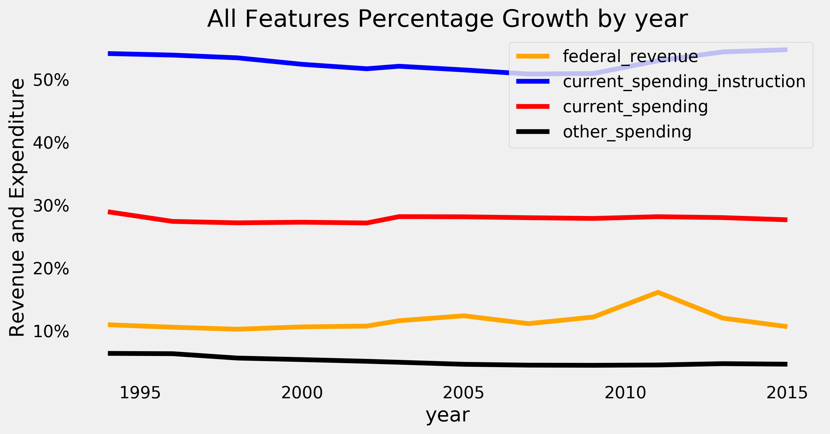
Education Financing Data Explorative Analysis

Slide 6
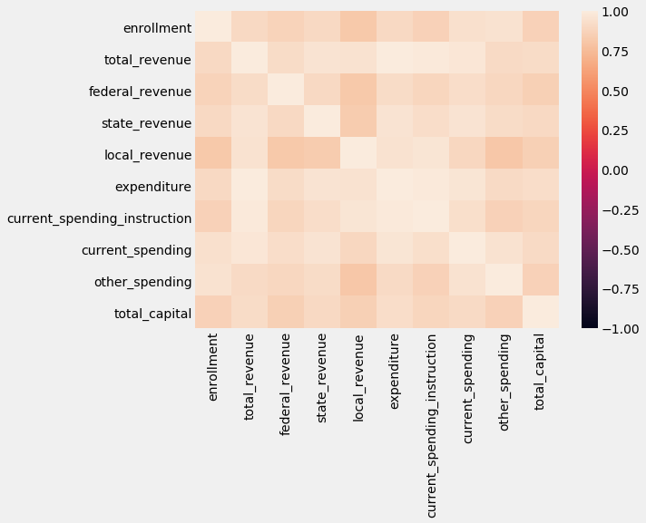
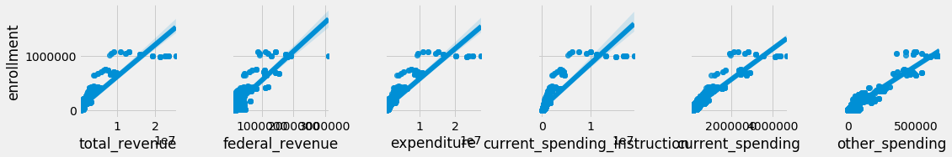
Features Correlation
Features of revenue and spending have highly correlation to the enrollments on district levels.

Slide 7
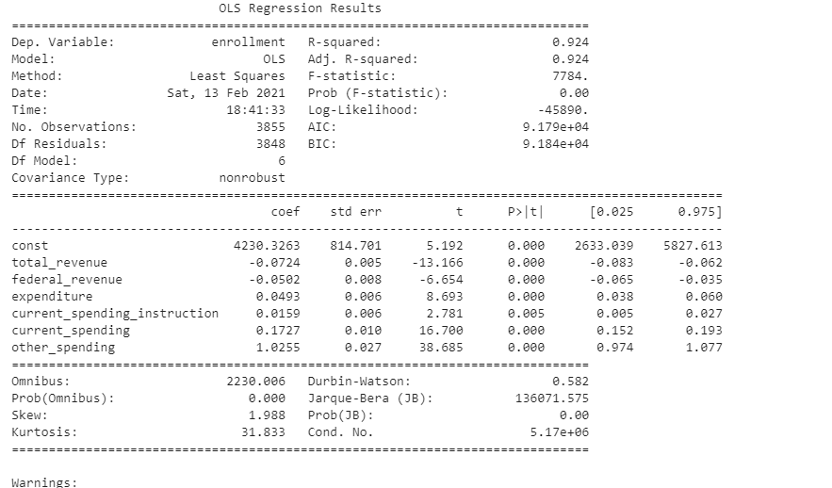
Significant Predictors
Multiple Regression indicate the statistically significant predictors of the Features.
The selected features have main effect on enrollment,
p <.001

Slide 8
Performance Evaluation
LR Algorithm with Feature Selection
Regularized Regression Algorithm after compare the features
Enrollments = 4230.32 -0.1 * total_revenue - 0.1 *federal_revenue
+ 0.1 *expenditure+ 0.02 *current_spending_instruction
+ 0.2 *current_spending + 1.0 *other_spending
MAE: 19949.20
RMSE: 30726.0
Enrollments = 4124 -0.1 * total_revenue -0.1*federal_revenue
+ 0.16 *current_spending + .02 *current_spending_instruction + 1.1 *other_spending
RMSE: 30554.39 (alpha=0.0)

Slide 9

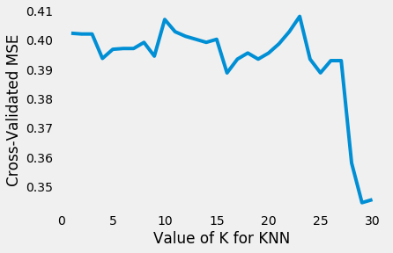
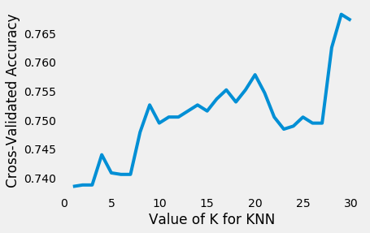
K Nearest Neighbors
KNN is used to create the classifier to predict the enrollment with a result or roughly 93.14 % accuracy.
5-folds Cross validation was used to evaluate the KNN algorithm
Both the accuracy and MSE indicated the best K is 28 ~ 29.

Slide 10
Comparison of LR and KNN
The proposed models of LR algorithm and KNN can predict enrollment with reliable accuracy.
LR Algorithm can be use for the projection of next year enrollment.
 | LR | KNN
Train Data | 2874 | 2891
Test Data | 958 | 964
Accuracy | 88.6% | 93.14%

Slide 11
Findings & Implication
The results indicated the spending on the instruction, payments to the government, and institutional supports are more likely to increase the district enrollments.
Expanding the federal and total revenue such as allocation of financial aid and scholarship is not the best solution to maximize the enrollments for elementary and secondary students .
Using the projection of LR algorithm and KNN by applying the enrollment from last year to project the enrollment of next year can help the management to assign money rewards efficiently.

Slide 12

Recommendation for Stakeholders
The elementary and secondary students' cohorts on the district level have large variation for the management of educational financing and budget the next year compared to the school year.
In terms of planning and evaluating the enrollments, using K-nearest neighbor would directly predict the enrollment of the cohort without identifying the variation on the school district's levels.
For the research purpose, the institutional strategic planning would approach the enrollment by implement LR projection.

Slide 13

Questions & Answers
Acknowledgement
General Assembly
Data Scientist
Part-time Course
yuzhang1@seattleschools.org

