Slide 1

Big Data Analytics Spark MLib

Slide 2
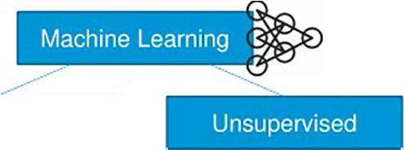
Mllib
Machine learning may be broken down into two classes of algorithms:
Supervised algorithms use labelled data in which both the input and output are provided to the algorithm
Unsupervised algorithms do not have the outputs in advance. These algorithms are left to make sense of the data without labels.
Supervised
Classification
Naive Bayes
-SVM
Regression
Linear
Logistic
Clustering
K Means
Dimensionality Reduction
Principal Component Analysis
-SVD

Slide 3
Spark and Machine Learning
MLlib in Spark: Provides common machine learning algorithms for classification, regression, clustering, and collaborative filtering. Some examples:
Logistic Regression
Decision Trees
K-means clustering
Random Forest
MLlib for Neural Networks: Though Spark MLlib doesn’t natively support deep neural networks, it provides infrastructure to run simpler machine learning algorithms on large datasets. For deep learning, integration with other libraries (like TensorFlow or Keras) is often used.
Why Spark for Machine Learning:
Distributed Model Training: Split datasets across nodes and train models concurrently.
Hyperparameter Tuning: Leverage Spark’s parallel processing to test multiple configurations at once.

Slide 4
Mllib Techniques
Techniques for Machine Learning. There are 3 common categories of techniques:
Classification
Clustering
Collaborative Filtering

Slide 5



Mllib - Techniques
-
Google
Gmal·
Classification: It is a family of supervised machine learning algorithms that designate input as belonging to one of several pre-defined classes
Some common use cases for classification include:
Credit card fraud detection
Email spam detection.
Clustering: In clustering, an algorithm groups objects into categories by analyzing similarities between input examples
In�•
·· ...
C
--
._....,.,
O..•llfMlmM•._.-.,_.,.____h_
....,,,
lf-•�INMO�hll:,...-P-111•1-.UII
,......
-·
.........
........
Mll., A
E,r..
.........,._,..lel"OI/All...llllohc'.b•.,._&IN(
-1u1 t,,--
,..,__ ...,, 4111111:
.......
.,._...,._
MMriun •••'"""'
o-, o.-, _______,..., _____ _
u..'--..s._,.;., "'° c- .....� ...-�&,11
•
.....
•
"°'
,........,.....,.,.
I!IiiI
y-cao,,,;�bK.limitl�p<oflHiil'Ml
....
"'-"5-f'..IIISOh«l!'lp,ll!Mlsi-.bK.MN1U011119� �
flOfflPal)� � l,old PabstMI in..o!flef 1,gtt...,n
11-die,i:tn M,c:Mc,1r1 •lMI.,to Mlf20 -• 1 1
Ashott Dinda.IIH • g"ood hHrt and learns quickly: Sunil Gavukar
l
�--- pr-()w,(la. "'-'"�·*�!8"--�!J!d.���IIQI��"'"'' •�11"11

Slide 6
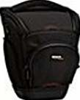



Mllib - Techniques
3. Collaborative Filtering: Collaborative filtering algorithms recommend items (this is the filtering part) based on preference information from many users (this is the collaborative part)
-
.... .,.
1-iifiitMI
·-..
)
Cuttomer• Who 8ot.19ht Tfll• Item AIM aought
.....,,,....
�E.le'IIM 1«il U!":$-wl��
C-C..,O,OSlA
�SOMC/,,Wf'Of'J
C.W-LP..t\D.__.
Cr4.l&T9t:'YlfL�
C.,,OUJlo�--•
bllltoy, u.c,1089001)
....... ,.,..
SOSOlCM«oQ,<Wf
.,,.,_
IOG�.C1IO-¢-'f
S2:UI...,_,_
sw•.,,,,,,_
Sit.I&""""-

Slide 7
Linear regression with many features
Suppose we have 𝑚 examples in our data set and 𝑛 = 𝑚 features (plus
assumption that features are linearly independent, though we’ll always assume this)
Then 𝑋 ∈ ℝ^{𝑚×𝑛} is a square matrix, and least squares solution is:
𝜃 =(𝑋^{𝑇}𝑋) −1_{𝑋}𝑇_{𝑌 = 𝑋}−1_{𝑋}−𝑇_{𝑋}𝑇_{𝑦 = 𝑋}−1_{𝑦}
and we therefore have 𝑋𝜃 = 𝑦 (i.e., we fit data exactly)
Note that we can only perform the above operations when 𝑋 is square, though if we have more features than examples, we can still get an exact fit by simply discarding features

Slide 8


Cross-validation
Although it is difficult to quantify the true generalization error (i.e., the error of these algorithms over the complete distribution of possible examples), we can
approximate it by holdout cross-validation
Basic idea is to split the data set into a training set and a holdout set
Training set (e.g. 70%) | Holdout / validation set (e.g. 30%)
All data
Train the algorithm on the training set and evaluate on the holdout set

Slide 9
K-fold cross-validation
A more involved (but actually slightly more common) version of cross validation
Split data set into 𝑘 disjoint subsets (folds); train on 𝑘 − 1 and evaluate on remaining fold; repeat 𝑘 times, holding out each fold once
Fold 1 | Fold 2 | … | Fold 𝑘
All data
Report average error over all held out folds

Slide 10
K-fold cross-validation
K=4-fold example:
Fold 1 | Fold 2 | Fold 3 | Fold 4
Train | Train | Train | Val
Train | Train | Val | Train
Train | Val | Train | Train
Val | Train | Train | Train

Slide 11
Cross-validation in code
A simple example of holdout cross-validation:
# compute a random split of the data
np.random.seed(0)
perm = np.random.permutation(len(df_daily)) idx_train = perm[:int(len(perm)*0.7)] idx_cv = perm[int(len(perm)*0.7):]
# scale features for each split based upon training
xt = df_daily.iloc[idx_train,0]
min_xt, rng_xt = (np.min(xt), np.max(xt) - np.min(xt)) xt = 2*(xt - min_xt)/rng_xt - 1.0
xcv = 2*(df_daily.iloc[idx_cv,0] - min_xt)/rng_xt -1 yt = df_daily.iloc[idx_train,1]
ycv = df_daily.iloc[idx_cv,1]
# compute least squares solution and error on holdout and training
X = np.vstack([xt**i for i in range(poly_degree,-1,-1)]).T theta = np.linalg.solve(X.T.dot(X), X.T.dot(yt))
err_train = 0.5*np.linalg.norm(X.dot(theta) - yt)**2/len(idx_train)
err_cv = 0.5*np.linalg.norm(Xcv.dot(theta) - ycv)**2/len(idx_cv)

Slide 12
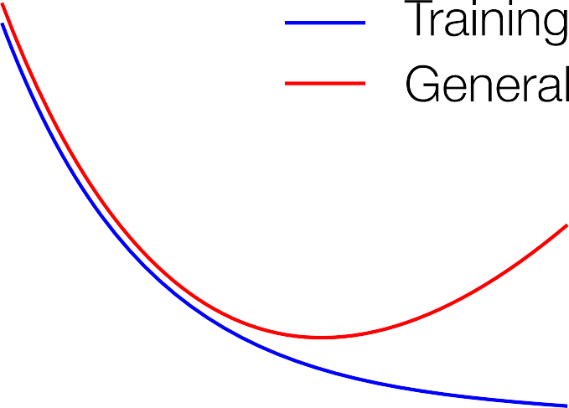







Cartoon version of overfitting
As model becomes more complex, training loss always decreases; generalization loss decreases to a point, then starts to increase

Slide 13

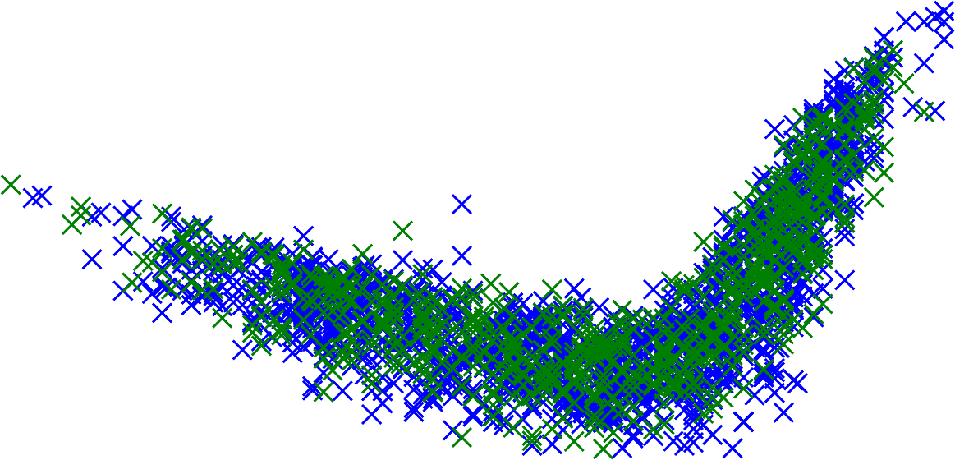

Cross-validation

Slide 14
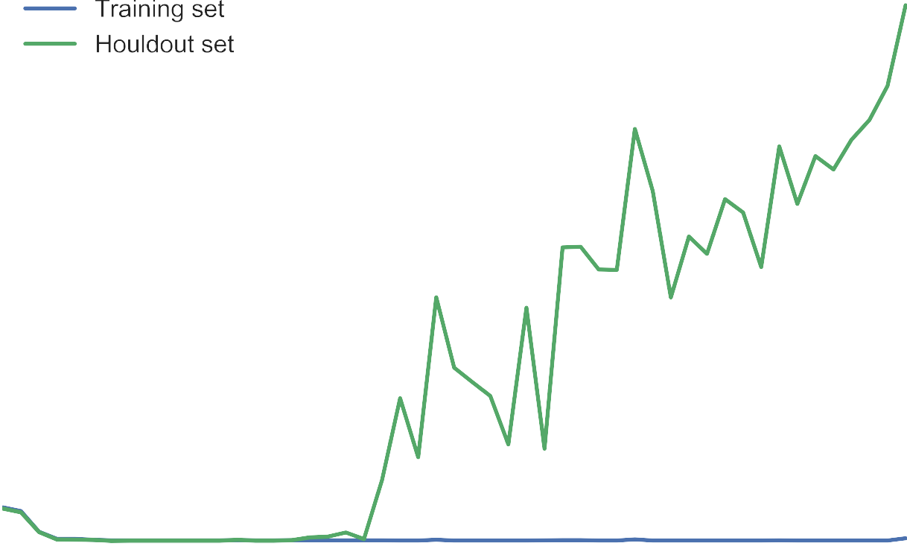


Training and cross-validation loss by degree

Slide 15

Training and cross-validation loss by degree

Slide 16
Regularization
We have seen that the degree of the polynomial acts as a natural measure of the “complexity” of the model, higher degree polynomials are more complex (taken to the limit, we fit any finite data set exactly)
But fitting these models also requires extremely large coefficients on these polynomials
For 50-degree polynomial, the first few coefficients are
𝜃 = −3.88 × 10⁶, 7.60 × 10⁶, 3.94 × 10⁶, −2.60 × 10⁷, …
This suggests an alternative way to control model complexity: keep the weights small (regularization)

Slide 17

Regularized least squares
For least squares, there is a simple solution to the regularized loss minimization problem
𝑚
minimize 11
_{𝜃}𝑇_{𝑥} 𝑖
𝜃
𝑖=1
− 𝑦 ^{𝑖 2} + 𝜆 𝜃
2
2
What happen as 𝜆 goes to zero?
What happen as 𝜆 gets really big?

Slide 18


Regularized loss minimization
This leads us back to the regularized loss minimization problem we saw before, but with a bit more context now:
𝑚
minimize 121 ℓ _{𝜃}
ℎ
𝜃
_{𝑥} 𝑖
, 𝑦 ^{𝑖} + ^{𝜆} 𝜃
2
2
2
𝑖=1
This formulation trades off loss on the training set with a penalty on high values of the parameters
By varying 𝜆 from zero (no regularization) to infinity (infinite regularization, meaning parameters will all be zero), we can sweep out different sets of model complexity

Slide 19
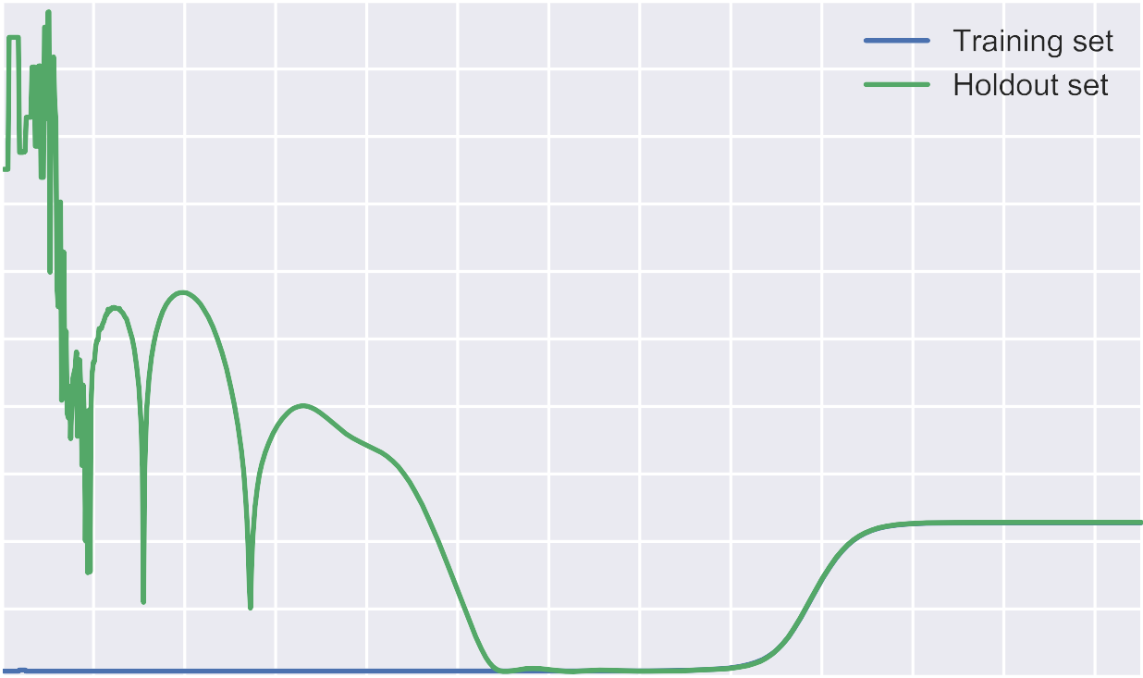


Training/cross-validation loss by regularization

Slide 20

Training/cross-validation loss by regularization

Slide 21

Regularized least squares
For least squares, there is a simple solution to the regularized loss minimization problem
𝑚
minimize 11
_{𝜃}𝑇_{𝑥} 𝑖
𝜃
− 𝑦 ^{𝑖 2} + 𝜆 𝜃
2
2
𝑖=1
Taking gradients by the same rules as before gives:
𝑚
𝛻_{𝜃}
11 𝜃^{𝑇}𝑥 ^{𝑖} − 𝑦 ^{𝑖 2} +𝜆 𝜃
𝑖=1
2
2
= 2𝑋^{𝑇}
𝑋𝜃 − 𝑦
+ 2𝜆𝜃
Setting gradient equal to zero leads to the solution
2𝑋^{𝑇} 𝑋𝜃 + 2𝜆𝜃 = 2𝑋^{𝑇} 𝑦 ⟹ 𝜃 = 𝑋^{𝑇}𝑋 + 𝜆𝐼
−1_{𝑋}𝑇_{𝑦}
Looks just like the normal equations but with an additional 𝜆𝐼 term

Slide 22
Overview
Classification Models
Comparison of Classification Models
Summary
Classification

Slide 23
Classification Models
The following classifiers are introduced
𝑘-nearest Neighbor
Decision Trees
Random Forests
Logistic Regression
Naive Bayes
Support Vector Machines
Neural Networks

Slide 24
Binary Classification
Many problems are binary
Will I get my money back?
Is this credit card fraud?
Will my paper be accepted?
…
Can all be formulated as either being in a class or not
èLabels true and false

Slide 25
Logistic Regression
Basic Idea:
Regression model of the probability that an object belongs to a class
Combines the 𝑙𝑜𝑔𝑖𝑡 function with linear regression
Linear Regression
𝑦 as linear combination of 𝑥₁, …, 𝑥_{𝑛}
𝑦 = 𝑏₀ + 𝑏₁𝑥₁ + ⋯+ 𝑏_{𝑛}𝑥_{𝑛}
The 𝑙𝑜𝑔𝑖𝑡 function
𝑙𝑜𝑔𝑖𝑡 𝑃 𝑦 = 𝑐 = ln
Logistic Regression
𝑃(𝑦=𝑐)
1−𝑃(𝑦=𝑐)
𝑙𝑜𝑔𝑖𝑡 𝑃 𝑦 = 𝑐 = 𝑏₀ + 𝑏₁𝑥₁ + ⋯+ 𝑏_{𝑛}𝑥_{𝑛}

Slide 26
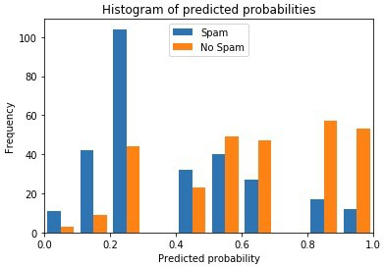




Thresholds for Scores
Different thresholds also possible
Threshold of 0.2 would miss “Spam” but better identify “No Spam”
Many “No Spam” incorrectly detected as spam if “highest” score is used

Slide 27


Odds Ratios
Probabilities vs. Odds
Probability: 𝑃 pass_exam = 0.75
Odds of passing the exam: 𝑜𝑑𝑑𝑠 pass_exam =
The odds if passing the exam is 3 to 1
0.75
= 3
1−0.75
If we invert the natural logarithm, we get
•
𝑃(𝑦=𝑐)
= exp 𝑏₀ + 𝑏₁𝑥₁ + ⋯+ 𝑏_{𝑛}𝑥_{𝑛} = ^{ς 𝑛}
exp(𝑏_{𝑗} 𝑥_{𝑗} )
Definition
1−𝑃(𝑦=𝑐)
𝑗=0
of odds
It follows that exp(𝑏_{𝑗}) is the odds ratio of feature 𝑗
Odds ratio means the change in odds if we increase 𝑥_{𝑗} by one.
Odds ratio greater than one means increased odds
Odds ratio less than one mean decreased odds

Slide 28
Type 1 Error Theorem
Metric | Equalized under
Selection probability | Demographic parity
Positive predictive value | Predictive parity
Negative predictive value | Predictive parity
False positive rates | Error rate balance
False negative rate | Error rate balance
Accuracy | Accuracy equity

Slide 29






Recall
1. Positive predictive value (PPV)
Prediction decision
Actual Outcome
Confusion Matrix Y=1 Y=0
2. False discovery rate (FDR)
TP | FP
FN | TN
d=1
d=0
3. False omission rate (FOR)
True positive (TP)
False positive(FP)
True negative (TN)
False negative (FN)
4. Negative predictive value (NPV)

Slide 30




Recall
5. True positive rate (TPR)
Prediction decision
Actual Outcome
Confusion Matrix Y=1 Y=0
6. False positive rate (FPR)
TP | FP
FN | TN
d=1
d=0
7. False negative rate (FNR)
True positive (TP)
False positive(FP)
True negative (TN)
False negative (FN)
8. True negative rate (TNR)

Slide 31


The Confusion Matrix
Table of actual values versus prediction Actual class
Predicted Class
 | whale | bear | other
whale | 29 | 1 | 3
bear | 2 | 22 | 13
other | 4 | 11 | 51
Two whales were incorrectly predicted as bears

Slide 32
The Binary Confusion Matrix
Actual class
 |  | true false
true |  | True Positives (TP) False Positives (FP)
false |  | False Negatives (FN) True Negatives (TN)
Predicted Class
False positives are also called Type I error
False negatives are also called Type II error

Slide 33
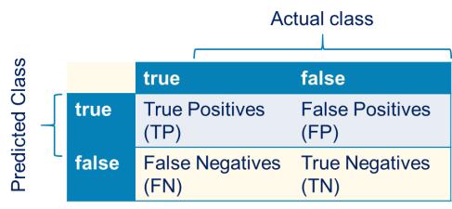
Binary Performance Metrics (1)
Rates per actual class
True positive rate, recall, sensitivity
Percentage of actually „True“ that is predicted correctly
True negative rate, specificity
Percentage of actually „False“ that is predicted correctly
𝑇𝑁𝑅 =
𝑇𝑁
𝑇𝑁+𝐹𝑃
False negative rate
Percentage of actually „True“ that is predicted wrongly
False positive rate
Percentage of actually „False“ that is predicted wrongly
𝐹𝑁
𝐹𝑃
𝐹𝑁𝑅 =
𝐹𝑃𝑅 =
𝐹𝑁+𝑇𝑃
𝐹𝑃+𝑇𝑁

Slide 34
Binary Performance Metrics (2)
Rates per predicted class
Positive predictive value, precision
Percentage of predicted „True“ that is predicted correctly
𝑇𝑃
𝑃𝑃𝑉 =
𝑇𝑃+𝐹𝑃
Negative predictive value
Percentage of predicted „False“ that is predicted correctly
𝑁𝑃𝑉 =
𝑇𝑁
𝑇𝑁+𝐹𝑁
False discovery rate
Percentage of predicted „True“ that is predicted wrongly
False omission rate
Percentage of predicted „False“ that is predicted wrongly
𝐹𝑃
𝐹𝑁
𝐹𝐷𝑅 =
𝐹𝑂𝑅 =
𝑇𝑃+𝐹𝑃
𝐹𝑁+𝑇𝑁

Slide 35
Binary Performance Metrics (3)
Metrics that take „everything“ into account
Accuracy
Percentage of data that is predicted correctly
𝑇𝑃+𝑇𝑁
𝑎𝑐𝑐𝑢𝑟𝑎𝑐𝑦
=
𝑇𝑃+𝑇𝑁+𝐹𝑃+𝐹𝑁
F1 score is harmonic mean of precision and recall
Matthews^{𝑙} correlation coefficient (MCC)
Chi-squared correlation between prediction and actual values
𝑝𝑟𝑒𝑐𝑖𝑠𝑖𝑜𝑛 × Recall
𝑇𝑃×𝑇𝑁−𝐹𝑃×𝐹𝑁
𝑀𝐶𝐶 =
𝐹1 –=2 X
Pr𝑒𝑐𝑖𝑠𝑖𝑜𝑛+𝑟𝑒𝑐𝑎l𝑙
√(𝑇𝑃+𝐹𝑃)(𝑇𝑃+𝐹𝑁)(𝑇𝑁+𝐹𝑃)(𝑇𝑁+𝐹𝑁)

Slide 36
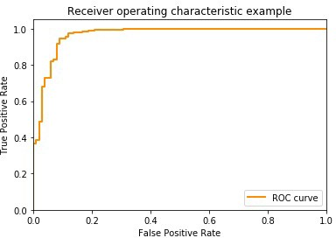
Receiver Operator Characteristics (ROC)
Plot of true positive rate (TPR) versus false positive rate (FPR)
Different TPR/FPR values possible due to thresholds for scores

Slide 37
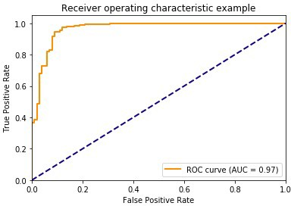
Area Under the Curve (AUC)
Large Area = Good Performance
Accounts for tradeoffs between TPR and FPR

Slide 38
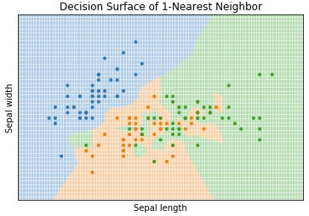
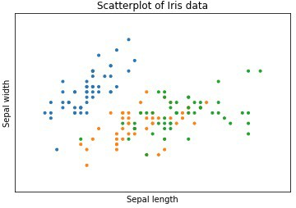
𝑘-nearest Neighbor
Basic Idea
Instances with similar feature values should have the same class
Class can be determined by looking at instances that are similar
Assign each instance the mode of its 𝑘 nearest instances

Slide 39
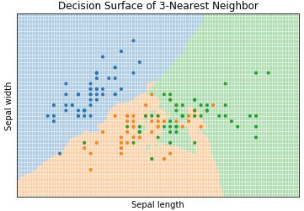
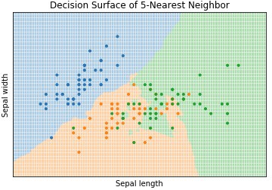
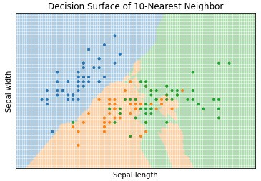
Impact of 𝑘

Slide 40
Basic Decision Tree Algorithm
Recursive algorithm
Stop if
Data is “pure”, i.e. mostly from class
Amount of data is too small, i.e., only few instances in partition
Otherwise
Determine „most informative feature“ 𝑋
Partition training data using 𝑋
Recursively create subtree for each partition
Details may vary depending on the specific algorithm
For example, CART, ID3, C4.5
General concept always the same

Slide 41
Use training data to learn decision tree
Consider input features 𝑥 ∈ ℝ²
𝑥₂
10
5
𝑥₁
5
10

Slide 42
Optimizing a single leaf
Consider input features 𝑥 ∈ ℝ²
𝑥₂
10
5
𝑥₁
5
10

Slide 43
Decision trees as ML algorithms
To specify the decision trees from a machine learning standpoint, we need to specify
…a decision tree (𝜃 is
1. What is the hypothesis function 𝒉_{𝜽} 𝒙 ?
shorthand for all the
parameters that define the
tree: tree structure, values to split on, leaf predictions, etc)
2. What is the loss function ℓ ℎ_{𝜃} 𝑥 , 𝑦 ?
3. How do we minimize the loss function?
𝑚
1
𝑚
minimize
121 ℓ(ℎ_{𝜃}
𝑖=1
_{𝑥} 𝑖
, 𝑦 ^{𝑖} )
𝜃

Slide 44
Decision trees as ML algorithms
To specify the decision trees from a machine learning standpoint, we need to specify
What is the hypothesis function ℎ_{𝜃} 𝑥 ?
What is the loss function ℓ 𝒉_{𝜽} 𝒙 , 𝒚 ?
3. How do we minimize the loss function?
𝑚
1
𝑚
minimize
121 ℓ(ℎ_{𝜃}
𝑖=1
_{𝑥} 𝑖
, 𝑦 ^{𝑖} )
𝜃

Slide 45



Reminder: MLE for Bernoulli
Maximum likelihood solution for Bernoulli given by
𝑚
𝑚
=
𝑖=1
maximize ◌ෑ
𝑝 𝑦 ^{𝑖} ; 𝜙
𝜙
1 − 𝜙
1−𝑦 ^{𝑖}
𝜙
_{𝑦} 𝑖
𝜙
maximize ◌_{𝑖=}ෑ ₁
Taking the negative log of the optimization objective (just to be consistent with our usual notation of optimization as minimization)
𝑚
maximize ℓ 𝜙
𝜙
= 11 𝑦 ^{𝑖}log 𝜙 + 1 − 𝑦 ^{𝑖} log 1 − 𝜙
𝑖=1
_{σ}𝑚
_{𝑦} 𝑖
_{⟹𝜙 =} 𝑖=1
𝑚

Slide 46
Loss functions in decision trees
Let’s assume the output is binary for now (classification task, we will deal with regression shortly), and assume 𝑦 ∈ 0,1
The typical decision tree algorithm using a probabilistic loss function that considers
𝑦 to be a Bernoulli random variable with probability ℎ_{𝜃}(𝑥)
_{𝑥} 𝑦
1−𝑦
𝑝 𝑦 ℎ_{𝜃} 𝑥 = ℎ_{𝜃} 1 − ℎ_{𝜃} 𝑥
The loss function is just the negative log probability of the output (like in maximum likelihood estimation)
ℓ ℎ_{𝜃} 𝑥 , 𝑦 = − log 𝑝 𝑦 ℎ_{𝜃} 𝑥
= −𝑦 log ℎ_{𝜃} 𝑥 − 1 − 𝑦 log 1 − ℎ_{𝜃} 𝑥

Slide 47
Optimizing decision trees
Key challenge: unlike models we have considered previously, discrete tree structure means there are no gradients
Additionally, even if we assume binary inputs i.e., 𝑥 ∈ 0,1 ^{𝑛}, there are 2^{2𝑛}
decision trees: 𝑛 = 7 means 3.4 × 10³⁸ possible trees
possible
Instead, we’re going to use greedy methods to incrementally build the tree (i.e., minimize the loss function) one node at a time

Slide 48
Optimizing a single leaf
Consider a single leaf in a decision tree (could be root of initial tree)
Let 𝒳 denote the examples at this leaf (e.g., in this partition), where 𝒳⁺ denotes the positive examples and 𝒳⁻ denotes negative (zero) examples
What should we choose as the (constant) prediction ℎ at this leaf?
_{𝒳}+
𝒳
_{𝒳}−
𝒳
minimize 11
ℎ
𝑥,𝑦∈𝒳
_{𝒳}+
ℓ ℎ, = −
log ℎ −
log(1 − ℎ)
⟹ℎ = ,
𝒳
Which achieves loss:
ℓ = −ℎ log ℎ − (1 − ℎ) log(1 − ℎ)

Slide 49
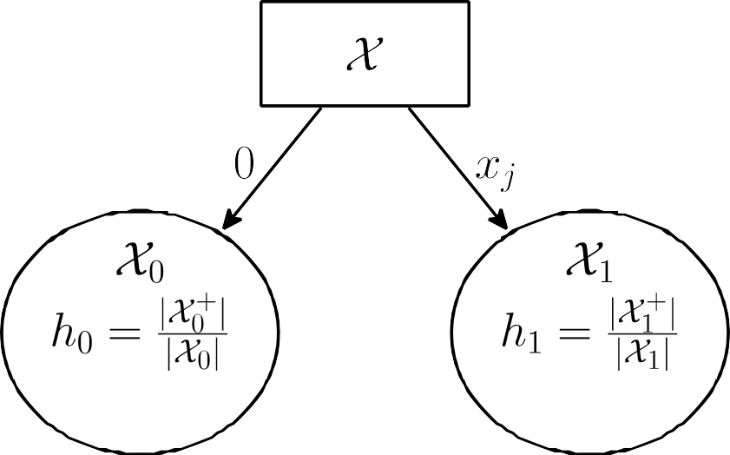

Optimizing splits
Now suppose we want to split this leaf into two leaves, assuming for the time being that 𝑥 ∈ 0,1 ^{𝑛} is binary
If we split on a given feature 𝑗, this will separate 𝒳 into two sets: 𝒳₀ and 𝒳₁ (with
𝒳^{+/−} and defined similarly to before), and we would choose optimal prediction
0/1
ℎ₀ = 𝒳⁺ / 𝒳₀ , ℎ₁ = 𝒳⁺ / 𝒳₁
0
1

Slide 50
Loss of split
The new leafs will each now suffer loss
ℓ₀ = −ℎ₀ log ℎ₀ − ℓ₁ = −ℎ₁ log ℎ₁ −
1 − ℎ₀
1 − ℎ₁
log 1 − ℎ₀
log 1 − ℎ₁
Thus, if we split the original leaf on feature 𝑗, we no longer suffer our original loss ℓ, but we do suffer losses ℓ₀ and ℓ₁, i.e., we have decreased the overall loss function
by ℓ − ^{𝒳−} ℓ
_{𝒳}+
− ℓ (this quantity is called information gain)
0 1
𝒳 𝒳
Greedy decision tree learning – repeat:
For all leaf nodes, evaluate information gain (i.e., decrease in loss) when splitting on each feature 𝑗
Split the node/feature that minimizes loss the most
(Run cross-validation to determine when to stop, or after N nodes)

Slide 51
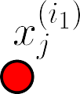
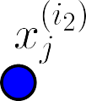
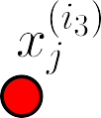
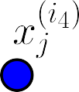
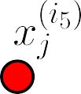
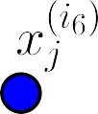
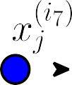

Continuous features
What if 𝑥_{𝑗}’s are continuous?
Solution: sort the examples by their 𝑥_{𝑗} values, compute information gain at each possible split point
𝒳₀𝒳₀
𝒳_{1𝒳}
1

Slide 52
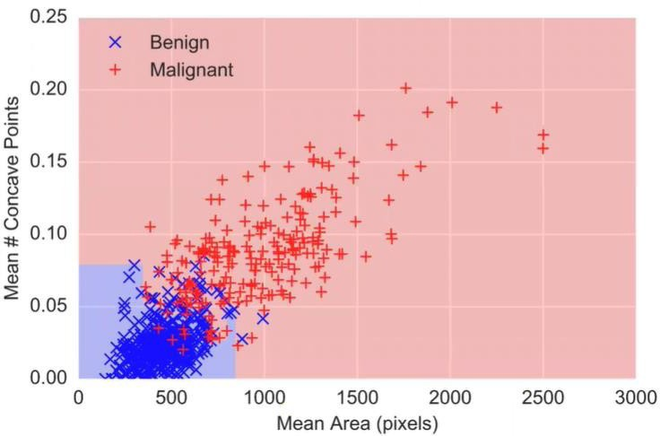
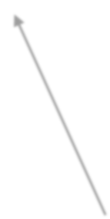
Decision tree surface for cancer prediction
…because mean concave points > 0.05, mean area > 791

Slide 53
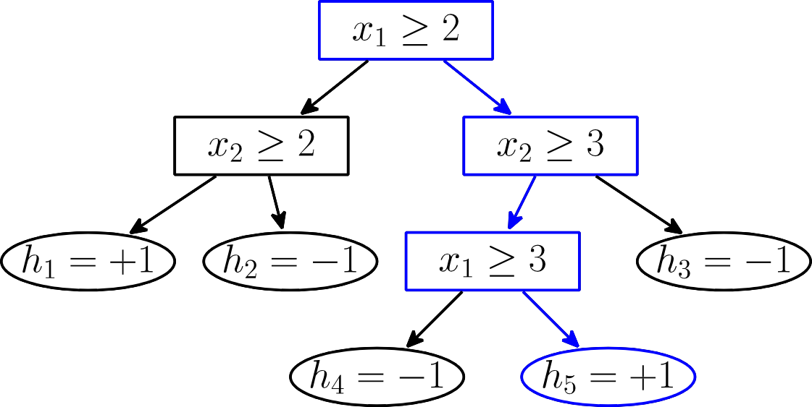
Interpretable models
Decision trees are the canonical example of an interpretable model
Why did we we predict +1?
…because 𝑥₁ ≥ 2, 𝑥₂ ≥ 3, 𝑥₁ ≥ 3
…because 𝑥₁ ≥ 3 𝑥₂ ≥ 3

Slide 54
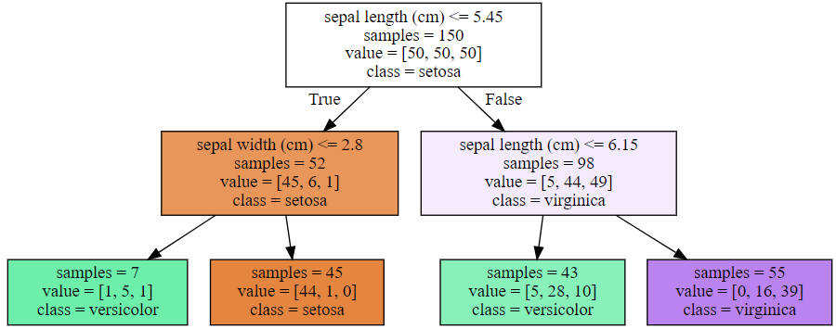
Decision Trees
Basic Idea
Make decisions based on logical rules about features
Organize rules as a tree

Slide 55




The „Most Informative Feature“
Information theory-based approach
Entropy of the class label
𝐻(𝐶)= − ^{σ}_{𝑐∈𝐶} 𝑝 (𝑐)log 𝑝(𝑐)
Conditional entropy of the class label based on feature 𝑋
𝐻(𝐶 𝑋)= − ^{σ}_{𝑥∈𝑋} 𝑝 (𝑥)^{σ}_{𝑐∈𝐶} 𝑝 (𝑥)log 𝑝(𝑐|𝑥)
Mutual Information
𝐼(𝐶, 𝑋)= 𝐻 (𝐶)− 𝐻 (𝐶 𝑋)
Feature with highest mutual information is most informative
Can be used as measure for purity
Interpret each dimension as random variable

Slide 56
Consider a decision tree training algorithm that stops after creating N nodes. If we increase N, the resulting tree is more likely to:
overfit
underfit

Slide 57
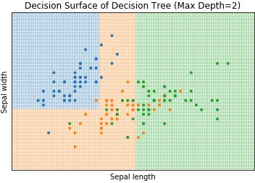
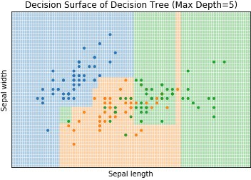

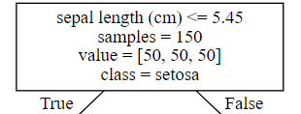
Decision Surface of Decision Trees
All decisions are axis-aligned
Overfitting

Slide 58
Ensembles of trees
Decision trees have notable advantages (they are relatively easy to interpret, usually fast to train, insensitive to scale of input features)
But, they are also quite limited in their representation power (require axis-aligned splits, don’t model probabilities very smoothly)
Basic idea of tree ensemble methods is to combine multiple tree models together to form a better predictor
Two of the most popular ensemble methods: random forests and boosting
(These models no longer interpretable in the sense we have discussed)

Slide 59
Boosting
Boosting originated as an idea in theoretical machine learning, for “boosting” the performance of weak classifiers (i.e., combining many classifiers that each had modest accuracy to one that had high accuracy)
After some initial success in theory, during the 90s there came to be several practical applications of boosting methods
There are many interpretations of boosting (experts still disagree on the “right” one!), and I’m going to highlight one:
We focus on the Gradient Boosted Regression Trees (GBRT) algorithm

Slide 60




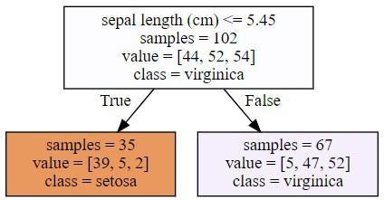
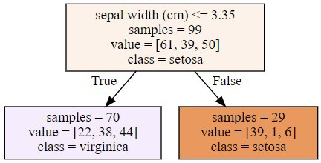
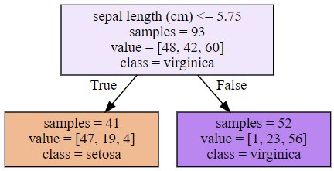
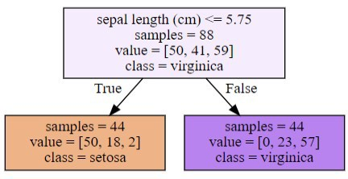
Random Forest
Basic Idea
Ensemble of randomized decision trees
Randomized attributes
Randomized subset
Classification as majority vote of random trees

Slide 61
Bagging as Ensemble Learner
Bagging is short for bootstrap aggregating
Randomly draw subsamples of training data
Build model for each subsample ensemble of models
Voting to create class
Can be weighted, e.g., using quality of ensemble models
Random Forests combine Bagging with
Short decision trees, i.e., low depth
Allowing only a random subset of features for each decision

Slide 62
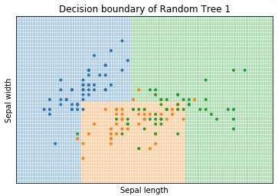
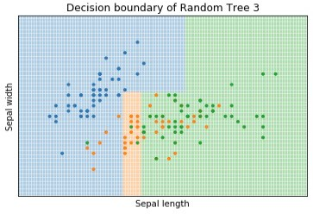
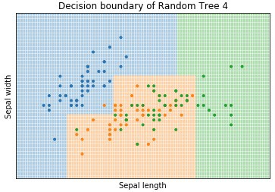
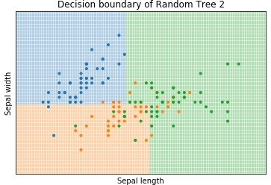
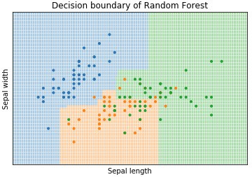
Decision Surface of Random Forests

Slide 63
Modern Streaming Architecture
Traditional batch systems process data hourly or daily
Modern systems require real-time event streaming
Kafka enables scalable event-driven pipelines
Streaming architecture supports analytics and monitoring
Kafka integrates with Spark, Airflow, and dbt

Slide 64
Apache Kafka Overview
Kafka is a distributed event streaming platform
Kafka stores streams of records called topics
Producers publish events into Kafka topics
Consumers subscribe and process events
Designed for high throughput and fault tolerance

Slide 65
Kafka Core Components
Producer: Sends messages into Kafka
Topic: Stream category for events
Broker: Kafka server managing topics
Consumer: Reads and processes messages
Consumer Groups: Enable scalable processing

Slide 66
Kafka Producer Example
Python Kafka producer example
Send JSON event messages
Real-time purchase or clickstream simulation
Used in fraud detection and analytics pipelines

Slide 67
Kafka Consumer Example
Consumer continuously listens to Kafka topics
Processes events in real time
Can trigger Spark ETL workflows
Supports scalable event-driven applications

Slide 68
dbt Overview
dbt = Data Build Tool
Modern analytics engineering framework
Transforms raw data into analytics-ready models
Uses SQL + version control
Integrates with cloud data warehouses

Slide 69
dbt Project Structure
Models define reusable SQL transformations
schema.yml defines tests and metadata
dbt_project.yml manages project configuration
Supports modular analytics engineering

Slide 70
dbt Workflow
Raw data loaded into PostgreSQL or warehouse
dbt transforms raw tables into business models
dbt test validates data quality
dbt docs generates lineage and documentation
dbt run executes SQL pipelines

Slide 71
Modern Data Engineering Pipeline
Kafka streams real-time events
Spark processes streaming or batch data
Airflow orchestrates workflows
dbt builds analytics models
PostgreSQL stores transformed data

Slide 72
Industry Use Cases
Netflix recommendation systems
Uber ride event streaming
Fraud detection pipelines
Real-time monitoring dashboards
Customer behavior analytics

