Slide 1


Big Data Analytics (Spring 2026) Hadoop with Pig and Hive

Slide 2
Hadoop Review
Hadoop is an open-source reimplementation of
A distributed file system
A map-reduce processing framework
Inspired by Google’s description of the technologies underpinning their search engine
It is a layer-cake of APIs, written mostly in Java, that one can use to write large, distributed, and scalable applications to search and process large datasets

Slide 3
Hadoop Layer Cake
PIG (Data Flow) | Hive (SQL emulation)
MapReduce (job scheduling, assignment, and shuffling)
Hbase (key-value store)
HDFS (Hadoop Distributed File System)
While Hadoop has many advantages, it is not intuitive to translate every data exploration/manipulation/searching task into a series of map-reduce operations.
Higher-level languages were needed.

Slide 4


High-level Hadoop Interfaces
PIG – A scripting language for transforming big data
Useful for “cleaning” and “normalizing” data
Three parts:
Pig Latin – The scripting language
Grunt – A interactive shell
Piggybank – A repository of Pig extensions
Deferred execution model
Hive – A SQL-inspired query-oriented language
Imposes structure, in the form of schemas, on Hadoop data
Creates “data warehouse” layers

Slide 5
Pig & Pig Latin
Abstraction layer for processing large data sets 2 Components
Pig Latin: the language used to express data flows
Grunt: the execution environment
Pig Program
Composed of series of operations, or transformations
The operations describe a dataflow that is translated into one or more MapReduce jobs

Slide 6
🐖 Pig & Pig Latin
MapReduce is powerful but hard to program, because you must write mapper and reducer functions manually.
Pig is a higher-level tool that simplifies this work.
Pig Latin is a data-flow language where each step is a transformation (like SQL operations: join, filter, group, sort).
The Pig engine automatically:
parses
checks
optimizes
turns Pig Latin into MapReduce
submits the job to Hadoop
monitors progress
So users only write Pig Latin, not Java MapReduce code.

Slide 7
Pig Relations
Pig variables are bags of tuples
Fields – data items
Tuples – a vector of fields (ordered fields)
Bags – a collection of unordered tuples
Unlike Relations in relational databases the tuples in a Pig bag, need not have the same number of fields, or the same types
Pig also supports Maps
Maps – a dictionary of name-value pairs
Bag
Tuple Tuple
Tuple
…
Tuple
Tuple Field 0
Field 1
Field 2
…Field N

Slide 8

Pig Latin Processing
Pig Latin script are processed line by line
Syntax and References are checked
Valid statements are added to a logical plan
Execution is deferred until either a DUMP or STORE statement is reached
Reused intermediate results are mapped to a
An HDFS filename, don't worry about where it really is.
Common Node
grunt> roster = LOAD "comp521/NFLrosters" USING PigStorage(','); grunt> RecentQBs = FILTER roster BY $5='QB' AND $1>2000; grunt> DUMP RecentQBs;

Slide 9
Anatomy of a Pig Script
Steps are like:
LOAD data → define schema
FILTER data
LOAD another dataset
JOIN datasets
FOREACH…GENERATE → select and rename columns
Pig runs in:
Local mode (quick testing)
Hadoop mode (actual cluster)

Slide 10

Anatomy of a Pig Script
Pig scripts are easy to read
With AS we define an "on-the-fly" data schema
roster = LOAD "comp521/NFLrosters" USING PigStorage(',') AS (team:chararray, year:int, jersey:int, name:chararray, position:chararray, starts:int, games:int);
recentQBs = FILTER roster BY position='QB' AND year>2000 AND starts > 0; Groups = GROUP recentQBs BY name;
STORE Groups INTO "recentQBTable";
FOREACH to specify processing steps for all tuples in a bagexample
e1 = LOAD "input/Employees" USING PigStorage(',') AS (name:chararray, age:int, zip:int, salary:double);
f = FOREACH e1 GENERATE age, salary; -- a projection
DESCRIBE f; -- gives the schema of relation f DUMP f;

Slide 11
Anatomy of a Pig Script
ORDER
emp = LOAD "input/Employees" USING PigStorage(',') AS (name:chararray, age:int, zip:int, salary:double);
sorted = ORDER emp BY salary;
LIMIT, SAMPLE
emp = LOAD "input/Employees" USING PigStorage(',') AS (name:chararray, age:int, zip:int, salary:double);
agegroup = GROUP emp BY age; shortlist = LIMIT agegroup 100;
JOIN
emp = LOAD "input/Employees" USING PigStorage(',') AS (name:chararray, age:int, zip:int, salary:double);
pbk = LOAD "input/Phonebook" USING PigStorage(',') AS (name:chararray, phone:chararray);
contact = JOIN emp BY name, pbk BY name; DESCRIBE contact;
DUMP contact;

Slide 12
Anatomy of a Pig Script
-- max_temp.pig: Finds the maximum temperature by year records =
LOAD 'input/ncdc/micro-tab/sample.txt'
AS (year:chararray, temperature:int, quality:int); filtered_records =
FILTER records
BY temperature != 9999 AND ( quality == 0 OR
quality == 1 OR quality == 4 OR quality == 5 OR quality == 9);
grouped_records =
GROUP filtered_records BY year;
max_temp =
FOREACH grouped_records
GENERATE group, MAX(filtered_records.temperature); DUMP max_temp;
53

Slide 13





Pig Latin Scripts Describe Dataflows
Every Pig Latin script describes one or more flows of data through a series of operations that can be processed in parallel (i.e. the next one can start before the ones providing inputs to it finish).
Dataflows are Directed Acyclic Graphs (DAGS)
Ordering and Scheduling is deferred until a node requires data
Load Foreach Join
Load
Load Join
Sort
Store
Store

Slide 14


Pig Latin’s Data Model
PIG – A dataflow scripting language
Automatically translated to a series of Map-Reduce jobs that are run on Hadoop
It requires no meta-data or schema
It is extensible, via user-defined functions (UDFs) written in Java or other languages (C, Python, etc.)
Provides run-time and debugging environments
A language specifically designed for data manipulations and analysis
Supports join, sort, filter, etc.
Automatically partitions large operations into smaller jobs and chains them together

Slide 15
🐝 Hive & HiveQL
Hive is a SQL-like data warehouse system built on top of Hadoop. Users write SQL (HiveQL), and Hive converts it into MapReduce jobs.
Hive Components
Shell: command line or interfaces
Driver: manages session
Compiler: parses SQL and optimizes
Execution Engine: runs jobs
Metastore: stores schemas & table metadata

Slide 16
Hive
Framework for data warehousing on top of Hadoop
Developed at Facebook for managing and learning from the huge volumes of data Facebook was generating
Makes it possible for analysts with strong SQL skills to run queries Used by many organizations
SQL is lingua franca in business intelligence tools
SQL is limited so Hive is not fit for building complex machine learning algorithms
Generates MR jobs when executing queries

Slide 17
Defining Hive Tables
A Hive table consists of
Data linked to a file or multiple files in an HDFS
Schema stored as mapping of the data to a set of columns with types
Schema and Data are separated
Allows multiple schemas on the same data
$ hive
hive> CREATE TABLE Roster (
team string, year int, jersey string, player string,
position string, starts int, games int)
ROW FORMAT DELIMITED FIELDS TERMINATED BY ',' STORED AS TEXTFILE;

Slide 18
Hive Data Model
Tables – structured data with column types
Partitions – divide tables by values (e.g., date) for fast queries
Buckets – hashed splits of partitions for sampling very large datasets

Slide 19
Hive File Layout
Stored in HDFS under: /user/hive/warehouse
Partitions & buckets become subdirectories
Data stored as flat files

Slide 20
Hive Interface
Hive is similar to SQL-92
Based on familiar database concepts, tables, rows, columns, and schemas
Makes "Big Data" appear as tables on the fly
Like Pig, Hive has a command-line shell
$ hive hive>
Or it can execute scripts
$ hive -f myquery.hive
There are also GUIs

Slide 21
Running Hive
--Launch Hive:
Hive
-- Loading data:
LOAD DATA INPATH 'mydata' INTO TABLE foo;
LOAD DATA LOCAL 'mydata' INTO TABLE foo;
-- Partitioning:
LOAD DATA INPATH 'new_logs' INTO TABLE mytable PARTITION (dt=2020-12-22);
-- Bucketing:
CREATE TABLE purchasers (...) CLUSTERED BY id INTO 32 BUCKETS;
SELECT avg(cost) FROM purchasers TABLESAMPLE (BUCKET 5 OUT OF 32);

Slide 22
Loading Hive Tables
Use LOAD DATA to import data into a HIVE table
$ hive
hive> LOAD DATA LOCAL INPATH 'comp521/NFLrosters' INTO TABLE Roster;
No files are modified by Hive, the schema simply imposes structure on the file as it is read
You can use the keyword OVERWRITE to modify previous loaded files
• Loading a file creates a "data warehouse"
• Schema is verified as data is queried
• Missing columns are mapped to NULL
hive> LOAD DATA INPATH 'comp521/NFLrosters' hive> OVERWRITE INTO TABLE Rosters; hive> INSERT INTO recentQBs
hive> SELECT * FROM Rosters
hive> WHERE position = 'QB' AND year > 2000 hive> AND starts > 0;

Slide 23
Hive DDL Commands:
SHOW TABLES
CREATE TABLE
DESCRIBE
ALTER
DROP
--Selecting data:
SELECT * FROM movie LIMIT 10;
--Saving output:
INSERT OVERWRITE TABLE newTable
SELECT ...

Slide 24
Operations on Hive Tables
Table Operation | Command Syntax
See current tables | hive> SHOW TABLES;
Check schema | hive> DESCRIBE Roster;
Change table | hive> ALTER TABLE Roster
name | RENAME TO PlayedFor;
Add a column | hive> ALTER TABLE Roster
 | ADD COLUMNS (pid, int);
Drop a partition | hive> ALTER TABLE Roster
 | DROP PARTITION (team='dallas-cowboys');

Slide 25
Sorting in Hive
Hive supports ORDER BY, but its result differs from SQL's
Only one Reduce step is applied and partial results are broadcast and combined
No need for any intermediate files
This allows optimization to a single MapReduce step
Hive also supports SORT BY with multiple fields
Produces a "total ordering" of all results
Might require multiple MapReduce operations
Might materialize several intermediate tables

Slide 26
Hive
CREATE EXTERNAL TABLE movie (id INT, name STRING, year INT) ROW FORMAT DELIMITED FIELDS TERMINATED BY '\t' LOCATION '/user/
root/movie'
CREATE EXTERNAL TABLE movierating (userid INT, movieid INT, rating INT) ROW FORMAT DELIMITED FIELDS TERMINATED BY '\t'
LOCATION '/user/cloudera/movierating'
SELECT * FROM movie
--Select oldest movie SELECT *
FROM movie
WHERE year != 0 SORT BY year LIMIT 1
--Select movies without rating SELECT name, year
FROM movie LEFT OUTER JOIN movierating
ON movie.id = movierating.movieid WHERE movieid IS NULL
--Update movies with numratings, avgrating DROP TABLE newmovie

Slide 27
Hive
hive> OK | select * from movie limit 10;
1 | Toy Story 1995
2 | Jumanji 1995
3 | Grumpier Old Men 1995
4 | Waiting to Exhale 1995
5 | Father of the Bride Part II | 1995
6 | Heat 1995
7 | Sabrina 1995
8 | Tom and Huck 1995
9 | Sudden Death 1995
10 | GoldenEye 1995
Time | taken: 0.067 seconds
root@master ~ # hive
Hive history file=/tmp/root/hive_job_log_root_201108031010_1952745660.txt

Slide 28
Hive Queries
SELECT
$ hive
hive> SELECT * FROM recentQBs WHERE name = "*Brady";
Supports the following:
WHERE clause
UNION ALL
DISTINCT
GROUP BY and HAVING
LIMIT
JOIN,
LEFT OUTER JOIN, RIGHT OUTER JOIN, OUTER JOIN
Returned rows are random, and may vary between calls

Slide 29
Hive Query Examples
hive> SELECT * FROM customers;
hive> SELECT COUNT(*) FROM customers; hive>
hive> SELECT first, last, address, zip FROM customers hive> WHERE orderID > 0
hive> GROUP BY zip; hive>
hive> SELECT customers.*, orders.* hive> FROM customers JOIN orders
hive> ON (customers.customerID – orders.customerID); hive>
hive> SELECT customers.*, orders.*
hive> FROM customers LEFT OUTER JOIN orders
hive> ON (customers.customerID – orders.customerID);
If you understand SQL, you should be able to follow
Note: These are queries, not transactions
The data's state could change between and within a query

Slide 30
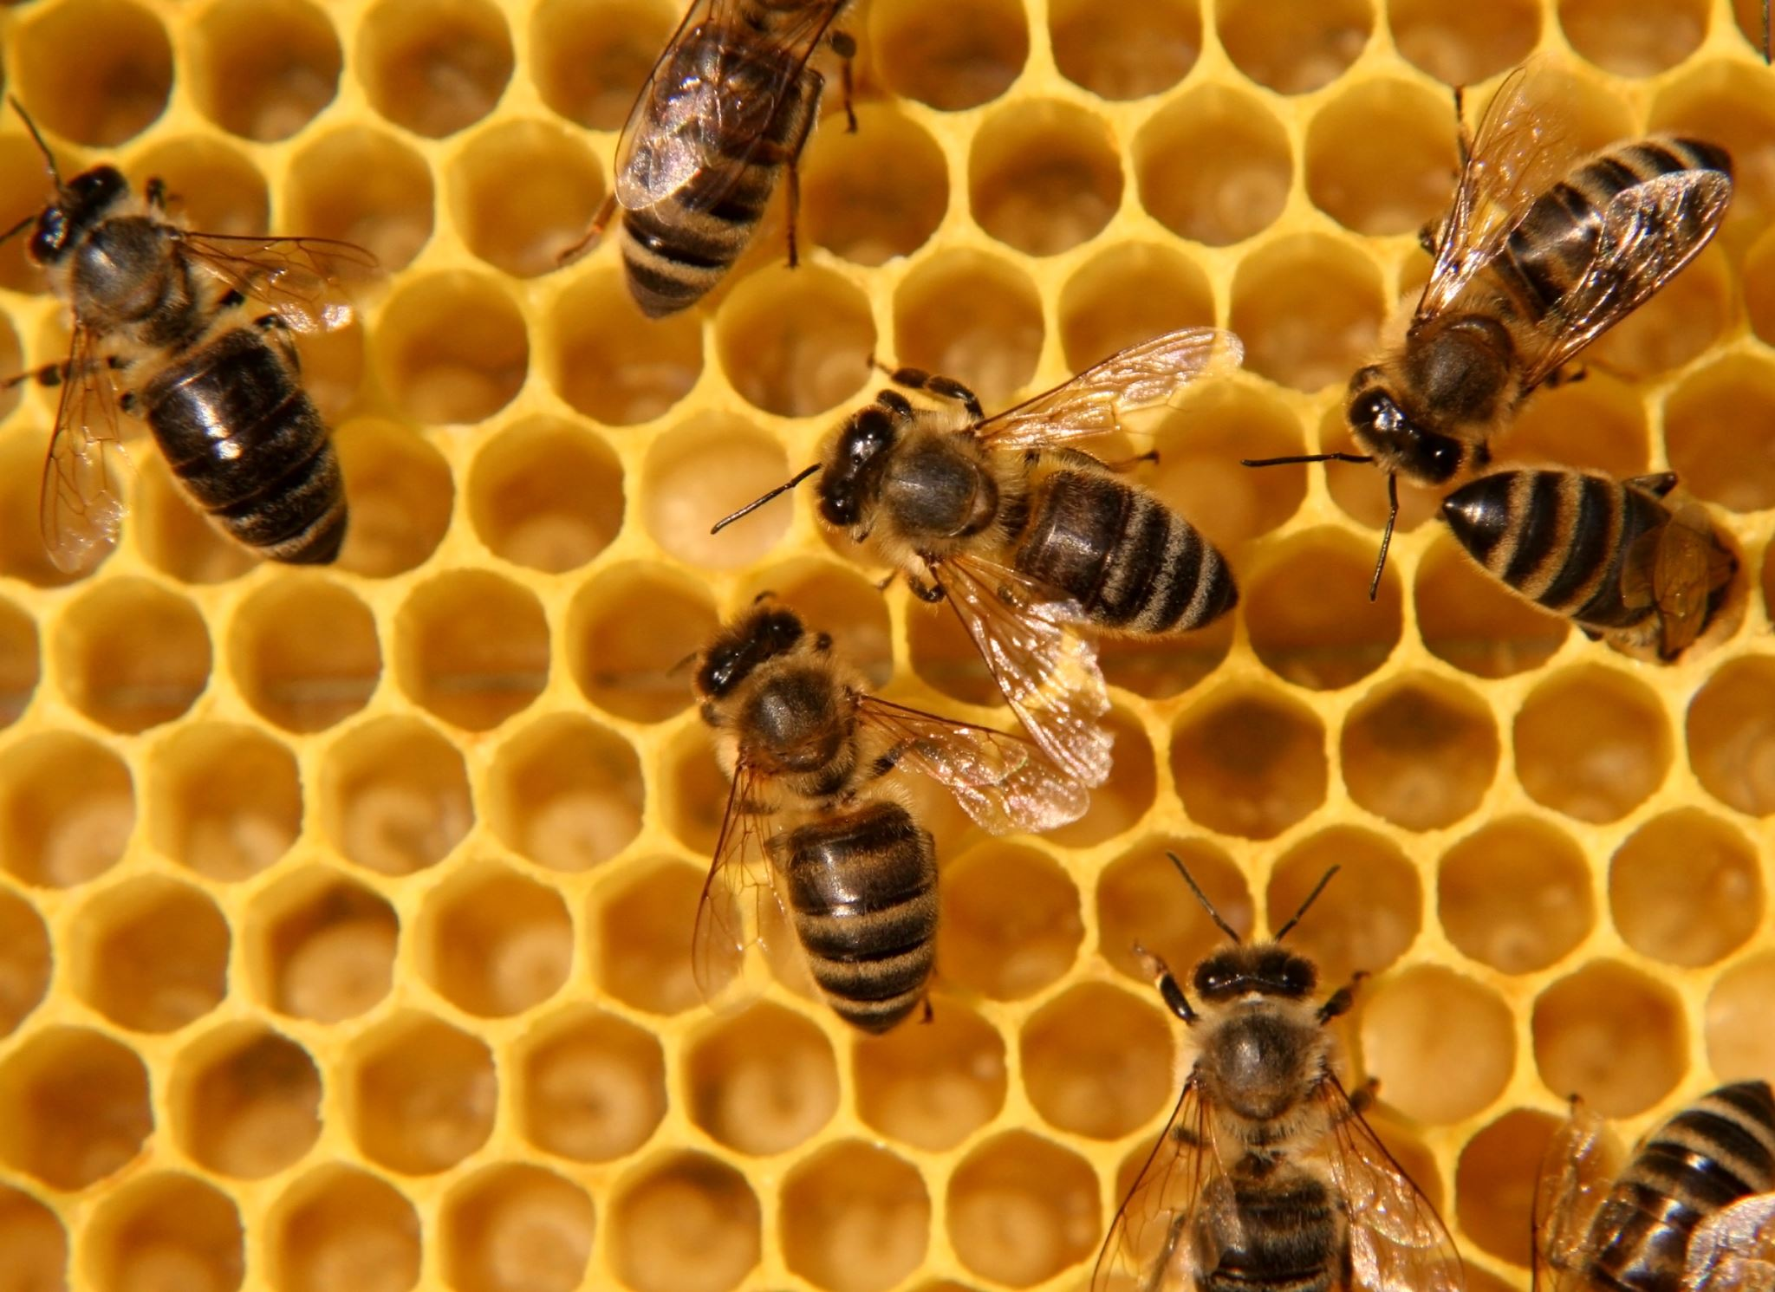
Hive Subqueries
hive> SELECT sid, mid, total FROM
hive> (SELECT sid, mid, refCnt + altCnt AS total hive> FROM genotype) gtypeTotals
hive> WHERE total > 20;
Hive allows subqueries only within FROM clauses
Subqueries are generally materialized (computed and saved as hive tables)
You MUST to include a name for the subquery result table
The columns of a subquery's SELECT list are available to the outer query

Slide 31

Summary
There are two primary "high-level" programming languages for Hadoop-- Pig and Hive
Pig is a "scripting language" that excels in specifying a processing pipeline that is automatically parallelized into Map-Reduce operations
Deferred execution allows for optimizations in scheduling Map-Reduce operations
Good for general data manipulation and cleaning
Hive is a "query languge" that borrows heavily from SQL, good for searching and summarizing data
Requires the specification of an "external" schema
Often materializes many more intermediate results than a DBMS would

