Slide 1



Big Data Analytics (Spring 2026)
II Map Reduce

Slide 2
Overview
∗ Review: MapReduce
∗ Introduction to Design Pattern
∗ MapReduce Design Pattern

Slide 3

MapReduce
∗ Simplifies large-scale computations that fit this model
∗ Allows user to focus on the problem without worrying about details
∗ Computer architecture not very important
  ∗ Portable model
∗ Fault tolerant, reliable, and supports thousands of nodes and petabytes of data
∗ If you can rewrite algorithms into Maps and Reduces, and your problem can be broken up into small pieces solvable in parallel, then Hadoop’s MapReduce is the way to go for a distributed problem solving approach to large datasets

Slide 4

MapReduce Design Pattern
∗ Provide a general framework for solving your data computation issues, without being specific to the problem domain
∗ Summarization
∗ Numerical Summarizations
∗ Counting with Counters
∗ Filtering
∗ Filtering
∗ Top Ten
∗ Distinct
∗ Data Organization
∗ Structured to Hierarchy
∗ Partition
∗ Shuffling
∗ Join
∗ Reduce Side Join
∗ Replicated Join

Slide 5

Design Pattern Rules
∗ A general repeatable solution to a commonly occurring problem in software design
∗ Not a finished design that can be transformed directly into source or machine code
∗ A description or template for how to solve a problem that can be used in many different situations
∗ Traditional OOP Design Pattern Samples

Slide 6

I. Summarization Pattern
∗ Your data is large and vast, with more data coming into the system every day
  ∗ ex. web user-logs
∗ Produce a top-level, summarized view of your data so you can glean insights not available from looking at a localized set of records alone
∗ Grouping similar data together and then performing an operation such as calculating a statistic, building an index, or just simply counting
∗ Patterns
  ∗ Numerical Summarizations
  ∗ Counting with Counters

Slide 7

Numerical Summarization
∗ Intent: Group records together by a key field and calculate a numerical aggregate per group to get a top-level view of the larger data set
∗ Multiple large data sets are being joined by a foreign key
∗ You want the flexibility of being able to execute any join operation
∗ Motivation
  ∗ Many data sets these days are too large for a human to get any real meaning out it by reading through it manually, e.g., terabytes of website log files.
∗ Applicability
∗ A large amount of network bandwidth
∗ minimum, maximum, average, median, and standard deviation
∗ Consider θ to be a generic numerical summarization function we wish to execute over some list of values (v₁, v₂, v₃, …, v_{n}) to find a value λ, i.e.
  λ = θ(v₁, v₂, v₃, …, v_{n}). Examples of θ include a minimum, maximum, average, median, and standard deviation

Slide 8
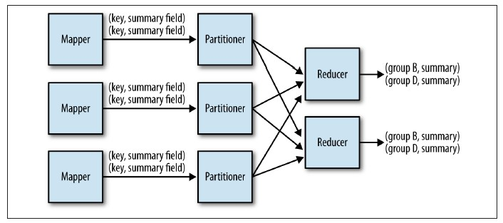
Numerical Summarization
∗ The Mapper
∗ Outputs keys that consist of each field to group by, and values consisting of any pertinent numerical items
∗ A Combiner will have, unlike a Reducer, is that the input/output key and value types must match the output types of your Mapper
∗ The Reducer
∗ Receives a set of numerical values (v1, v2, v3, …, vn) associated with a group-by key records to perform the
aggregation function λ. The value of λ is output with the given input key
∗ Reducers can get data from multiple Mappers as part of the partitioning process. Combiners can only get its input from one Mapper

Slide 9
Numerical Summarization
∗ Resemblances
SELECT MIN(numericalcol1), MAX(numericalcol1), COUNT(*) FROM table GROUP BY groupcol2;
∗ Known uses
∗ Word count, Record count
∗ Min, Max, Count of a particular event
∗ Average, Median, Standard deviation

Slide 10
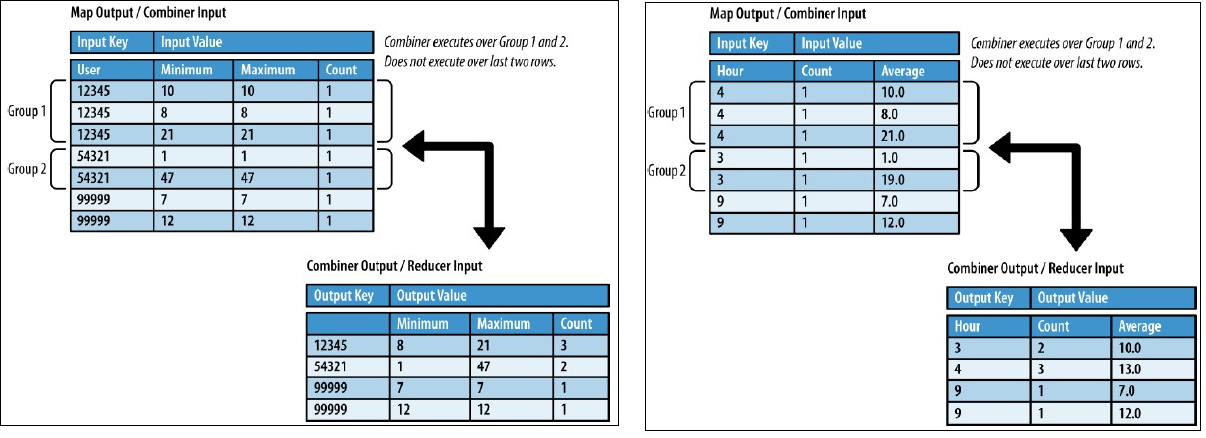
Numerical Summarization
∗ Performance Analysis
∗ Aggregations perform well when the combiner is properly used.
∗ Data skew of reduce groups: many more intermediate key/value pairs with a specific key than other keys, one reducer is going to have a lot more work to do than others

Slide 11

Numerical Summarization
Min / Max / Count
Average (c1*avg1 +c2*avg2 +c3*avg3)/(c1+c2+c3) Median and Standard Deviation
Smart Median and Standard Deviation

Slide 12

Counting with Counters
∗ Intent: An efficient means to retrieve count summarizations of large data sets
∗ Motivation
  ∗ A count or summation can tell you a lot about your data as a whole
  ∗ Simply use the framework’s counters à no reduce phase and no summation
∗ Applicability
  ∗ You have a desire to gather counts or summations over large data sets
  ∗ The number of counters you are going to create is small

Slide 13
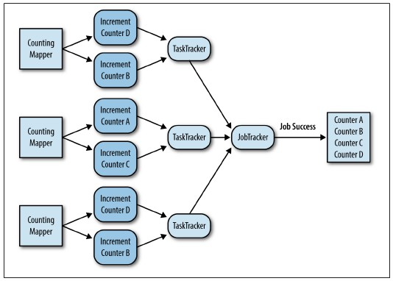
Counting with Counters
∗ The mapper
∗ processes each input record at a time to increment counters based on certain criteria
∗ The Reducer
∗ incremented by one if counting a single
instance
∗ incremented by some number if executing a summation

Slide 14
Counting with Counters
∗ Consequences
  ∗ the final output is a set of counters grabbed from the job framework (no actual output)
∗ Known uses
  ∗ Count number of records (over a given time period)
  ∗ Count a small number of unique instances
  ∗ Counters can be used to sum fields of data together
∗ Performance analysis
  ∗ Using counters is very fast, as data is simply read in through the mapper and no output is written
    ∗ Performance depends largely on the number of map tasks being executed and how much time it takes to process each record

Slide 15
Counting with Counters

Slide 16

II. Filtering Pattern
∗ Don’t change the actual records
∗ To understand a smaller piece of data
  ∗ Find a subset of data, whether it be small, like a top-ten listing, or large, like the results of a deduplication
∗ Patterns
  ∗ Filtering
  ∗ Top Ten
  ∗ Distinct

Slide 17

Filtering
∗ Intent: Filter out records that are not of interest
∗ Motivation
  ∗ Your data set is large and you want to take a subset of this data to focus in on it and perhaps do follow-on analysis
∗ Applicability
  ∗ The data can be parsed into “records” that can be categorized through some well-specified criterion determining whether they are to be kept

Slide 18
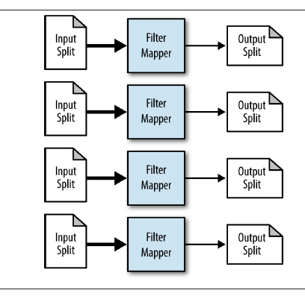
Filtering
∗ The Mapper
∗ Consider an evaluation function f that takes a record and returns a Boolean value of true or false. If this function returns true, keep the record; otherwise, toss it out
∗ The Reducer
∗ No reducer

Slide 19
Filtering
∗ Consequences
  ∗ A subset of the records that pass the selection criteria.
    ∗ If the format was kept the same, any job that ran over the larger data set should be able to run over this filtered data set, as well.
∗ Known uses
  ∗ Closer view of data
  ∗ Tracking a thread of events
  ∗ Distributed grep
  ∗ Data cleansing
  ∗ Simple random sampling
  ∗ Removing low scoring data (if you can score your data)

Slide 20
Filtering
∗ Resemblances
SELECT * FROM table WHERE value < 3;
∗ Performance Analysis
∗ NO reducers
∗ Data never has to be transmitted between the map and reduce phase.
∗ Most of the map tasks pull data off of their locally attached disks and then write back out to that node.
∗ Both the sort phase and the reduce phase are cut out

Slide 21
Filtering

Slide 22
Top Ten
∗ Intent:
  ∗ Retrieve a relatively small number of top K records, according to a ranking scheme in your data set, no matter how large the data
∗ Motivation
∗ Finding records that are typically the most interesting
∗ To find the best records for a specific criterion
∗ Applicability
∗ It is able to compare one record to another to determine which is “larger”
∗ The number of output records should be significantly fewer than the number of input
  records a total ordering of the data set

Slide 23
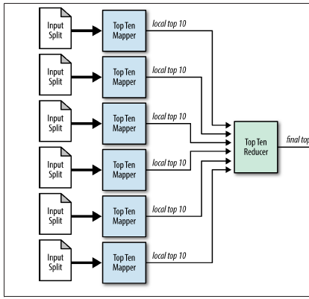
Top Ten
∗ The mapper
∗ Each mapper determines the top ten records of its input split and outputs them to the reduce phase
∗ The mappers are essentially filtering their input split to the top ten records, and the reducer is responsible for the final ten
∗ The Reducer
∗ Use an identity reducer to collect the results without doing anything with them
∗ Just remember to configure your job to only use
one reducer!
∗ Multiple reducers would shard the data and would result in multiple “top ten” lists

Slide 24
Top Ten
∗ Consequences
∗ The top K records are returned
∗ Known uses
∗ Outlier analysis
∗ Select interesting data (most valuable data)
∗ Catchy dashboards
∗ Resemblances
SELECT * FROM table WHERE col4 DESC LIMIT 10

Slide 25

Top Ten
∗ Performance Analysis
  ∗ How many records (K*M) the reducer is getting?
    ∗ The sort can become an expensive operation when it has too many records and has to do most of the sorting on local
  ∗ The reducer host will receive a lot of data over the network à a network resource hot spot
    ∗ Naturally, scanning through all the data in the reduce will take a long time if there are many records to look through
    ∗ Any sort of memory growth in the reducer has the possibility of blowing through the Java virtual machine’s memory
  ∗ Writes to the output file are not parallelized
∗ Reference
  ∗

Slide 26
Top Ten

Slide 27
Distinct
∗ Intent:
  ∗ To find a unique set of values from similar records
∗ Motivation
  ∗ Reducing a data set to a unique set of values has several uses
∗ Applicability
  ∗ You have duplicates values in data set; it is silly to use this pattern otherwise.

Slide 28
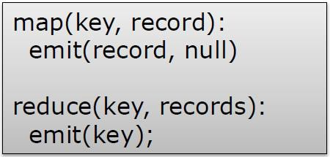
Distinct
∗ Structure
∗ It exploits MapReduce’s ability to group keys together to remove duplicates
∗ Mapper transforms the data and doesn’t do much in the reducer
∗ The Mapper will get the user ID from each input record. This user ID will be output as the key with a null value
∗ Duplicate records are often located close to another in a data set, so a combiner will deduplicate them in
the map phase.
∗ Each reducer is given a unique key and a set of null values. These values are ignored and the input key is written to the file system with a null value

Slide 29
Distinct
∗ Consequences
∗ The output records are guaranteed to be unique, but any order has not been preserved due to the random partitioning of the records
∗ Known uses
∗ Deduplicate data
∗ Getting distinct values
∗ Protecting from an inner join explosion
∗ Resemblances
SELECT DISTINCT * FROM table;

Slide 30
Distinct

Slide 31
III. Data Organization Pattern
∗ All about reorganizing data
∗ Patterns
∗ Structured to Hierarchical
∗ Partition
∗ Total Order
∗ Shuffling

Slide 32

Structured to Hierarchical
∗ Intent
  ∗ Transform your row-based data to a hierarchical format, such as JSON or XML
∗ Motivation
  ∗ Creates new records from data that started in a very different structure
  ∗ Migrating data from an RDBMS to a Hadoop system
  ∗ Data doesn’t always come grouped together
  ∗ Create the denormalized records for MapReduce
∗ Applicability
  ∗ data sources that are linked by some set of foreign keys
  ∗ data is structured and row-based

Slide 33
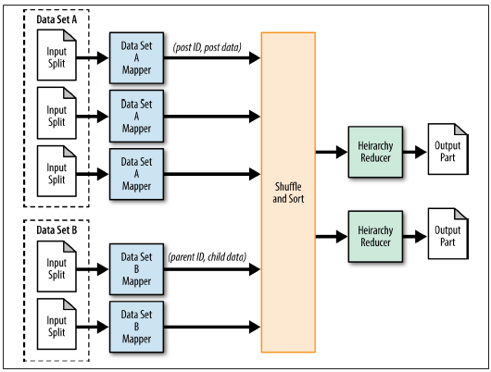
Structured to Hierarchical
∗ MultipleInputs allows you to specify different input paths and different mapper classes for each input
∗ Mappers load the data and parse the records into one cohesive format
∗ In general, a combiner isn’t going to help too much here
∗ The reducer receives the data from all the different sources key by key. All of the data for a particular grouping is going to be provided for you in one iterator, so all that is left for you to do is build the hierarchical data structure from the list of data Items

Slide 34

Structured to Hierarchical
∗ Known Usage
  ∗ Pre-joining data
  ∗ Preparing data for HBase or MongoDB
∗ Performance Analysis
  ∗ Be aware of how much data is being sent to the reducers from the mappers
  ∗ Be aware of the memory footprint of the object that the reducer builds

Slide 35
Structured to Hierarchical

Slide 36
Partitioning
∗∗ Intent
Moves the records into categories (i.e., shards, partitions, or bins), but it doesn’t really care about the order of records.
∗ Take similar records in a data set and partition them into distinct, smaller data sets.
∗ Motivation
∗ Want to look at a particular set of data—such as postings made on a particular date—the data items are normally spread out across the entire data set.
∗ Partitioning by date is one of the most common schemes
∗ Applicability
∗ knowing how many partitions you are going to have ahead of time

Slide 37
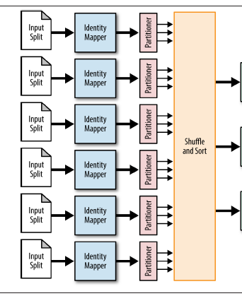
Partitioning
∗ In most cases, the identity mapper can be used
∗ The custom partitioner will determine which reducer to send each record to; each reducer corresponds to particular partitions
∗ In most cases, the identity reducer can be
used
∗ The output folder of the job will have one part file for each partition

Slide 38

Partitioning
∗ Known Usage
  ∗ The output folder of the job will have one part file for each partition
  ∗ Partition pruning by category
∗ Performance Analysis
  ∗ the resulting partitions will likely not have similar number of records
  ∗ Split very large partitions into several smaller partitions

Slide 39
Partitioning

Slide 40
Shuffling
∗ Intent
∗ You have a set of records that you want to completely randomize
∗ The total order sorting and shuffling patterns are opposites in terms of effect, but the latter is also concerned with the order of data in records
∗ Motivation
∗ Completely destroying the order
∗ Structure
∗ All the mapper does is output the record as the value along with a random key
∗ The reducer sorts the random keys, further randomizing the data

Slide 41
Shuffling
∗ Consequences
∗ Each reducer outputs a file containing random records.
∗ Resemblances
SELECT * FROM table ORDER BY RAND();
∗ Performance Analysis
∗ Since the reducer each record goes to is completely random, the data distribution across reducers will be completely balanced
∗ The size of the files will also be very predictable: each is the size of the data set divided by the number of reducers

Slide 42
Window Function
What Is a Window Function
Definition: A window function performs a calculation across a set of rows that are related to the current row.
Unlike GROUP BY, it doesn’t collapse rows — you still see individual records. Key Clause: PARTITION BY divides rows into groups (partitions).
The window function runs independently within each partition.

Slide 43
Window Function
SELECT DISTINCT
  employee_id,
  department,
  sale_amount,
SUM (sale_amount) over (PARTITION BY Department) AS total_sales_per_dept
FROM
sales;
Sales Table
employee_id | department | sale_amount
1 | HR | 580,000
2 | HR | 525,000
3 | IT | 810,000
4 | IT | 190,000
5 | Finance | 500,000

Slide 44
Window Function
employee_id | department | sale_amount | total_sales_per_dept
1 | HR | 580,000 | 1,105,000
2 | HR | 525,000 | 1,105,000
3 | IT | 810,000 | 1,000,000
4 | IT | 190,000 | 1,000,000
5 | Finance | 500,000 | 500,000

Slide 45
Shuffling

Slide 46
IV. Join Pattern
∗ The SQL Joins clause is used to combine records from two or more tables in a database
∗ Joins are possibly one of the most complex operations one can execute in MapReduce
∗ MapReduce is very good at processing large data sets by looking at every record or group in isolation, so joining two very large data sets together does not fit into the paradigm gracefully
∗ We need to know what data set a record came from in order to process it correctly
∗ Network bandwidth is a very important resource and joins have a tendency to use a lot
∗ Patterns
∗ Reduce Side Join
∗ Replicated Join

Slide 47
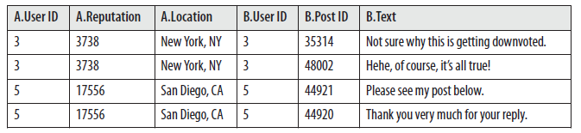
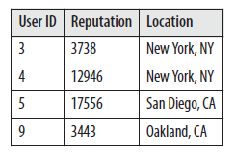
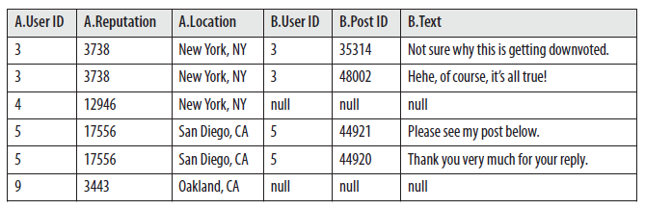
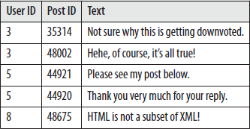
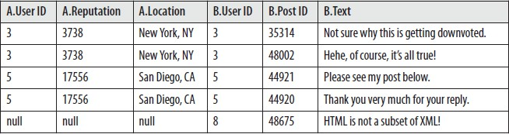
Refresher on Joins
∗ Inner Join
∗ Left Outer Join
∗ Right Outer Join

Slide 48
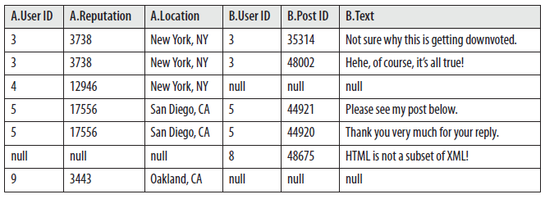
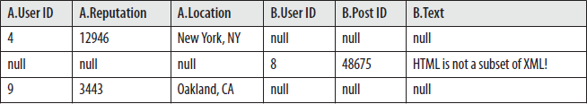
Refresher on Joins
∗ Full Outer Join
∗ Anti Join
∗ An anti join is a full outer join minus the inner join. That is, the resulting table contains only records that did not contain a match on f.

Slide 49
Refresher on Joins
Employees Table
Departments Table
emp_id | name | dept_id
1 | Alice | 1
2 | Bob | 2
3 | Carol | NULL
4 | David | NULL
dept_name | dept_id
HR | 1
IT | 2
Finance | 3

Slide 50
Refresher on Joins
LEFT JOIN
SELECT e.name, d.dept_name FROM employees e
LEFT JOIN departments d ON e.dept_id = d.dept_id;
Output Table name dept_name Alice HR
Bob IT Carol NULL David NULL

Slide 51
Refresher on Joins
RIGHT JOIN
SELECT e.name, d.dept_name FROM employees e
RIGHT JOIN departments d ON e.dept_id = d.dept_id;
Output Table
name dept_name Alice HR
Bob IT NULL Finance

Slide 52
Refresher on Joins
Inner JOIN
SELECT e.name, d.dept_name FROM employees e
INNER JOIN departments d ON e.dept_id = d.dept_id;
Output Table
name dept_name Alice HR
Bob IT

Slide 53
Refresher on Joins
FULL OUTER JOIN
SELECT e.name, d.dept_name FROM employees e
FULL OUTER JOIN departments d ON e.dept_id = d.dept_id;
Output Table
name dept_name Alice HR
Bob IT Carol NULL David NULL NULL Finance

Slide 54
Refresher on Joins
5 ANTI JOIN
a) Employees without a department
SELECT e.name
FROM employees e
LEFT JOIN departments d ON e.dept_id = d.dept_id WHERE d.dept_id IS NULL;
Output Table
| name |
| |
| Carol |
| David |

Slide 55
Refresher on Joins
5 ANTI JOIN
b) Departments without employees
SELECT d.dept_name
FROM departments d
LEFT JOIN employees e ON e.dept_id = d.dept_id WHERE e.dept_id IS NULL;
Output Table
| dept_name |
| |
| Finance |

Slide 56
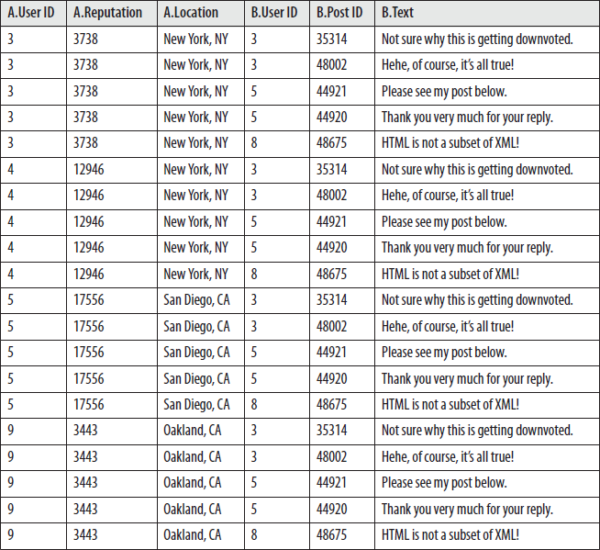
Refresher on Joins
∗ Cartesian product
∗ A Cartesian product or cross product takes each record from a table and matches it up with every record from another table. If table X contains n records and table Y contains m records, the cross product of X and Y, denoted X × Y, contains n × m records.

Slide 57
Refresher on Joins
CROSS JOIN (Cartesian Join)
A CROSS JOIN returns every possible combination of rows from both tables.
If the first table has A rows and the second has B rows, the result will have A × B rows.
Employment Table
Department Table
| dept_id | dept_name |
| ------- | --------- |
emp_id name dept_id
1 Alice 10
2 Bob 20
| 10 | HR |
| 20 | IT |
3 Carol 30

Slide 58
Refresher on Joins
SELECT e.name, d.dept_name FROM employees e
CROSS JOIN departments d;
Output Table
| name | dept_name |
|
| Alice | HR |
| Alice | IT |
| Bob | HR |
| Bob | IT |
| Carol | HR |
| Carol | IT |

Slide 59
Refresher on Joins
Explanation
There is no join condition.
Every employee is paired with every department. Often used to:
Generate test data
Produce all combinations (e.g., sizes × colors) Build matrices or pivot-like structures

Slide 60
Reduce Side Join
∗ Intent
∗ Join large multiple data sets together by some foreign keys
∗ Motivation
∗ Simple to implement in Reducers
∗ Supports all the different join operations
∗ No limitation on the size of your data sets
∗ Applicability
∗ Multiple large data sets are being joined by a foreign key
∗ You want the flexibility of being able to execute any join operation
∗ A large amount of network bandwidth

Slide 61
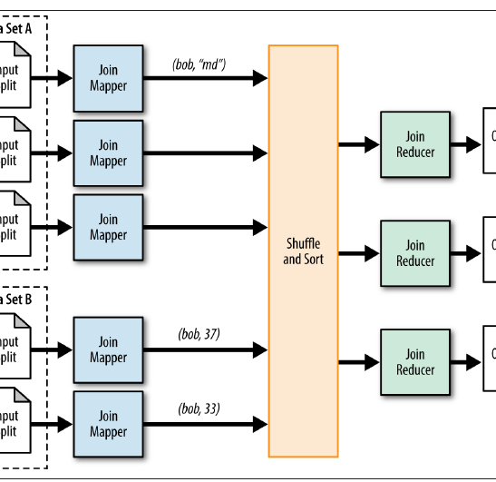
Reduce Side Join
∗ The mapper prepares the join operation
∗ Takes each input record from each of the data sets
∗ Extracts foreign key from each record
∗ Output key: foreign key
∗ Output value: entire input record which is flagged by some unique identifier for the data set
∗ Reducer performs the desired join operation by collecting the values of each input group into temp lists
∗ Lists are then iterated over and the records from both sets are joined together
∗ Output is a number of part files equivalent to the number of reduce tasks

Slide 62
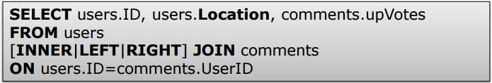
Reduce Side Join
∗ Resemblances
∗ Performance Analysis
∗ The whole data moves across the network to reducers
∗You can optimize by using projection and sending only the required fields
∗Number of reducers typically higher than normal
∗If you can use any other Join type for your problem, use that instead

Slide 63
Reduce Side Join
Reduce Side Join

Slide 64
Replicated Side Join
∗ Intent
∗ Eliminates the need to shuffle any data to the reduce phase
∗ Motivation
∗ All the data sets except the very large one are essentially read into memory during the setup phase of each map task, which is limited by the JVM heap
∗ Applicability
∗ All of the data sets, except for the large one, can be fit into main memory of each map task

Slide 65
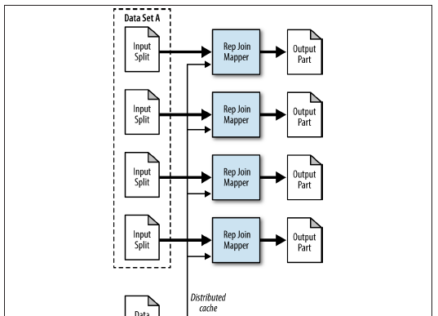
Replicated Side Join
∗ Map-only pattern
∗ Read all files from the distributed cache and
store them into in-memory lookup tables
∗ Process each record and joins it with all the data stored in-memory

Slide 66
Replicated Side Join
∗ Performance Analysis
∗ A replicated join can be the fastest type of join executed because there is no reducer required
∗ The amount of data that can be stored safely inside JVM

Slide 67
Replicated Side Join
Replicated Side Join

Slide 68
Summary
∗ MapReduce has proven to be a useful abstraction
∗ Greatly simplifies large-scale computations
∗ Hadoop is widely used
∗ Focus on problems, let MapReduce deal with messy details

Slide 69
Map Reduce in Practice II Design patterns
The End

Slide 70
Total Order
∗ Intent
∗ Sort data in parallel on a sort key
∗ Motivation
∗ Sorting is easy in sequential programming
∗ Divide and Conquer
∗ Applicability
∗ sort key has to be comparable so the data can be ordered

Slide 71
Total Order
∗ An analyze phase that determines the ranges
∗ The mapper does a simple random sampling. When dividing records, it outputs the sort key as its output key so
that the data will show up sorted at the reducer
∗ Ahead of time, determine the number of records in the total data set and figure out what percentage of records you’ll need to analyze to make a reasonable sample
∗ Only one reducer will be used here
∗ An order phase that actually sorts the data
∗ The mapper extracts the sort key in the same way as the analyze step
∗ A custom partitioner is used that loads up the partition file
∗ The reduce function simply takes the values that have come in and outputs them. The number of reducers needs to be equal to the number of partitions for the TotalOrderPartitioner to work properly

Slide 72
Total Order
∗ Performance Analysis
∗ Expensive: load and parse the data twice, first to build the partition ranges, and then to actually sort the data.
∗ The job that builds the partitions is straightforward and efficient since it has only one reducer and sends a minimal amount of data over the network. The output file is small, so writing it out is trivial
∗ The order step of the job has performance characteristics similar to the other data organization patterns, because it has to move all of the data over the network and write all of the data back out

Slide 73
Total Order
Total Order

Slide 74


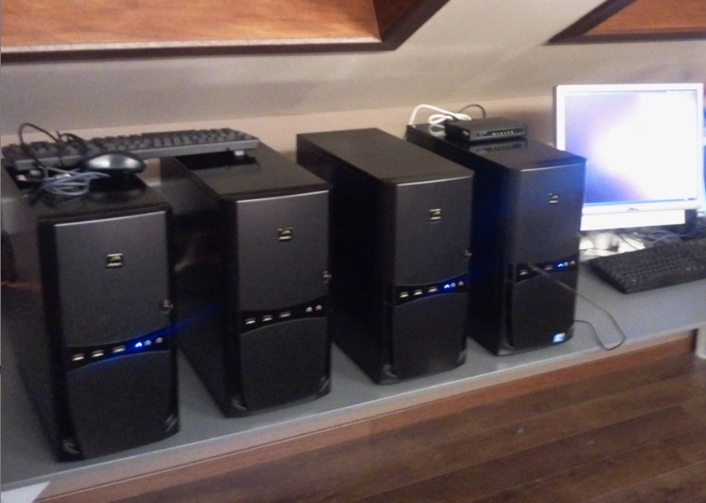
New Hardware Approach
Traditional Exotic HW
big central servers
SAN
RAID
Hardware reliability Limited scalability Expensive
Big Data Commodity HW
racks of pizza boxes
Ethernet
JBOD
Unreliable HW Scales further
Cost effective

Slide 75
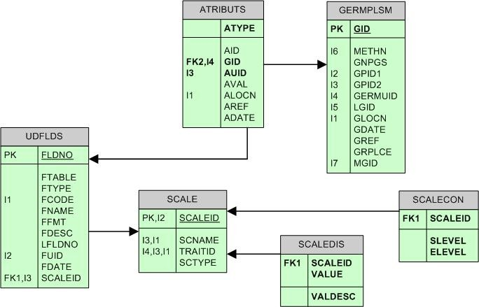
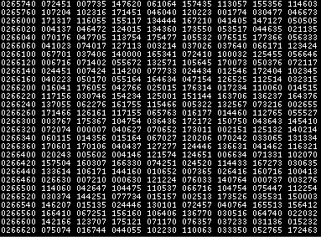
New Software Approach
Traditional Monolotic
Centralized
RDBMS
Schema first Proprietary
Big Data Distributed
- storage & compute nodes Raw data
Open source

Slide 76
Hadoop
De facto big data industry standard (batch) Vendor adoption
IBM, Microsoft, Oracle, EMC, ... A collection of projects at Apache
HDFS, MapReduce, Hive, Pig, Hbase, Flume, Oozie, ...
Main components
HDFS
MapReduce
Cluster
Set of machines running HDFS and MapReduce

Slide 77
Distributions
Cloudera
www.cloudera.com
Cloudera Enterprise subscription
Currently CDH3
  Linux package
  Virtual machine
  Cloud
Stack
  hadoop, hbase, hive, pig, mahout, flume, ...
Cloudera SCM
Connectors for Teradata, Netezza, Microstrategy and Quest

Slide 78
Distributions
Hortonworks
www.hortonworks.com
Hortonworks Data Platform Powered by Apache Hadoop, 100% opensource solution
IBM
Offers a derivative version of Apache Hadoop that IBM supports on IBM JVMs on a number of platforms
Microsoft
Hadoop on Azure & Hadoop on Premise Apache Hadoop
Distribution for individual components only

Slide 79
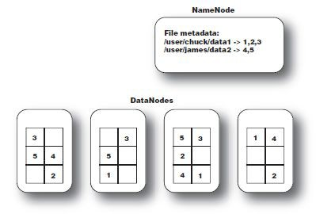
HDFS

Slide 80
Access to HDFS
The HDFS java client api’s can be used
Typically, files are moved from local filesystem into HDFS Using hadoop fs commands
Through Hue (Cloudera SCM) Fuse
HDFS DAV

Slide 81
hadoop fs examples
Get directory listing of user home directory in hdfs
hadoop fs -ls
Get directory listing of root directory
hadoop fs -ls /
Copy a local file to hdfs (user home directory)
hadoop fs -copyFromLocal foo.txt foo.txt Move a file from hdfs to local disk
hadoop fs -copyToLocal /user/geert/foo.txt foo.txt Display the contents of a file
hadoop fs -cat /data/as400/customers.txt Make a new directory (user home directory)
hadoop fs -mkdir output

Slide 82
hadoop fs examples
Remove a directory
hadoop fs -rm /business/data
Remove a directory and all its content (recursive)
hadoop fs -rmr /business/data
More information about hadoop fs command options
http://hadoop.apache.org/common/docs/r0.20.2/hdfs_shell.html

Slide 83
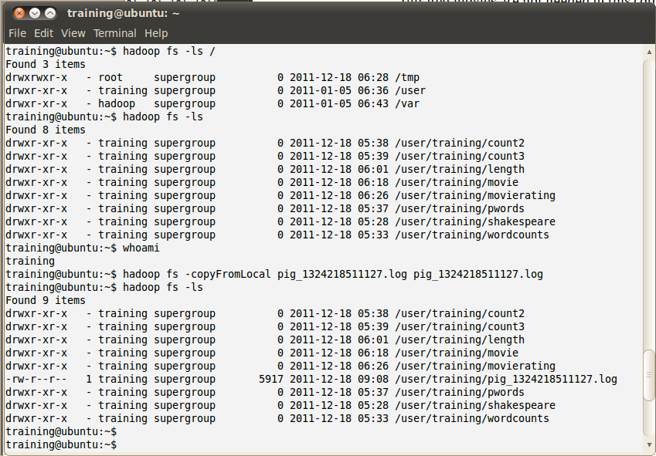
hadoop fs examples

Slide 84
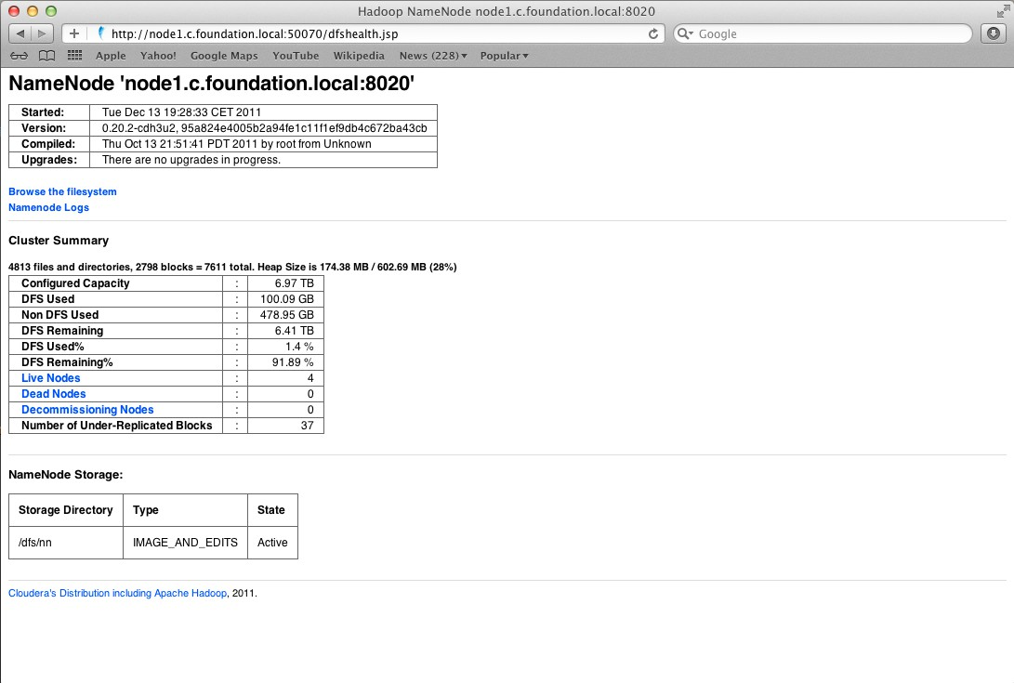
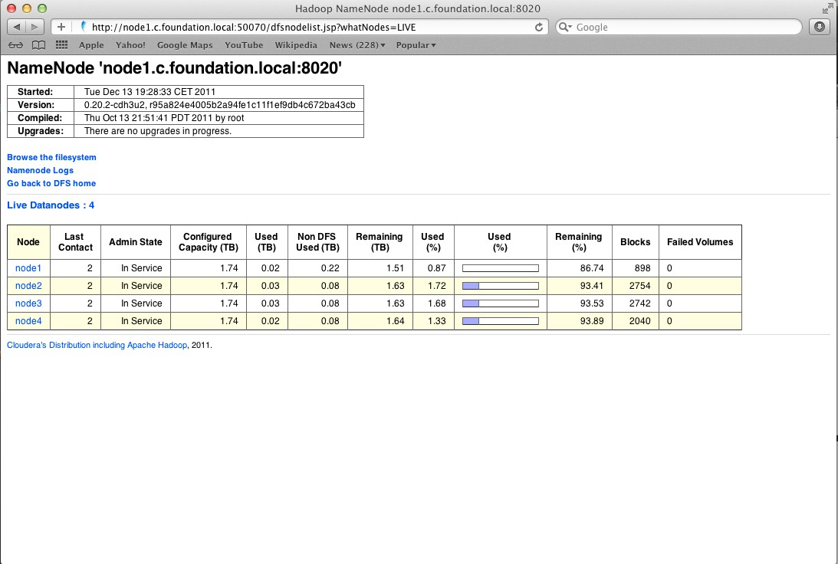
Hadoop Namenode webpage
32
32

Slide 85
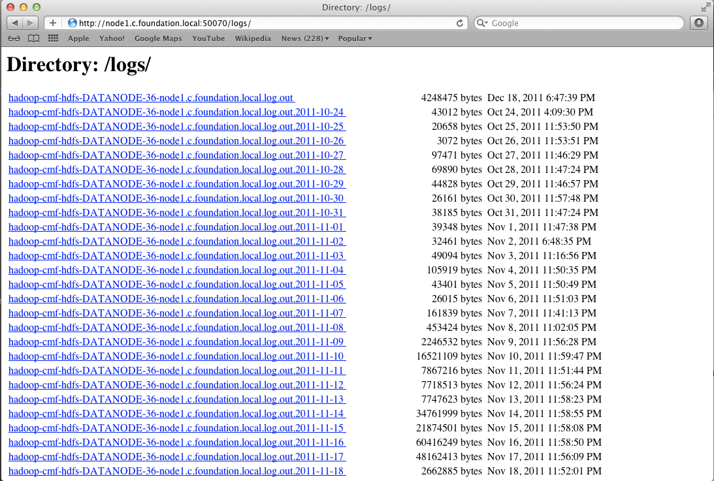
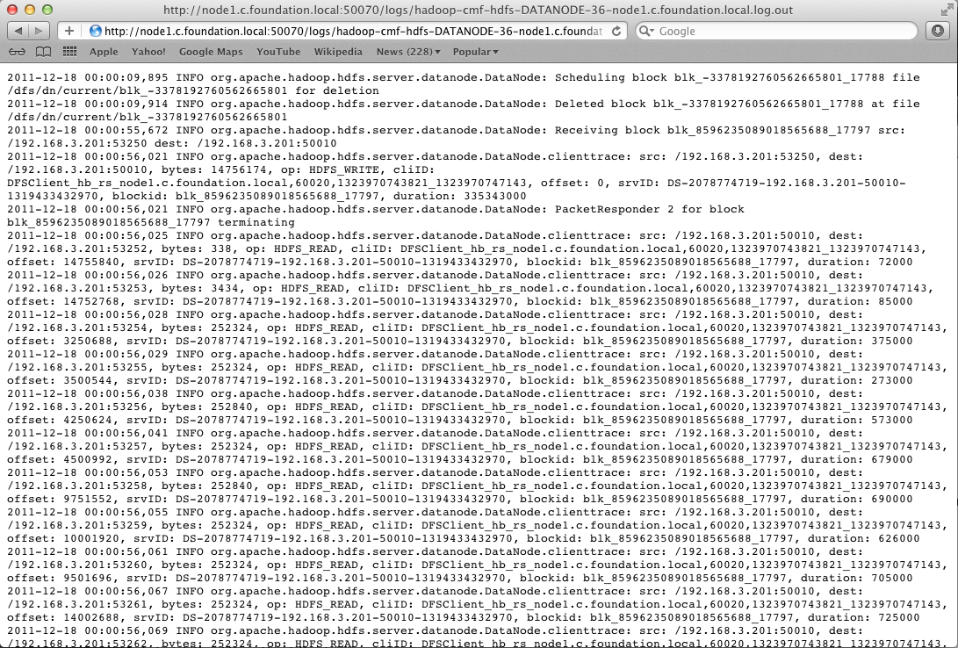
Hadoop Namenode webpage

Slide 86
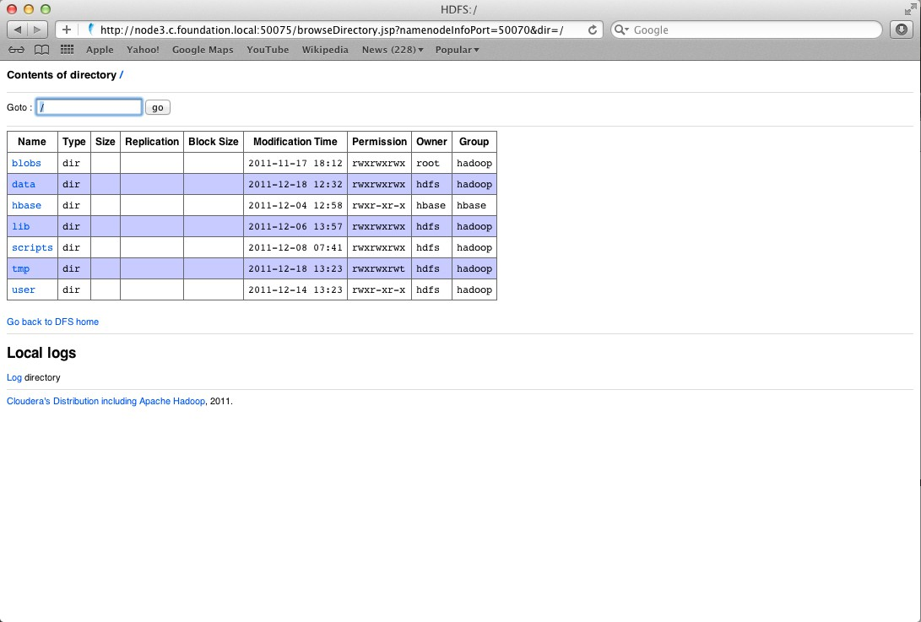
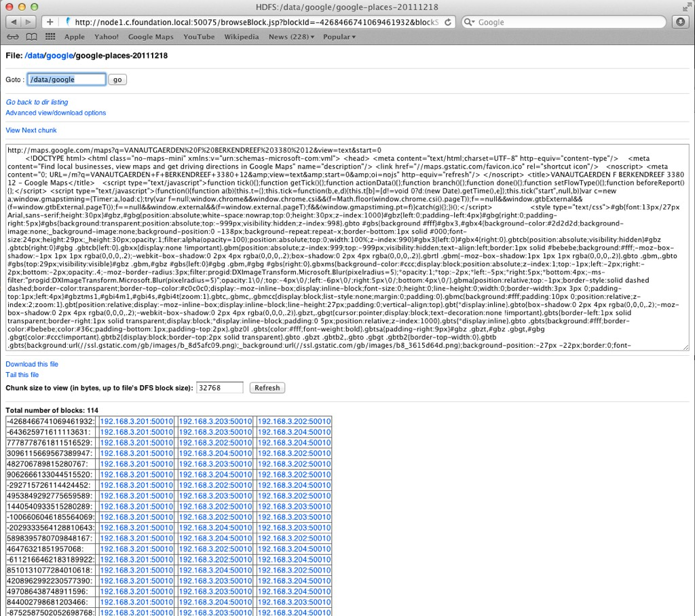
Hadoop Namenode webpage

Slide 87
MapReduce
MapReduce is the system used to process data in the Hadoop cluster Consists of two phases
  Map & Reduce
Between the two is a stage known as the shuffle and sort Data Locality
  Each Map task operates on a discrete portion of the overall dataset
  Typically one HDFS block of data
After all Maps are complete, the MapReduce system distributes the intermediate data to nodes which perform the Reduce phase

Slide 88
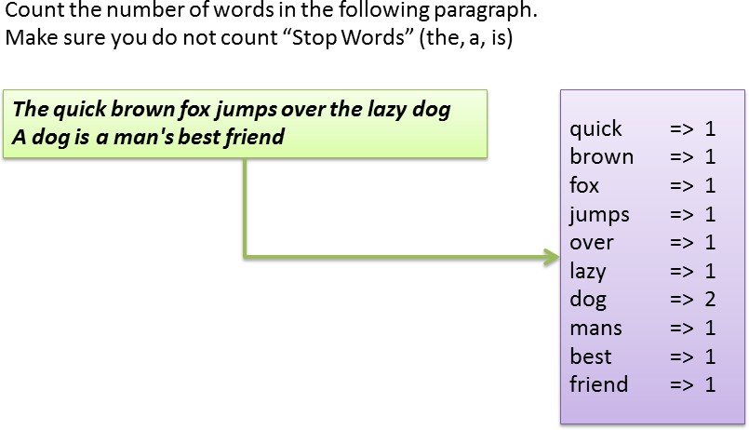
MapReduce

Slide 89
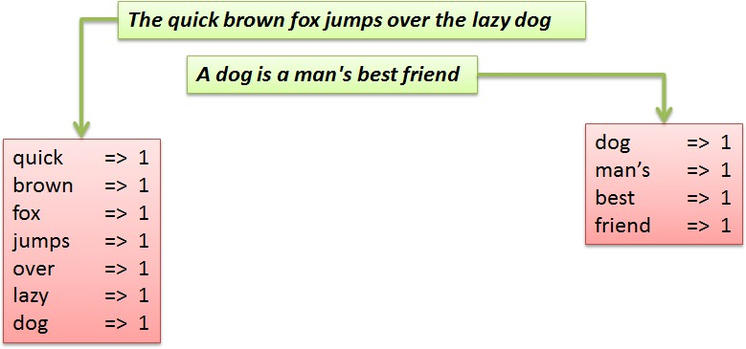
MapReduce

Slide 90
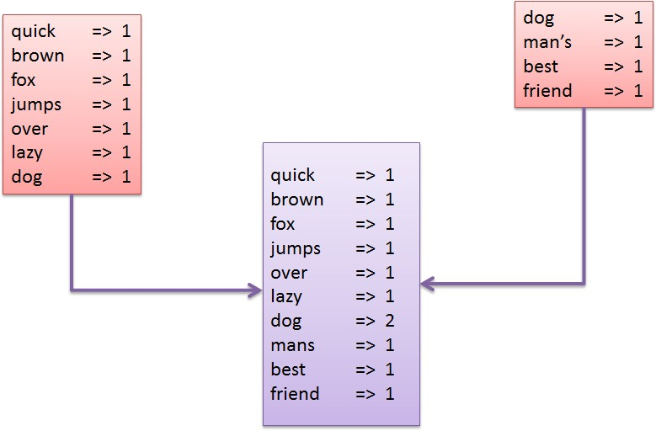
MapReduce

Slide 91
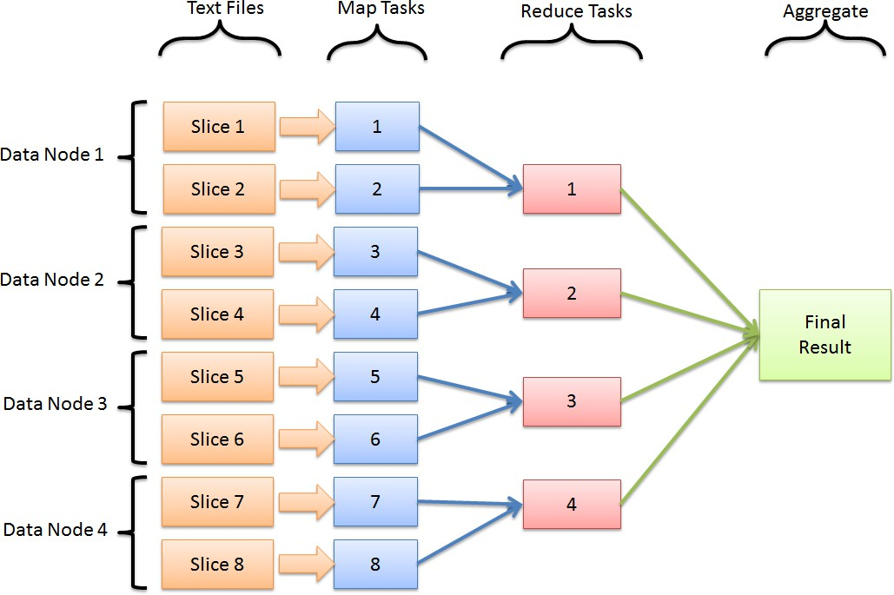
MapReduce

Slide 92
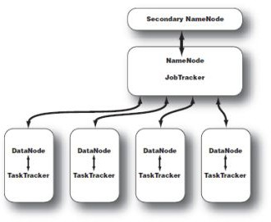
Hadoop Architecture

Slide 93
MapReduce In Action Calculate average word length per first letter of word
AverageWordLength.java: launches job
LetterMapper.java: mapper per first letter
AverageReducer.java: calculates average length

Slide 94
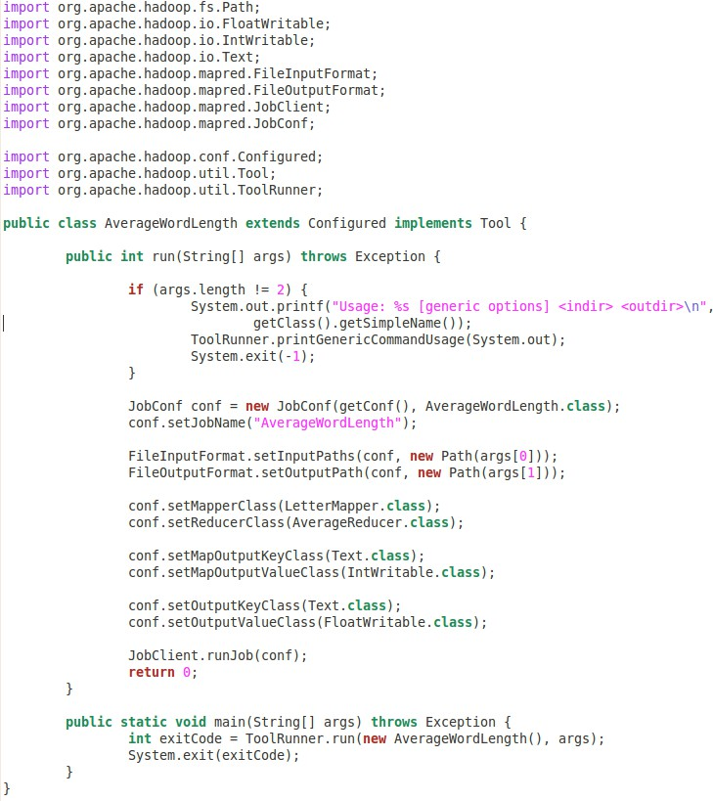
AverageWordLength

Slide 95
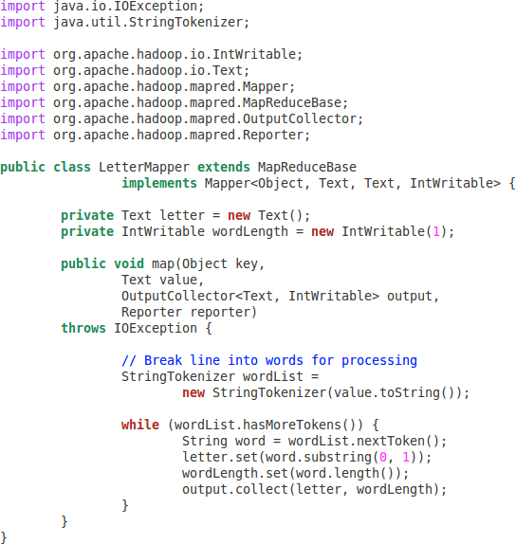
LetterMapper

Slide 96
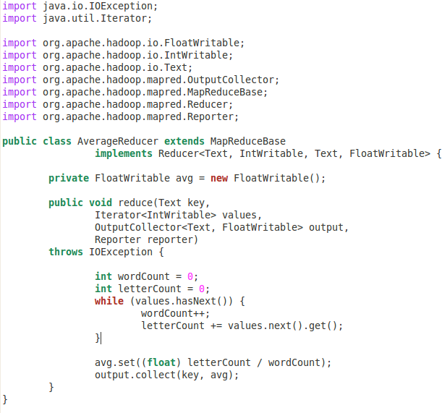
AverageReducer

Slide 97
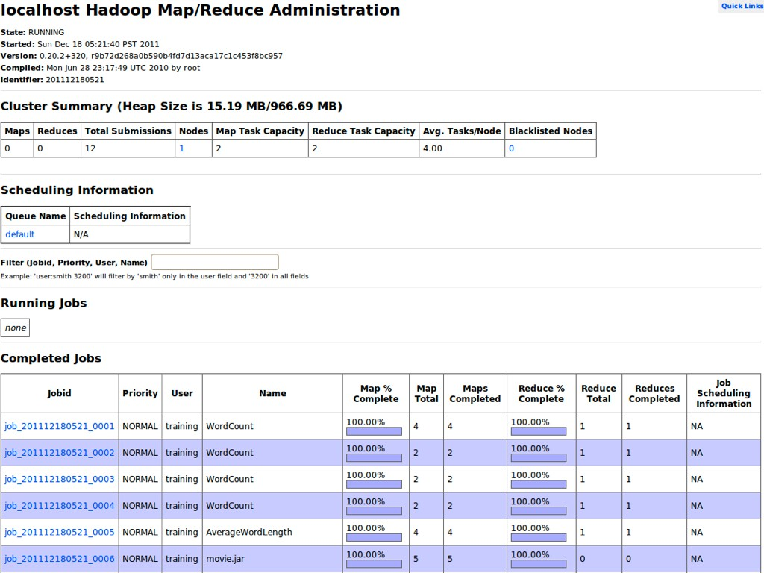
JobTracker page

Slide 98
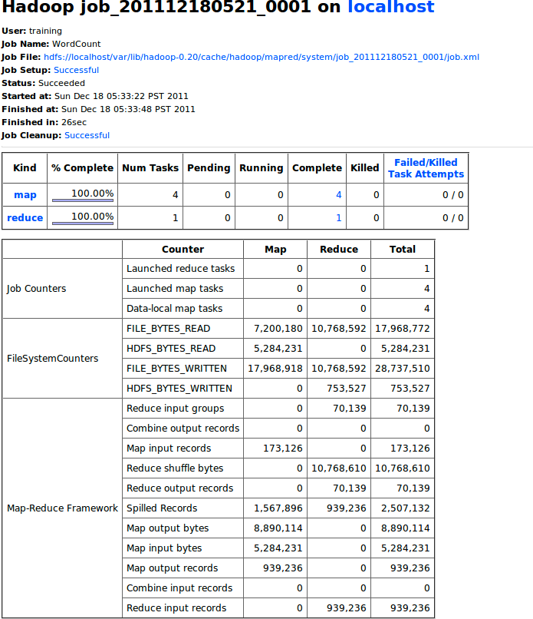
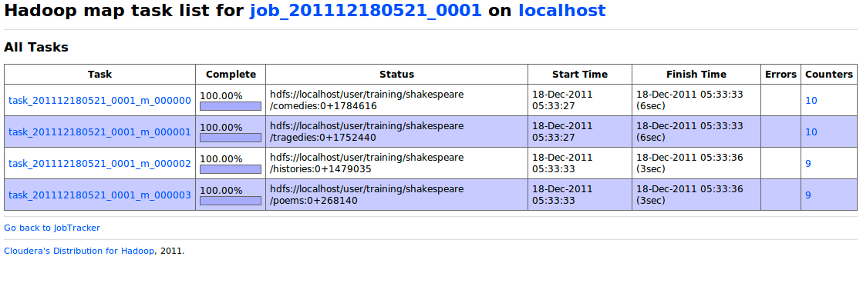
JobTracker page
The Hadoop Ecosystem

Slide 99

YARN = Cluster Resource Manager
YARN stands for Yet Another Resource Negotiator.
It is the operating system of a Hadoop cluster.
What YARN does:
Allocates CPU, memory, and containers to applications
Schedules and manages tasks in the cluster
Allows multiple processing engines to run on Hadoop (Spark, Hive, MapReduce, etc.)
Tracks failures, retries, and container usage
Think of YARN like:
Air Traffic Control — it decides which job gets resources, when, and where.

Slide 100

2. MapReduce = A Data Processing Model / Framework
MapReduce is a programming model for processing large-scale data in parallel.
What MapReduce does:
Breaks a big job into small tasks
Performs:
Map → Shuffle → Reduce
Runs tasks across many machines
Works best for batch, long-running processes
Think of MapReduce like:
The actual airplane — doing the work (processing data), scheduled by YARN.

Slide 101

How They Work Together
Before Hadoop 2.0:
MapReduce
Spark
MapReduce = both compute engine + resource manager
So now, on Hadoop you can run:
Tez
Only one type of job could run: MapReduce
MapReduce becomes just one of the processing frameworks
Flink
All managed by YARN.
After Hadoop 2.0 (with YARN):
YARN handles cluster resources
Storm
And more…

Slide 102
Quick Summary
Modern clusters mostly use:
Spark on YARN (faster, in-memory)
But MapReduce still exists for legacy, reliability, and heavy batch workloads.
Component | What It Is | What It Does | Analogy
YARN | Resource manager | Assigns cluster resources, schedules jobs | Air traffic controller
MapReduce | Processing model | Executes map and reduce tasks | The airplane doing the work

Slide 103
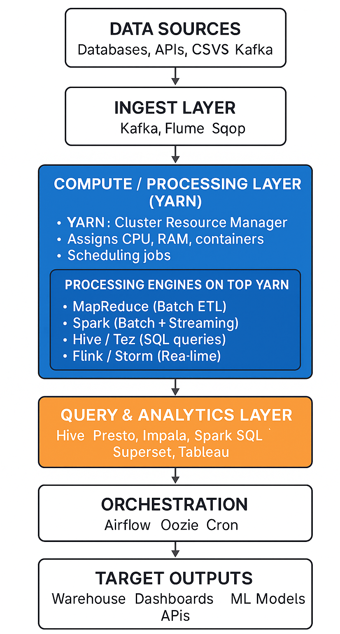
YARN + MapReduce Fit in This Architecture

Slide 104

END

