Slide 1

Spark Introduction
Big Data Analytics (Spring 2026)

Slide 2
Outline
01
02
03
04
05
Introducing Spark
Understanding Spark Architecture
Learning Spark Programming Basics: RDD
Getting Familiar with DataFrames API
Programming SQL with Spark

Slide 3
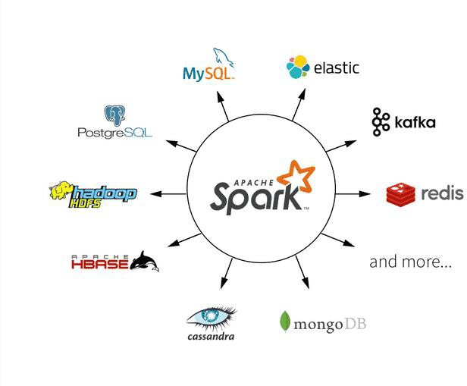
What is Spark
Apache open source project
  originally developed at AMPLab
  (University of California Berkeley)
Unified, general data processing engine that operates across varied data workloads and platforms

Slide 4
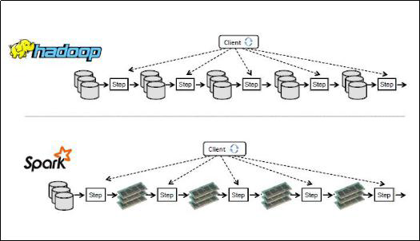
Spark vs. Hadoop
Spark: Computing framework
Hadoop: Distributed File System (HDFS) + Computing framework (MR)

Slide 5
Why Apache Spark
Fast, expressive cluster computing system compatible with Apache Hadoop
  Works with any Hadoop-supported storage system (HDFS, S3, Avro, …)
Up to 100× faster
Often 2-10× less code
Single environment for data munging, data wrangling, and Machine Learning (ML)
In-memory computation model – Fast!
  Effective for iterative computations and ML
Elegant Developer APIs
  Scala, Python, Java

Slide 6

Uses for Spark
Extract – Transform – Load (ETL) operations
Data access operations, such as SQL queries and visualizations
Predictive analytics and machine learning
Text mining and text processing
Real-time event processing
Graph applications
Pattern recognition
Recommendation engines

Slide 7

Design Philosophy
Speed
  Commodity Servers: hundreds of GB memory, multiple cores, multithreading
  Directed acyclic graph (DAG)
  In memory intermediate results, limited disk I/O
Ease of Use
  Resilient Distributed Dataset (RDD)
  DataFrames, Datesets
  Transformations and actions
Modularity
  Scala, Java, Python, SQL, R
  Spark SQL, Spark Structured Streaming, Spark MLlib, GraphX
Extensibility
  Decouple storage and compute
  Data stored in myriad sources: Hadoop, Cassandra, HBase, MongoDB, Hive, RDBMS, and more
  DataFrameReaders and DataFrameWriters: Kafka, Kinesis, Azure Storage, Amazon S3

Slide 8
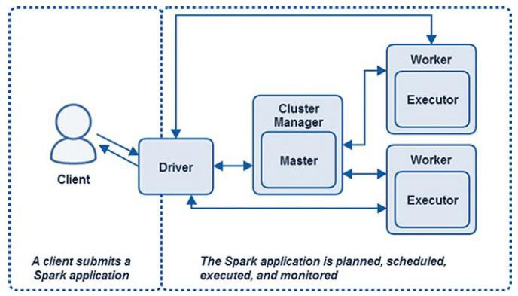
Spark Components and Architecture
Spark Driver
Cluster Manager
Spark Executor

Slide 9
Spark Driver
Spark Driver
  Spark application starts and finishes with Spark Driver
  Communicates with cluster manager
  Requests resources (CPU, memory, etc.)
  Transforms Spark operations into DAG (tasks and stages)
  Schedule and distributes tasks across Spark executor
SparkSession
  Spark Driver is responsible for creating SparkSession
  Provide single unified entry point (in Spark 1, SparkContext, SQLContext, HiveContext, StreamingContext)
  Define DataFrames and Datasets
  Read from data sources
  Access catalog metadata

Slide 10

Spark Workers and Executors
Spark Executor
  Runs on each worker node in cluster
  Communicate with driver and execute tasks on workers
  Many executors work in parallel
Spark Worker
  Hosts executor process (finite or fixed number of executors)
  Works and executors are aware only of tasks allocated to them
  Driver is responsible for understanding the compete set of tasks and dependencies

Slide 11

Spark Master and Cluster Master
Spark Master and Cluster Master
  Central processes that monitor, reserve, and allocate distributed cluster resources
  Can be separate process (distributed), or can combine into one (standalone mode)
Spark Master
  Requests resources in cluster and makes them available to Spark Driver
  Negotiates resources with Worker nodes and track status and monitor process
Cluster Manager
  Monitor Worker nodes and reserving resources on these nodes

Slide 12
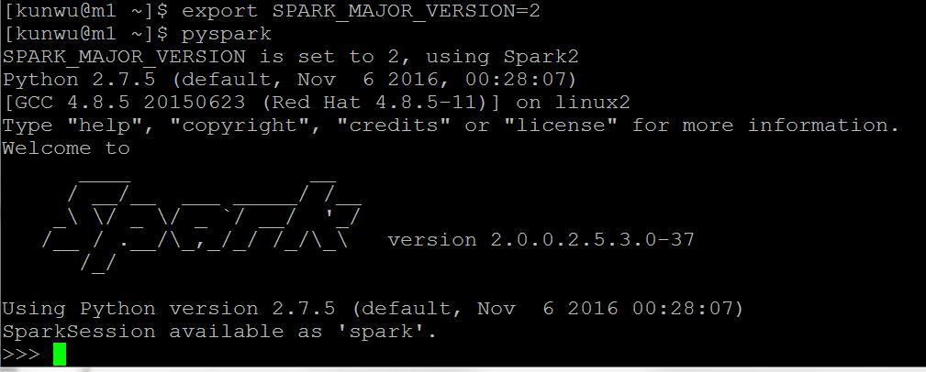
Spark Environment
Downloading Apache Spark
Using PySpark Shell

Slide 13
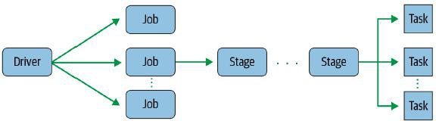
Spark Application
Spark Jobs
  Driver converts Spark application into one or more Spark jobs
  Driver transforms each job into a DAG (execution plan)
Spark Stages
  Created based on what operations can be performed serially or in parallel
  One or multi stages
Spark Tasks
  Unit of execution, federated across each Spark executor
  Each task maps to a single core and works on a single partition of data

Slide 14

Spark Programming Basics: Resilient Distributed Datasets
RDD: the most basic abstraction in Spark
Contains Datasets
What a Name
Immutable: cannot be update
Lineage
  Initial datasets loaded
  Any intermediate datasets
  Final resultant datasets
  Resilient: Dependencies à Resiliency
  Distributed: Partitions à Parallel computation
  Datasets: discussed above
    Compute function à Iterator[T]

Slide 15
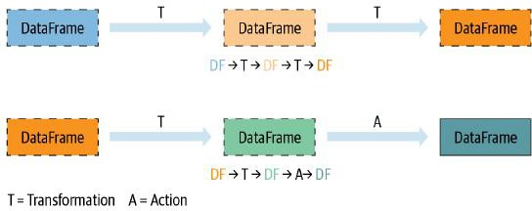
Transformations and Actions
Transformations
  Transform Spark DataFrame into new DataFrame without altering original data
  select(), filter()
  Lazy evaluate results not computed immediately
  Rearrange, coalesce and optimize transformations into stages
Actions
  Action triggers lazy evaluation of all recorded transformations

Slide 16
Demo 1
Sample PySpark Program to Search for Errors in Log Files
  Loading data into an RDD
  Creating a new RDD using a filter transformation
  Using an action to save resultant RDD to disk

Slide 17
Loading Data into RDDs
Initialize at least one RDD with data from external source
Initial RDD is used to create further intermediate RDDs or final RDD through series of transformations and actions
Initial RDD can be created
  Loading data from files
  Loading data from a data source
  Loading data programmatically
  Loading data from a stream

Slide 18
Creating RDD from Files
Various Formats
  Unstructured text files
  Semi structured files: JSON
  Structured files: CSV
  Serialized binary encoded formats: SequenceFiles, protobufs
  Columnar file formats: Parquet, ORC
Data Locality with RDDs
  Spark tries to read data into RDD from nodes close to it
  From local file system: ensure the file is available in the same relative path on all worker nodes

Slide 19
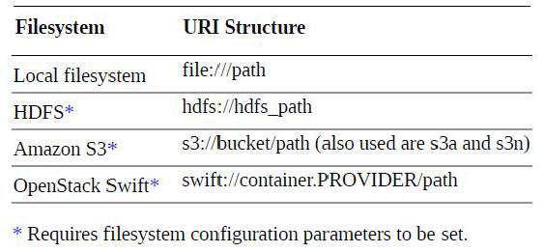
Filesystem Schemes and URI
Followed by ://

Slide 20
Methods for Creating RDD from Files
TextFile()
wholeTextFiles()
Demo 2
sc.textFile(name, minPartitions=None, use_unicode=True)
Create RDDs from files, directories, or glob patterns
By default, in HDFS, each block of the file creates a single partition
sc.wholeTextFiles(path, minPartitions=None, use_unicode=True)
read a directory containing multiple files
Each file is represented as a record consisting of a key containing the filename and a value containing the contents of the file
hdfs:///user/XX/data/hdfslog/

Slide 21
Creating RDD from JSON
spark.read.json
Demo 3
  Sample JSON
  Multiline JSON (need spark 2.2)
  Multiple JSON files
  Read all JSON files from a directory

Slide 22
Creating RDD from CSV
spark.read.csv
Demo 4
Default read
Read with header
Read with delimiter
Read with specified schema
Write

Slide 23
Creating RDD Programmatically
Lists, arrays or collections
sc.parallelize(c, numSlices=None)
sc.range(start, end=None, step=1, numSlices=None)
Create empty RDD
Demo 5

Slide 24
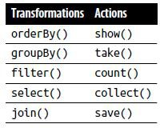
Operations on RDDs
Transformations vs. Actions
  Transformations operate on an RDD and return a new RDD
  Actions operate against an RDD and return a value or perform an output operation
Coarse-Grained vs. Fine-Grained Transformations
  Coarse-Grained operations apply a function against every element in the dataset, and they return a new dataset with the transformations applied
  Fine-grained transformations can manipulate a single record or data cell, such as single-row updates in a relational database or put operations in a NoSQL database

Slide 25
Operations on RDDs
Lazy Evaluation defers processing until an action is called (i.e., when output is required)
  Allows Spark to combine operations where possible
  Reduce processing stages and minimize amount of data transferred between executors (shuffling)
RDD Persistence and Reuse
  RDDs are created and exist predominantly in memory on executors
  After RDDs transform into new RDDs, and are not need for any other operations, they are removed permanently
  If still needed, it must be reevaluated in its entirety each time
  persist()
  Demo 6 and Demo 7

Slide 26
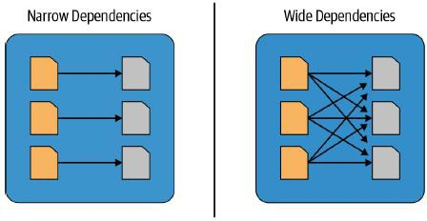
Operations on RDDs
RDD Lineage
  The sequence of transformations that resulted in the RDD
  Directed Acyclic Graph (DAG), consisting of dependencies between RDDs
Narrow dependencies
  Any transformation where a single output partition can be computed from a single input partition
  filter(), contains()
Wide dependencies
  Data from other partitions is read in , combined, and written to disk
  groupBy(): force a shuffle of data from each executor’s partitions
  orderBy(): require output from other partitions to compute final aggregation

Slide 27
Operations on RDDs
Fault tolerance
  Immutable RDDs between transformations
  Any RDD with all of its partitions can be reconstructed to the state it was in at the time of the failure
  Non-deterministic functions can produce different output give the same inputs
  Impact the ability to recreate RDDs in a consistent, repeatable state
Query plan: transformations contribute a query plan, and action execute query plan

Slide 28

Type of RDD
PairRDD: Key/Value paris
DoubleRDD: a collection of double values only
DataFrame: data organized into named and typed columns
SequenceFileRDD: created from a SequenceFile
HadoopRDD: provides functionality for reading data stored in HDFS (v1)
NewHadoopRDD: (HDFS, Hbase, S3)
JdbcRDD: from SQL query to a JDBC connection (Scala only)
UnionRDD: results from union() operation against two or more RDDs

Slide 29
RDD Transformations
RDD.map(<function>, preservesPartitioning=False)
RDD.flatMap(<function>, preservesPartitioning=False)
        sentences = sc.parallelize([“I love Spark”])
          words = sentences.flatmap(lamda line: lines.split (“ “))
          Results :
          [“I”, “love”, “Spark”]
          RDD.filter(<function>)
Demo 8
RDD.distinct(numPartitions=None)
RDD.groupBy(<function>, numPartitions=None)
RDD.sortBy(<keyfunc>, ascending=True, numPartitions=None)
Demo 9

Slide 30
RDD Actions
RDD.count()
RDD.collect()
RDD.take(n)
RDD.top(n, key=None)
RDD.first()
Demo 10

Slide 31
RDD Actions
RDD.reduce(<function>)
RDD.fold(zeroValue, <function>)
RDD.foreach(<function>)
Demo 11

Slide 32
Transformations on PairRDD
Dictionary functions
  RDD.keys()
  RDD.values()
Functional transformations
  RDD.keyBy(<function>) <K, V> <new key, <K, V>>
RDD.mapValues(<function>) <K, V> <K, [new values]>
RDD.flatMapValues(<function>) <K, V> <K, V1>, <K, V2>
Grouping, aggregation, and sorting operations
  RDD.groupByKey(numPartitions=None, partitionFunc=<hash_fn>)
  RDD.reduceByKey(<function>, numPartitions=None, partitionFunc=<hash_fn>)
  RDD.foldByKey(zeroValue, <function>, numPartitions=None, partitionFunc=<hash_fn>)
  RDD.sortByKey(ascending=True, numPartitions=None, keyfunc=<function>)
Join functions

Slide 33
Join Transformations
RDD.join(<otherRDD>, numPartitions=None)
RDD.leftOuterJoin(<otherRDD>, numPartitions=None)
RDD.rightOuterJoin(<otherRDD>, numPartitions=None)
RDD.fullOuterJoin(<otherRDD>, numPartitions=None)
RDD.cogroup(<otherRDD>, numPartitions=None)
RDD.cartesian(<otherRDD>)
Demo 13

Slide 34
Exercise 1(Not Applied )
Joining Datasets in Spark
Bay Area Bike Share Data Challenge
  https://s3.amazonaws.com/sparkusingpython/bike-share/stations/stations.csv
  https://s3.amazonaws.com/sparkusingpython/bike-share/status/status.csv
  https://s3.amazonaws.com/sparkusingpython/bike-share/trips/trips.csv
  https://s3.amazonaws.com/sparkusingpython/bike-share/weather/weather.csv
Question:
  Find the average number of bikes available by the hour for one week (February 22 to February 28) for stations located in the San Jose area only

Slide 35
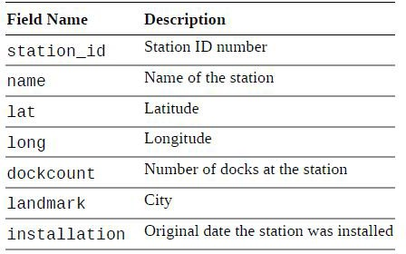
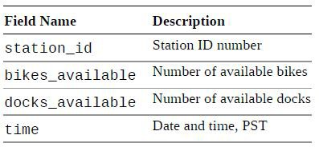
Exercise 1 More Information

Slide 36
Transformations on Sets
RDD.union(<otherRDD>)
RDD.intersection(<otherRDD>)
RDD.subtract(<otherRDD>, numPartitions=None)
RDD.subtractByKey(<otherRDD>, numPartitions=None)
Demo 14

Slide 37
Transformations on Numeric RDD
RDD.min(key=None)
RDD.max(key=None)
RDD.mean()
RDD.sum()
RDD.stdev()
RDD.variance()
RDD.stats()
Demo 15

Slide 38
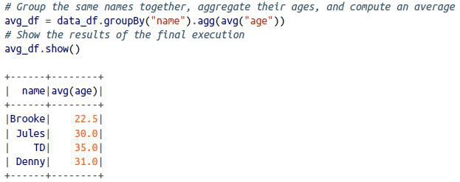

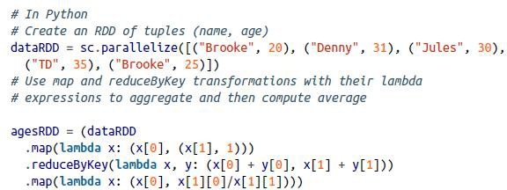
Key Merits and Benefits
Expressivity, Simplicity, Composability, Uniformity

Slide 39
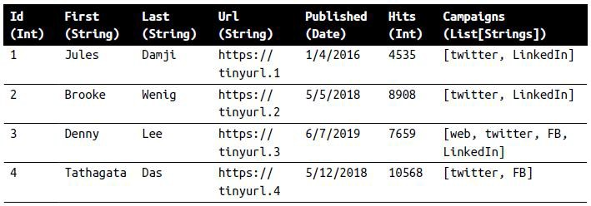
DataFrame
Remember Pandas?
Distributed in-memory tables with named columns and schemas
Each column has a specific data type: integer, string, array, map, real, date, timestamp, etc.

Slide 40
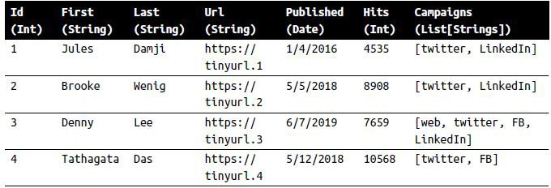
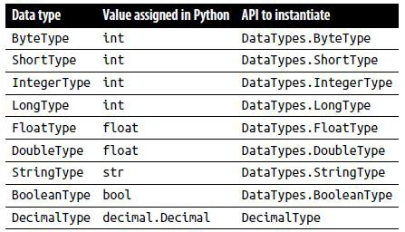
General Data Types vs PySpark Data Types
General DataFrame
PySpark Data Types

Slide 41
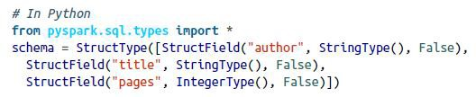

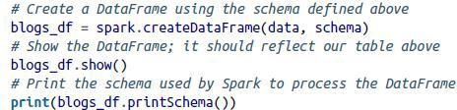
Schemas
Schema defines the column names and associated data types for a DataFrame
Define schema
  Define schema programmatically
Employ a Data Definition Language (DDL) string

Slide 42
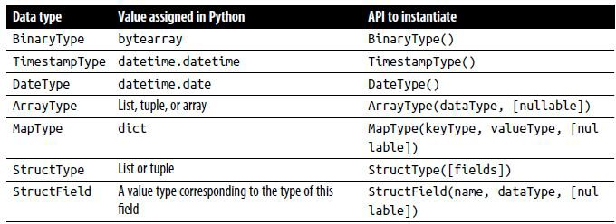
Structured and Complex Data Types

Slide 43
Columns and Expressions
Similar to pandas or RDBMS table: named columns
Describe a type of field
How to use columns
List all columns by names
Perform operations on values using relational or computational expressions
Use logical or mathematical expressions on columns

Slide 44
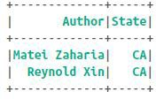
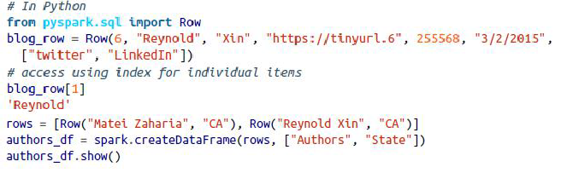
Rows
Column in DataFrame can’t exist in isolation: each column is part of a row in a record, and all rows together constitute a DataFrame
A row object contains one or more columns
Each column may be of the same data type (e.g., integer or string)
Or they can have different types (integer, string, map, array, etc.)

Slide 45
Getting Started with DataFrames
Creating DataFrame from an existing RDD
Creating DataFrames from JSON
Creating DataFrams from Flat Files
Converting DataFrames to RDDs
Demo 16

Slide 46
Using DataFrames
DataFrame Metadata Operations
  DataFrame.columns()
  DataFrame.dtypes()
Basic DataFrame Operations
  DataFrame.show(n=20, truncate=True)
  DataFrame.select(*cols)
  DataFrame.drop(col)
  DataFrame.filter(condition)
  DataFrame.distinct()
Demo 18

Slide 47
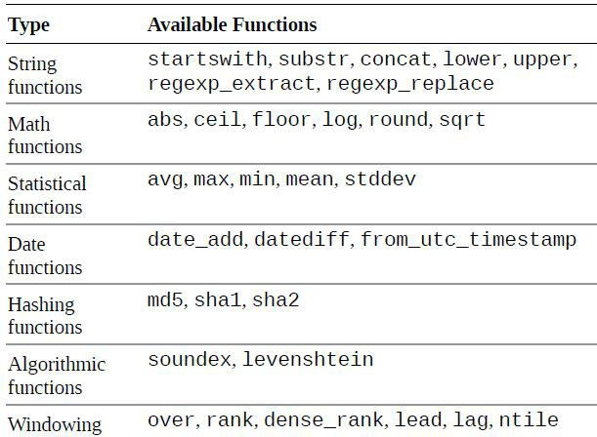
DataFrame Built-in Functions

Slide 48
User Defined Functions in DataFrame
Column-level UDFs to incorporate into Spark programs by using the udf() method
pyspark.sql.functions.udf(func, returnType=StringType)
func is a named or anonymous function, using the lambda syntax, that operates on a column within a DataFrame row
The returnType argument specifies the datatype of the object returned from the function
Demo 19

Slide 49
Operations on Multiple DataFrames
DataFrame.join(other, on=None, how=None)
DataFrame.orderBy(cols, ascending)
DataFrame.groupBy(cols)
Demo 20

Slide 50
GCP Serverless Data Pipeline
BigQuery • Dataflow • Dataproc • Pub/Sub • Cloud Storage
Architecture Overview
Core GCP Services
ETL Pipeline
AWS vs GCP
Best Practices

Slide 51
End-to-End GCP Architecture
Cloud Storage → Pub/Sub → Dataflow → Dataproc → BigQuery → Looker
Serverless-first design
Supports batch and streaming
Notes:
👉 “A scalable, serverless-first pipeline for ingestion, processing, and analytics on GCP.”

Slide 52
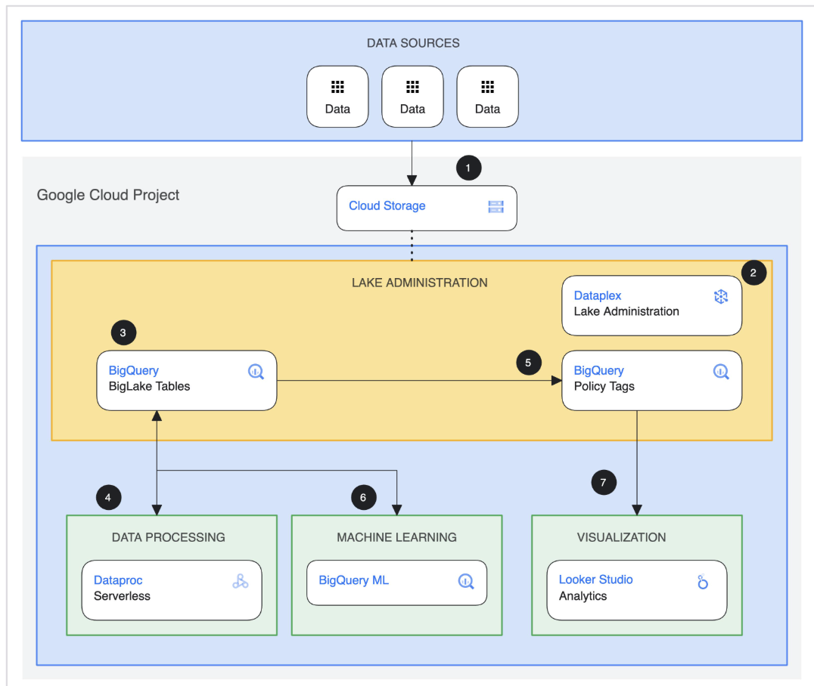
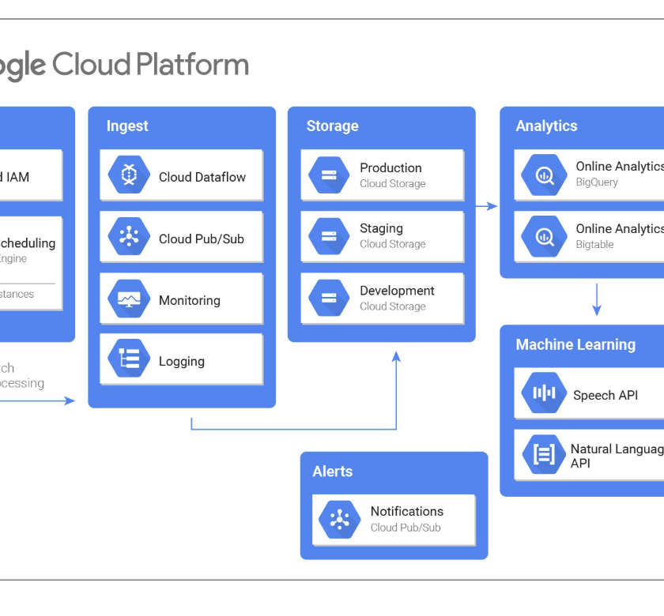
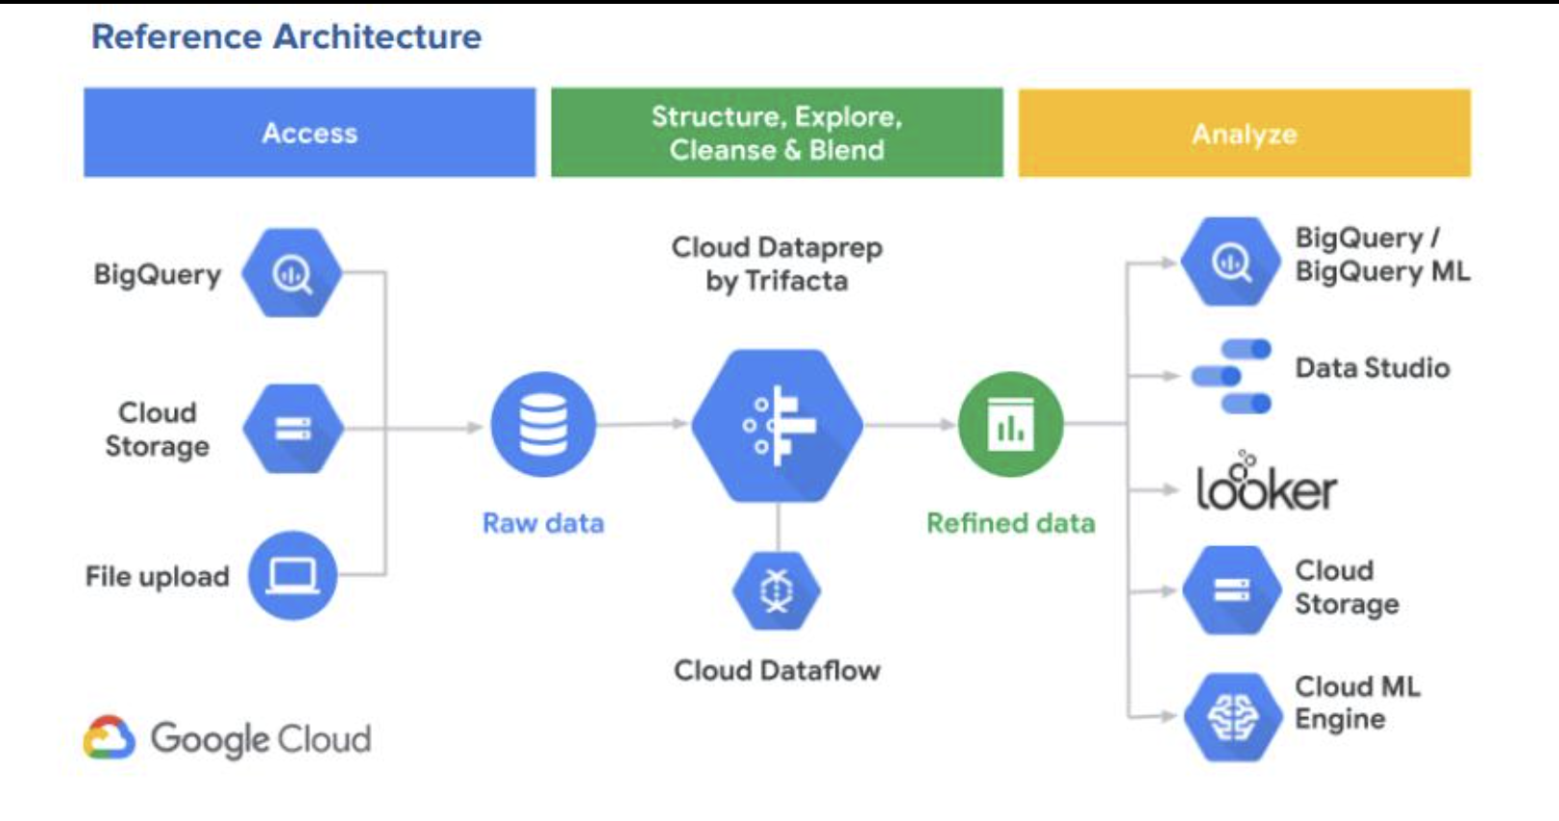
End-to-End GCP Architecture

Slide 53
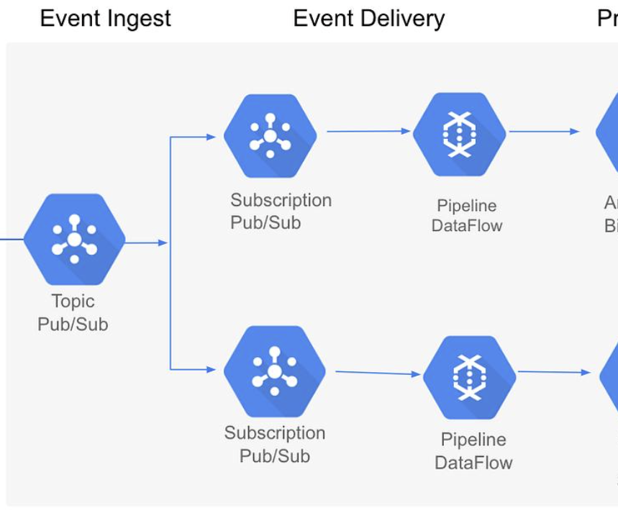
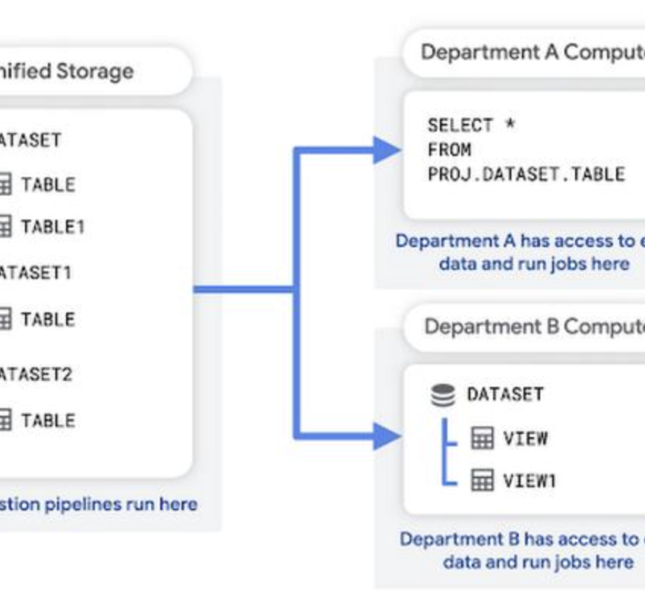
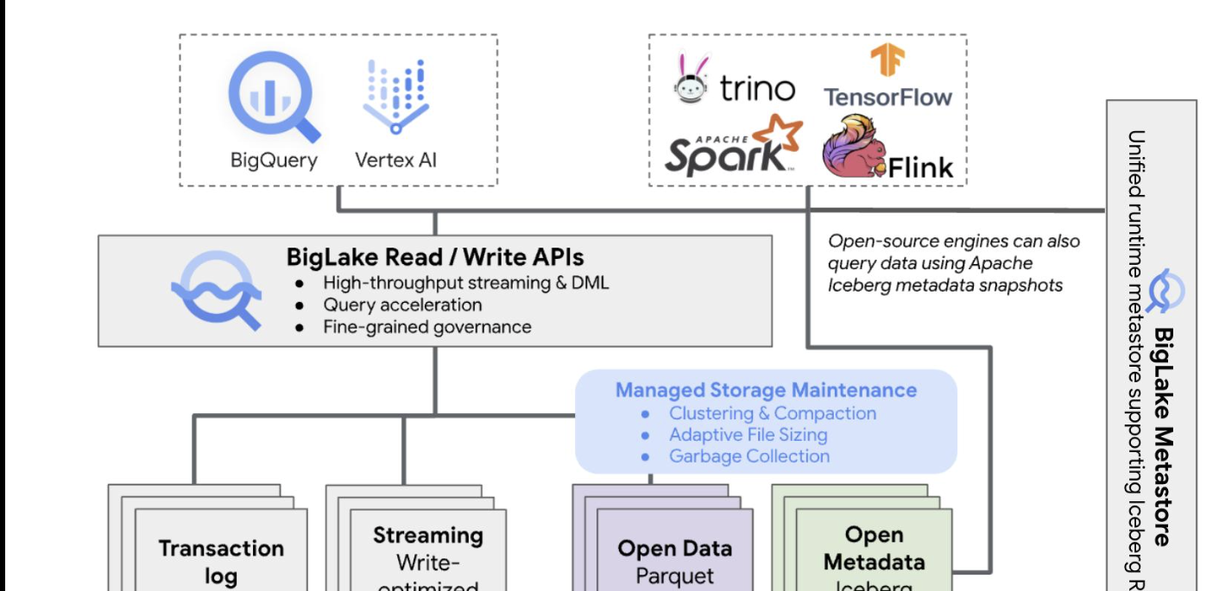
End-to-End GCP Architecture

Slide 54
GCP ETL Pipeline
Ingest → Cloud Storage
Stream → Pub/Sub
Process → Dataflow
Store → BigQuery
-------------------------------------------------
Upload → Cloud Storage
Stream → Pub/Sub
Process → Dataflow
Heavy compute → Dataproc (optional)
Store → BigQuery

Slide 55
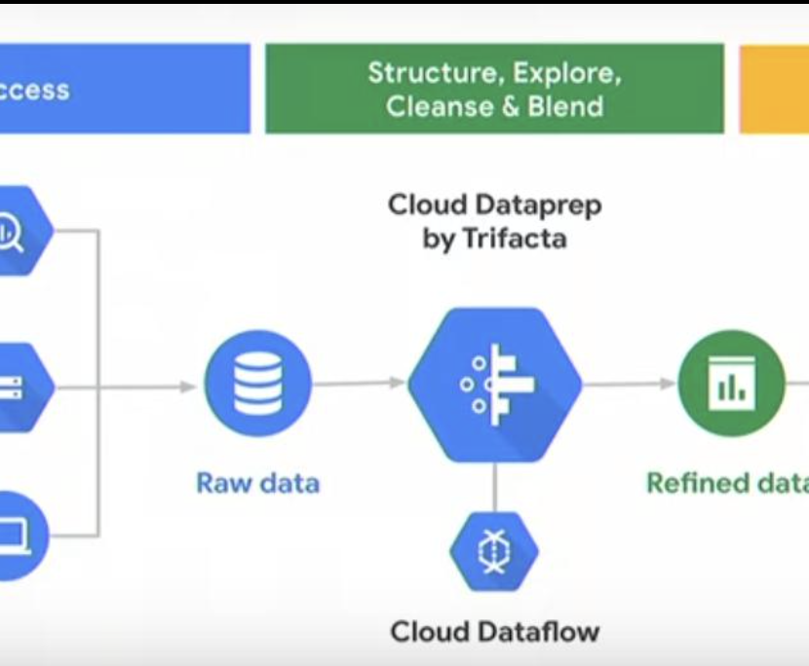
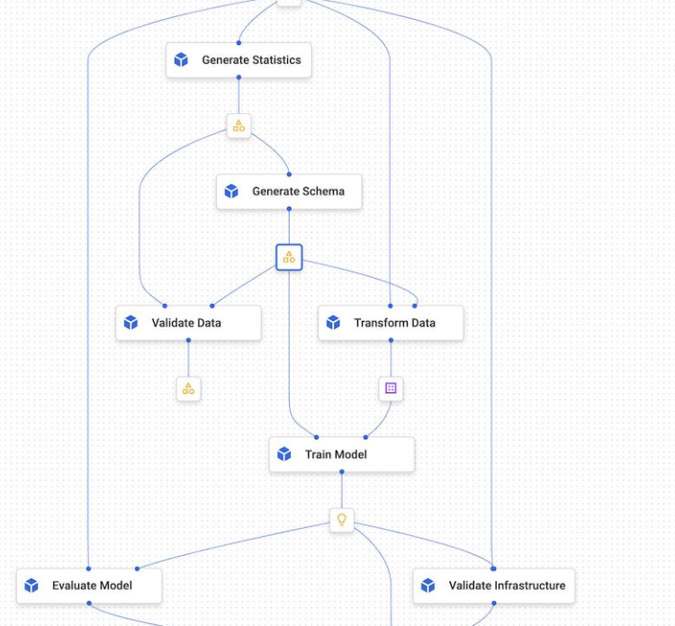
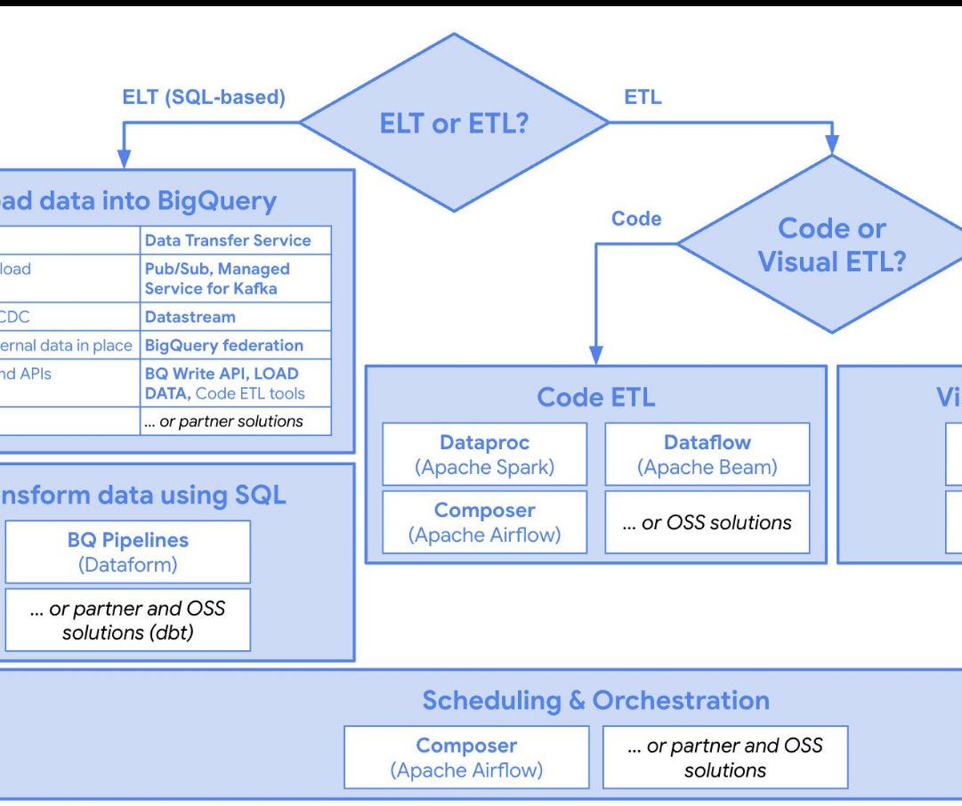
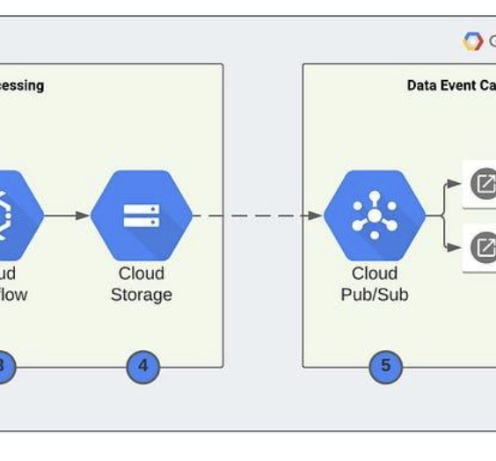
GCP ETL Pipeline

Slide 56
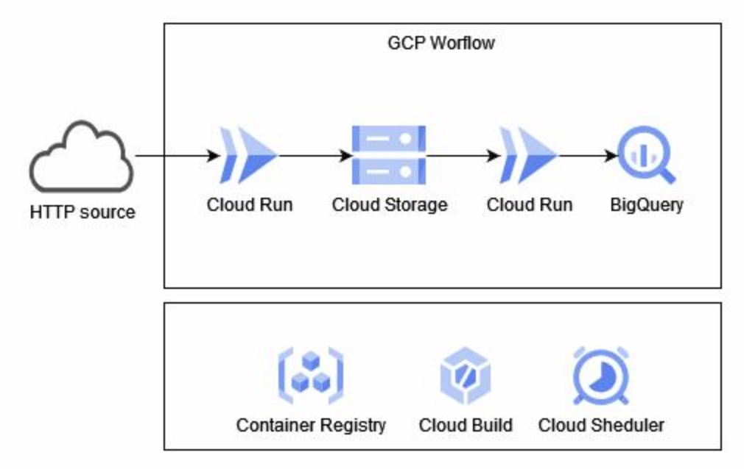
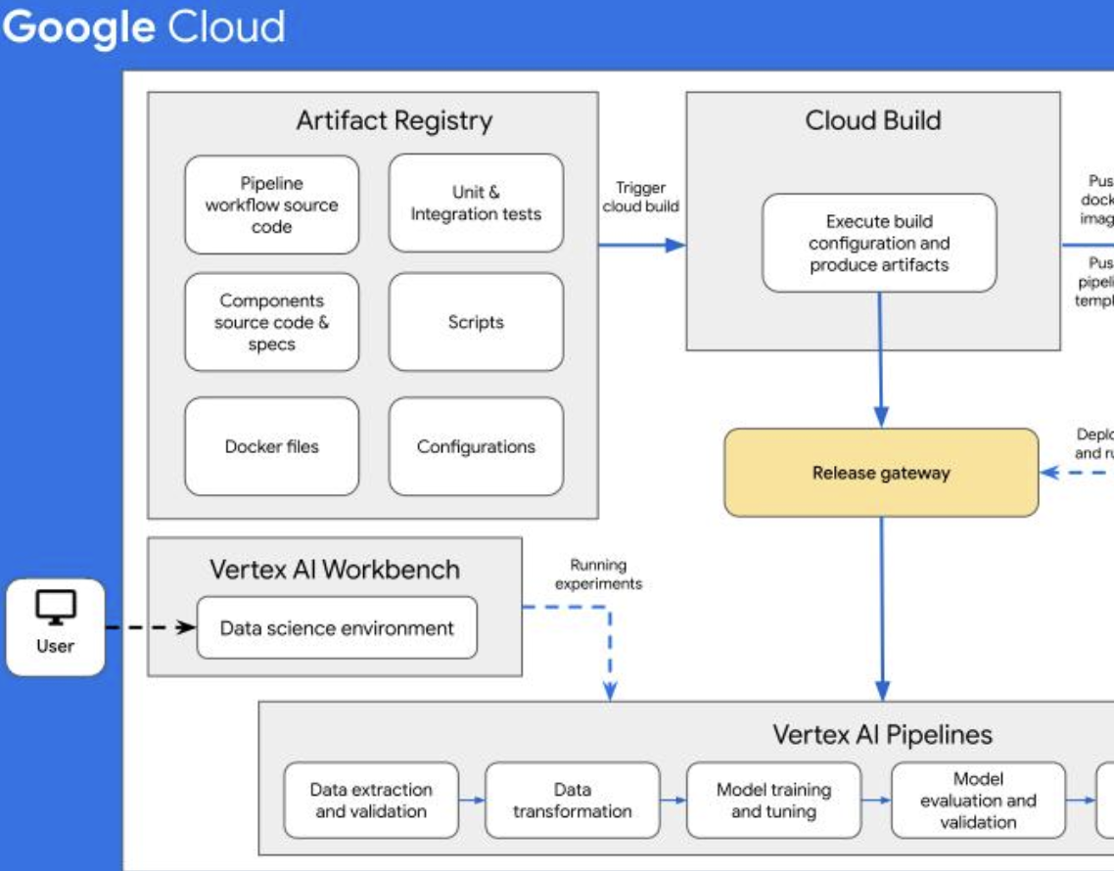
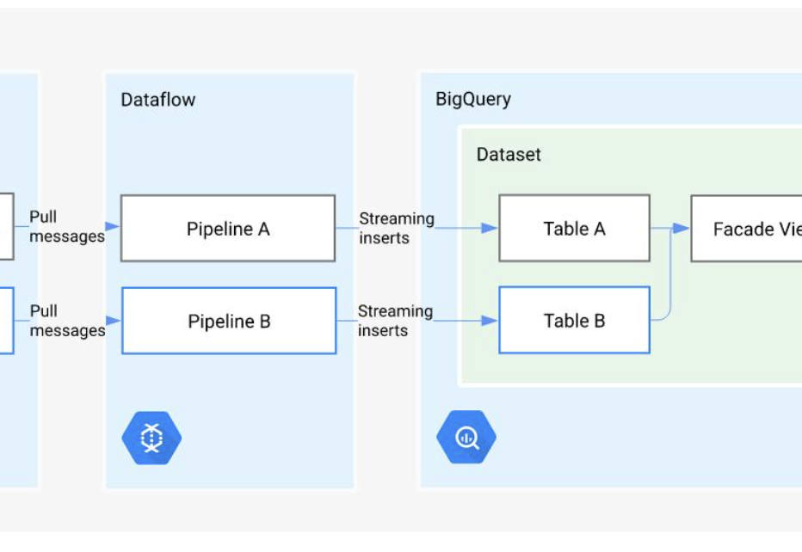
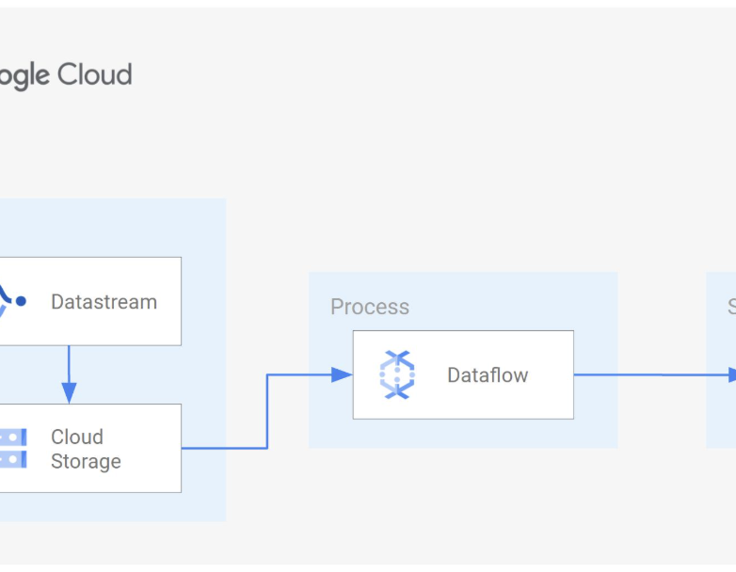
GCP ETL Pipeline

Slide 57

Cloud Storage(S3 equivalent)
Data lake layer
Highly durable and scalable
Stores raw and processed data
Stores raw & processed data
Highly durable & scalable
Supports batch & streaming ingestion
Equivalent to AWS S3
Notes:
“Cloud Storage is the foundation of the data lake in GCP.”

Slide 58
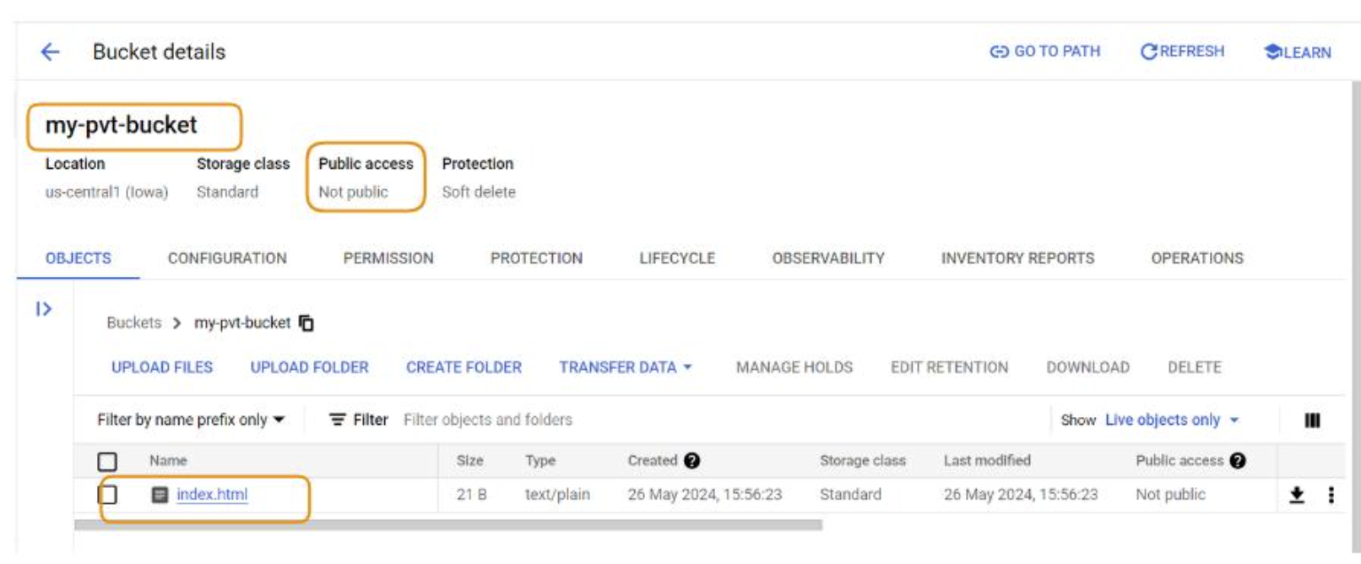
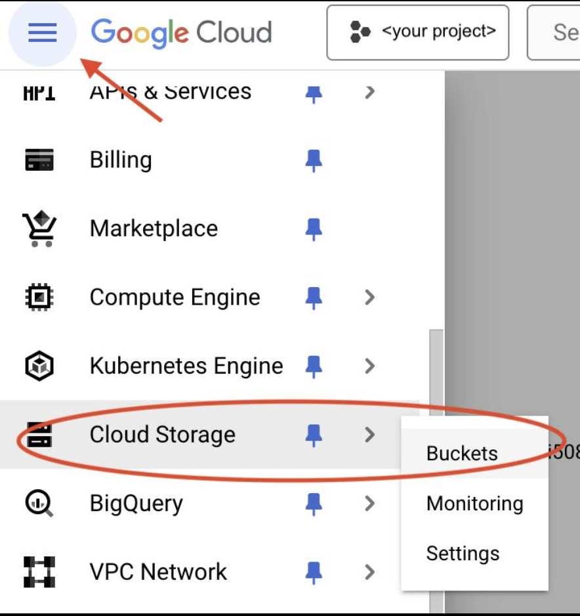
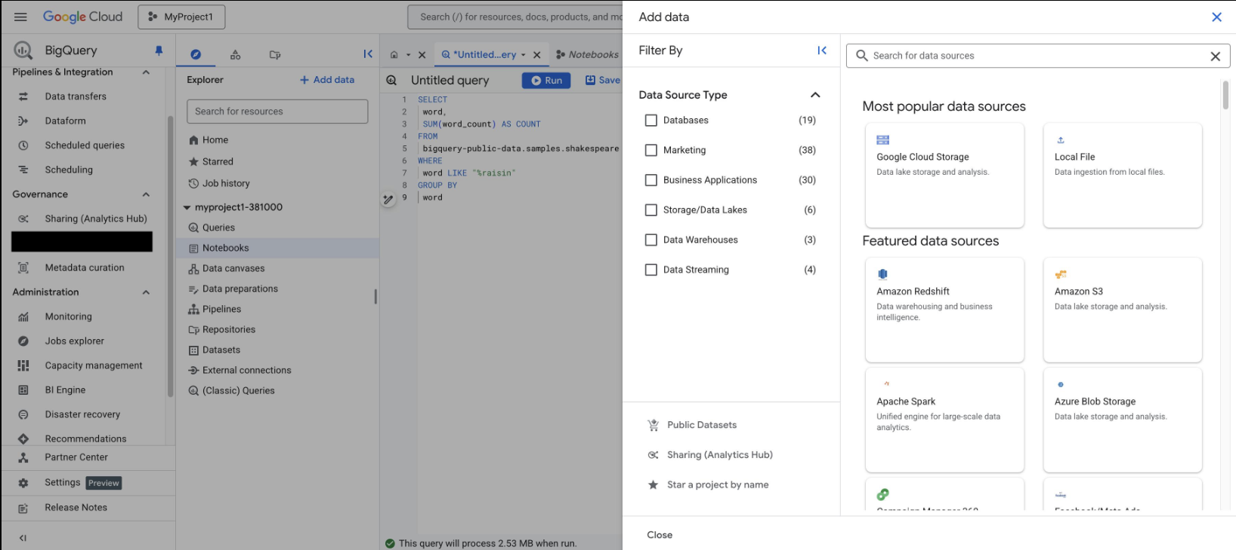
Cloud Storage
Notes:
“Cloud Storage is the foundation of the data lake in GCP.”

Slide 59
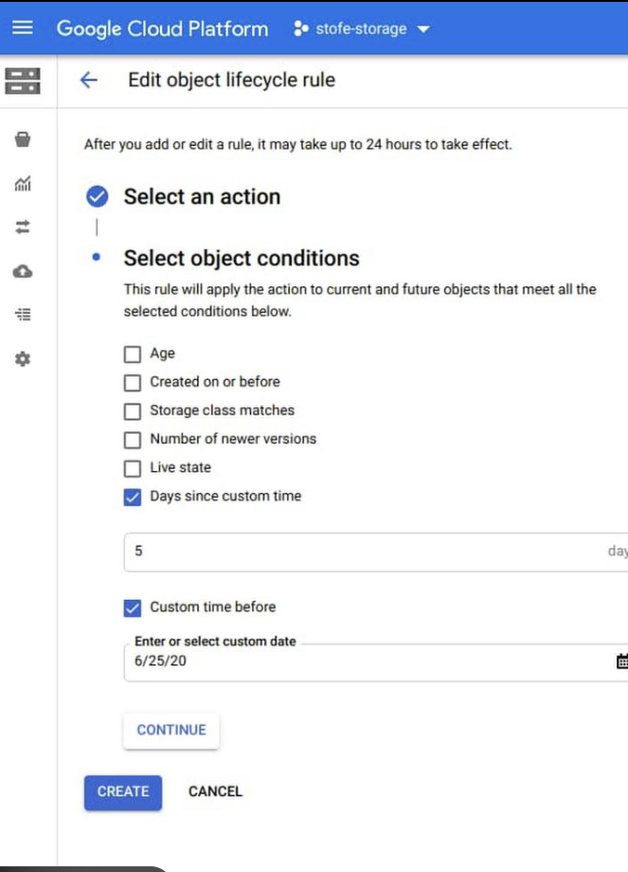
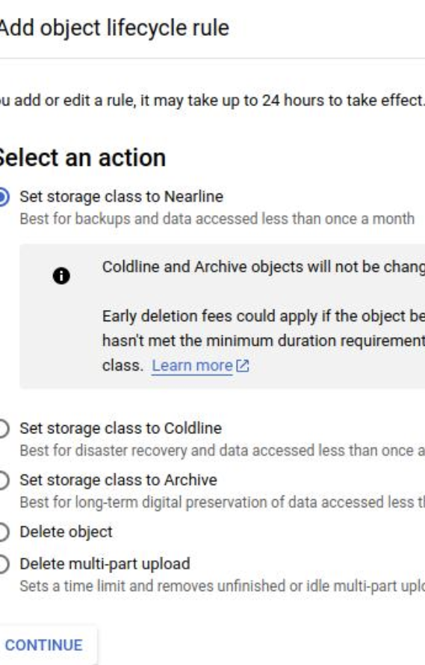
Cloud Storage
Notes:
“Cloud Storage is the foundation of the data lake in GCP.”

Slide 60

BigQuery (Redshift equivalent)
Serverless data warehouse
SQL analytics engine
Petabyte-scale performance
Fully managed, serverless
SQL-based analytics
Handles petabyte-scale data
Built-in ML (BigQuery ML)
Notes:
“BigQuery eliminates cluster management unlike Redshift.”

Slide 61
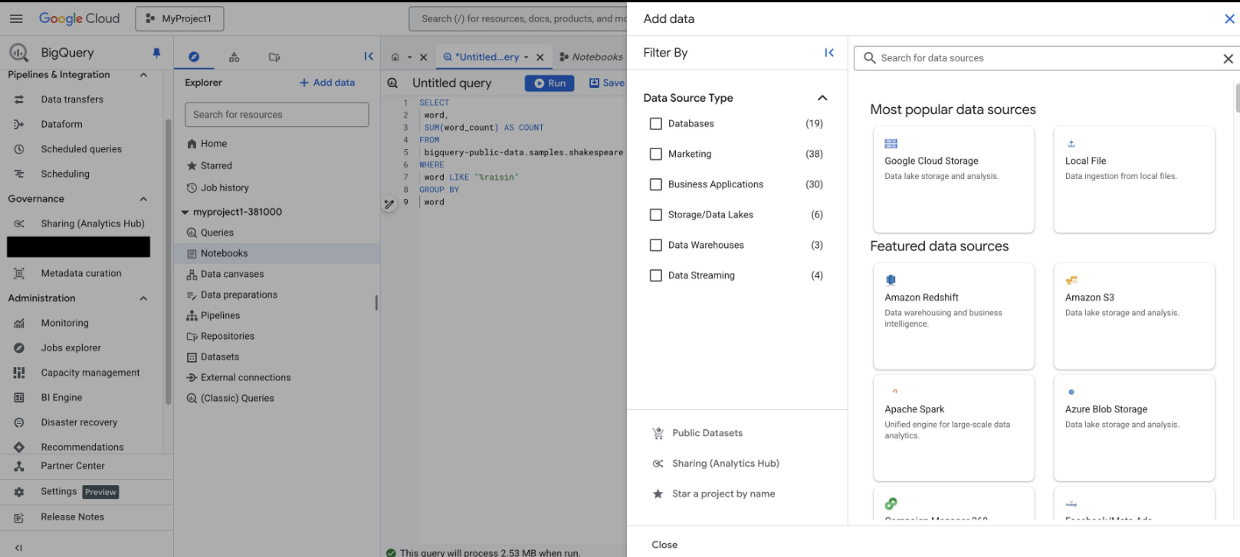
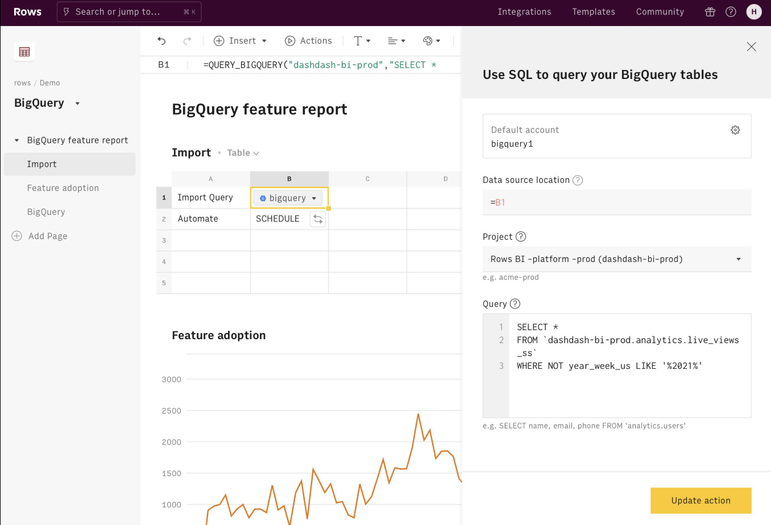
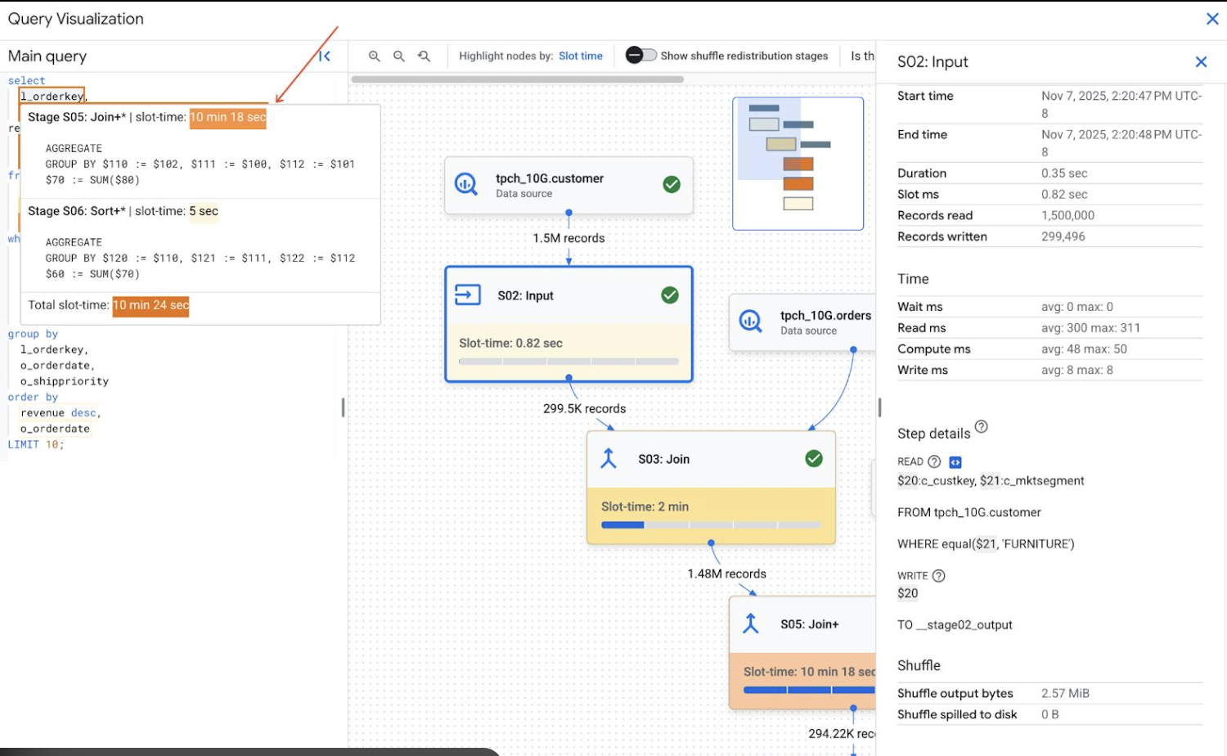
BigQuery
Notes:
“BigQuery eliminates cluster management unlike Redshift.”

Slide 62
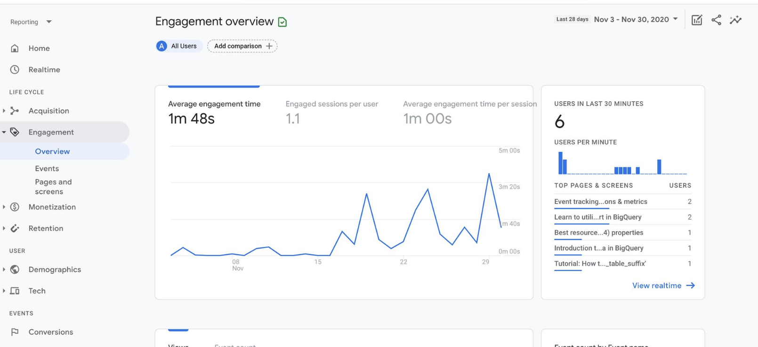
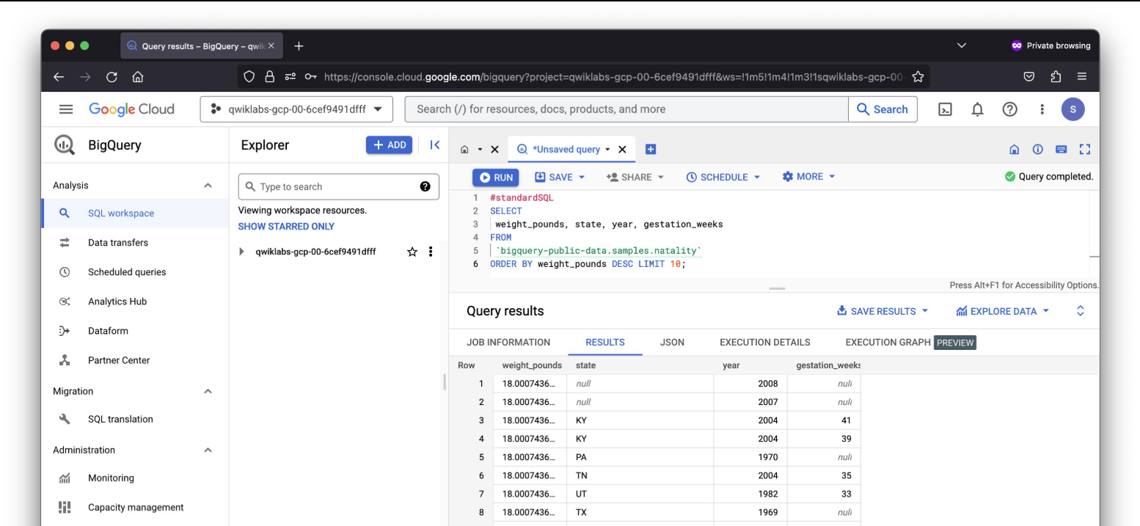
BigQuery
Notes:
“BigQuery eliminates cluster management unlike Redshift.”

Slide 63

Dataflow (Glue/Lambda equivalent)
Batch + streaming processing
Apache Beam-based
Auto-scaling ETL
Built on Apache Beam
Supports batch + streaming
Auto-scaling, serverless
ETL + real-time pipelines
Notes:
“Dataflow replaces Glue + Lambda for unified processing.”

Slide 64
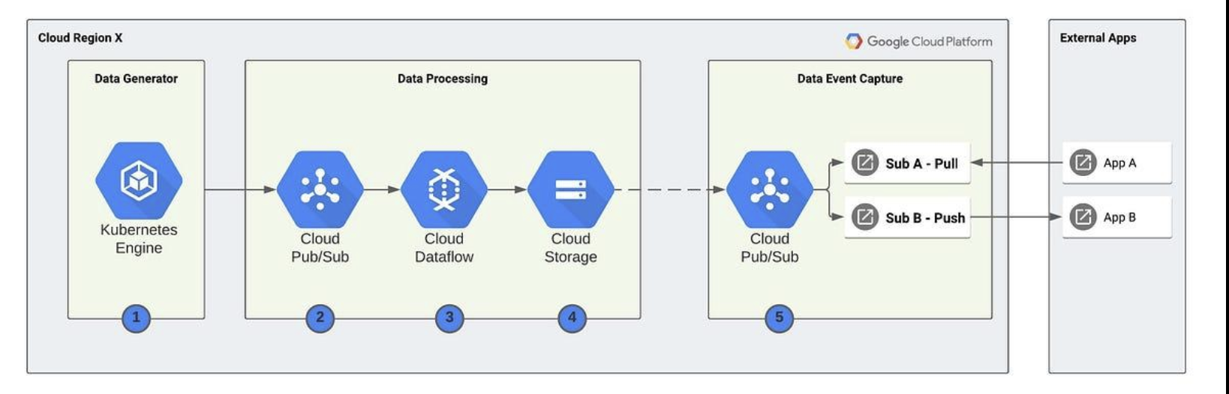
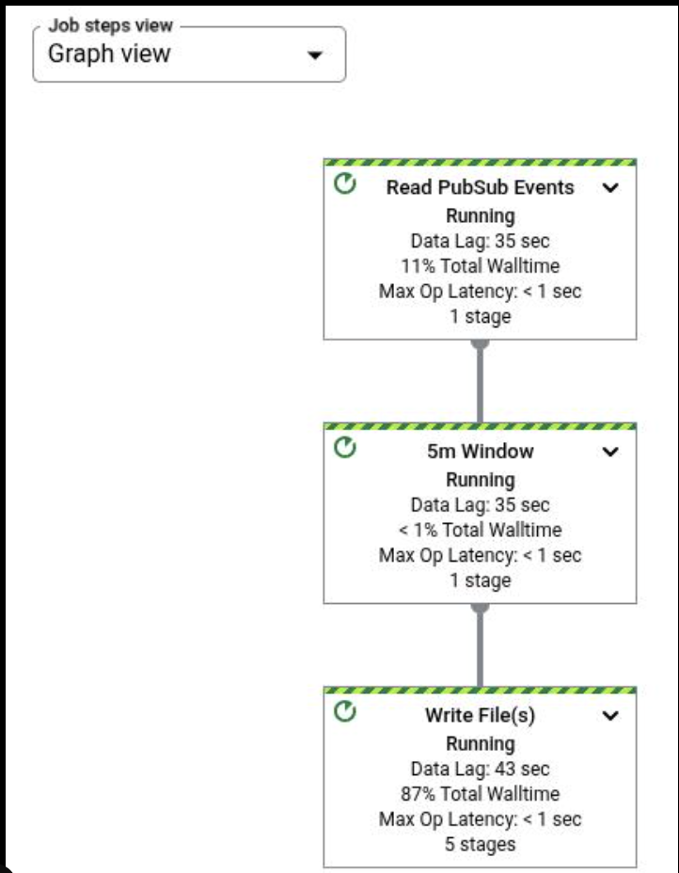
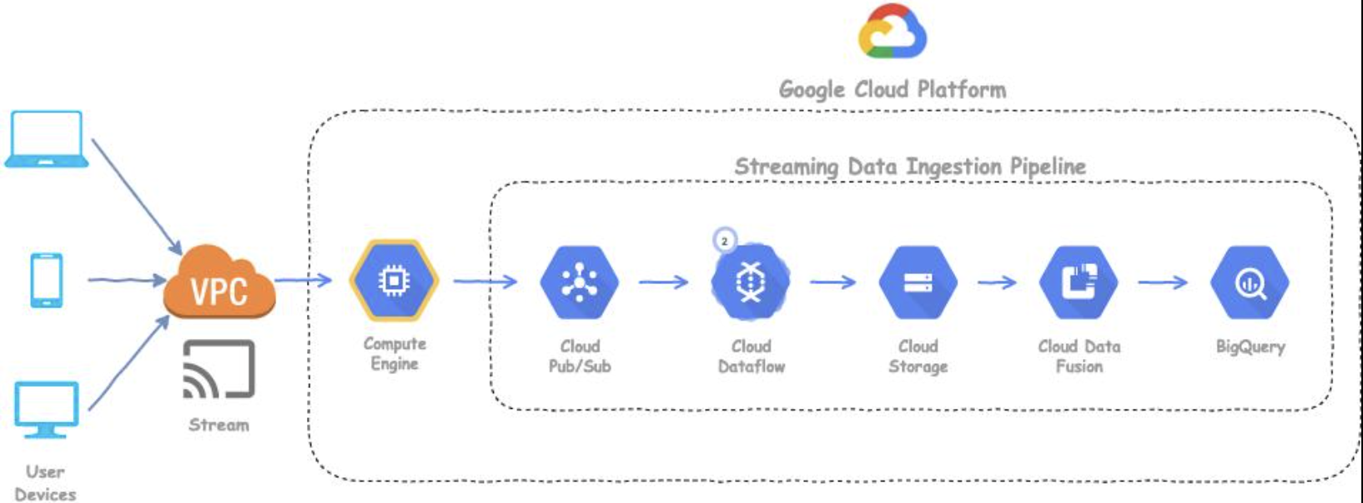
Dataflow
Notes:
“Dataflow replaces Glue + Lambda for unified processing.”

Slide 65
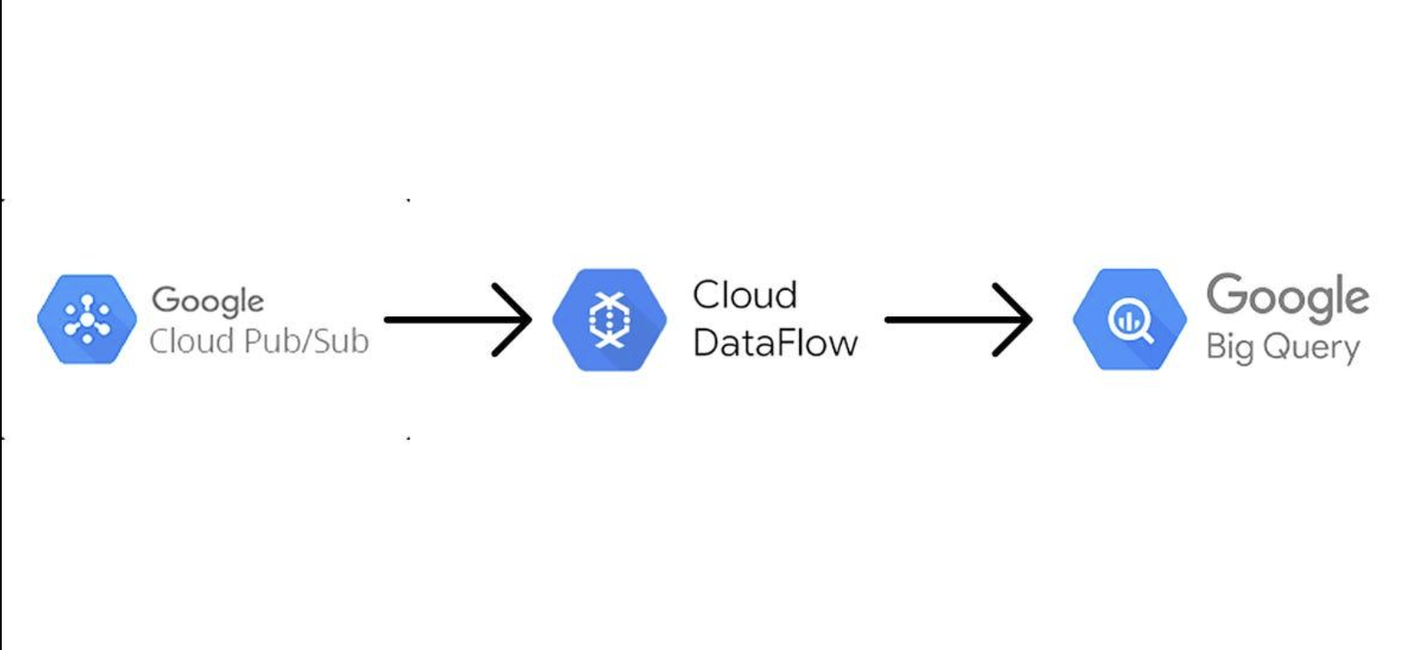

Dataflow
Notes:
“Dataflow replaces Glue + Lambda for unified processing.”

Slide 66

Dataproc (EMR equivalent)
Managed Spark/Hadoop
Fast cluster startup
Used for ML workloads
Runs Spark, Hive, Hadoop
Fast cluster startup (~90 sec)
Lower cost than traditional clusters
Used for heavy ML / batch jobs
Notes:
“Dataproc = EMR but faster startup and tighter GCP integration.”

Slide 67




Dataproc (EMR equivalent)
Notes:
“Dataproc = EMR but faster startup and tighter GCP integration.”

Slide 68



Dataproc (EMR equivalent)
Notes:
“Dataproc = EMR but faster startup and tighter GCP integration.”

Slide 69
Pub/Sub (Kinesis equivalent)
Real-time messaging
Event-driven ingestion
Decouples systems
Event-driven ingestion
Decouples systems
Scalable streaming backbone
Notes:
“Pub/Sub enables real-time data pipelines.”

Slide 70




Pub/Sub (Kinesis equivalent)
Notes:
“Pub/Sub enables real-time data pipelines.”

Slide 71



Pub/Sub (Kinesis equivalent)
Notes:
“Pub/Sub enables real-time data pipelines.”

Slide 72

Cloud Functions / Cloud Run (Lambda equivalent)
Serverless compute
Triggered by events
Used for APIs and processing
Triggered by events (Pub/Sub, Storage)
No infrastructure management
Lightweight processing / APIs

Slide 73



Cloud Functions / Cloud Run (Lambda equivalent)

Slide 74
AWS vs GCP
AWS | GCP
S3 | Cloud Storage
Glue | Dataflow
Lambda | Cloud Functions
EMR | Dataproc
Redshift | BigQuery
Notes:
“GCP is more serverless-native, especially with BigQuery and Dataflow.”

Slide 75

END

Slide 76
Day 3 — Spark Fundamentals
RDD vs DataFrame
Lazy Evaluation
Spark SQL
PySpark Notebook Lab

Slide 77
RDD Fundamentals
RDD = Resilient Distributed Dataset
Distributed across cluster nodes
Immutable and fault tolerant
Foundation of Spark processing

Slide 78
DataFrame Fundamentals
Structured distributed table
Schema + column types
Optimized with Catalyst engine
Preferred modern Spark API

Slide 79
Lazy Evaluation
Spark delays execution until action occurs
Transformations build DAG
Actions trigger execution
Improves optimization and performance

Slide 80
Spark SQL
Run SQL queries on DataFrames
Supports joins and aggregations
Integrates with BI tools
Common production analytics workflow

Slide 81
PySpark Notebook Setup
Install pyspark
Create SparkSession
Load CSV datasets
Run transformations interactively

Slide 82
Hands-On Lab — Step 1
Start Jupyter Notebook
Import SparkSession
Create Spark application
Read CSV dataset

Slide 83
Hands-On Lab — Step 2
Filter records
Group and aggregate sales
Use Spark SQL
Display results with show()

Slide 84
Hands-On Lab — Step 3
Save transformed dataset
Write output CSV or Parquet
Validate results
Push code to GitHub

Slide 85
Production Spark Best Practices
Use DataFrames over RDDs
Partition large datasets
Cache reused DataFrames
Monitor Spark UI and logs

