Slide 1


Big Data Analytics (Fall 2025)
I Hadoop Ecosystem

Slide 2

Overview
∗ Big Data Introduction
∗ Introduction to MapReduce
∗ Yarn
∗ Case Study
∗ Design Pattern
∗ Demo

Slide 3
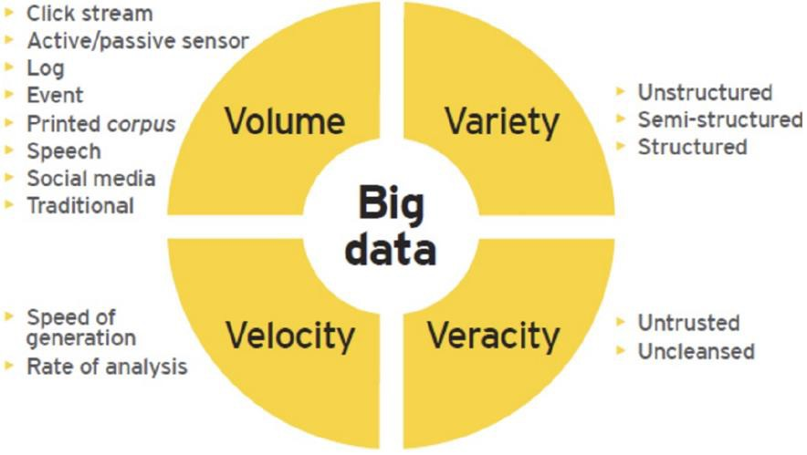
What is Big Data

Slide 4
Opportunity
 | High Wage | Median Wage | Projected Job Openings | Growth% | National wide # of Jobs
Software Engineer | $138,800 | $100,690 | 186,600 | 17% | 1,114,000
Network Engineer | $115,300 | $77,810 | 30,200 | 8% | 382,600
Electrical Design Engineer | $148,000 | $89,630 |  | 4% | 315,900
Data Scientist | $148,000 | $110,620 | 8,100 | 11% | 75,600
Data Engineer | $129,980 | $95,800 | 118,600 | 21% | 567,800
Data Analyst | $124,000 | $85,900 | 140,000 | 19% | 495,500
Finance Analyst | $160,760 | 95,320 | 32,300 | 12% | 268,360

Slide 5

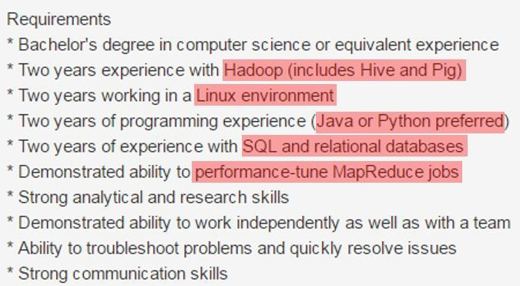
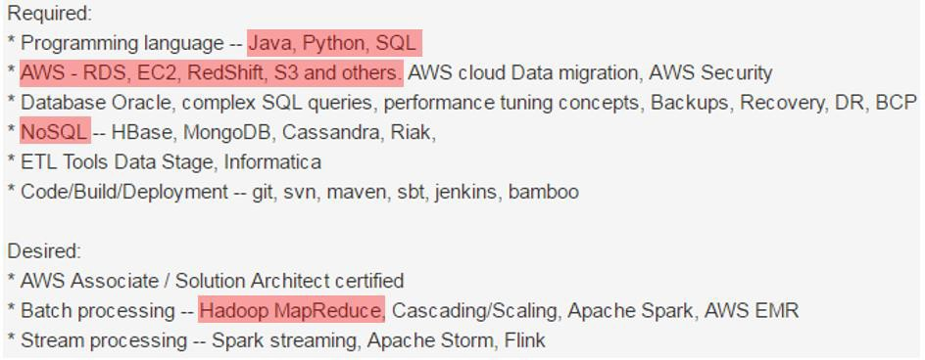
Data Engineer Positions

Slide 6
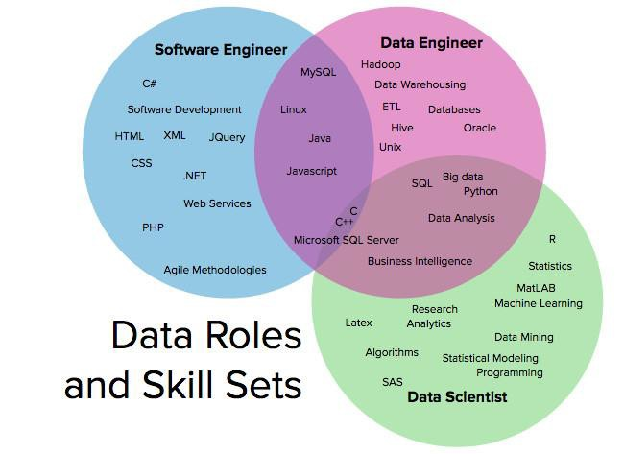
Collaboration
8

Slide 7
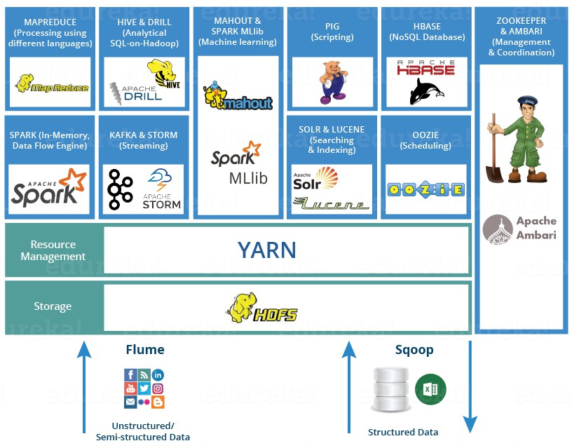
Big Data Ecosystem
9

Slide 8

Technical Skills
∗ Python, C/C++ Java, Perl
∗ Data Structure and Algorithm
∗ UNIX, Linux, Solaris and MS Windows
∗ SQL-based Technologies (e.g.
PostgreSQL and MySQL)
∗ Statistical Analysis and Modeling
∗ Hadoop-based Technologies (e.g. MapReduce, Hive, Pig, Spark, etc.)
∗ NoSQL Technologies (e.g. Cassandra and
MongoDB)
∗ MatLab, SAS, R
∗ Data Warehousing Solutions
∗ Machine Learning
∗ Data Mining
∗ Predictive Modeling, NLP and Text Analysis
∗ Visualization

Slide 9

Overview
∗ Creative Problem-Solving: Approaching data organization challenges with a clear eye on what is important; employing the right approach/methods to make the maximum use of time and human resources.
∗ Effective Collaboration: Carefully listening to management, data scientists and data architects to establish their needs.
∗ Intellectual Curiosity: Exploring new territories and finding creative and unusual

Slide 10

The Origins of HDFS
∗ A distributed storage layer that satisfied the following requirements
∗ schemaless
∗ durable
∗ capable of handling component failure
∗ automatically rebalanced
∗ October 2003, Google File System
∗ Nutch Distributed File System: abstract cluster’s storage so that it presents itself as a single reliable file system

Slide 11
Birth of Hadoop
∗ February 2006, Cutting pulled out GDFS and MapReduce out of the Nutch code base and created a new incubating project
∗ Same year, Cutting joined Yahoo!
∗ ! ! ! Hadoop ! ! !
∗ “It wasn't as though Hadoop was architected around batch because we felt batch was best. Rather, batch, MapReduce in particular, was a natural first step because it was relatively easy to implement and provided great value. Before Hadoop, there was no way to store and process petabytes on commodity hardware using open-source
software. Hadoop's MapReduce provided folks with a big step in capability.”

Slide 12

Cambrian Explosion
∗ “of more normal evolution, as use of these technologies now spreads through industries.”
∗ 2007, Facebook, Twitter, LinkedIn and many others started doing serious work with Hadoop
∗ In February, Yahoo! reported that their production Hadoop cluster is running on 1000 nodes
∗ 2008, HBase, Pig, Hive
∗ First professional system integrator dedicated to Hadoop was born: Cloudera
∗ 2009, Amazon started providing MapReduce hosting service
∗ 2010, Yahoo went down
∗ 2011, Hortonworks
∗ 2012, Yahoo!’s Hadoop cluster counts 42 000 nodes; Number of Hadoop contributors reaches 1200

Slide 13
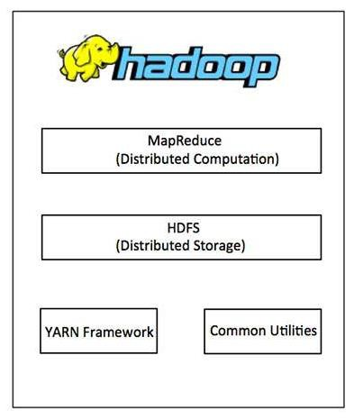
Hadoop Components
∗ Hadoop Common: Java libraries and utilities required by other Hadoop modules. These libraries provides file system and OS level abstractions and contains the necessary Java files and scripts required to start Hadoop.
∗ Hadoop Distributed File System (HDFS™): A distributed file system that provides high-throughput access to application data.
∗ Hadoop YARN: This is a framework for job scheduling and cluster
resource management.
∗ Hadoop MapReduce: This is YARN-based system for parallel processing of large data sets.

Slide 14

HDFS Design Goal
∗ Recover from hardware failure
∗ Streaming data access
∗ Large data file / dataset
∗ Write-once-read-many IO model
∗ Move computation to data
∗ Commodity hardware
∗ Do not conflict with OS file system
∗ Not good – low-latency and many small files

Slide 15
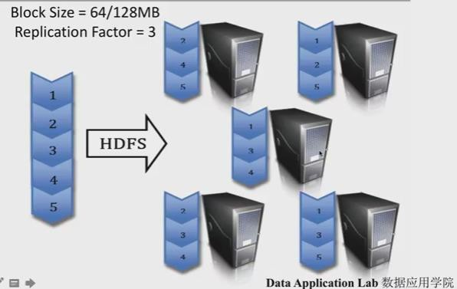
Hadoop File System

Slide 16
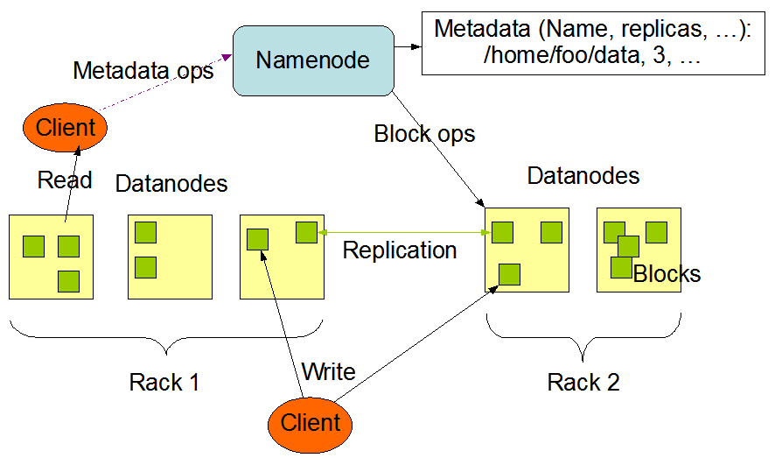
HDFS Architecture

Slide 17
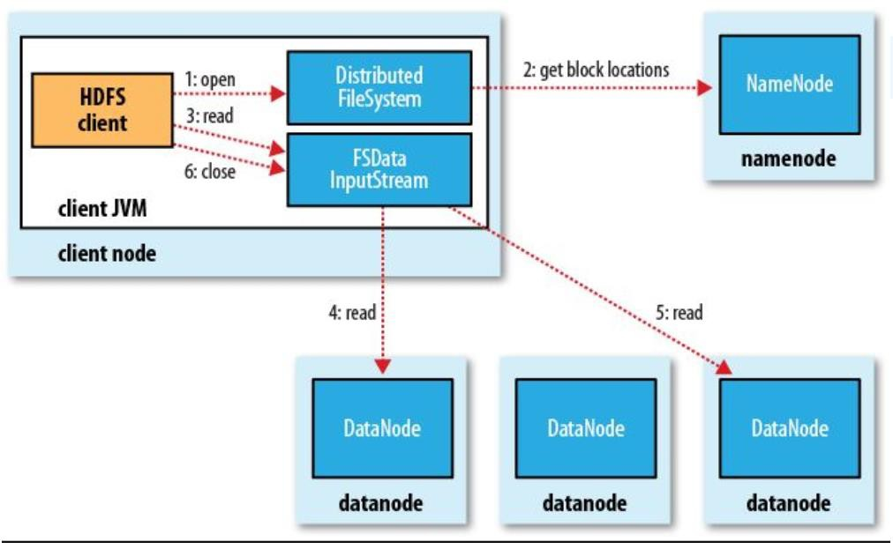
HDFS Read

Slide 18
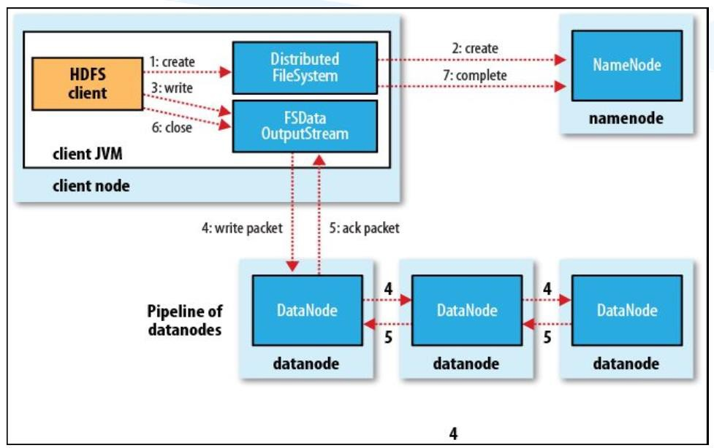
HDFS Write

Slide 19
Namenode and Datanode

Slide 20
Handle Failures
∗ NameNode Failure
∗ Multiple copies of FSImage and EditLog
∗ Second NameNode
∗ 2.0 – NameNode Federation
∗ DataNode Failure
∗ Heartbeat
∗ Re-replication
∗ Cluster re-balance
∗ Network Partition
∗ Remove dead node
∗ Re-replication
∗ File Corruption - checksum

Slide 21
Fault Tolerance
∗ Workers are periodically pinged by master
∗ No response = failed worker
∗ Master writes periodic checkpoints
∗ On errors, workers send “last gasp” UDP packet to master
∗ Detect records that cause deterministic crashes and skips them
∗ Input file blocks stored on multiple machines
∗ When computation almost done, reschedule in-progress tasks
∗ Avoids “stragglers”

Slide 22
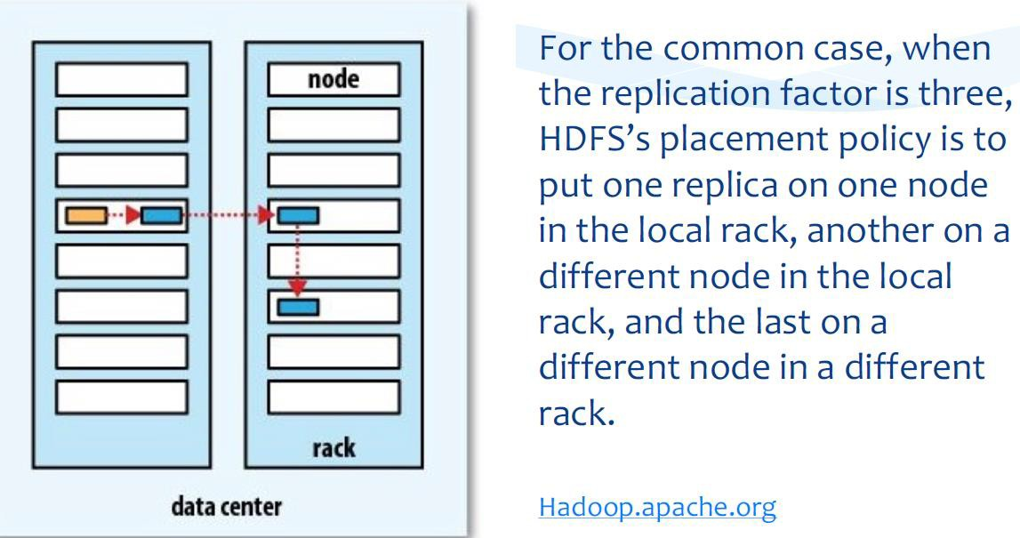
Replica

Slide 23
Debugging
∗ Offers human readable status info on http server
∗ Users can see jobs completed, in-progress, processing rates, etc.
∗ Sequential implementation
∗ Executed sequentially on a single machine
∗ Allows use of gdb and other debugging tools

Slide 24
Map Reduce Motivation
∗ Large Scale Data Processing
∗ Process lots of data (>1TB)
∗ Want to use hundreds of CPUs
∗ Challenges
∗ Automatic parallelization and distribution
∗ Fault-tolerance
∗ I/O scheduling
∗ Status and monitoring

Slide 25



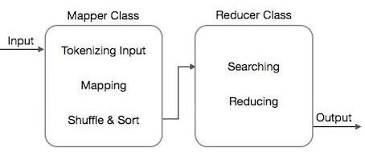
Typical Big Data Problem
Iterate over a large number of records
Extract something of interest from each
Shuffle and sort intermediate results
Aggregate intermediate results
Generate final output
Key Idea:
Provide a Functional Abstraction for These Two Operations

Slide 26

Map Reduce Core Functionality
∗ Map step
∗ Master node takes large problem input and slices it into smaller sub problems; distributes these to worker nodes
∗ Worker node may do this again; leads to a multi-level tree structure
∗ Worker processes smaller problem and hands back to master
∗ Reduce Step
∗ Master node takes the answers to the sub problems and combines them in a predefined way to get the output/answer to original problem

Slide 27
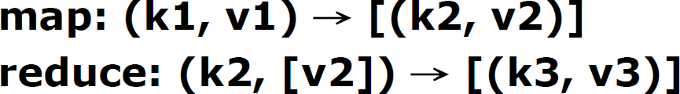
Map Reduce Overview
∗ A Programming Model
∗ Inspired by functional programming
∗ Allows expressing distributed computations on massive amounts of data
∗ An Execution Framework
∗ Designed for large-scale data processing
∗ Designed to run on clusters of commodity hardware
∗ Libraries take care of EVERYTHING else
∗ Parallelization
∗ Fault Tolerance
∗ Data Distribution
∗ Load Balancing
∗ Two basic operations on the input
∗ Map
∗ Reduce

Slide 28
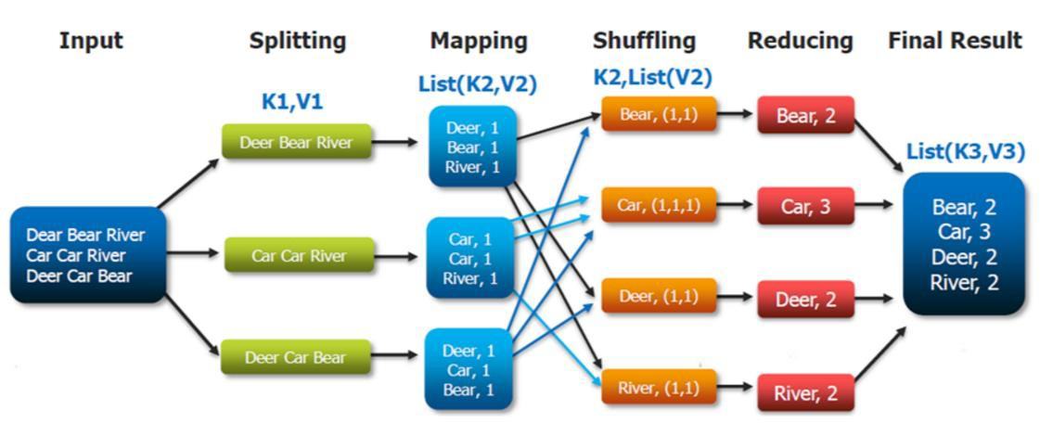
Word Count Example

Slide 29
Where MapReduce Works
∗ The calculations should be possible to run the calculation on a subset of data, and merge partial results
∗ The dataset size is big enough (or the calculations are long enough) that the infrastructure overhead of splitting it up for independent computations and merging results will not hurt overall performance

Slide 30
MapReduce Terms
Term | Description
Job | The whole process to execute: the input data, the mapper and reducers execution and the output data
Task | Every job is divided among the several mappers and reducers; a task is the job portion that goes to every single mapper and reducer
Split | The input file is split into several splits (the suggested size is the HDFS block size, 64Mb / 128Mb)
Record | The splits is read from mapper by default a line at the time: each line is a record. Using a class extending FileInputFormart, the record can be composed by more than one line
Partition | The set of all the key-value pairs that will be sent to a single reducer. The default partitioner uses an hash function on the key to determine to which reducer send the data

Slide 31
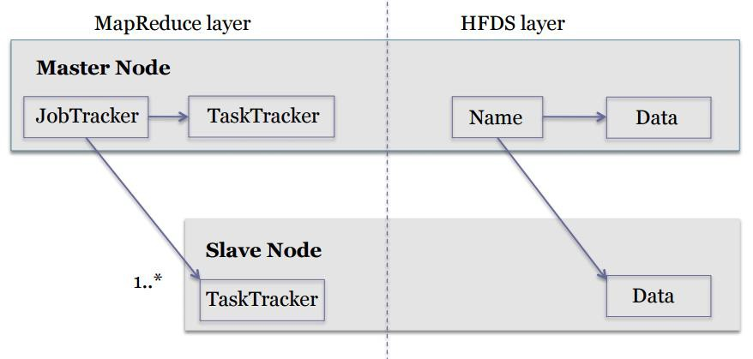
Map Reduce Framework
∗ Per cluster node
∗ Single JobTracker per master
∗ Responsible for scheduling the jobs’ component tasks on the slaves
∗ Monitors slave progress
∗ Re-executing failed tasks
∗ Single TaskTracker per slave
∗ Execute the tasks as directed by the
master

Slide 32
Map Reduce Core Functionality II
∗ Data Flow
∗ Input reader – divides input into appropriate size splits which get assigned to a Map
function
∗ Map function – maps file data to smaller, intermediate pairs
∗ Partition function – finds the correct reducer given the key and number of reducers, returns the desired Reduce node
∗ Compare function – input for Reduce is pulled from the Map intermediate output
and sorted according to the compare function
∗ Reduce function – takes intermediate values and reduces to a smaller solution handed back to the framework
∗ Output writer – writes file output

Slide 33
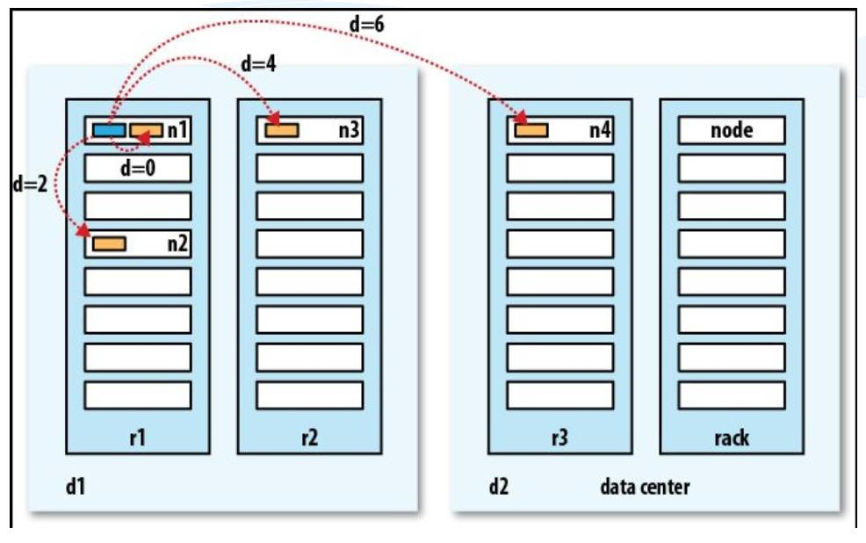
Rack Awareness

Slide 34
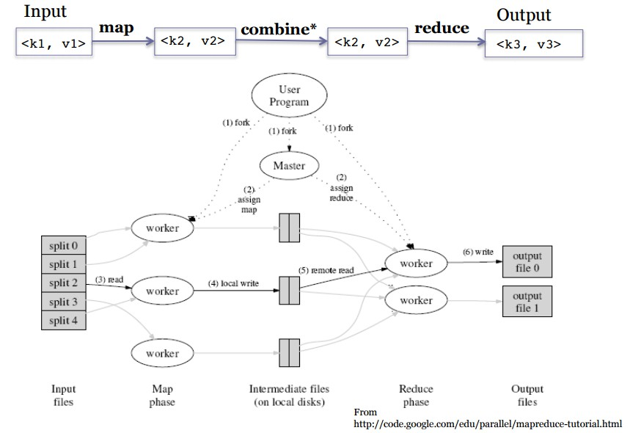
Input and Output II

Slide 35
Bad Input
∗ Hadoop provides an option to skip bad records:
∗ SkipBadRecords class
∗ Used when map tasks crash deterministically on certain input
∗ Usually, a result of bugs in the map function
∗ May be in 3rd party libraries
∗ Tasks never complete successfully even after multiple attempts
∗ Framework goes into ‘skipping mode’ after a certain number of map failures
∗ Number of records skipped depends on how frequently the processed record
counter is incremented by the application

Slide 36
Map Reduce Core Functionality III
∗ A MapReduce Job controls the execution
∗ Splits the input data-set into independent chunks which are processed by the map
tasks in a completely parallel manner
∗ The framework sorts the outputs of the maps
∗ which are then input to the reduce tasks
∗ A MapReduce Task is sent the output of the framework to combine and reduce
∗ Both the input and the output of the job are stored in a file-system
∗ The framework takes care of scheduling tasks, monitoring them and re-
executes the failed tasks

Slide 37
Distributed Grep
grep grep grep
Very big data
Split data
matches
Split data
matches
All matches
Split data
matches
cat
Split data
grep
matches

Slide 38
Distributed Word Count
count count count
Very big data
Split data
count
Split data
count
merged
count
Split data
count
merge
Split data
count
count

Slide 39
Map + Reduce
Very big data
M A P
R E D U C E
Result
Partitioning
Function
∗ Map
∗ Accepts input key/value pair
∗ Emits intermediate key/value pair
∗ Reduce
∗ Accepts intermediate key/value*
pair
∗ Emits output key/value pair

Slide 40
Example: Counting Word
∗ Two input files
∗ Input <filename, file text>
∗ Parses file and emits <word, count> pairs
∗ file1: “hello world hello moon”
∗ file2: “goodbye world goodnight moon”
∗ Three operations
∗ Map
∗ Combine
∗ Reduce

Slide 41

Output per Step
∗ Map
∗ First Map:
< hello, 1 >
< world, 1 >
< hello, 1 >
< moon, 1 >
∗ Combine
∗ First Map:
< moon, 1 >
< world, 1 >
< hello, 2 >
∗ Reduce
∗ First Map:
< goodbye, 1 >
< goodnight, 1 >
< moon, 2 >
< world, 2 >
< hello, 2 >
Second Map:
< goodbye, 1 >
< world, 1 >
< goodnight, 1 >
< moon, 1 >
Second Map:
< goodbye, 1 >
< world, 1 >
< goodnight, 1 >
< moon, 1 >

Slide 42
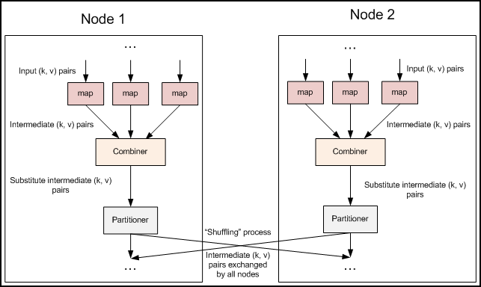
Combiner

Slide 43
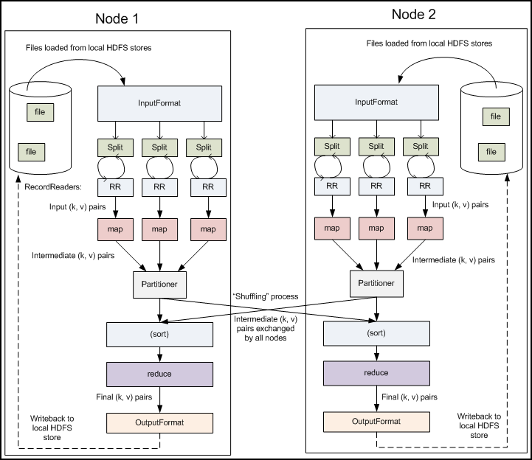
Partitioner and Sort

Slide 44
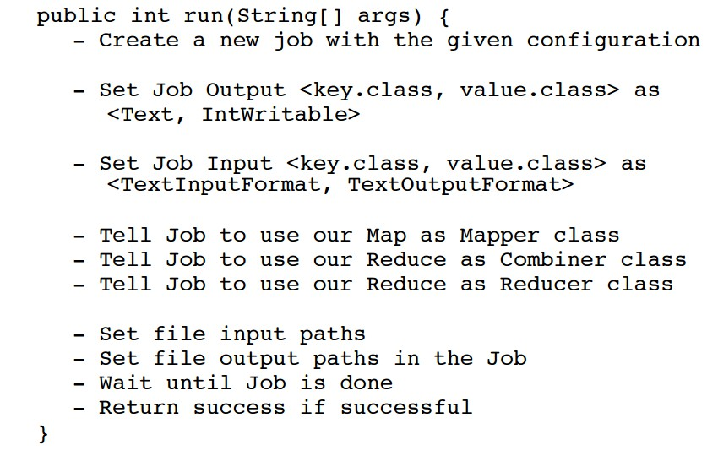
Main Run Method: Pseudocode
For the Hadoop Code of RDD on Spark please see below https://drive.google.com/drive/folders/1nGsrNeJwtDa7C2hAEmcbB_VdPQk3QgCJ

Slide 45
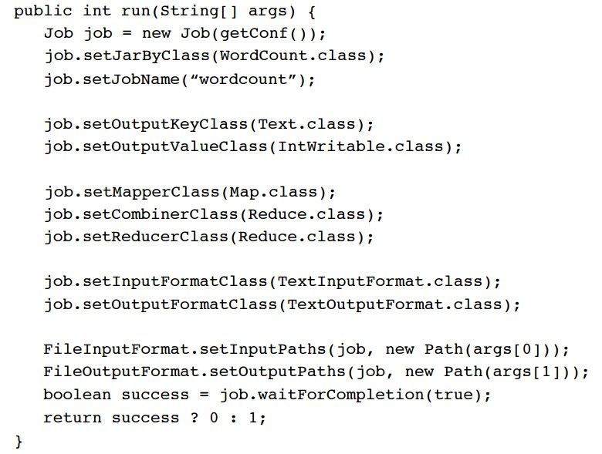
Main Run Method: The Engine

Slide 46
Job Details
∗ Job sets the overall MapReduce job configuration
∗ Job is specified client-side
∗ Primary interface for a user to describe a MapReduce job to the Hadoop framework for
execution
∗ Used to specify
∗ Mapper
∗ Combiner (if any)
∗ Partitioner (to partition key space)
∗ Reducer
∗ InputFormat
∗ OutputFormat
∗ Many user options; high customizability

Slide 47
Job Details II
∗ Jobs can be monitored by users
∗ Users can chain MapReduce jobs together to accomplish complex tasks
which cannot be done with a single MapReduce job
∗ make use of Job.waitForCompletion()
∗ and Job.submit()

Slide 48
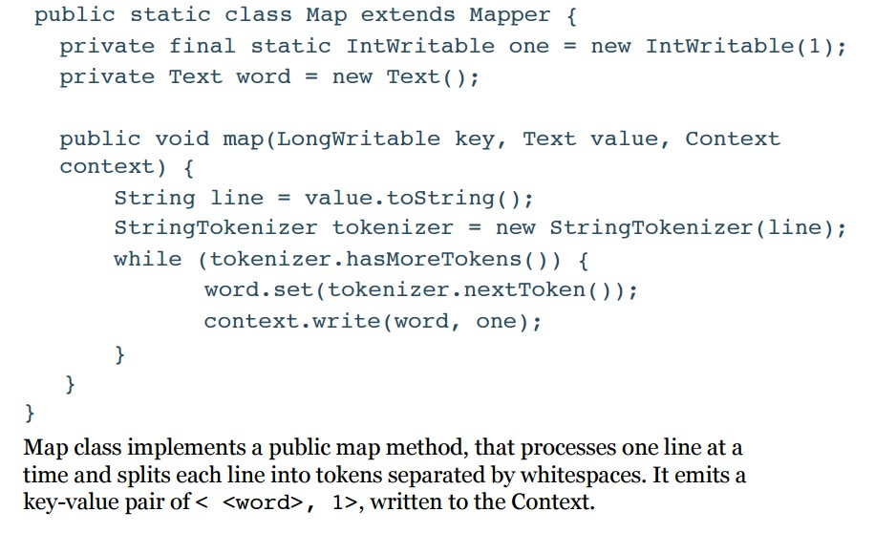
Map class for WordCount
https://colab.research.google.com/drive/17ExNzsO_R_YSy5V-bZDhvNdQqieZJPv6

Slide 49
Mapper
∗ Mapper maps input key/value pairs to a set of intermediate key/value pairs
∗ Implementing classes extend Mapper and override map()
∗ Main Mapper engine: Mapper.run()
∗ setup()
∗ map() for each input record
∗ cleanup()
∗ Mapper implementations are specified in the Job
∗ Mapper instantiated in the Job
∗ Output data is emitted from Mapper via the Context object
∗ Hadoop MapReduce framework spawns one map task for each logical representation of a unit of input work for a map task
∗ e.g. a filename and a byte range within that file

Slide 50
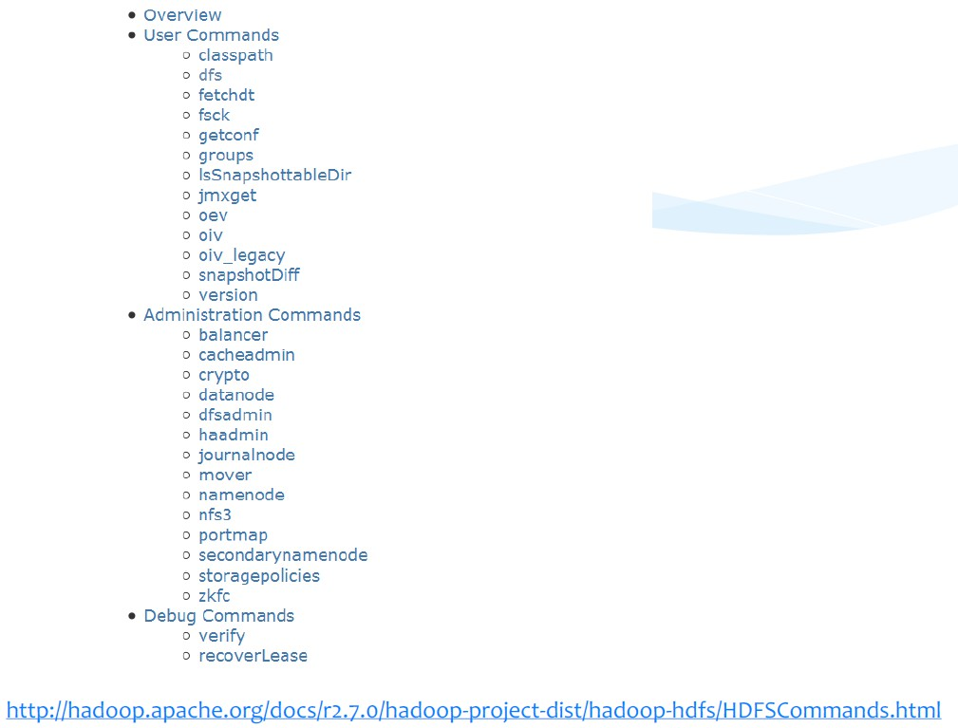
HDFS Command

Slide 51

How Many Maps?
∗ The number of maps is driven by the total size of the inputs
∗ Hadoop has found the right level of parallelism for maps is between 10-
100 maps/node
∗ If you expect 10TB of input data and have a block size of 128MB, you will have 82,000 maps
∗ Number of tasks controlled by number of splits returned and can be user overridden

Slide 52
Combine Class
∗ Specifies how to combine the maps for local aggregation
∗ In this example, it is the same as the Reduce class
∗ Output after running combiner:
∗ Second Map:
< goodbye, 1 >
< world, 1 >
< goodnight, 1 >
< moon, 1 >
∗ First Map:
< moon, 1 >
< world, 1 >
< hello, 2 >

Slide 53
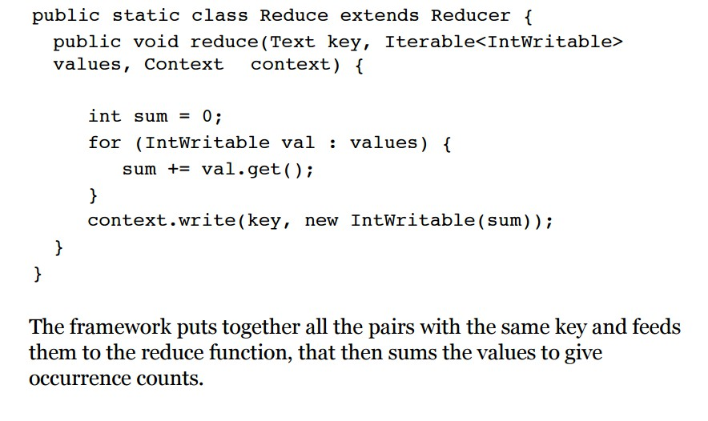
Reduce Class for WordCount

Slide 54
Reducer
∗ Reduces a set of intermediate values which share a key to a (usually smaller) set of values
∗ Sorts and partitions Mapper outputs
∗ Number of reduces for the job set by user via Job.setNumReduceTasks(int)
∗ Reduce engine
∗ receives a Context containing job’s configuration as well as interfacing methods that
return data back to the framework
∗ Reducer.run()
∗ setup()
∗ reduce() per key associated with reduce task
∗ cleanup()

Slide 55

Observations
∗ No reduce can begin until map is complete
∗ Specify the Job configuration
∗ Specify input/output locations
∗ Supply map and reduce functions via implementations of appropriate interfaces and/or abstract classes
∗ If map worker fails any time before reduce finishes, task must be
completely rerun
∗ Master must communicate locations of intermediate files
∗ MapReduce library does most of the hard work for us!

Slide 56

Conclusions
∗ Simplifies large-scale computations that fit this model
∗ Allows user to focus on the problem without worrying about details
∗ Computer architecture not very important
∗ Portable model
∗ Fault tolerant, reliable, and supports thousands of nodes and petabytes of data
∗ If you can rewrite algorithms into Maps and Reduces, and your problem can be broken up into small pieces solvable in parallel, then Hadoop’s MapReduce is the way to go for a distributed problem-solving approach to large datasets

Slide 57

Limitations
∗ Cannot control the order in which the maps or reductions are run
∗ A database with an index will always be faster than a MapReduce job on unindexed data
∗ Reduce operations do not take place until all Maps are complete (or have failed then been skipped)
∗ General assumption that the output of Reduce is smaller than the input to Map; large data source used to generate smaller final values

Slide 58
HDFS Command

Slide 59
Hadoop 1 vs. Hadoop 2
No | Hadoop1 | Hadoop2
1 | Supports MapReduce (MR) processing model only. Does not support non-MR tools | Allows to work in MR as well as other distributed computing models like Spark, Hama, Giraph, Message Passing Interface) MPI & HBase coprocessors.
2 | MR does both processing and cluster-resource management. | YARN (Yet Another Resource Negotiator) does cluster resource management and processing is done using different processing models.
3 | Has limited scaling of nodes. Limited to 4000 nodes per cluster | Has better scalability. Scalable up to 10000 nodes per cluster
4 | Works on concepts of slots – slots can run either a Map task or a Reduce task only. | Works on concepts of containers. Using containers can run generic tasks.
5 | A single Namenode to manage the entire namespace. | Multiple Namenode servers manage multiple namespaces.
6 | Has Single-Point-of-Failure (SPOF) – because of single Namenode- and in the case of Namenode failure, needs manual intervention to overcome. | Has to feature to overcome SPOF with a standby Namenode and in the case of Namenode failure, it is configured for automatic recovery.
7 | MR API is compatible with Hadoop1x. A program written in Hadoop1 executes in Hadoop1x without any additional files. | MR API requires additional files for a program written in Hadoop1x to execute in Hadoop2x.
8 | Has a limitation to serve as a platform for event processing, streaming and real-time operations. | Can serve as a platform for a wide variety of data analytics-possible to run event processing, streaming and real-time operations.
9 | A Namenode failure affects the stack. | The Hadoop stack – Hive, Pig, HBase etc. are all equipped to handle Namenode failure.
10 | Does not support Microsoft Windows | Added support for Microsoft windows

