Slide 1
Big Data Analytics (Spring 2026)
ETL and Data Pipeline Automation

Slide 2



ETL Overview
1
2
3
4
Batch Data Processing
Stream Data Processing
Q &A

Slide 3
ETL Overview
1

Slide 4
Common ETL Language
SQL/Stored Procedure
Python
SAS
Java
Javascript
Shell/Bash
SparkSQL/PySpark/Scala

Slide 5
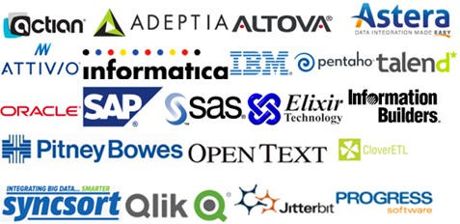
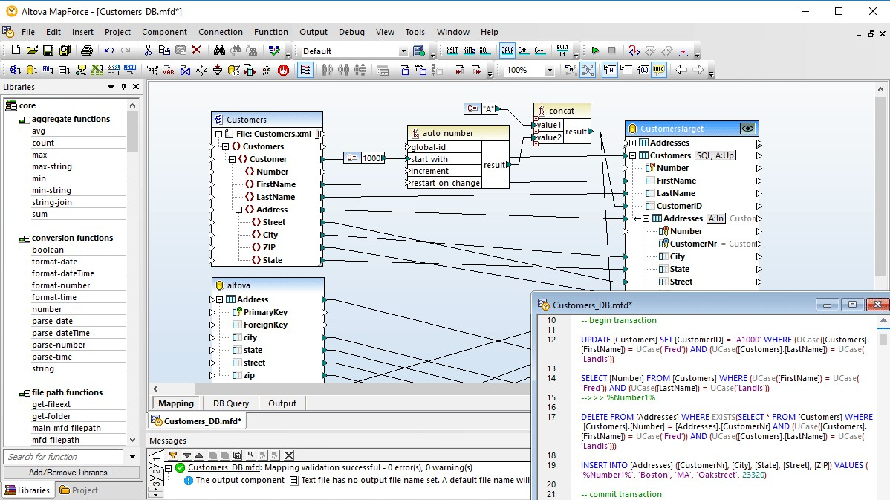
ETL Tools

Slide 6
ETL on HDFS
Flume | Apache Flume is a distributed, reliable, and available software for efficiently collecting, aggregating, and moving large amounts of log data. It has a simple and flexible architecture based on streaming data flows.
Sqoop | Apache Sqoop is a command-line interface application for transferring data between relational databases and Hadoop
Hive | Apache Hive gives an SQL-like interface to query data stored in various databases and file systems that integrate with Hadoop
Pig | Apache Pig is a platform for analyzing large data sets that consists of a high-level language for expressing data analysis programs, coupled with infrastructure for evaluating these programs.
Presto | Presto is an open source distributed SQL query engine for running interactive analytic queries against data sources of all sizes ranging from gigabytes to petabytes.

Slide 7
ETL on the Cloud
Service/Software | Description | Key Features
AWS Data Pipeline | AWS Data Pipeline is a web service that helps you reliably process and move data between different AWS compute and storage services, as well as on-premises data sources, at specified intervals. | More control of underlying computing resources Support almost all data sources and destinations
AWS Glue | AWS Glue is a completely managed/serverless ETL service. You just have to configure AWS Glue to point to your data stored in AWS. It automatically discovers your data and stores the related metadata in the AWS Glue Data Catalog. | Serverless Best used to transform data between RDS, DynamoDB, S3, Redshift)
Hevo | No-code cloud based data pipeline service. Not only move data from several sources into various destinations – data warehouses, databases, file storage but also various SaaS applications. | Ready to use data source integrations No-code platform Real-time data replication
Stitch Data | Stitch is a cloud-first, open source platform forrapidly moving data. | Integrates with over 90 data sources

Slide 8

Case Study: SuperStore

Slide 9
Tasks
Create SUPERSTORE Database
Load data into SUPERSTORE DB
Design data model
Design ETL pipeline
Create data warehouse tables
ETL from SUPERSTORE to DWH

Slide 10
4 ways to load data into Snowflake
Use UI
Use insert into script
Use SnowSQL Command-Line Interface*
Use Python Pandas

Slide 11
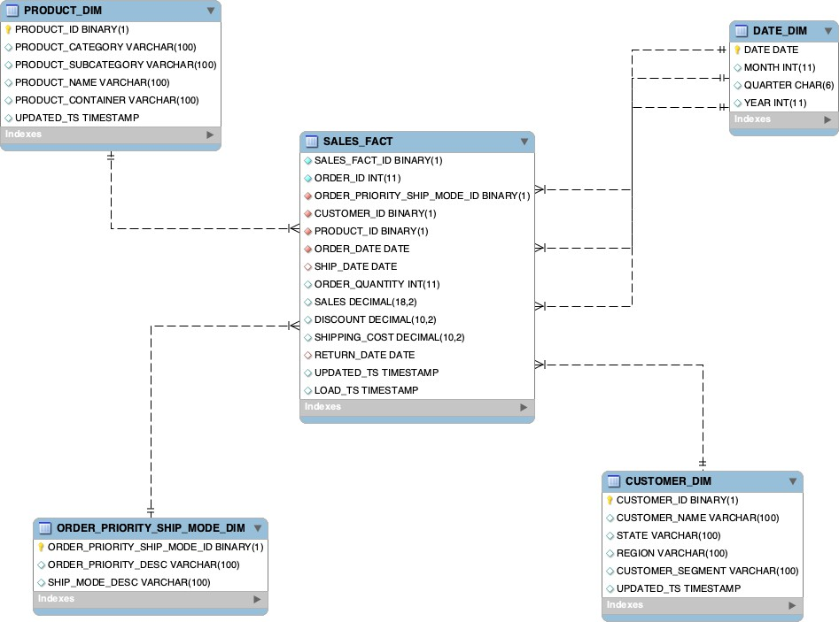
Data Model Design

Slide 12
Data Pipeline Design
DWH
SUPERSTORE
STAGING
CL
CUST_DIM
DATE_DIM
SALES
SALES_STG
SALES_FACT
RETURNS
RETURNS_STG
PROD_DIM
JUNK_DIM

Slide 13
Data Warehouse Design

Slide 14
DWH Design Process
1
2
3
4
5
6
7
Architecture Design
Data Modeling
ETL Development
Metrics (PL) Design
Data Management
BI/Dashboard Development
Performance Turning

Slide 15
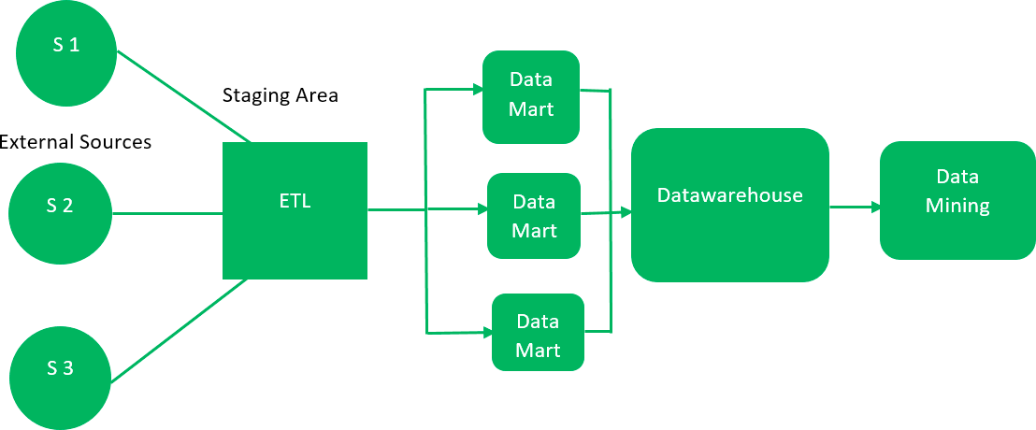
1. Architecture Design: Bottom UP Approach

Slide 16
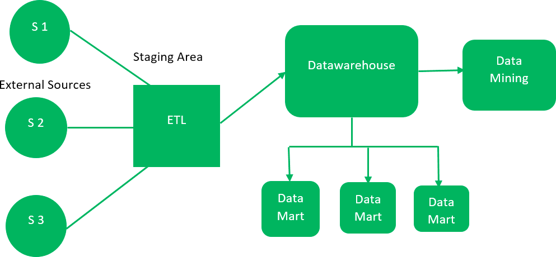
2. Architecture Design: Top Down Approach

Slide 17
3. Data Management
Metadata
Data Classification & Tagging
Business Data Quality
Data Lineage
Data Description
Data Summary
PII & NPI
PCI

Slide 18
4. Data Security & Risk
Access Control
Separation of production environment
Encryption
Masking & Tokenization
Data Retention and Purging

Slide 19
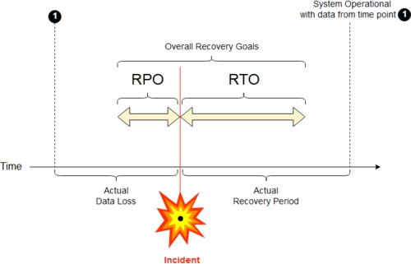
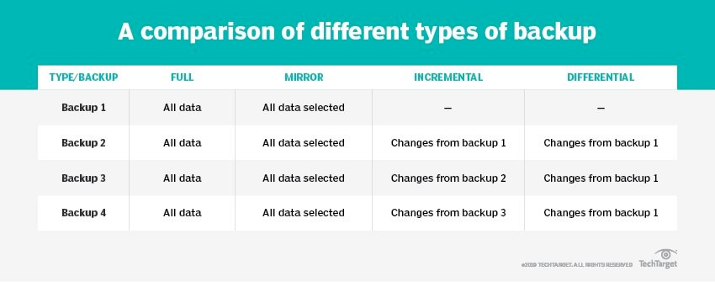
5. Data Backup & Recovery
Recovery Point Objective
Types of Data Backup
Failover

Slide 20
6. Performance Turning
Infrastructure
Data Modeling & Table Optimization
Query Optimization
  Tradeoff between speed and storage
  Nodes vs Clusters
  Index
  Partition
  Clustering
  Modern DB/DWH optimize queries and caches results
  Run small statements in parallel
  Use CTE to reduce duplication
  Use Explain to check execution plan
  Know the infrastructure and data model

Slide 21
Demo ETL Pipeline
1
2
3
4
5
Step 1. CTE with LAG and LEAD to compare each customer's purchase with the previous and next purchases to analyze purchase trends over time
Step 2: Create a CTE to get customer + sales info
Step 3: Create a CTE to get customer + sales info
Step 4: Aggregate daily sales
Step 4: Analytics with LAG/LEAD for day-to-day comparison

Slide 22
Step 1. Create CTE and then analyze with LAG and LEAD to compare each customer's purchase with the previous and next purchases to analyze purchase trends over time
WITH customer_cte AS
(
SELECT
customer_id, purchase, purchase_date
FROM customers
)
SELECT
customer_id,
purchase,
purchase_date,
LAG(purchase) OVER (ORDER BY purchase_date) AS previous_purchase,
LEAD(purchase) OVER (ORDER BY purchase_date) AS next_purchase
FROM customer_cte
ORDER BY purchase_date;

Slide 23
-- Step 3: Create a CTE to get customer + sales info
WITH customer_sales_cte AS (
SELECT
c.customer_id,
c.customer_name,
s.sales_date,
s.total_amount,
s.return_amount
FROM customers c
JOIN fact_sales s
ON c.customer_id = s.customer_id
),

Slide 24
WITH daily_sales AS (
SELECT
sales_date,
total_amount,
-- previous day's sales
LAG(total_amount) OVER (ORDER BY sales_date) AS prev_day_sales,
-- next day's sales
LEAD(total_amount) OVER (ORDER BY sales_date) AS next_day_sales,
-- difference from previous day
total_amount - LAG(total_amount) OVER (ORDER BY sales_date) AS diff_from_prev,
-- difference to next day
LEAD(total_amount) OVER (ORDER BY sales_date) - total_amount AS diff_to_next
FROM daily_sales ORDER BY sales_date
),
-- Step 4: Create Aggregate daily sales Table

Slide 25
-- Step 4: Analytics with LAG/LEAD for day-to-day comparison
SELECT
sales_date,
total_sales,
total_returns,
-- previous day's sales/returns
LAG(total_sales) OVER (ORDER BY sales_date) AS prev_day_sales,
LAG(total_returns) OVER (ORDER BY sales_date) AS prev_day_returns,
-- next day's sales/returns
LEAD(total_sales) OVER (ORDER BY sales_date) AS next_day_sales,
LEAD(total_returns) OVER (ORDER BY sales_date) AS next_day_returns,
-- differences
total_sales - LAG(total_sales) OVER (ORDER BY sales_date) AS diff_sales_prev_day,
total_returns - LAG(total_returns) OVER (ORDER BY sales_date) AS diff_returns_prev_day,
LEAD(total_sales) OVER (ORDER BY sales_date) - total_sales AS diff_sales_next_day,
LEAD(total_returns) OVER (ORDER BY sales_date) - total_returns AS diff_returns_next_day
FROM daily_sales
ORDER BY sales_date;

Slide 26





scrape.py
Architecture Design
scrape_jobs()
scrape
task: scrape_indeed_j obs
add_jobs()
write
DAG: indeed
email_jobs.py
read
task: email_indeed_jo bs
email()
email
Copyright @ Data Application Lab

Slide 27

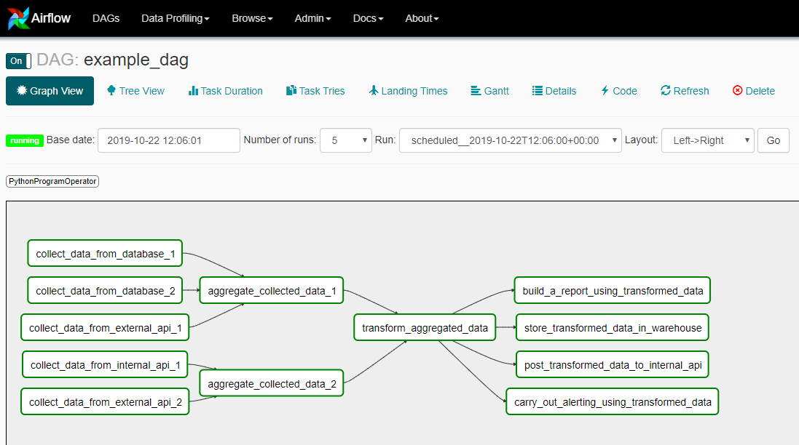
Scheduling
Common Schedulers
  Airflow
  Luigi
  Jenkins
  Oozie
  Cron
  Celery
https://crontab.guru/

Slide 28
ETF Airflow - Weather Dag
https://github.com/krishnaik06/ETLWeather/blob/main/README.md
Open the docker
brew upgrade astro
docker ps
CONTAINER ID IMAGE COMMAND CREATED STATUS PORTS NAMES
astro dev start
✔ Project image has been updated
⠇ Project is starting up…

Slide 29
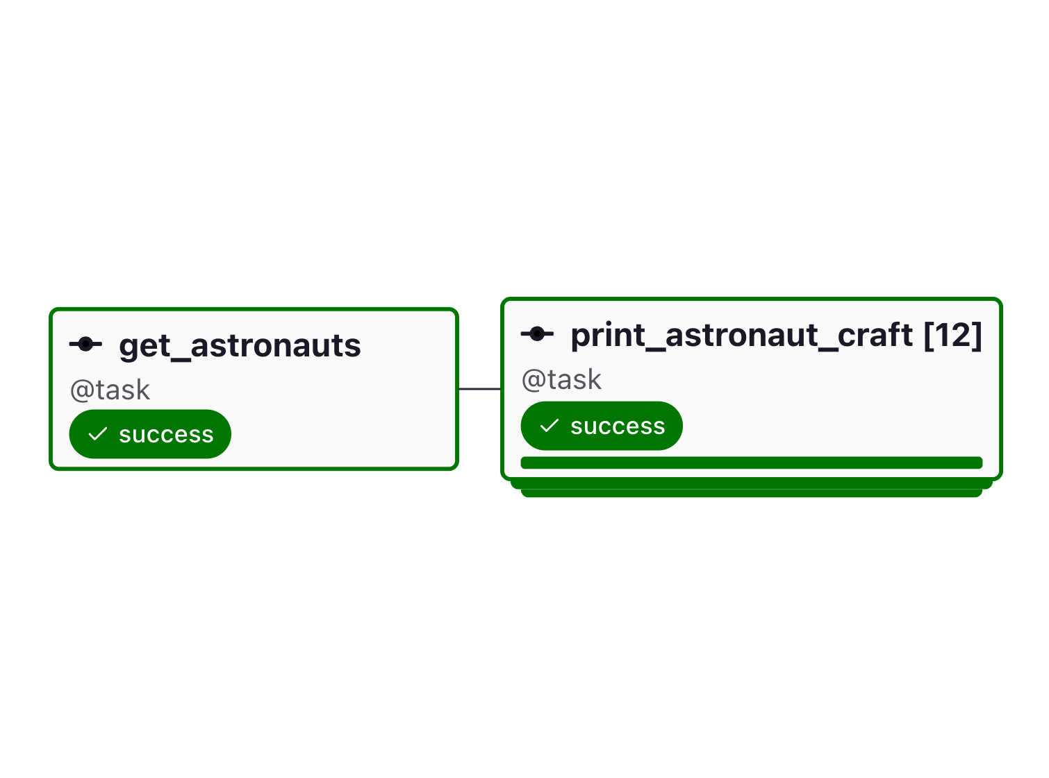
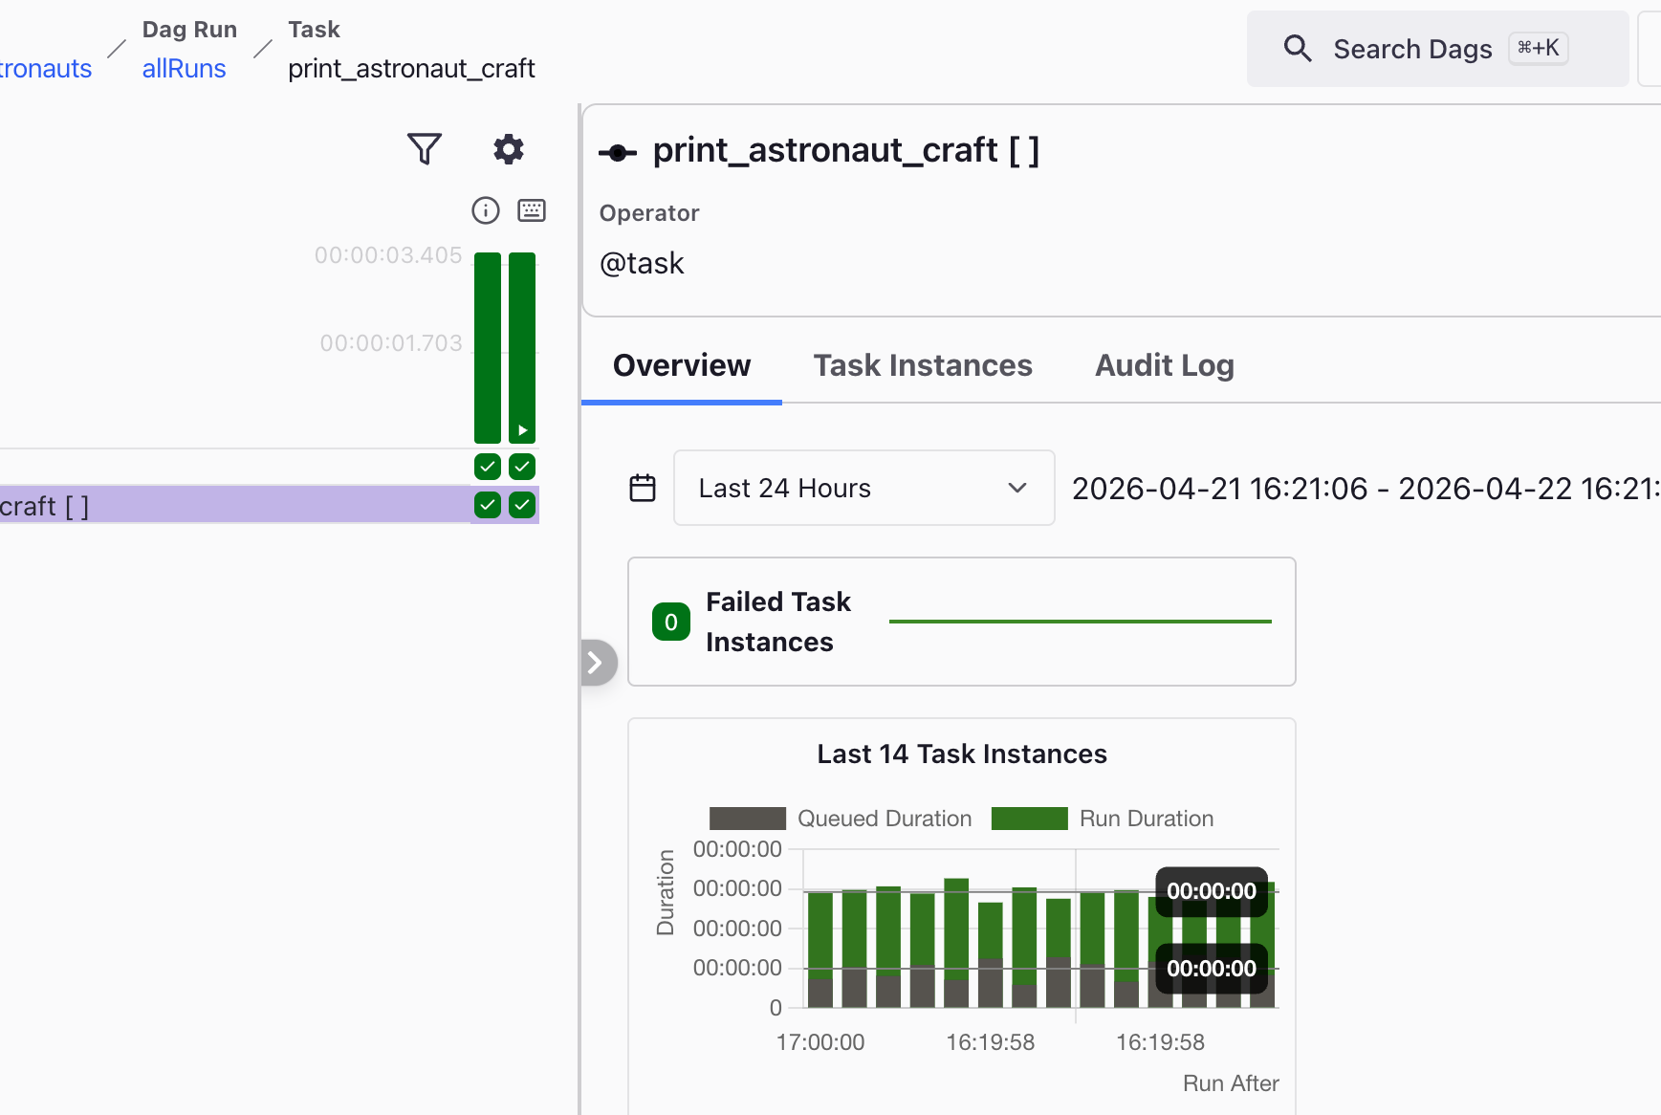
ETF Airflow - Weather Dag

Slide 30
Full Load vs Incremental Load
Full Load
Incremental Load
New and updated records only
Used for BAU load
Batch vs Stream load
Schema evolution
Requires continuous monitoring
  All rows in source data
  Often used for historical/onetime load
  Can be used for BAU load sometimes such like snapshots
T-1 load strategy:
History in-depth
  Snapshot or full changes
  One time validation

Slide 31

Batch Data Processing
2

Slide 32


ETL Data Pipeline Design
DWH
SUPERSTORE
STAGING
CL
PL
CUST_DIM
DATE_DIM
SALES_FACT_B C
SALES
SALES_STG
Report
SALES_FACT
RETURNS
RETURNS_ST G
PL_MTH_SALES
_PROD_CUST
PROD_DIM
JUNK_DIM

Slide 33

Stream Data Processing
3

Slide 34
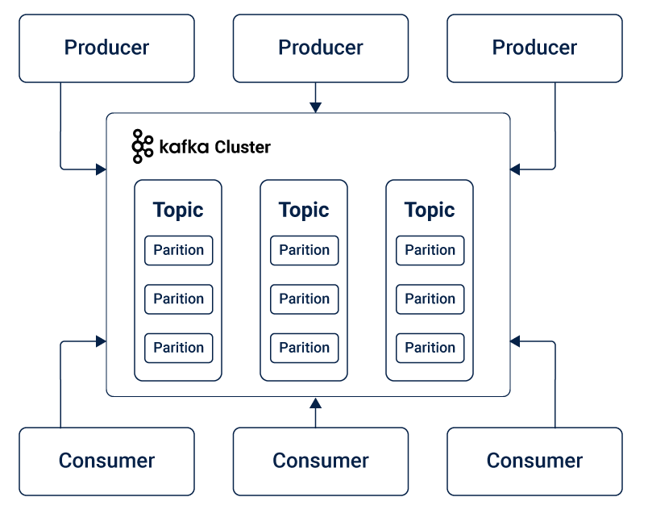
Introduce Kafka MPP Streaming

Slide 35
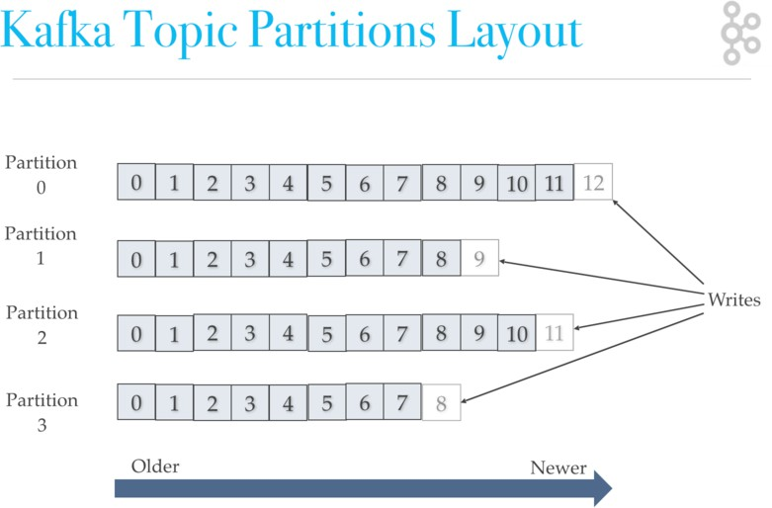
Kafka Partition
offset

Slide 36
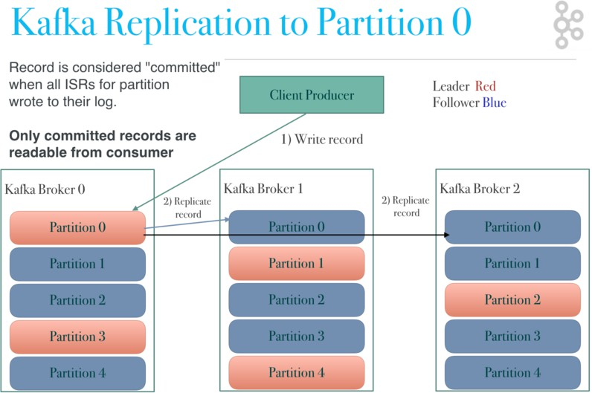
Kafka Brokers

Slide 37
Instruction—Set up Kafka Docker Environment
Create AWS access key
Create Twitter access tokens and consumer keys
Download and install docker: https://docs.docker.com/get-docker/ Use Landoop’s Kafka Image to start Kafka in a container:
docker run --name kafka -p 2181:2181 \
-p 3030:3030 \
-p 8081-8083:8081-8083 \
-p 9581-9585:9581-9585 \
-p 9092:9092 \
-e AWS_ACCESS_KEY_ID=<Your AES Access Key> \
-e AWS_SECRET_ACCESS_KEY=<Your AWS Secret Access Key>\
-e ADV_HOST=127.0.0.1 \
landoop/fast-data-dev:latest
new terminal) Bash in to the container: docker exec -it kafka /bin/bash (use docker -ps to list active containers)
Create a new folder twitter: mkdir twitter Install python and necessary packages
apk add --update --no-cache python3 && ln -sf python3 /usr/bin/python
python3 -m ensurepip
pip3 install --no-cache --upgrade pip setuptools
pip install kafka-python
pip install tweepy
Exit and stop Docker: docker stop kafka
Copy producer.py and consumer.py into the container
  docker cp consumer.py kafka:/twitter (remember to update Twitter access tokens and consumer keys)
  docker cp producer.py kafka:/twitter
(

Slide 38
Instruction—Create topic, producer, and Kafka S3 connect
Start the container: docker start kafka
Bash into the container: docker exec -it kafka /bin/bash
Create a new topic “trump”
kafka-topics --create --zookeeper localhost:2181 --replication-factor 1 --partitions 3 --topic trump
  Start producer: python twitter/producer.py
  (In a new container terminal) Start consumer: python consumer.py
  Go to http://localhost:3030 and look for data in the “trump” topic under “topics”-”trump”
  Create an S3 bucket: dal-kafka-twitter-trump (you need a different name)
  Create a Kafka S3 connector (copy properties in the notes, remember to update bucket name & region). Check data in the bucketa

Slide 39
Instruction: Load data from S3 to SF
Create a stage
Create a table has a variant column
Create a pipe
Show pipes to get the ARN in the notification_channel column
Create a new event from S3
Start producer in the container
Check data in Snowflake table in a minute

Slide 40
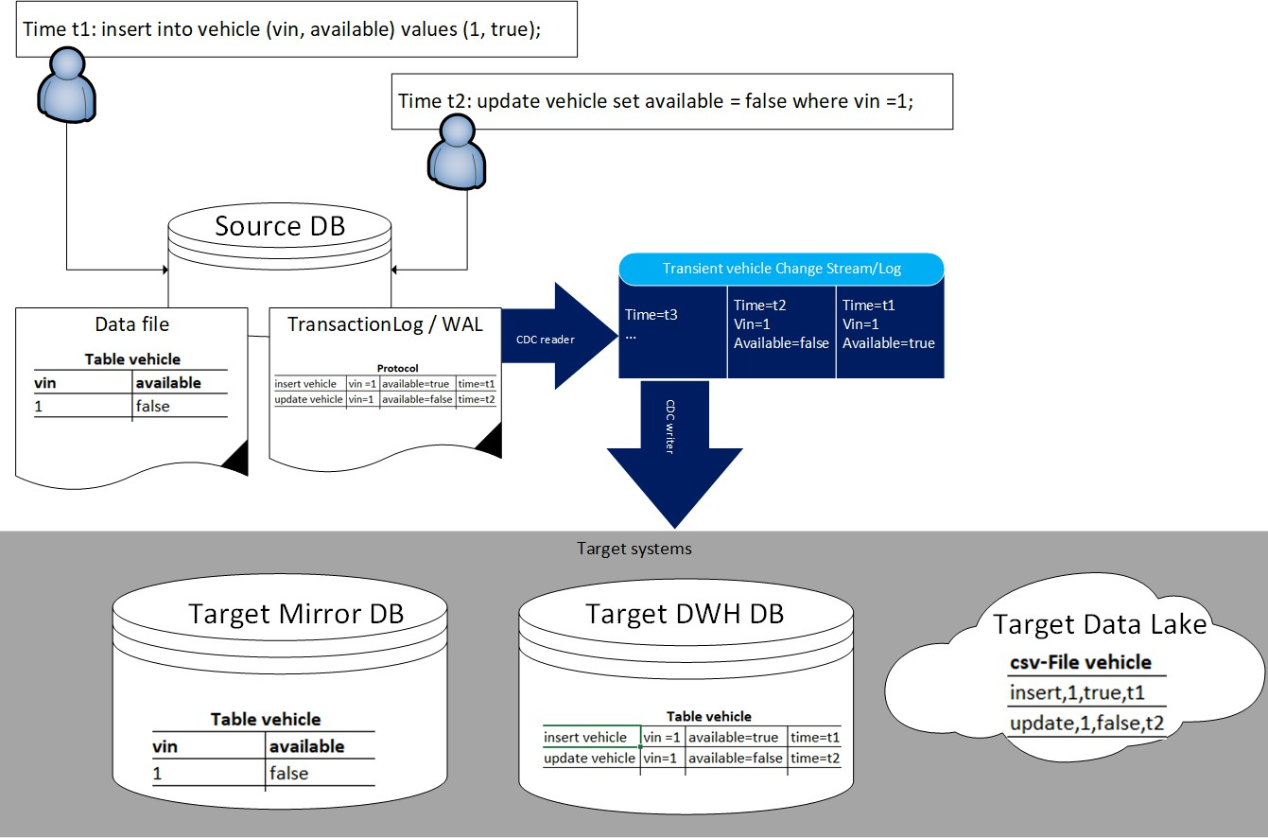
Log based Change Data Capture

Slide 41
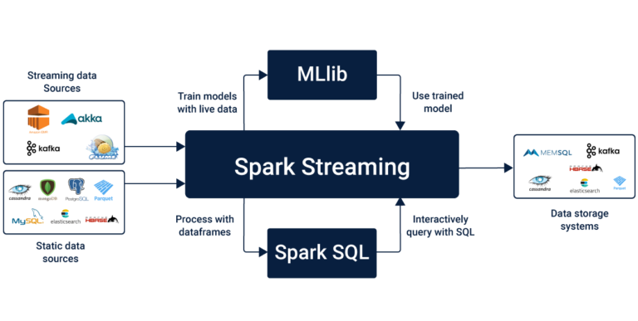
Spark Streaming Processing

Slide 42
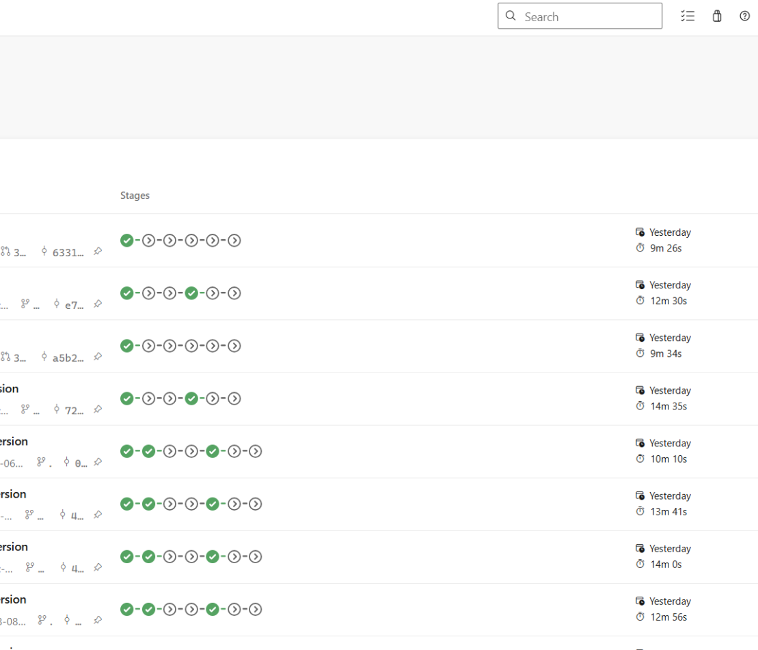
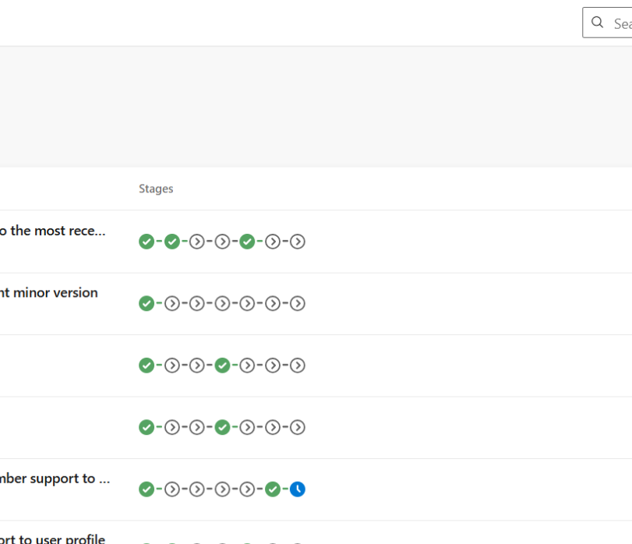
Azure Synapse WorkFlow

Slide 43
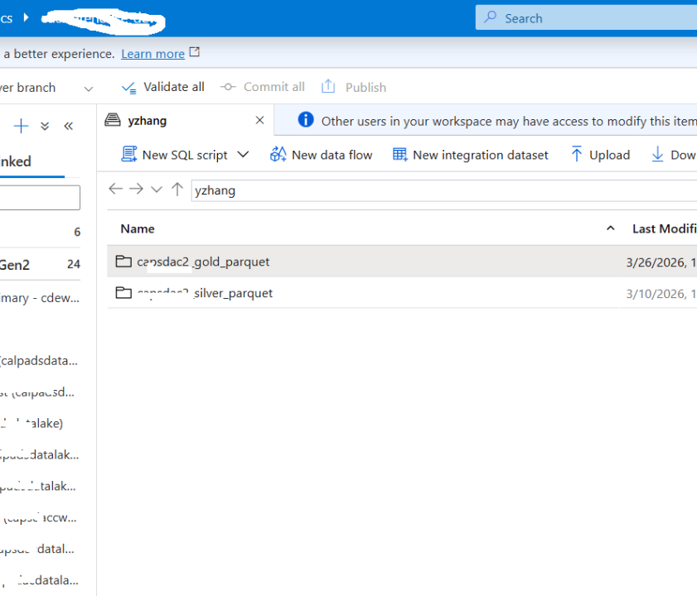
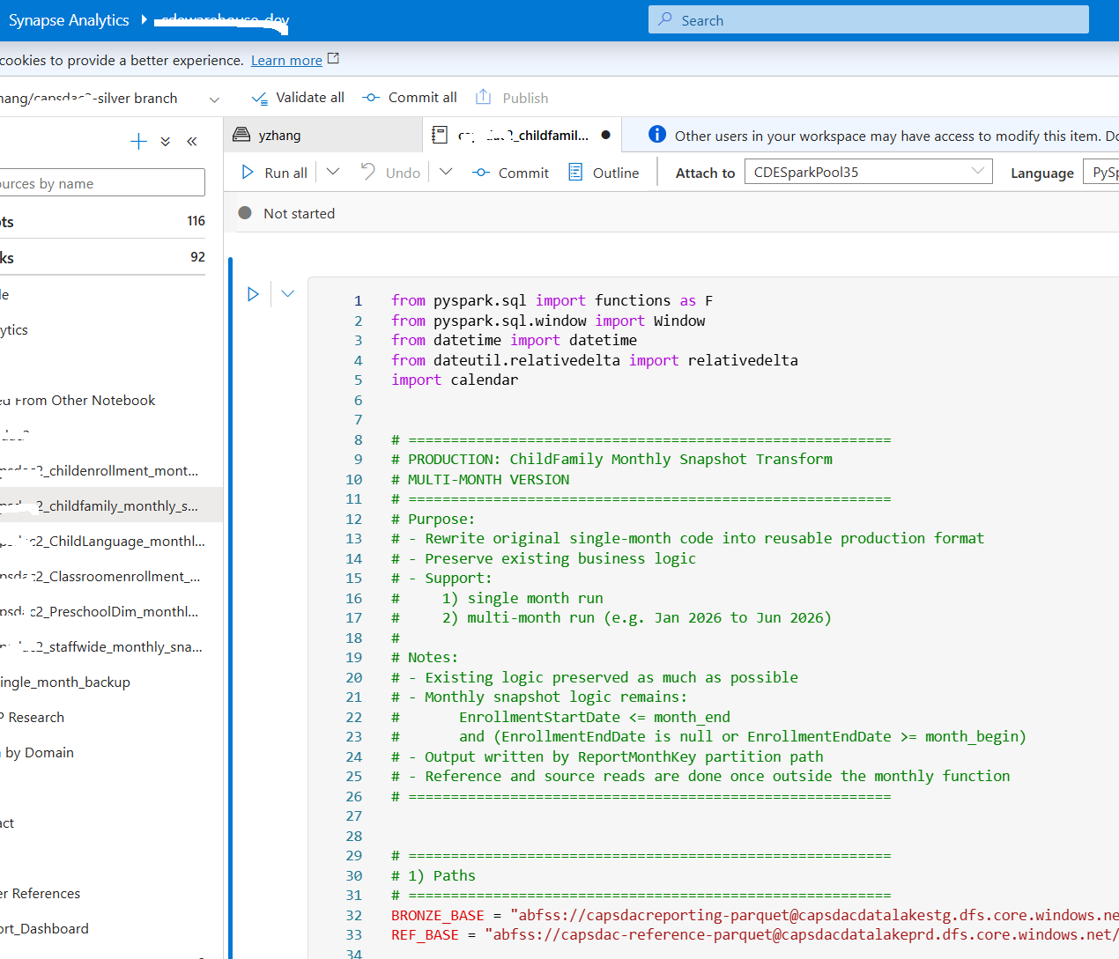
Azure Synapse WorkFlow

Slide 44
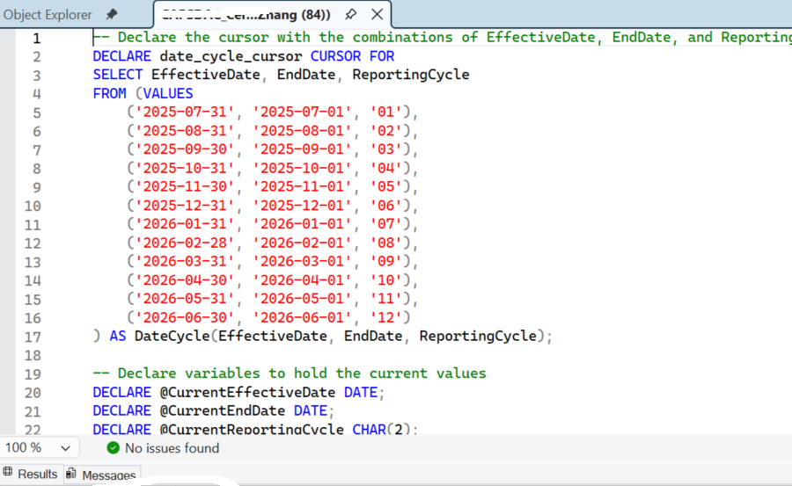
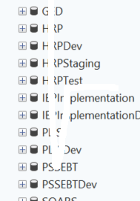
Microsoft SQL Server

Slide 45
DAY 4 — Apache Airflow Fundamentals
Goal: Teach orchestration properly
MOST IMPORTANT INDUSTRY DAY
Topics:
• DAGs
• scheduling
• retries
• operators
• dependencies
• execution flow

Slide 46
What is Apache Airflow?
Open-source workflow orchestration platform
Used to automate ETL and analytics pipelines
Core concepts:
• DAG (Directed Acyclic Graph)
• Tasks
• Operators
• Scheduling
• Monitoring and Logging

Slide 47
Airflow Architecture
Main Components:
• Webserver
• Scheduler
• Metadata Database
• DAG Files
Execution Flow:
DAG → Tasks → Scheduler → Logs → Monitoring

Slide 48
Understanding DAGs
DAG = Directed Acyclic Graph
Defines workflow dependencies
Example:
task1 >> task2 >> task3
Airflow executes tasks in dependency order

Slide 49
Create Your First DAG
Example DAG:
from airflow import DAG
from airflow.operators.python import PythonOperator
with DAG(...) as dag:
task1 = PythonOperator(...)
task2 = PythonOperator(...)
task1 >> task2

Slide 50
Scheduling and Retries
Scheduling Concepts:
• daily
• hourly
• cron scheduling
Retry Example:
retries=3
retry_delay=timedelta(minutes=5)
Improves production reliability

Slide 51
Airflow Operators
Common Operators:
• PythonOperator
• BashOperator
• EmailOperator
• BranchPythonOperator
Operators define the actual task execution logic

Slide 52
Logging and Monitoring
Airflow provides:
• task logs
• DAG history
• retries
• error tracking
Students learn how to debug ETL pipelines using Airflow logs

Slide 53
Guided Lab — Build ETL DAG
Students build:
daily_pipeline_dag.py
Workflow:
Extract Data
↓
Transform Data
↓
Load PostgreSQL
Add retries and logging

Slide 54
Assignment and Deliverables
Assignment:
Create daily_pipeline_dag.py
Deliverable:
• Working DAG
• Task dependencies
• Retries configured
• Logging enabled
• Airflow UI demonstration

