Slide 1

Big Data Analytics (Fall 2025)

Slide 2
What is Spark SQL
A Spark module for structured data processing
Provides programming abstraction called DataFrames
Act as distributed SQL query engine
Enables unmodified Hadoop HIVE queries to run up to 100x faster

Slide 3
Spark SQL Engine
Unifies Spark components and permits abstraction to DataFrames in Java, Scala, Python, and R
Connects to the Apache Hive metastore and tables
Reads and writes structured data with a specific schema from structured file formats and converts data into temporary tables
Offers an interactive Spark SQL shell for quick data exploration
Provides a bridge to (and from) external tools via standard database JDBC/ODBC connectors
Generates optimized query plans and compact code for the JVM, for final execution

Slide 4
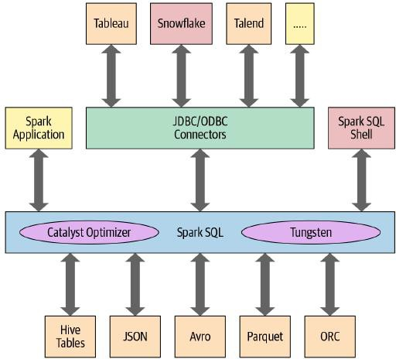
Spark SQL Stacks

Slide 5
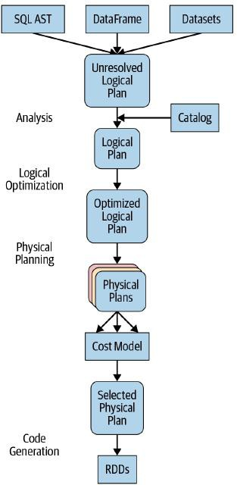
Catalyst Optimizer
Takes computational query and converts into execution plan
  Analysis
  Logical Optimization
  Physical Planning
  Code Generation

Slide 6

Phase 1: Analysis
Spark SQL engine generates abstract syntax tree (AST)
  Any columns or table names will be resolved by consulting internal Catalog
  Catalog holds a list of names of columns, data types, functions, tables, etc.

Slide 7

Phase 2: Logical Optimization
Apply standard rule-based optimization approach
  Construct a set of multiple plans
  Assign cost to each plan using cost-based optimizer
Layout as operator trees

Slide 8
Phase 3: Physical Planning
Generate an optimal physical plan for the selected logical plan
Use physical operators that match available in Spark execution

Slide 9
Phase 4: Code Generation
Project Tungsten
  Generate efficient Java bytecode to run on each machine
  Use state-of-the-art compiler technology for code generation to speed up execution

Slide 10

Query Example
SparkSession
  Provides a unified entry point for programming Spark with structured API
  Access Spark functionality
  sql() method returns a DataFrame

Slide 11

Query Example
Airline On-Time Performance and Causes of Flight Delays data set
  Date: a string like 02190925. When converted, this maps to 02-19 09:25 am
  Delay: delay in minutes between the scheduled and actual departure times
  Distance: gives the distance in miles from the origin airport to the destination
  Origin: origin airport code
  Destination: destination airport code
Demo 21

Slide 12
SQL Tables and Views
Spark Table
Data:
Metadata: schema, description, table name, database name, column names, partitions, physical location
Apache Hive Metastore
Managed Tables
Spark manages both metadata and data in the file store
Local filesystem, HDFS, Amazon S3 or Azure, etc.
Unmanaged Tables
Spark manages metadata
You manages data in external data source, for example, Cassandra

Slide 13
Creating Tables
Managed table
  CREATE TABLE managed_us_delay_flights_tbl ( date STRING,
delay INT, distance INT, origin STRING,
destination STRING )
Unmanaged table
  CREATE TABLE us_delay_flights_tbl ( date STRING,
delay INT, distance INT, origin STRING,
destination STRING
USING csv OPTIONS (PATH ‘/sample.csv’)
Demo 22

Slide 14

Creating Views
Global
Visible across all SparkSessions on a given cluster
Session Scope
Visible only to a single SparkSession
Disappear after Spark application terminates
SQL
CREATE OR REPLACE GLOBAL TEMP VIEW us_origin_airport_SFO_global_tmp_view AS SELECT date, delay, origin, destination from us_delay_flights_tbl WHERE
origin = 'SFO';

Slide 15

Creating Views
SparkSQL
df_sfo = spark.sql("SELECT date, delay, origin, destination FROM us_delay_flights_tbl WHERE origin
= 'SFO'")
df_sfo.createOrReplaceGlobalTempView("us_origin_airport_SFO_global_tmp_view")
Demo 23

Slide 16


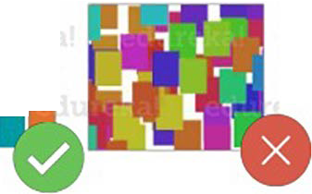

e
Spark SQL Features
Spark SQL integrates relational processing with Spark's functional programming____,
SpafK1 SQL
e
Spark SQL is used for the structured/semi structured data analysis in Spark
• •
• ••
•
____,
■•
111111
••• ••
-■ 1■
■
111111
••••
111111
1111

Slide 17
edureka!
Spark SQL Overview
e I Performance And Scalability
Performance: Spark SQL Vs Hadoop
,
.....,.,.,��
3000 �
2000
1500
e'.lr.
1000 •,,...,
500 "Ii-----
Number Of Iterations
" ( .. ,. ,. "t ., .... l
' .

Slide 18
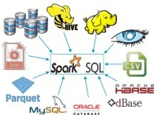


Spark SQL Flow Diagram
edureka!
0 Spark SQLhas the following libraries:
1. Data Source API
DataFrame API
Interpreter & Optimizer
SOL Service
Data Source AP!
l DataFrame AP!
0 The flow diagram represents a Spark SQL process using all the four libraries in sequence
Named Columns
Spark SQL Service
Spa� SQL
RESULTS
...
Resilient Distributed Dataset
Interpreter &
Optimizer
..^{y}...

Slide 19



Spark Streaming
0 Spark Streaming is used for processing real-time streaming data
Spofkl Streaming
0 It is a useful addition to the core Spark AP!
0 Spark Streaming enables high-throughput and fault-tolerant stream processing of live data streams
Spart< Streaming
Spark Engine
0 The fundamental stream unit is DStream which is basically a series of RDDs to process the real-time data
Figure: Streams In Spark Streaming

Slide 20
Introducing Spark Streaming
Continuous processing of endless streams of data
Design Goals
  Low latency
  One-time Event Processing
  Linear Scalability
  Integration with Spark Core and DataFrame APIs
Provides a unified programming model for both stream and batch operations

Slide 21
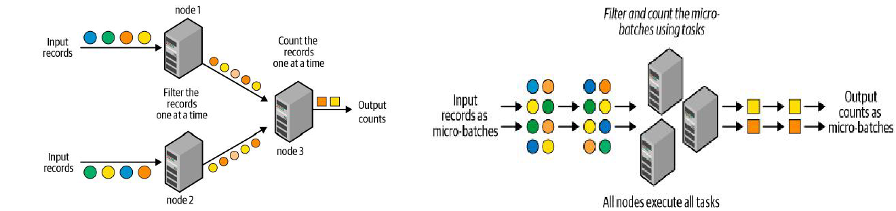
Evolution of Spark Stream Engine
Traditional Record-at-a-time Processing Model
Advent of Micro-Batch Stream Processing

Slide 22
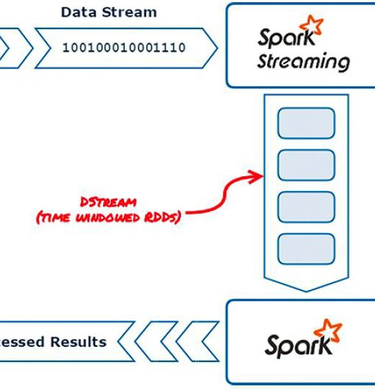
Spark Streaming Architecture
Discretized Steams (Dstreams)
  Batches if data stored in multiple RDDs
  Each batch represents a time window, typically in seconds
  The resultant RDDs can be processed using core Spark RDD API and all transformations

Slide 23
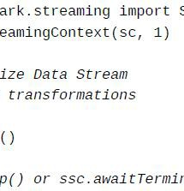
Creating a StreamingContext
StreamingContext: entry point
Start() to trigger evaluation of incoming data after establishing a StramingContext
Stop() or awaitTermination() to stop the StreamingContext programmatically

Slide 24
Introduction to DStreams
A Dstream represents a continuous sequence of RDDs created from a continuous stream of data, with each underlying RDD representing a time window within the stream
Created from streaming data sources such as TCP sockets, messaging systems, streaming APIs (such as the Twitter streaming API), and more
Also created from transformations performed on existing DStreams, such as map(), flatMap(), and other operations
DStreams support two types of operations:
Transformations
Output operations: analogous to RDD actions

Slide 25
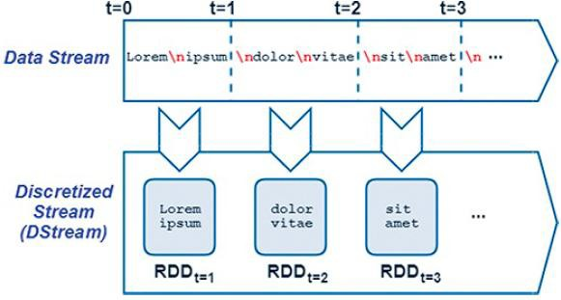
Spark Discretized Streams

Slide 26
DStream Sources
socketTextStream()
From an input TCP source defined by the hostname and port arguments
textFileStream()
By monitoring a directory from an instance of HDFS
Demo 25
Demo 26

Slide 27
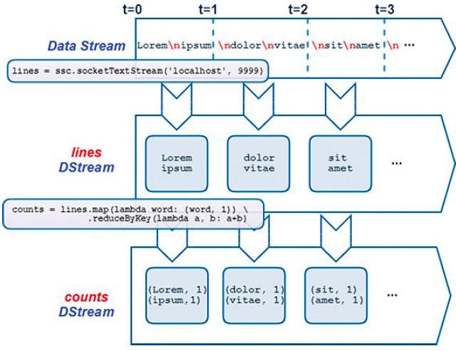
Dstream Transformations

Slide 28
DStream Lineage and Checkpoint
Maintained for fault tolerance much the same way that RDDs and DataFrames maintain their lineage
Checkpointing is often necessary because streaming applications are by definition long-lived applications
StreamingContext.checkpoint(directory)
Enables periodic checkpointing of DStream operations for durability and fault tolerance
DStream.checkpoint(interval)
Enable periodic checkpointing of RDDs of a particular Dstream
Demo 27

Slide 29
DStream Output Operations
DStream output operations write data, results, events, or other data to a console, a filesystem, a database, or another destination, such as a messaging platform like Kafka
DStream.pprint(num=10)
DStream.saveAsTextFiles(prefix, suffix-=None)
DStream.foreachRDD(func)

Slide 30
State Operations
Maintain state across batches of data, with the state updated as each new batch is processed
State DStreams are created and updated using the special updateStateByKey() transformation
DStream.updateStateByKey(updateFunc, numPartitions=None)
Demo 28

Slide 31
Sliding Window Operation
Look at aggregations over a specific window (the last hour or day)
window()
reduceByKeyAndWindow()

Slide 32
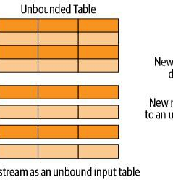
Structured Streaming
Fully integrated with DataFrame API
Streaming data sources are treated as an unbounded table that is continually appended to

Slide 33
Structured Streaming Data Sink
Each data item arriving on a stream is treated like a new record appended to a table, referred to as the Input Table
The output from a Structured Streaming operation is referred to as the
Result Table
Output from Structured Streaming operations is written out by the DataFrameWriter object
Output sinks in Spark’s Structured Streaming define where the Result Table is written to
  File Sink
  Console Sink
  Memory Sink

Slide 34
Output Modes
Where: output sinks
How: output modes
Append: Outputs only new rows added to the Result Table since the last trigger
Complete: Outputs the entire Result Table, including all updates and transformations, after each trigger
Update: Outputs only rows in the Result Table that have updated since the last trigger are output

Slide 35
Spark Use Cases
Processing in parallel large data sets distributed across a cluster
Performing adhoc or interactive queries to explore and visualize data sets
Building, training, and evaluating machine learning models using MLlib
Implementing end-2-end data pipelines from myriad streams of data
Analyzing graph data sets and social networks

Slide 36
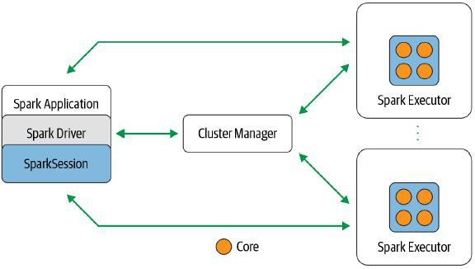
Revisit Components and Architecture

Slide 37
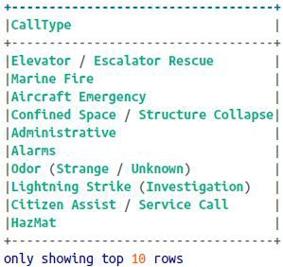

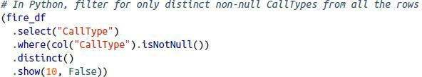
Revisit Transformations and Actions
Projections: select()
Filters: filter(), where()

Slide 38
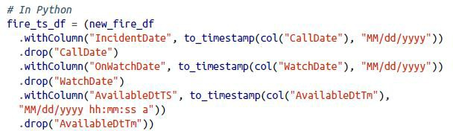
Transformations and Actions
Renaming: withColumnRenamed()
  Remember immutable?
  When we rename, we get a new DataFrame while retaining the original name
Change column data type
Adding
Dropping

Slide 39
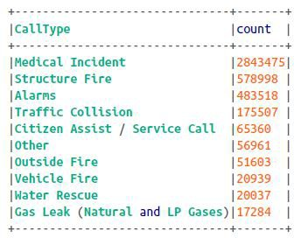
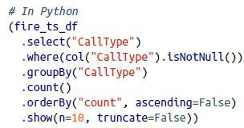
Transformations and Actions
Aggregation: groupBy(), orderBy(), count()

Slide 40

Transformations and Actions
collect()
  Returns a collection of all the Row objects in entire DataFrame or DataSet
  This is resource-heavy and dangerous for extremely large DataFrames
  take(n): peek at some row records and return pnly first n Row objects

Slide 41
Transformations and Actions
Aggregation: min(), max(), sum()
stat()
describe()
correlation()
covariance()
sampleBy()

Slide 42
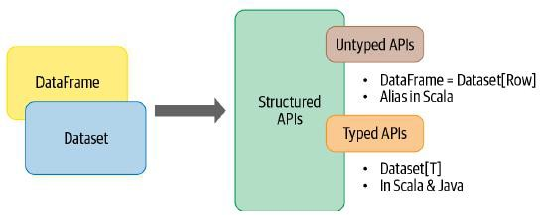
Dataset API
Typed and Untyped API
Datasets make sense only in Java and Scala, whereas in Python and R only DataFrames make sense
Python and R are not compile-time type-safe; types are dynamically inferred or assigned during execution, not during compile time

Slide 43
When to Use DataFrames
Rich semantics, high-level abstractions, and domain specific APIs
High-level expressions, filters, maps, aggregation, averages, sum, SQL queries, columnar access and use of lambda functions on semi- structured data
Unification and simplification of APIs across Spark Libraries
If you are a R user, use DataFrames
If you are a Python user, use DataFrames and resort back to RDDs if you need more control

Slide 44
DAY 5 — Docker + Spark + Airflow Integration
Goal: Build realistic production workflows
Container orchestration with Docker Compose
Airflow orchestration of Spark ETL jobs
PostgreSQL warehouse integration
Hands-on production-style pipeline deployment

Slide 45
Docker Compose Architecture
Services in the stack:
• Airflow Webserver
• Airflow Scheduler
• PostgreSQL Warehouse
• Mock API Service
• Spark / PySpark Runtime
Volumes persist warehouse and Airflow metadata
Networks allow service communication

Slide 46
Docker Networking and Volumes
Docker Networks:
• Containers communicate by service name
• Example: warehouse-postgres:5432
Docker Volumes:
• Persist PostgreSQL data
• Persist Airflow metadata
• Share DAGs and Spark jobs across containers

Slide 47
Airflow Triggering Spark Jobs
Airflow orchestrates Spark jobs using BashOperator
Example:
BashOperator(
task_id="run_spark_etl",
bash_command="python /opt/airflow/spark_jobs/api_to_postgres_spark.py"
)
Production orchestration pattern

Slide 48
DAY 6 — Real ETL Pipeline Project
Goal: Industry portfolio ETL pipeline
Pipeline:
API
↓
Spark Cleaning
↓
PostgreSQL Warehouse
↓
Airflow DAG

Slide 49
API Ingestion with Python
Use requests.get() to ingest external data
Example:
response = requests.get(API_URL)
payload = response.json()
Common API pipeline concepts:
• JSON payloads
• Authentication
• Pagination
• Error handling

Slide 50
Spark Data Cleaning Workflow
Spark transformations:
df_clean = df.dropna()
df_clean = df_clean.filter(col("amount") > 0)
Data quality improvements:
• Remove null records
• Filter invalid rows
• Standardize schemas
• Add ingestion timestamps

Slide 51
Load Data into PostgreSQL
Warehouse loading using JDBC
Example:
df.write.jdbc(
url=WAREHOUSE_JDBC_URL,
table="cleaned_sales_events"
)
Supports scalable warehouse loading

Slide 52
Airflow DAG ETL Flow
DAG Tasks:
1. check_services
2. run_spark_etl
3. verify_warehouse_tables
Benefits:
• scheduling
• monitoring
• retries
• logging
• dependency management

Slide 53
Production ETL Best Practices
Use Docker for reproducible environments
Use Airflow for orchestration and monitoring
Use Spark for scalable data transformation
Store clean data in warehouse tables
Version control with GitHub
Add logging and data quality validation
Monitor failures through Airflow logs

