Slide 1




Intro To Python For Data Analysis
Week 4 Plotting a Map

Slide 2
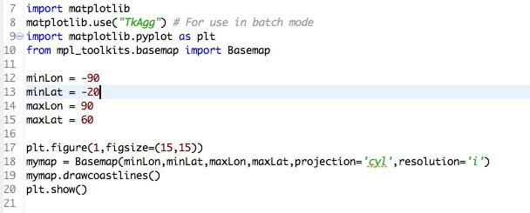
Plotting a Map
Plotting a Map!

Slide 3
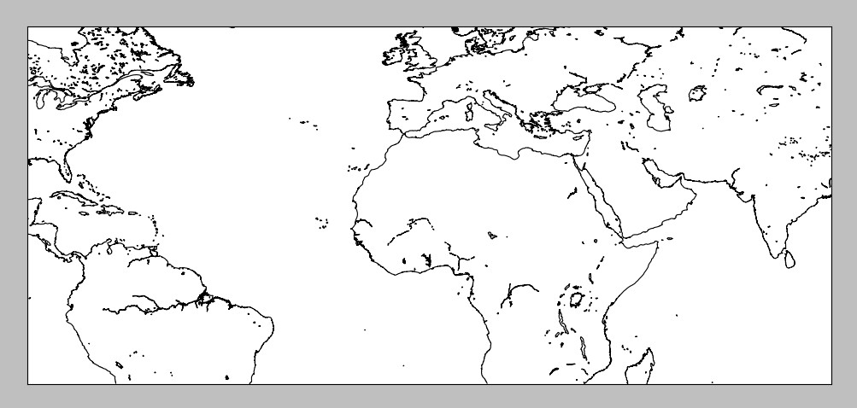
Plotting a Map
Look, it’s a map!

Slide 4
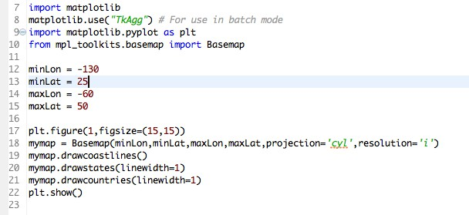
Plotting a Map
Plotting the United States

Slide 5
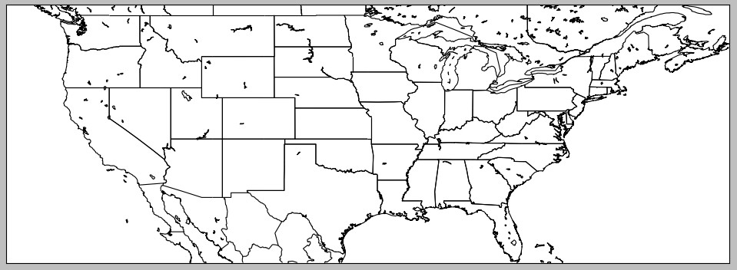
Plotting a Map

Slide 6
Plotting a Map
SUCCESS!

Slide 7
Intro To Python For Data Analysis
Week 4 Plotting a Map

Slide 8
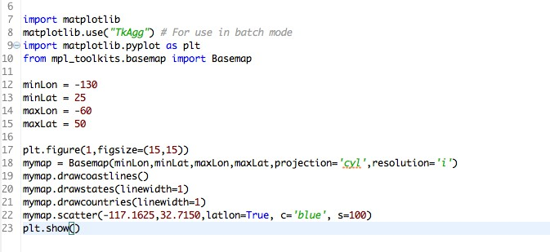
Plotting a Map
Plotting scatter data on a map!

Slide 9
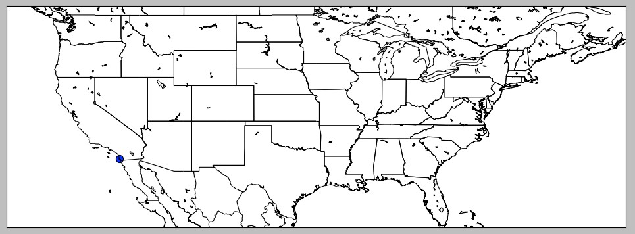
Plotting a Map

Slide 10
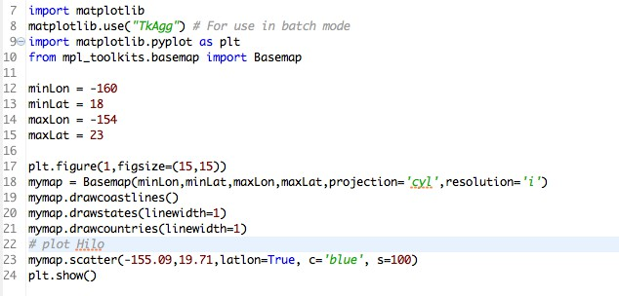
Plotting a Map
Plotting Hawaii with a dot on Hilo

Slide 11
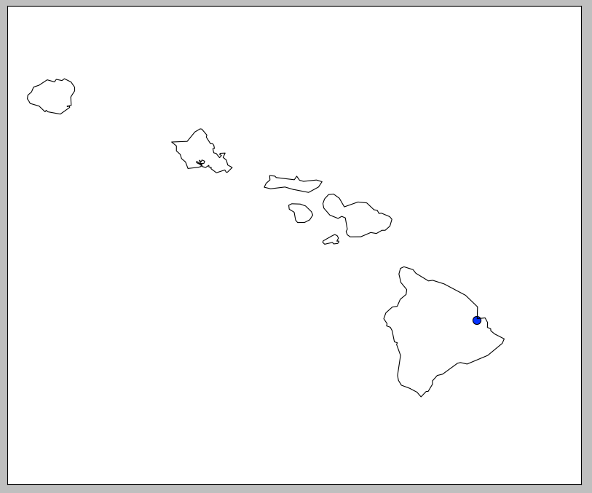
Plotting a Map

Slide 12
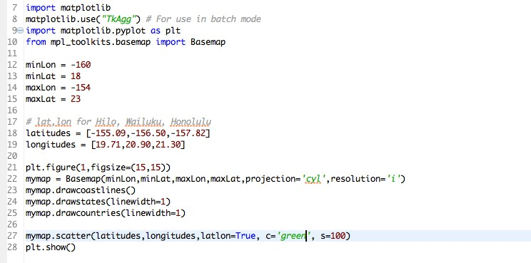
Plotting a Map

Slide 13
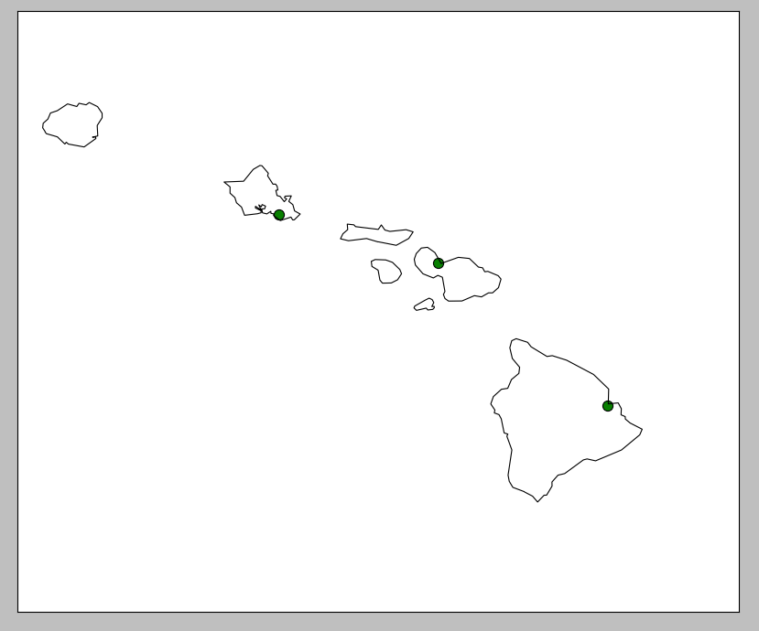
Plotting a Map

Slide 14
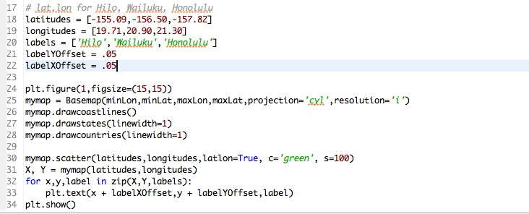
Plotting a Map

Slide 15
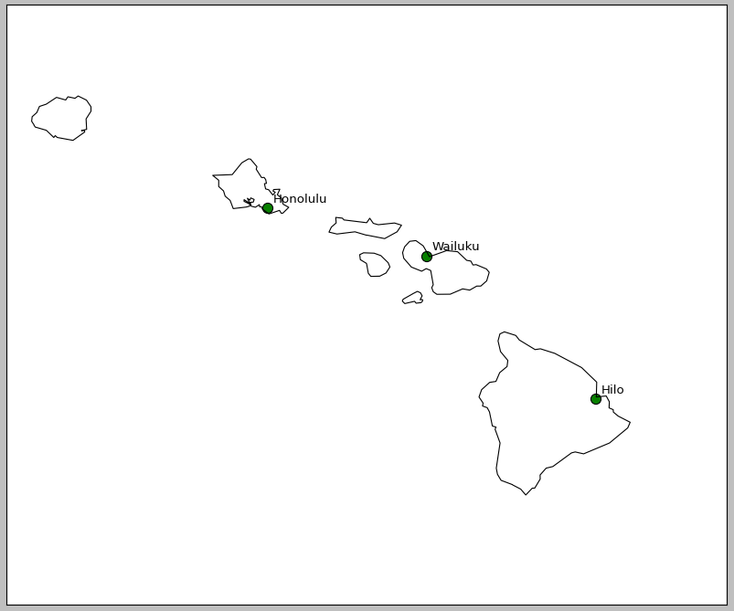
Plotting a Map

Slide 16
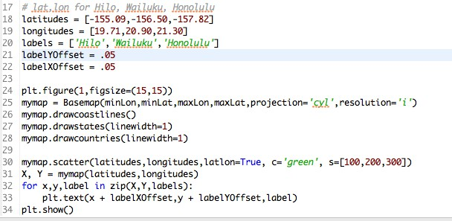
Plotting a Map

Slide 17
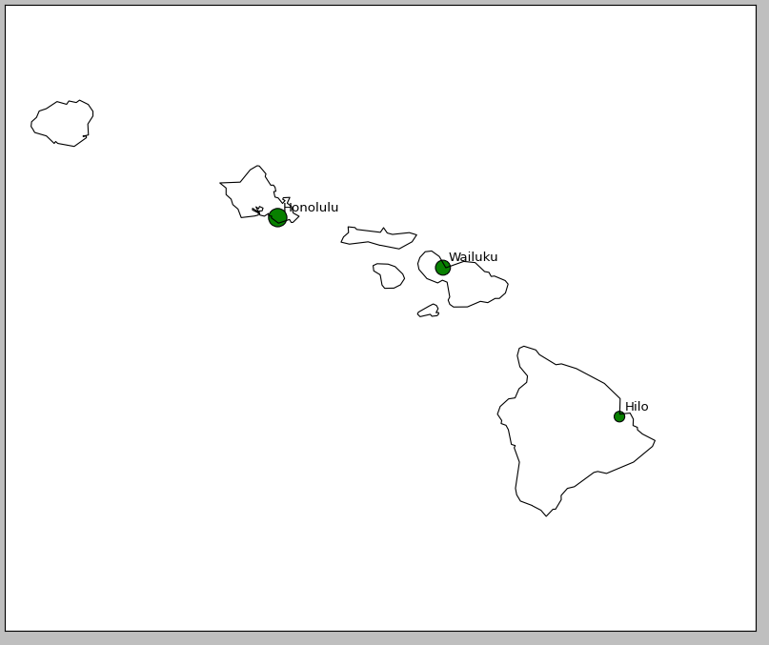
Plotting a Map

