Slide 1



Intro To Python For Data Analysis
Week 1 Overview

Slide 2
What will we do this week?
Install Python 3.X (with the Anaconda Distribution)
Intro to Jupyter Notebooks
Review Material From Intro To Programming With Python (This week and next week)
Variables
Flow Control
Functions
File I/O

Slide 3
What will we do this week?
You will see videos with the title Intro To Programming With Python – we are borrowing material from that course.
Intro To Programming With Python is a 7 week course, we are cramming review into 2 weeks.

Slide 4

What will we do this week?
That’s it, let’s go!

Slide 5
What is Anaconda
Anaconda is a free Python distribution including all the most popular python packages for data-science.
Hassle free installation!

Slide 6
What is Anaconda
1. What if I already have Python installed?

Slide 7
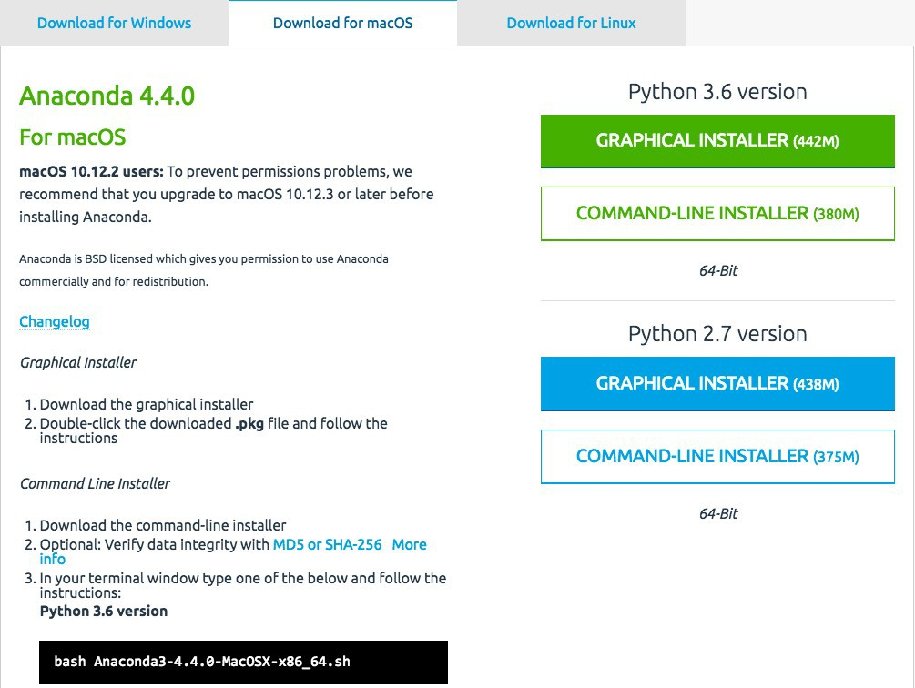

Installing Anaconda
1. Go to: http://continuum.io/downloads

Slide 8
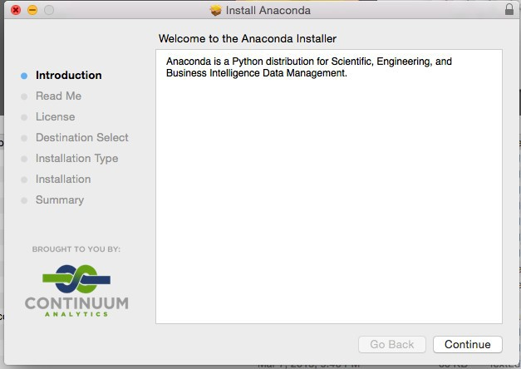
Installing Anaconda
1. Open the downloaded package

Slide 9
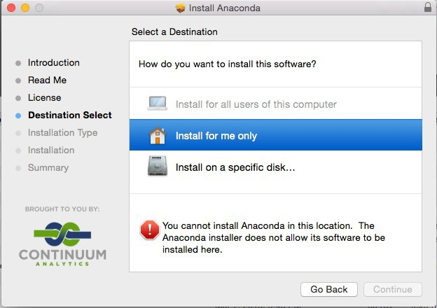
Installing Anaconda
1. Note this error below.

Slide 10
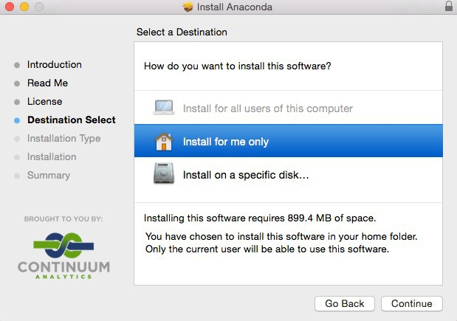
Installing Anaconda
1. Just click on the “Install for me only” selection.

Slide 11
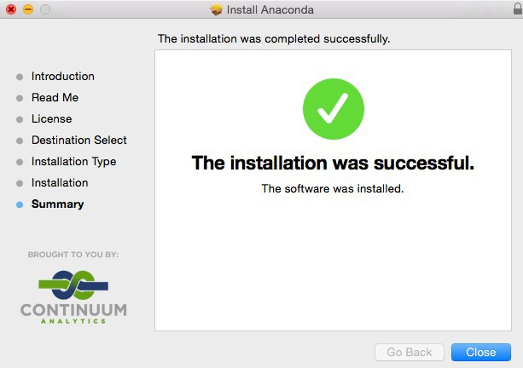
Installing Anaconda
1. Proceed to complete install.

Slide 12
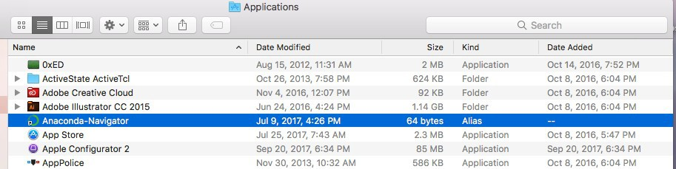
Check the Installation
1. Find the Anaconda Navigator

Slide 13
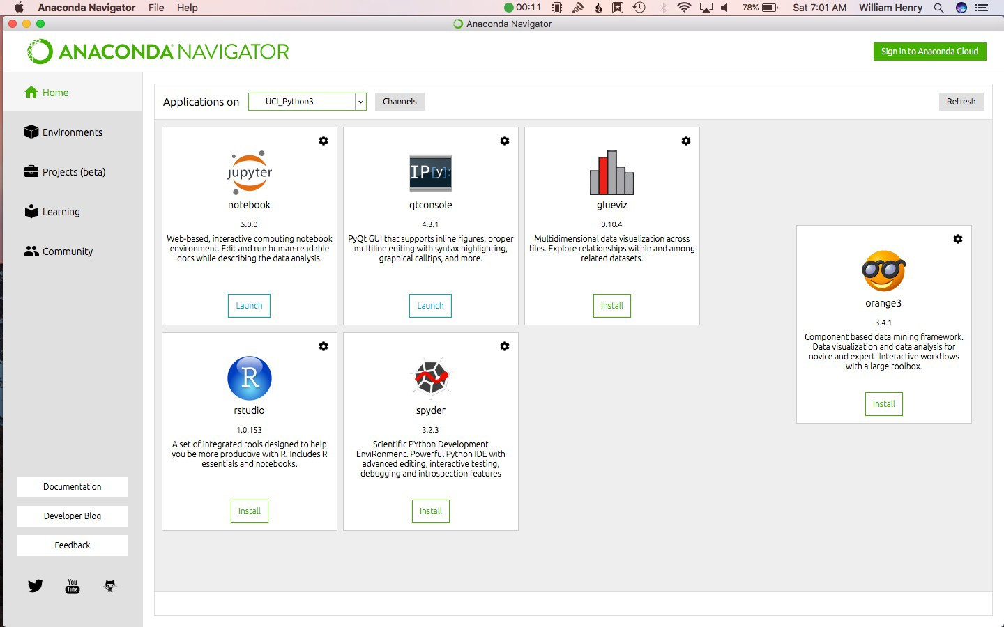
Check the Installation
1. Open Anaconda Navigator

Slide 14
Check the Installation
SUCCESS!

Slide 15
Intro To Python For Data Analysis
Jupyter Basics

Slide 16
What is Jupyter?
“The Jupyter Notebook is an open-source web application that allows you to create and share documents that contain live code, equations, visualizations and explanatory text. Uses include: data cleaning and transformation, numerical simulation, statistical modeling, machine learning and much more.” – jupyter.org
An easy environment to learn python in.
Excellent for data exploration and prototyping.
Julia – Python - R

Slide 17
Opening Jupyter
1. Open the Anaconda Navigator

Slide 18
Opening Jupyter
1. Click “Launch” in the Jupyter Notebook Square

Slide 19
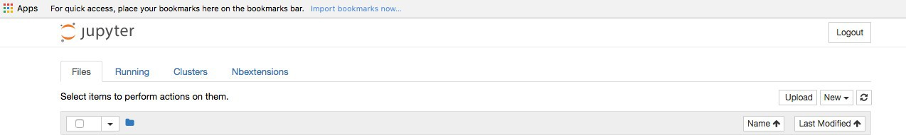
Creating a Notebook
This is what you should see:
Now, click on ‘New’ and select ‘Python 3’
You just created a new Jupyter notebook.

Slide 20
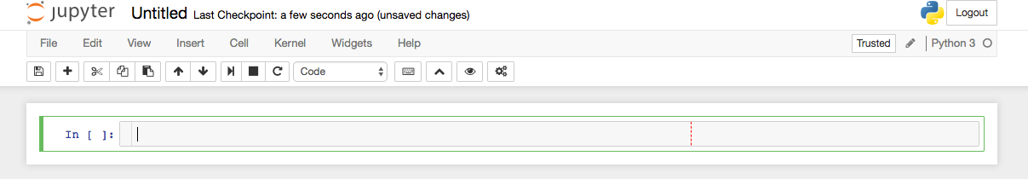
Creating a Notebook
Now, let’s change the title.
Click on Untitled and type in ‘My First Notebook’

Slide 21
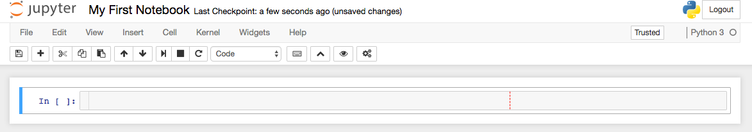
Creating a Notebook
You should now see this:

Slide 22
Jupyter Basics
SUCCESS!

Slide 23
Intro to Programming with Python
Jupyter Basics

Slide 24
Jupyter Basics
In this lecture we will learn:
What a cell in a notebook is
How to switch from edit mode to command mode
How to create a cell
How to delete a cell
How to execute a cell

Slide 25

Jupyter Basics
Open the notebook we created in the last lecture:
This is a cell
Click on it once to highlight it
Press ‘enter’ to go into edit mode. There will now be a blinking cursor in the cell and you can type in it

Slide 26
Jupyter Basics
Now hit ‘esc’ to exit edit mode. You are now in command mode
Type ‘a’ to create a cell above the one currently selected
Type ‘b’ to create a cell below the one currently selected
Type ‘d’ twice to delete the cell you have currently selected
Press control-enter to execute a cell
Let’s watch me do this in real time, feel free to follow along

Slide 27
Jupyter Basics
SUCCESS!

Slide 28
Intro to Programming with Python
Python Documentation and Stackoverflow

Slide 29
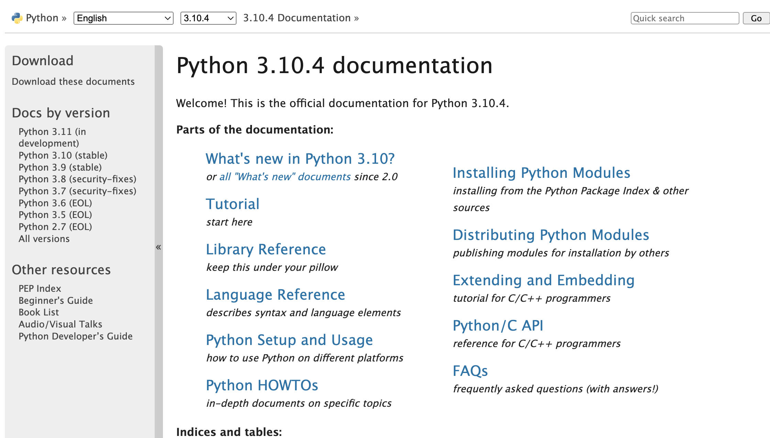
1. Go here: https://docs.python.org/3.10.4/

Slide 30
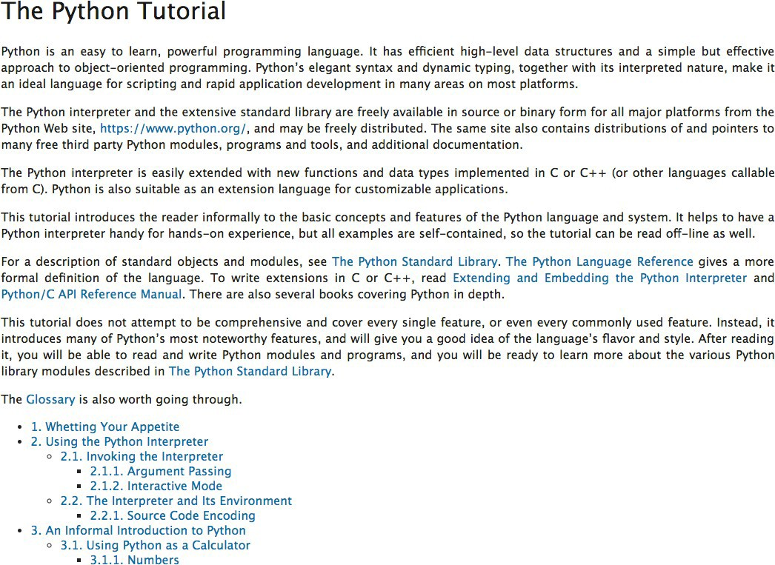
Python Documentation

Slide 31
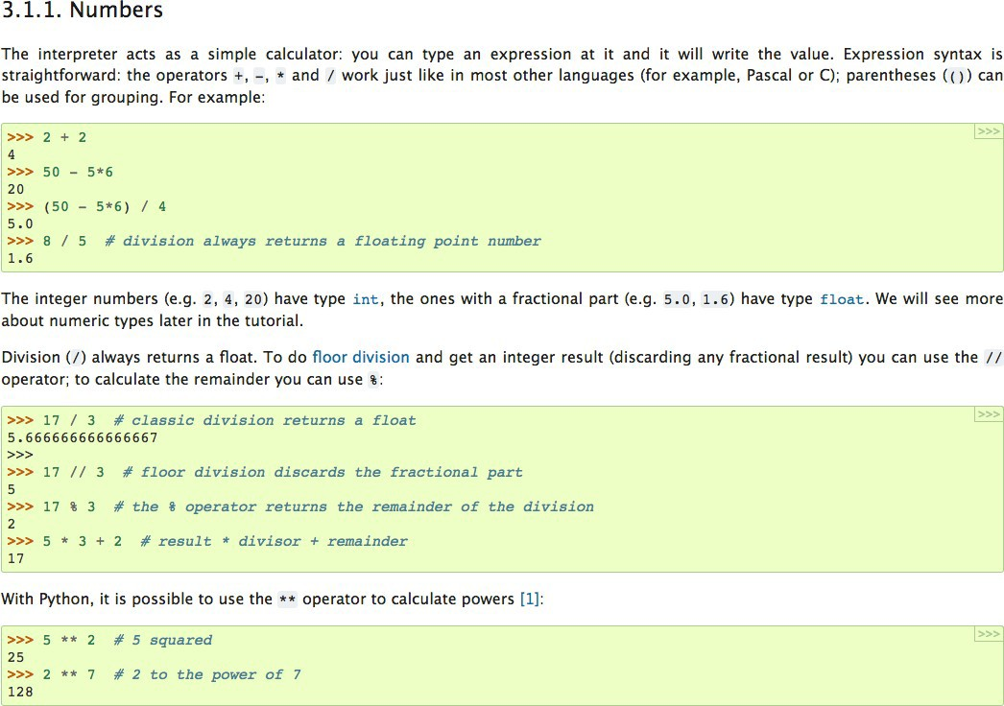
Python Documentation

Slide 32
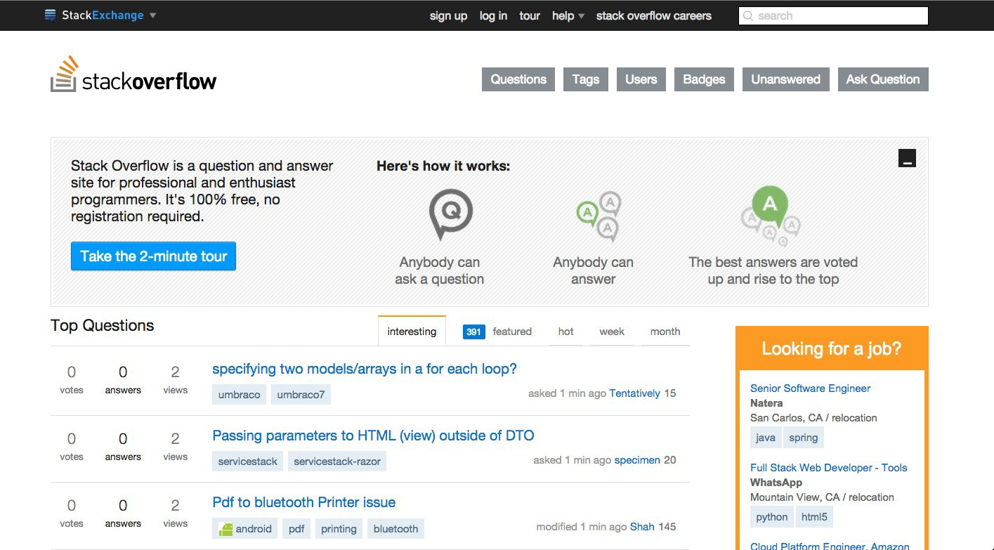
Stackoverflow
Go to: http://stackoverflow.com/

Slide 33
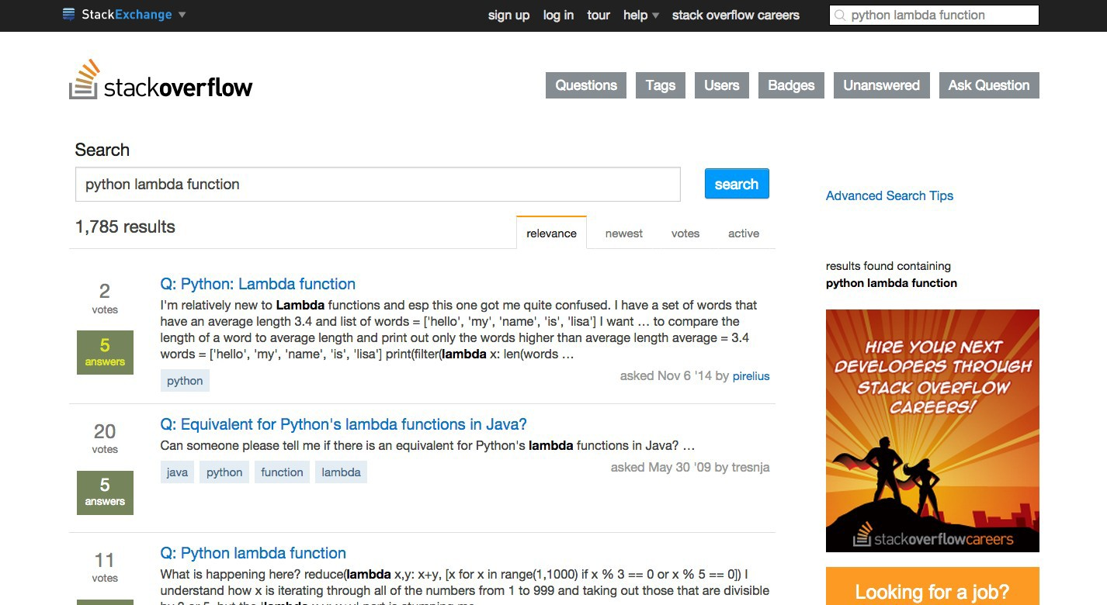
Stackoverflow

Slide 34
Success
SUCCESS!

