Slide 1



Intro To Python For Data Analysis
Jupyter Basics

Slide 2
What is Jupyter?
“The Jupyter Notebook is an open-source web application that allows you to create and share documents that contain live code, equations, visualizations and explanatory text. Uses include: data cleaning and transformation, numerical simulation, statistical modeling, machine learning and much more.” – jupyter.org
An easy environment to learn python in.
Excellent for data exploration and prototyping.
Julia – Python - R

Slide 3
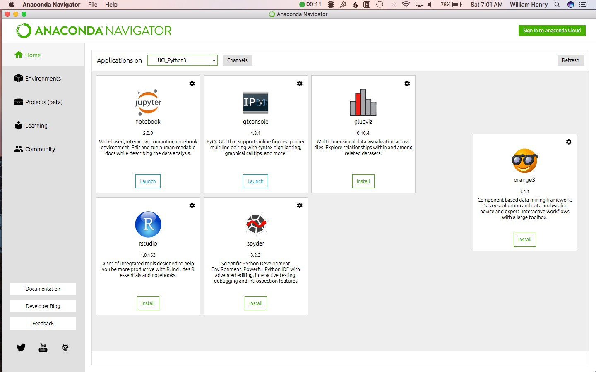
Opening Jupyter
1. Open the Anaconda Navigator

Slide 4
Opening Jupyter
1. Click “Launch” in the Jupyter Notebook Square

Slide 5
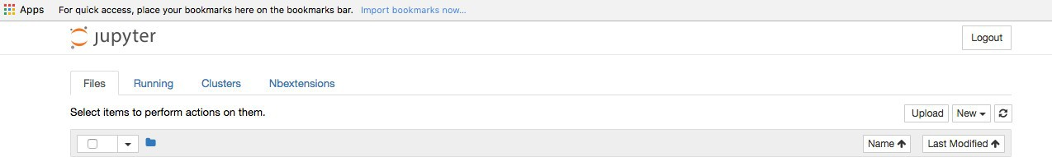
Creating a Notebook
This is what you should see:
Now, click on ‘New’ and select ‘Python 3’
You just created a new Jupyter notebook.

Slide 6
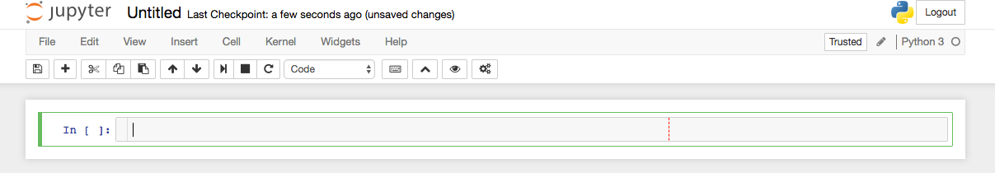
Creating a Notebook
Now, let’s change the title.
Click on Untitled and type in ‘My First Notebook’

Slide 7
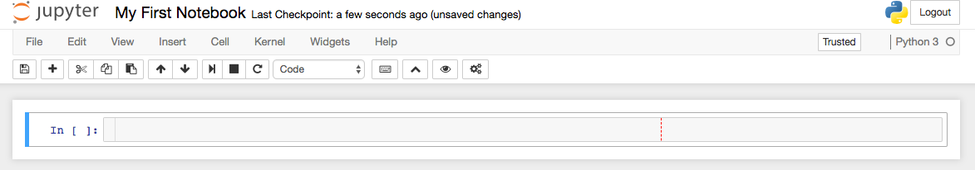
Creating a Notebook
You should now see this:

Slide 8

Jupyter Basics
SUCCESS!

