Slide 1



Intro to Programming with Python
Python Documentation and Stackoverflow

Slide 2
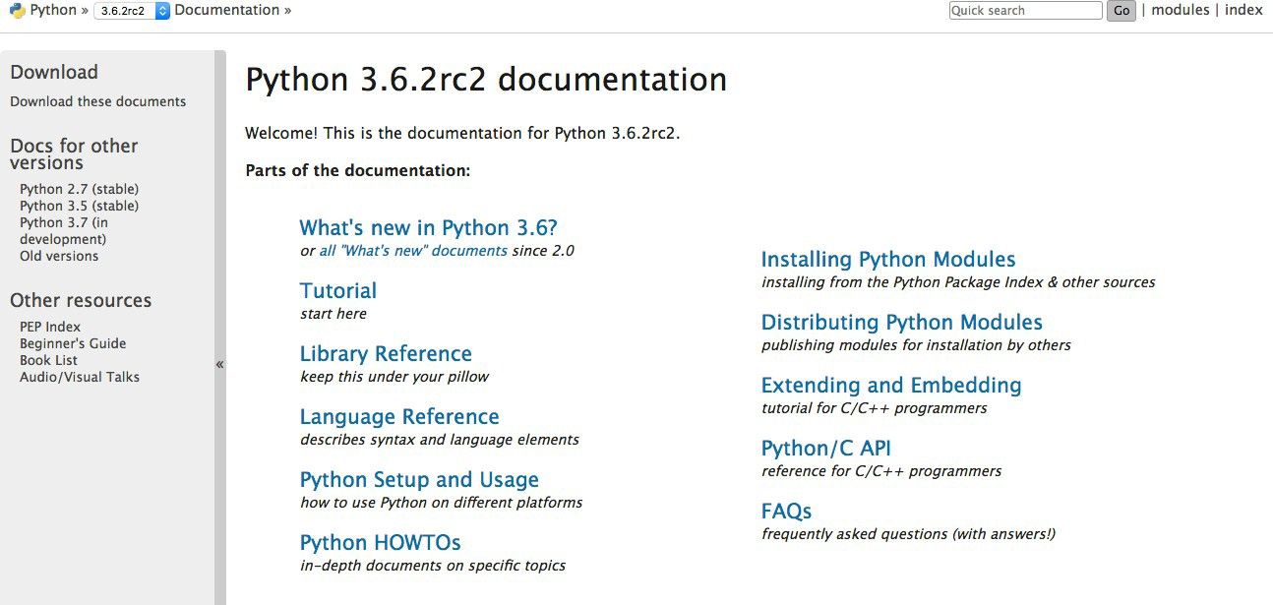
What/Where is the Python Documentation
1. Go here: https://docs.python.org/3.6/

Slide 3
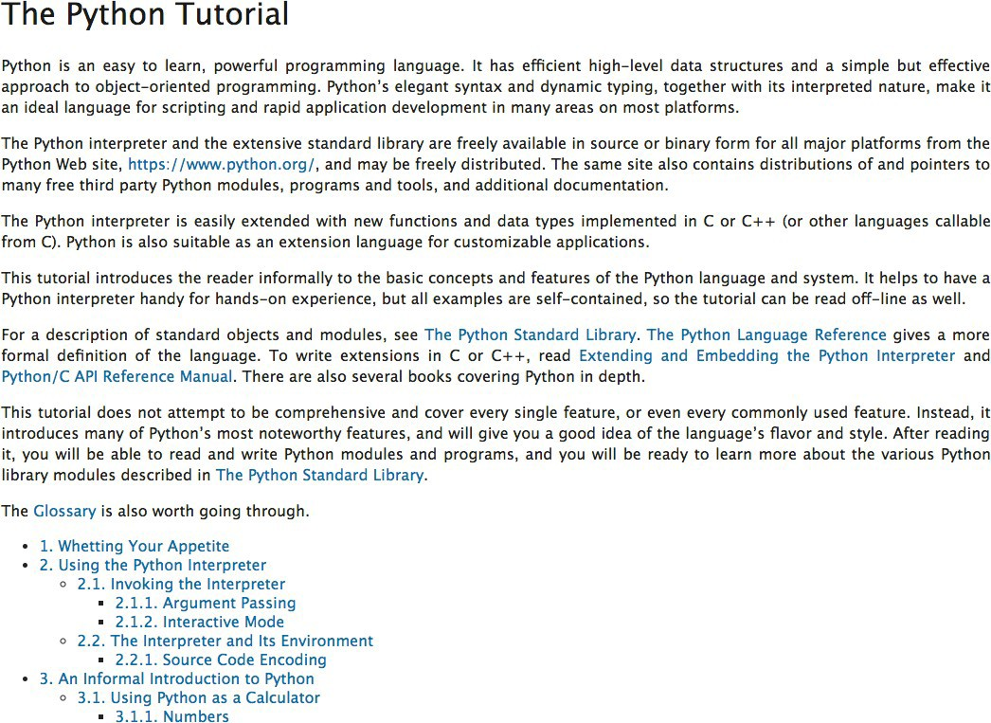
Python Documentation

Slide 4
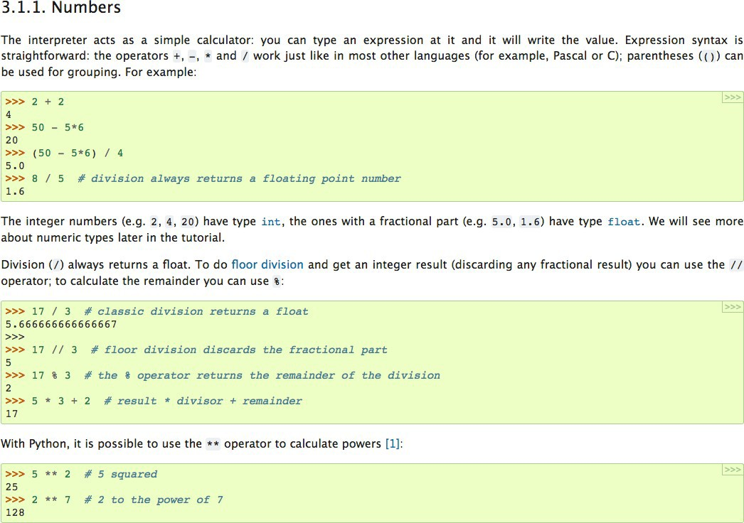
Python Documentation

Slide 5
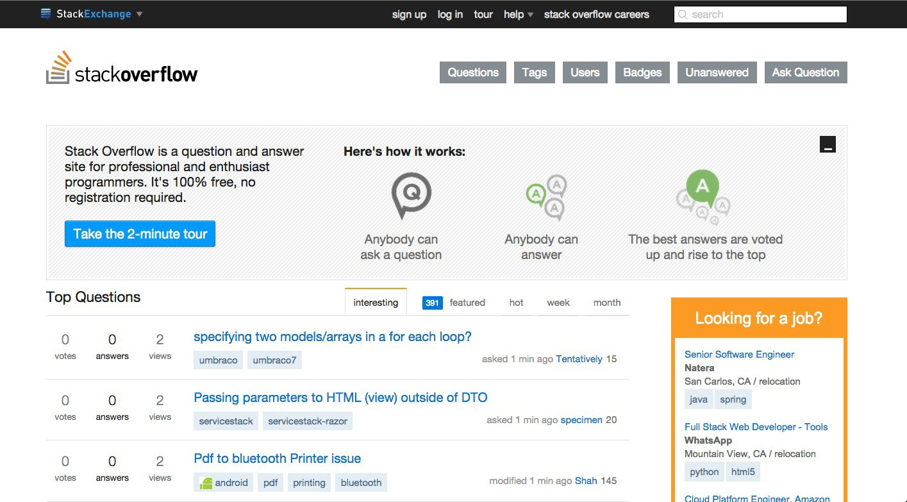
Stackoverflow
Go to: http://stackoverflow.com/

Slide 6
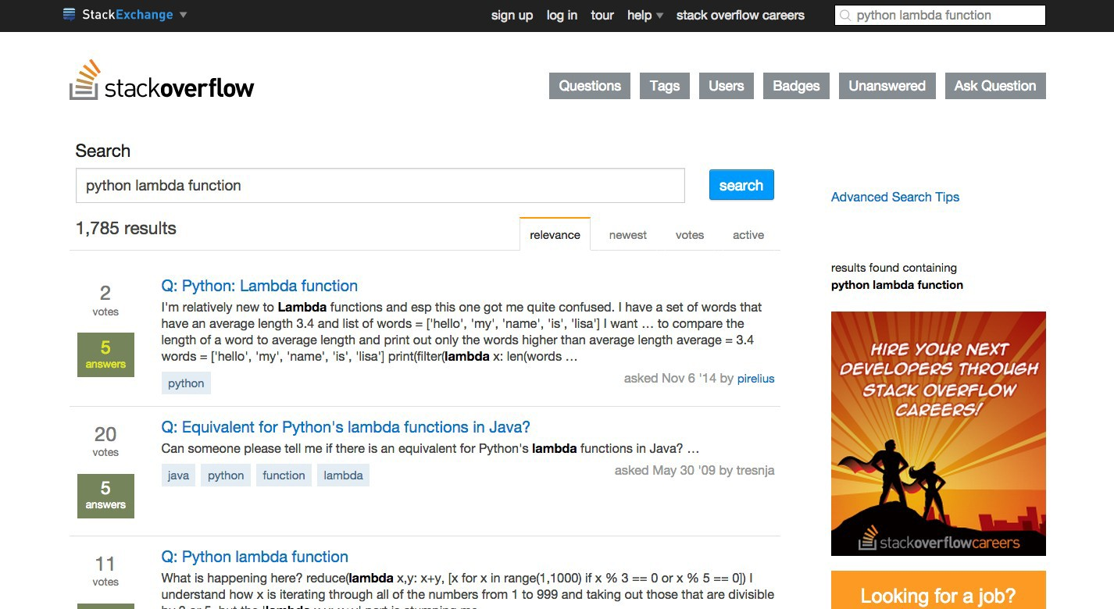
Stackoverflow

Slide 7
Success
SUCCESS!

