Slide 1

Virtual Session 2
Introduction and Environment Setup
Univariate Analysis/Descriptive Analytics
Multivariate Analysis/Diagnostic Analytics
Networks and Spatial Analytics/Descriptive + Diagnostic Analytics
Time Series Analysis
Interactive Visual Analytics
Storytelling + Prescriptive Analytics
Advanced Topics

Slide 2

Agenda
Data explanation
Tableau topics
Univariate analysis assignment

Slide 3
Agenda
Data explanation
Tableau topics
Univariate analysis assignment

Slide 4
Data
SP500_sector_data.csv:
Flat file contains OHLC data for stock market sector ETF data.

Slide 5
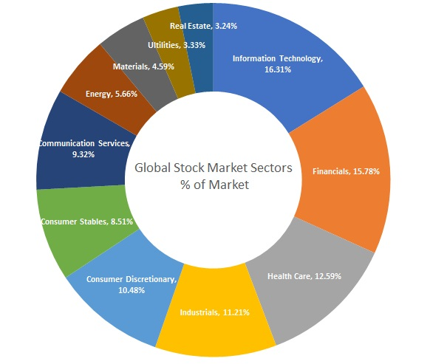
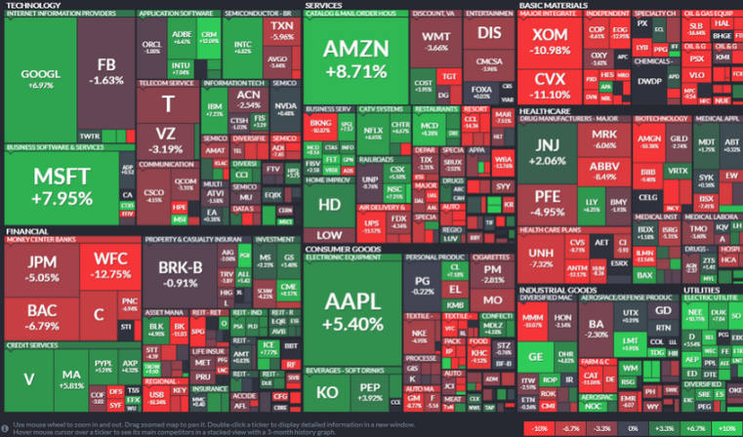
Sectors
US stock market sectors
ETF proxy for sectors as indices
Notes:
exchange traded funds (ETFs)

Slide 6
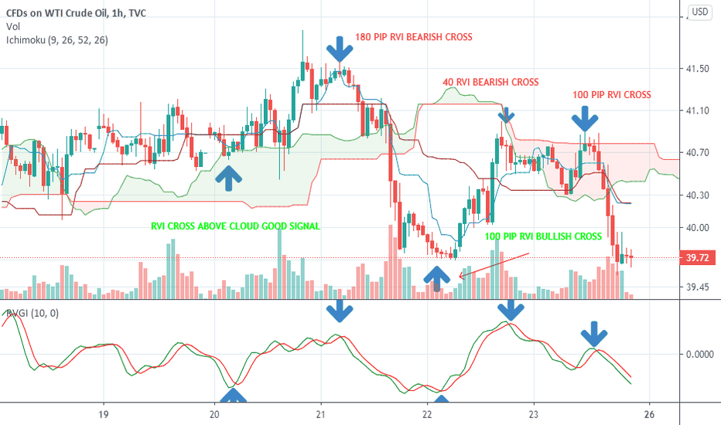
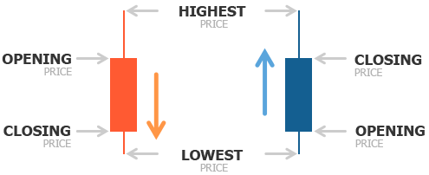
Fields
Symbol
Date (Trading day)
Open, High, Low, Close, Adjusted Close
Log Return (calculated from adjusted close)

Slide 7
Why use returns?
Normalization
Required for comparative analysis
Required for multivariate analysis (next module)

Slide 8
Why use log returns?
Simple returns:
Asymmetric range [-100%, ∞)
Easy to understand
Log returns:
Symmetric range (-∞, ∞)
For very short durations, log returns and simple returns are close to equal (approximate raw-log equality)
Easy to calculate aggregations over time periods (time-additivity)
Appear normally distributed which makes for easier modelling (sum of normally distributed variables is also normal)

Slide 9

Reference: Simple vs Log Return
Simple return:
$$r_{t}=\frac{P_{t}}{P_{t−1}}−1$$
Log return:
$$R_{t}=\ln\left(1+r_{t}\right)$$

Slide 10

Reference: Total Log Returns
Logarithmic rate of return (continuously compounded return):
One period return: $R_{t}=\ln\left(\frac{P_{t}}{P_{t−1}}\right)=\ln\left(P_{t}\right)−ln⁡(P_{t−1})$
Total return over periods 1 to n:
$R_{total}=\sum_{i=1}^{n}{R_{i}}=R_{1}+R_{2}+ …+R_{n}$

Slide 11

Reference: Average Log Returns
Average return
Arithmetic:
$\overline{R}=\frac{1}{n}\sum_{i=1}^{n}{R_{i}}=\frac{1}{n}(R_{1}+…+R_{n})$
Geometric:
$$\sqrt[n]{\prod_{i=1}^{n}{(1+R_{i})}}−1 =\sqrt[n]{\left(1+R_{1}\right)∗…∗\left(1+R_{n}\right)}−1$$

Slide 12

Reference: Log Returns to Simple Return
Converting log return to simple return
$$r_{t}=e^{ln⁡(1+R_{t})}−1$$

Slide 13
Agenda
Data explanation
Tableau topics
Univariate analysis assignment

Slide 14
Tableau Topics
Data Types
Data Relationships
Visualization Parameters
Filters
Chart parameters
Formatting
Pages
Table calculations

Slide 15
Agenda
Data explanation
Tableau topics
Univariate analysis assignment

Slide 16
Questions to ask pre-analysis
Who is the audience?
What are the assumptions?
What is the objective?

Slide 17
Questions to ask pre-analysis
Who is the audience?
Market analysts, reporters, economists, investment managers, quants, traders, or other?
What are the assumptions?
What is the objective?

Slide 18
Questions to ask pre-analysis
Who is the audience?
What are the assumptions?
Clean, complete, and tidy data
Format
Frequency, granularity, date exceptions
Adjusted close and log returns are calculated correctly
What is the objective?

Slide 19
Questions to ask pre-analysis
Who is the audience?
What are the assumptions?
What is the objective?
Understand statistical properties
Hone feature space representation via transformations, data wrangling, etc.
Evaluate completeness of the dataset to capture ground truth
Consider potential modeling methods for diagnostic and predictive analysis

Slide 20
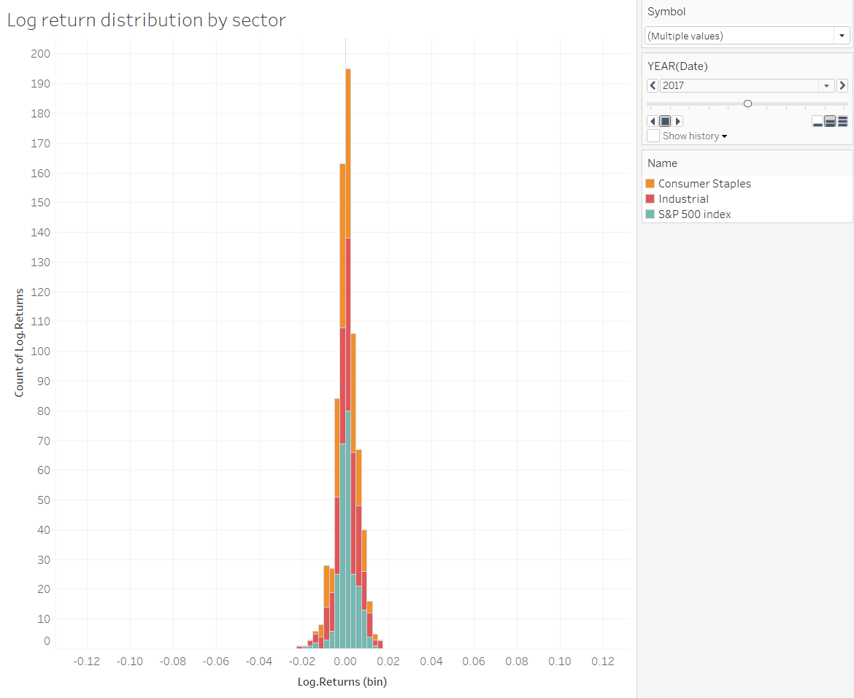
Question 1
Distribution of log returns. Create a filter that allows the user to view one or more distributions at the same time (e.g., one or more sectors and/or the SP500). This can be on the same graph or in faceted graphs. Add a page control to show how the distributions evolve year by year.

Slide 21
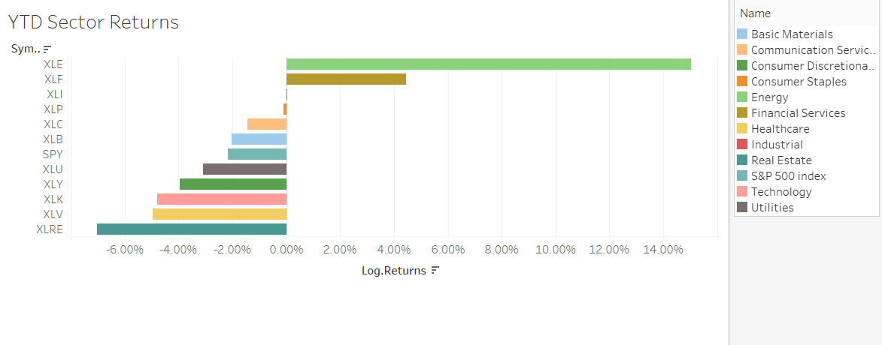
Question 2
Bar graph rankings of the year-to-date sector returns (from start of 2022 to most recent data point) sorted from best to worst. Include the S&P 500 index in the graph.

Slide 22
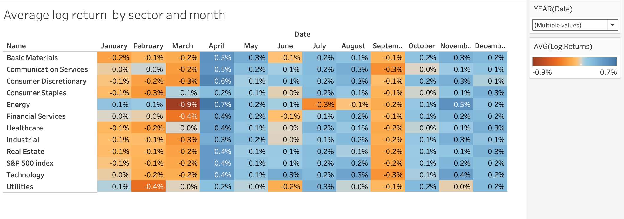
Question 3
Heatmap table showing average returns grouped by month for all sectors and the S&P 500. Use a dropdown to select the sector or index. Create a filter allowing the user to filter by years.

Slide 23
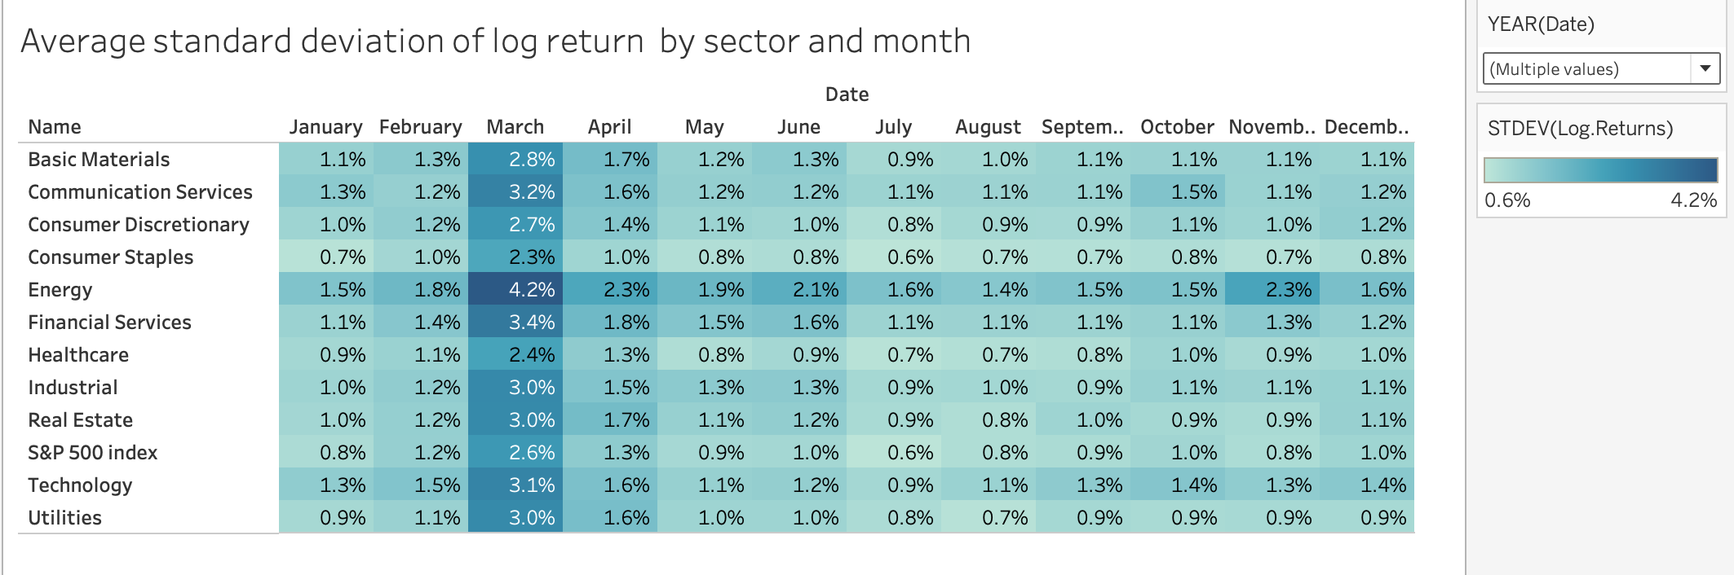
Question 4
Heatmap table showing average standard deviation of returns grouped by month for any sectors and the S&P 500 (use a dropdown to select the sector or index). Create a filter allowing the user to filter by years.

Slide 24
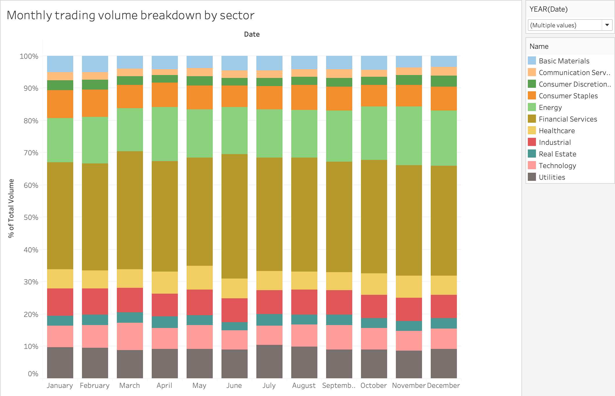
Question 5
Create a proportions plot that expresses the percentage of trading volume by sector grouped by month (make sure to exclude the S&P 500 index in the calculations). Create a filter allowing the user to filter by years.
To generate the percentile bar chart:
Select the total percentage.
Choose the table option (dropdown).

Slide 25
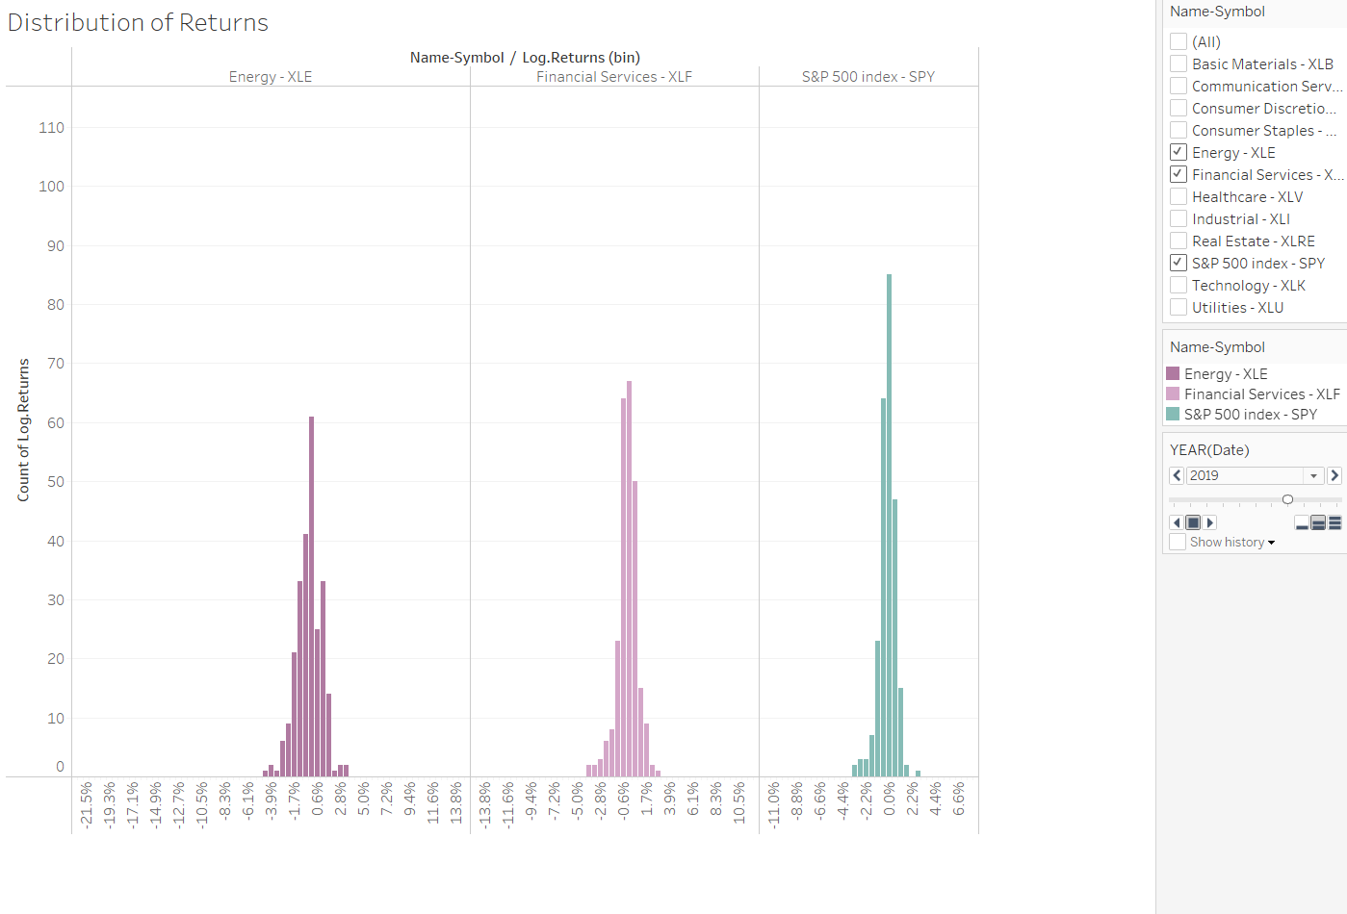
Question 1
Distribution of returns. Create a filter that allows the user to view one or more distributions at the same time (e.g., one or more sectors and/or the SP500). This can be on the same graph or in faceted graphs. Add a page control to show how the distributions evolve year by year.

Slide 26
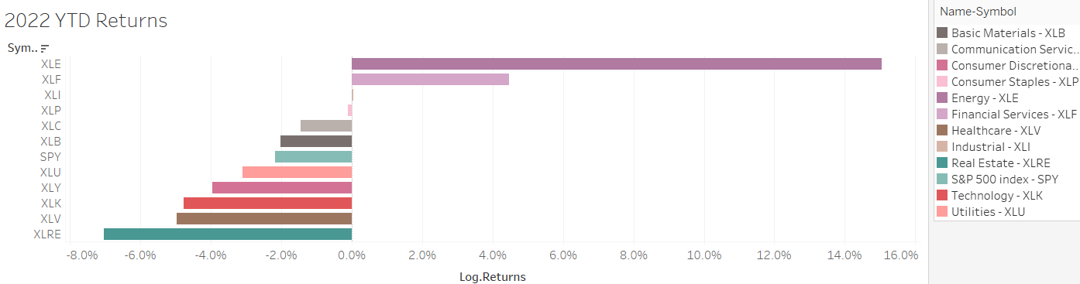
Question 2
Bar graph rankings of the year-to-date sector returns (from start of 2022 to most recent data point) sorted from best to worst. Include the S&P 500 index in the graph.

Slide 27
Question 3
Heatmap table showing average returns grouped by month for all sectors and the S&P 500. Use a dropdown to select the sector or index. Create a filter allowing the user to filter by years.

Slide 28
Question 4
Heatmap table showing average standard deviation of returns grouped by month for any sectors and the S&P 500 (use a dropdown to select the sector or index). Create a filter allowing the user to filter by years.

Slide 29
Question 5
Create a proportions plot that expresses the percentage of trading volume by sector grouped by month (make sure to exclude the S&P 500 index in the calculations). Create a filter allowing the user to filter by years.

