Slide 1

Virtual Session 6
Introduction and Environment Setup
Univariate Analysis/Descriptive Analytics
Multivariate Analysis/Diagnostic Analytics
Networks and Spatial Analytics/Descriptive + Diagnostic Analytics
Time Series Analysis
Interactive Visual Analytics
Storytelling + Prescriptive Analytics
Advanced Topics

Slide 2
Announcements
Module 7 project description has been posted. This will give you additional time for the final project. Module 6-8 assignments are all related.

Slide 3
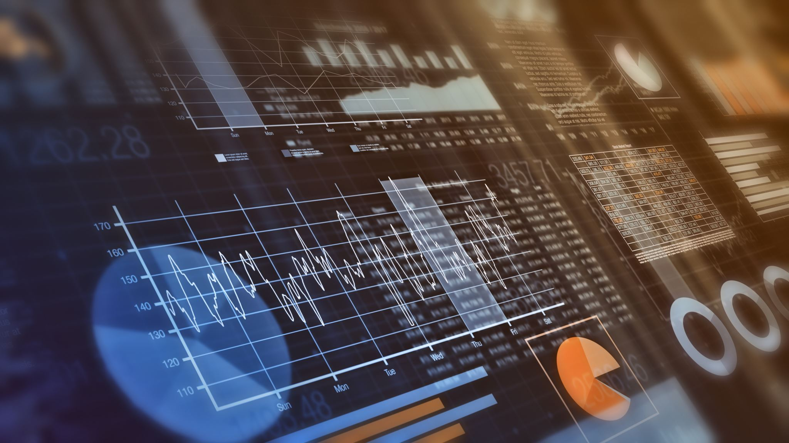
Agenda
Review of Module 5 Assignment
Overview of Module 6 Assignment
Overview of Capstone Projects

Slide 4
Agenda
Review of Module 5 Assignment
Overview of Module 6 Assignment
Overview of Capstone Projects

Slide 5
Agenda
Review of Module 5 Assignment
Overview of Module 6 Assignment
Overview of Capstone Projects

Slide 6
Module 6: The Dashboard Challenge
In order to monitor what is happening in the financial markets and the economy, you will create a descriptive analytics dashboard to keep track of the changes in the S&P 500 market performance:
What happened in the financial markets (to the S&P 500 index and each sector) in absolute terms and in terms of change from the previous period? (Previous period could be day, month, quarter or year.)
What happened in the economic data by month, quarter, or year in terms of change from the previous period? Use an appropriate reporting frequency.
3 additional visualizations. For these visualizations, state:
What the question and purpose(s) of the visualization are hoping to answer or show?
What calculations or transformations were necessary?
What is the focal point of the graph?

Slide 7
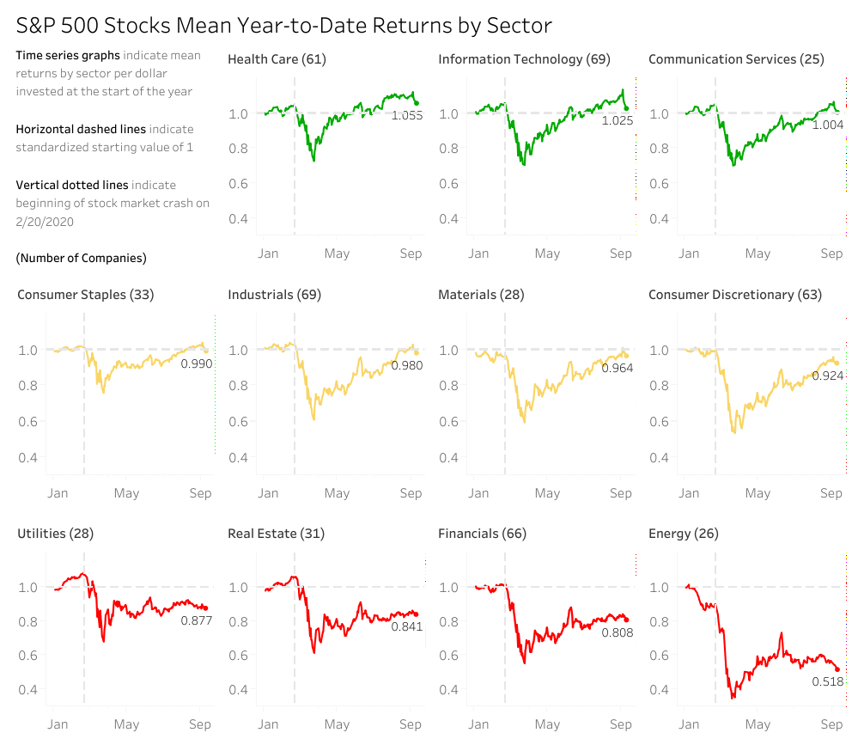
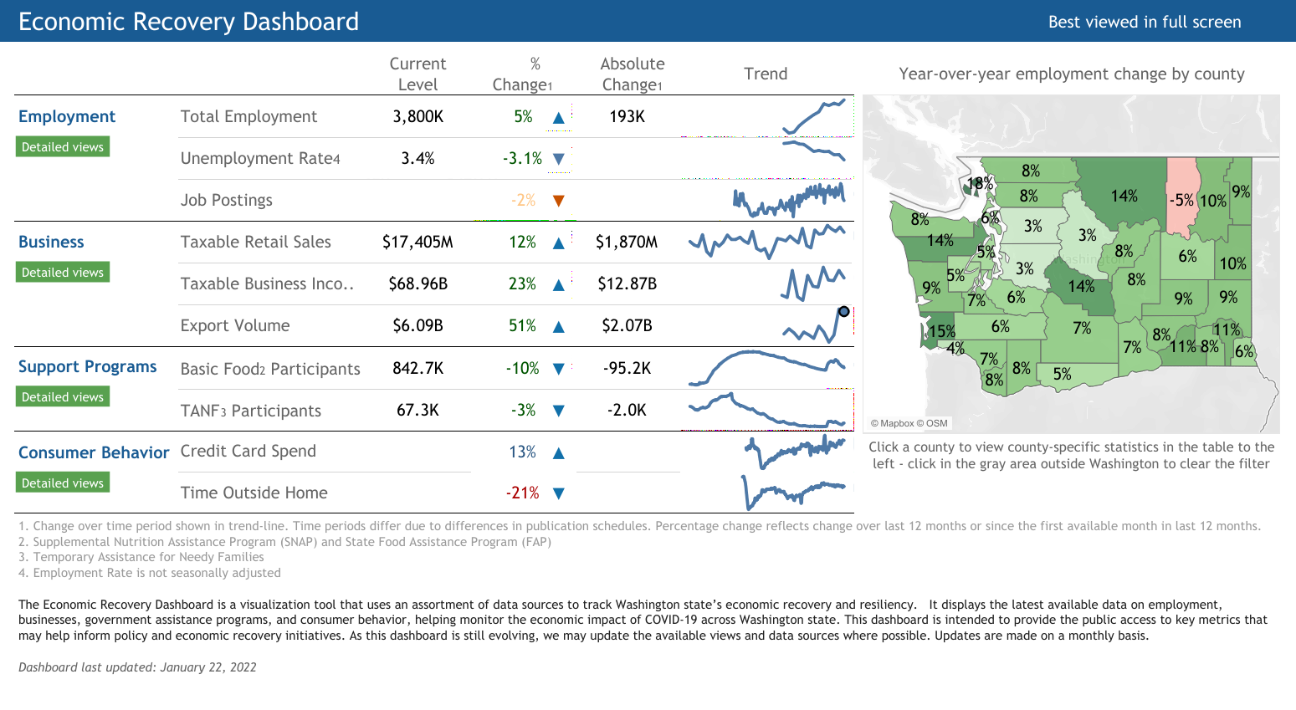
Macroeconomic and financial dashboard
https://public.tableau.com/app/profile/jerald1726/viz/YTDstockviz1/Dashboard1
https://public.tableau.com/app/profile/commerceeconomicdashboard/viz/EconomicRecoveryDashboard_15990778138680/Primarydashboard
Explore more ideas at:
https://public.tableau.com/app/search/vizzes

Slide 8
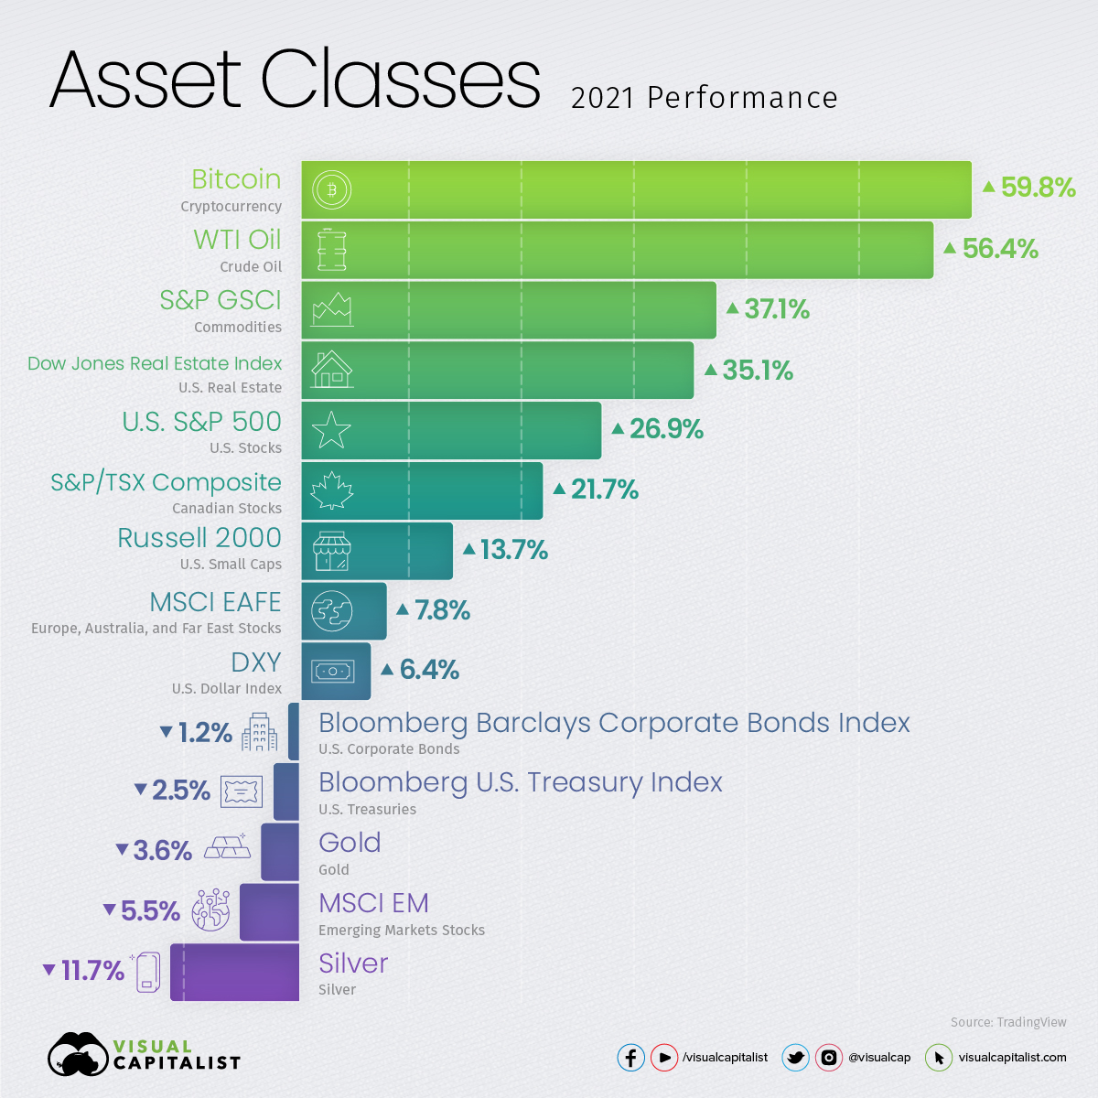
Visual design
The audience for the dashboard is now much broader. Pay particular attention to the design of the visualizations and limit complex interactions.

Slide 9
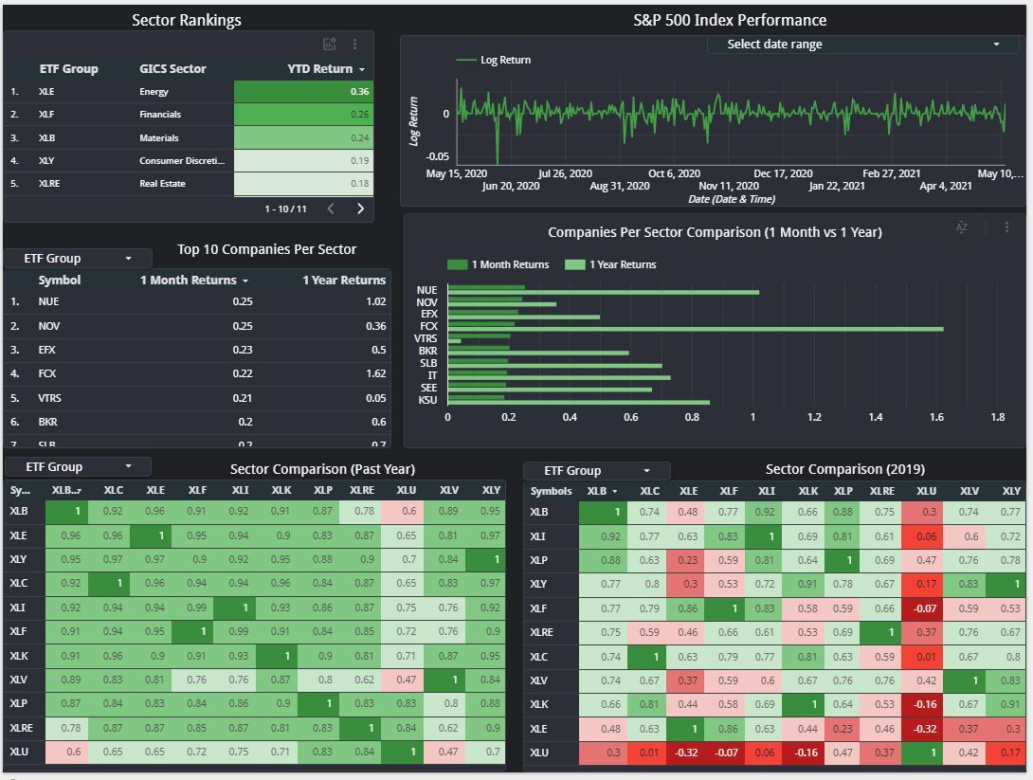
Example
Sector performance and the top 10 constituent companies in each sector by return performance
Past student submission (Melanie S.)

Slide 10
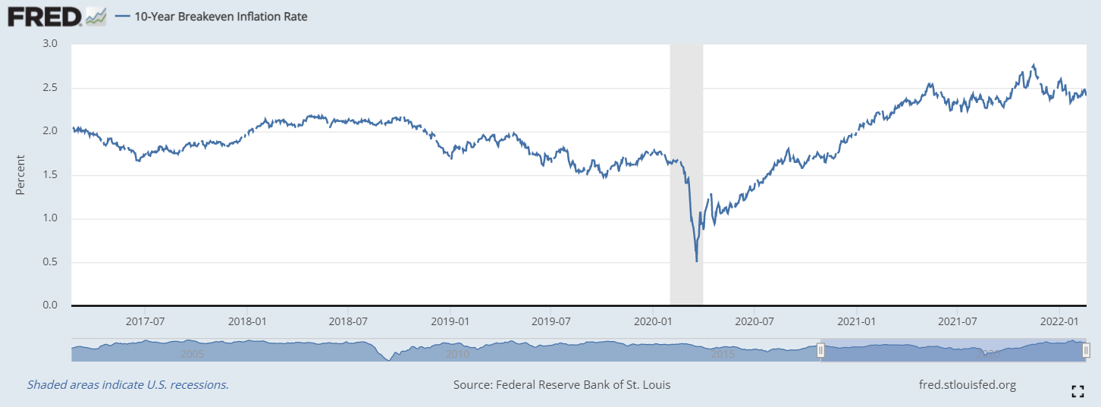
Data Sources
Updated S&P500 stock data file (includes newer data points)
https://fred.stlouisfed.org/
Recommended:
Consumer Price Index
Real GDP
Unemployment
Interest rates
(See At A Glance, Popular Series, and Latest Releases for ideas)
Notice they often have seasonally adjusted and non-seasonally adjusted time series data.
Other data including individual stock ticker data and international stock indices

Slide 11
Recall: Design questions (from last module)
Minimum Data Set
State rankings by unemployment and change in unemployment for any given period of time
Sector log returns for any given period of time
Query Parameters
Dates under consideration
Unknowns
Dates for when certain sectors showed large declines or increases

Slide 12
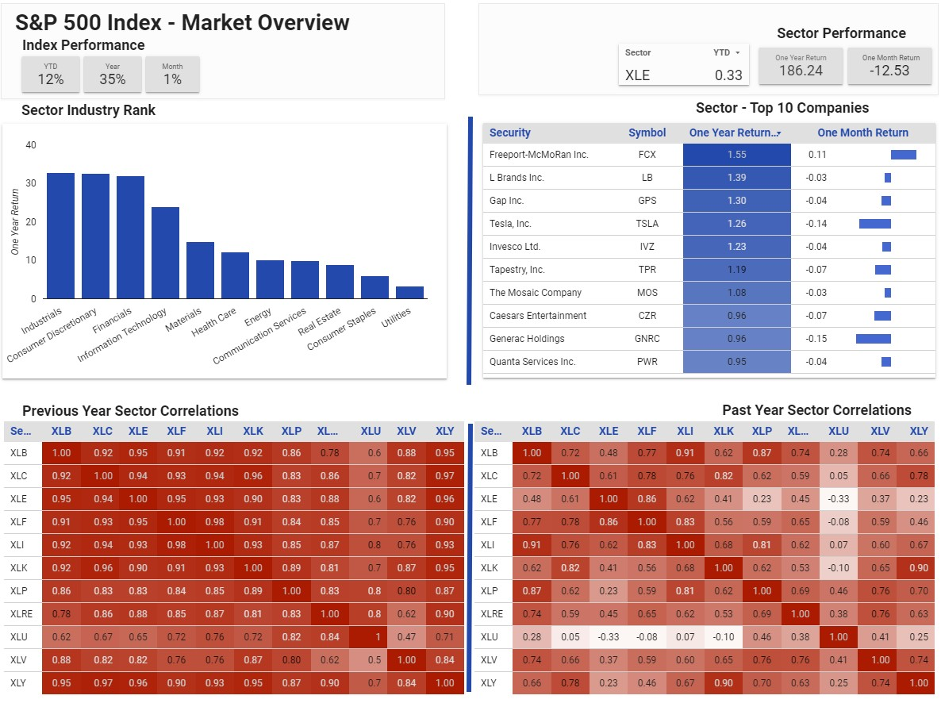
Dashboard Tips
Try to create a well-defined scope for a set of queries that can be answered by the dashboard such that it:
Makes it clear to see what the answer is to the query
Requires interactivity only to change the parameters of the query (if at all)
The goal is to enable someone to ask: “What happened to X on event E?”
X: set of all data that is of interest
E: set of query parameters
Past student submission (Janet L.)

Slide 13
Dashboarding basics in Tableau
Understanding filter scope
Limiting query results
Dashboard Objects
Basic elements
Interactions
Navigation

Slide 14
Agenda
Review of Module 5 Assignment
Overview of Module 6 Assignment
Overview of Capstone Projects

Slide 15
Capstone Project
Create a story showing the biggest gainers and losers in the financial markets. You can compare those movements to any economic data you wish. If you can import the data into Tableau, you can use it.
Select any historical year (2012, 2019, 2020, etc.), preferably one that has a complete dataset. Which of the economic data series (and transformations of those series) you choose is up to you. You will not make any causal connections between the data.
Comment on what you observe and lead the viewer through a storytelling arc through the events of the year.

Slide 16
Capstone Project (cont’d)
Describe what happened that year covering at least:
Changes in the market by S&P 500 sector. Change should not be limited to price but at a minimum the change in the monthly return of the price series. You can look at the univariate or multivariate visualizations to notice any changes in the statistical properties or relationships. No change in their properties may be interesting as well if the economic environment drastically changed yet they remained constant.
Changes in the overall S&P500
Time-dependent changes
Relationships between market components
Changes to any macroeconomic variables and their relationships to the market

Slide 17
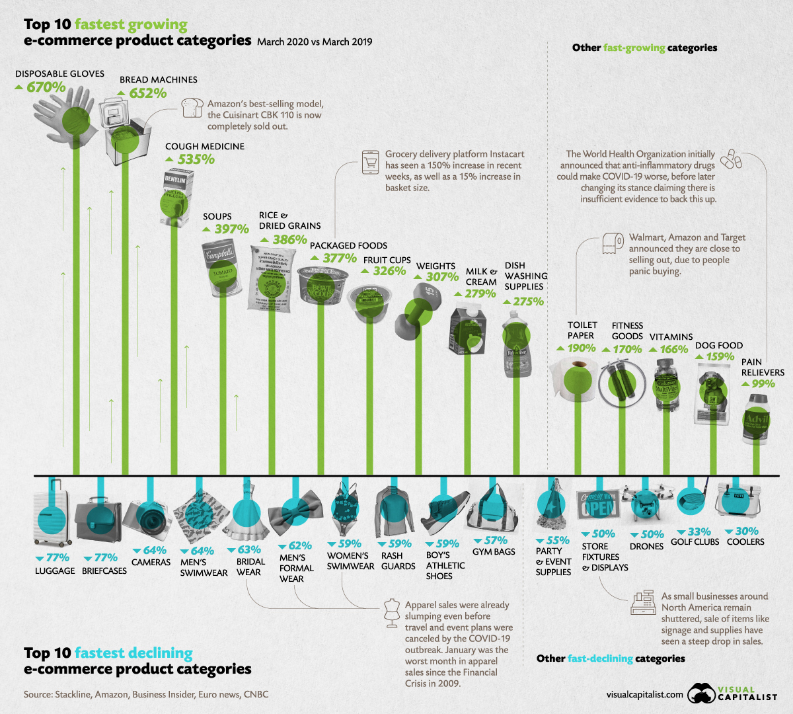
Creating a Story
Example: “The Pandemic Economy - What are Shoppers Buying Online During COVID-19?”
First challenge is to tell a story using only visual cues, annotations, and narrative structure.
For the capstone project, you can use any tools at your disposal, not just Tableau’s Story mode.

Slide 18
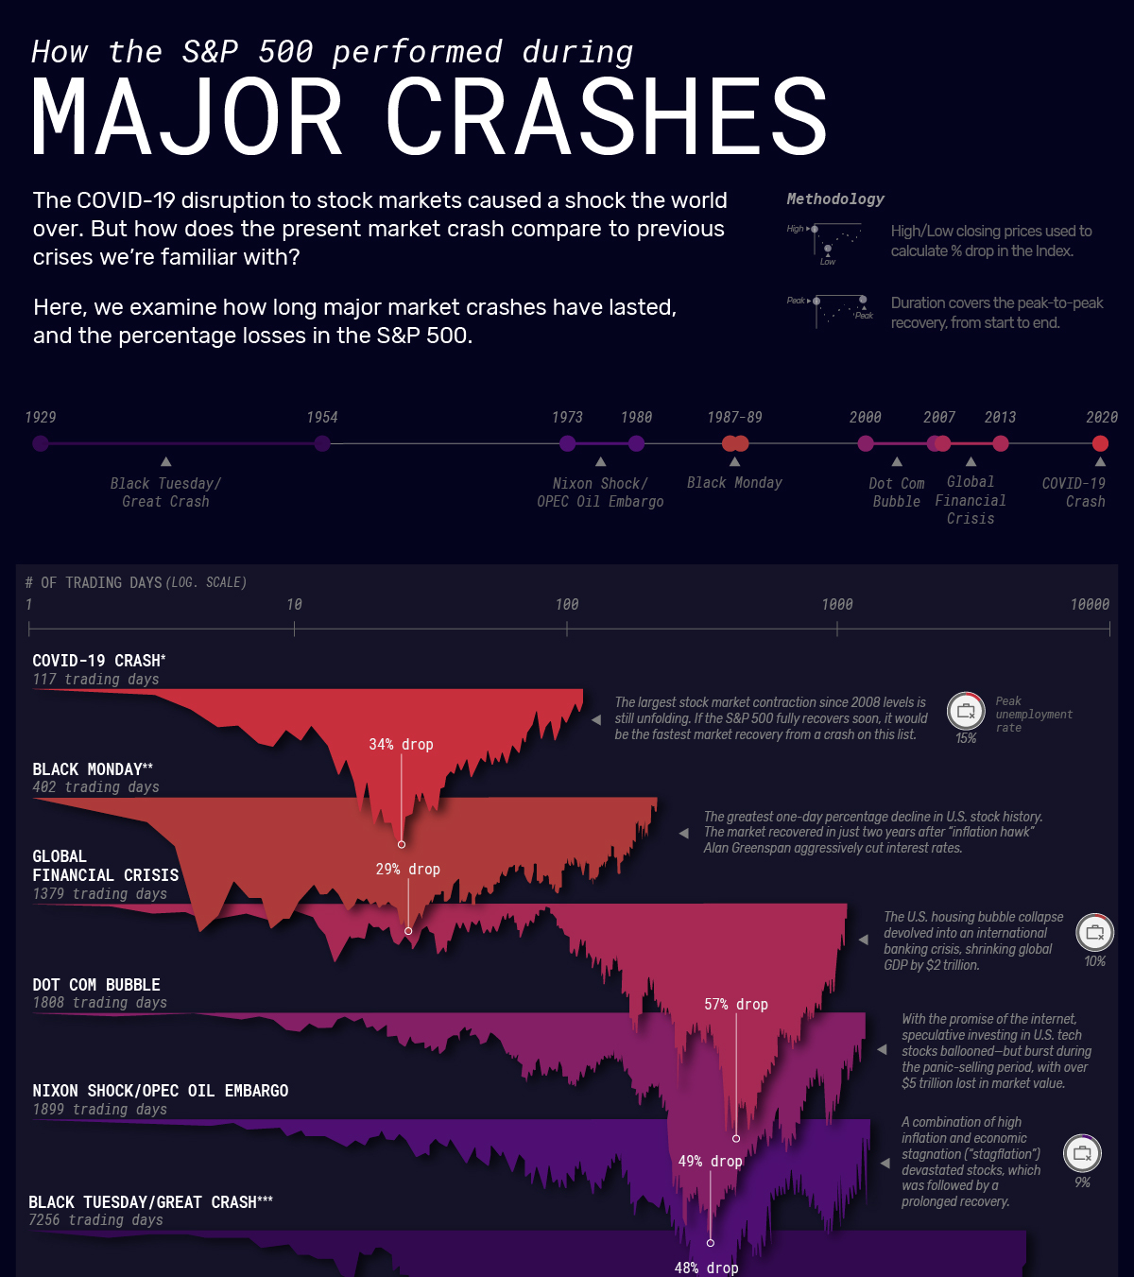
Presentation
The second part of the capstone project is to record a short (<8 minute) presentation of your Module 7 story where you narrate and direct the audience through the key points.
You can use any tools you wish to record the presentation.

Slide 19
Demos
Using Story mode
Example story

Slide 20
Next Session
Additional information on the final project and presentation
Story creation
Course topic review
Open forum

Slide 21
Week 6 Data Density and Visual Understanding
Instructions: In order to monitor what is happening in the financial markets and the economy, you will create a descriptive analytics dashboard to keep track of the changes in the S&P 500 market performance.
Just as one uses a vehicle dashboard to assist their driving, diagnose the vehicle in real-time, and provide sensor data, financial and economic dashboards are similarly relied upon to provide up-to-date information to manage finances, diagnose economic risks, and determine policy. While it is tempting to cram as much information into the dashboard as possible, the objective of this dashboard is to provide an investor with a quick summary of what has happened in the past year (from current month to same month last year).

Slide 22
Using any of the previous visualizations or calculations you have created up to this point, you will now create a dashboard that quickly answers:
Question 1. What happened in the financial markets to the index and each sector by day, month, year-to-date in absolute terms and in terms of change from the previous period?
Question 2. What happened in the economic data by month (if exists), quarter, year in terms of change from the previous period?
Question 3. Which sectors gained or lost the most by month, and for the rolling year?
Question 4. Which economic statistics showed the biggest movements by quarter, year, and group them by the type of statistic they measure?

Slide 23
3 additional visualizations. For these visualizations, state:
What the question and purpose(s) of the visualization are hoping to answer or show?
What calculations or transformations were necessary?
What is the focal point of the graph?
Assume that the target audience is a general audience largely informed about the markets. The goal is to provide a single resource that presents all of the information in a concise and visually effective manner.

