Slide 1

Virtual Session 7
Introduction and Environment Setup
Univariate Analysis/Descriptive Analytics
Multivariate Analysis/Diagnostic Analytics
Networks and Spatial Analytics/Descriptive + Diagnostic Analytics
Time Series Analysis
Interactive Visual Analytics
Storytelling + Prescriptive Analytics
Advanced Topics

Slide 2
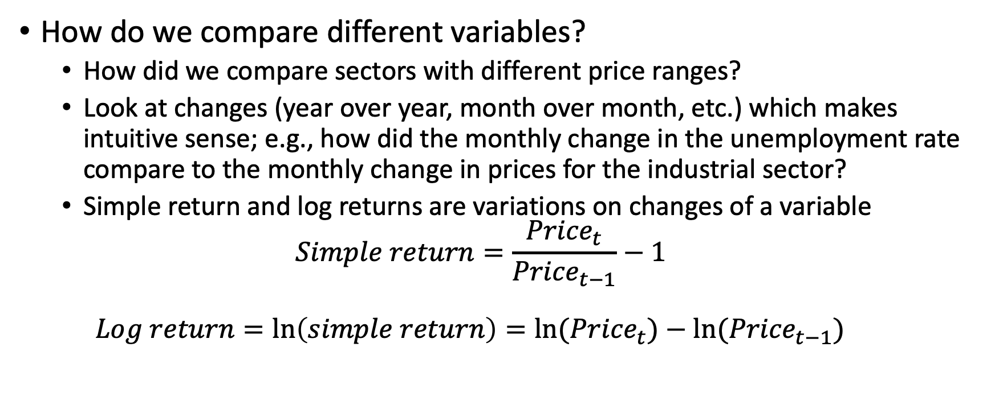
Comparing variables
How do we compare different variables?
How did we compare sectors with different price ranges?
Look at changes (year over year, month over month, etc.) which makes intuitive sense; e.g., how did the monthly change in the unemployment rate compare to the monthly change in prices for the industrial sector?
Simple return and log returns are variations on changes of a variable $Simple return=\frac{{Price}_{t}}{{Price}_{t−1}}−1$ $Log return=\ln\left(simple return\right)={ln⁡(Price}_{t})−ln({Price}_{t−1})$

Slide 3
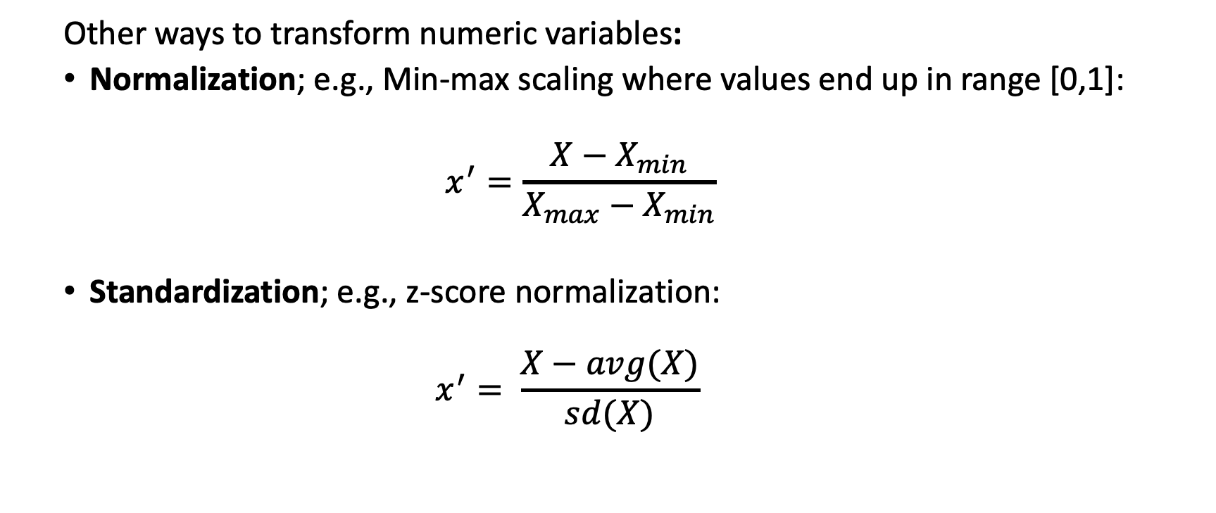
Transforming variables
Other ways to transform numeric variables:
Normalization; e.g., Min-max scaling where values end up in range [0,1]:
$$x^{′}=\frac{X−X_{min}}{X_{max}−X_{min}}$$
Standardization; e.g., z-score normalization: $x^{′}= \frac{X−avg(X)}{sd(X)}$

Slide 4

Designing dashboards
Behind any dashboard design lies three primary design constraints:
Objectives
Is the dashboard for operational, analytical, or strategic use?
Time requirements
What is the attention level of the audience to process or view the information?
Audience
What understanding of the data or domain do they already have?
Are there any accessibility constraints?
What medium (print, digital, web, mobile, etc.) will they view this?

Slide 5

Three Rules of Visual Communication
Have
Have a clear purpose
Why do you need a visualization?
Who is the intended audience?
Where is the visualization going to live?
Show
Show the data clearly
Make
Make the message obvious
Be conscious of your color and design decisions
Focus attention to the important areas
Eliminate clutter
What evidence supports the purpose?
Do not lie or misrepresent data
Choose the correct graph type
Choose the correct scaling, mappings, and aesthetics

Slide 6
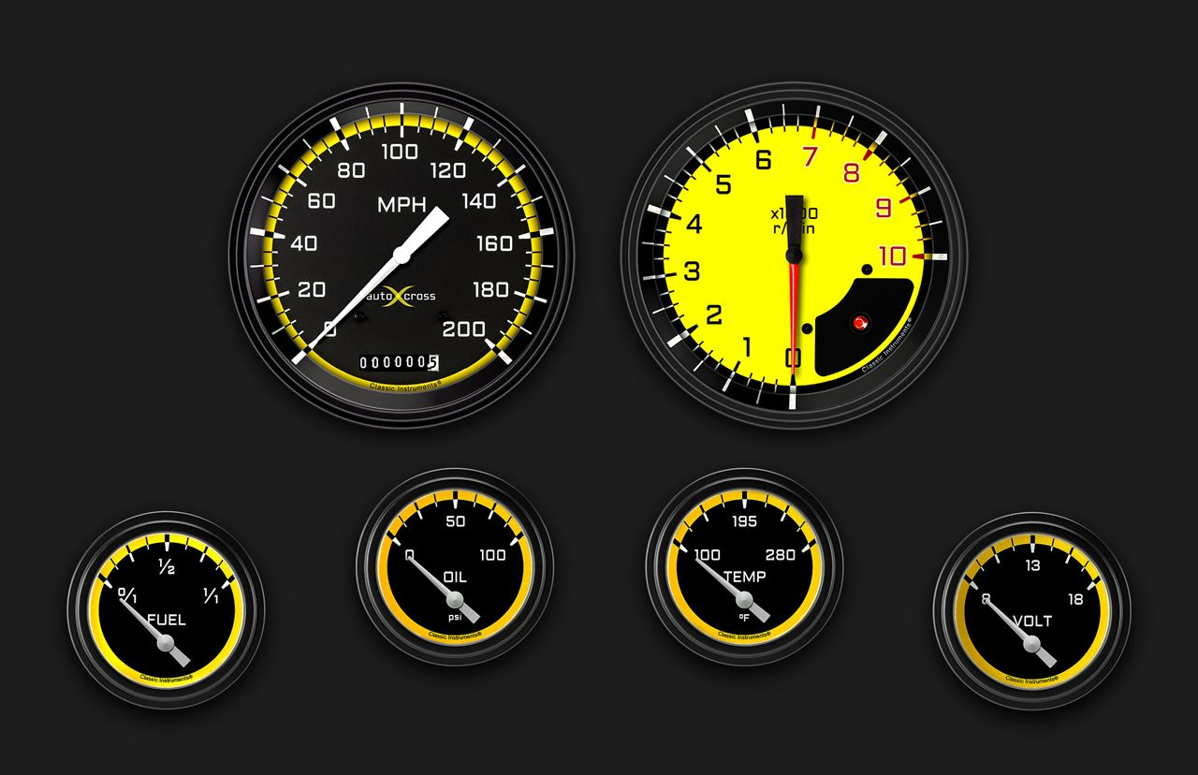
Designing Dashboards

Slide 7
Focal staging
Focal Group 1
Designing the layout and flow of information can also be thought of as a grammar of graphics problem where we map focus to meta-level aesthetics.
Focal Group 2
Focal Group 3

Slide 8
Focal staging
Focal Group 1
The focal hierarchy is established in two scales.
The first scale maps size to importance
Focal Group 2
Focal Group 3
Increasing focal priority

Slide 9
Focal staging
Focal Group 1
The second scale maps position to secondary focal priority importance.
Focal Group 2
Focal Group 3

Slide 10
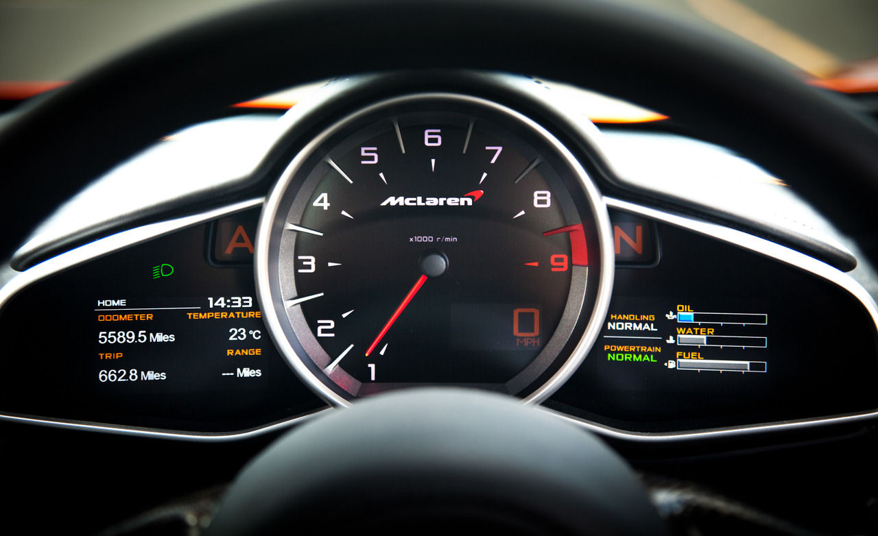
Can you identify the focal groups here?

Slide 11
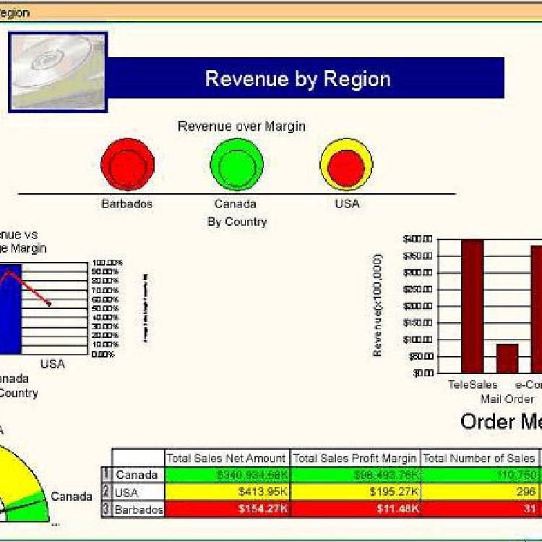
Poor layout and flow
Poorly-made dashboards seemingly have no logic to the layout nor any understanding of the data properties or relationships.

Slide 12
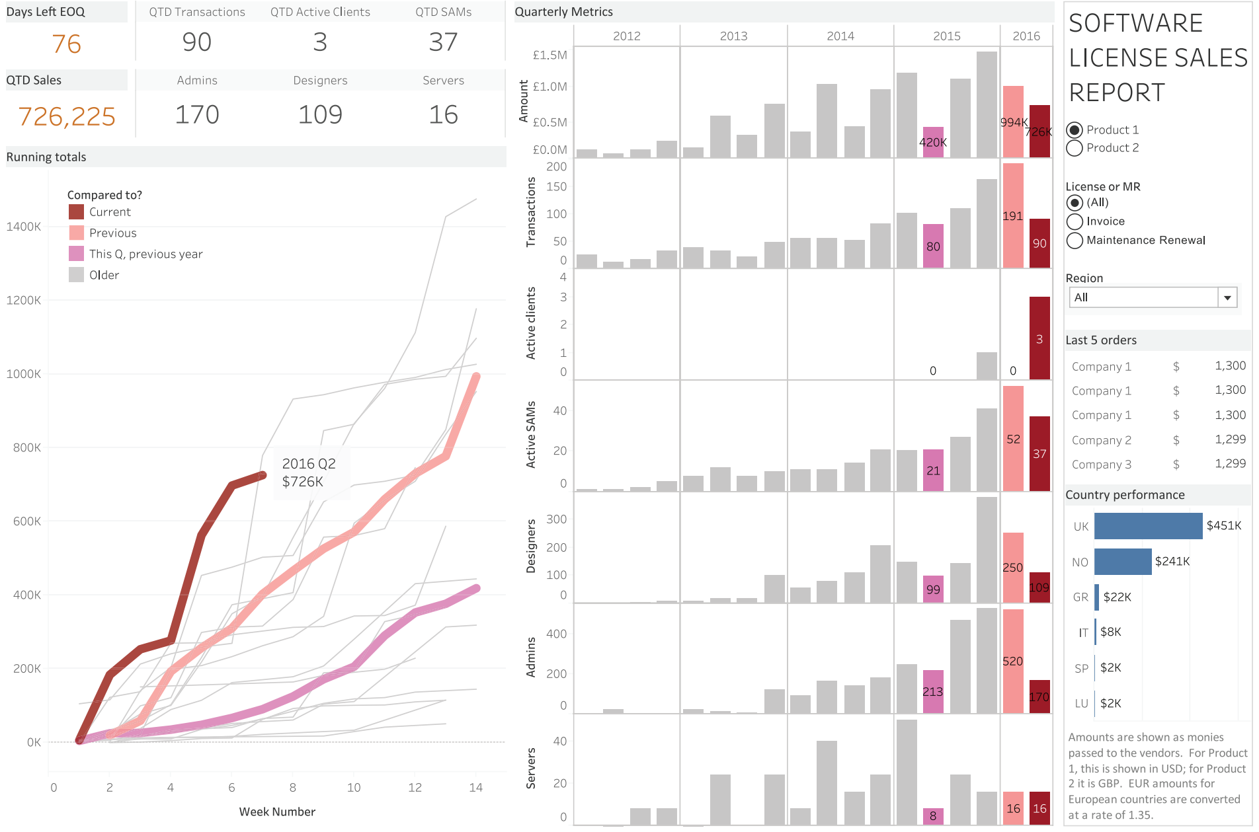
What is the layout and flow here?

Slide 13
Use wireframes for layout and flow
Group 3
Group 1
Wireframe mockups help to quickly design focal flow using simple shapes and layout arrangements.
Group 2

Slide 14
Agenda
Assignment 6 Comments
Additional information on the final project and presentation
Story creation
Course topic review
Open forum

Slide 15
Project description
Instructions: The objective is to direct the audience through a guided tour of the relative performance of the market defined by the S&P 500 sectors and how they have moved over time relative to the overall economy.
Create a story showing the biggest gainers and losers in the financial markets. Compare those movements to any economic data you wish (as long as you can import the data into Tableau, you can use it). Select any historical year (2000, 2008, 2019, etc.), preferably one that has a complete dataset. Which of the economic data series (and transformations of those series) you choose is up to you. You will not make any causal connections between the data. Simply, you need to comment on what you observe and lead the viewer through a storytelling arc through the events of the year. (I recommend comparing the year that you choose to the historical average of the data or with the previous year.)
Then, you will walk the viewer, step-by-step to describe what happened that year covering at least:
Changes in the market by S&P 500 sector. Change should not be limited to price but at a minimum the change in the monthly return of the price series. You can look at the univariate or multivariate visualizations to notice any changes in the statistical properties or relationships. No change in their properties may be interesting as well if say the economic environment drastically changed.
Changes in the overall S&P500
Time-dependent changes
Relationships between market components
Changes to any macroeconomic variables and their relationships to the market

Slide 16
Final Project and Presentation Info
The simplest approach is to:
Expand your dashboard into individual charts
Highlight and annotate the important points
Organize the sequence into a narrative

Slide 17
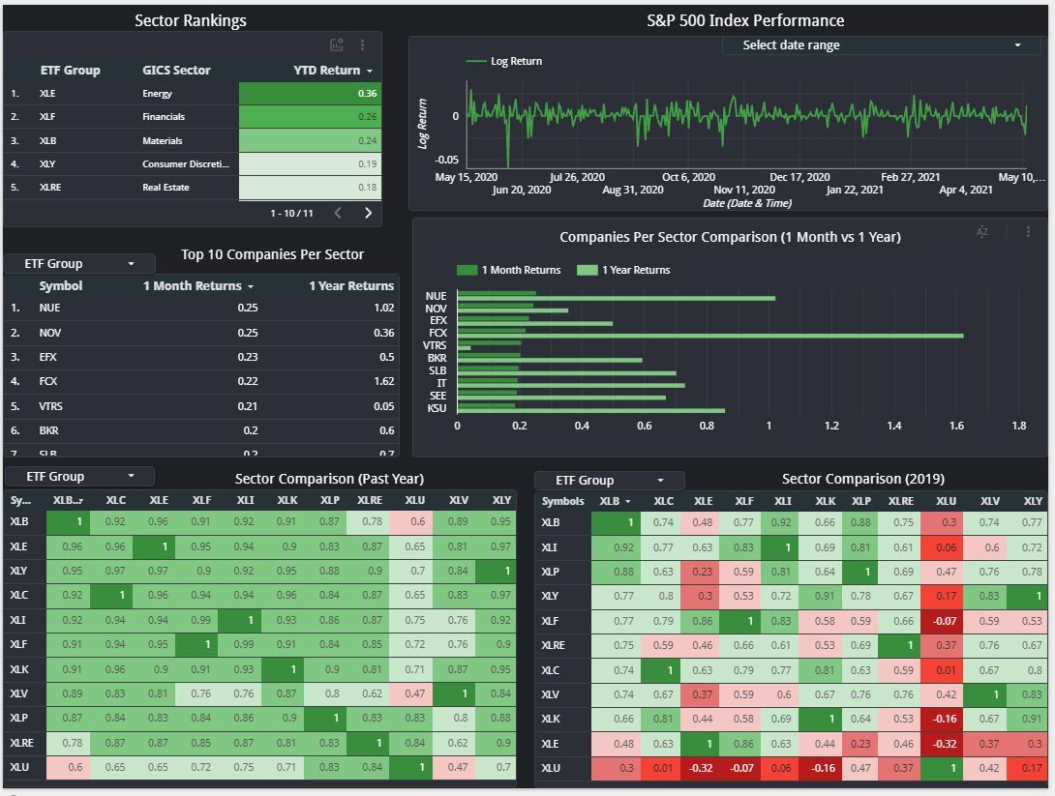
Starting with the dashboard
Have a clear purpose for the story. For each chart:
Why do you need a visualization?
What evidence supports the story?
Select the charts that support your narrative (abductive reasoning)

Slide 18
Extract the headline data
Show the data clearly
Do not misrepresent data
Choose the correct graph type
Choose the correct scaling, mappings, and aesthetics
Make sure the information is clearly labeled to indicate dates, events, categories, etc.

Slide 19
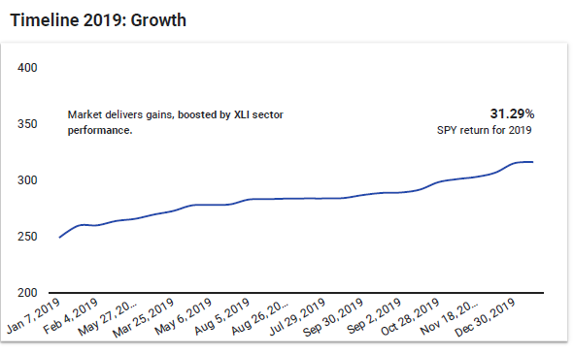
Extract and hone visualizations that drive your point
Make the message obvious
Be conscious of your color and design decisions
Focus attention to the important areas
Eliminate clutter
Notes:
XLE stock latest Energy Select Sector SPDR Fund

Slide 20
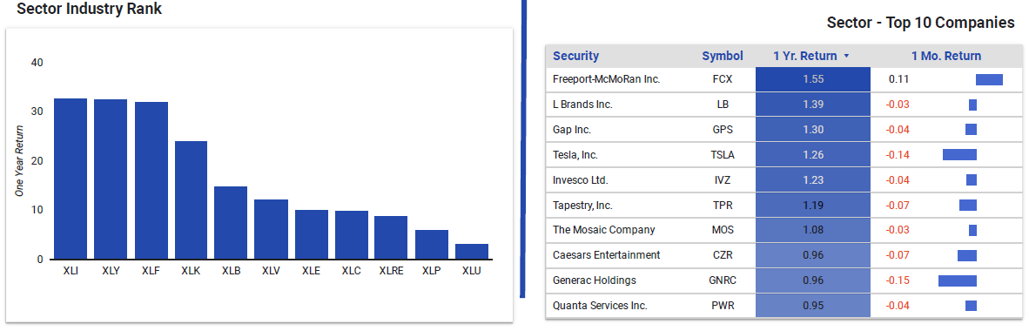
Provide detail and supporting evidence
Optimize data-ink-ratio to add as much information as possible with the least amount of visual noise

Slide 21
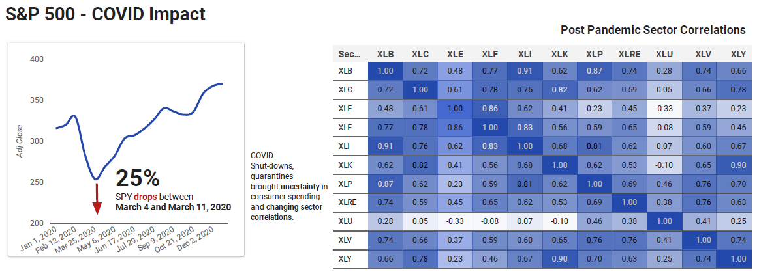
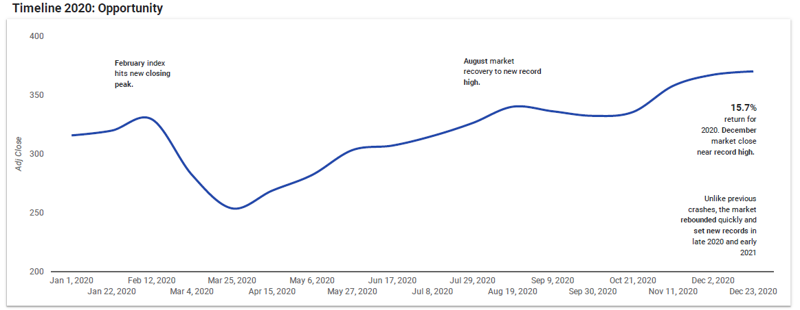
Annotate the story
Direct the audience focus to the key data points and guide them linearly through the story

Slide 22
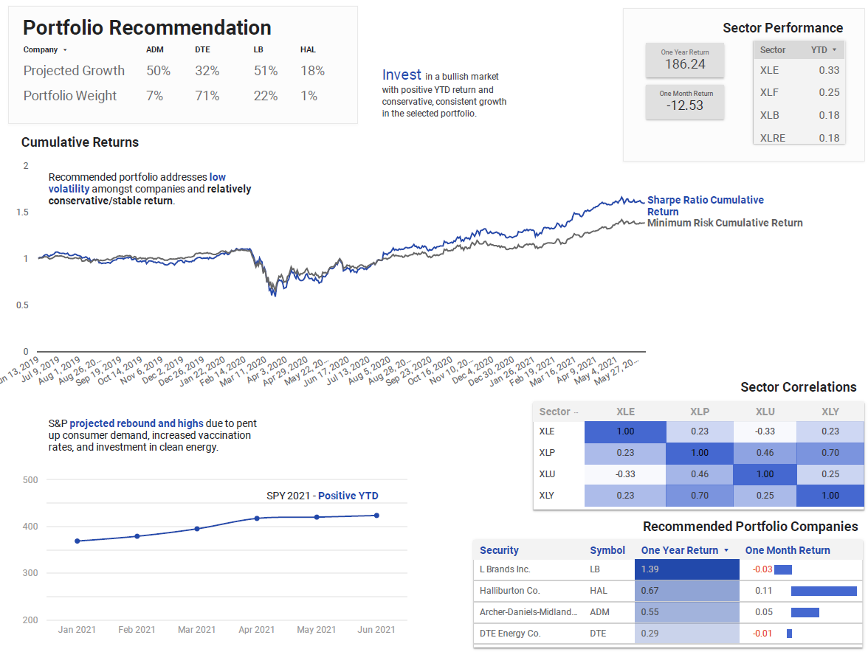
Structure the narrative
Every well-constructed analytics story will answer at a minimum:
What happened
Why it happened
Why it matters

Slide 23
Final Project and Presentation Info
Tools
Excel (Inspecting, cleansing, and possibly pre-calculating data)
Tableau
Visualization design:
Tableau, Illustrator, Inkscape, Photoshop, Gimp, or After Effects (!)
Presentation:
Tableau, PowerPoint, Google Slides, or Keynote
Final format for capstone project can be either:
Published story on Tableau Public or uploaded packaged workbook.
PDF file
Presentation file (Powerpoint, Keynote, or Slides)
Final format for capstone project presentation can be:
Narrated recording of Powerpoint, Keynote, or Google Slides

Slide 24
From Tableau to Illustrator
Optional design tool route

Slide 25
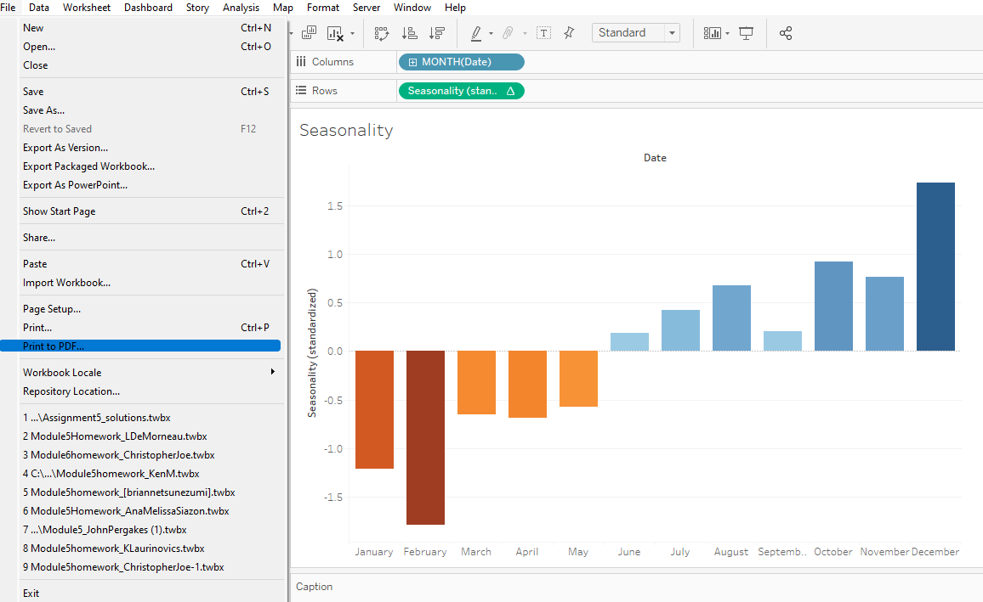
Step 1:
Print the worksheet to PDF format
This creates editable SVG graphics

Slide 26
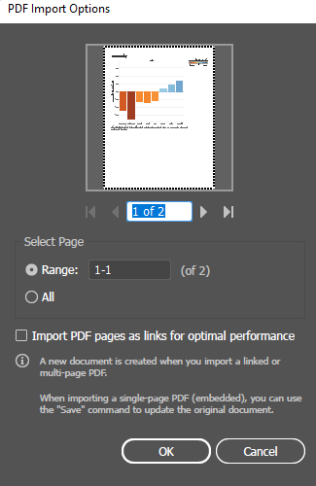
Step 2:
In Adobe Illustrator, open the saved .pdf file
Ignore any missing font warnings

Slide 27
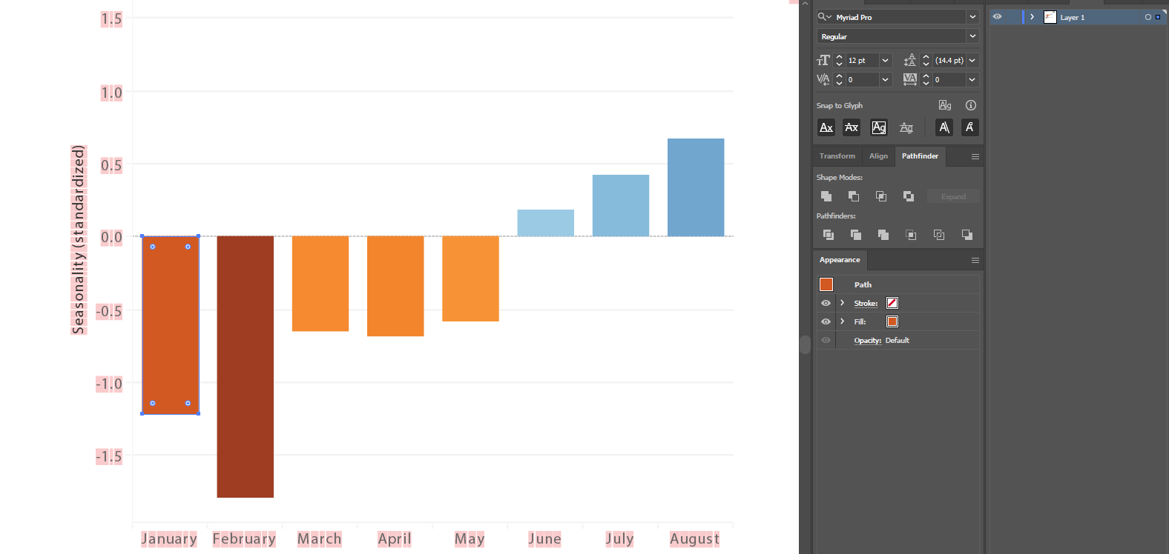
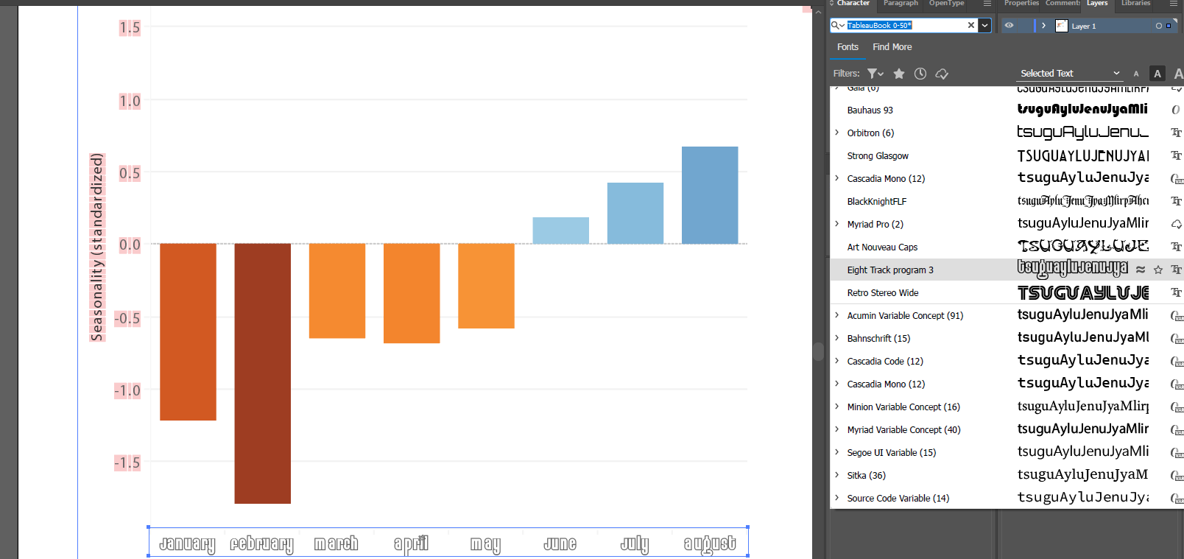
Step 3:
Each chart element can be styled like any other vector graphics element.

Slide 28
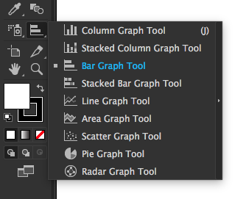
Comments
Inkscape (https://inkscape.org/) is a free alternative to Illustrator
If the dataset is small and only a simple graph is needed, Illustrator’s Graph tool can be used for native visualizations

Slide 29
From Tableau to Photoshop
Optional design tool route

Slide 30
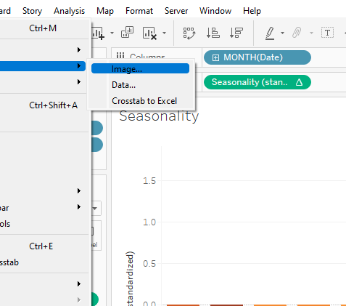
Step 1:
Export the worksheet as an image

Slide 31
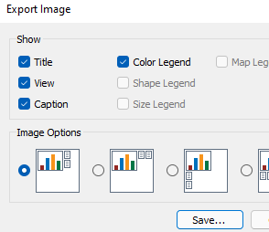
Step 2:
Choose the export options

Slide 32
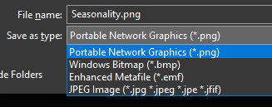
Step 3:
Export as .png file and save the file

Slide 33
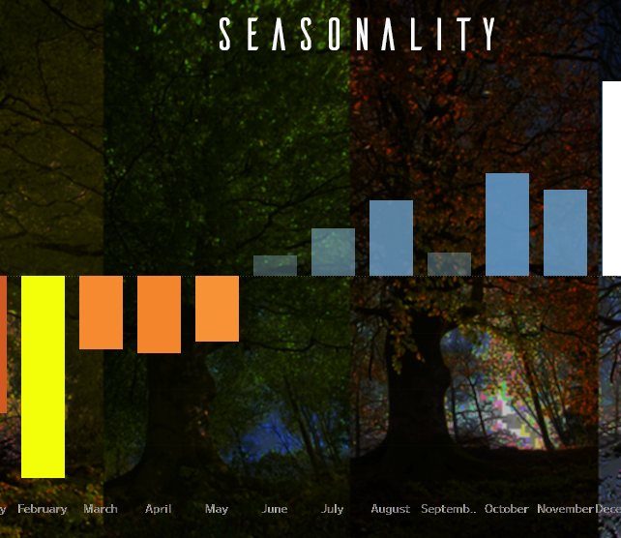
Step 4:
Open the file in Photoshop
Manipulate the elements and layers to achieve the desired style
This is a horrendous chart and is what can go wrong if you muck with every element in Photoshop without design

Slide 34
Comments
Gimp (https://www.gimp.org/) is a free alternative to Photoshop
Image editing approach is not nearly as flexible as using scalable graphics like in Illustrator

