Slide 1
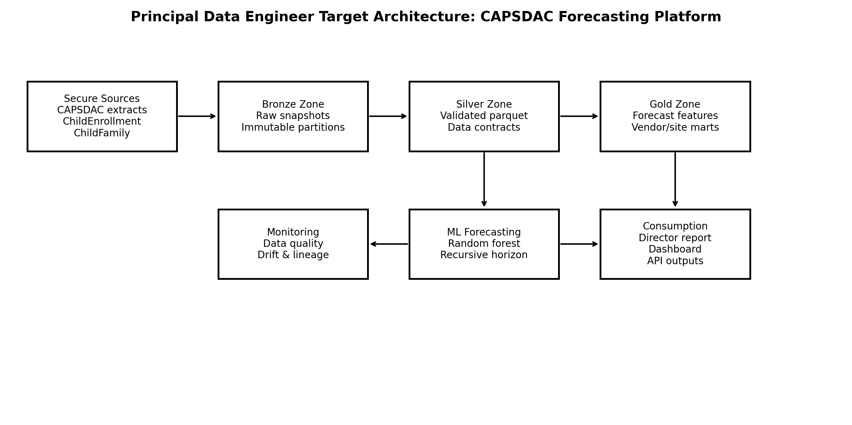
CAPSDAC Enrollment Forecast Platform
Principal Data Engineer Portfolio Upgrade
Lakehouse-ready data product
Data contracts, governance, and privacy controls
ML forecasting and executive reporting

Slide 2
Why This Project Fits Principal Data Engineer Roles
From notebook ML to governed education data product
Owns the end-to-end platform: source data, validation, features, model, reports
Demonstrates privacy-conscious handling of sensitive education data
Connects technical architecture to staffing, capacity, and budget decisions
Shows cloud productionization: S3, Glue, Step Functions, SageMaker, Athena, monitoring
CAPSDAC Principal Data Engineer Upgrade | 2

Slide 3
Current Repository Strength + Upgrade Gap
What already works, and what had to be strengthened
Original repo: preprocessing, lag features, recursive forecast, vendor/site analysis
Gap for principal roles: production architecture, data contracts, CI/CD, monitoring
Upgrade adds modular package design, tests, cloud deployment skeletons, governance docs
Outcome: more credible for principal, staff, and AI data platform interviews
CAPSDAC Principal Data Engineer Upgrade | 3

Slide 4
Target Architecture
Bronze/Silver/Gold lakehouse with ML and reporting layers
Bronze: immutable monthly CAPSDAC-style snapshots
Silver: validated parquet and contract-driven conformance
Gold: forecast features and vendor/site contribution marts
ML layer: recursive random forest forecast and artifact tracking
Consumption: dashboard, director report, CSV/API-ready outputs
CAPSDAC Principal Data Engineer Upgrade | 4

Slide 5
Data Contracts and Governance
Prevent schema drift and protect sensitive education data
Required grain: SnapshotMonth x PreschoolCDSCode
Quality rules: non-negative enrollment, no duplicate site-month keys
Privacy rules: no child names, DOB, address, guardian IDs, or credentials
Public package uses synthetic de-identified data only
Site-Month
Data grain
No PII
Privacy stance
No duplicates
Quality rule
Planning only
Use case
CAPSDAC Principal Data Engineer Upgrade | 5

Slide 6
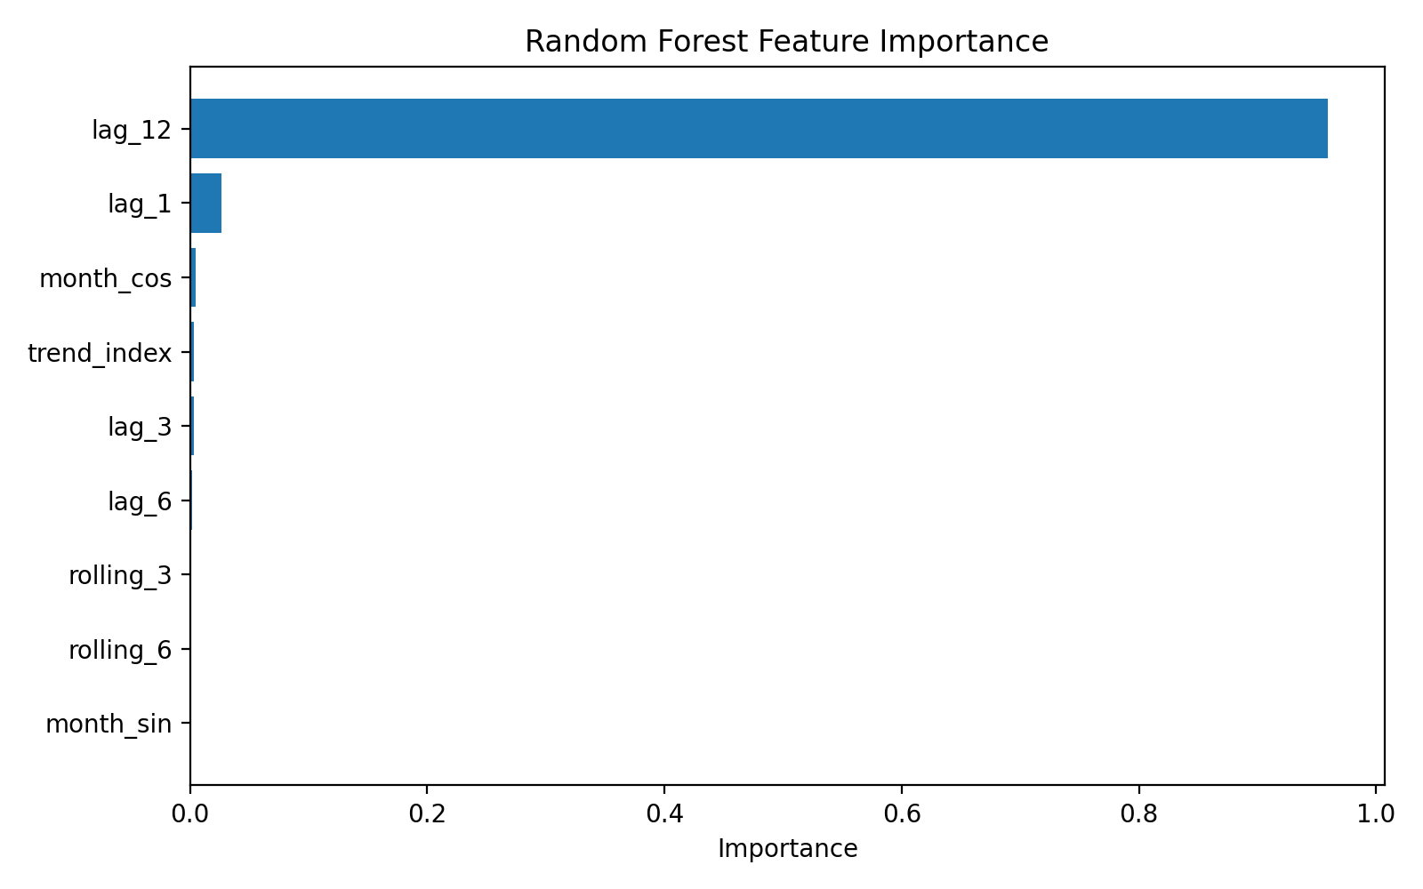
Machine Learning Methodology
Short-horizon planning model designed for interpretability
Lag features: 1, 3, 6, and 12 month enrollment history
Rolling features: 3 and 6 month recent momentum
Seasonality: month sine/cosine indicators
Model: Random Forest Regressor for nonlinear site-level demand patterns
Forecast: recursive multi-month site forecasts aggregated to vendor/statewide
CAPSDAC Principal Data Engineer Upgrade | 6

Slide 7
Model Results and Explainability
Model metrics and feature importance communicate reliability
Holdout MAE: 4.13
Holdout RMSE: 5.49
Holdout R2: 1.00
Feature importance highlights lag and seasonal drivers
Used for aggregate planning, not certified counts or individual decisions
4.13
MAE
5.49
RMSE
1.00
R2
CAPSDAC Principal Data Engineer Upgrade | 7

Slide 8
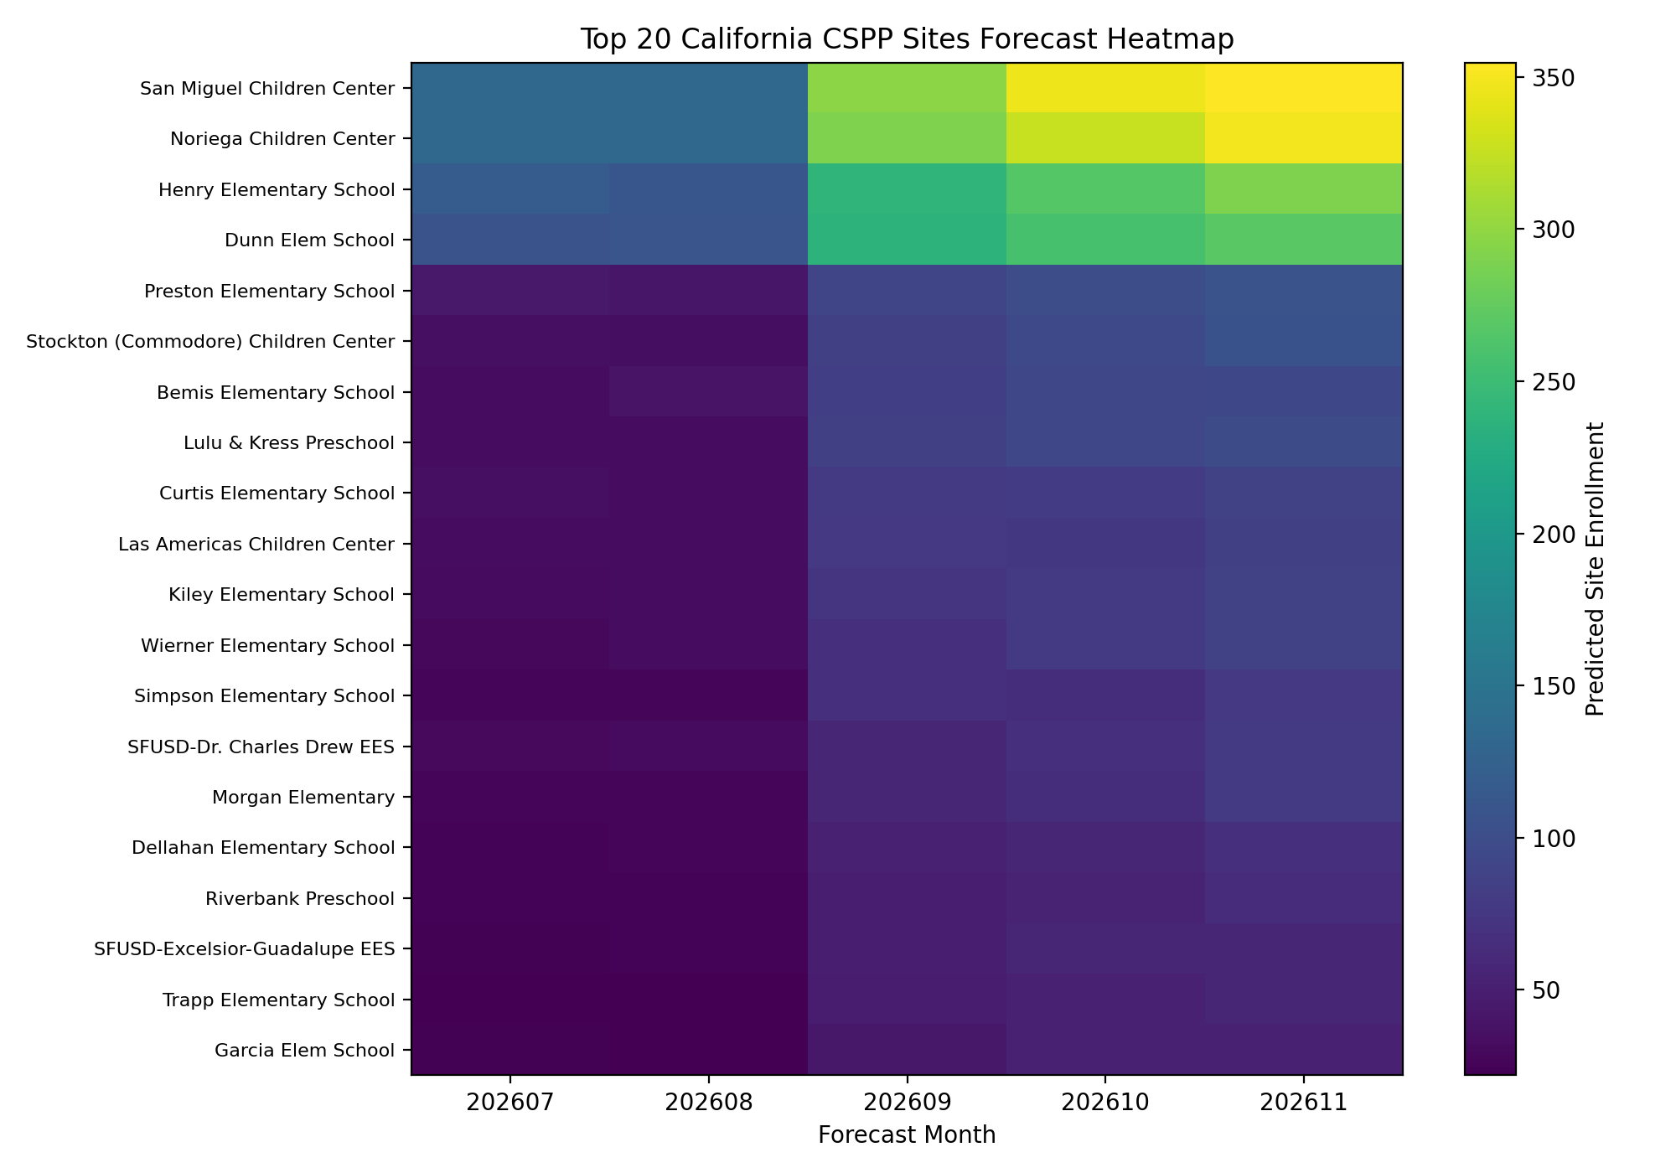
Forecast Outputs
Planning outputs at statewide, vendor, and site levels
Statewide forecast supports budget timing and staffing readiness
Vendor forecast identifies concentration risk among large providers
Site heatmap supports targeted capacity planning
Outputs are stored as reproducible CSV and figure artifacts
CAPSDAC Principal Data Engineer Upgrade | 8

Slide 9
Operational Excellence
What makes this principal-level engineering
Automated validation and reproducible pipeline scripts
GitHub Actions CI for tests and quality checks
Monitoring plan: row counts, missing vendors/sites, forecast drift, schema drift
Cloud roadmap: S3, Glue, Step Functions, SageMaker, Athena, QuickSight, CloudWatch
CAPSDAC Principal Data Engineer Upgrade | 9

Slide 10
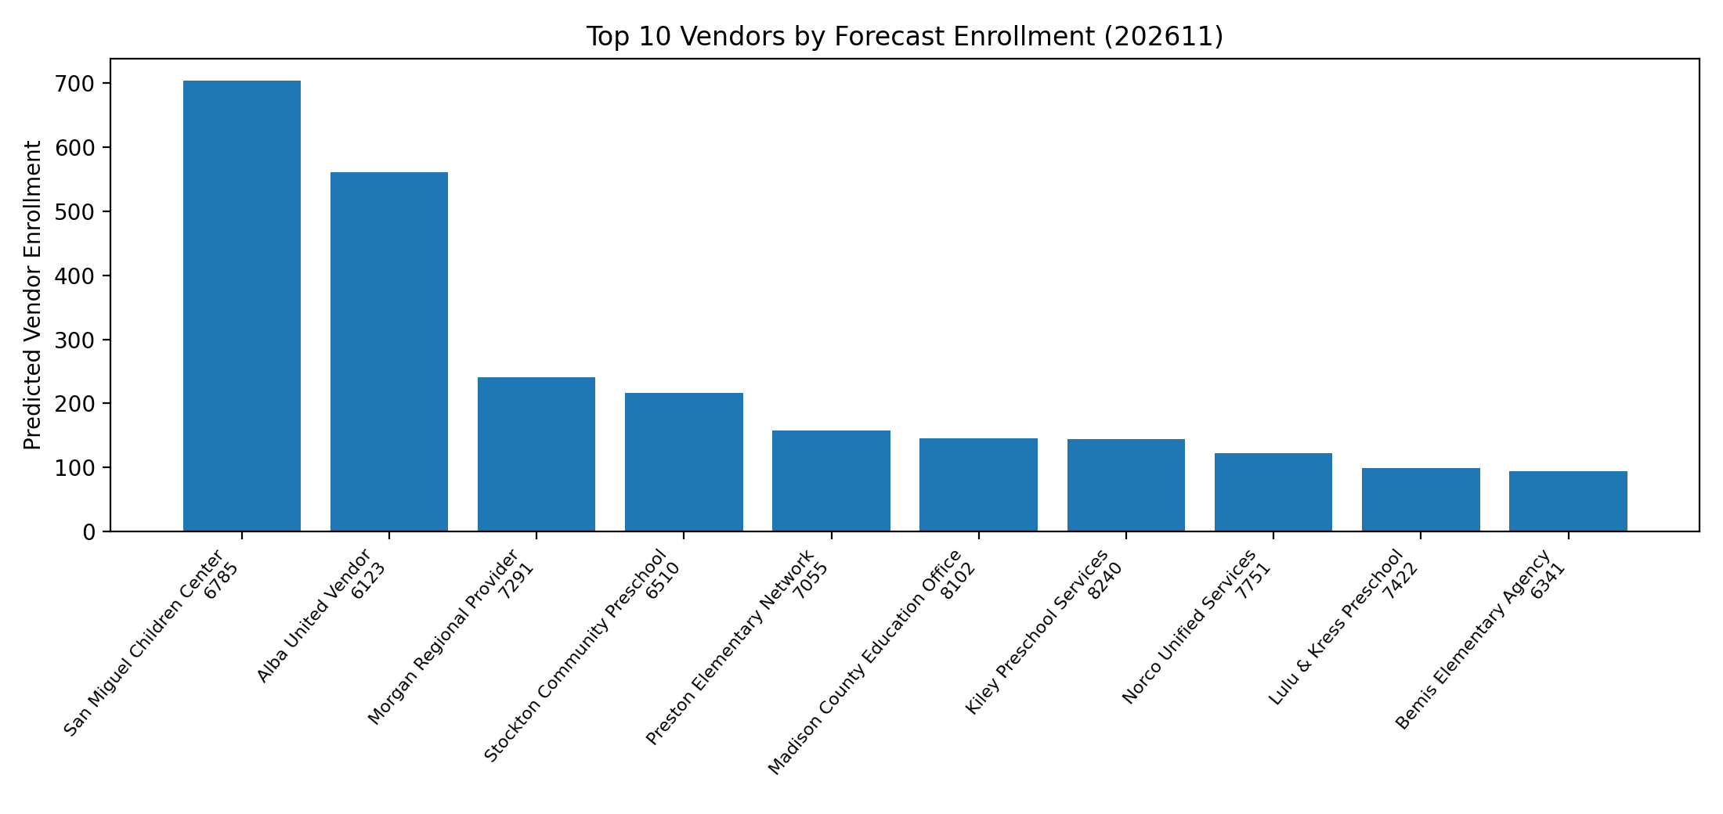
Business Impact
Translate platform outputs into director-level decisions
Target capacity support to high-demand sites
Plan staffing ahead of school-year peaks
Treat leading vendors as strategic partners and concentration risks
Use forecasts alongside policy judgment and domain review
CAPSDAC Principal Data Engineer Upgrade | 10

Slide 11
Interview Talk Track
60-second answer for principal data engineer interviews
I upgraded CAPSDAC forecasting into a governed data platform
I designed lakehouse layers, data contracts, model training, forecast outputs, and executive reporting
I added cloud production architecture, monitoring, CI/CD, and privacy controls
The project shows I can turn analytics into reliable data products
CAPSDAC Principal Data Engineer Upgrade | 11

Slide 12
Roadmap
How to take the portfolio into production
1. Connect secure CAPSDAC extracts
2. Register Bronze/Silver/Gold tables
3. Add monthly backtesting and drift monitoring
4. Deploy forecast refresh in SageMaker
5. Publish Athena/QuickSight data product
6. Formalize governance and access controls
CAPSDAC Principal Data Engineer Upgrade | 12

Slide 13
Conclusion
The strongest story is platform ownership
This project now demonstrates end-to-end ownership of an education data product.
It combines data engineering, governance, applied ML, stakeholder reporting, and cloud architecture.
For principal roles, the value is not only forecast accuracy; it is reliability, privacy, repeatability, and executive decision support.
CAPSDAC Principal Data Engineer Upgrade | 13

