Slide 1

Comparing Machine Learning Algorithms for Predicting ICU Patients’ Mortality
Yu Zhang
Data Scientist
May 2021
zhangyu027@gmail.com

Slide 2

Statement of the Problems
Efforts have been made to identify Clinically relevant statistical methods and machine learning applications that are optimal in predict the ICU patients’ mortality.
The knowledge gaps are still in utilizing machine learning to help ICU physicians make optimal clinical decisions and early and accurate identification of ICU patients with a high risk of in-hospital deaths.
The current study applied and evaluate the performance of four different machine learning algorithms in predicting ICU in-hospital deaths. My goal was to identify the best algorithm using demographic data, vital, and laboratory data, which can, in turn, improve the prognosis and clinical outcomes.
Notes:
Clinical trial data min max day hour body lab sr·ow·suhs

Slide 3
Clinical Questions
What are the features of patients’ demographic, lab visit and vital signs to predict ICU patients’ in-hospital death?
Which is the best machine learning model to predict the ICU patients’ mortality among XGboosting, logistic regression, decision tree and KNN?
What are the recommendation of the machine learning algorithm to the doctors and physician to best perform clinical interventions for critically ICU patients?

Slide 4
Methods, Metrics and Features
Train ICU visit data: 91713 (size)
Features: (103)
Patients Demographic (19)
Lab: min, max by day and hours (46).
Vital sign of min, max by day and hours (38)
Predictors: Probability of Hospital Death(‘1’), Survival (‘0’)
Predictive Modeling: four ML models
Metrics: Accuracy score, Recall, F1 score, ROC AUC
Confusion Matrix

Slide 5
Supervised Learning Modeling (classifier)
Logistic Regression: (tradition maximum likelihood estimate and independent Input)
K Nearest Neighbor: (non-parametric)
Decision Tree: (use gini and entropy to find the best break point)
XGboosting: (optimize number of features)
Notes:
Xgboost does capture non linear relationships, use of gradient boosting it can optimize arbitrary metrics.

Slide 6

Methods
Model Training
Prediction
Action
Data Preprocessing
Explanation
Evaluation Model
Data Integration
Integration with Prior belief
Lab Data
Vital Sign
Patients’ Demographics
ICU Clinical Support

Slide 7
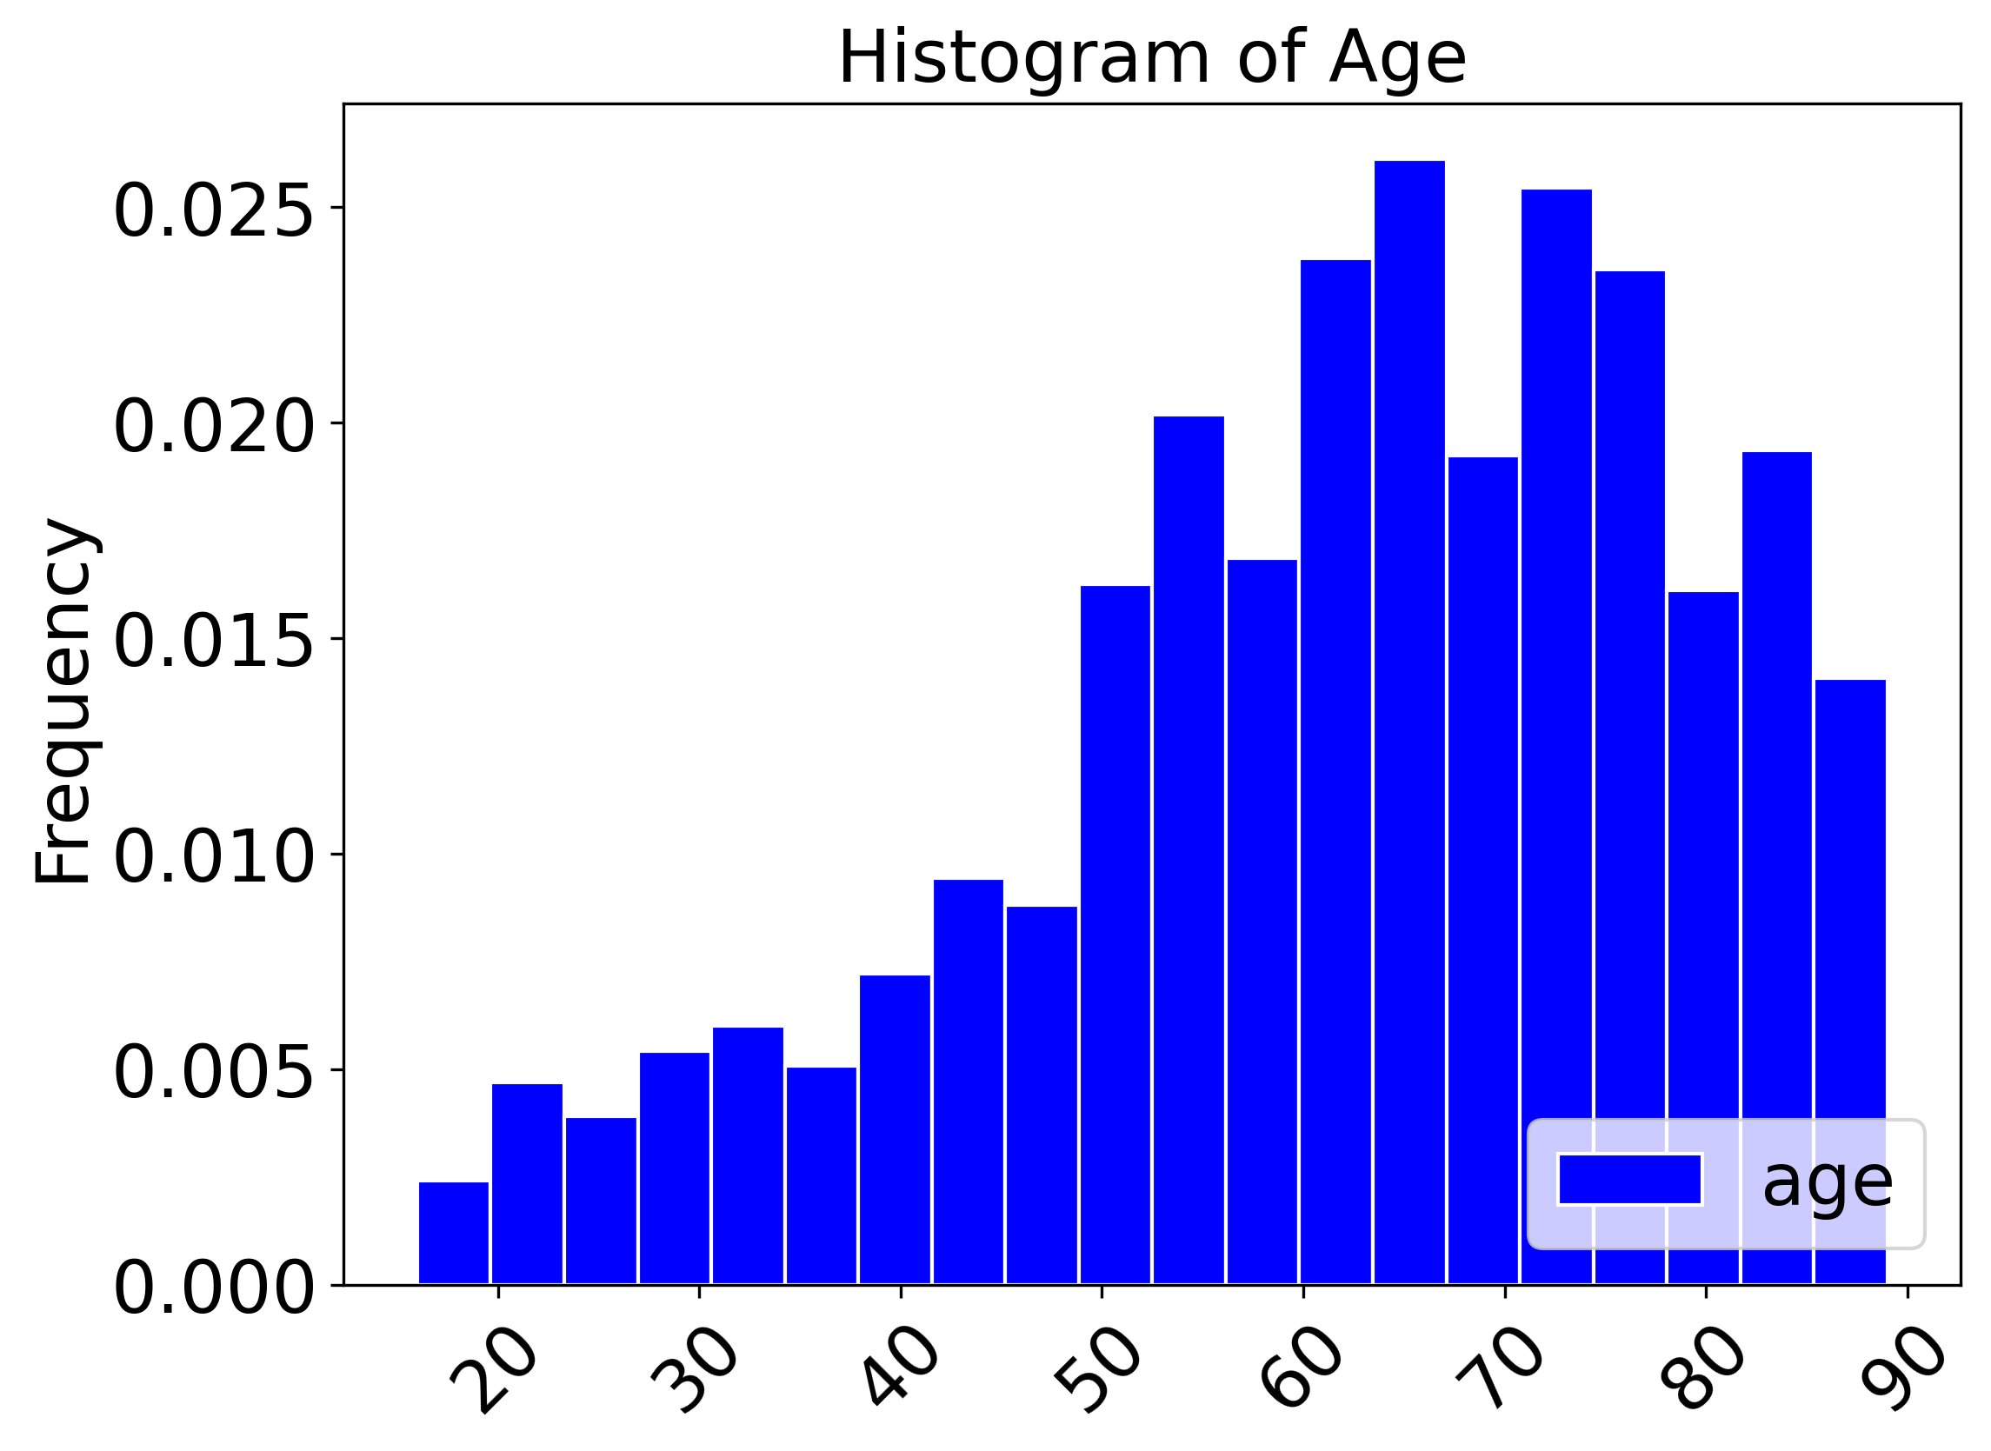
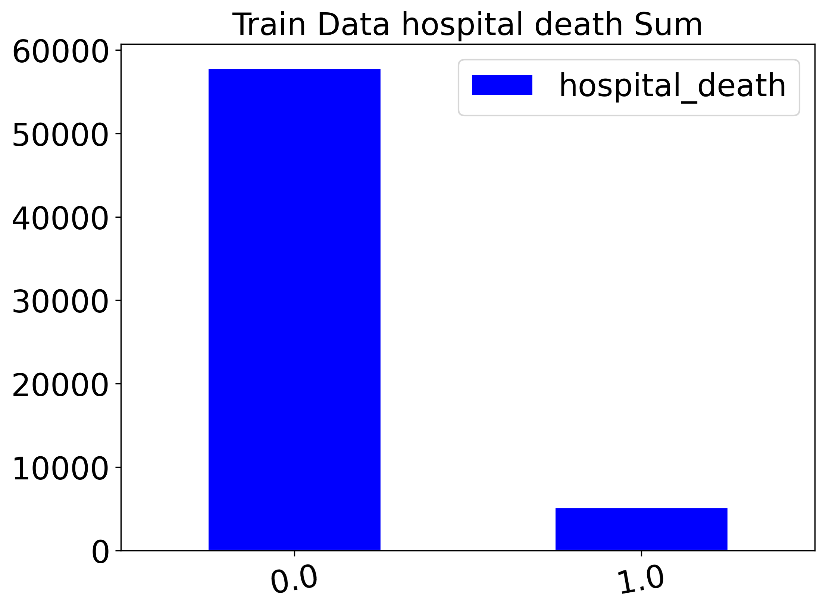
Exploratory Data Analysis
Patients’ age over 90 are excluded from the data
Imbalanced data of deaths and survival in training data

Slide 8
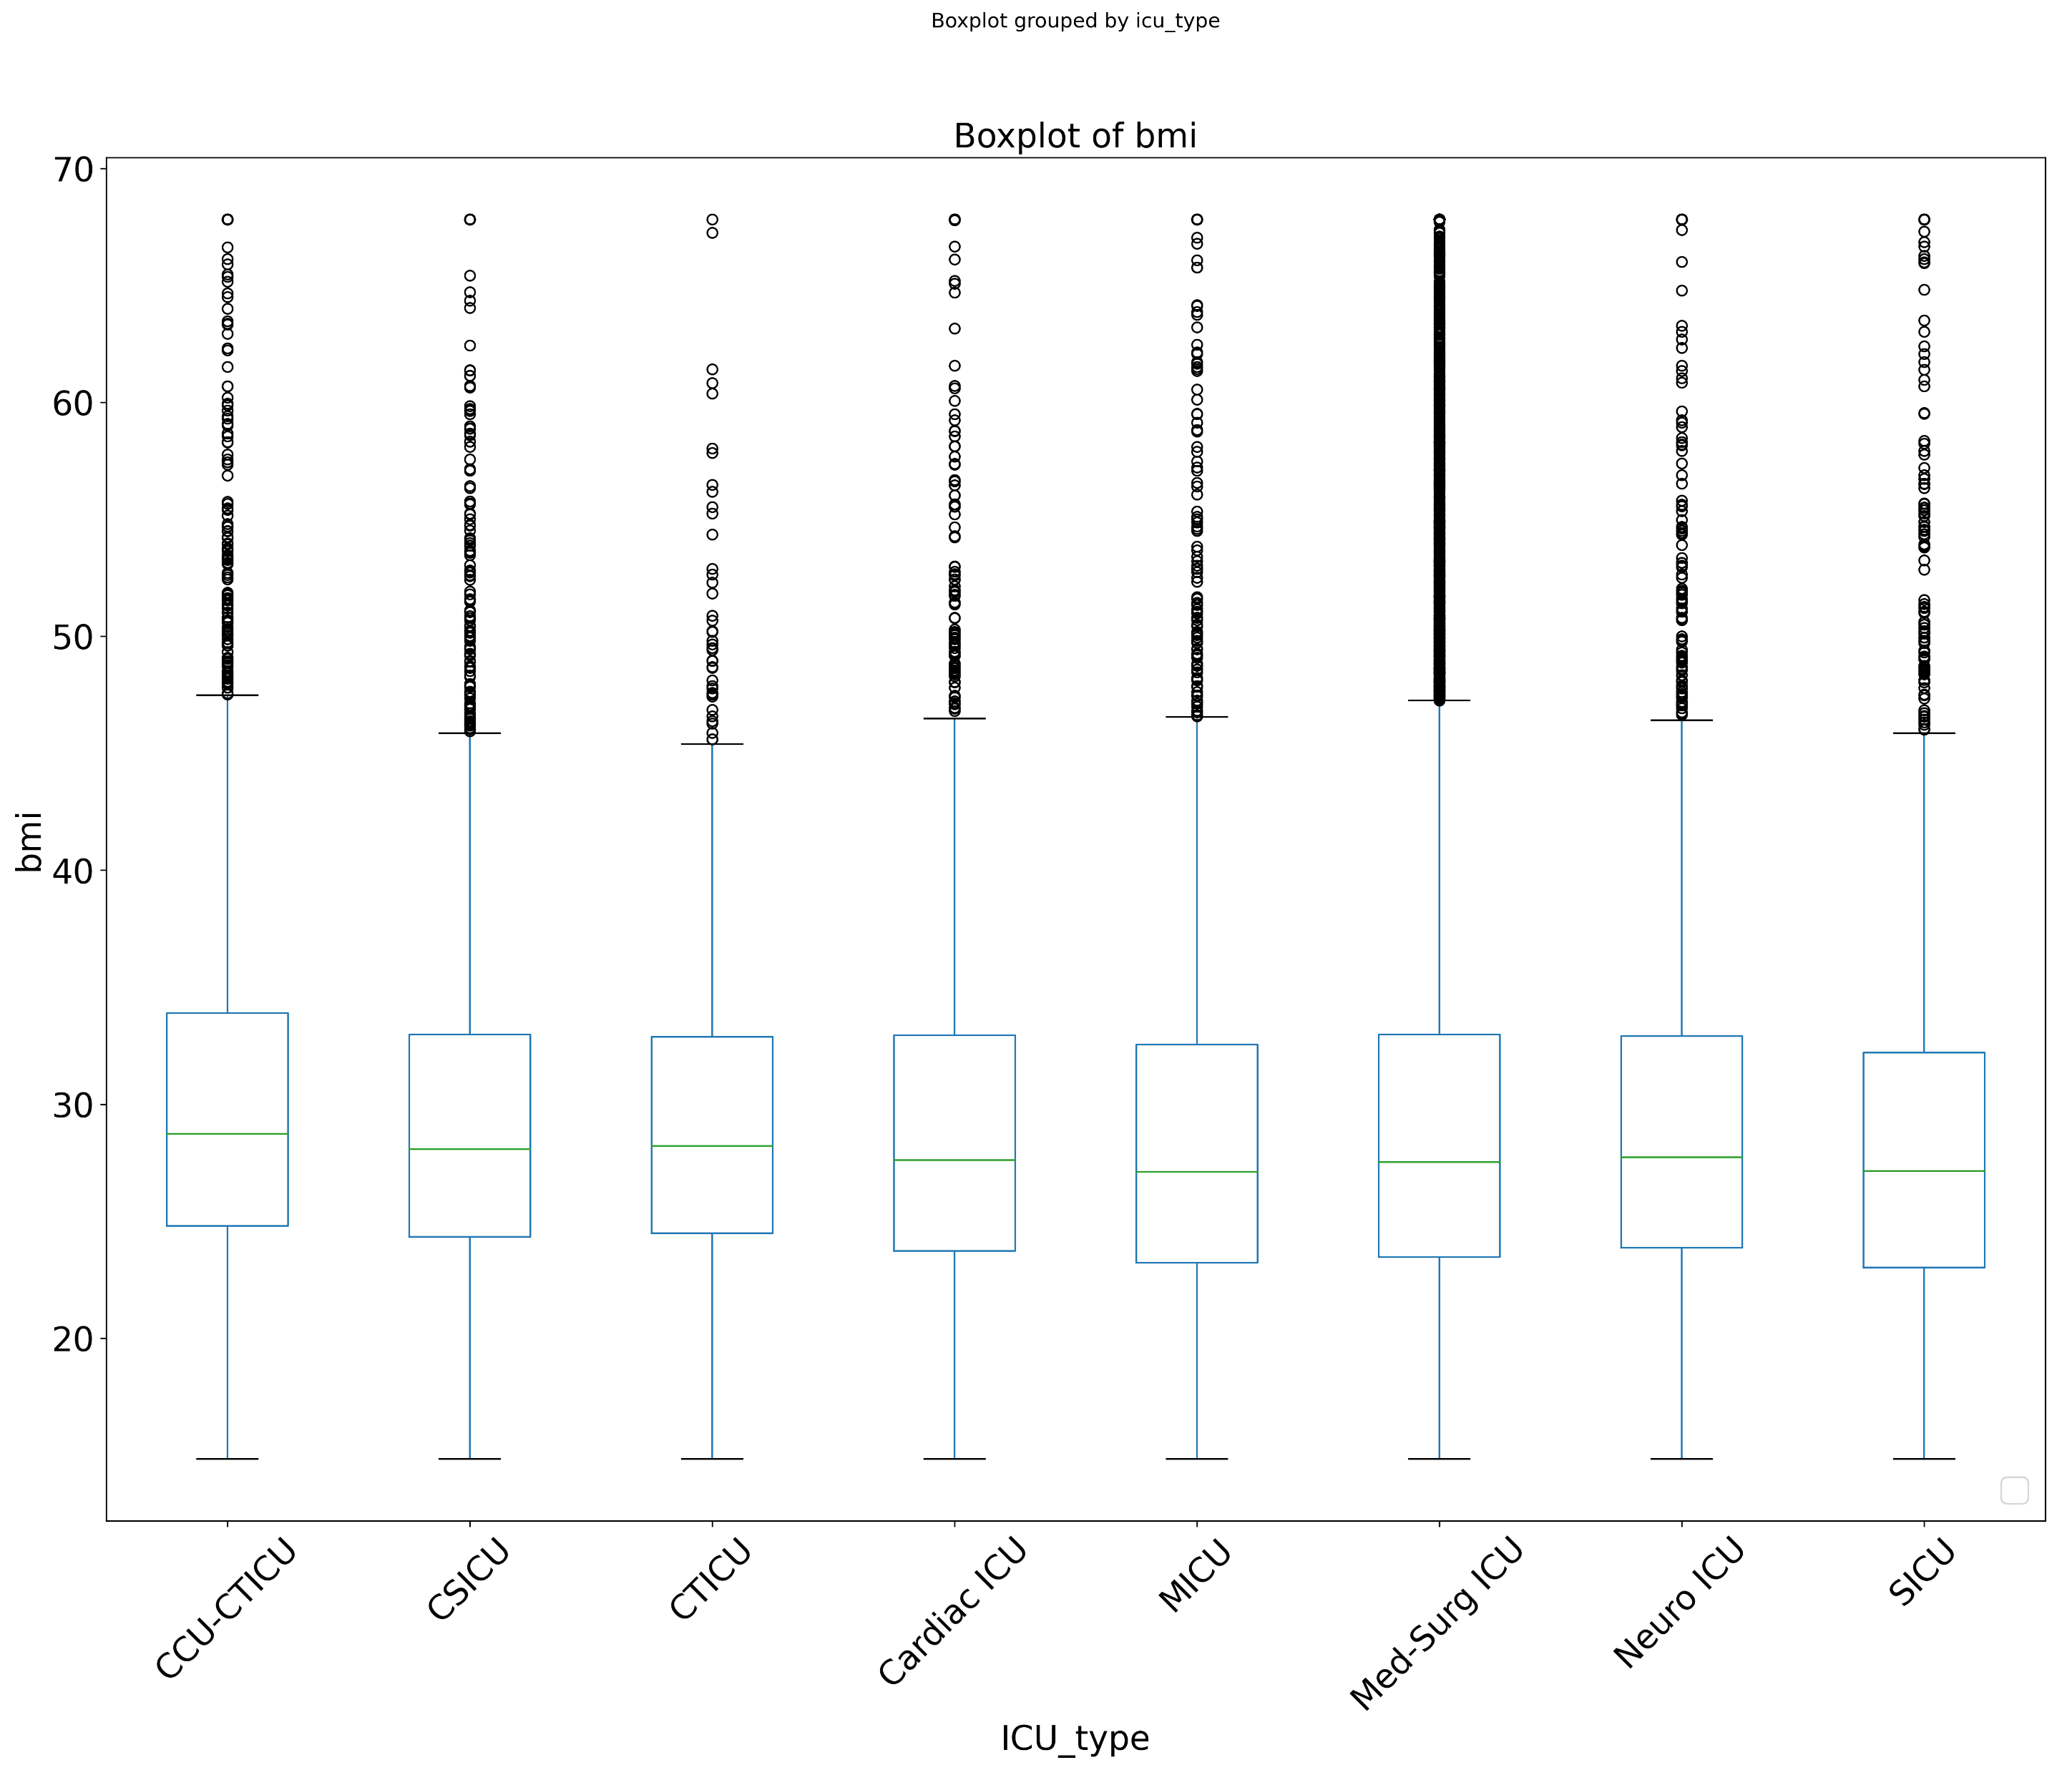
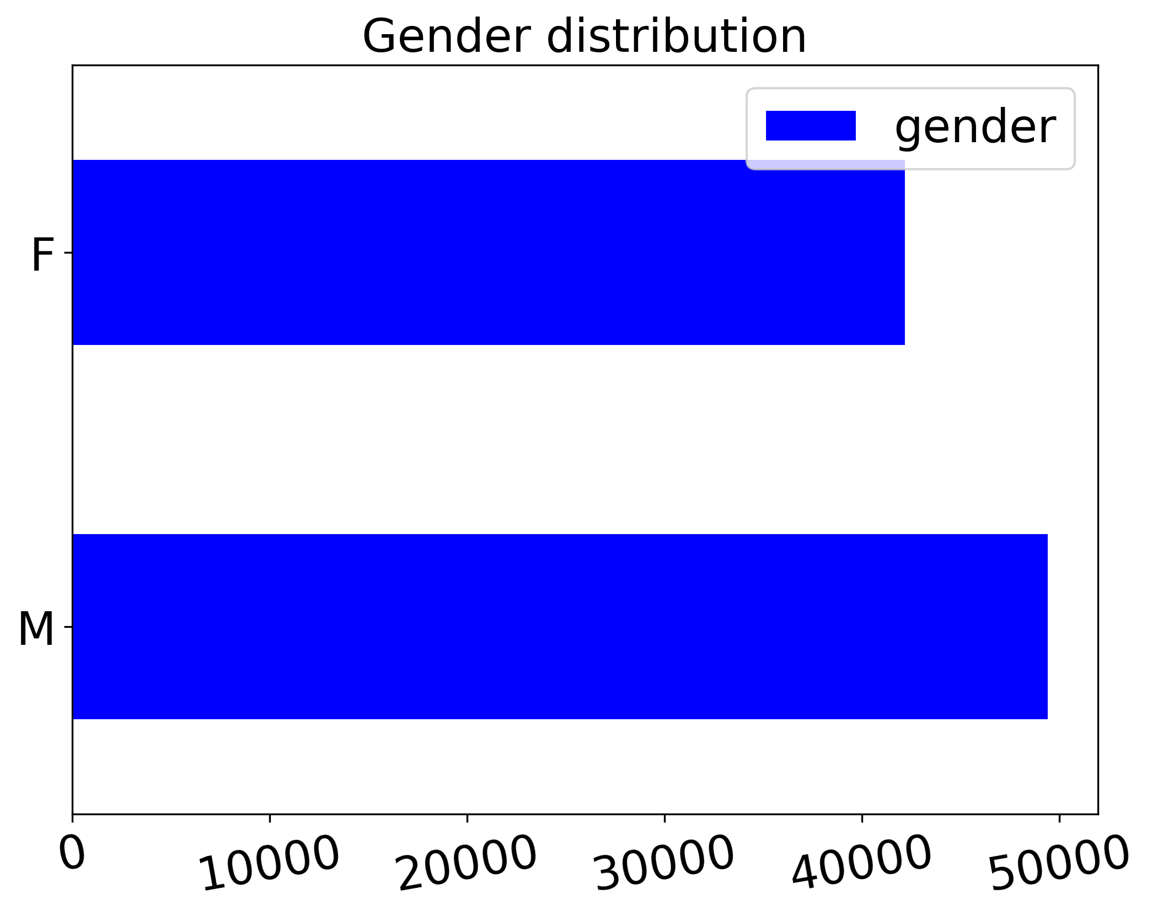
Exploratory Data Analysis
Body mass index are equally distributed in the ICU Types.
Gender data are balanced.

Slide 9
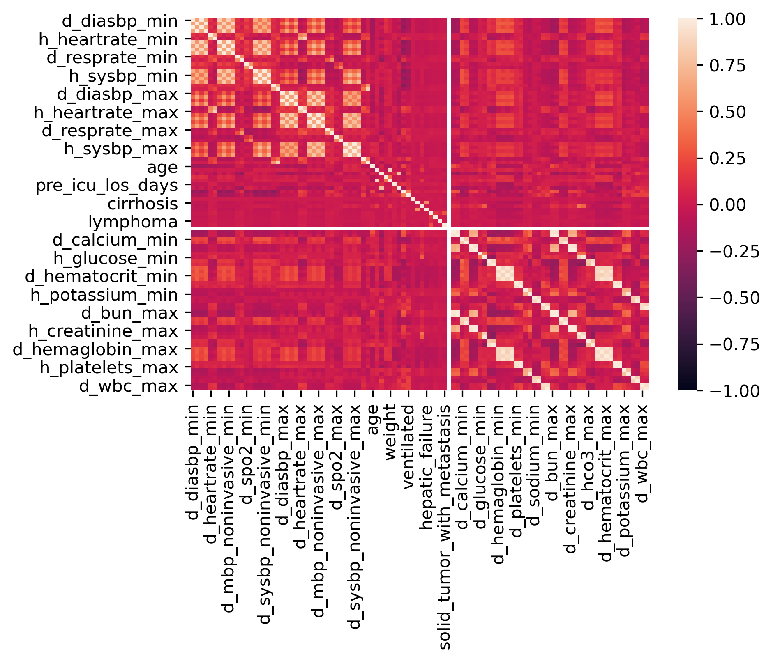
Feature Correlation & Sig Predictors
Heat map identifies the features of high or low correlation features.
Solid tumor metastasis, lymphoma, day_diasbp_min, and day_mbc_max are removed from the model for high correlation with any other features.
Cirrhosis is removed due to the none correlation to other features

Slide 10
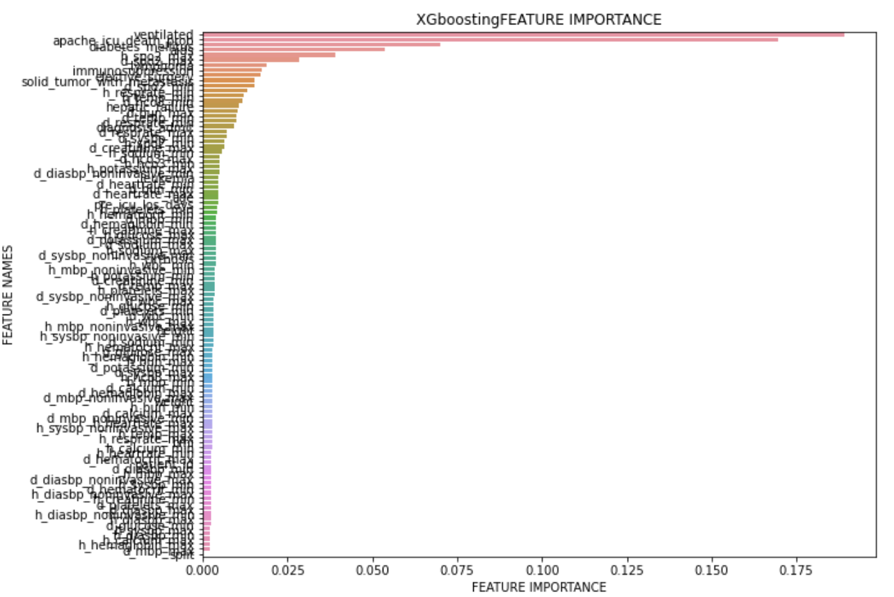
Feature Importance Ranking
The outcomes only stands out four features, Other features show no effect thus remove from the model.
Hyperparameter tuning is applied to use only four features that have the importance to the model
Decision Tree Feature Importance
 | Features | Coefficient
48 | apache_icu_death_prob | 0.785
49 | ventilated | 0.191
52 | diabetes_mellitus | 0.023
15 | d_sysbp_min | 0.001

Slide 11
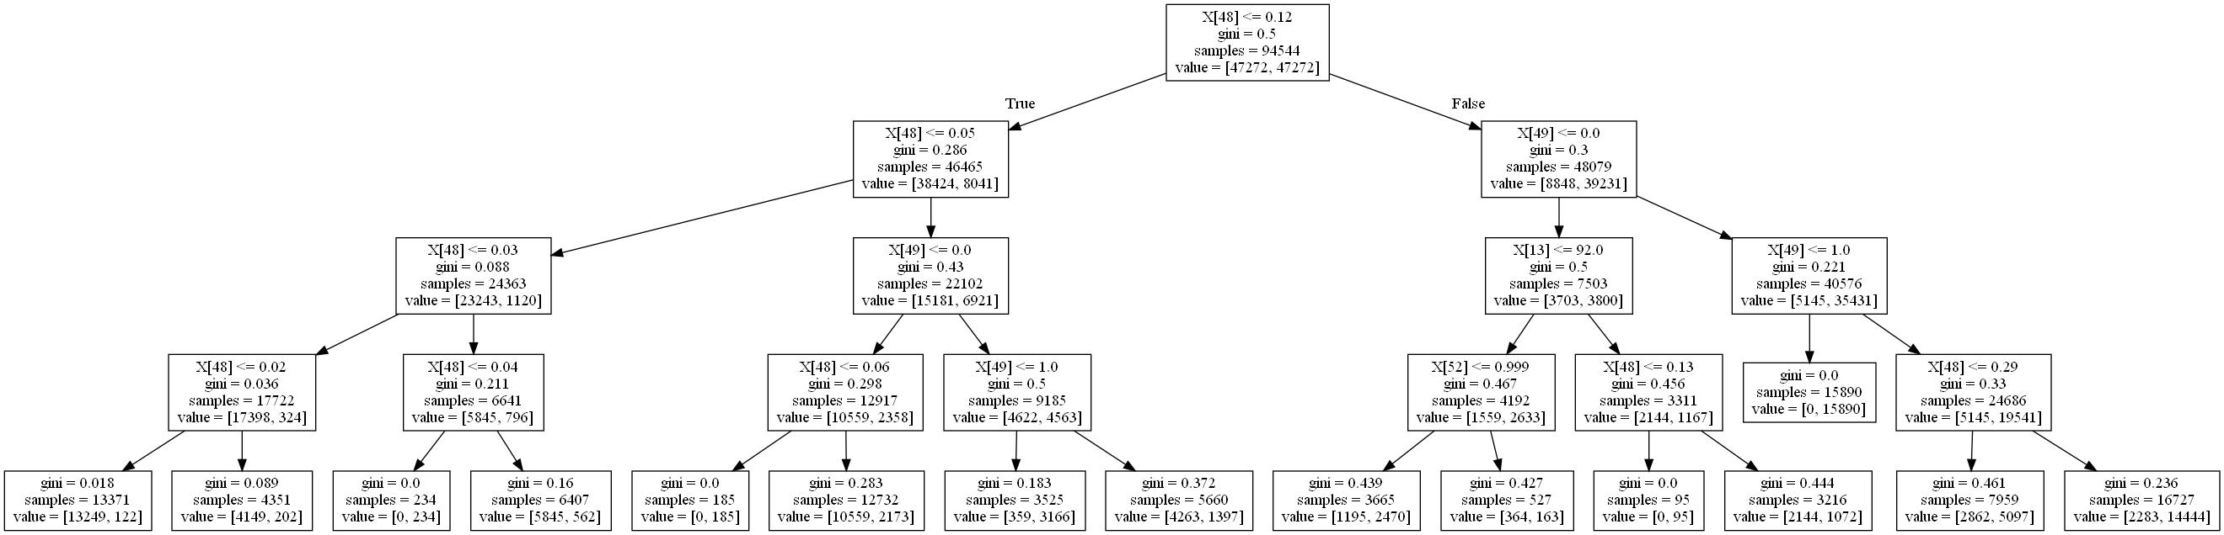
Decision Tree for Clinical Implication
Calibration: APACHE <= 0.12
Clinical Critical Value:
Ventilated < 0
diabetes_mellitus: <= 0.99,
systolic blood pressure: <= 92.0
Notes:
apache_icu_death_prob: Probabilistic prediction of in ICU mortality for the patient using the current "gold standard" tool (APACHE)
Ventilated: Whether the patient was invasively ventilated at the time of the highest scoring arterial blood gas using the oxygenation scoring algorithm
d_sysbp_min: systolic blood pressure, either non-invasively or invasively measured
diabetes_mellitus: Whether the patient has cirrhosis and additional complications including jaundice and ascites, upper GI bleeding, hepatic encephalopathy, or coma.

Slide 12
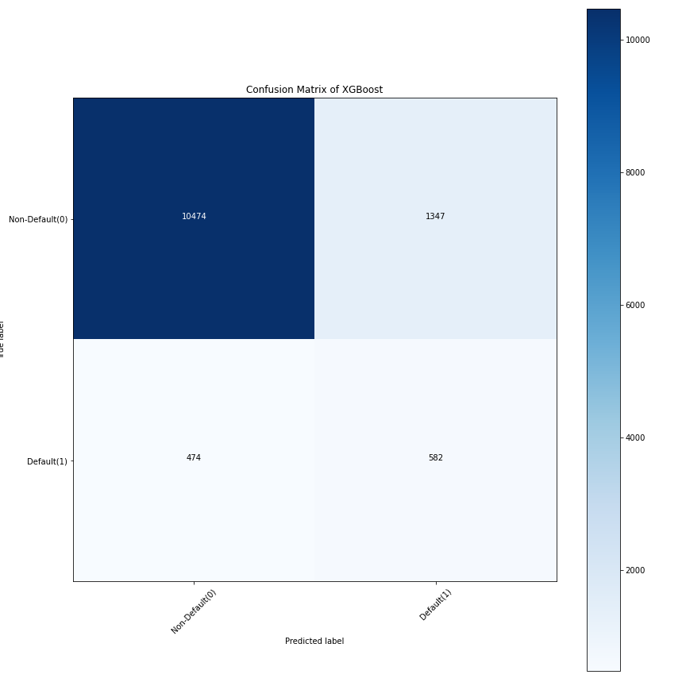
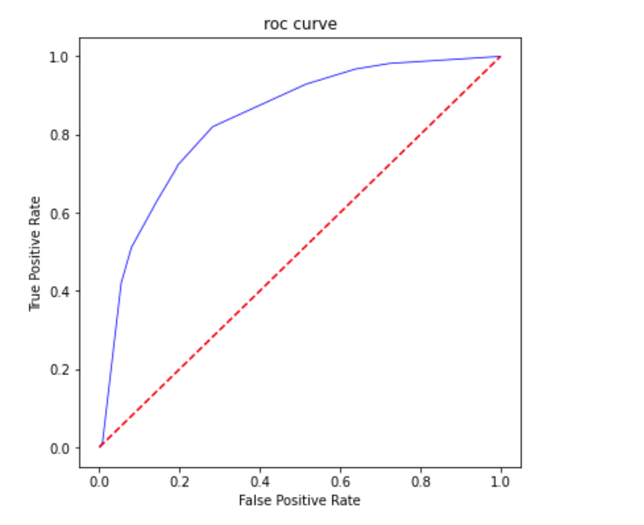
Hyperparameter Tuning
Notes:
Model parameters are learned during training when we optimize a loss function using something like gradient descent.

Slide 13
Models Performance Comparison
 | 5- Folds Cross validation Mean accuracy sore | F1 Score | Recall Confusion Matrix (TPR) | AUC ROC curve | Confusion Matrix (FPR)
Decision Tree | 0.79 | 0.36 | 0.73 ** | 0.84 | 0.20
KNN | 0.91 | 0.36 | 0.42 | 0.62 | 0.08
Logistic Regression | 0.92 | 0.41 | 0.68 | 0.78 | 0.15
XGboosting | 0.93 ** | 0.68 ** | 0.55 | 0.88 ** | 0.11**
Notes:
FPR no death but predict death
TPR death and death **
TP
NF

Slide 14
Findings & Implication
The machine learning-based models developed in this study are compared to their prediction performance on each metric. Amongst them, XGboosting showed the best performance in predicting the risk of in-hospital death.
The model provides the calibration of the APACHE probability and control of ventilated levels to protect the patients at risk. Other features like diabetes mellitus can be used as a reference to prioritize the patients at risk.
It has the potential to assist physicians in the ICU to perform appropriate clinical interventions for critically ill patients and thus may help improve the pre-diagnostic of patients in the ICU.

Slide 15

Questions & Answers
Zhangyu027@gmail.com

