Slide 1
OPERATING SYSTEMS
刘波
liugubin530@126.com

Slide 2
Textbook
Modern Operating Systems, Andrew S.Tanenbaum, Prentice Happ, Fourth Edition, 2017.11
References
  Abraham Silberschatz, Peter Baer Galvin, Greg Gagne, Operating system concepts (7th Edition)，高等教育出版社，2007年3月(中文翻译版2010年1月)
  William Stallings著，陈向群、陈渝等译，操作系统: 精髓与设计原理(原书第6版)，机械工业出版社，2010年9月
  谢旭升 朱明华 张练兴 李宏伟 编著，操作系统教程，机械工业出版社，2012月1月（高等院校精品课程系列教材）

Slide 3
Course requirement
  Final exam: 60%
  Homework: 20%
  Experiments: 20%

Slide 4
Content of this book
  Introduction (chapter 1)
  Processes and Threads (chapter 2)
  Deadlocks (chapter 6)
  Memory management (chapter 3)
  File Systems (chapter 4)
  Input /Output (chapter 5)

Slide 5
Chapter 1 Introduction
1.1 What is an operating system
1.2 History of operating systems
1.3 Computer hardware review
1.4 The operating system zoo
1.5 Operating system concepts
1.6 System calls
1.7 Operating system structure

Slide 6
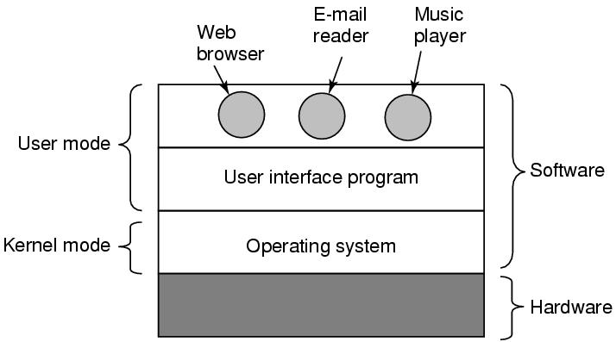
1.1 Where?
A computer system consists of
  Hardware
  Software

Slide 7
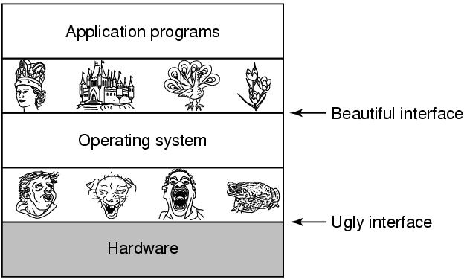
What is OS?
It is an extended machine (top-down)
  Hides the messy details which must be performed
  Presents user with a virtual machine, easier to use

Slide 8
What is OS?
It is a resource manager (bottom-up)
  Allow multiple programs to run at the same time
  Manage and protect memory, I/O devices, and other resources
  Includes multiplexing (sharing) resources in two different ways:
    In time
    In space

Slide 9
1.2 History of Operating Systems
First generation 1945 - 1955
  vacuum tubes, plug boards
Second generation 1955 - 1965
  transistors, batch systems
Third generation 1965 – 1980
  ICs and multiprogramming
Fourth generation 1980 – present
  personal computers and workstations (Network operating systems and distributed operating systems)
  Requirement ----→ development

Slide 10
History of Operating Systems (1)
Vacuum tubes, handwork
mode
  User: operator and programmer
  Machine language
  I/O: plugboard, punched cards
characteristic
  The user occupy the machine alone
  CPU wait the user load and unload the plugboard
conflict
  CPU (high) ----- handwork (low)
Method
  Special operator, batch system

Slide 11
History of Operating Systems (2)
Transistors, batch system
Mode
  User: operator or programmer
  Language: assembly language, Fortran…
  I/O: card, tape
  - os: Monitor (execute the jobs )
  - online batch system / off-line batch system

Slide 12

Early off-line batch system
  (a) Programmers bring cards to 1401
  (b) 1401 reads batch of jobs onto tape
  (c) Operator carries input tape to 7094
  (d) 7094 does computing
  (e) Operator carries output tape to 1401
  (f) 1401 prints output

Slide 13
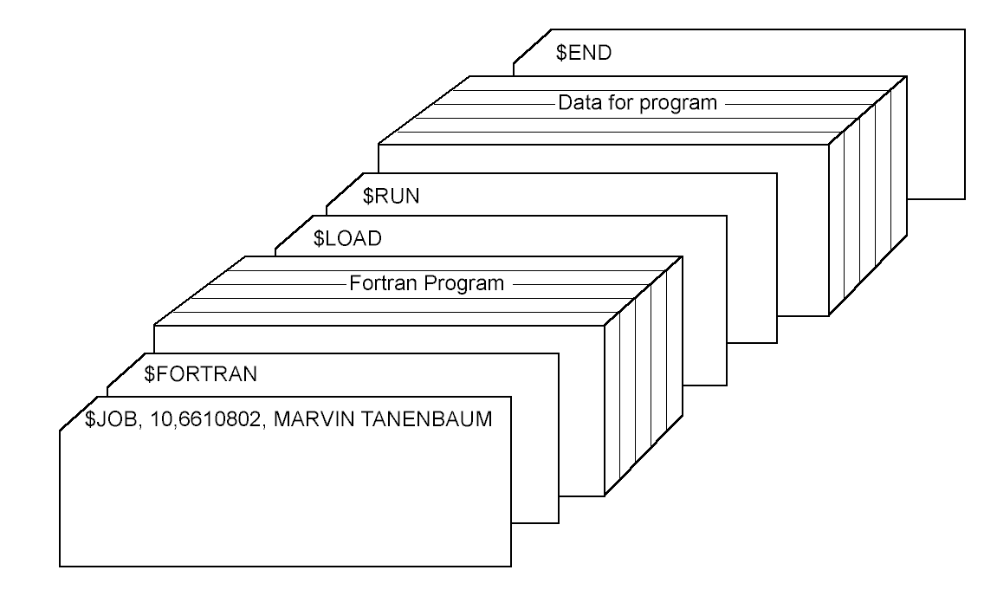
Job: program, data, job specification
Structure of a typical FMS job – 2nd generation
Notes:
Flaw: cpu and I/o 忙闲不均

Slide 14
History of Operating Systems (3)
IC, multiprogramming
Batch system: good efficiency, bad interaction.
time-sharing system
(a variant of multiprogramming):
  multi users share the computer, each has a online terminal;
  Allocate CPU by time slice(时间片);
  quick response time.

Slide 15

History of Operating Systems (3)
Mode
  Partition memory into several pieces, with a different job in each partition
  Parallel in macroscopic
  Serial in microcosmic
Multiprogramming system
  three jobs in memory – 3rd generation

Slide 16
Fourth generation 1980 – Present
Large scale integration (LSI)
Operating systems for personal computers
  CP/M (Control Program for Microcomputers)
  DOS (Disk Operating System) ➔ MS-DOS
  GUI (Graphical User Interface)
  Windows ➔ Windows 95/98/Me
  Windows NT➔ Windows 2000➔ Windows XP➔ Vista ➔Win7 ➔Win8 ➔Win10
  UNIX:
    X Windows
    Linux, GNOME, KDE

Slide 17
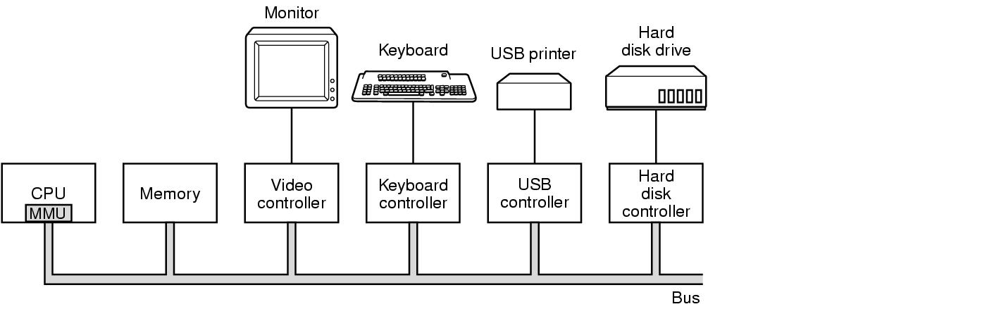
1.3 Computer Hardware Review
Some of the components of a simple personal computer

Slide 18
Computer Hardware Review (CPU)
calculator, controller, registers, cache.
Registers: (quick, high price, low capability)
  data register
  address register
  PC：Program Counter
  IR：Instruction Register
  PSW：Program Status Word

Slide 19
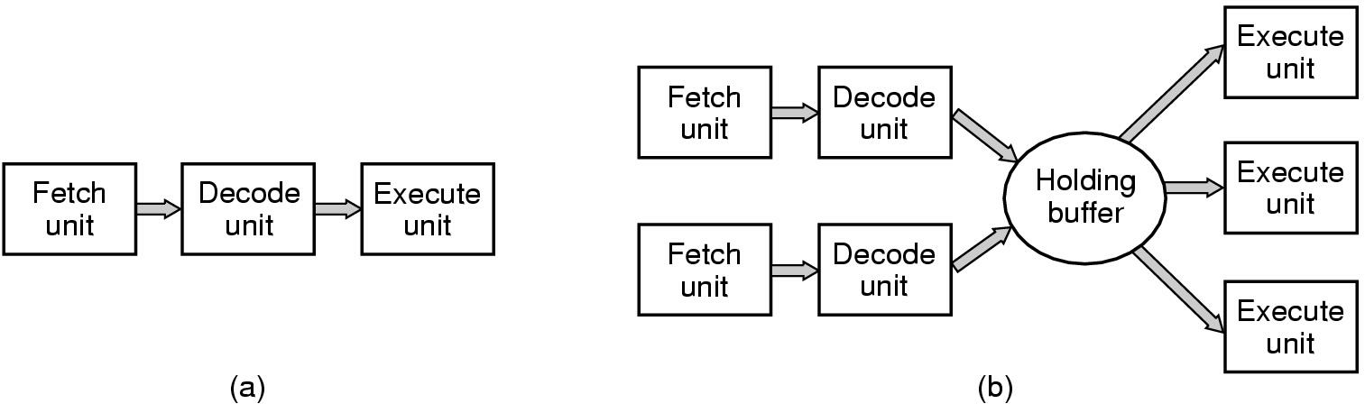
Process of instructions
(a) A three-stage pipeline
(b) A superscalar (超标量) CPU

Slide 20
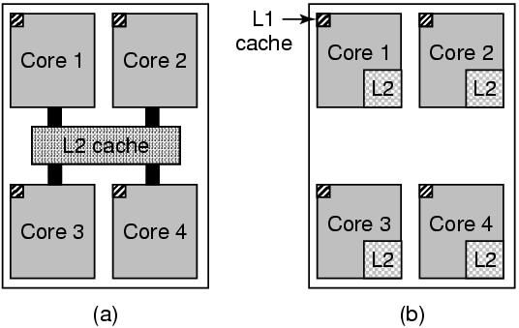
Multithreaded and Multicore Chips
Figure 1-8. (a) A quad-core chip with a shared L2 cache.
(b) A quad-core chip with separate L2 caches.

Slide 21
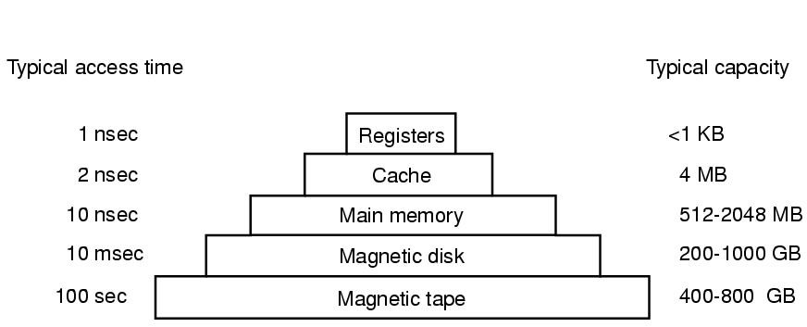
Computer Hardware Review (Memory)
Capability, speed, cost
A typical memory hierarchy
  The numbers shown are rough approximations

Slide 22
Cache
  Questions when dealing with cache:
    When to put a new item into the cache.
    Which cache line to put the new item in.
    Which item to remove from the cache when a slot is needed.
    Where to put a newly evicted item in the larger memory.
  Multi-level cache (2-level or 3-level)

Slide 23
RAM
  With two or more programs in main memory at once, two problems must be solved:
    How to protect the programs from one another and the kernel from them all.
    How to handle relocation.

Slide 24
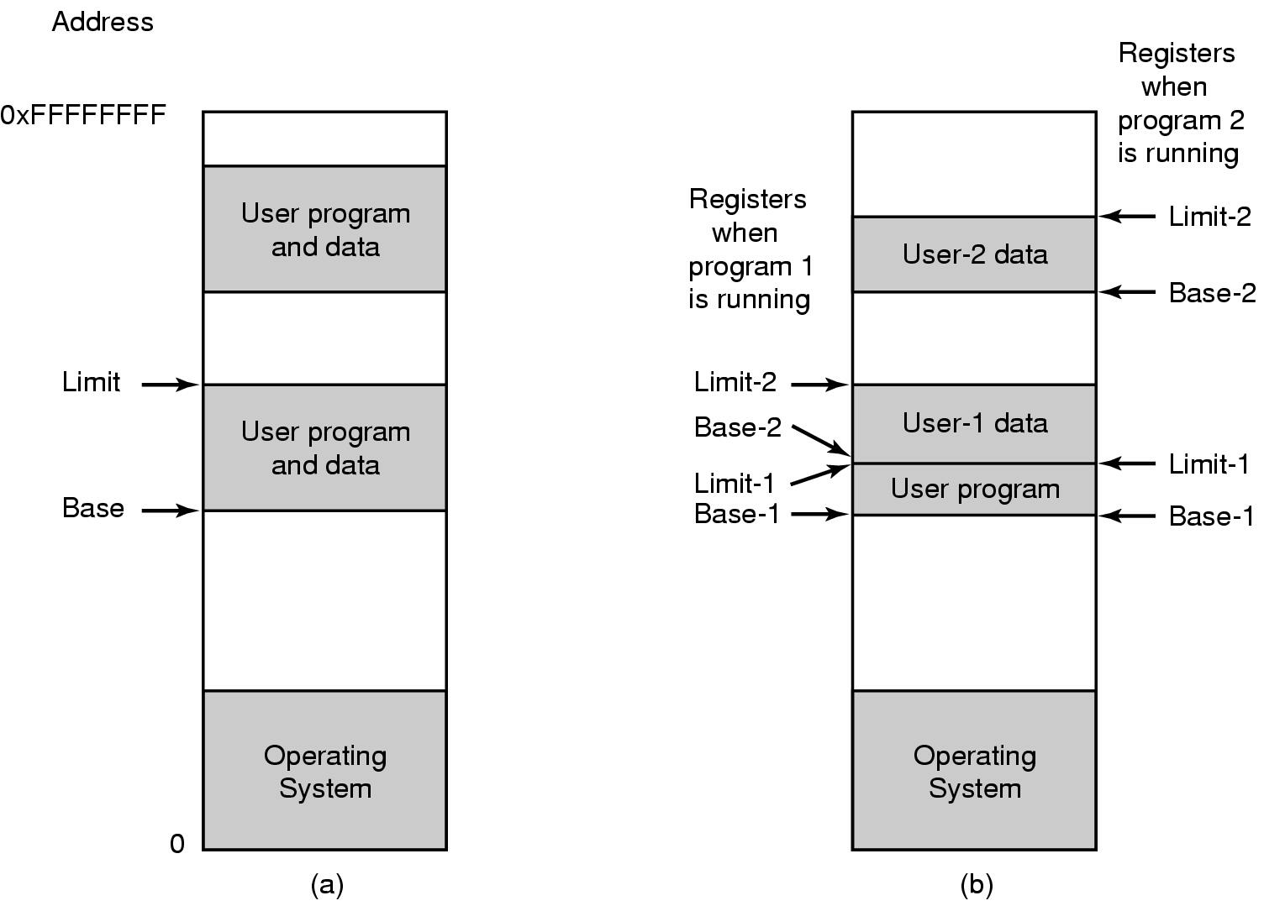
One base-limit pair and two base-limit pairs

Slide 25
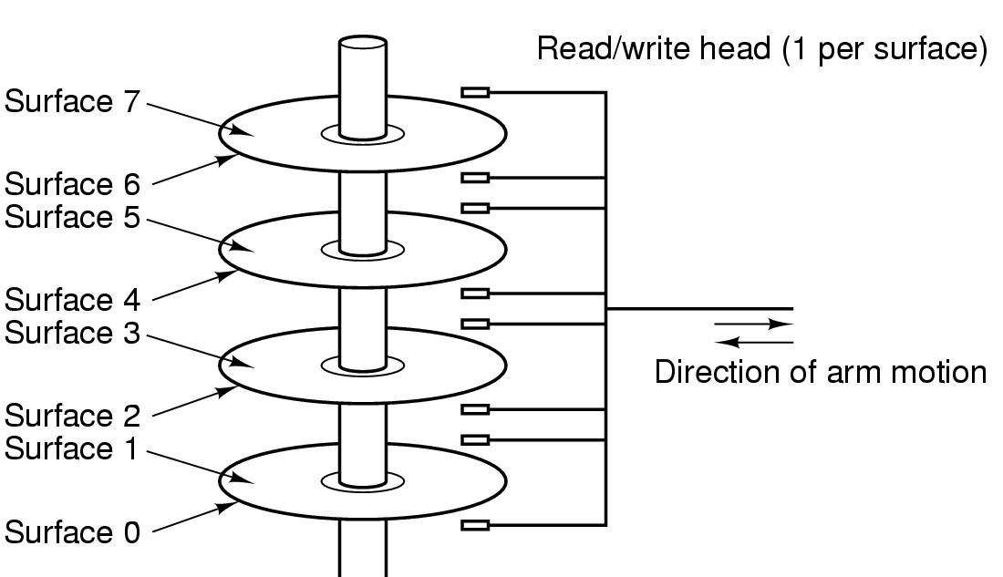
Disk
Structure of a disk drive

Slide 26
Computer Hardware Review (I/O)
I/O devices generally consist of two parts: a controller and the device itself.
  Device driver: the software that talks to a controller, giving it commands and accepting responses.
Input and output can be done in three different ways:
  Program-controlled I/O (Polling)
  Interrupt-driven I/O
  Direct Memory Access (DMA)

Slide 27
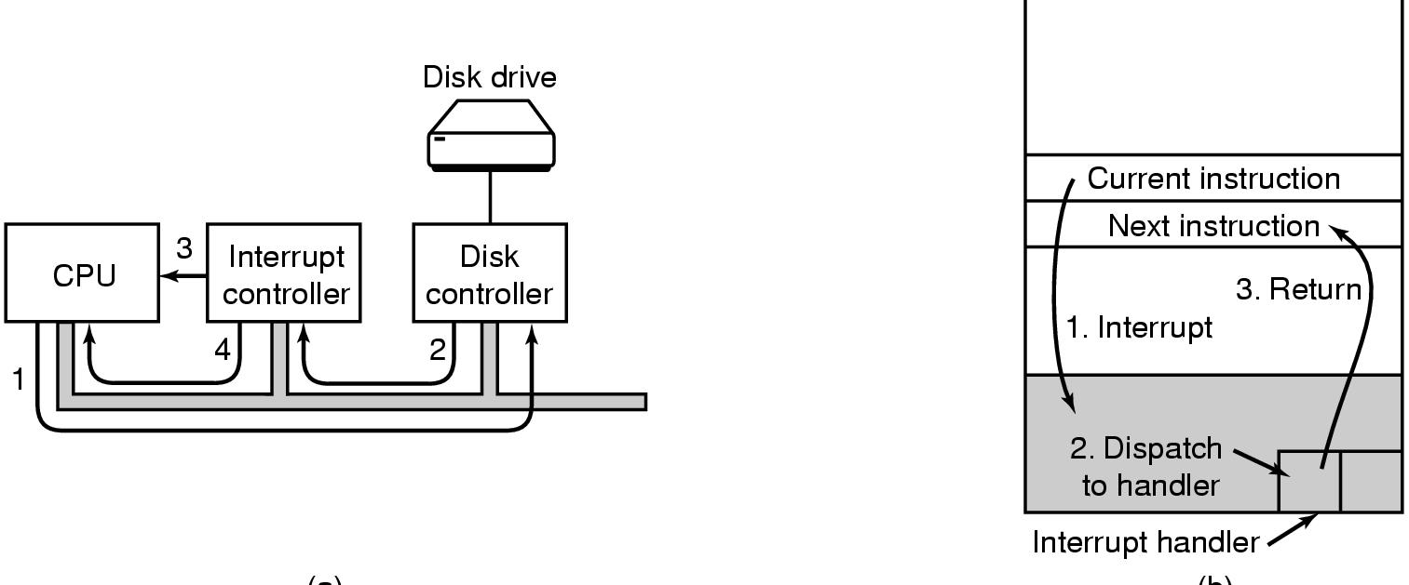
(a)
(b)
(a) The steps in starting an I/O device and getting interrupt
(b) How the CPU is interrupted

Slide 28
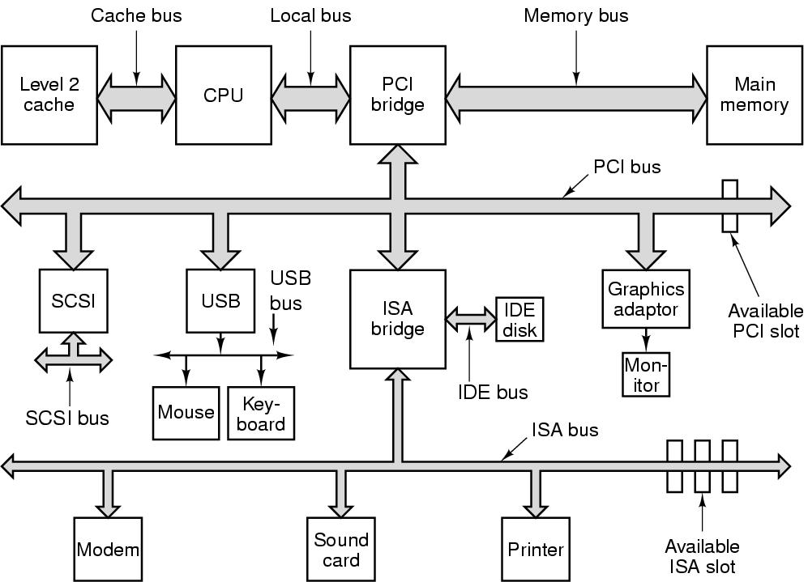
Computer Hardware Review (Buses)
The structure of a large Pentium system

Slide 29
1.4 The Operating System Zoo
Mainframe operating systems
  E.g.: OS/390, zOS
Server operating systems
  E.g.: Solaris, FreeBSD, Linux, Windows Server 200x
Multiprocessor operating systems
Personal computer operating systems
  E.g.: Win 7/8/10, Vista, Macintosh, Linux, FreeBSD
Handheld operating systems
  E.g.: Android, iOS

Slide 30
Embedded operating systems
  E.g.: QNX, VxWorks
Sensor node operating systems
  E.g.: Tiny OS
Real-time operating systems
  Hard real-time system: the action absolutely must occur at a certain moment, such as e-Cos.
Smart card operating systems
  Java Virtual Machine (JVM)

Slide 31
1.5 Operating System Concepts (Processes)
A process is a program in execution.
为了描述和控制进程的运行，系统为每个进程定义了一个数据结构——进程控制块PCB (Process Control Block)。所谓系统创建一个进程，就是由系统为某个程序设置一个PCB，用于对该进程进行控制和管理。进程任务完成，由系统收回其PCB，该进程便消亡。系统将根据某PCB而感知相应进程的存在，故说PCB是进程存在的唯一标志。
The information about a process (PCB) is stored in an operating system table called the process table.

Slide 32
Operating System Concepts (Processes)
A process called the command interpreter or shell read commands from a terminal.
If a process can create one or more other process (child processes) and these process create child processes, we can build them in a tree structure.
In UNIX, there is a parent process for all processes.

Slide 33
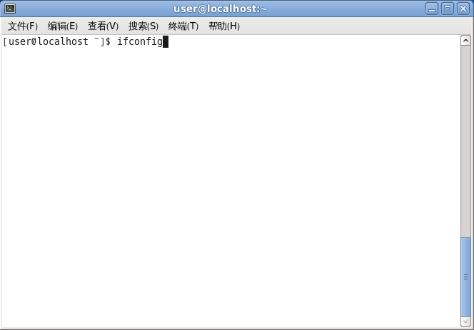
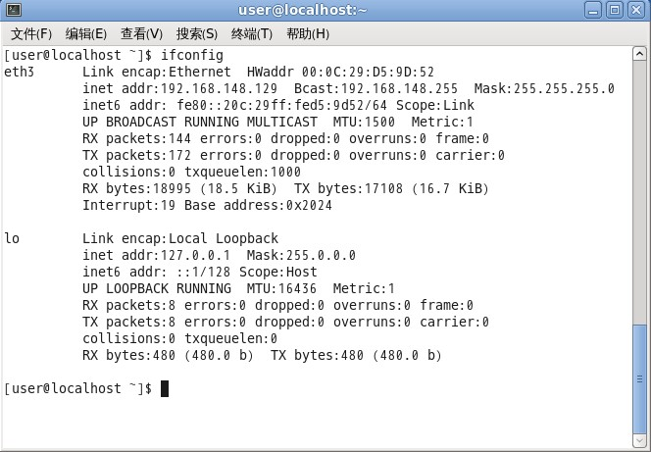
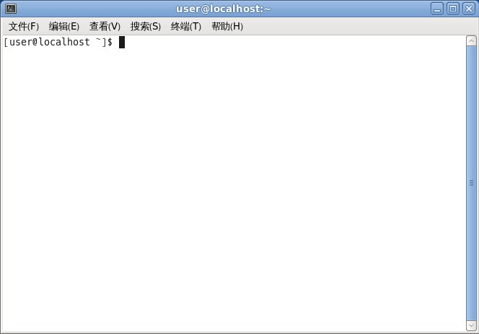
Operating System Concepts (Processes)

Slide 34

Operating System Concepts (Processes)
A process tree
  Process A created two child processes, B and C
  Process B created three child processes, D, E, and F

Slide 35
Operating System Concepts (Processes)
Process have many status: running, blocked, ready.
Each person authorized to use a system is assigned a UID (User IDentification). A process is assigned a PID (Process IDentification).
Users can be members of groups, each of which has a GID (Group IDentification).
The superuser (root in UNIX) has special privilege to violate many of the protection rules.
The communication to cooperate and synchronize processes is called interprocess communication.

Slide 36
Operating System Concepts
(Address Spaces & Files)
Address Space: a list of memory allocations from 0 to some maximum, which the process can read and write.
In virtual memory the operating system keeps part of the address space in main memory and part on disk.
A file system provides users with a nice, clean abstract model of device-independent files.
A directory is used to group files together.
A path name can specify the location of a file.
A root directory is the top of the directory hierarchy. In Unix, / is the root directory.
Each process has a current working directory (pwd).

Slide 37
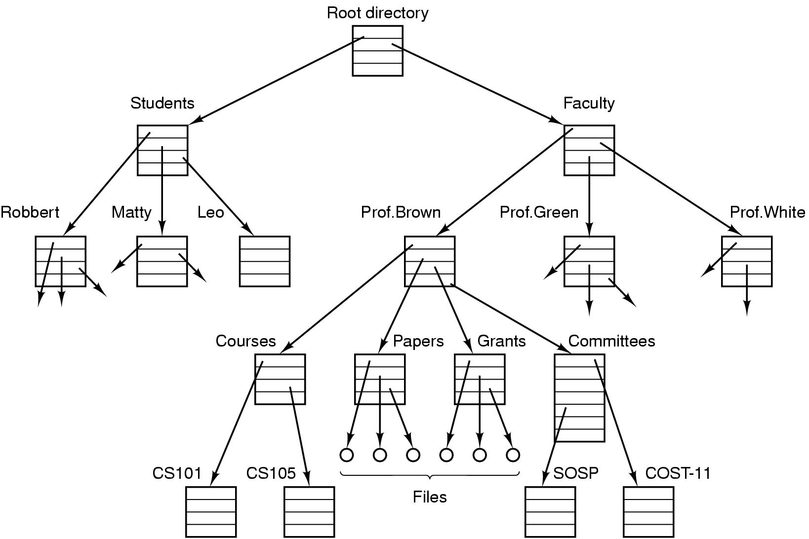
Operating System Concepts (Files)
A file system for a university department

Slide 38
Operating System Concepts (Files)
If a file access is permitted, the system return small integer called a file descriptor to use in subsequent operations.
Two kinds of special files exist in UNIX under the /dev directory: block special files (disks) and character special files (printers, modems).
In UNIX the mounted file system is used to deal with removable media (mount).

Slide 39
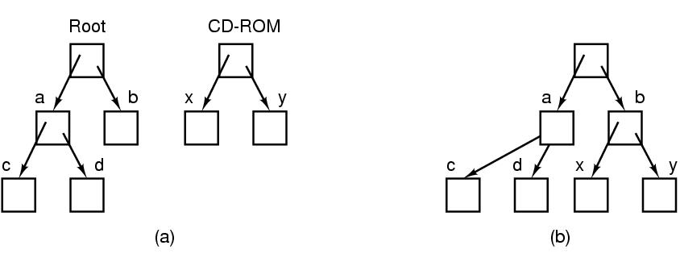
Operating System Concepts (Files)
Before mounting,
  The files on the CD-ROM are not accessible
After mounting,
  The files on the CD-ROM are part of the file hierarchy

Slide 40
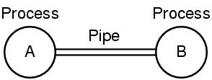
Operating System Concepts (Files)
A pipe is a sort of pseudofile that can be used to connect two processes.
Two processes connected by a pipe

Slide 41
Operating System Concepts
(Protection & Shell)
Files in UNIX are protected by a 9-bit binary protection code.
  The protection code consists of three 3-bit fields, one for owner, one for group, and one for others.
  Each field has a bit for read, a bit for write, and a bit for execute. They are known as rwx bits.
The UNIX command interpreter is called the shell.
Many shells exist, including sh, csh, ksh, and bash.
The user can use < and > to redirect the standard input and output. The ampersand (&) can be put after a command to start it as a background job.

Slide 42
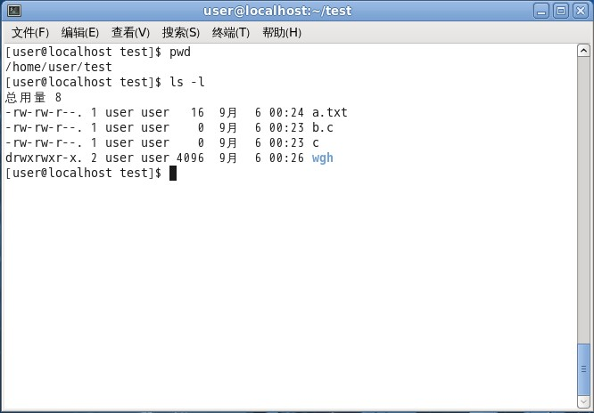
Operating System Concepts
(Protection & Shell)

Slide 43
Operating System Concepts
(Protection & Shell)
date >file
sort <file1 >file2
cat file1 file2 file3 | sort >/dev/lp
cat file1 file2 file3 | sort >/dev/lp &

Slide 44
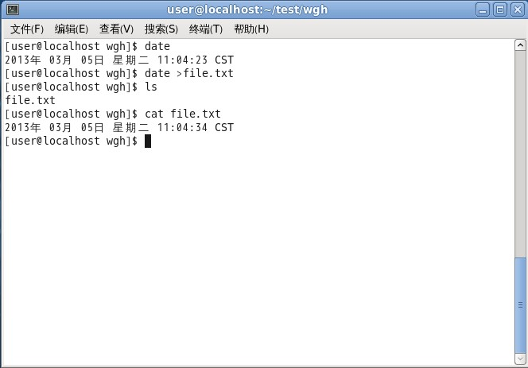
Operating System Concepts
(Protection & Shell)

Slide 45
1. 6 System Calls
System calls provide the interface between a running program and the operating system.
Process management
File management
Directory or Device management
Miscellaneous
  Information maintenance
  Communications

Slide 46

Steps in Making a System Call
There are 11 steps in making the system call
read (fd, buffer, nbytes)

Slide 47
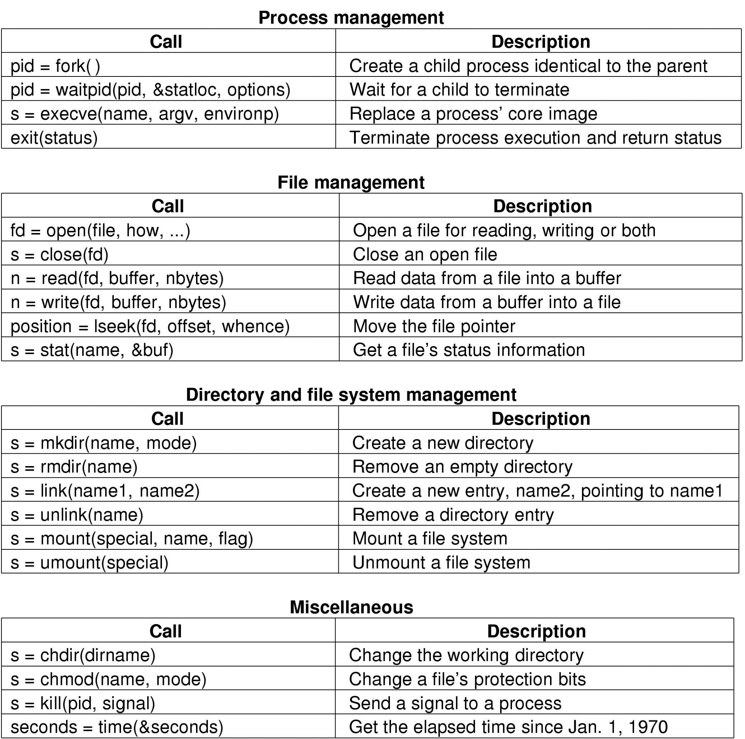
Some System Calls For Process Management

Slide 48
System Calls for Process
Fork creates a duplicate of the original process.
UNIX examples
  fork system call creates new process.
  execve system call used after a fork to replace the process’ memory space with a new program.
  waitpid system call used to move the parent process off the ready queue until the termination of the child.
Exit system call is used when a process is finished executing.

Slide 49
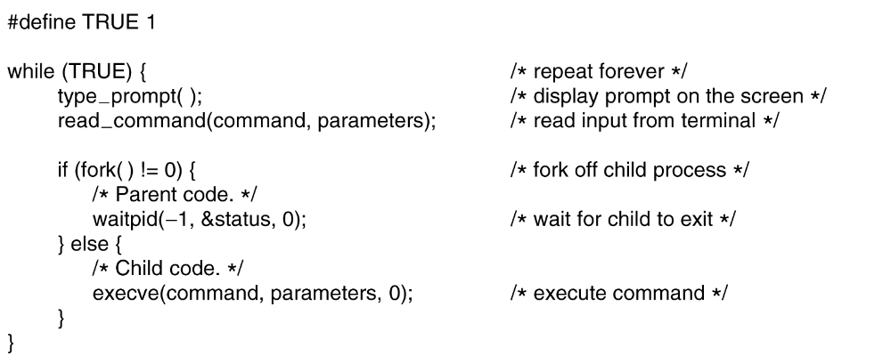
System Calls (Process)
A stripped down shell:

Slide 50
Forking Processes
/* fork processes */
main()
{
int i, pid;
for (i=1; i<=3; i++) {
if ((pid = fork()) == 0) {
printf("In child %d. \n", i);
}
}
}

Slide 51
Forking Processes
P
I = 1
I = 2
I = 3
I = 2
I = 3
I = 3
I = 3

Slide 52
Some System Calls For File Management

Slide 53
Some System Calls For Directory Management

Slide 54
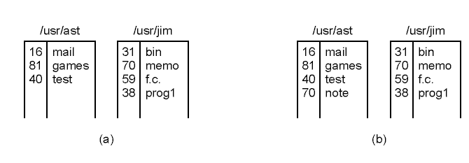
System Calls (Linking)
link(“/usr/jim/memo”, “/usr/ast/note”);
(a) Two directories before linking /usr/jim/memo to ast's directory
(b) The same directories after linking

Slide 55
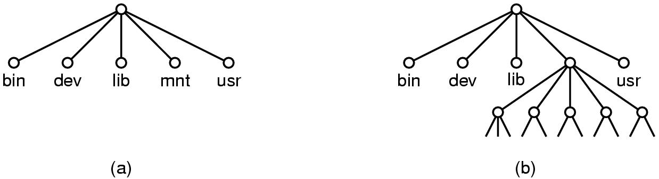
System Calls (Mounting)
mount(“/dev/fd0”, “/mnt”, 0)
(a) File system before the mount
(b) File system after the mount

Slide 56
Some System Calls For Miscellaneous Tasks

Slide 57
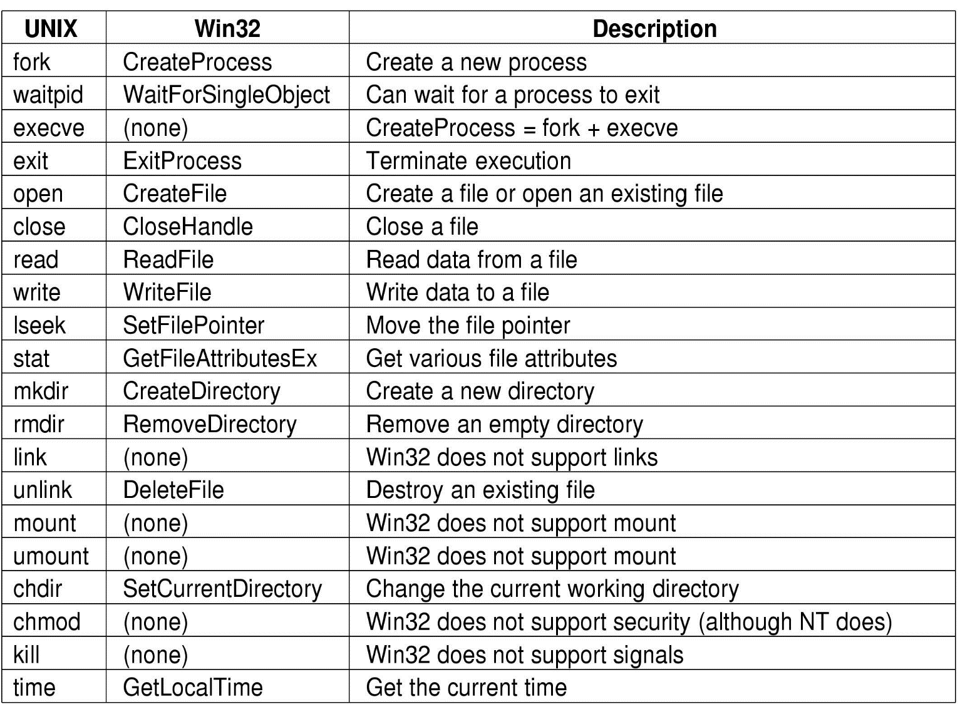
System Calls (Win32 API)
The Win32 API calls that roughly correspond to the UNIX calls of Fig. 1-18.

Slide 58
1.7 Operating System Structure
Monolithic System - "the big mess".
  All operating system operations are put into a single file. The operating system is a collection of procedures, each of which can call any of the others.
Layered System
  The operating system is organized as a hierarchy of layers of processes
Client-server model or microkernel
  micro-kernel and service processes.
  The operating system is collection of servers that provide specific services; e.g., file server, etc.
Virtual Machine

Slide 59
Operating System Structure (Monolithic)
Monolithic systems – basic structure:
  A main program that invokes the requested service procedure.
  A set of service procedures that carry out the system calls.
  A set of utility procedures that help the service procedures.

Slide 60
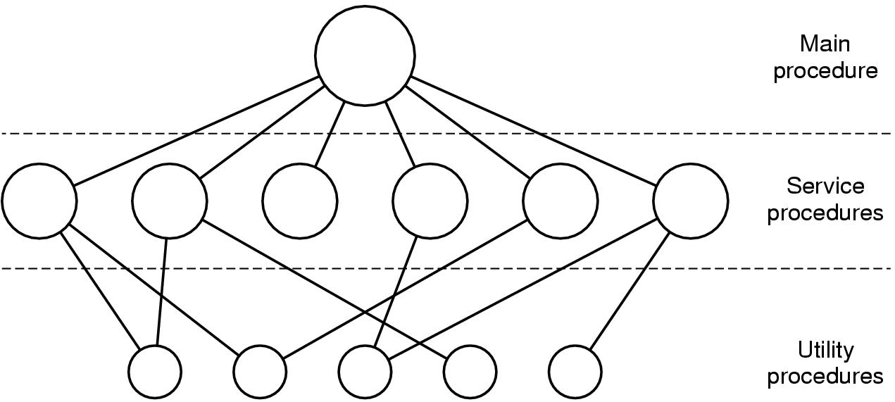
Operating System Structure (Monolithic)
Simple structuring model for a monolithic system

Slide 61
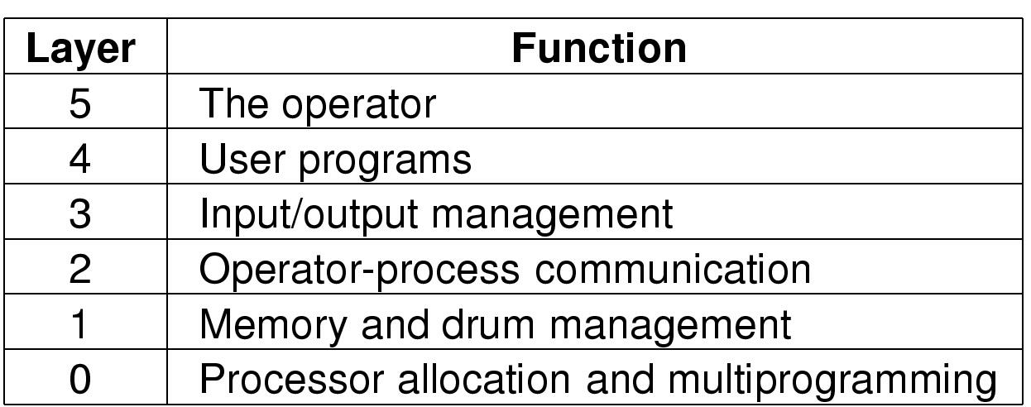
Operating System Structure (Layered)
Structure of the THE operating system

Slide 62
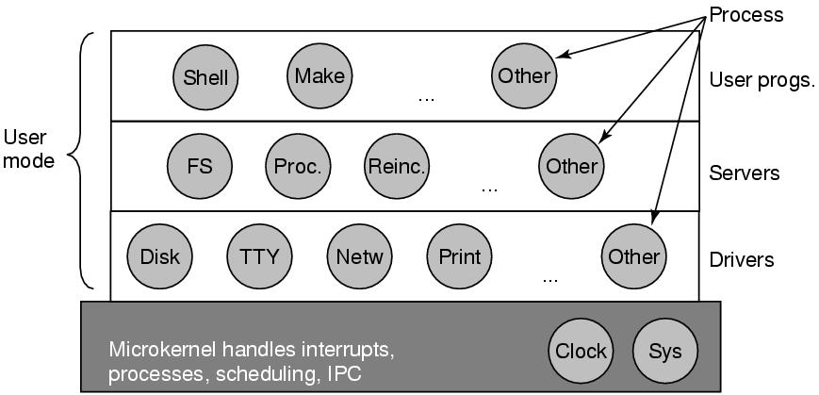
Operating System Structure (Microkernels)
Structure of the MINIX 3 system.

Slide 63
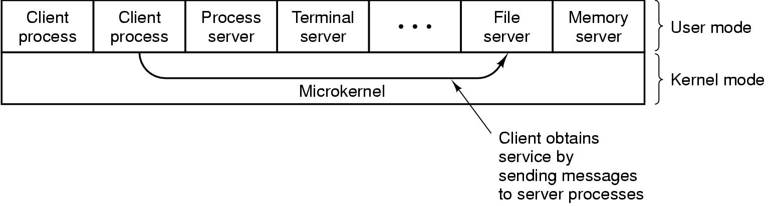
Operating System Structure (Client-server)
The client-server model

Slide 64
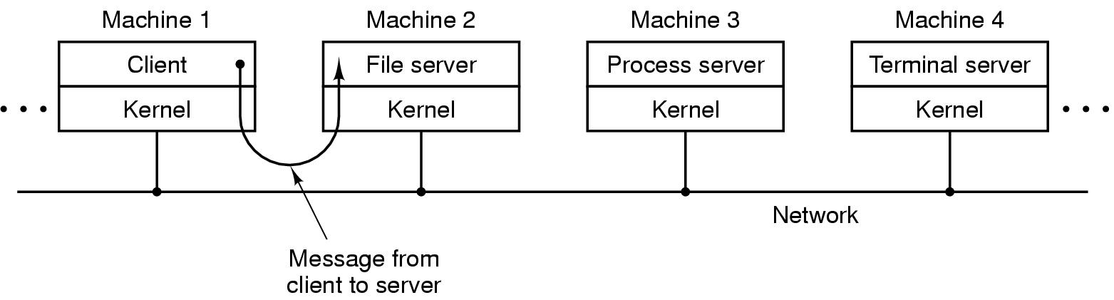
Operating System Structure (Client-Server)
The client-server model in a distributed system

Slide 65
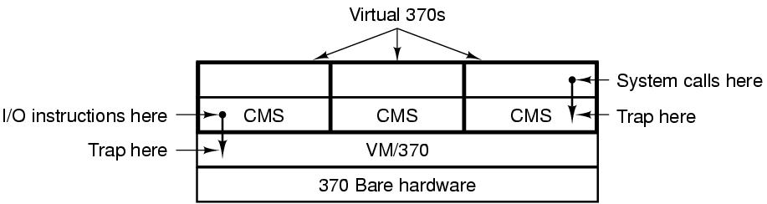
Operating System Structure (Virtual Machines)
The structure of VM/370 with CMS.
Tanenbaum, Modern Operating Systems 3 e, (c) 2008 Prentice-Hall, Inc. All rights reserved. 0-13-6006639

Slide 66
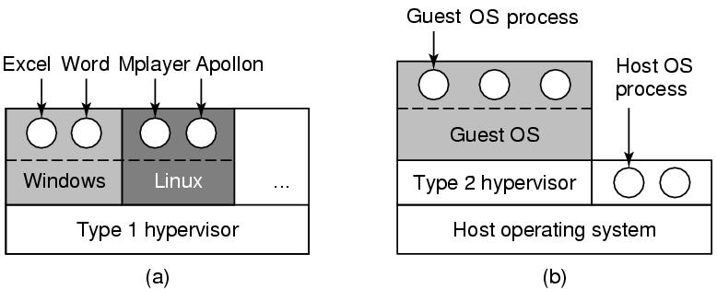
Operating System Structure (Virtual Machines)
(a) A type 1 hypervisor. (b) A type 2 hypervisor.
Tanenbaum, Modern Operating Systems 3 e, (c) 2008 Prentice-Hall, Inc. All rights reserved. 0-13-6006639

Slide 67
Summary
Two viewpoints of OS: resource managers, and extended machines.
History of OS
handwork → batch systems → multiprogramming systems → personal computer systems
Computer hardware
The operating system zoo
Processes, Address Space, Files, and Protection
System calls
OS structure

