Slide 1
Processes and Threads
Chapter 2
2.1 Processes
2.2 Threads
2.3 Interprocess communication
2.4 Classical IPC problems
2.5 Scheduling

Slide 2
2.1 Process
1. Sequential Execution
Sequential
  the order of program structure (maybe switch or loop)
Close
  Occupy all resource alone
Reappear
  if the initial condition be same, the result be same.
2. Concurrency Execution: Lose all the character
Notes:
单道程序系统中，程序顺序运行的特点：
顺序性：每一操作必须在下一操作开始前结束；
封闭性：程序一旦开始运行，其结果不受外界因素的影响，因为一道程序独占主机资源，资源的状态（除初始状态）只有本程序可以改变；
可再现性：只要程序执行时的环境和初始条件相同，当程序重复执行时，不管执行速度如何，都获得相同的结果。
例子：一个人住一栋房子时自己独占房子里的一切资源，多个人住一栋房子时会对资源竞争使用问题。

Slide 3
Concurrency → Process
  Multiprogramming
  Problem:
  compete the resource;
  communication;
  collaboration ….
  Solution: process concept
Notes:
当有多道程序时，程序顺序执行的三个特性将消失；
多个程序会竞争使用资源、相互通信与合作，所以每个程序的运行将是走走停停，用静态的程序概念已经没法描述程序的活动，所以出现了进程。

Slide 4

The Process Model
In the process model, all runnable software is organized as a collection of processes.
Multiprogramming of four programs
Conceptual model of 4 independent, sequential processes
Only one program active at any instant

Slide 5
Process Concept
  from MULTICS and CTSS/360 system (task)
  An abstraction of a running program
  a program in execution
进程，即是一个具有一定独立功能的程序关于某个数据集合的一次活动。
Analogy: birthday cake recipe;
activity (reading, fetching, baking)

Slide 6
Difference between process and program
Program: the collection of instruction, static concept; Process: describe concurrency, dynamic concept
Process include program, data, and PCB
Process: temporary; Program: permanent
A program can be the execution program of multiple process; also, a process can call multiple programs.
Process can create other process in it.

Slide 7
Process Creation (when?)
Principal events that cause process creation
  System initialization (reboot)
  Execution of a process creation system call (fork())
  User request to create a new process
      Command line or click an icon
  Initiation of a batch job
Foreground processes are those that interact with users and perform work for them.
Background processes that handle some incoming request are called daemons.

Slide 8
Process Creation
In UNIX, a fork() system call is used to create a new process.
  Initially, the parent and the child have the same memory image, the same environment strings, and the same open files.
  The execve() system call can be used to load a new program.
  But the parent and child have their own distinct address space.
In Windows, CreateProcess handles both creation and loading the correct program into the new process.
How to list the running processes?
  In UNIX, use the ps command.
  In Windows, use the task manager.

Slide 9
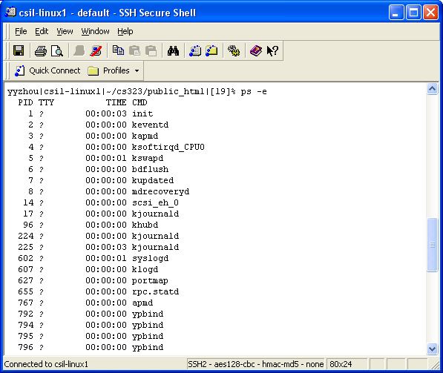
Unix Example: ps

Slide 10
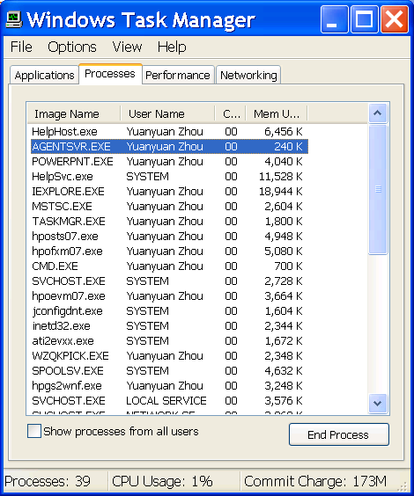
Windows Task Manager

Slide 11
Process Termination (when?)
Conditions which terminate processes
  Normal exit (voluntary)
    Exit in UNIX and ExitProcess in Windows.
  Error exit (voluntary)
    Example: Compiling errors.
  Fatal error (involuntary)
    Example: Core dump
  Killed by another process (involuntary)
    Kill in UNIX and TerminateProcess in Windows.
Notes:
Error exit：是指进程发现了错误，如gcc file.c时，发现file.c并不存在，编译器就会退出；
Fatal error：是指进程引起的错误，通常是由于程序中的错误所致，如执行了一条非法指令，引用不存在的内存，除数为零等；

Slide 12
Process Hierarchies
Parent creates a child process, child processes can create its own processes
Forms a hierarchy (init)
  UNIX calls this a "process group“
Windows has no concept of process hierarchy
  all processes are created equal

Slide 13
Process States (1)
basic process states
  Running - using the CPU.
  Ready - runnable (in the ready queue).
  Blocked - unable to run until an external event occurs; e.g., waiting for a key to be pressed.

Slide 14
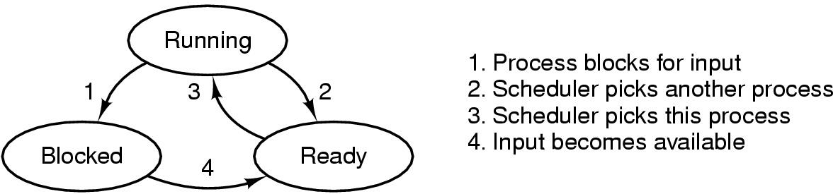
Process States (2)
Transitions between process states:

Slide 15
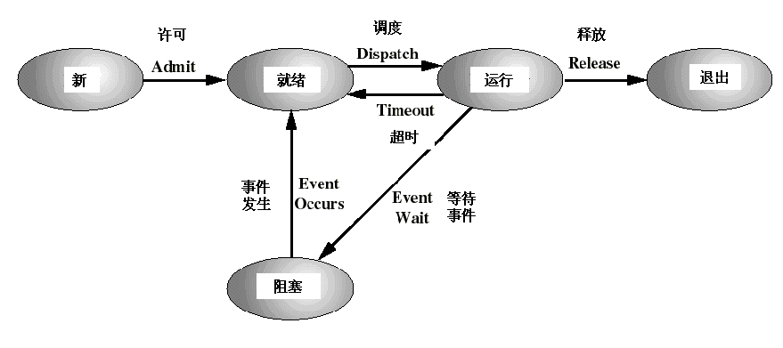
Process States (3)
Other process states
New state, Exit state:

Slide 16
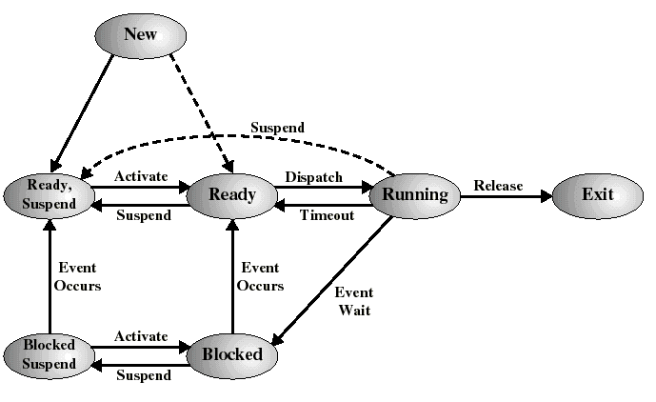
Process States (4)
Suspend :
  Blocked, suspend state
  Ready, suspend

Slide 17
Implementation of Processes(1)
What is in a process? [Process image]
  User program
  User data
  Stack (procedure call and parameter passing)
  PCB[process control block]
  (process attribute)
    In kernel

Slide 18
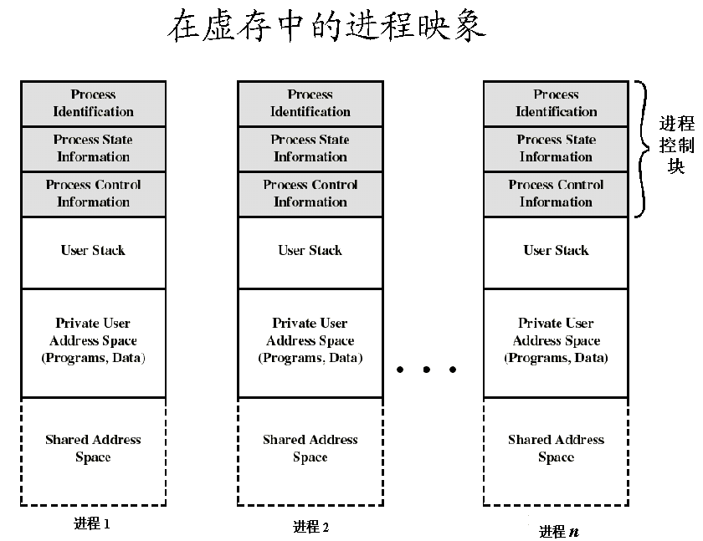

Slide 19
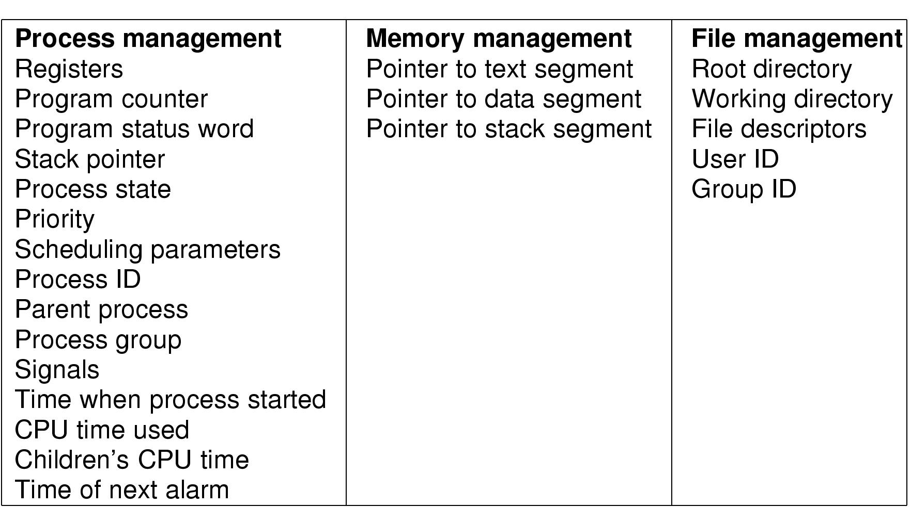
Implementation of Processes(2)
Some of the fields of a typical process table entry

Slide 20
Implementation of Processes(3)
Process Context
  The static description of the whole execution process
  User Context, Register Context, System Context
Context Switch
  Switch CPU from one process to another
  Performed by scheduler (chapter 2.5)
  It includes:
    save PCB state of the old process;
    load PCB state of the new process;
    Flush memory cache;
    Change memory mapping;
  Context switch is expensive(1-1000 microseconds)
    No useful work is done (pure overhead)
    Can become a bottleneck

Slide 21
Implementation of Processes(4)
Process table or PCB table
  Os maintain a process table, each entry is PCB.
  The size of PCB table determine the concurrency degree of system.
Two organization form:
  Link
  Index
Index Table
PCB Table
Ready
Ready
PCB Table
Blocked
Blocked

Slide 22
Summary(1)
What is process
Difference between process and program
Process states and model
What information in a process
Process Context switch

Slide 23
2. Thread
Basic attribute of Process:
  Resource allocate unit
  Scheduler unit
OS must do:
  Create process
  Terminate process
  Switch Process
  Spend much time and space, restrict the concurrency.

Slide 24
Thread concept
如何能使多个程序更好地并发执行，同时又尽量减少系统的开销，成为设计操作系统的重要目标。
将进程的两个基本属性分开，由操作系统分开处理：
  对于作为调度和分派的基本单位，不同时作为拥有资源的单位，以做到“轻装上阵”；
  对于拥有资源的基本单位，又不对之进行频繁的切换。
A thread – lightweight process (LWP)
  Thread: a basic unit of CPU utilization.
  Process: a basic unit of resource allocation.

Slide 25
Thread concept
原进程PCB的内容分成两部分：
  描述进程资源和空间的部分；
  描述执行现场、状态及调度的部分。
将第二部分内容作为线程控制块TCB的内容，且一个进程内允许多个线程存在。
新进程描述为：
  一个独立的进程空间，可装入进程映像；
  一个独立的进程相关联的执行文件；
  进程所用的系统资源；
  一个或多个线程。（进程在创建时一般同时创建好第一个线程，其他线程按需要由用户程序请求创建）

Slide 26
Thread concept
线程不拥有系统资源，只有其运行所必需的一些数据结构：TCB, a program counter, a register set, and a stack. 它与该进程内其它线程共享该进程所拥有的全部资源。
  堆栈和寄存器用来存储线程内的局部变量；
  线程控制块TCB用来说明线程存在的标识、记录线程属性和调度信息
A traditional (heavyweight) process has a single thread of control.
If the process has multiple threads of control, it can do more than one task at a time. This situation is called multithreading.

Slide 27
Thread vs Process
进程是资源分配的基本单位，所有与该进程有关的资源分配情况，如打印机、I/O缓冲队列等，均记录在进程控制块PCB中，进程也是分配主存的基本单位，它拥有一个完整的虚拟地址空间。而线程与资源分配无关，它属于某一个进程，并与该进程内的其它线程一起共享进程的资源。
不同的进程拥有不同的虚拟地址空间，而同一进程中的多个线程共享同一地址空间。
进程调度的切换将涉及到有关资源指针的保存及进程地址空间的转换等问题。而线程的切换将不涉及资源指针的保存和地址空间的变化。所以，线程切换的开销要比进程切换的开销小得多。

Slide 28
Thread vs Process
进程的调度与切换都是由操作系统内核完成，而线程则既可由操作系统内核完成，也可由用户程序进行。
进程可以动态创建进程。被进程创建的线程也可以创建其它线程。
进程有创建、执行、消亡的生命周期。线程也有类似的生命周期。

Slide 29
Thread Advantage
  Thread creation, short
  Thread exit, short
  Thread switch, short
  Communication of threads, simple
  (share the memory and file resource of process)

Slide 30

Single and Multithreaded Processes

Slide 31

The Thread Model (1)
(a) Three processes each with one thread
(b) One process with three threads

Slide 32
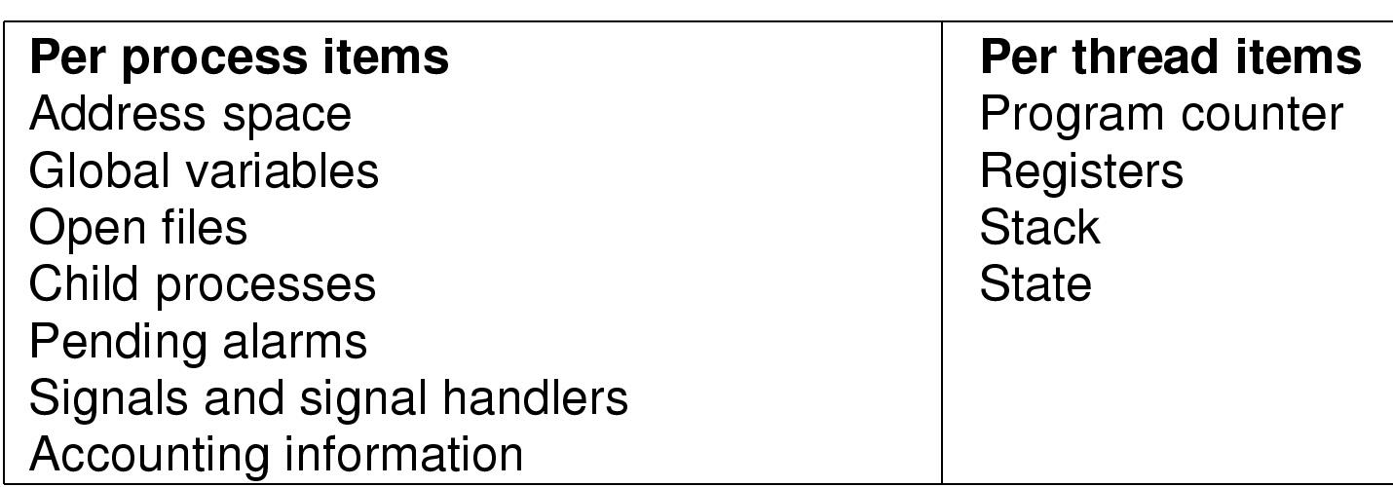
The Thread Model (2)
Items shared by all threads in a process
Items private to each thread

Slide 33

The Thread Model (3)
Each thread has its own stack

Slide 34
Thread Usage
Why do you use threads?
  Responsiveness: Multiple activities can be done at same time. They can speed up the application.
  Resource Sharing: Threads share the memory and the resources of the process to which they belong.
  Economy: They are easy to create and destroy.
  Utilization of MP (multiprocessor) Architectures: They are useful on multiple CPU systems.
Example - Word Processor, Spreadsheet
  One thread interacts with the user.
  One formats the document (spreadsheet).
  One writes the file to disk periodically.
  Why not three processes?

Slide 35

Thread Usage (1)
A word processor with three threads

Slide 36
Thread Usage(2)
Example – Web server
  One thread, the dispatcher, distributes the requests to a worker thread.
  A worker thread handles the requests.

Slide 37

Thread Usage (2)
A multithreaded Web server

Slide 38
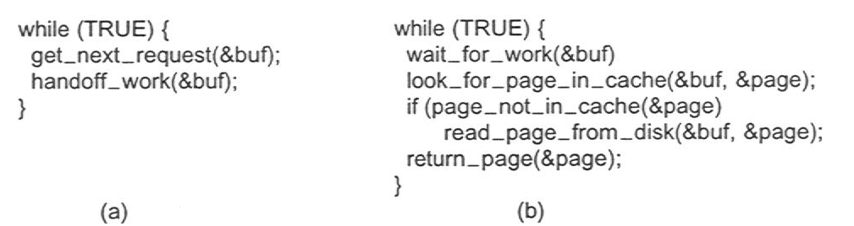
Thread Usage (2)
Rough outline of code for previous slide
  (a) Dispatcher thread
  (b) Worker thread

Slide 39
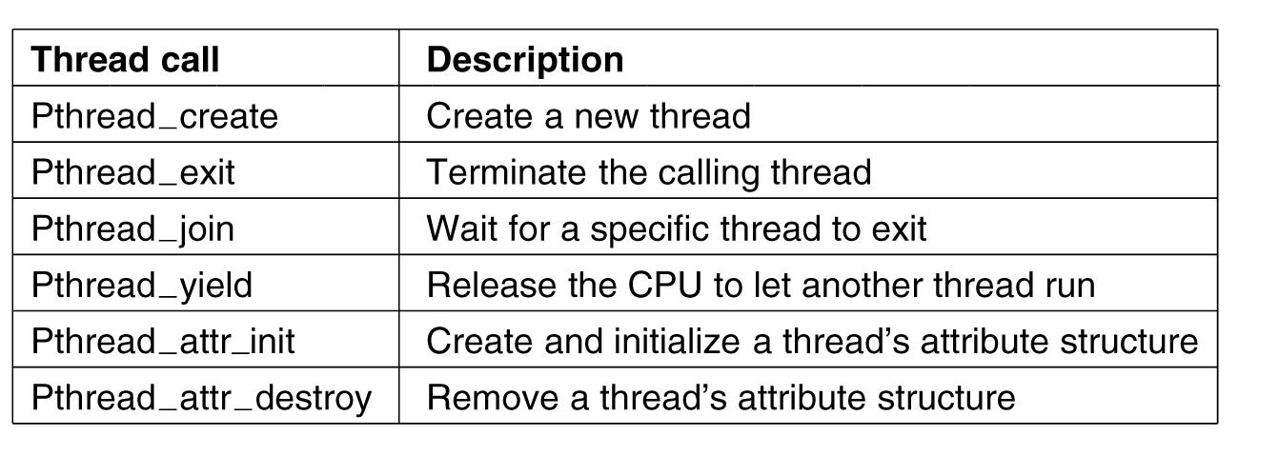
POSIX Threads
Figure 2-14. Some of the Pthreads function calls.
Notes:
为了实现可移植的线程程序，IEEE组织定义了线程的标准——Pthread线程包

Slide 40
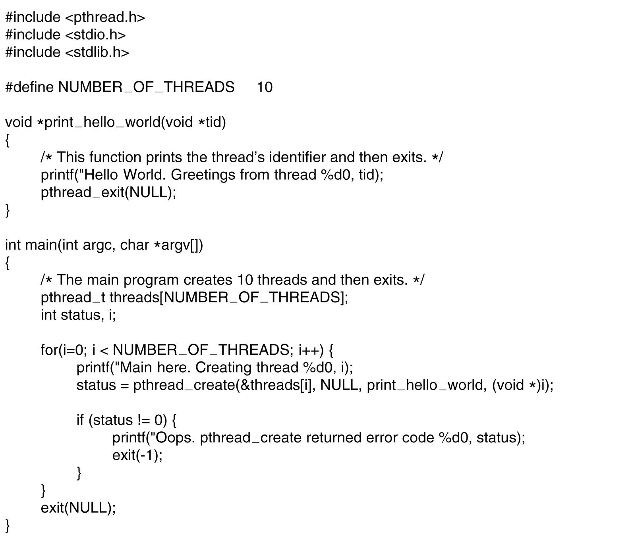
POSIX Threads
Figure 2-15. An example program using threads.

Slide 41
Implementation of Threads
Three mechanism
  Implementing threads in user space
  Implementing threads in kernel space
  Hybrid Implementations

Slide 42
User Threads(ULT)
The threads package entirely in user space, kernel doesn’t know thread
Threads management done by user-level threads library
Thread switch don’t need kernel privilege, user-level threads are fast to create and manage.
Problem: If the kernel is single-threaded, then any user-level thread performing a blocking system call will cause the entire process to block.
Examples of threads library
- POSIX Pthreads
- Mach C-threads
- Solaris UI-threads

Slide 43
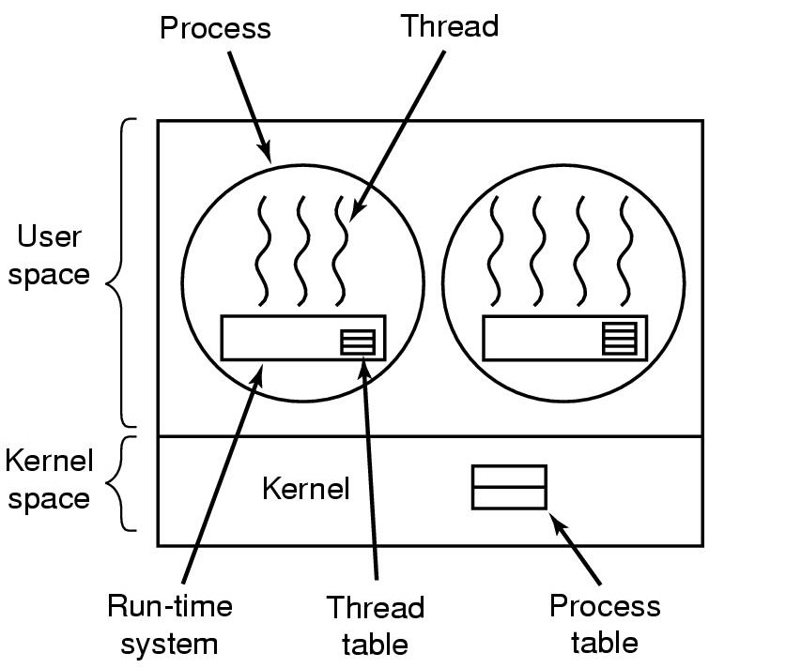
Implementing Threads in User Space
A user-level threads package

Slide 44
Kernel Threads(KLT)
Supported by the Kernel: The kernel performs thread creation, scheduling, and management in kernel space.
No thread library, kernel provide API
Kernel maintain context of process and thread
Thread switch need kernel
Thread is the basic unit of Scheduler .
Disadvantage: high cost
Examples
- Windows 95/98/NT/2000/XP

Slide 45
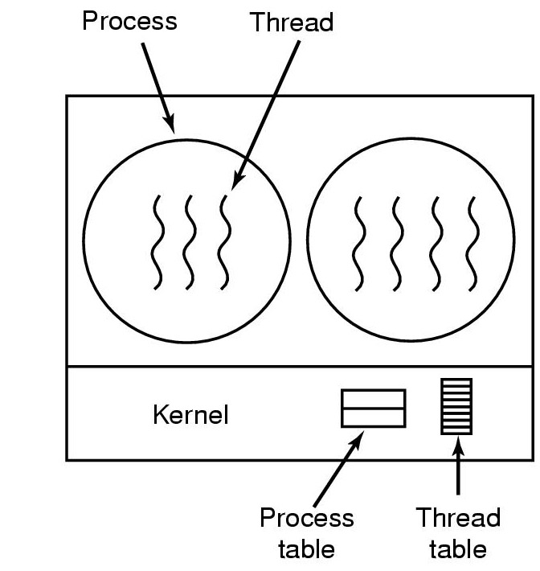
Implementing Threads in the Kernel
A threads package managed by the kernel

Slide 46
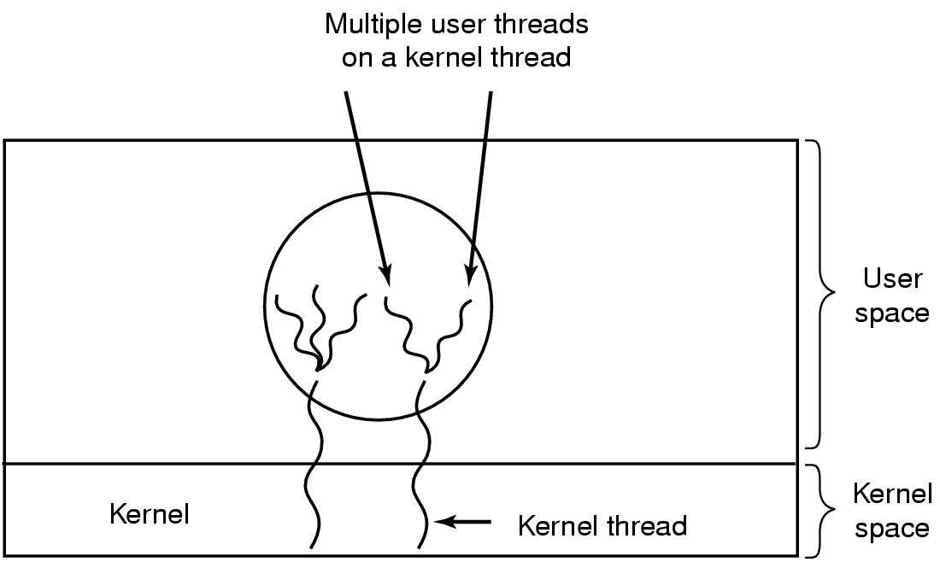
Hybrid Implementations
Multiplexing user-level threads onto kernel-level threads
(SUN solaris)

Slide 47
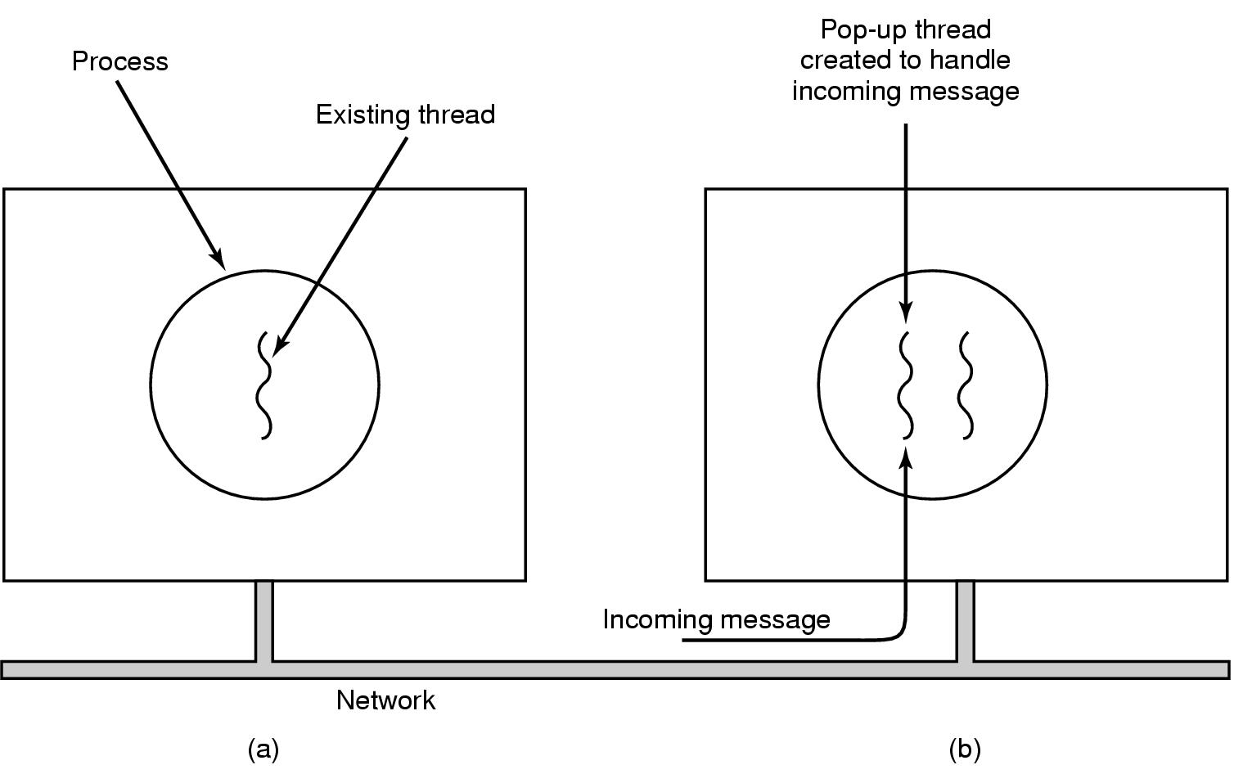
Pop-Up Threads
Creation of a new thread when message arrives
  (a) before message arrives
  (b) after message arrives
Notes:
在分布式系统中经常使用线程，一个例子是如何处理到来的消息；
弹出式线程的好处：这种线程相当新，没有历史——没有必须存储的寄存器、堆栈等，所以可以快速创建，从而使得消息的到达与开始处理之间的时间非常短。

Slide 48
Summary(2)
What is thread? Why need threads?
Difference between process and thread
Thread Usage
Thread Implementations and their tradeoffs
  User-level
  Kernel-level
  Hybrid
  Pop-up threads
Next lecture: Inter-process Communication

