Slide 1
Chapter 2
Processes and Threads
2.1 Processes
2.2 Threads
2.3 Inter-process communication
2.4 Classical IPC problems
2.5 Scheduling

Slide 2
Inter-process Communication
Three issues are involved in inter-process communication (IPC)
  How one process can pass information to another.
  Resource shared (e.g. printer)
    How to make sure two or more processes do not get into each other’s way when engaging in critical activities.
  Process cooperation
    Proper sequencing when dependencies are present.

Slide 3
Spooling Example: Correct
Process 1
Spooler Directory
Process 2
int next_free;
int next_free;
…
out
1
next_free = in;
4
abc
Stores F1 into
next_free;
Prog.c
2
5
6
Prog.n
3
in=next_free+1
in
7
F1
4
next_free = in
8
F2
9
5
Stores F2 into
next_free;
…
in=next_free+1
6

Slide 4
Spooling Example: Races
Process 1
Shared memory
Process 2
int next_free;
int next_free;
…
out
1
next_free = in;
/* value: 7 */
4
abc
5
Prog.c
2
next_free = in
/* value: 7 */
6
Prog.n
in
Stores F2 into
next_free;
7
F2
3
F1
4
in=next_free+1
Stores F1 into
next_free;
5
…
6
in=next_free+1

Slide 5
Race conditions
Race conditions are situations in which several processes access shared data and the final result depends on the order of operations.
The key to avoid race conditions is to prohibit more than one process from reading and writing the shared data at the same time.
Mutual exclusion
Some way of making sure that if one process is using a shared variable or file, the other processes will be excluded from doing the same thing.

Slide 6
Critical Resource(临界资源)
  一次仅允许一个进程访问的资源称为临界资源
  临界资源包括：
    硬件资源：输入机、打印机等
    软件资源：变量、表格、队列、文件等
Critical Region (Critical Section)
  The part of the program where the critical resource is accessed is called critical region or critical section.
If we could arrange matters such that no two processes were ever in their critical regions at the same time, we could avoid races.

Slide 7
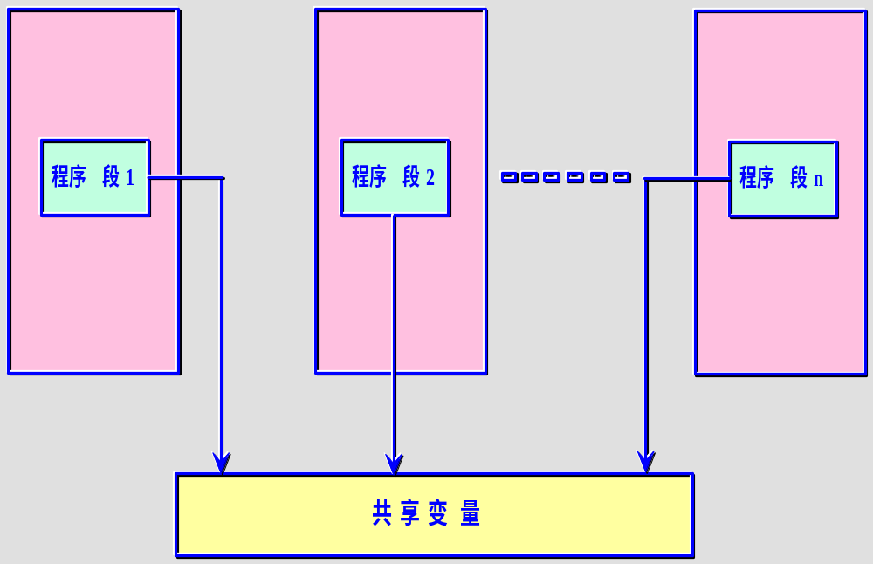

Slide 8
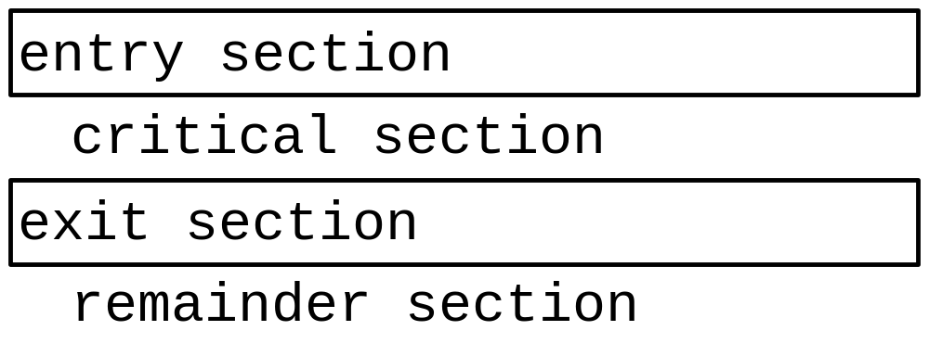
P₁
P₂
a := a +1
print (a)
a := a -1
print (a)
P₃
If a < 0
then
a := a +1
else
a:= a-1
Mutual exclusion
Notes:
当一个进程在它的临界区中时，其他的进程就不允许进入它自己的临界区，即各进程要互斥地进入自己的临界区，所以，每个进程在进入临界区之前，要先提出申请，经允许后方可进入，用以实现此请求的代码段称为进入区（entry section）

Slide 9
Critical Region Requirement
Four conditions to provide mutual exclusion
  No two processes simultaneously in critical region
  No assumptions made about speeds or numbers of CPUs
  No process running outside its critical region may block another process
  No process must wait forever to enter its critical region

Slide 10

Mutual exclusion using critical regions

Slide 11
Mutual Exclusion
Possible Solutions
  Disabling Interrupts
  Lock Variables
  Strict Alternation
  Peterson’s solution
  TSL
  Sleep and Wakeup

Slide 12
Solution 1 - Disabling Interrupts
How does it work?
  Disable all interrupts just after entering a critical section and re-enable them just before leaving it.
Why does it work?
  With interrupts disabled, no clock interrupts can occur. (The CPU is only switched from one process to another as a result of clock or other interrupts, and with interrupts disabled, no switching can occur.)
Problems:
  What if the process forgets to enable the interrupts?
  Multiprocessor? (disabling interrupts only affects one CPU)
Only used inside OS

Slide 13
Solution 2 - Lock Variable
shared int lock = 0;
/* entry_code: execute before entering critical section */
while (lock != 0) /* do nothing */ ;
lock = 1;
- critical section -
/* exit_code: execute after leaving critical section */
lock = 0;
This solution may violate property 1. If a context switch occurs after one process executes the while statement, but before setting lock = 1, then two (or more) processes may be able to enter their critical sections at the same time.

Slide 14
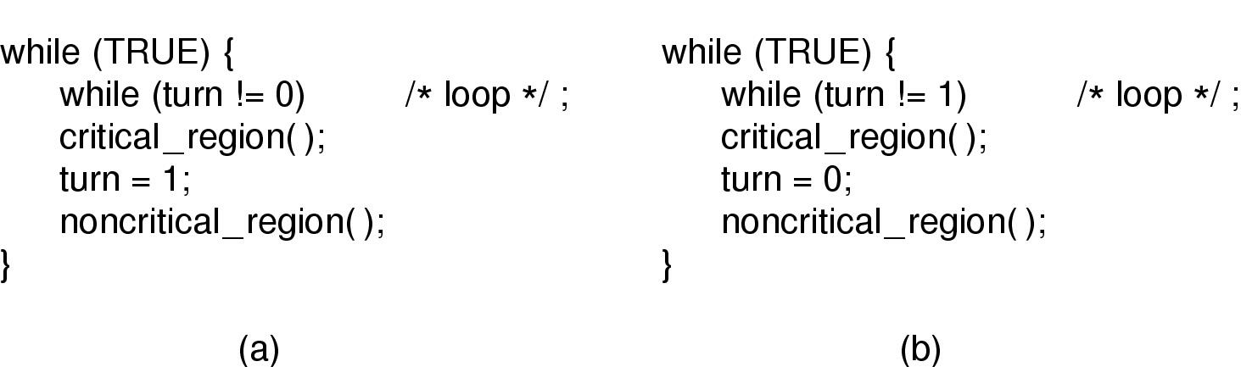
Solution 3 - Strict Alternation
This solution may violate property 3. Since the processes must strictly alternate entering their critical sections, a process wanting to enter its critical section twice in a row will be blocked until the other process decides to enter (and leave) its critical section.

Slide 15
Solution 4 - Peterson’s
process i
enter_region ( i );
Critical region
leave_region ( i );
Noncritical region

Slide 16
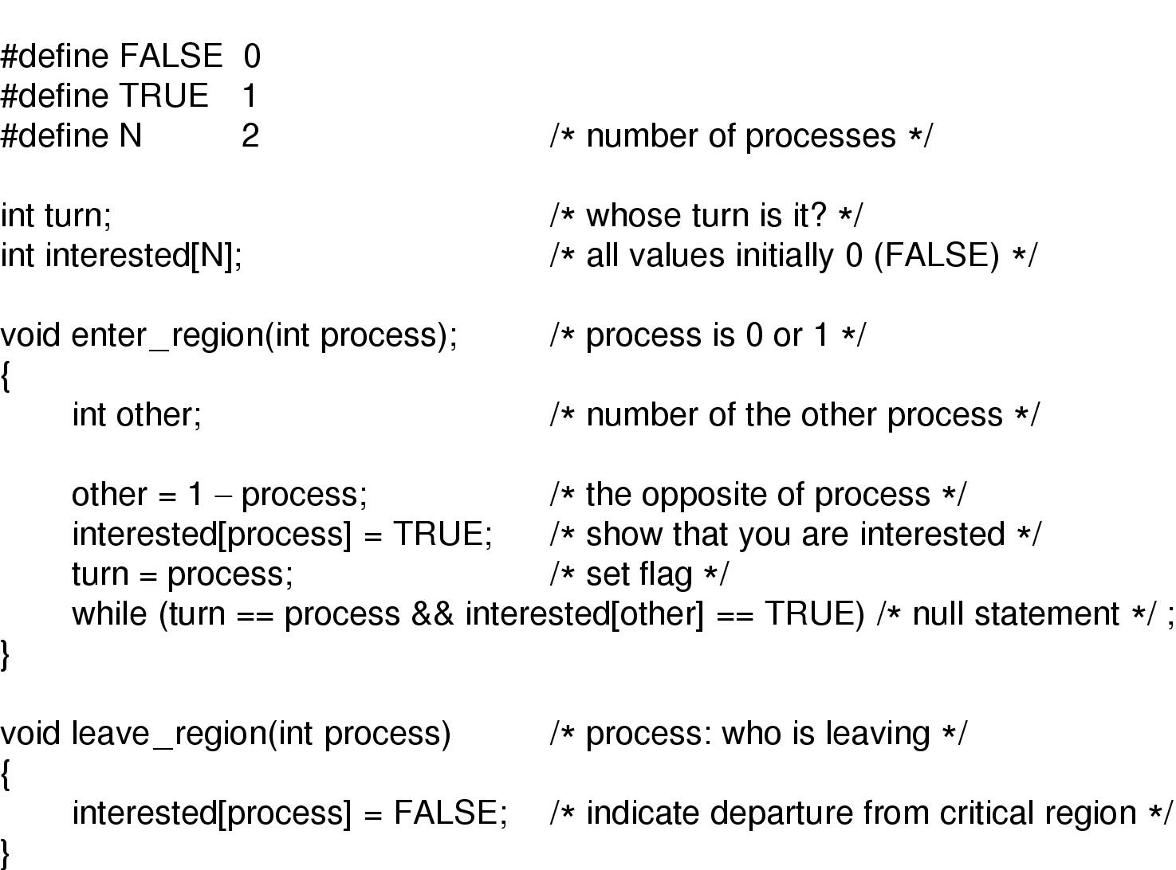
Solution 4 - Peterson’s
Peterson's solution for achieving mutual exclusion

Slide 17
Hardware solution 5:
Test-and-Set Locks (TSL)
The hardware must support a special instruction, tsl, which does 2 things in a single atomic action:
tsl register, flag
  (a) copy a value in memory (flag) to a CPU register
  (b) set flag to 1.

Slide 18
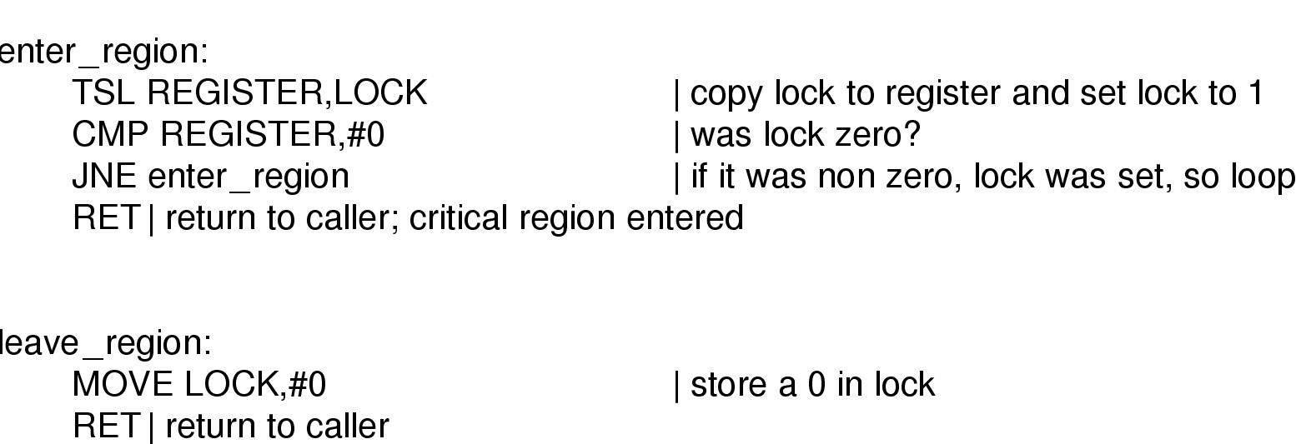
Test-and-Set Locks (TSL)
Entering and leaving a critical region using the
TSL instruction
返回

Slide 19
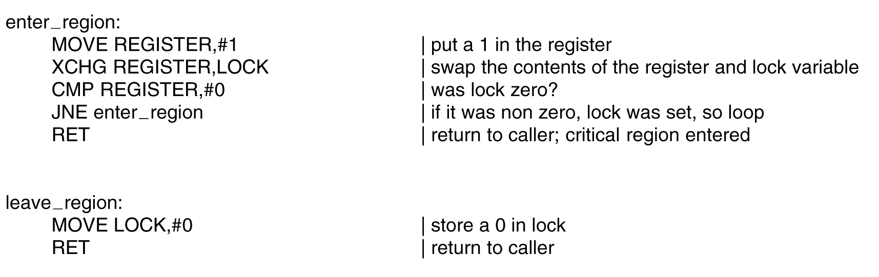
Test-and-Set Locks (TSL)
Entering and leaving a critical region
using the XCHG instruction.

Slide 20
Mutual Exclusion with Busy Waiting
The last two solutions, 4 and 5, require BUSY-WAITING; that is, a process executing the entry code will sit in a tight loop using up CPU cycles, testing some condition over and over, until it becomes true.
Busy-waiting may lead to the PRIORITY-INVERSION PROBLEM if simple priority scheduling is used to schedule the processes.

Slide 21
Mutual Exclusion with Busy Waiting
Example: Test-and-set Locks:
P0 (low) - in cs -x
|
context
switch
|
P1 (high) -----tsl-cmp-jnz-tsl... x-tsl-cmp... x-... forever.
Note, since priority scheduling is used, P1 will keep getting scheduled and waste time doing busy-waiting. :-(
Thus, we have a situation in which a low-priority process is blocking a high-priority process, and this is called PRIORITY-INVERSION.

Slide 22
Sleep and Wakeup
Solution of previous problems: sleep and wakeup
        (busy waiting)
  Block instead of busy waiting when it is not allowed to enter the Critical Region (sleep)
  Wakeup when it is OK to retry entering the critical region

Slide 23
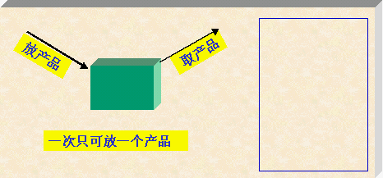
Producer-Consumer Problem (Bounded-buffer problem )
Consider two processes share a circular buffer that can hold N items.
Producers add items to the buffer and Consumers remove items from the buffer.
The Producer-Consumer Problem is to restrict access to the buffer so correct executions result.

Slide 24
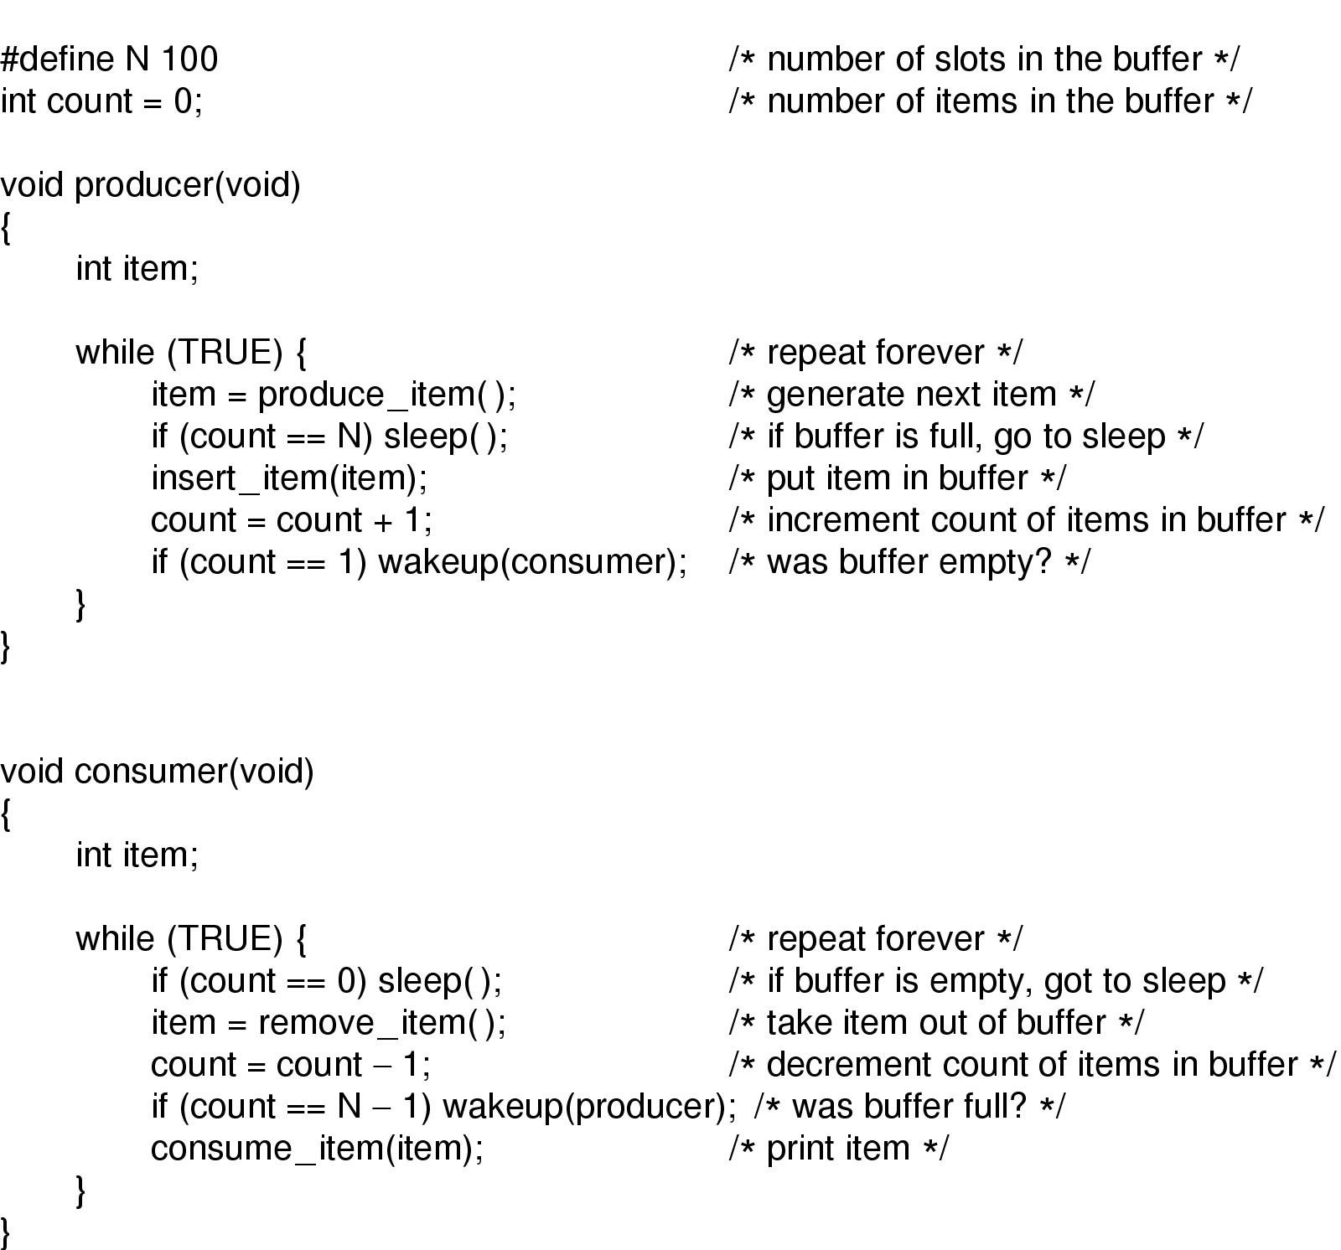
Sleep and Wakeup
Switch to producer
Producer-consumer problem with fatal race condition

Slide 25
Semaphores (E.W. Dijkstra,1965)
A SEMAPHORE, S, is a structure consisting of two parts:
(a) an integer counter, COUNT
(b) a queue of pids of blocked processes, Q
That is,
    struct sem_struct {
    int count;
    queue Q;
    } semaphore;
    semaphore S;

Slide 26
Semaphores
A semaphore count represents count number of abstract resources
  Counting semaphores: 0..N
  Binary semaphores: 0,1
There are 2 operations on semaphores
  The Down (P) operation is used to acquire a resource and decrements count.
  The Up (V) operation is used to release a resource and increments count.
Any semaphore operation is indivisible, must be executed atomically. (what is primitive?)

Slide 27
Semaphores
Suppose that P is the process making the down and up system calls. The operations are defined as follows:
P操作 DOWN(S):
S.count = S.count - 1; //apply for a resource
if (S.count < 0) //if no resource
block(P);
(a) enqueue the pid of P in S.Q,
(b) block process P (remove the pid from the ready queue), and
(c) pass control to the scheduler.
执行一次P操作后，若S.count<0，则|S.count|等于Q队列中等待S资源的进程数。

Slide 28
Semaphores
V操作 UP(S):
S.count = S.count + 1; //release a resource
if ( S.count<= 0 ) // have process blocked
wakeup(P) for some process P in S.Q;
(a) remove a pid from S.Q (the pid of P),
(b) put the pid in the ready queue, and
(c) pass control to the scheduler.
执行一次V操作后，若S.count≤0，则表明Q队列中仍有因等待S资源而被阻塞的进程，所以需要唤醒(wakeup)Q队列中的进程。

Slide 29
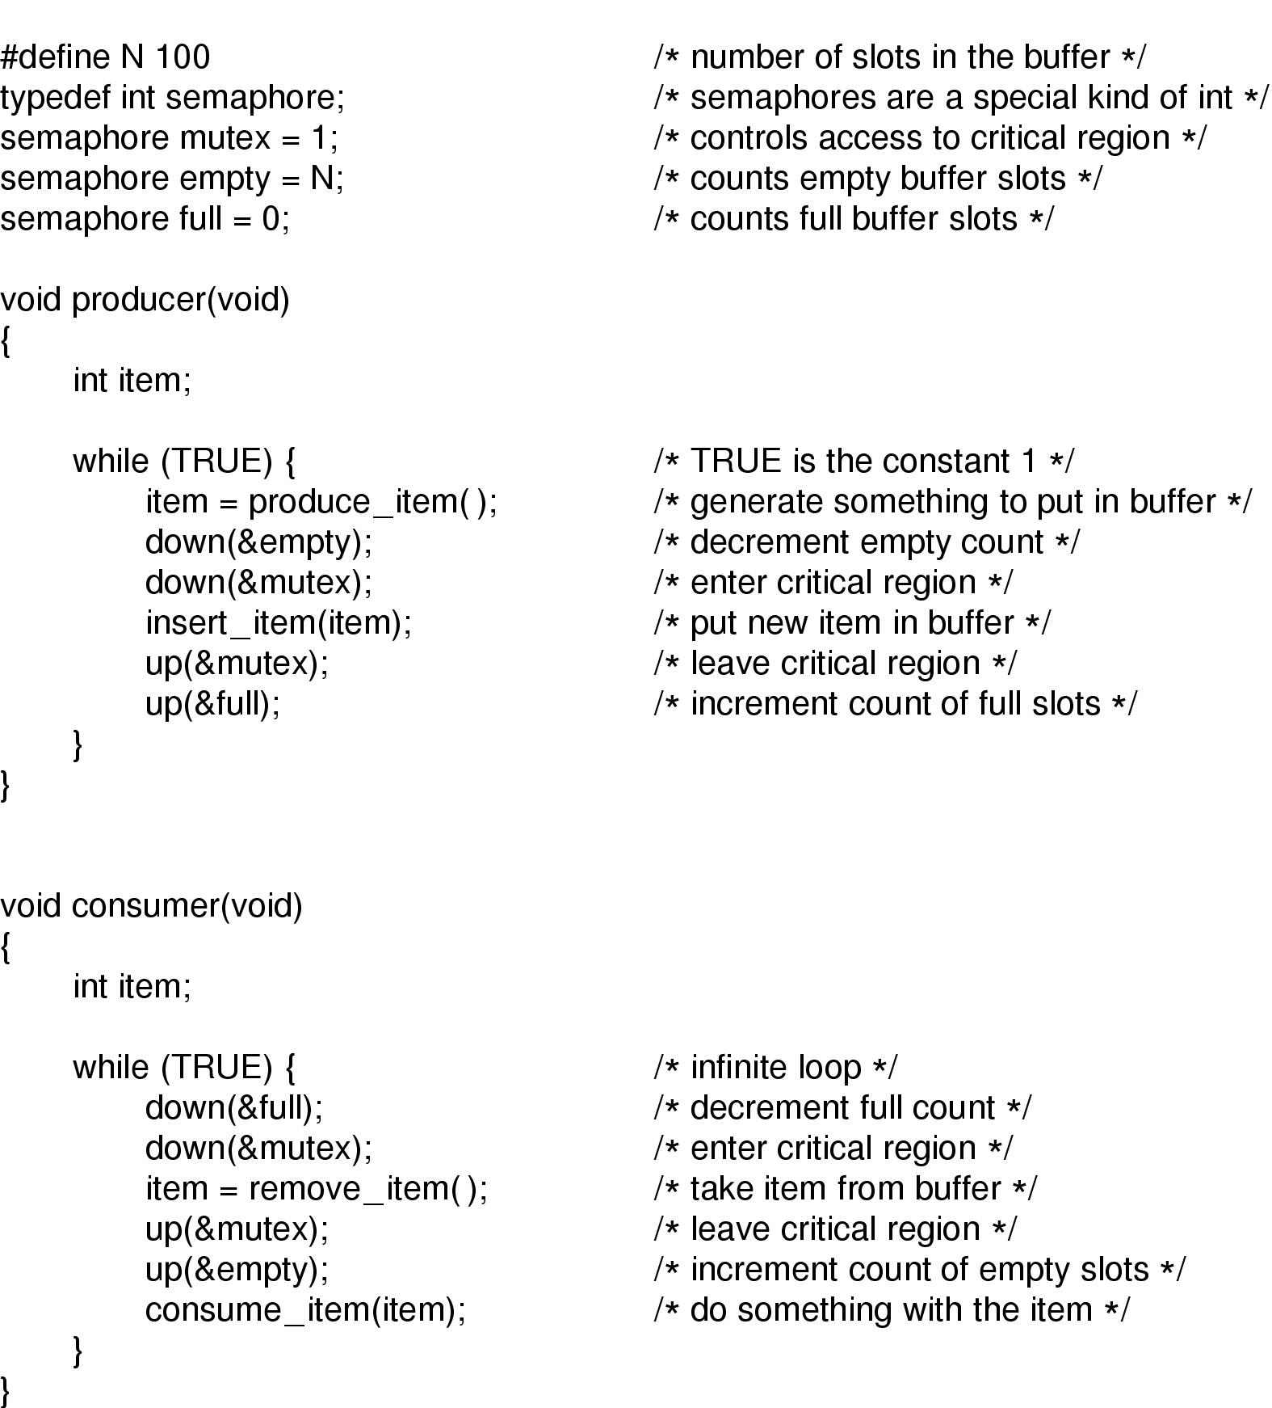
The producer-consumer problem using semaphores
exchange

Slide 30
In conclusion, we use semaphores in two different ways:
  mutual exclusion (mutex);
  process synchronization (full, empty).
Is it easy to use semaphores?

Slide 31
Mutex: Binary Semaphore
Simplified version of semaphore
Mutex is used for mutual exclusion problem
A variable with only 2 states
      Lock
      Unlock

Slide 32
Mutual Exclusion Problem using Mutex
semaphore mutex = 1; /* set mutex.count = 1 */
DOWN(mutex);
- critical section -
UP(mutex);
For two parallel processes, the value of mutex is 1, 0, -1
For N parallel processes, the value range of mutex is 1~ -(N-1)

Slide 33
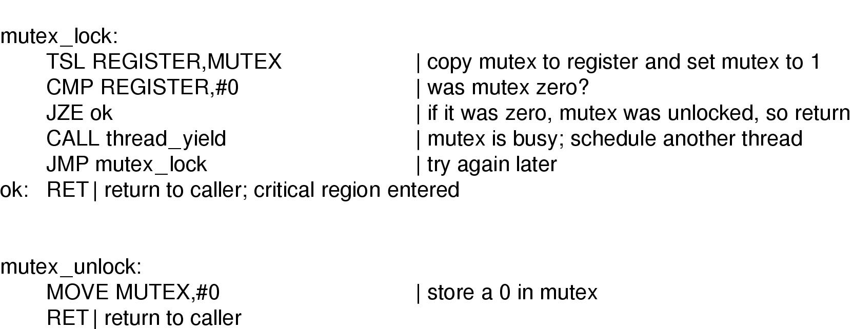
Mutex Implementation using TSL
TSL的enter_region
Implementation of mutex_lock and mutex_unlock

Slide 34
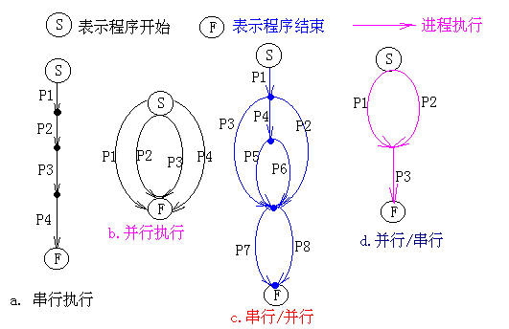
Using Semaphores
Process Synchronization: Order process execution

Slide 35
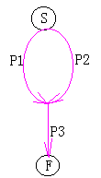
Using Semaphores
Suppose we have 3 processes: P1, P2, and P3. P1 and P2 must finish executing before P3.
The processes may be synchronized using semaphores:
  S1=0: P1 still unfinished;
  S2=0: P2 still unfinished;

Slide 36
Using Semaphores
P1() P2() P3()
{ { {
…… …… DOWN(S1);
UP(S1); UP(S2); DOWN(S2);
} } ……
}

Slide 37
讨论：
1) 信号量的物理含义
S.count>0表示有S.count个资源可用
S.count=0表示无资源可用
S.count<0则|S.count|表示S等待队列中的进程个数
P(S)：表示申请一个资源
V(S)：表示释放一个资源。信号量的初值应该大于等于0
2) P,V操作必须成对出现，有一个P操作就一定有一个V操作
  当为互斥操作时，它们同处于同一进程；
  当为同步操作时，则不在同一进程中出现。
  如果P(S1)和P(S2)两个操作在一起，那么P操作的顺序至关重要，一个同步P操作与一个互斥P操作在一起时同步P操作在互斥P操作前；
  而两个V操作的顺序无关紧要。

Slide 38
3) 信号量同步的缺点
用信号量可实现进程间的同步，但由于信号量的控制分布在整个程序中，其正确性分析很困难。
4) 引入管程
  1973年，Hoare和Hanson提出一种高级同步原语——管程； 其基本思想是把信号量及其操作原语封装在一个对象内部。
  管程是管理进程间同步的机制，它保证进程互斥地访问共享变量，并方便地阻塞和唤醒进程。
  管程可以函数库的形式实现。相比之下，管程比信号量好控制。

Slide 39
Monitors
A monitor is a collection of procedures, variables, and data structures that can only be accessed by one process at a time (for the purpose of mutual exclusion).
To allow a process to wait within the monitor, a condition variable must be declared, as condition x, y;
Condition variable can only be used with the operations wait and signal (for the purpose of synchronization).
  The operation
  wait(x);
  means that the process invoking this operation is suspended until another process invokes
  signal(x);
  The signal(x) operation resumes exactly one suspended process. If no process is suspended, then the signal operation has no effect.

Slide 40
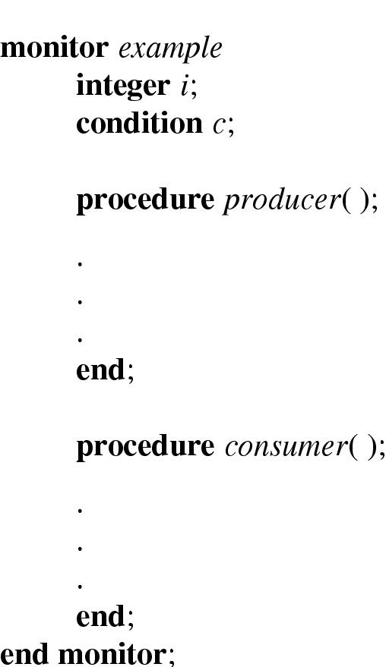
Monitors
Example of a monitor

Slide 41
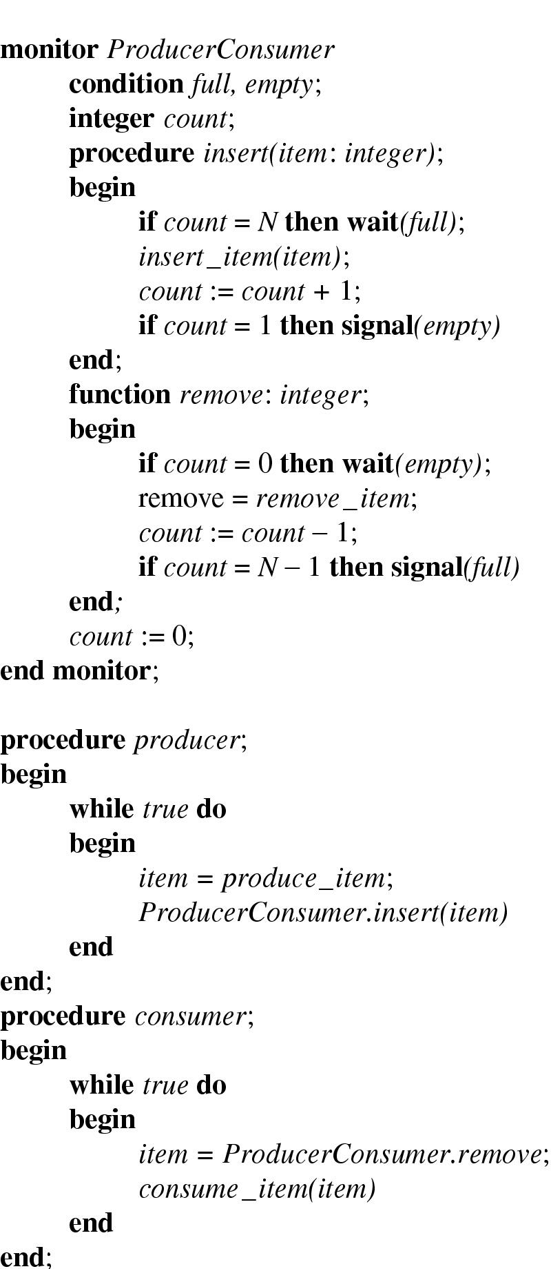
Monitors
Outline of producer-consumer problem with monitors
  only one monitor procedure active at one time
  buffer has N slots

Slide 42
Message passing
Possible Approaches of IPC:
  1) Shared memory
  2) Shared file mode;
  pipe: is a shared file
    One end is for reading and one end is for writing.
  3) Message passing:
  primitive: send and receive
    Assign each process a unique address such as addr. Then, send messages directly to the process:
    send(addr, msg);
    recv(addr, msg);
    Use mailboxes:
    send(mailbox, msg);
    recv(mailbox, msg);

Slide 43
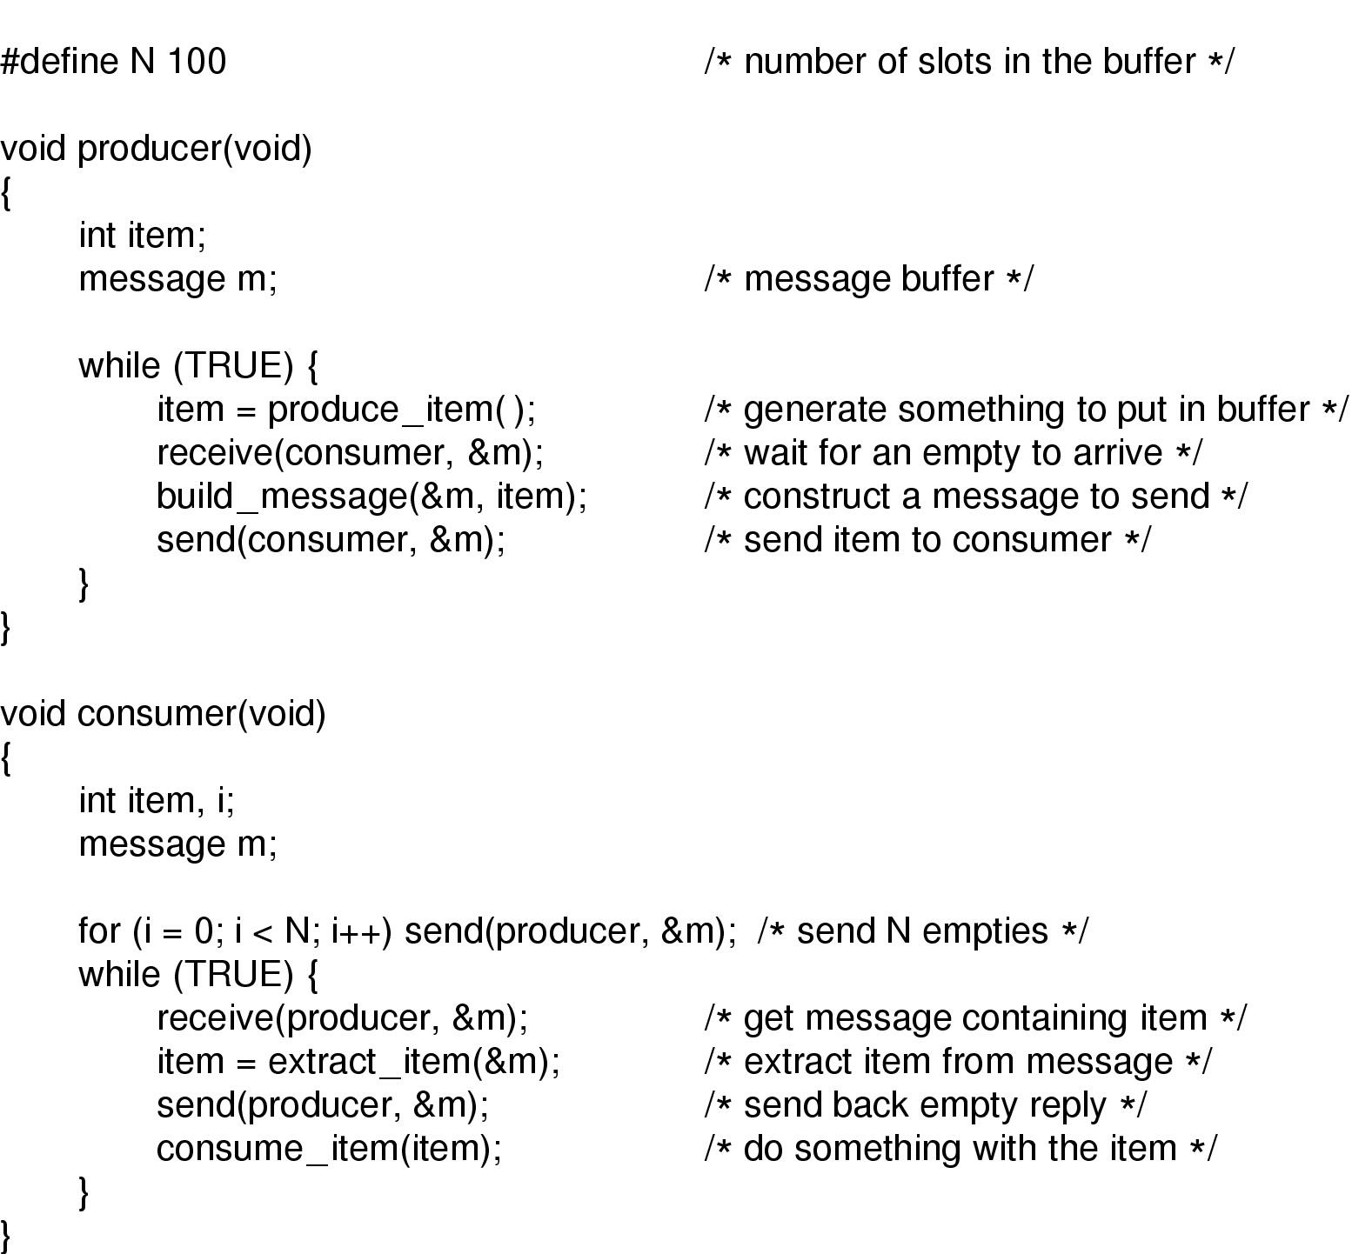
Message Passing
The producer-consumer problem with N messages

Slide 44
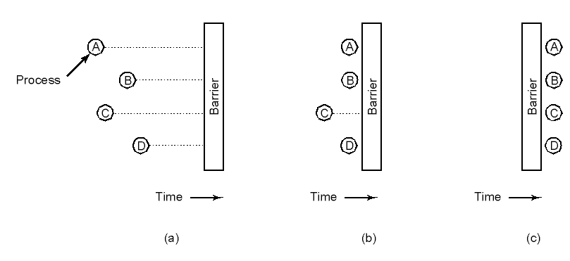
Barriers
Use of a barrier
    processes approaching a barrier
    all processes but one blocked at barrier
    last process arrives, all are let through
Example: Parallel matrix multiplication

Slide 45
Classical IPC Problems
These problems are used for testing every newly proposed synchronization scheme:
  Bounded-Buffer (Producer-Consumer) Problem
  Dining-Philosophers Problem
  Readers and Writers Problem

Slide 46
Dining Philosophers
Dining Philosophers Problem [Dijkstra, 1965]:
Problem:
  Five philosophers are seated around a table. There is one fork between each pair of philosophers.
  Each philosopher needs to grab the two adjacent forks in order to eat.
  Philosophers alternate between eating and thinking.
  They only eat for finite periods of time.

Slide 47

Dining Philosophers
Philosophers eat/think
Eating needs 2 forks
Pick one fork at a time
How to prevent deadlock

Slide 48
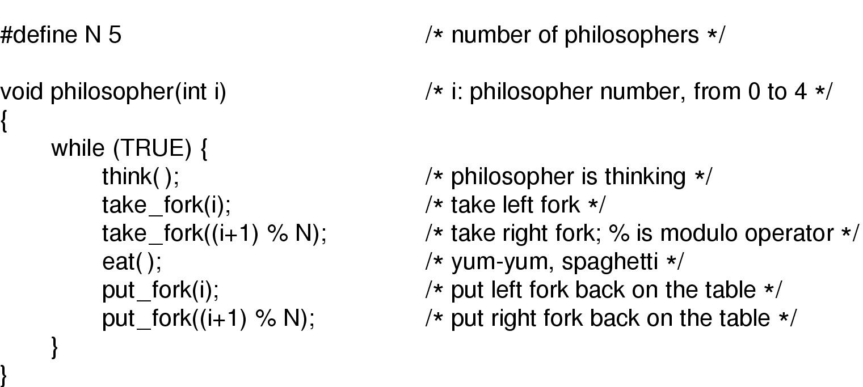
Dining Philosophers
A nonsolution to the dining philosophers problem

Slide 49
Dining Philosophers
Problem:
  Suppose all philosophers execute the first DOWN operation, before any have a chance to execute the second DOWN operation; that is, they all grab one fork. Then, deadlock will occur and no philosophers will be able to proceed. This is called a CIRCULAR WAIT.
Other Solutions:
  Only allow up to four philosophers to try grabbing their forks.
  Asymmetric solution: Odd numbered philosophers grab their left fork first, whereas even numbered philosophers grab their right fork first.
  Protect the five statements following think() by mutex
  Pick-up the forks only if both are available. See Fig. 2-46.

Slide 50
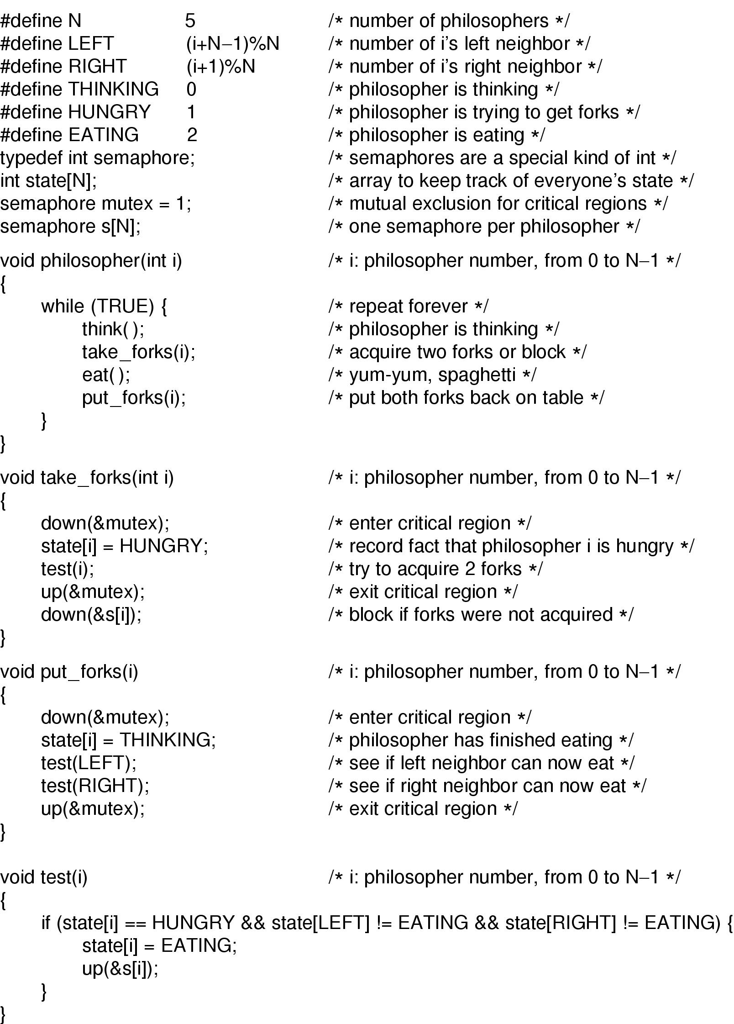
Dining Philosophers
Solution to dining philosophers problem (part 1)

Slide 51
Dining Philosophers
Solution to dining philosophers problem (part 2)

Slide 52
Readers and Writers Problem
The readers and writers problem models access to a shared database.
Rules:
  Multiple readers can read the data simultaneously
  Only one writer can write the data at any time
  A reader and a writer cannot in critical section together.
 | Reader | Writer
Reader | OK | No
Writer | No | No

Slide 53
Readers and Writers Problem
One solution (reader preference):
  Suppose new reader come: if writer is waiting and some reader is reading, then read ok.
  Suppose new writer come: if no reader or writer, it can write, else wait.
One variation of the problem, called weak readers preference, is to suspend the incoming readers as long as a writer is waiting.

Slide 54
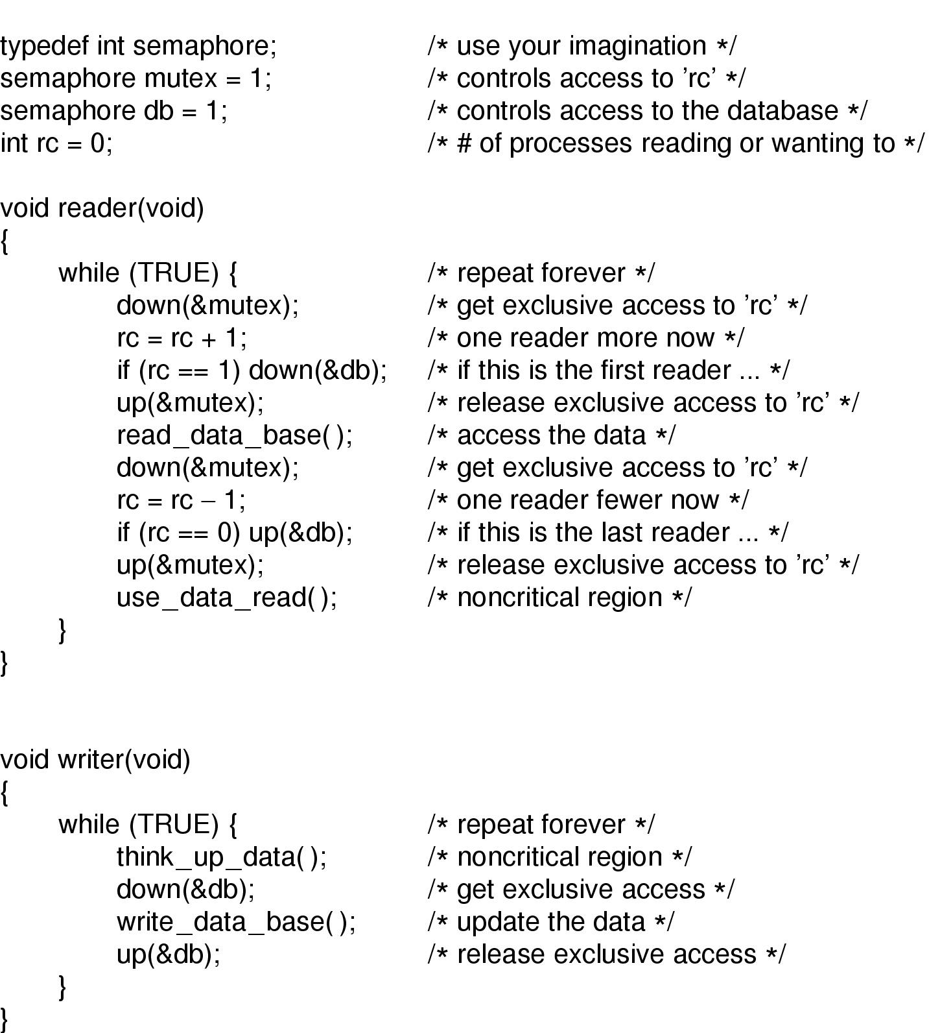
Readers and Writers Problem
entry
exit
A solution to the readers and writers problem

Slide 55
Summary
Race condition, Critical region and mutual exclusion
Mutual exclusion using busy waiting
  Peterson’s Solution
  TSL
Sleep and Wakeup
Semaphores
Monitor
Barrier
Passing Message
Classic synchronization problems
  Dining-Philosophers Problem
  Readers and Writers Problem

