Slide 1
Chapter 2
Processes and Threads
2.1 Processes
2.2 Threads
2.3 Inter-process communication
2.4 Classical IPC problems
2.5 Scheduling

Slide 2
Content of this lecture
Why Scheduling?
When to Schedule?
Basic Scheduling Algorithm
  Batch systems
    First-Come First-Served
    Shortest job first
  Interactive systems
    Round-robin
    Priority scheduling
    Multi Queue & Multi-level Feedback
    Guaranteed Scheduling, Lottery Scheduling, and Fair Sharing Scheduling
Summary

Slide 3


Scheduling
Deciding which process/thread should occupy the resource (CPU) to run next.
(CPU (horsepower))
I want to ride it
Whose turn is it?
Process 1
Process 2
Process 3

Slide 4
Process Scheduler
Proc1: 20 time units
Proc2: 4 time units
Proc3: 2 time units
Preemptive vs.
non-preemptive
CPU
Scheduler
Proc 1
Proc 10
Proc 2
Proc 11
Proc 3
Proc 12
Ready queue
Blocked queue

Slide 5
Preemptive vs. Non-preemptive
Non-preemptive scheduling:
  The running process keeps the CPU until it voluntarily gives up the CPU
    process exits
    switches to blocked state
    1and 4 only (no 3)
  Disadvantage?
Preemptive scheduling:
  The running process can be interrupted and must release the CPU (can be forced to give up CPU)
  Preemptive principles?
Running
4
Terminated
3
1
Ready
Blocked
Notes:
Non-preemptive scheduling缺点：紧急任务不能马上得到响应，运行时间短的任务等待时间长（响应时间长）；
Preemptive的原则：时间片、优先级、短作业

Slide 6
CPU Scheduling
Problem to solve
  When (scheduling opportunity)
  when to allocate CPU to process?
  What (scheduling algorithm)
  what is the principle of allocation?
  How (context - switch)
  How to allocate CPU? scheduling- process?

Slide 7

1. Scheduling
(Process Behavior)
Bursts of CPU usage alternate with periods of I/O wait
  a CPU-bound process
  an I/O bound process

Slide 8
2. When to schedule?
A new process is created
The running process exits
The running process is blocked
I/O interrupt (some processes will be ready)
Clock interrupt (every 10 milliseconds)

Slide 9
3. Scheduling Algorithm
Properties of a GOOD Scheduling Algorithm:
Fair (nobody cries)
Priority (lady first)
Efficiency (make best use of equipment)
Encourage good behavior (good boy/girl)
Support heavy loads (degrade gracefully)
Adapt to different environments (interactive, real-time…)

Slide 10
Performance Criteria
Fairness
Efficiency: keep resources as busy as possible
Policy Enforcement
  seeing that stated policy is carried out
Throughput: number of processes that completes in unit time
Turnaround Time (also called elapse time)
  amount of time to execute a particular process from the time its entered
Waiting Time
  amount of time process has been waiting in ready queue
Response Time
  amount of time from when a request was first submitted until first response is produced.
Proportionality
  meet users' expectation
Meeting Deadlines: avoid losing data
Predictability

Slide 11
Different Systems, Different Focuses
For all
  Fairness, policy enforcement, resource balance
Batch Systems
  Max throughput, min turnaround time, max CPU utilization
Interactive Systems
  Min Response time, best proportionality
Real-Time Systems
  predictability, meeting deadlines

Slide 12
Single Processor Scheduling Algorithms
Batch systems
  First Come First Serve (FCFS)
  Shortest Job First
Interactive Systems
  Round Robin
  Priority Scheduling
  Multi Queue & Multi-level Feedback
  Guaranteed Scheduling
  Lottery Scheduling
  Fair Sharing Scheduling

Slide 13
(1) First Come First Served (FCFS)
Also called FIFO. Process that requests the CPU FIRST is allocated the CPU FIRST.
Non-preemptive
Used in Batch Systems
Implementation: FIFO queues
  A new process enters the tail of the queue
  The scheduler selects from the head of the queue.
Performance Metric: Average Waiting Time.
Given Parameters:
  Burst Time (in ms), Arrival Time and Order

Slide 14
FCFS Example
Process | Duration | Order | Arrival Time
P1 | 24 | 1 | 0
P2 | 3 | 2 | 0
P3 | 4 | 3 | 0
The final schedule:
P1 (24)
P2 (3)
P3 (4)
0
24
27
P1 waiting time: 0
P2 waiting time: 24
P3 waiting time: 27
The average waiting time:
(0+24+27)/3 = 17

Slide 15
FCFS Example (cont.)
Suppose that the processes arrive in the order
P₂ , P₃ , P₁
The Gantt chart for the schedule is:
Waiting time for P₁ = 7; P₂ = 0; P₃ = 3
Average waiting time: (7 + 0 + 3)/3 = 3.3
Much better than previous case.
Convoy effect: short process behind long process
P2 (3)
P3 (4)
P1 (24)
0
3
7

Slide 16
Problems with FCFS
Non-preemptive
Not optimal AWT (Average Waiting Time)
Cannot utilize resources in parallel:
  Assume 1 process CPU bounded and many I/O bounded processes
  result: Convoy effect, low CPU and I/O Device utilization
  Why?

Slide 17
Why Convoy Effects?
Consider n-1 jobs in system that are I/O bound and 1 job that is CPU bound.
I/O bound jobs pass quickly through the ready queue and suspend themselves waiting for I/O.
CPU bound job arrives at head of queue and executes until complete.
I/O bound jobs rejoin ready queue and wait for CPU bound job to complete.
I/O devices idle until CPU bound job completes.
When CPU bound job complete, other processes rush to wait on I/O again.
CPU becomes idle.

Slide 18
(2) Shortest Job First (SJF)
Schedule the job with the shortest elapse time first
Scheduling in Batch Systems
Two types:
  Non-preemptive
  Preemptive
Requirement: the elapse time needs to know in advance
Optimal if all the jobs are available simultaneously (provable)
  Gives the best possible AWT (average waiting time)

Slide 19
Non-preemptive SJF: Example
Process | Duration | Order | Arrival Time
P1 | 6 | 2 | 0
P2 | 8 | 4 | 0
P3 | 7 | 3 | 0
P4 | 3 | 1 | 0
P4 (3)
P1 (6)
P3 (7)
P2 (8)
0
3
9
16
24
P4 waiting time: 0
P1 waiting time: 3
P3 waiting time: 9
P2 waiting time: 16
The total time is: 24
The average waiting time (AWT):
(0+3+9+16)/4 = 7

Slide 20
Comparing to FCFS
Process | Duration | Order | Arrival Time
P1 | 6 | 1 | 0
P2 | 8 | 2 | 0
P3 | 7 | 3 | 0
P4 | 3 | 4 | 0
P1 (6)
P2 (8)
P3 (7)
P4 (3)
0
6
14
21
24
The total time is the same.
The average waiting time (AWT):
(0+6+14+21)/4 = 10.25
(comparing to 7)
P1 waiting time: 0
P2 waiting time: 6
P3 waiting time: 14
P4 waiting time: 21

Slide 21
SJF is not always optimal
Is SJF optimal if all the jobs are not available simultaneously?
Process | Duration | Order | Arrival Time
P1 | 10 | 1 | 0
P2 | 2 | 2 | 2
P1 (10)
P2 (2)
0
2 (p2 arrives)
10
12
P1 waiting time: 0
P2 waiting time: 8
The average waiting time (AWT):
(0+8)/2 = 4

Slide 22
What if the scheduler waits for 2 time units? (Do it yourself)
Process | Duration | Order | Arrival Time
P1 | 10 | 2 | 0
P2 | 2 | 1 | 2
P2 (2)
P1 (10)
0
2
4
14
P1 waiting time: 4
P2 waiting time: 0
The average waiting time (AWT):
(0+4)/2 = 2
However: waste 2 time units of CPU

Slide 23
Preemptive SJF
Also called Shortest Remaining Time First
  Schedule the job with the shortest remaining time required to complete
Requirement: the elapse time needs to be known in advance

Slide 24
Preemptive SJF: Same Example
Process | Duration | Order | Arrival Time
P1 | 10 | 1 | 0
P2 | 2 | 2 | 2
P1 (2)
P2 (2)
P1 (8)
0
2
4
12
P1 waiting time: 4-2 =2
P2 waiting time: 0
The average waiting time (AWT):
(0+2)/2 = 1
No CPU waste!!!

Slide 25
A Problem with SJF
Starvation
  In some condition, a job is waiting for ever
  Example: SJF
    Process A with elapse time of 1 hour arrives at time 0
    But ever 1 minute from time 0, a short process with elapse time of 2 minutes arrive
    Result of SJF: A never gets to run

Slide 26
Interactive Scheduling Algorithms
Usually preemptive
  Time is sliced into quantum (time intervals)
  Scheduling decision is also made at the beginning of each quantum
Performance Criteria
  Min Response Time
  best proportionality
Representative algorithms:
  Round-robin
  Priority-based
  Multi Queue & Multi-level Feedback
  Guaranteed Scheduling
  Lottery Scheduling
  Fair Sharing Scheduling

Slide 27
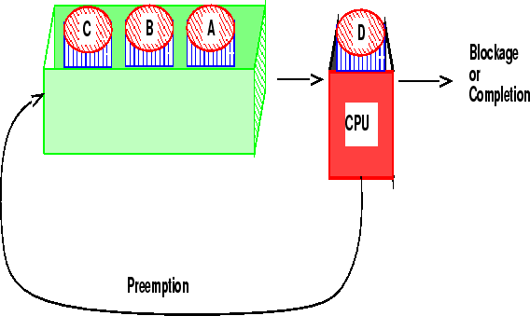
(3) Round-robin
One of the oldest, simplest, most commonly used scheduling algorithm
Select process/thread from ready queue in a round-robin fashion (take turns)
Problem:
Do not consider priority
Context switch overhead

Slide 28
Round-robin: Example
Process | Duration | Order | Arrival Time
P1 | 3 | 1 | 0
P2 | 4 | 2 | 0
P3 | 3 | 3 | 0
Suppose time quantum is: 1 unit, P1, P2 & P3 never block
P1
P2
P3
P1
P2
P3
P1
P2
P3
P2
0
10
P1 waiting time: 4
P2 waiting time: 6
P3 waiting time: 6
The average waiting time (AWT):
(4+6+6)/3 = 5.33

Slide 29
Time Quantum
Time slice too large
  FCFS behavior
  Poor response time
Time slice too small
  Too many context switches (overheads)
  Inefficient CPU utilization
Heuristic: 70-80% of jobs block within time-slice
Typical time-slice 10 to 100 ms

Slide 30
(4) Priority Scheduling
Each job is assigned a priority.
FCFS within each priority level.
Select highest priority job over lower ones.
Rational: higher priority jobs are more mission-critical
  Example: display a video film in real time vs. send email
Problems:
  May not give the best AWT
  indefinite blocking or starving a process

Slide 31
Set Priority
Two approaches
  Static (for system with well known and regular application behaviors)
  Dynamic (otherwise)
Priority may be based on:
  Cost to user
  Importance of user
  Process type
  Requirement to resource
  Aging
  Percentage of CPU time used in last X hours.

Slide 32
Priority Scheduling: Example
Process | Duration | Priority | Arrival Time
P1 | 6 | 4 | 0
P2 | 8 | 1 | 0
P3 | 7 | 3 | 0
P4 | 3 | 2 | 0
P2 (8)
P4 (3)
P3 (7)
P1 (6)
0
8
11
18
24
P2 waiting time: 0
P4 waiting time: 8
P3 waiting time: 11
P1 waiting time: 18
The average waiting time (AWT):
(0+8+11+18)/4 = 9.25
(worse than SJF:7)

Slide 33
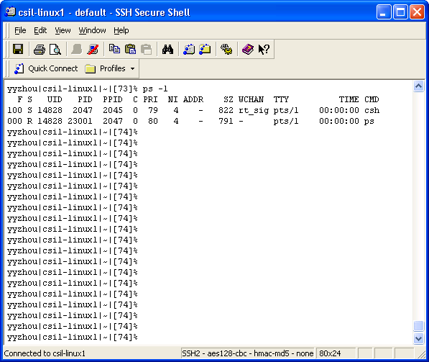
Priority in Unix

Slide 34
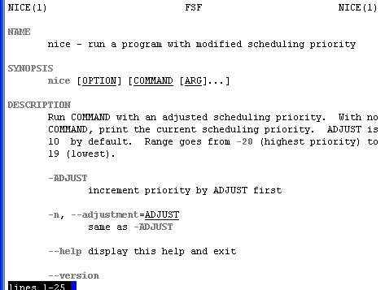
Be “nice” in Unix
Nobody wants to

Slide 35
(5) Multi-Queue Scheduling
Hybrid between priority and round-robin
Processes assigned to one queue permanently
Scheduling between queues
  Fixed Priorities
  % CPU spent on queue
Example
  System processes (highest priority)
  Interactive programs (Round Robin)
  Background Processes (FCFS)
  Student Processes

Slide 36
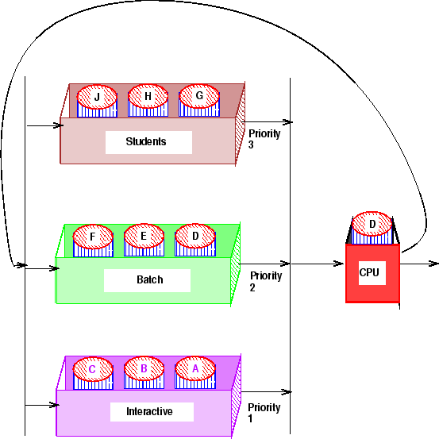
Multi-Queue Scheduling: Example
20%
30%
50%

Slide 37
Real Life Analogy
Tasks (to-do list) for poor Bob
  Class 1 priority (highest): tasks given by his boss
    Finish the project (50%)
  Class 2 priority: tasks for his wife
    Buy a valentine present (30%)
  Class 3 priority (lowest): Bob’s tasks
    Watch TV (20%)

Slide 38
(6)A Variation: Multi-level Feedback Algorithm
Multi-Level Queue with priorities
Processes move between queues
Each queue represents jobs with similar CPU usage
Jobs in a given queue are executed with a given time-slice
Rational:
  Once an I/O process completes an I/O request, it should have higher CPU priority.

Slide 39
Multi-level Feedback Algorithm (Details)
Example (CTSS): Queue_{i} has time-slice t 2^{i}
  If a job in Queue_{i} doesn't block by end of time-slice, it is moved to Queue_{i+1}
  Lowest priority Queue is FCFS

Slide 40
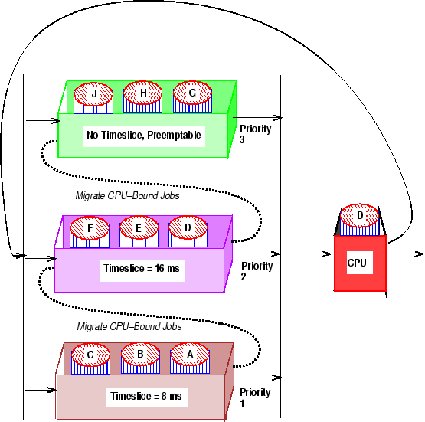
Multi-level Feedback Algorithm: Example

Slide 41
Quiz
Consider a multi-level feedback queue in a single-CPU system. The first level (queue 0) is given a quantum of 4 ms (scheduled using RR), the second one a quantum of 8 ms (scheduled using RR), the third is scheduled using FCFS. Assume jobs arrive all at time zero with the following CPU burst times (in ms): 4, 7, 12, 20, 25 and 30. Show the Gantt chart for this system (5 points) and compute the average turnaround time.

Slide 42
Queue 0:
Queue 1:
Queue 2:
Since all jobs enter the system at time 0, the turnaround time is the time of completion. The average turnaround time is :
(4 + 27 + 35 + 67 + 80 + 98)/6 = 311/6 = 51.83
0
4
8
12
16
20
24
J1 | J2 | J3 | J4 | J5 | J6
24
27
35
43
51
59
J2 | J3 | J4 | J5 | J6
59
67
80
98
J4 | J5 | J6

Slide 43
Review: Scheduling Algorithms
Batch systems
  First come first serve
  Shortest job first
Interactive systems
  Round-robin
  Priority scheduling
  Multi-Queue & Multi-level feedback

Slide 44
(7) Guaranteed Scheduling (QoS)
Make real promises to the users about performance and then live up to them.
Example:
  with n processes running, the scheduler makes sure that each one gets 1/n of the CPU cycles.
Scheduling:
  compute the ratio of actual CPU time consumed to CPU time entitled
  Select the one with the lowest ratio

Slide 45
(8) Lottery Scheduling
More commonly used
Probability-based:
  Give processes lottery tickets. At scheduling time, a lottery ticket is chosen at random, and the process holding that ticket gets that resource.
Give more tickets for higher priority processes
Advantages:
  Simple
  Highly responsive
  Can support cooperation between processes
  Easy to support priority and proportion requirement

Slide 46
(9) Fair-Share Scheduling
Is Round-robin fair?
  Yes, it is (from process point of view)
  No, it may be not (from user point view)
User-based fair share scheduling
  Each user gets fair share
Example:
  Alice has 4 processes: A1, A2, A3, A4
  Bob has 1 process: B1
  Then A1, A2, A3, A4 are entitled only to 50% CPU, while B1 alone is entitled to 50%
  Possible scheduling sequence: A1,B1,A2,B1,A3,B1,A4,B1,……

Slide 47
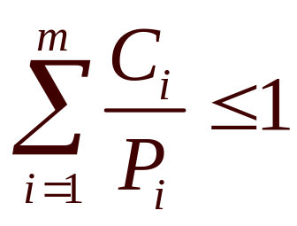
Scheduling in Real-Time Systems
The scheduler makes real promises to the user in terms of deadlines or CPU utilization.
Schedulable real-time system
  Given
    m periodic events
    event i occurs within period P_{i} and requires C_{i} seconds
  Then the load can only be handled if

Slide 48
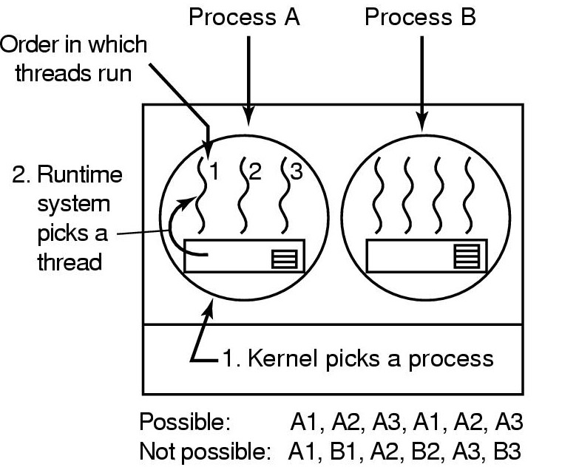
User-level Thread Scheduling
Possible Scheduling
50-msec quantum
run 5 msec/CPU burst

Slide 49
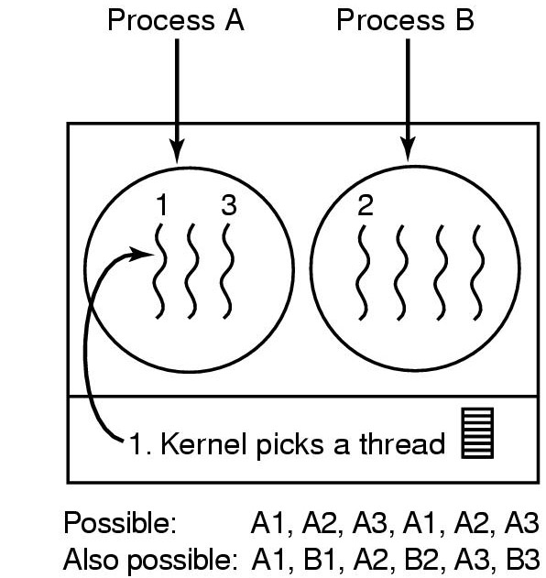
Kernel-level Thread Scheduling
Possible scheduling
50-msec quantum
threads run 5 msec/CPU burst

Slide 50
Summary
What is scheduling
Scheduling objectives
CPU Scheduling
FCFS
Shortest job first (SJF)
Priority
Round-robin
Multi-Queue
Multi-level Feedback
Scheduling algorithms
  Guaranteed Scheduling
  Lottery Scheduling
  Fair Sharing Scheduling
Scheduling for
  Real-time systems
  Threads

Slide 51
Homework
1、4、14、18、29、34、39、45、60

