Slide 1
Chapter 3
Memory Management
3.1 No Memory Abstraction
3.2 A Memory Abstraction: Address Space
3.3 Virtual Memory
3.4 Page Replacement Algorithm
3.5 Segmentation

Slide 2
Storage Hierarchy
Ideally programmers want memory that is
  Large
  Fast
  Nonvolatile
  Inexpensive
Memory hierarchy
  A few MBs of fast, expensive, volatile cache memory
  A few GBs of medium-speed, medium price, volatile main memory (RAM)
  A few TBs of slow, cheap, nonvolatile disk storage
Memory manager handles the memory hierarchy.

Slide 3
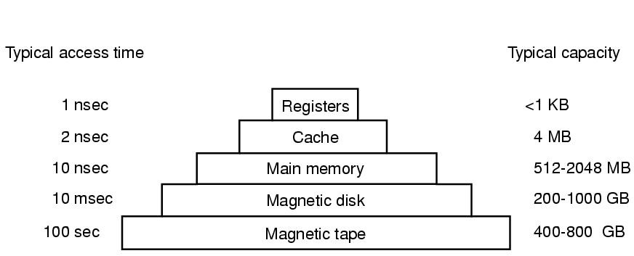
Storage Hierarchy

Slide 4
Memory
Program must be brought into memory and placed within a process for it to be run.
Consecutive address space (memory unit)，is used for store the code and data of process.
System section and User section

Slide 5
Objective
Support multiprogramming
Convenience to user, Hide hardware details to user program, Auto-load user program
Solve program space > memory space
Process can be flexible in memory
Quick access
Storage protection and security
Share and communication
Performance and cost

Slide 6
Task
Memory allocate and free
Address relocation
Memory share and protection
Memory expansion

Slide 7

No Memory Abstraction
The simplest memory abstraction is no memory abstraction. Every program simply saw the physical memory.
It is not possible to run two programs in memory at the same time.
Three different ways to organize memory with OS and one user program.

Slide 8
Multiple Programs without Memory Abstraction
IBM 360
  Divide memory into 2-KB blocks
  Assign each block a 4-bit protection key, which saved in special registers of CPU
  PSW also contains a 4-bit key
  When a process access memory, compare the protection code of the memory block with the PSW key.

Slide 9
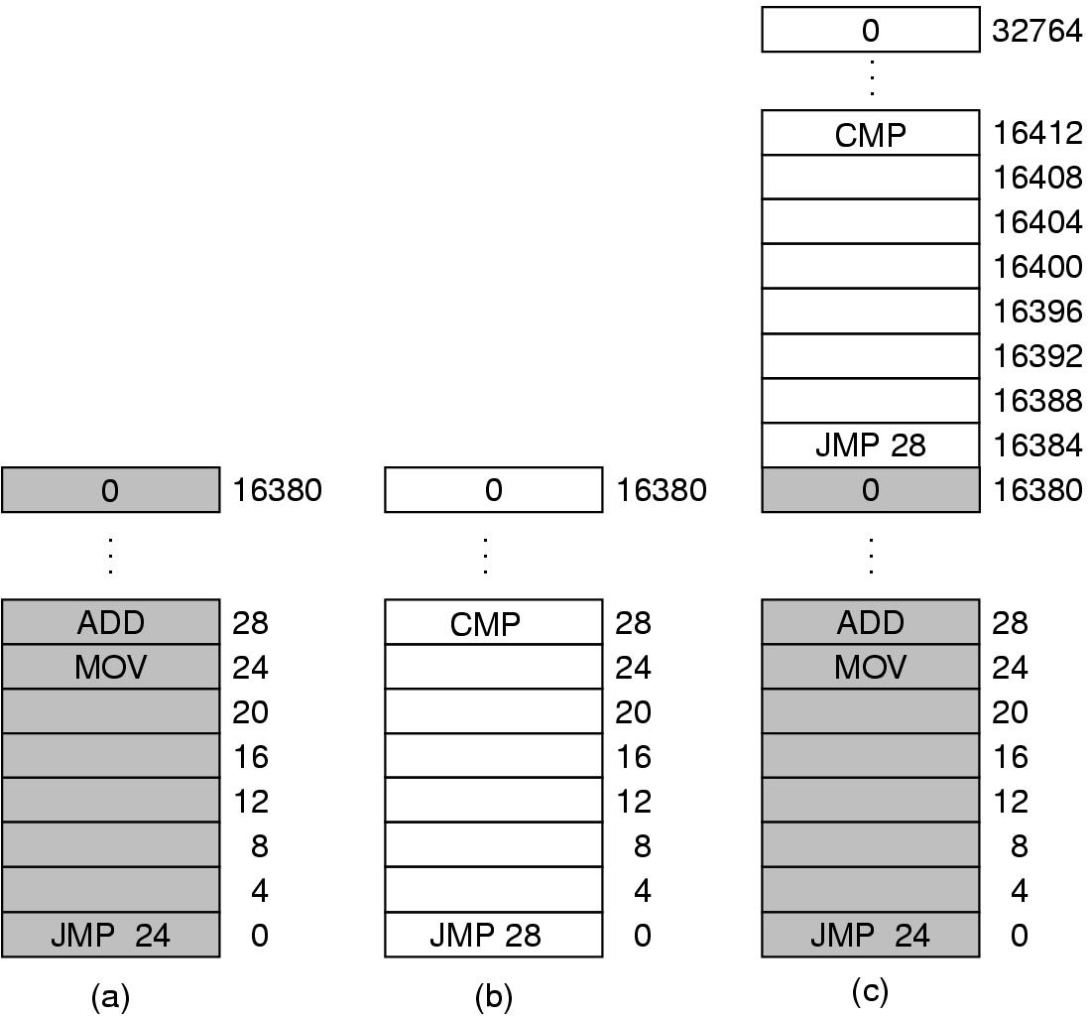
Multiple Programs without Memory Abstraction
Illustration of the relocation problem.

Slide 10
Address Spaces
To allow multiple applications to be in memory at the same time without interfering with each other, two problems must be solved:
  Protection
    Primitive solution: Label chunks of memory with a protection key, and compare the key of the executing process to that of every memory word fetched.
  Relocation
A better solution: Address Space
  Address space is a set of addresses that a process can use to address memory.

Slide 11
Address Spaces
Each process has its own address space, independent of those belonging to other processes.
  Logical address space, range (0 to max)
    Logical addresses, Virtual addresses
Dynamic Relocation
  Map each process’ address space onto a different part of physical memory.
  Physical address space, range (R+0 to R+max) for base value R
    Physical addresses, Real addresses
  Base and Limit Registers

Slide 12
Base and Limit Registers
Limit Register
Base Register
Memory
Logical
Address LA
Base
Address
BA
Limit Address
CPU
Address
<
+
MA+BA
Memory
Address
MA
Physical
Address
PA
Base Address
Fault

Slide 13
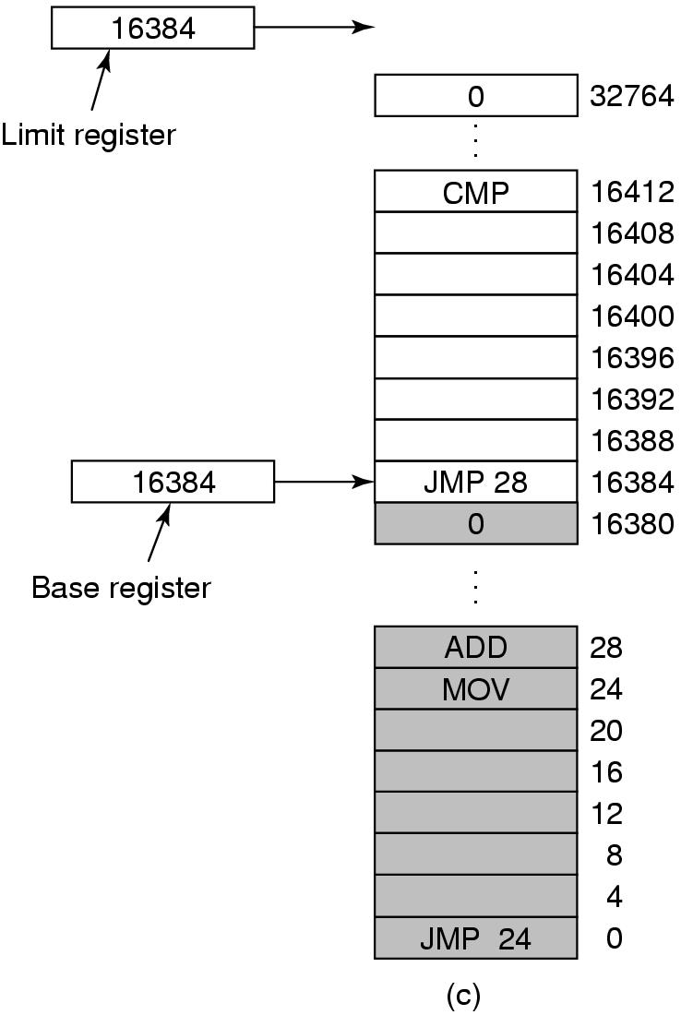
Base and Limit Registers
Base and limit registers can be used to give each process a separate address space.

Slide 14
Swapping (1)
Lots of programs, total size exceeds memory
  Swapping: brings the whole process into memory, runs it for a while, and then move it back on the disk.
  Virtual memory: allows programs to run even when they are only partially in main memory.
Swapping allows several processes to share a partition
Processes that grow can be swapped out and swapped back in a bigger partition

Slide 15

Swapping (2)
Memory allocation changes as processes come into memory and leave it. The shaded regions are unused memory.

Slide 16
Swapping (3)
Allocating memory dynamically
  When a process come, allocate space as it demand if have enough space;
  Or process wait on disk;
With processes swapping in and swapping out, there will be many holes (External Fragmentation)

Slide 17
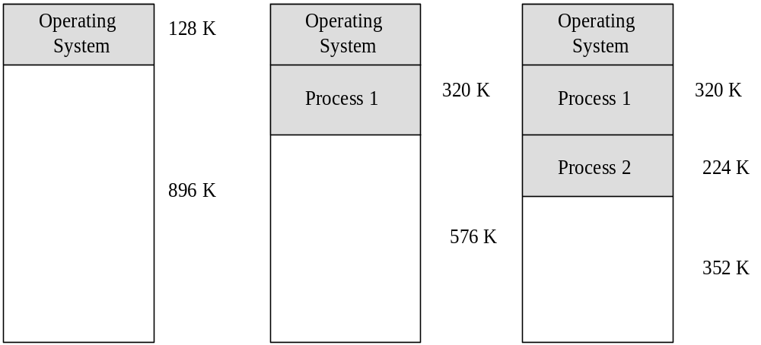

Slide 18
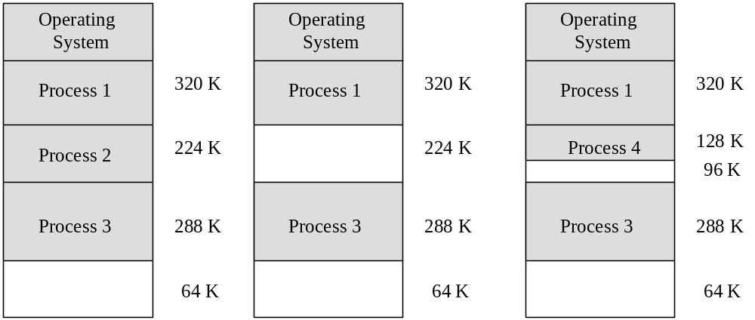

Slide 19
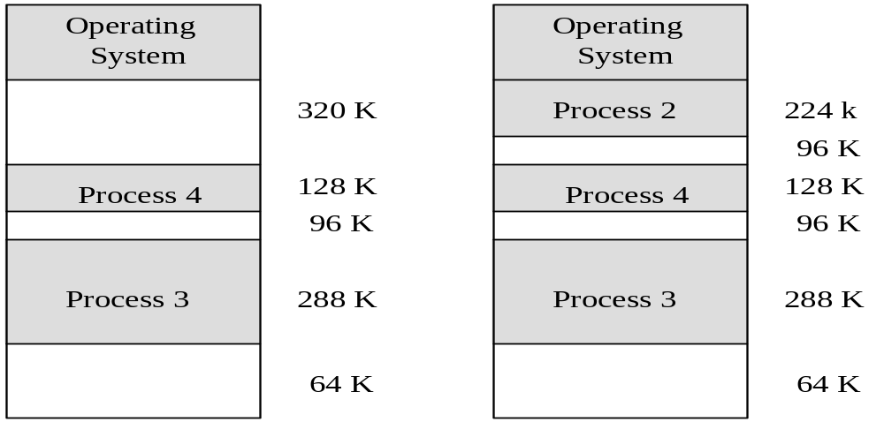
The holes need be compacted together to generate a large free space.

Slide 20
Compaction
(Similar to Garbage Collection)
Assumes programs are all re-locatable
Processes must be suspended during compaction
Need be done only when fragmentation gets very bad
5
Monitor
Job 7
Job 5
Job 3
Job 8
Free
Job 6
6
Monitor
Job 7
Job 5
Job 3
Job 8
Free
Job 6
7
Monitor
Job 7
Job 5
Job 3
Job 8
Free
Job 6
8
Monitor
Job 7
Job 5
Job 3
Job 8
Free
Job 6
9
Monitor
Job 7
Job 5
Job 3
Job 8
Job 6
Free

Slide 21

Memory Management with Bitmaps
Use bitmaps or free lists.
Memory is divided into allocation units.
  One allocation unit corresponds to 1bit in the bitmap
  0: free, 1: allocated

Slide 22
Size of allocation unit
  The smaller the allocation unit, the larger the bitmap.
Problem: allocation
  When a new process arrives, the manager must find consecutive 0 bits in the map.
  Searching a bitmap for a run of a given length is a slow operation.

Slide 23
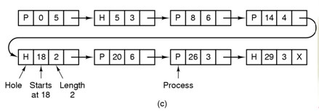
Memory Management with
Linked Lists
Use a linked list of allocated and free memory segments (called hole)
  sorted by the address or by the size

Slide 24
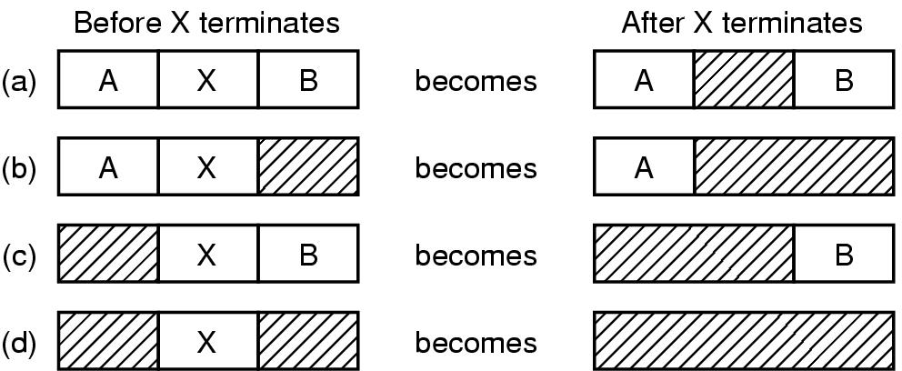
Memory Management with
Linked Lists
Sorting by address has the advantage:
  When a process terminates or is swapped out, updating the list is straightforward.
Four neighbor combinations for the terminating process X

Slide 25
Storage Placement Strategies
How to satisfy a request of size n from a list of free holes.
First Fit
  Use the first available hole whose size is sufficient to meet the need.
  Problem: Creates average size holes.
Next Fit
  Minor variation of first fit: search for the last hole stopped.
  Problem: slightly worse performance than first fit.

Slide 26
Storage Placement Strategies
Best Fit
  Use the hole whose size is equal to the need, or if none is equal, the hole that is larger but closest in size.
  Problem: Creates small holes that can't be used.
Worst Fit
  Use the largest available hole.
  Problem: Gets rid of large holes making it difficult to run large programs.
Quick Fit
  maintains separate lists for some of the more common sizes requested.
  When a request comes for placement it finds the closest fit.
  This is a very fast scheme, but a merge is expensive.

Slide 27
8
K
8
K
12
K
First Fit
12
K
22
K
16K
Best Fit
6
K
Last
allocated
18
K
block (14K)
2
K
8
K
8
K
6
K
6
K
Allocated block
14
K
Free block
14
K
Next Fit, Worst Fit
36
K
20
K
Before
After

Slide 28
Overlaying
One program, using lots of memory
  Overlaying (1960s): split programs into little pieces, called overlays.
  Allow one or some overlays in memory at the same time, many overlays can use common memory space. (see next page)
  The work of swapping overlays in and out is done by OS, but the programmer should split the program into pieces manually, which increases the complexity of programming.

Slide 29
Overlaying
Secondary Storage
Main Program
Overlay 1
0K
5k
Overlay 2
Overlay Manager
7k
Overlay Area
Overlay 1
Overlay 2
Overlay 3
Overlay 1
12k
Overlay 3

Slide 30
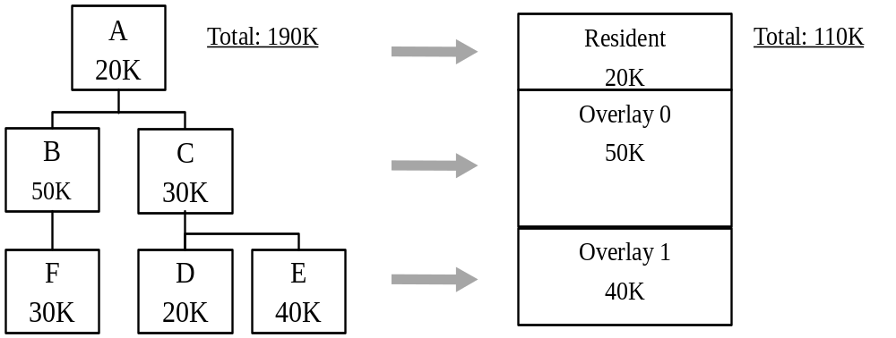
Overlaying Example
An alternative approach：(100K)
  A(20K) ：20K；
  B(50K)、D(20K)、E(40K) ：50K；
  C(30K)、F(30K) ：30K；

Slide 31
Virtual Memory
Virtual memory – separation of user logical memory from physical memory.
  Provide user with virtual memory that is as big as user needs
  Logical address space can therefore be much larger than physical address space.
  Store virtual memory on disk
  Only part of the program needs to be in memory for execution.
  Allows address spaces to be shared by several processes.
  Allows for more efficient process creation.
  Load and store cached virtual memory without user program intervention

Slide 32
Principle of Locality
Locality of reference:
  During the phase of execution the process references relatively small fraction of its pages.
  Time locality
  Space locality

Slide 33

Basic idea of Virtual Memory
Paging is a technique used to implement virtual memory.
  Pages: the virtual address is divided up into units .
  Page frames: the corresponding units in the physical memory.
The MMU (memory management unit) translates a virtual address into a physical address

Slide 34
Suppose the computer can generate 16-bit addresses, (0-64k). However, the computer only has 32k of memory ➔ 64k program can be written, but not loaded into memory.
A Present/Absent bit keeps track of whether or not the page is mapped.
Reference to an unmapped page causes the CPU to trap to the OS.
This trap is called a Page fault. The MMU selects a little used page frame, writes its contents back to disk, fetches the page just referenced, and restarts the trapped instruction.

Slide 35
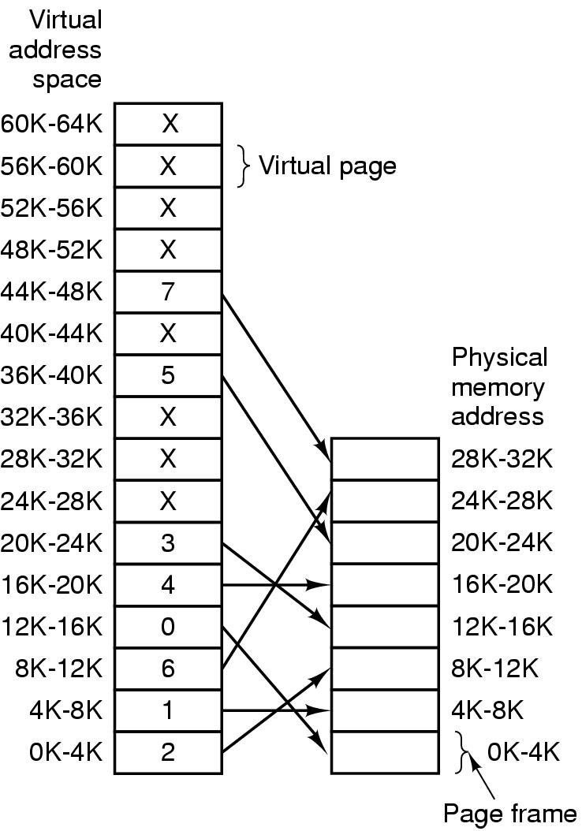
Paging
The relation between virtual addresses
and physical
memory addresses given by page table.

Slide 36

Paging Model Example

Slide 37
Page Table
Virtual address: Virtual page number (high-order bits) and an offset (low-order bits)
The purpose of the page table is to map virtual pages onto page frames.

Slide 38

Typical page table entry
Page frame number - map the frame number
Present/absent bit - 1/0 indicates valid/invalid entry
Protection bit - what kinds of access are permitted.
Modified bit (dirty bit) - set when modified and writing to the disk occur
Referenced bit - Set when page is referenced (help decide which page to evict)
Caching disabled - Cache is used to keep data that logically belongs on the disk in memory to improve performance.

Slide 39
Paging Request
Request Page 3
Page Table
VM
Frame
Memory
1
Real Memory
2
1
3
3
1
4
2
1
2
3
4
5
3
6
7
4
8
Virtual Memory Stored on Disk
Disk
1
2
3
4
5
6
7
8

Slide 40
Paging
Request Page 1
Page Table
VM
Frame
Real Memory
1
2
1
Memory
1
2
3
3
1
2
4
3
5
1
2
3
4
6
4
7
8
Virtual Memory Stored on Disk
Disk
1
2
3
4
5
6
7
8

Slide 41
Paging
Request Page 6
Page Table
VM
Frame
1
2
1
Real Memory
Memory
2
1
3
3
1
4
2
5
3
1
2
3
4
6
3
7
4
8
Virtual Memory Stored on Disk
Disk
1
2
3
4
5
6
7
8

Slide 42
Paging
Request Page 2
Page Table
VM
Frame
Real Memory
1
2
1
Memory
2
4
1
3
3
1
2
4
5
3
1
2
3
4
6
3
4
7
8
Virtual Memory Stored on Disk
Disk
1
2
3
4
5
6
7
8

Slide 43
Paging
Request Page 8: Swap page 2
to disk first
Page Table
VM
Frame
1
Real Memory
Memory
2
4
1
3
3
1
2
4
5
3
1
2
3
4
6
3
4
7
8
Virtual Memory Stored on Disk
Disk
1
2
3
4
5
6
7
8

Slide 44
Paging
Load Page 8 to Memory
Page Table
VM
Frame
Real Memory
1
1
Memory
2
4
3
2
3
1
4
3
5
1
2
3
4
6
3
4
7
8
2
Virtual Memory Stored on Disk
Disk
1
2
3
4
5
6
7
8

Slide 45
Paging Example
A logical address (on 32-bit machine with 4K page size) is divided into:
  a page number consisting of 20 bits.
  a page offset consisting of 12 bits.
Thus, a logical address is as follows:
page number
page offset
p
d
20
12

Slide 46
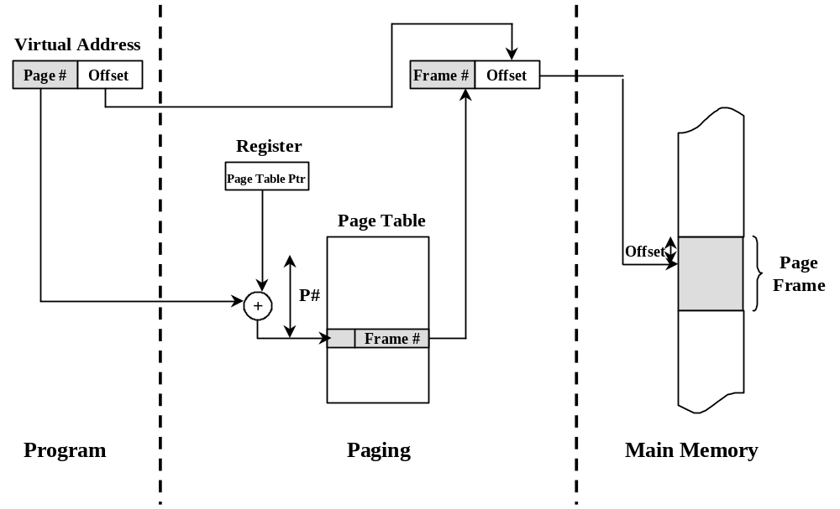

Slide 47
Page Tables Issues
Two major issues of the page tables are faced:
  The mapping must be fast because it is done on every memory access!!
  Page tables may be extremely large (e.g. most computers use)
32-bit address with 4k page size, 12-bit offset
➔20 bits for virtual page number
➔1 million entries!

Slide 48
Page Tables Issues
Single page table consisting of an array of hardware registers. As a process is started up, the registers are loaded with page table.
  Advantage - simple
  Disadvantage - expensive if table is large and loading the full page table at every context switch hurts performance.
Leave page table in memory - a single register points to the table
  Advantage - context switch cheap
  Disadvantage - one or more memory references to read table entries

Slide 49
Virtual-To-Physical Lookups
Programs only know virtual addresses
Each virtual address must be translated
  May involve walking hierarchical page table
  Page table stored in memory
  So, each program memory access requires several actual memory accesses
Solution: cache “active” part of page table
  Translation Look-aside Buffers (TLBs)
  TLB also called “associative memory”

Slide 50
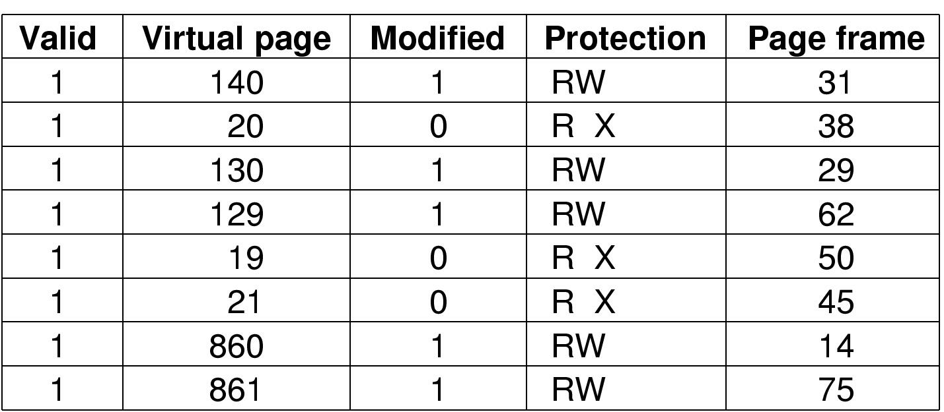
Bits in a TLB Entry
Common (necessary) bits
  Virtual page number: match with the virtual address
  Physical page number: translated address
  Valid
  Access bits: kernel and user (nil, read, write)
Optional (useful) bits
  Process tag
  Reference
  Modify
  Cacheable

Slide 51
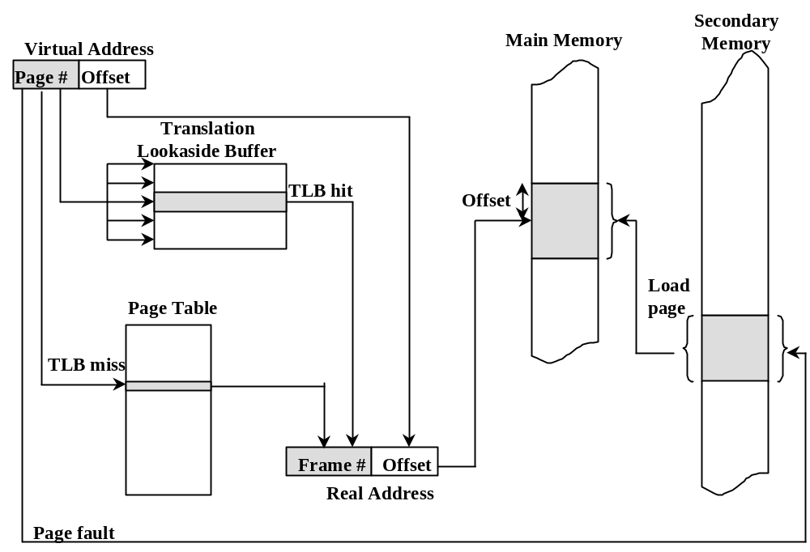
Translation Look-aside Buffer (TLB)

Slide 52
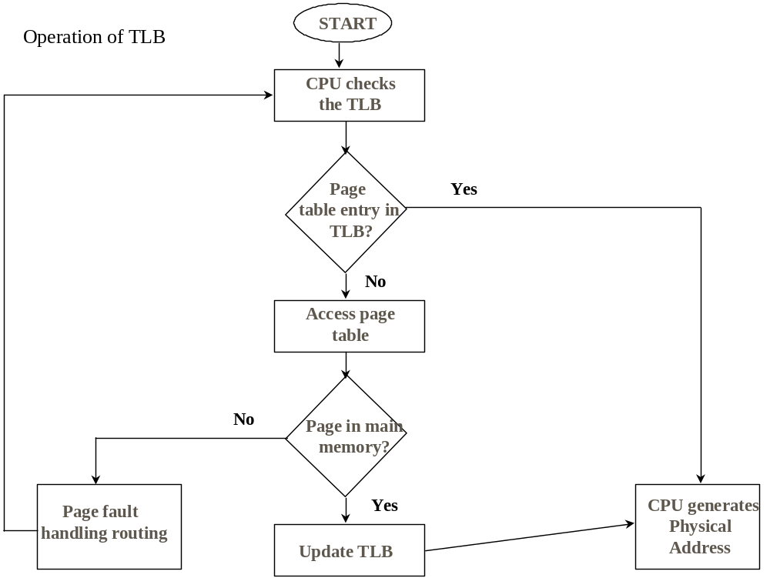

Slide 53
TLB Function
If a virtual address is presented to MMU, the hardware checks TLB by comparing all entries simultaneously (in parallel).
If match is valid, the page is taken from TLB without going through page table.
If match is not valid
  MMU detects miss and does an ordinary page table lookup.
  It then evicts one page out of TLB and replaces it with the new entry, so that next time that page is found in TLB.
TLB hit ratio (Page address cache hit ratio)
  Percentage of time page found in associative memory

Slide 54
Hardware-Controlled TLB
On a TLB miss
  Hardware loads the PTE (Page Table Entry) into the TLB
    Need to write back if there is no free entry
  Generate a fault if the page containing the PTE is invalid
  VM software performs fault handling
  Restart the CPU
On a TLB hit, hardware checks the valid bit
  If valid, pointer to page frame in memory
  If invalid, the hardware generates a page fault
    Perform page fault handling
    Restart the faulting instruction

Slide 55
Software-Controlled TLB
On a miss in TLB, generate a TLB fault, then trap to OS (software)
  Check if the page containing the PTE is in memory
  If no, perform page fault handling
  Write back if there is no free entry, then load the PTE into the TLB
  Restart the faulting instruction
On a hit in TLB, the hardware checks valid bit
  If valid, pointer to page frame in memory
  If invalid, the hardware generates a page fault
    Perform page fault handling
    Restart the faulting instruction

Slide 56
Multilevel Page Tables
Since the page table can be very large, one solution is to page the page table
Divide the page number into
  An index into a page table of second level page tables
  A page within a second level page table
Advantage:
  reduce the table size.
  don't keep page tables in memory that are not needed.

Slide 57
Multiple-Level Page Tables
Virtual address
pte
dir
table
offset
.
.
.
Directory
.
.
.
.
.
.
.
.
.
What does this by us? Sparse address spaces and easier paging

Slide 58
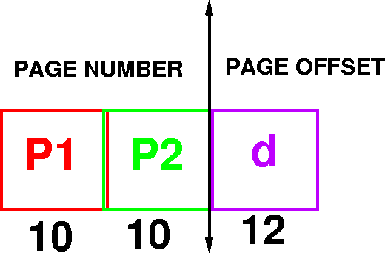
Example Addressing on a Multilevel Page Table System
A logical address (on 32 bit machine with 4k page size) is divided into
  A page number consisting of 20 bits
  A page offset consisting of 12 bits
Divide the page number into
  A 10-bit page number
  A 10-bit page offset

Slide 59

Performance: Since each level is stored as a separate table in memory, converting a logical address to a physical one in a four-level paging may take five memory accesses.

Slide 60
Inverted Page Tables
Main idea
  One PTE for each physical page frame
  Hash (Vpage, pid) to Ppage#
Pros
  Small page table for large address space
Cons
  Lookup is difficult
  Overhead of managing hash chains, etc
Physical
address
Virtual
address
pid
vpage
offset
k
offset
0
pid
vpage
k
n-1
Inverted page table

Slide 61
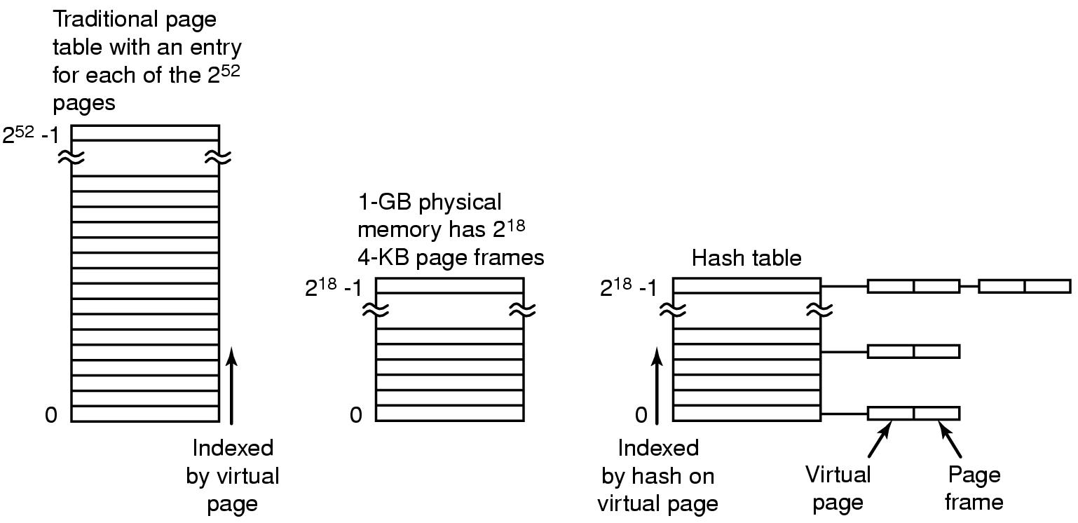
Inverted Page Tables
Comparison of traditional page table with an inverted page table

Slide 62
Inverted Page Table
Virtual Address (004006)
Page Table
004
006
0
1
5
0
0
1
4
1
0
005
006
Physical Address (005006)

