Slide 1
Chapter 3
Memory Management
Fetch Strategies
Page Replacement
  -Optimal -FIFO -LRU -NRU
  -Second-chance
Design Issues for paging systems
Implementation Issues
Segmentation
Summary

Slide 2
Paging Policies
Fetch Strategies
  When should a page be brought into primary (main) memory from secondary (disk) storage.
Replacement Strategies
  Which page now in primary storage is to be removed from primary storage when some other page or segment is to be brought in and there is not enough room.
Clean Strategies
  When a page in memory is brought out?

Slide 3
Demand Fetching
Algorithm Never bring a page into primary memory until it’s needed.
  Page fault occurs.
  Check if a valid virtual memory address. Kill job if not.
  If valid reference, check if it’s cached in memory already (perhaps for some other process.) If so, skip to 7.
  Find a free page frame.
  Map address into disk block and fetch disk block into page frame. Suspend user process.
  When disk read finished, add vm mapping for page frame.
  If necessary, restart process.

Slide 4
Prepaging
Algorithm bring a page into primary in advance.
When page-fault happens, the page needed and adjacent pages will be brought into memory.
  Advantage: improve the I/O efficiency when fetch page.
  Disadvantage: based on prediction, if the fetched page is rare referenced, low efficiency.
  Used when loading page.
Notes:
加载页面时经常用预先调页的方式，因为一个允许被调入系统的新的作业，一开始应给予一组页框，装入相应的一组页面

Slide 5
Page Replacement
Find location of page on disk
Find a free page frame
  If free page frame use it
  Otherwise, select a page frame using the page replacement algorithm
  Write the selected page to the disk if necessary and update any necessary tables
Read the requested page from the disk.
Restart the user process.

Slide 6
Page Replacement Strategies
The Principle of Optimality
  Replace the page that will not be used again the farthest time in the future.
Random page replacement
  Choose a page randomly
FIFO - First in First Out
  Replace the page that has been in primary memory the longest
NRU - Not Recently Used
  An approximation to LRU.
LRU - Least Recently Used
  Replace the page that has not been used for the longest time
NFU - Not Frequently Used
  Replace the page that is used least often
Working Set
  Keep in memory those pages that the process is actively using.

Slide 7
Principal of Optimality
Description:
  Assume that each page can be labeled with the number of instructions that will be executed before that page is first references, i.e., we would know the future reference string for a program.
  Then the optimal page algorithm would choose the page with the highest label to be removed from the memory.
Impractical because it needs future references
If future references are known
  should not use demand fetching
  should use pre paging to allow paging to be overlapped with computation.
This algorithm provides a basis for comparison with other schemes.

Slide 8
FIFO Page Replacement Algorithm
Maintain a linked list of all pages
  in order they came into memory with the oldest page at the front of the list.
Page at beginning of list replaced
Advantage: easy to implement
Disadvantage
  page in memory the longest (perhaps often used) may be evicted

Slide 9
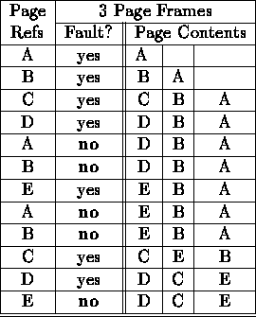
Optimal Example
12 references, 7 faults

Slide 10
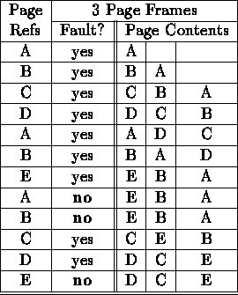
FIFO
12 references, 9 faults

Slide 11
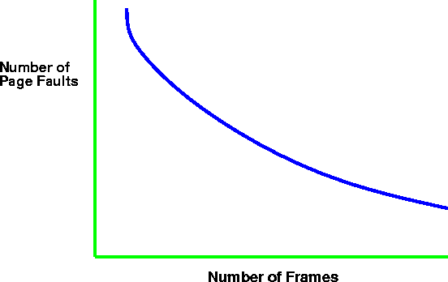
Paging Behavior with Increasing
Number of Page Frames

Slide 12
Belady's anomaly
Belady discovered more page frames might not always have fewer page faults. This is called Belady's anomaly.
A paging system can be characterized by three items:
  The reference string of the executing process.
  The page replacement algorithm.
  The number of page frames available in memory.

Slide 13
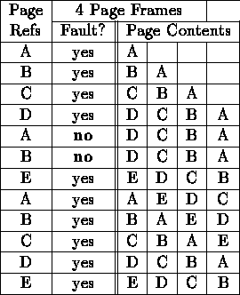
Belady's Anomaly (for FIFO)
As the number of page frames increase, so does the fault rate.
12 references, 10 faults

Slide 14
Second Chance Page Replacement Algorithm
Inspect R bit:
if R = 0 ➔ evict the page
if R = 1 ➔ set R = 0 and put page at end (back) of list. The page is treated like a newly loaded page.

Slide 15
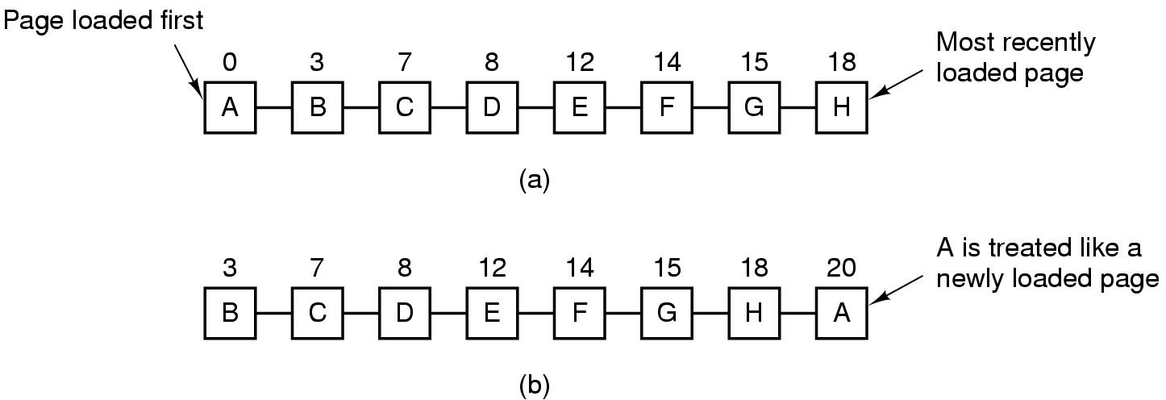
Second Chance Page Replacement Algorithm
Operation of a second chance
  Pages sorted in FIFO order
  Page list if fault occurs at time 20, A has R bit set
  (numbers above pages are loading times)

Slide 16
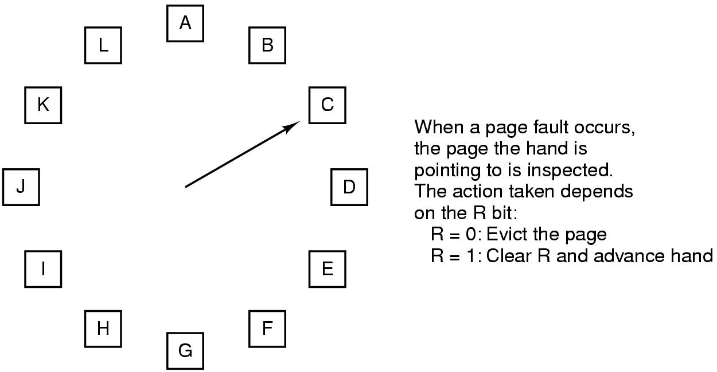
The Clock Page Replacement Algorithm
Clock Replacement Algorithm: a different implementation of second chance

Slide 17
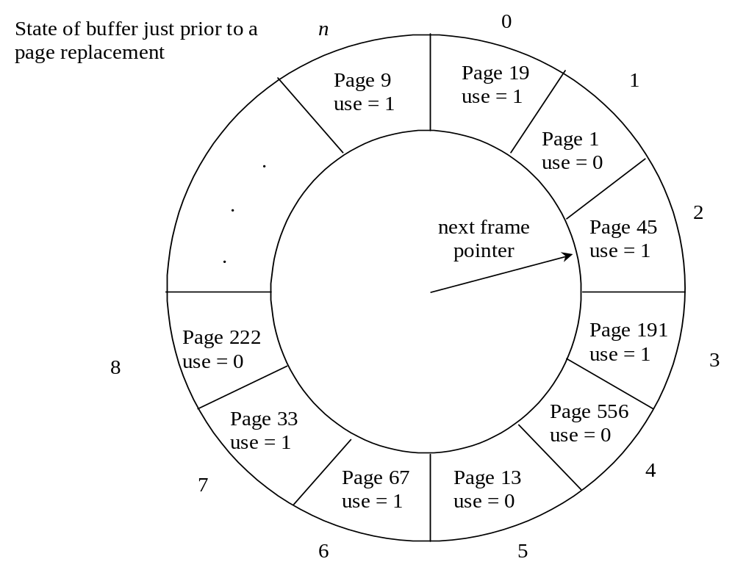

Slide 18
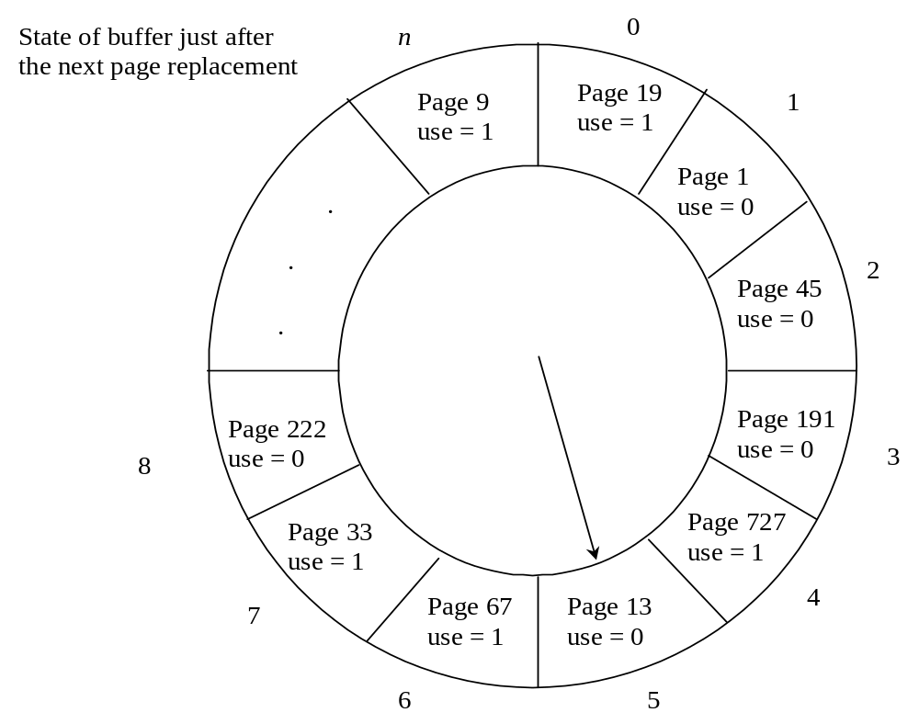

Slide 19
Not Recently Used Page Replacement Algorithm (NRU)
Each page has Reference bit(R) and Modified bit(M).
  bits are set when page is referenced (read or written recently), modified (written to)
  when a process starts, both bits R and M are set to 0 for all pages.
  periodically, (on each clock interval (20msec) ), the R bit is cleared. (i.e. R=0).
Pages are classified
  Class 0: not referenced, not modified
  Class 1: not referenced, modified
  Class 2: referenced, not modified
  Class 3: referenced, modified
NRU removes page at random
  from lowest numbered non-empty class

Slide 20
Least Recently Used (LRU)
Assume pages used recently will used again soon
  throw out page that has been unused for longest time
Software Solution: Must keep a linked list of pages
  most recently used at front, least at rear
  update this list every memory reference ➔ Too expensive!!
Hardware solution 1: Equip hardware with a 64 bit counter.
  That is incrementing after each instruction.
  After memory reference, the counter value is stored in the page table entry of the page that was just referenced.
  choose page with lowest value counter
  periodically zero the counter

Slide 21
Least Recently Used (LRU)
Hardware solution 2:
  Maintain a matrix of n x n bits for a machine with n page frames.
    When page frame K is referenced:
    (i) Set row K to all 1s.
    (ii) Set column K to all 0s.
    The row whose binary value is smallest is the LRU page.

Slide 22
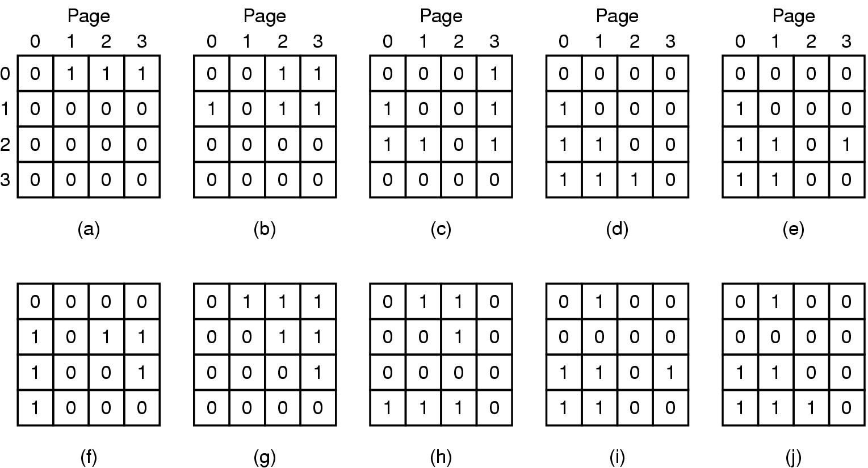
LRU
LRU using a matrix – pages referenced in order 0,1,2,3,2,1,0,3,2,3

Slide 23
Simulating LRU in Software
LRU hardware is not usually available.
  NRU: evict a page that is NOT recently used;
  LRU: evict a page that is LEAST recently used;
NFU (Not Frequently Used) is implemented in software.
  At each clock interrupt, the R bit is added to the counter associated with each page. When a page fault occurs, the page with the lowest counter is replaced.
  Problem: NFU never forgets, so a page referenced frequency long ago may have the highest counter.
Modified NFU = NFU with Aging - at each clock interrupt:
  the counters are shifted right one bit, and
  the R bits are added to the leftmost bit.
  In this way, we can give higher priority to recent R values.

Slide 24
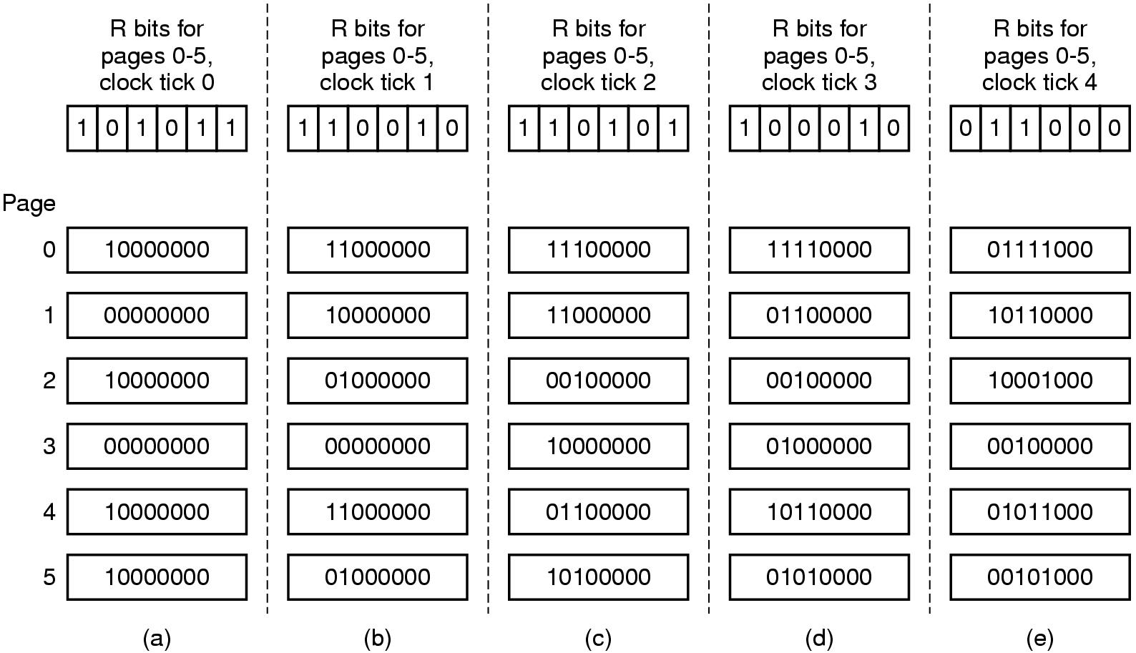
Simulating LRU in Software
The aging algorithm simulates LRU in software
Note 6 pages for 5 clock ticks, (a)~(e)

Slide 25
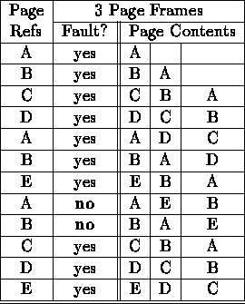
LRU
12 references, 10 faults

Slide 26
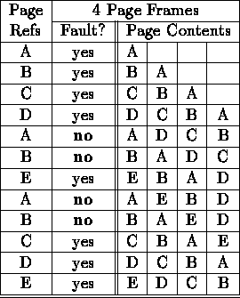
LRU and Anomalies
Anomalies cannot occur.
12 references, 8 faults

Slide 27
The Working Set Page Replacement Algorithm (1)
The working set is the set of pages used by the k most recent memory references
w(k,t) is the size of the working set at time, t
Example:
26157775162341234443434441327
| |t₁ | |t₂
ws(t₁)={1,2,5,6,7}
ws(t₂)={3,4}

Slide 28
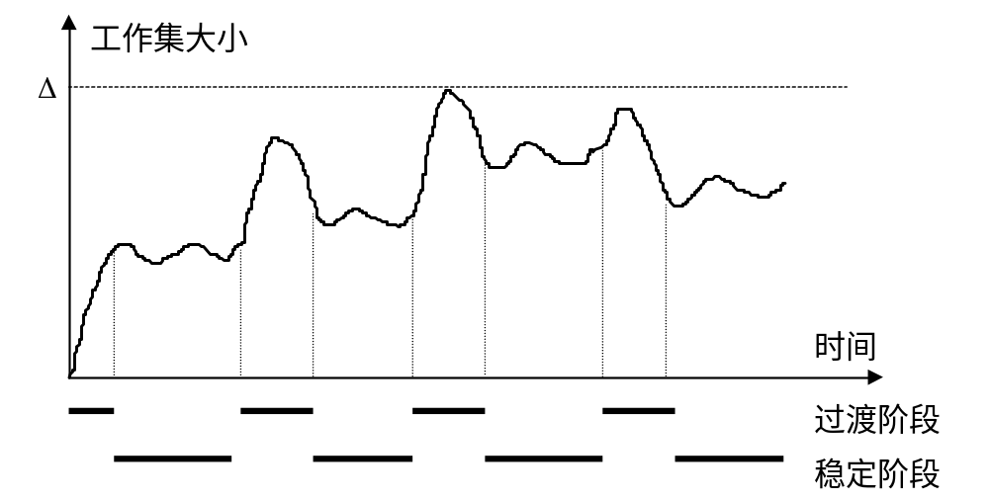
进程开始执行后，随着访问新页面逐步建立较稳定的工作集。
当内存访问的局部性区域的位置大致稳定时，工作集大小也大致稳定；
局部性区域的位置改变时，工作集快速扩张和收缩过渡到下一个稳定值。

Slide 29
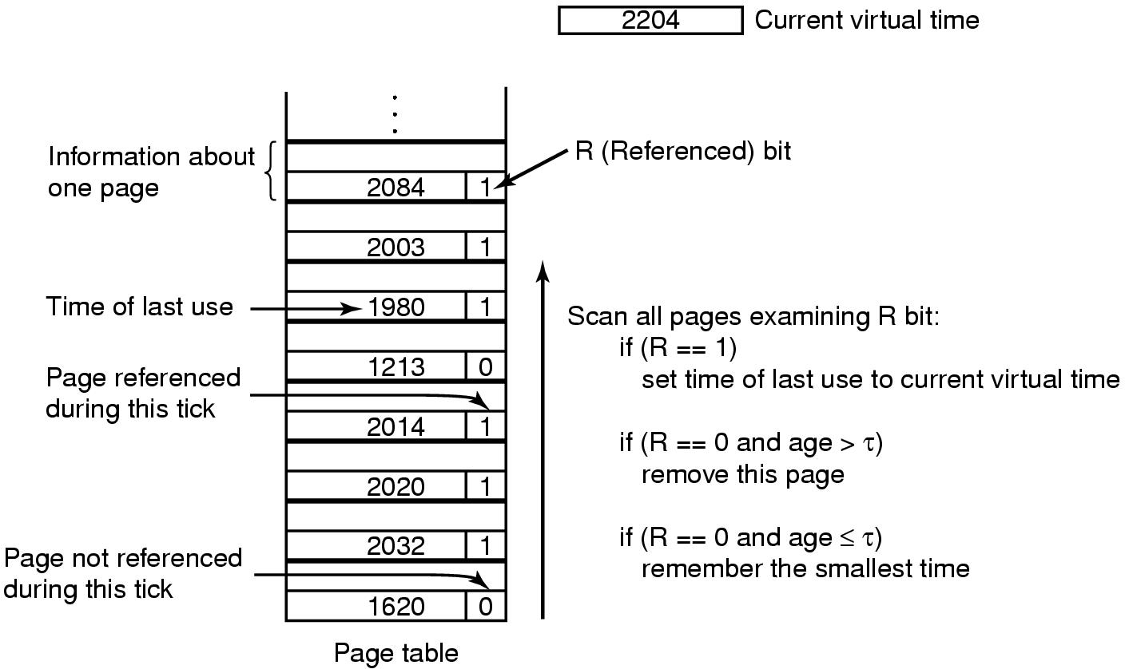
The Working Set Page Replacement Algorithm (2)
The working set algorithm

Slide 30
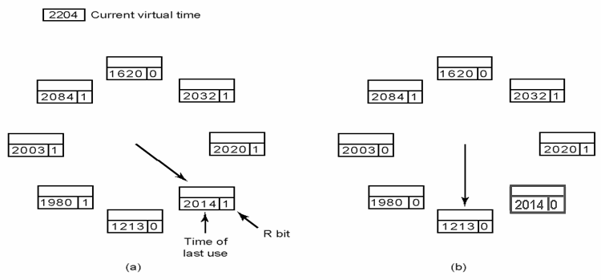
The WSClock Page Replacement Algorithm
Operation of the WSClock algorithm.
(a) and (b) give an example of what happens when R = 1.

Slide 31
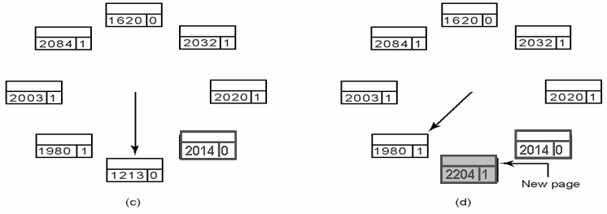
The WSClock Page Replacement Algorithm
Operation of the WSClock algorithm.
(c) and (d) give an example of R = 0.

Slide 32
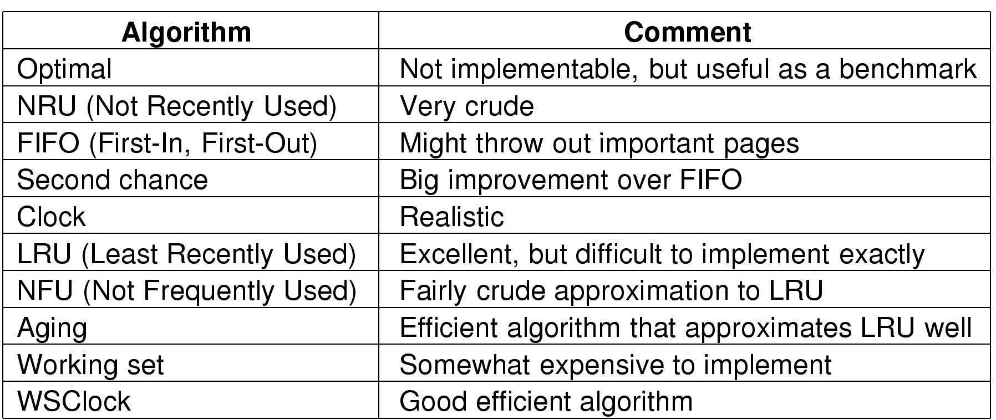
Review of Page Replacement Algorithms

Slide 33
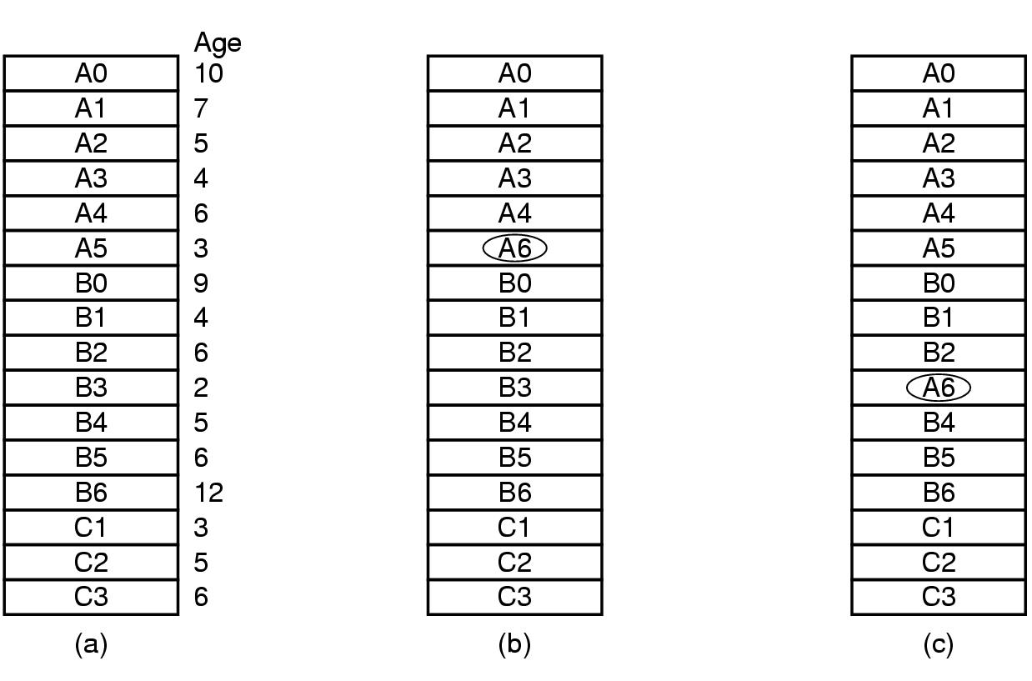
Design Issues for Paging Systems
Local versus Global Allocation Policies (1)
Original configuration
Local page replacement
Global page replacement

Slide 34
Load Control
Despite good designs, system may still thrash
Some processes need more memory
but no processes need less
Solution :
Reduce a number of processes competing for memory
  swap one or more to disk, divide up pages they held
  reconsider degree of multiprogramming

Slide 35
Page Size (1)
Small page size
Advantages
  less internal fragmentation
  less unused program in memory
Disadvantages
  programs need many pages, larger page tables

Slide 36
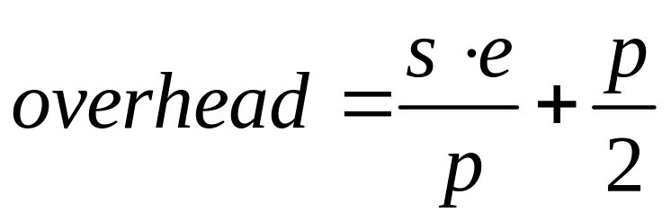
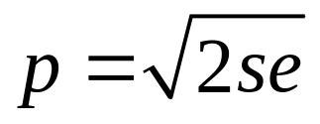
Page Size (2)
Overhead due to page table and internal fragmentation
Where
  s = average process size in bytes
  p = page size in bytes
  e = page entry size in bytes
page table space
internal fragmentation
Optimized when
S=1MB, e=8, p=4KB

Slide 37
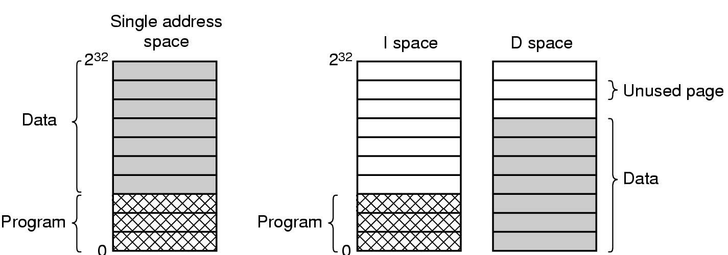
Separate Instruction and Data Spaces
One address space
Separate I and D spaces

Slide 38
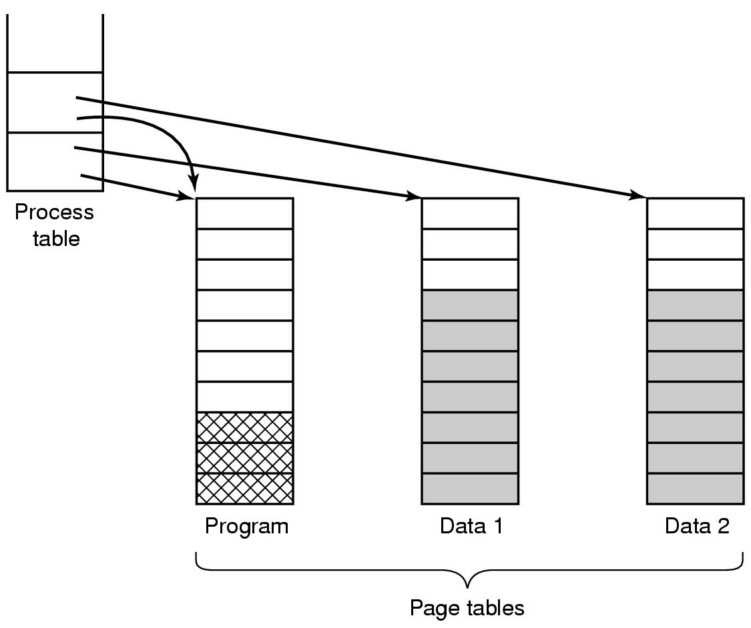
Shared Pages
Separate instruction and data space, easy to share
Two processes sharing same program sharing its page table

Slide 39
Cleaning Policy
Need for a background process, paging daemon
  periodically inspects state of memory
When too few frames are free
  selects pages to evict using a replacement algorithm
It can use same circular list (clock)
  as regular page replacement algorithm but with diff ptr (front hand & back hand)

Slide 40
Implementation Issues
Operating System Involvement with Paging
Four times when OS involved with paging
Process creation
  determine program size
  create page table
Process execution
  MMU reset for new process
  TLB flushed
Page fault time
  determine virtual address causing fault
  swap target page out, needed page in
Process termination time
  release page table, pages

Slide 41
Page Fault Handling (1)
Hardware traps to kernel, saving the PC on the stack
General registers saved
OS determines which virtual page needed
OS checks validity of address, seeks page frame
If selected frame is dirty, write it to disk, suspend the process

Slide 42
Page Fault Handling (2)
OS brings schedules new page in from disk. While page loading, process still suspend
Disk interrupts, page tables updated
Faulting instruction backed up to when it began
Faulting process scheduled
Registers restored
Program continues

Slide 43
Segmentation
The virtual memory solution so far is paging (one-dimensional)
For some applications, having two or more virtual address spaces may be much better than having only one.
  For example, a compiler has many tables that are built up as compilation proceeds, such as source text, symbol table, constant table, parse tree and stack.

Slide 44

Segmentation (1)
One-dimensional address space with growing tables
One table may bump into another

Slide 45
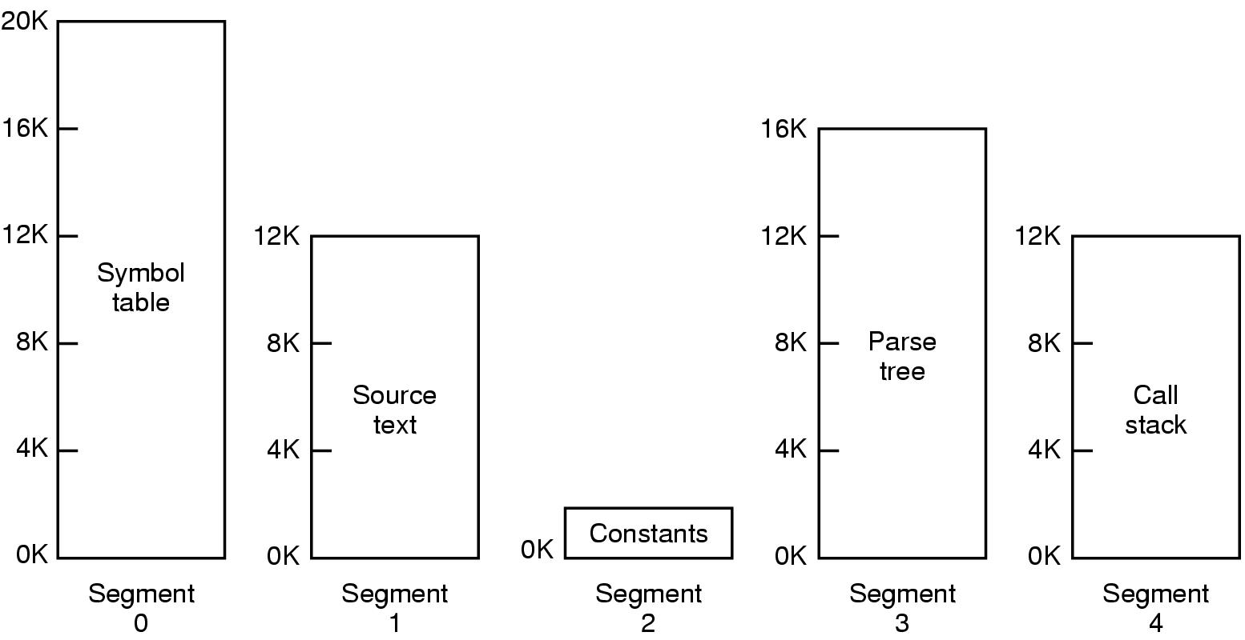
Segmentation (2)
Allows each table to grow or shrink, independently

Slide 46
Segmentation (3)
Segmentation is a memory-management scheme that supports user view of memory.
Pages are fixed in size, segments are variable sized.
A program is a collection of segments. A segment is a logical unit such as:
  Main program
  Procedure
  Function
  Symbol table
  Stack

Slide 47
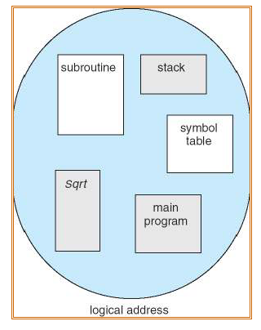
Segmentation (4)
User’s view of a program

Slide 48
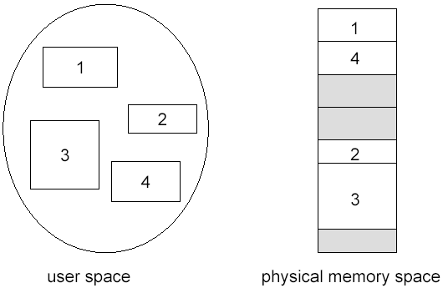
Segmentation (5)
Logical view of segment
Notes:
Fluctuate-变动, 波动, 涨落, 上下, 动摇
vt.使动摇, 使波动, 使起伏
accommodate
[ E5kCmEdeit ]
vt.供应, 供给, 使适应, 调节, 和解, 向...提供, 容纳, 调和
vi.适应

Slide 49
Segmentation Architecture (1)
Logical address consists of two parts:
<segment-number, offset>
Segment table: maps two-dimensional user-defined addresses into one-dimensional physical addresses; each table entry has:
  Base: contains the starting physical address where the segments reside in memory
  Limit: specifies the length of the segment
Segment-table base register (STBR) points to the segment table’s location in memory

Slide 50
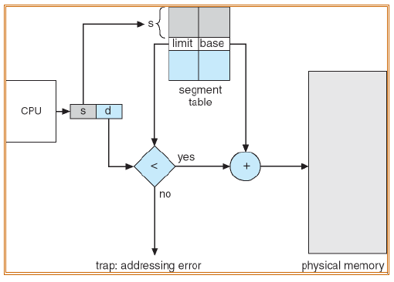
Address Translation
Notes:
Fluctuate-变动, 波动, 涨落, 上下, 动摇
vt.使动摇, 使波动, 使起伏
accommodate
[ E5kCmEdeit ]
vt.供应, 供给, 使适应, 调节, 和解, 向...提供, 容纳, 调和
vi.适应

Slide 51
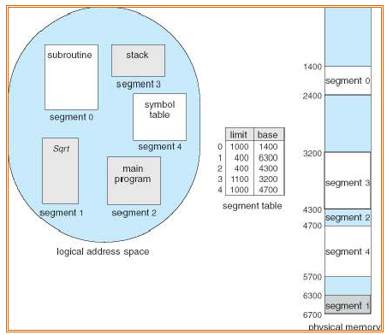
Example of Segmentation
Notes:
Fluctuate-变动, 波动, 涨落, 上下, 动摇
vt.使动摇, 使波动, 使起伏
accommodate
[ E5kCmEdeit ]
vt.供应, 供给, 使适应, 调节, 和解, 向...提供, 容纳, 调和
vi.适应

Slide 52
Segmentation Architecture (2)
Protection
  With each entry in segment table associate
    validation bit = 0 ⇒ illegal segment
    read/write/execute privileges
Protection bits associated with segments; code sharing occurs at segment level
Since segments vary in length, memory allocation is a dynamic storage-allocation problem

Slide 53
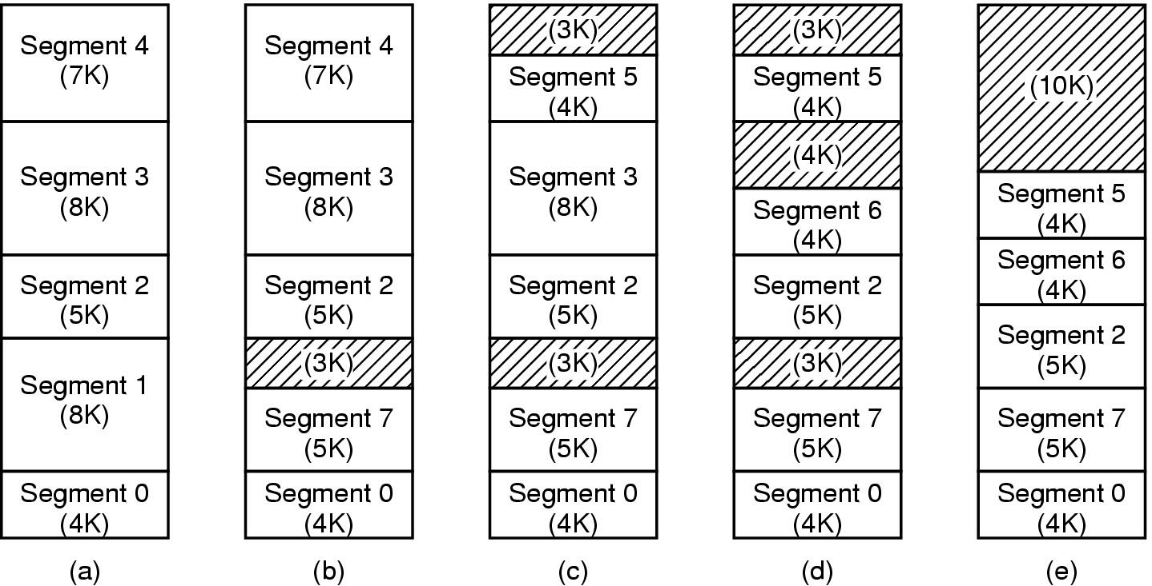
Implementation of Pure Segmentation
(a)-(d) Development of checkerboarding
(e) Removal of the checkerboarding by compaction
Notes:
SEG1out ,seg7 in

Slide 54

Paging vs. Segmentation
Comparison of paging and segmentation
Notes:
Fluctuate-变动, 波动, 涨落, 上下, 动摇
vt.使动摇, 使波动, 使起伏
accommodate
[ E5kCmEdeit ]
vt.供应, 供给, 使适应, 调节, 和解, 向...提供, 容纳, 调和
vi.适应

Slide 55
Advantage of Segmentation
May be possible to shrink/grow segments
Each segment can be given its own protection information...this is a much easier protection scheme than trying to protect each page of memory
Linking programs is a trivial task
Code can be shared between processes easily. Just load the code segment once. Copies of the same program access the same segment.

Slide 56
Disadvantage of Segmentation
Programmer must be aware of the memory model in use (at the assembly level, anyway)
Just like with swapping systems, fragmentation can waste much memory.
Segments may be too large to fit in physical memory

Slide 57

Segmentation with paging (1)
Segmentation in virtual memory, paging in real memory
A segment is composed of pages
An address has three components
The real memory contains only the demanded pages of a segment, not the full segment

Slide 58
Segmentation with paging (2)
Required
  Each process needs a segment table
    This table may be segmented and paged itself!
  Each entry in the segment table points to the page table for that segment
    Like before, this may be a multi-level page table

Slide 59
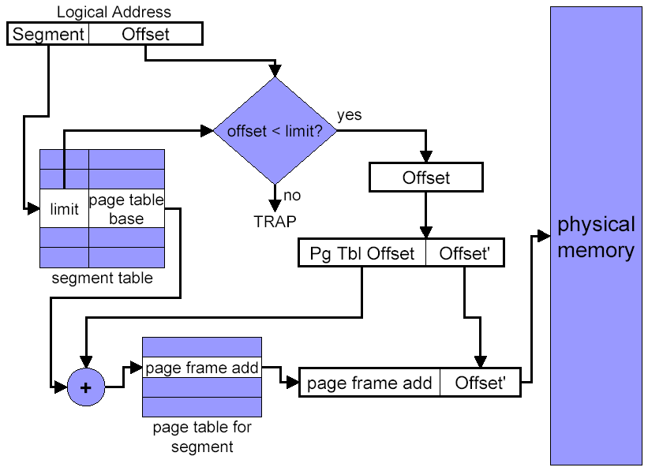
Address Translation

Slide 60
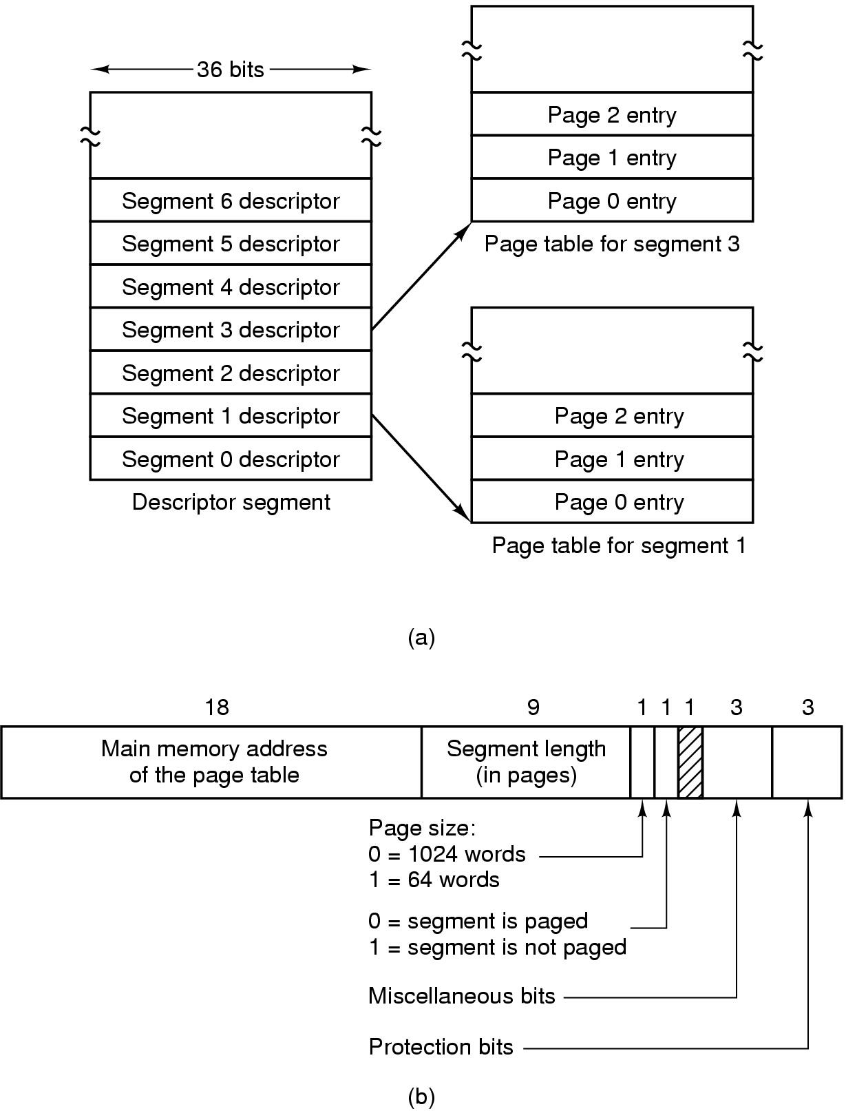
Segmentation with Paging: MULTICS
Descriptor segment points to page tables
Segment descriptor – numbers are field lengths

Slide 61
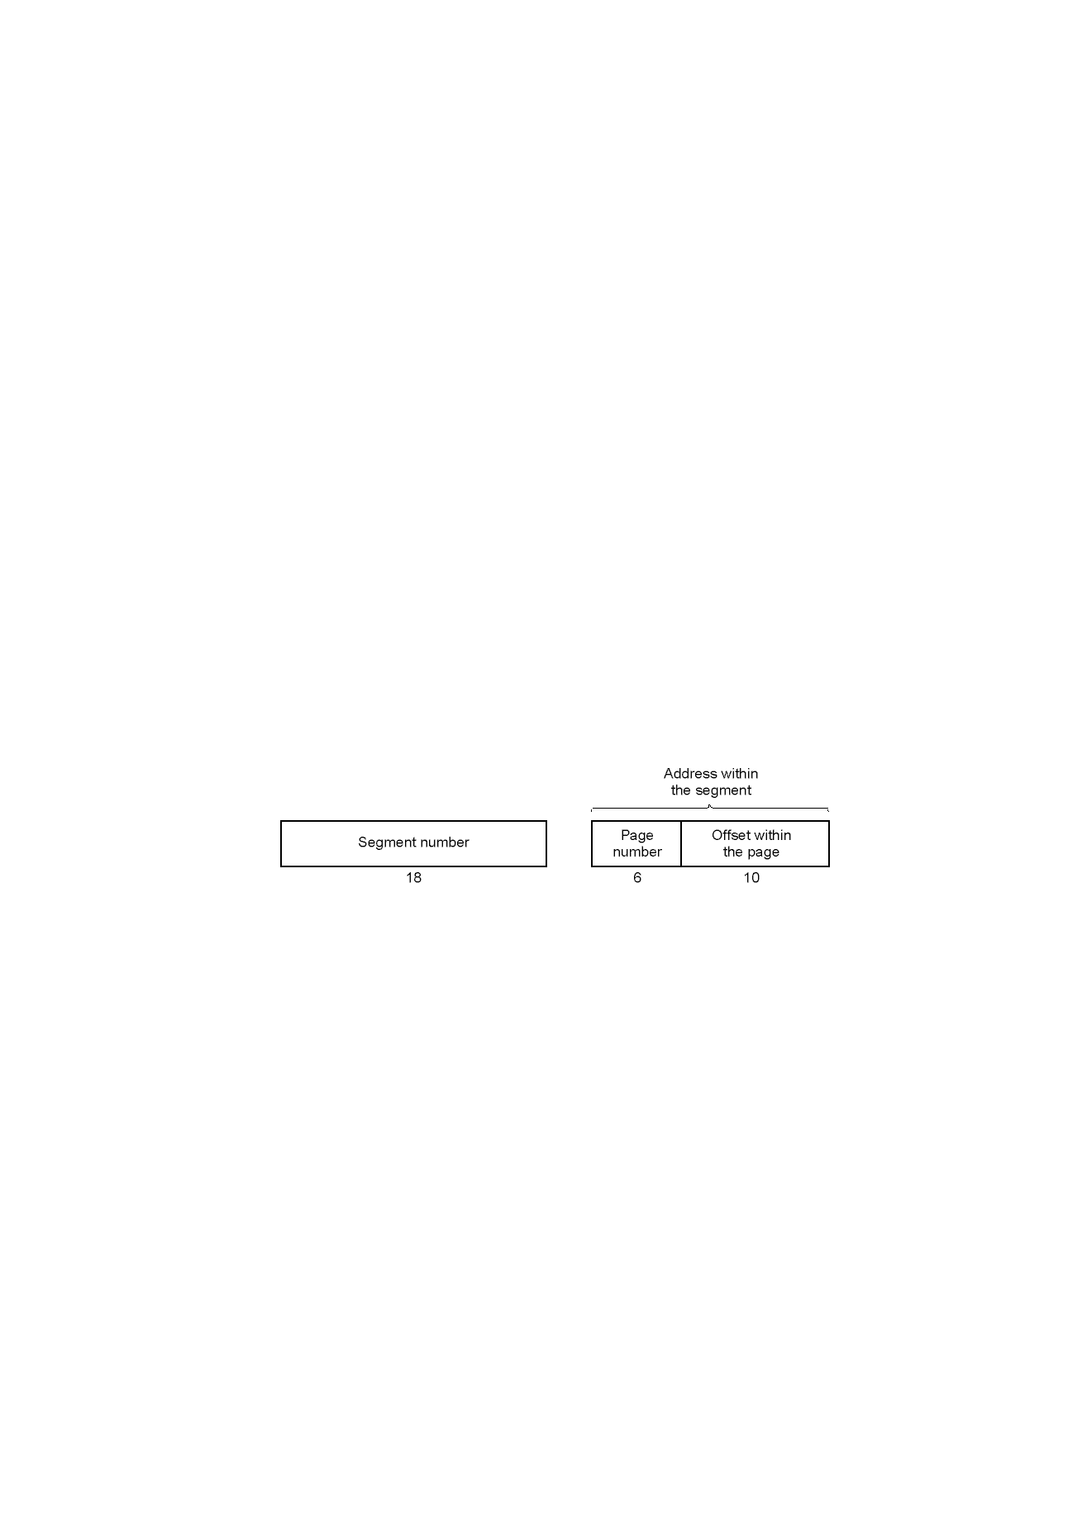
Segmentation with Paging: MULTICS
A 34-bit MULTICS virtual address

Slide 62
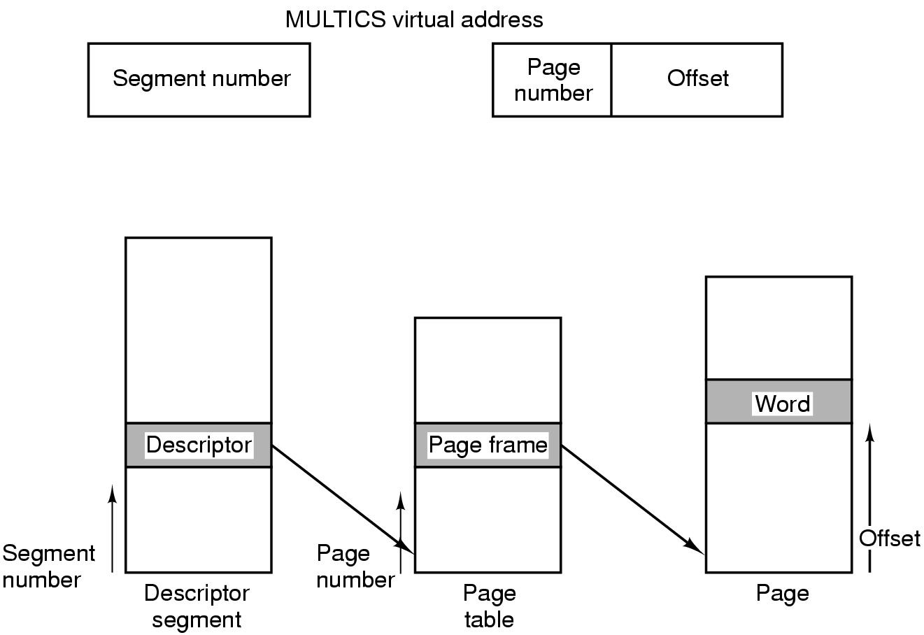
Segmentation with Paging: MULTICS
Conversion of a 2-part MULTICS address into a main memory address

Slide 63
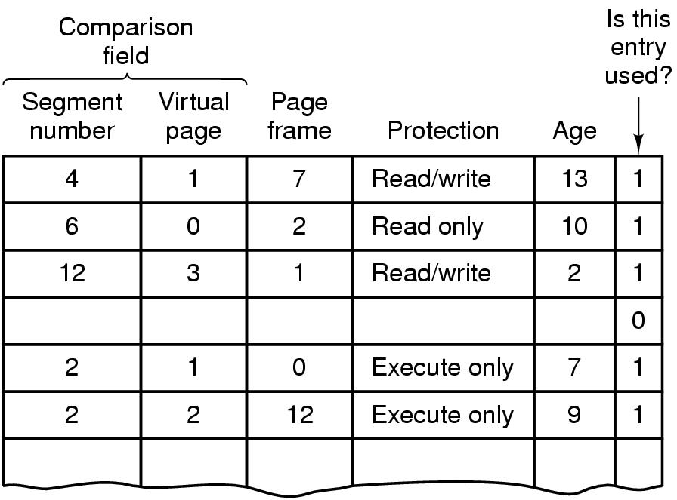
Segmentation with Paging: MULTICS
Simplified version of the MULTICS TLB
Existence of 2 page sizes makes actual TLB more complicated

Slide 64
Summary
Fetch Strategies
Page Replacement
  Optimal
  FIFO, Second-chance, Clock
  NRU, LRU, NFU, Aging
  Working Set, WSClock
Design Issues for paging systems
Implementation Issues
Segmentation

Slide 65
Homework
4、6、7、17、19、25、28、30、32、36、38

