Slide 1
Chapter 4
File Systems
Files
Directories
File System Implementation
Example File Systems

Slide 2
Overview
Requirements for long term information storage:
  Must store large amounts of data
  Information stored must survive the termination of the process using it
  Multiple processes must be able to access the information concurrently
Solution: Store information on disk or other external media in units called files.
The file system is a part of operating system that manages files.

Slide 3
Basic Functions of File System
Present logical (abstract) view of files and directories
  Hide complexity of hardware devices
Facilitate efficient use of storage devices
  Optimize access, e.g., to disk
Support sharing
  Provide protection

Slide 4
File System
User’s view on file systems (4.1, 4.2)
  How files are named?
  What operations are allowed on them?
  What the directory tree looks like?
Implementer’s view on file systems (4.3)
  How files and directories are stored?
  How disk space is managed?
  How to make everything work efficiently and reliably?

Slide 5
Files
Contents
  File Naming
  File Structure
  File Types
  File Access
  File Attributes
  File Operations
  An Example Program Using File System Calls

Slide 6
File Naming (1)
File naming - FileName.FileExtention
Valid name
  Number of characters
    Strings of letters, digits, and special characters
    Up to 255 characters
  lower vs. upper case
Extension
  Tied to type of file
  Used by applications

Slide 7
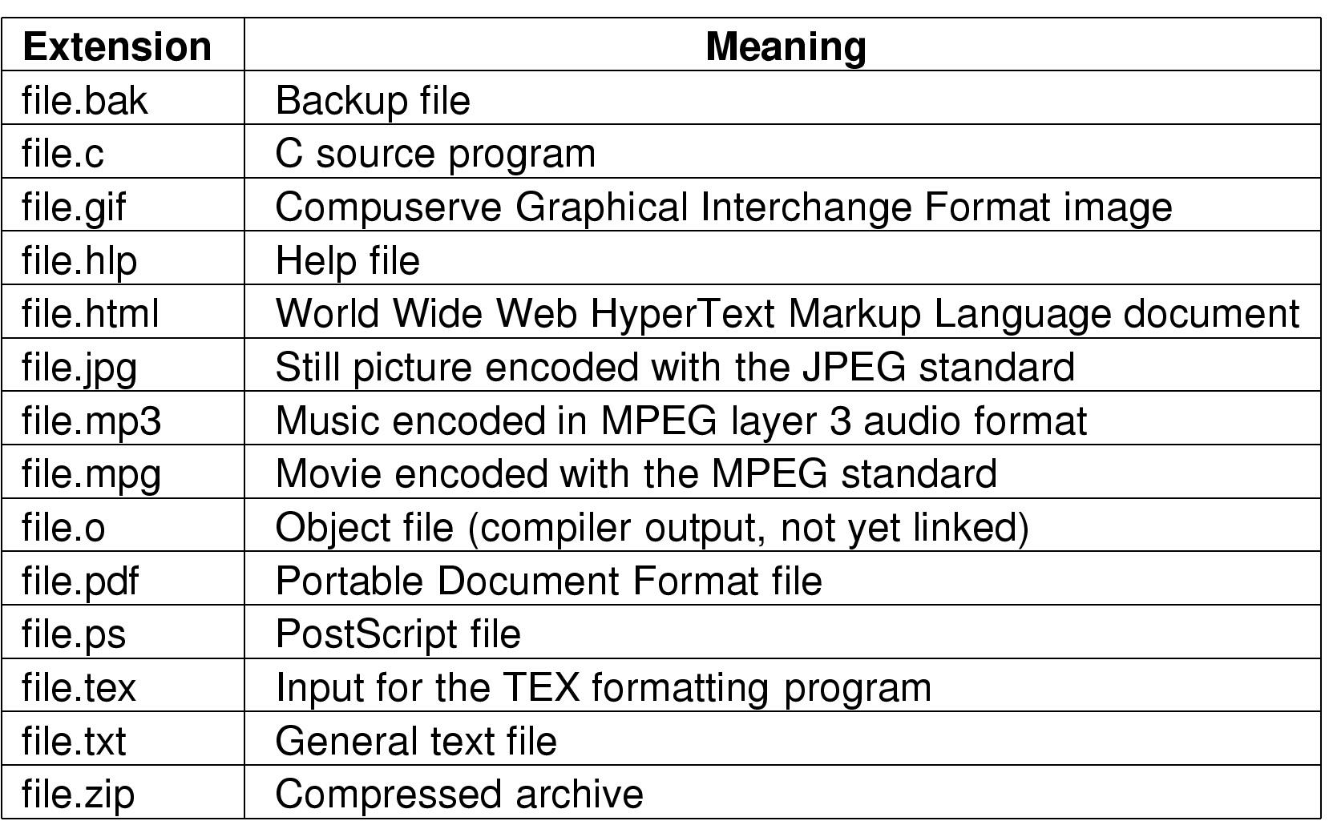
File Naming (2)
Typical file extensions

Slide 8
File Structure (1)
None - sequence of words, bytes (Unix, Windows)
Simple record structure
  Lines
  Fixed length
Complex Structures
  Record Tree
    Records not necessarily the same length
    Records contain keys
    Tree sorted on key

Slide 9
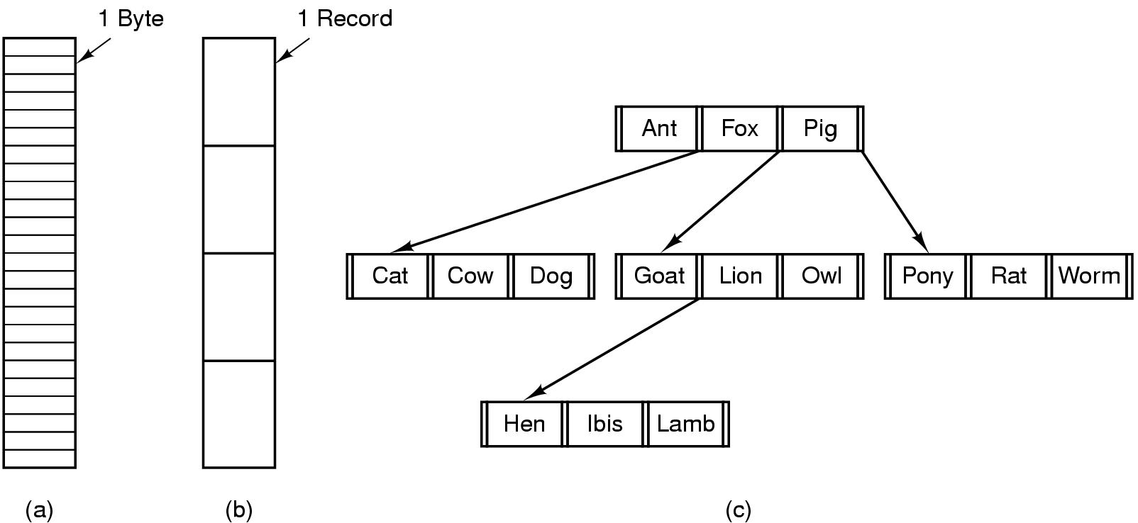
File Structure (2)
Three kinds of files
  byte sequence
  record sequence
  tree

Slide 10
Files types (1)
File types
  Regular files contain user information
    ASCII file: displayed, printed, edited
    Binary file (internal structure): executable file, archive file
  Directories are system files for maintaining the structure of the file system.
  Character special files are used to model serial I/O devices such as terminals, printers, and networks.
  Block special files are used to model disks.

Slide 11
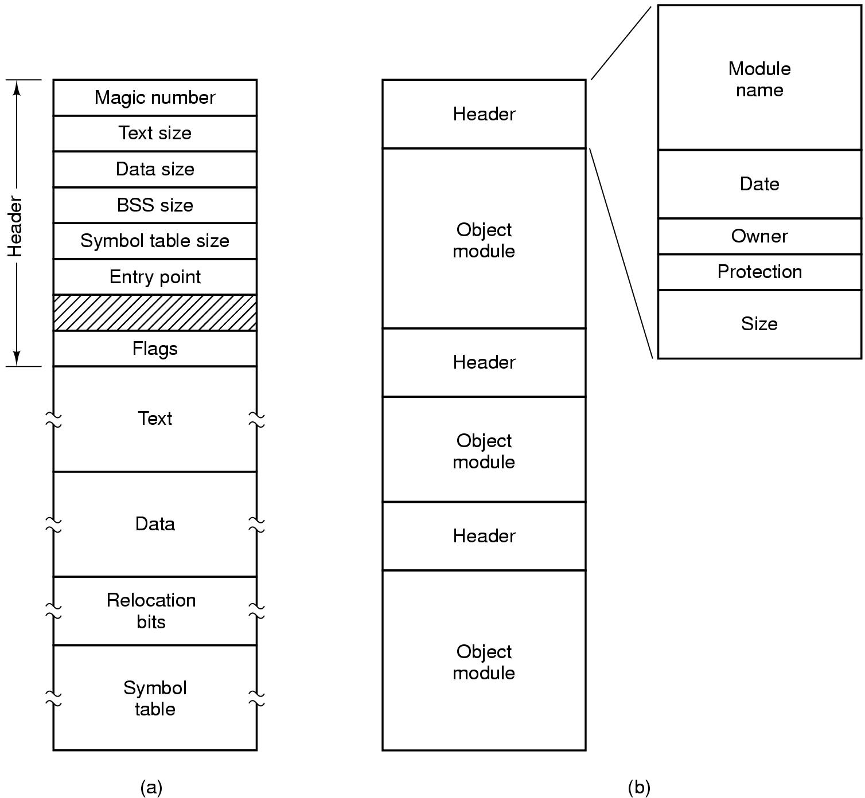
File Types (2)
(a) An executable file (b) An archive

Slide 12
File Access
Sequential access
  read all bytes/records from the beginning
  cannot jump around, could rewind or back up
  convenient when medium was magnetic tape
Random access
  bytes/records read in any order
  essential for database systems
  Two methods are used for specifying where to start reading.
    read and then move file marker
    move file marker (seek), then read (UNIX, Windows)

Slide 13
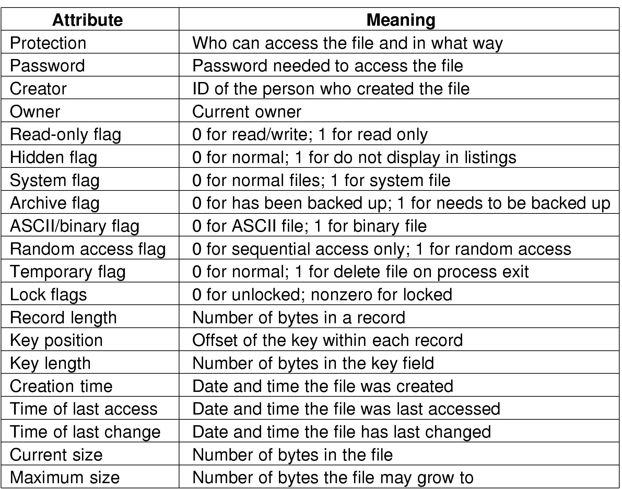
File Attributes
Operating systems associate extra information with each file, called file attributes (metadata).
Possible file attributes

Slide 14
File Operations
Operations for “sequence of bytes” files
  Create
  Delete
  Open
  Close
  Read
  Write
  Append
  Seek
  Get attributes
  Set Attributes
  Rename

Slide 15
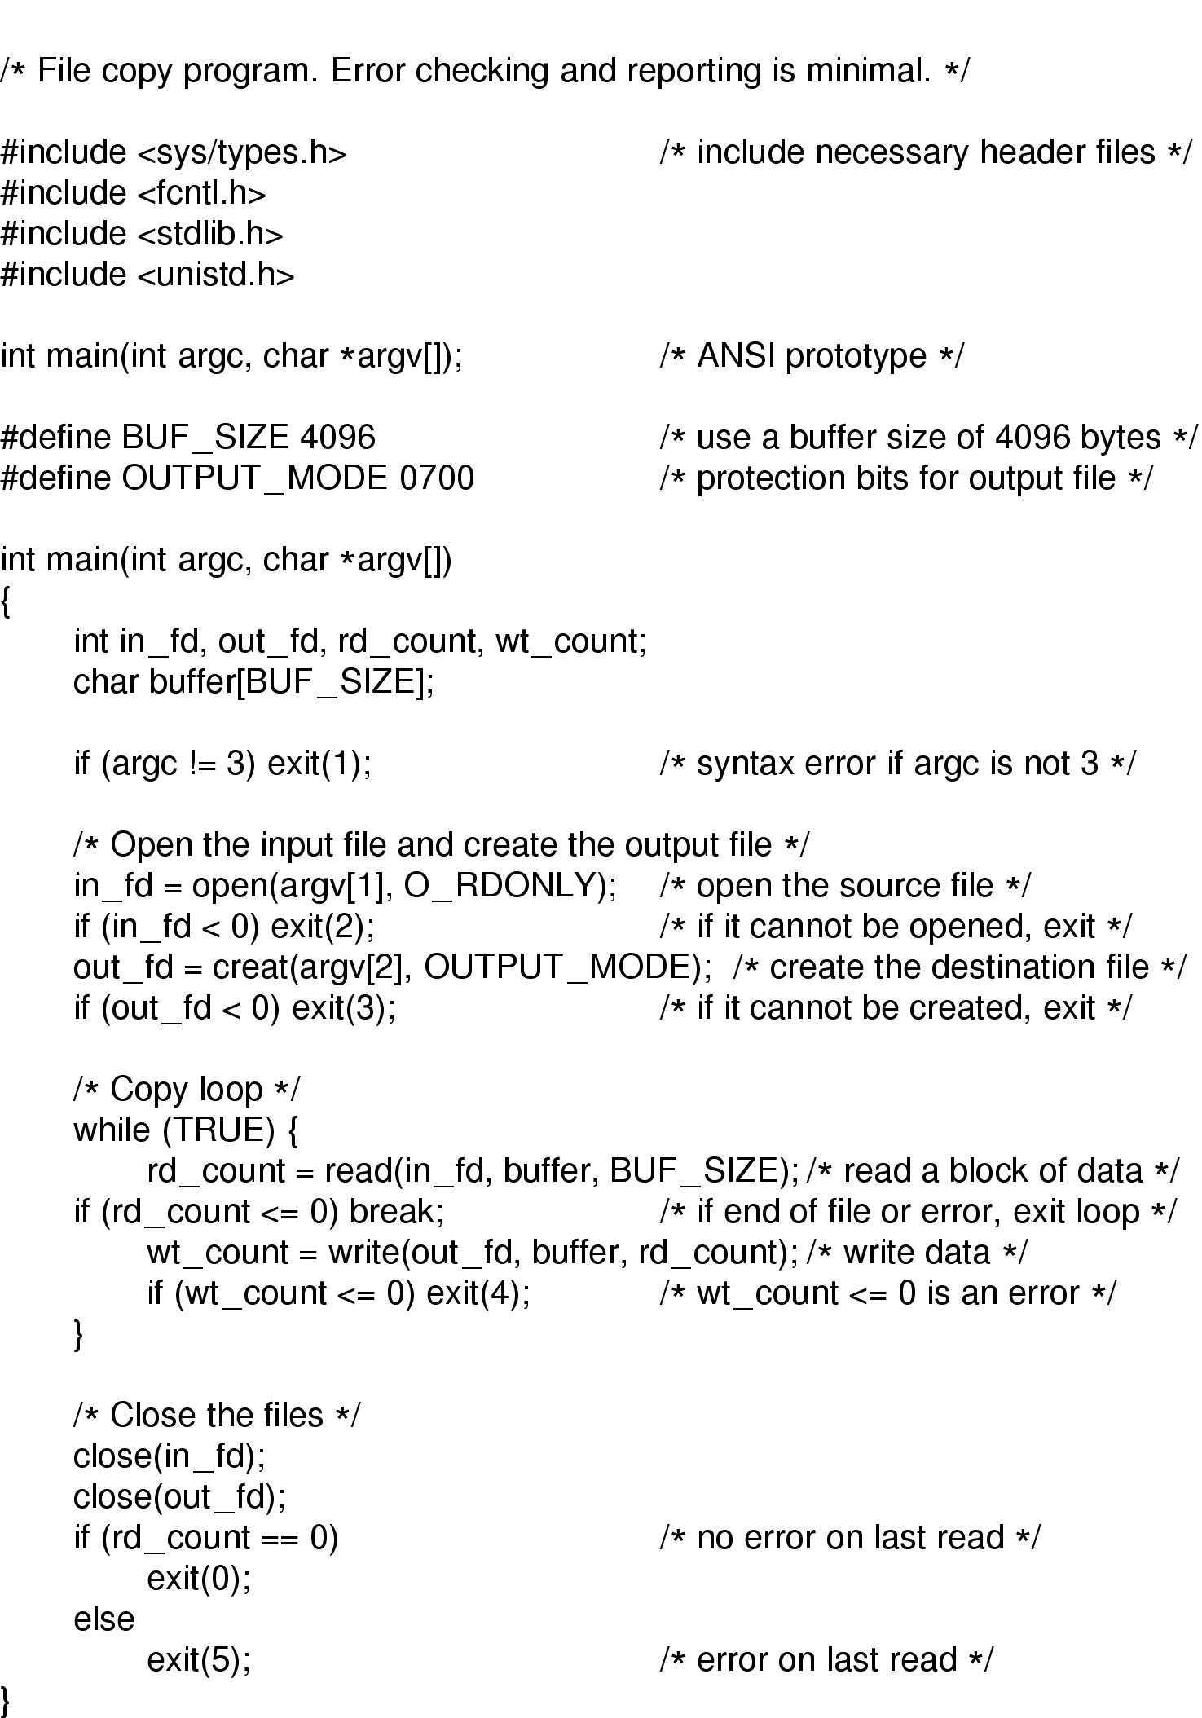
An Example Program Using File System Calls (1)
A Unix program that copy files . [Copyfile sourcefile destfile]

Slide 16
An Example Program Using File System Calls (2)

Slide 17
Directory
Contents
  Single-level Directory System
  Two-level Directory System
  Hierarchical Directory System
  Path Names
  Directory Operations

Slide 18
Directory
File systems have directories or folders to keep track of files.
Directory is a file containing correspondence between filenames and file locations
Directory entries contain info about a file
  i.e. its attributes
Directory entries are created when the files they describe are created and removed when files are deleted

Slide 19
Organize the Directory to Obtain…
Efficiency – locating a file quickly
Naming – convenient to users
  Two users can have same name for different files
  The same file can have several different names
Grouping – logical grouping of files by properties (e.g., all Java programs, all games, …)

Slide 20
Directory Structure
A single-level directory has one directory (root) containing all the files.
A two-level directory has a root directory and user directories.
A hierarchical directory has a root directory and arbitrary number of subdirectories.

Slide 21
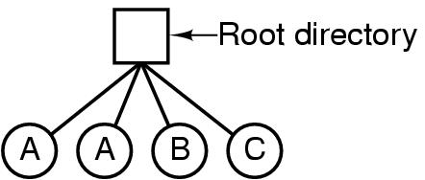
A single level directory system (1)
A single level directory system
  contains 4 files
  owned by 3 different people, A, B, and C

Slide 22
A single level directory system (2)
Advantage
  Easy to support and understand
Disadvantages
  Naming Problem
    All files must have unique names
    Name Collision Problem
  Grouping Problem
    Difficult to remember file names in a large file system

Slide 23
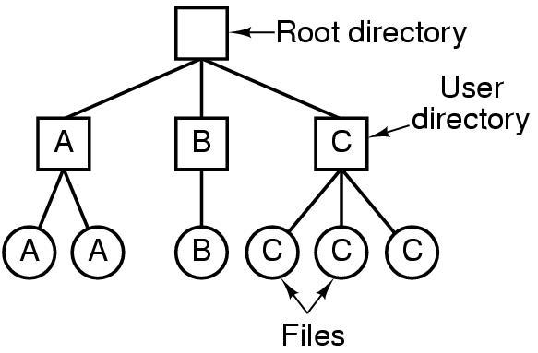
Two-level Directory Systems (1)
A user name and a file name define a path name
Letters indicate owners of the directories and files

Slide 24
Two-level Directory Systems (2)
Advantages
  Resolves name-collision problem
    Can have the same file name for different user
  Efficient searching
  File sharing and protection
Disadvantage
  Grouping problem not resolved

Slide 25
Hierarchical Directory Systems (1)
Generalization of two-level directory (with arbitrary height)
Leaf nodes are files
Interior nodes are directories
Each user has a current directory (working directory)
  Can change current directory via cd command or system call
Path names can be absolute or relative

Slide 26
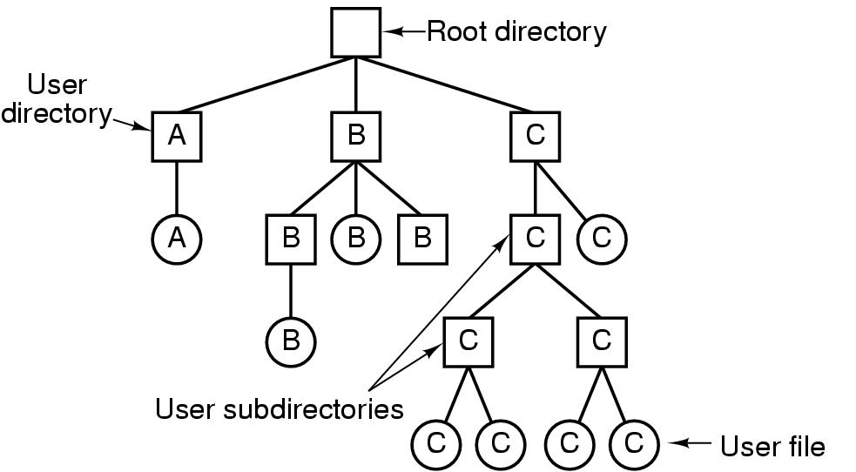
Hierarchical Directory Systems (2)
A hierarchical directory system

Slide 27
Path Name (1)
Two different methods are used to specify file names in a directory tree:
  Absolute path name consists of the path from the root directory to the file.
  Relative path name consists of the path from the current directory (working directory).
The path name would be written:
  Winodws \usr\ast\mailbox
  UNIX /usr/ast/mailbox
Dot and dotdot are two special entries in the file system.
  Dot (.) refers to the current directory.
  Dot dot (..) refers to its parent.

Slide 28
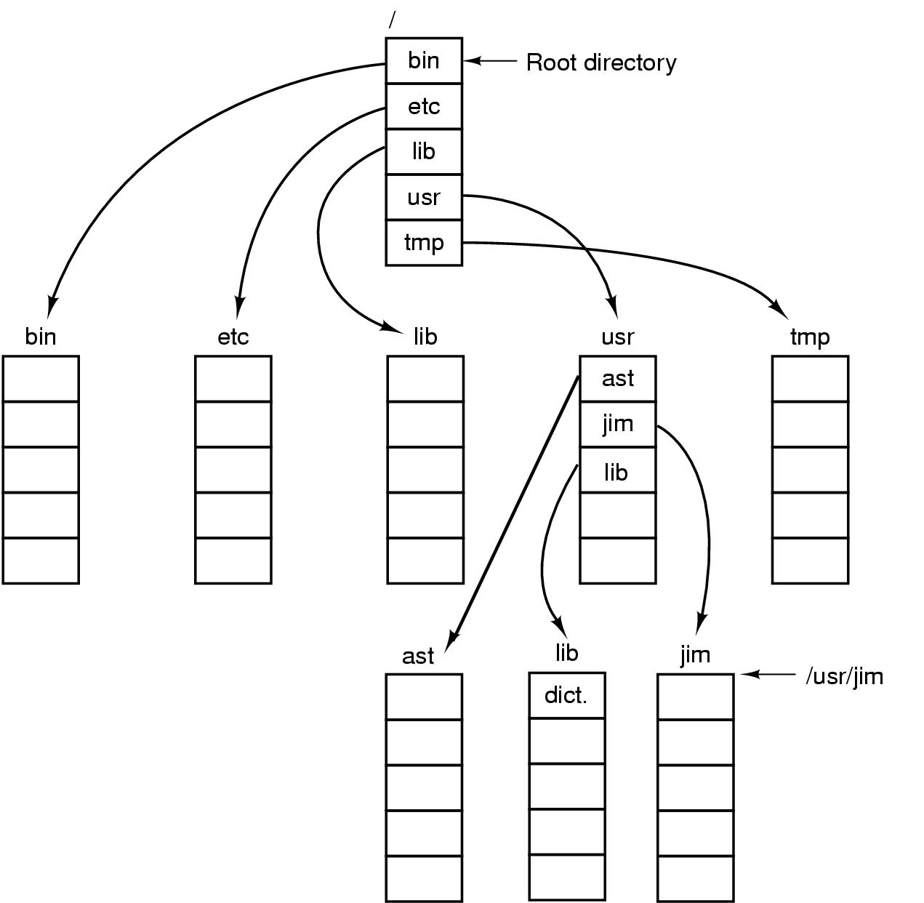
Path Name (2)
Assume working Dir
  /usr/ast
Example
  cp /usr/lib/dictionary .
  cp ../lib/dictionary .
A UNIX directory tree

Slide 29
Directory Operations
Create a new directory
Delete an empty directory
Open a directory for reading
Close a directory to release space
Readdir
  return next entry in the directory
Rename a directory
Link
  Create a link from the existing file to a path name. (ie. Make a “hard link”.)
Unlink
  remove a “hard link”

Slide 30
File System Implementation
Contents
  File System Layout
  Implementing Files
  Implementing Directory
  Shared Files
  Disk Space Management
  File System Reliability
  File System Performance

Slide 31
File System Layout (1)
MBR (Master Boot Record) in sector 0 is used to boot the computer.
The partition table gives the starting and ending addresses of each partition, one of which is marked as active
Each partition can hold its own file system, Unix file system, Window file system or others
Every partition starts with a “boot block”
  The boot block contains a small program, which can load the OS in that partition
OS Startup
  BIOS reads MBR, then locates the active partition, reads in its boot block and executes it

Slide 32
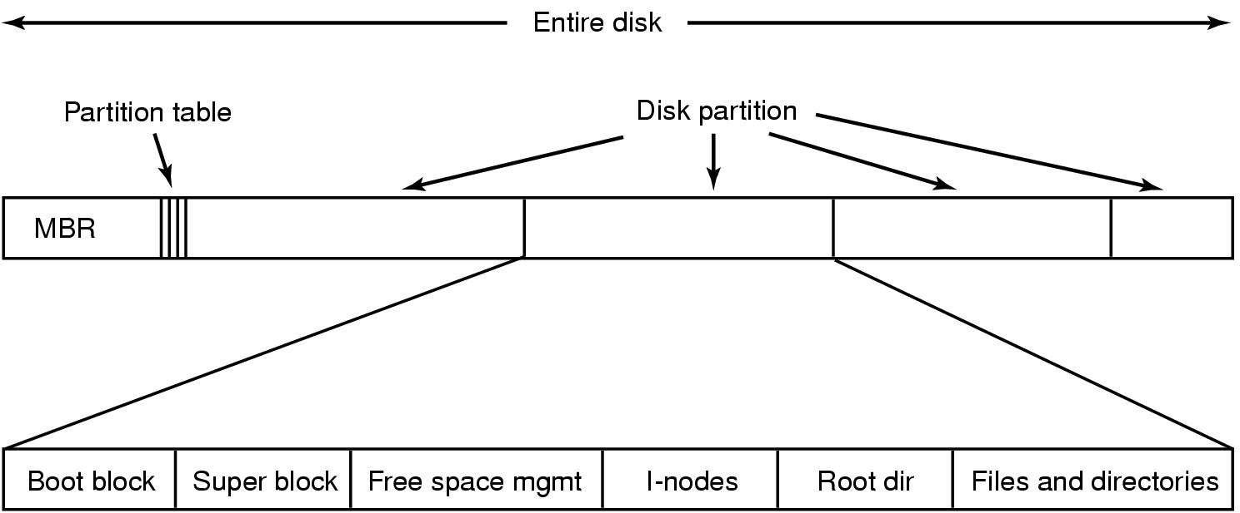
File System layout (2)
A possible file system layout

Slide 33
Implementing files
Implementing file storage is keeping track of which disk blocks go with which files.
Three methods
  Contiguous Allocation
  Linked List Allocation
  Indexed Allocation

Slide 34

Contiguous Allocation (1)
Store each file as contiguous block of data.
(a) Contiguous allocation of disk space for 7 files
(b) State of the disk after files D and F have been removed

Slide 35
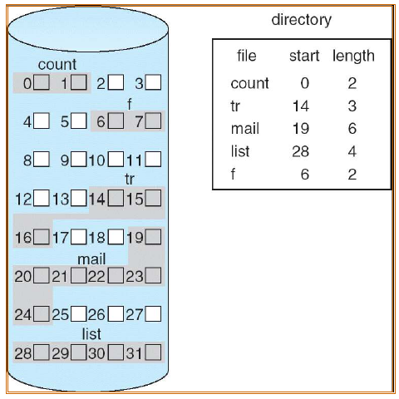
Contiguous Allocation (2)

Slide 36
Contiguous Allocation (3)
Advantages
  Simple to implement (Need only starting sector & length of file)
  Read performance is excellent (suits for sequential access and direct access)
Disadvantages
  Disk fragmentation
  The maximum file size must be known when file is created, or files cannot grow
Good for CD-ROMs, DVDs and other write-once optical media
  All file sizes are known in advance
  Files are never deleted

Slide 37

Linked List Allocation (1)
Storing a file as a linked list of disk blocks, blocks may be scattered anywhere on the disk.
The first word of each block is used as a pointer to the next one.

Slide 38
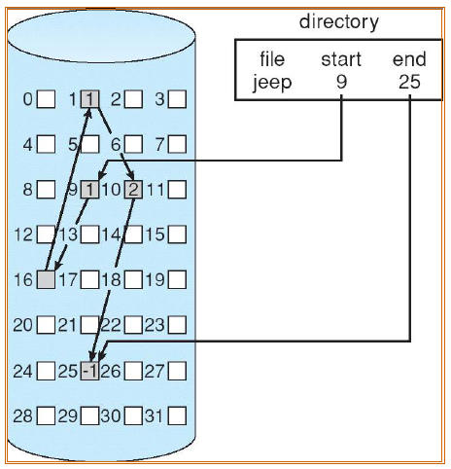
Linked List Allocation (2)

Slide 39
Linked List Allocation (3)
Advantages:
  No external fragmentation
  Directory entries are simple (Need only starting address)
  A file can continue to grow as long as free blocks are available
  Good for sequential access
Disadvantages:
  Random access slow
  The amount of data in a block is not a power of 2

Slide 40
Linked List Allocation Using FAT (1)
Take table pointer word from each block and put them in an index table, FAT (File Allocation Table).
A section of disk at the beginning of each partition is set aside to contain FAT
FAT should be kept in memory to minimize disk seeks
  Space overhead can be substantial
File Allocation Table
  One entry per block on the disk, ordered by block number
  Each entry contains the address of the “next” block
  End of file marker (-1)
  A special value (e.g. -2) indicates the block is free
Used by OS/2 and MS-DOS

Slide 41
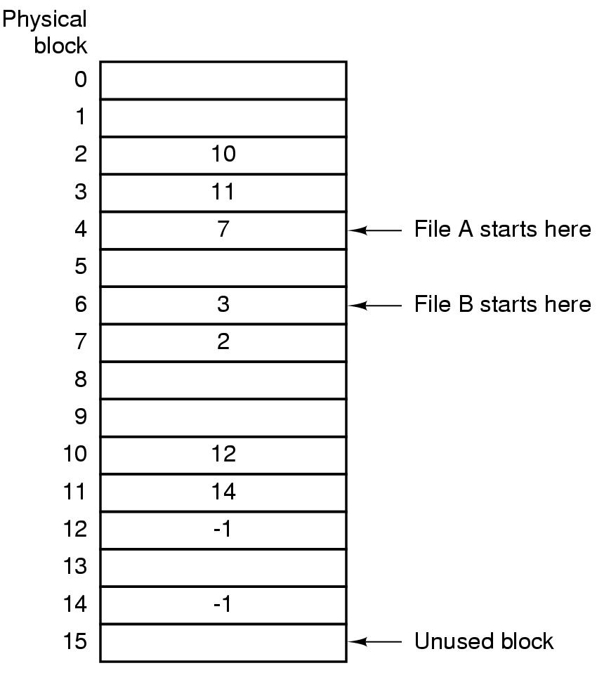
Linked List Allocation Using FAT (2)
Linked list allocation using FAT in RAM

Slide 42
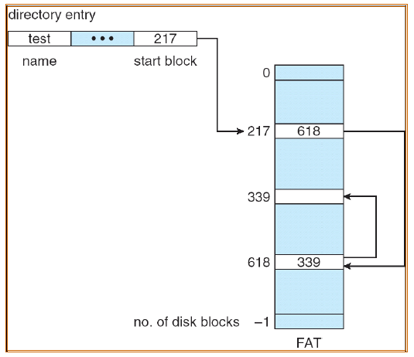
Linked List Allocation Using FAT (3)

Slide 43
Linked List Allocation Using FAT (4)
Advantages
  The entire block is available for data
  Random access...
    Search the linked list (but all in memory)
  Directory Entry needs only one number
    Starting block number
Disadvantage
  Entire table must be in memory all at once!
    Example
      200 GB = disk size
      1 KB = block size
      4 bytes = FAT entry size
      800 MB of memory used to store the FAT

Slide 44
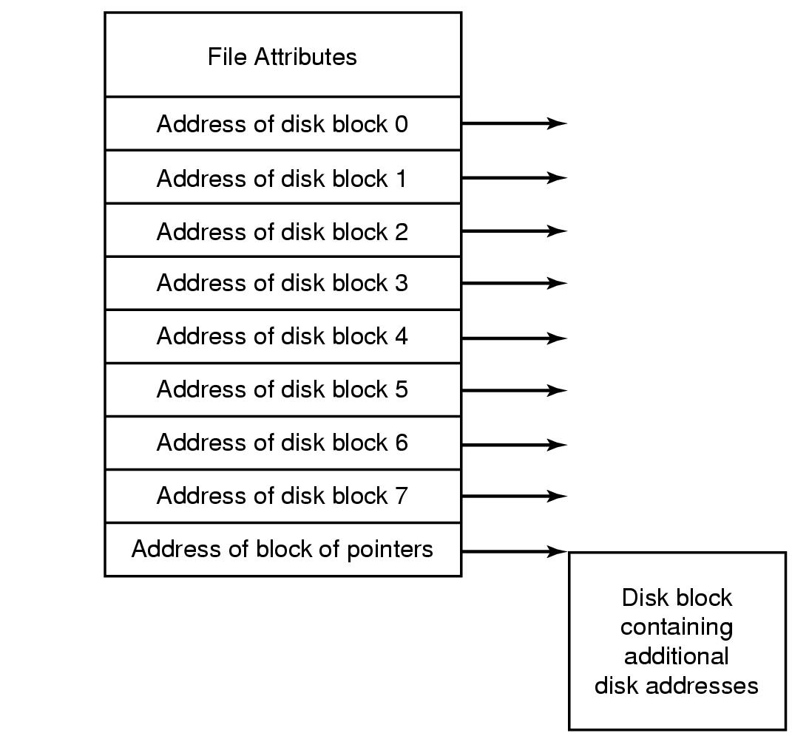
Indexed Allocation (i-Node) (1)
Bring all the pointers together into one location (index block or index-node)
Each file has its own index-node (i-node), which lists the attributes and disk block addresses of the file.
An example i-node

Slide 45
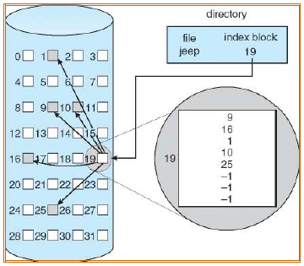
Indexed Allocation (i-Node) (2)
Loading the i-node need only into memory when the corresponding file is opened.
Each directory entry contains i-number only
Example:

Slide 46
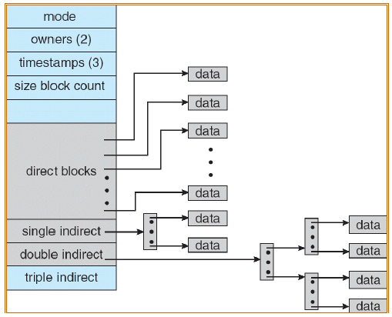
Indexed Allocation (i-Node) (3)
Multi-level Indexed Allocation

Slide 47
Indexed Allocation (i-Node) (4)
Advantages
  Supports direct access
  Without suffering from external fragmentation
  i-node need only be in memory when the corresponding file is open
Disadvantage
  Space overhead for indexes

Slide 48
Implementation Directories (1)
When a file is opened, the file system uses the path name to locate the directory entry.
The directory entry provides information needed to find the disk blocks.
  disk address of the entire file (contiguous blocks)
  the number of first block (linked list)
  the number of i-node (i-node)
Where to store attributes? In directory or i-node?

Slide 49
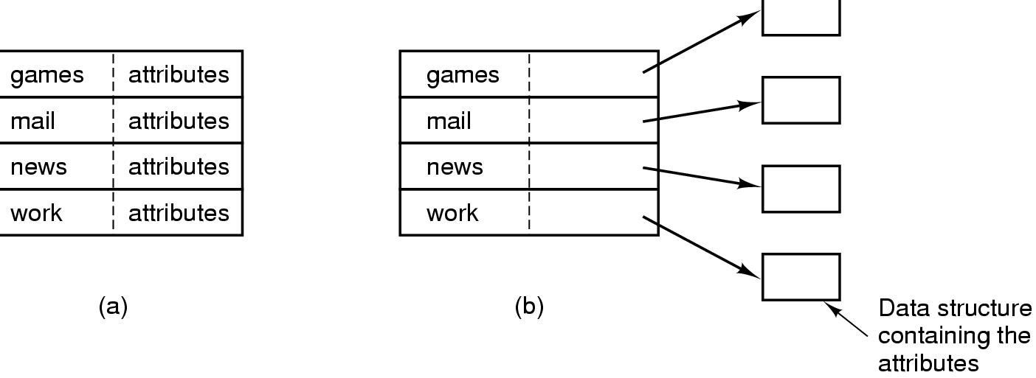
Implementing Directories (2)
(a) A simple directory – MS-DOS/Windows
  fixed size entries
  disk addresses and attributes in directory entry
(b) Directory in which each entry just refers to an i-node - UNIX

Slide 50
Implementation Directories (3)
Handling long file names in a directory:
  Fixed-length names (Waste space)
  In-line (When a file is removed, a variable-sized gap is introduced.)
  Heap (The heap management needs extra effort.)
How to search files in each directory?
  Linearly
  Hash table
  Cache the results of searches

Slide 51
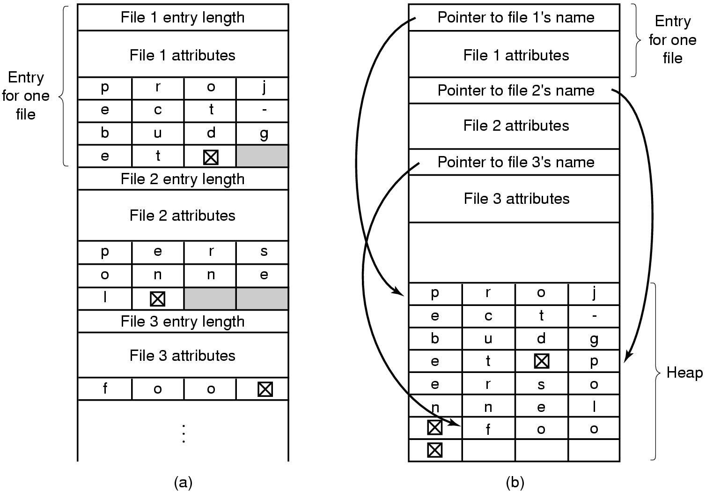
Implementing Directories (4)
Two ways of handling long file names in directory
  (a) In-line
  (b) In a heap

Slide 52
Shared Files (1)
A shared file is used to allow a file to appear in several directories.
The connection between a directory and the shared file is called a link. The file system is a Directed Acyclic Graph (DAG), not a tree.
Problems
  If directories contain disk address, a copy of the disk address will have to be made in directory B.
  If B or C append the file, the new blocks will only appear in one directory.

Slide 53
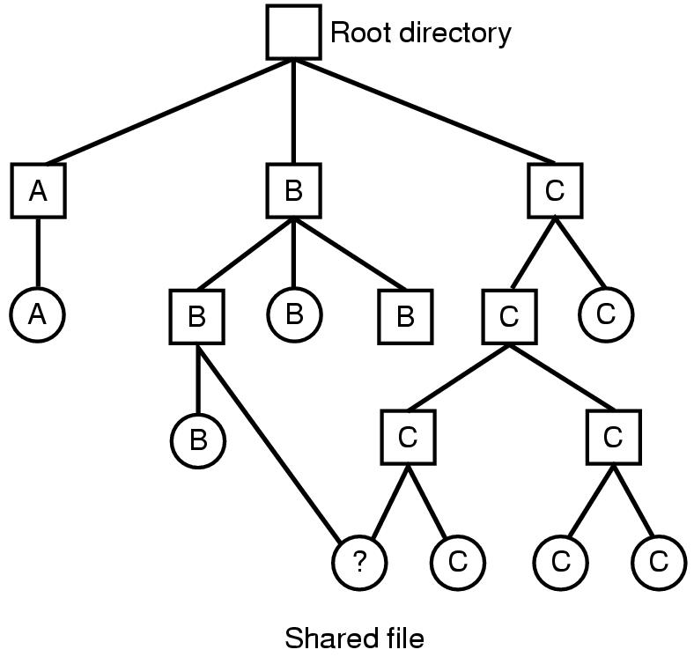
Shared Files (2)
File system containing a shared file

Slide 54
Shared Files (3)
Solution:
  Do not list disk block addresses in directories but in a little data structure, i-node ➔ Hard Link
    Both directories point to the same i-node (next page)
  Create a new file of type LINK which contains the path name of the file to which it is linked ➔ Symbolic Link (Soft Link)
    One directory points to the file’s i-node
    Other directory contains the “path”
    See page 57

Slide 55
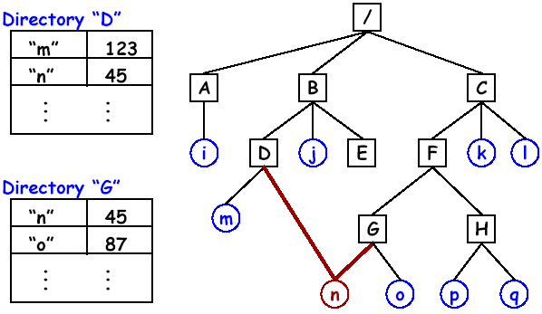
Shared Files (4)
Hard Link

Slide 56
Shared Files (5)
Pat’s working directory: /users/pat/bin/
$ ls -l
total 4
-rwxr-xr-x 1 pat DP3832 1358 Jan 15 11:01 lcat
-rwxr-xr-x 1 pat DP3832 504 Apr 21 18:30 xtr
$ ln /users/steve/wb . (hard link)
$ ls -l
total 5
-rwxr-xr-x 1 pat DP3832 1358 Jan 15 11:01 lcat
-rwxr-xr-x 2 steve DP3725 89 Jun 25 13:30 wb
-rwxr-xr-x 1 pat DP3832 504 Apr 21 18:30 xtr

Slide 57
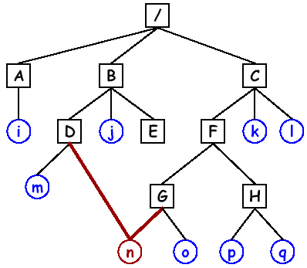
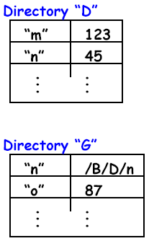
Shared Files (6)
Symbolic Link

Slide 58
Shared Files (7)
$ rm wb
$ ls -l
total 4
-rwxr-xr-x 1 pat DP3832 1358 Jan 15 11:01 lcat
-rwxr-xr-x 1 pat DP3832 504 Apr 21 18:30 xtr
$ ln -s /users/steve/wb ./symwb (symbolic link)
$ ls -l
total 5
-rwxr-xr-x 1 pat DP3832 1358 Jan 15 11:01 lcat
lrwxr-xr-x 1 pat DP3725 15 Jul 20 15:22 symwb->/users/steve/wb
-rwxr-xr-x 1 pat DP3832 504 Apr 21 18:30 xtr

Slide 59
Shared Files (8)
Deleting a file
  Directory entry is removed from directory
  All blocks in file are returned to free list
  What about sharing???
    Multiple links to one file (in Unix)
Hard Links
  Put a “reference count” field in each i-node
  Counts number of directories that point to the file
  When removing file from directory, decrement count
  When count goes to zero, reclaim all blocks in the file
Symbolic Link (only the owner directory has a pointer to i-node)
  Remove the real file... (normal file deletion)
  Symbolic link becomes “broken”

Slide 60
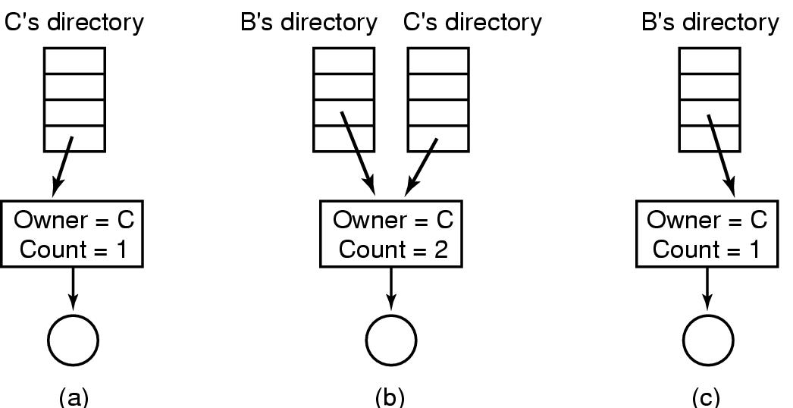
Shared Files (9)
(a) Situation prior to linking
(b) After the link is created
(c) After the original owner removes the file

Slide 61
Shared Files (10)
Problems of symbolic link
  Extra overhead in the traversing path
  Having multiple copies of a file may set copied when dumping a file onto a tape.

Slide 62
Journaling File Systems (1)
Journaling File System
  Keep a log of what the file system is going to do before it does it
  If the system crashes before it completes its planned work
    Rebooting the system
    Look in the log to see what’s going on at the time of crash
    Finish the job
  E.g., NTFS, ext3, ReiserFS

Slide 63
Journaling File Systems (2)
Operations required to remove a file in UNIX
  Remove the file from its directory.
  Release the i-node to the pool of free i-nodes.
  Return all the disk blocks to the pool of free disk blocks.
The journaling file system
  Write a log entry listing the three actions to be completed, and write the log entry to disk
  Only after the log entry has been written to disk, the various operations can begin
    After the operations complete successfully, the log entry is erased
    If the system crashes, upon recovery the file system can check the log to see if any operations were pending.

Slide 64
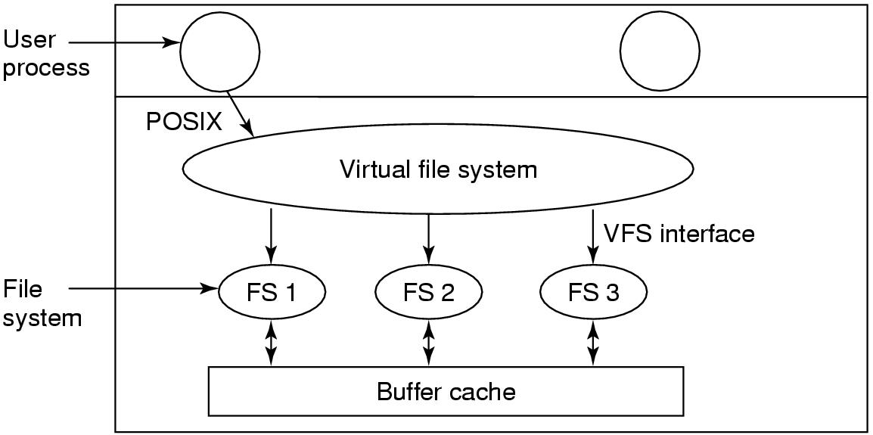
Virtual File Systems
Position of the virtual file system.

Slide 65
Disk space management
Strategies for storing an n byte file:
  Allocate n consecutive bytes of disk space - segment
  Allocate a number [n/k] blocks of size k bytes each - paging
Problem of contiguous allocation
  If the file grows it will have to be moved on the disk, it is an expensive operation and causes external fragmentation. =>
Almost all file systems chop files up into fixed-size blocks that need not to be adjacent.

Slide 66
Block size (1)
Review
  File systems define a block size
    Block size = 2^{n} * sector size
    Contiguous sectors are allocated to a block
  File systems view the disk as an array of blocks
    Must allocate blocks to file
    Must manage free space on disk

Slide 67
Block size (2)
Large block sizes
  Internal fragmentation
    Last block has (on average) 1/2 wasted space
  Lots of very small files; waste is greater.
  Lower disk space utilization, but better performance
Small block sizes
  More seeks; file access will be slower.
  Better disk utilization, but poor performance
Usual size k = 1k, 2k or 4k

Slide 68
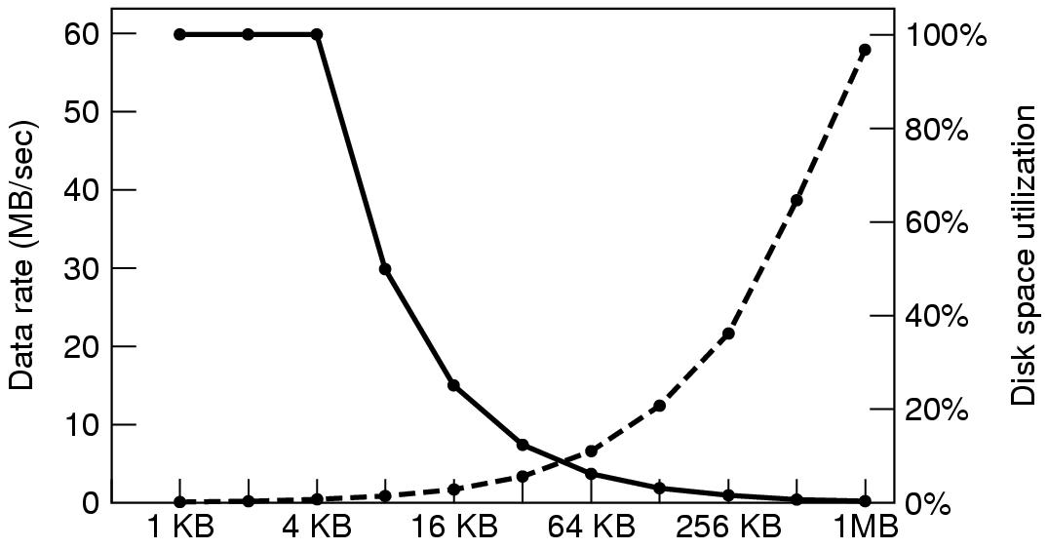
Block size (3)
Dotted line (left hand scale) gives data rate of a disk
Dark line (right hand scale) gives disk space efficiency
Assume all files are 4KB

Slide 69
Keeping Track of Free Blocks (1)
Use linked list of disk blocks: each block holds as many free disk block numbers as will fit.
  With 1 KB block and 32-bit disk block number ➔ 1024 * 8/32 = 256 disk block numbers ➔ 255 free blocks (and) 1 next block pointer.
Use bit-map: A disk with n blocks requires a bit map with n bits
  Free blocks are represented by 1's
  Allocated blocks represented by 0's
  16GB disk has 2²⁴ 1-KB and requires 2²⁴ bits ➔ 2048 blocks
  Using a linked list = 2²⁴/255 = 65793 blocks. However, these blocks can be freed up as the disk is filled up.
Bit map generally better if it can be kept completely in memory.

Slide 70
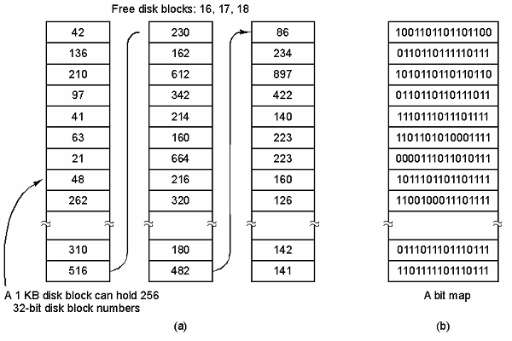
Keeping Track of Free Blocks (2)
(a) Storing the free list on a linked list
(b) A bit map

Slide 71
File System Reliability (1)
The loss of a file system can be catastrophic.
Backups are made to handle
  Recover from disaster
  Recover from stupidity (e.g. Recycle bin)
Where to backup? Tertiary storage
  Tape: holds 10 or 100s of GBs, costs pennies/GB
    sequential access ⇒ high random access time
Backup takes time and space

Slide 72
File System Reliability (2)
Backup Issues
  Should the entire FS be backup up?
    Binaries, special I/O files usually not backed up
  Do not backup unmodified files since last backup
    Incremental dumps: complete per month, modified files daily
  Compress data before writing to tape
  How to backup an active FS?
    Not acceptable to take system offline during backup hours
  Security of backup media

Slide 73
File System Reliability (3)
Two strategies for dumping a disk to tape:
  Physical dump: starts at block 0 to the last one, write each block in order
    Advantages: simple and fast
    Disadvantages
      Can not skip selected directories
      Can not make incremental dumps
      Can not restore individual files upon request

Slide 74
File System Reliability (4)
Two strategies for dumping a disk to tape:
  Logical dump: starts at one or more specified directories and recursively dumps all files and directories found that have changed since some given base date
    Base date could be of last incremental dump, last full dump, etc.
    Also dump all directories (even unmodified) that lie on the path to a modified file or directory

Slide 75
File System Reliability (5)
File System Consistency
  Most systems have a utility program that checks file system consistency
    Windows: scandisk
    UNIX: fsck
  Two types of consistency checks can be made:
    Blocks
    Files (directory)
  fsck: checking blocks
    Reads all the i-nodes and mark used blocks
    Examines the free list or bit maps and mark free blocks

Slide 76
File System Reliability (6)
File System Consistency
  Inconsistent States
    Some block is not in a file or on free list (“missing block”)
      Add it to the free list
    Some block is on the free list more than once
      Can’t happen when using a bitmap for free blocks
      Fix the free list so the block appears only once
    Some block is in more than one file
      Allocate another block
      Copy the block
      Put it in a file
      Notify the user that one file may contain data from another file
    Some block is on free list and is in some file
      Remove it from the free list

Slide 77
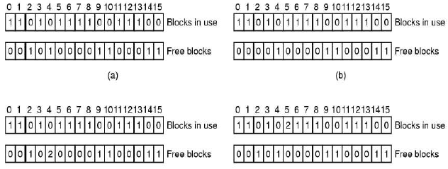
File System Reliability (7)
block number
block number
(c)
(d)
File system states
(a) consistent (b) missing block
(c) duplicate block in free list (d) duplicate data block

Slide 78
File System Reliability (8)
File System Consistency
  fsck: checking directories
    Use a per-file counter instead of per-block
    Recursively descends the tree from the root directory, increasing the counter for each file, include hard links.
    Compare these numbers with the link counts stored in the i nodes.
    Problems: Reference count is too large or too small
    Solution
      Correct the reference count, force the link count in the i-node to the actual number of directory entries.

Slide 79
File System Performance
Caching
  Avoid disk I/O overhead
Block Read Ahead
Reducing Disk Arm Motion
  Avoid seek overhead

Slide 80
Example File Systems
The MS-DOS File System
The Windows 98 File System
The Unix V7 File System

Slide 81
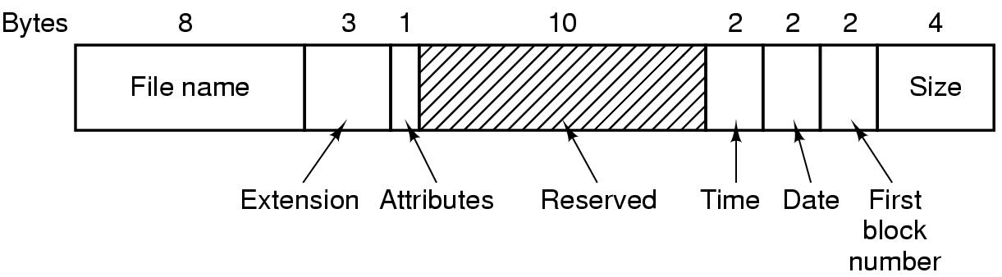
The MS-DOS File System (1)
The MS-DOS directory entry

Slide 82
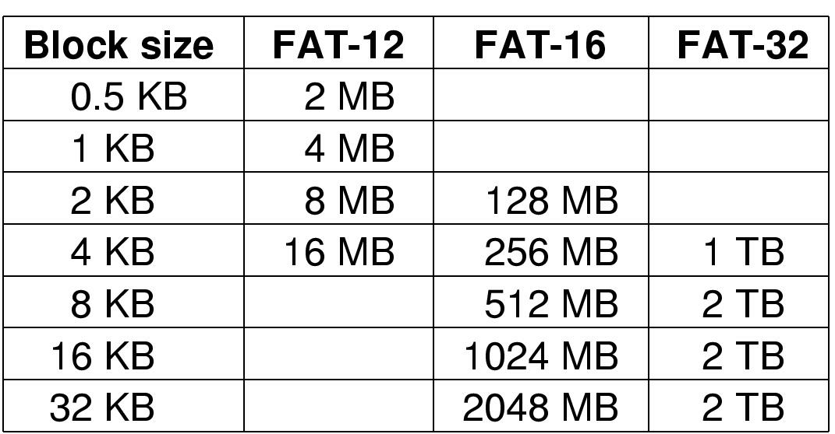
The MS-DOS File System (2)
Maximum partition for different block sizes
(The empty boxes represent forbidden combinations)

Slide 83
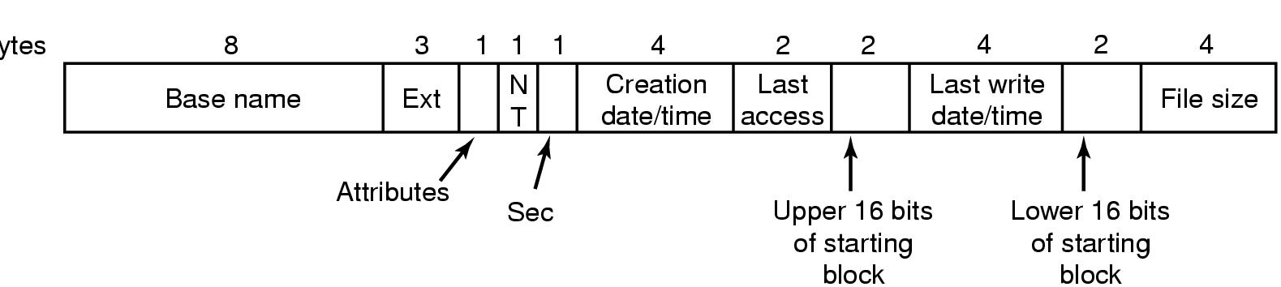
The Windows 98 File System (1)
Bytes
The extended MOS-DOS directory entry used in Windows 98

Slide 84
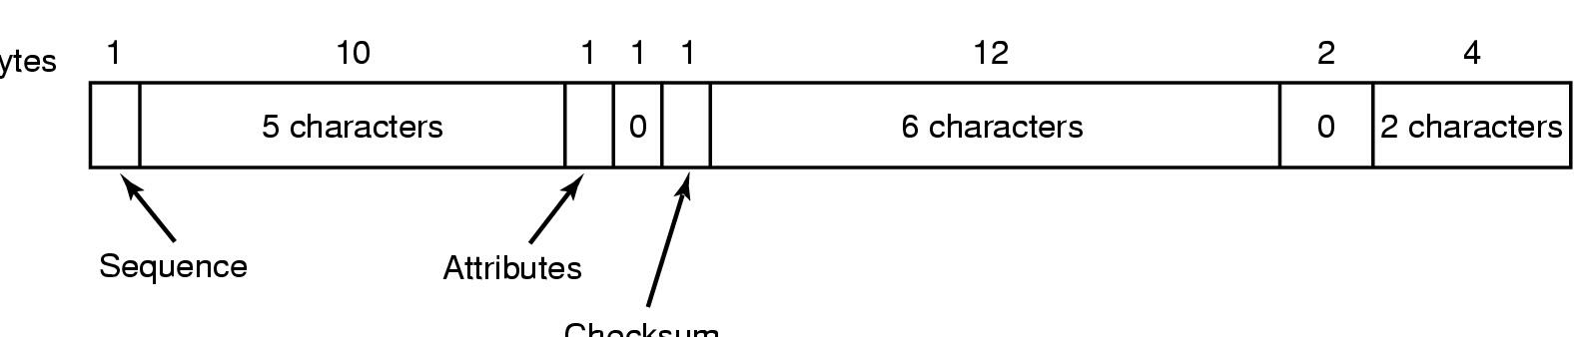
The Windows 98 File System (2)
Bytes
Checksum
An entry for (part of) a long file name in Windows 98

Slide 85
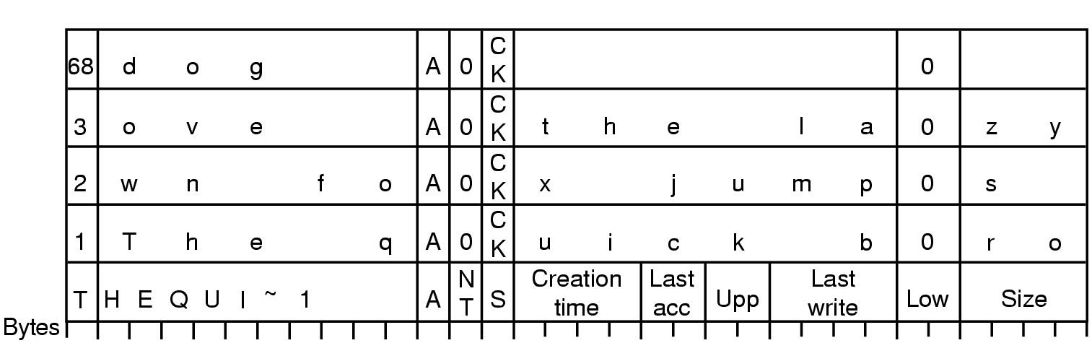
The Windows 98 File System (3)
r
An example of how a long name is stored in Windows 98
(File name: The quick brown fox jumps over the lazy dog)

Slide 86
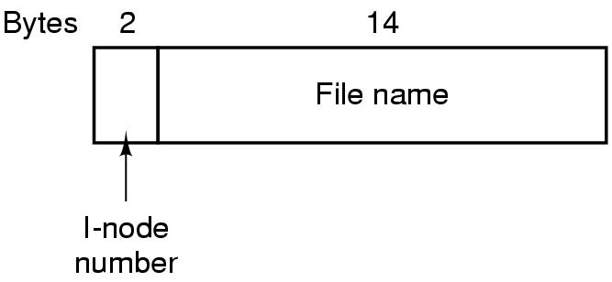
The UNIX V7 File System (1)
A UNIX V7 directory entry

Slide 87
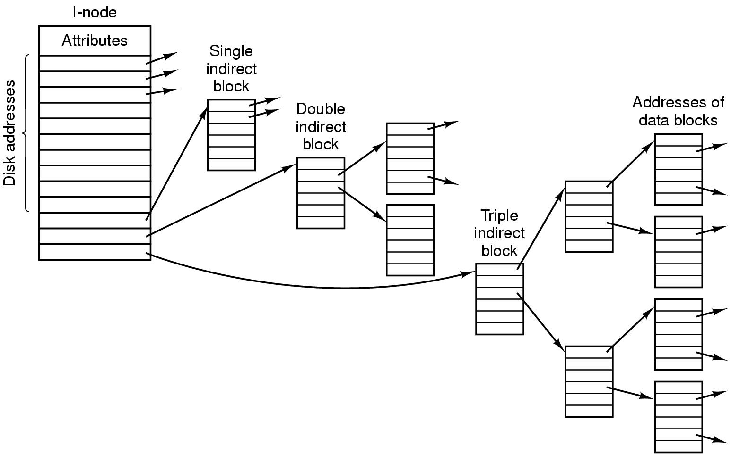
The UNIX V7 File System (2)
A UNIX i-node

Slide 88
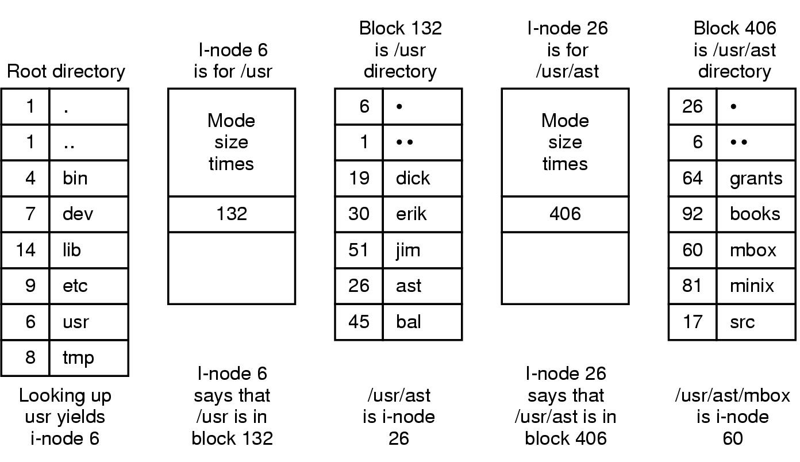
The UNIX V7 File System (3)
The steps in looking up /usr/ast/mbox

Slide 89
Quiz
How many disk operations are needed to read the second block of the file /usr/student/lab/mp1.tar? Why?
(Assume that nothing else along the path is in memory. Also assume that all directories fit in one disk block. )

Slide 90
Solution
        i-node for /
        directory for /
        i-node for /usr
        directory for /usr
        i-node for /usr/student
        directory for /usr/student
        i-node for /usr/student/lab
        directory for /usr/student/lab
        i-node for /usr/student/lab/mp1.tar
        the second block of /usr/student/lab/mp1.tar
        In total, 10 disk reads are required.

Slide 91
Summary
Files
Directories
File system implementation
Example file systems

Slide 92
Homework
4、25、40、41

