Slide 1
Chapter 5
Input/Output
Principles of I/O hardware
Principles of I/O software
I/O software layers
Disks

Slide 2
OS and I/O
One of the main functions of OS is to control all the I/O devices
  Issue commands to the devices
  Catch interrupts
  Handle errors
  Provide an interface between the devices and the rest of OS
    Make device independent

Slide 3
I/O Hardware
Hardware views
  Chips, circuits, power supplies, motors, wires, etc
    This is inside of a device (electrical engineers concerned)
  Programming I/O devices is what an OS designer interested in
    The commands the hardware accepts
    The functions it carries out
    The errors reported back…

Slide 4
I/O Devices
Incredible variety of I/O devices
  Storage Devices (Disk, tape)
  Transmission Devices (Network Card, Modem)
  Human Interface Devices (Screen, Keyboard, mouse)
  Specialized Devices (Joystick)
Devices Classification
  Block or character-stream
  Sequential or random-access
  Synchronous or asynchronous devices
  Sharable or dedicated
  read-write, read only, or write only
  Speed of operation

Slide 5
I/O Devices
Block Devices
  Stores information in fixed-size blocks, each one with its own address
  512B~32KB per block
  It’s possible to read or write each block independently of all the other ones
  E.g. Disks
Character device
  Delivers or accepts a stream of characters
  Not addressable and no seek operation
  E.g. Printers, network interfaces, mouse, etc

Slide 6
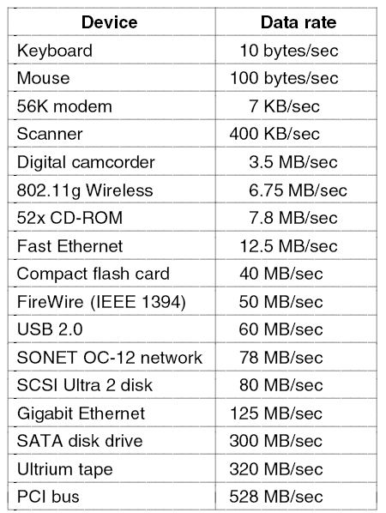
I/O Devices
Some typical device, network, and bus data rates

Slide 7
Device Controllers
I/O devices have components:
  mechanical component (the device itself)
  electronic component
The electronic component is the device controller or adapter.
  On PCs, it often takes the form of a chip on the parentboard or a printed circuit card that can be inserted into an expansion slot.
  May be able to handle multiple devices

Slide 8
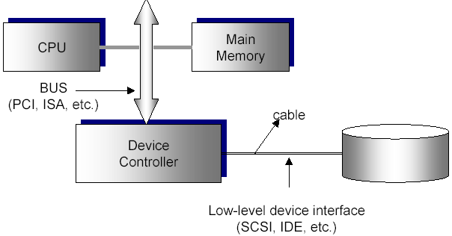
Device Controllers
Controller's tasks (e.g. disk)
  convert serial bit stream to block of bytes
  perform error correction as necessary
  make available to main memory

Slide 9
Device Controllers
Each controller have a few registers that are used for communicating with the CPU.
The operating system can command the device by writing into these registers and learn the device’s state by reading from these registers.
CPU
外
部
设
备
控
制
逻
辑
电
路
控制寄存器
状态寄存器
数据寄存器

Slide 10
Device Controllers
Problems:
  How to addresses these control registers and data buffers
  How to transfer data between controller and memory
Methods:
  Separate I/O and memory space
  Memory-mapped I/O
  Hybrid Scheme

Slide 11
Separate I/O and memory space
Each control register is assigned a special address called I/O port number, an 8- or 16-bit integer.
Special I/O instructions are used to read/write from/into these control registers
  IN REG, PORT
    Read a byte or word from control register addresses as PORT into the CPU register REG.
  OUT REG, PORT
    Write the content of CPU register REG into the control register addresses as PORT.
Separate I/O and memory space
Most early computers worked this way

Slide 12
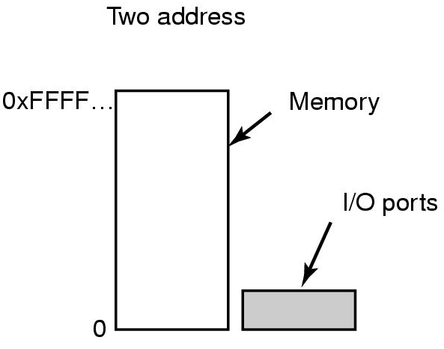
Separate I/O and memory space
IN R0, 4
MOV R0, 4
are completely different.
4 in the first instruction refers to control register whose address is 4.
4 in the second instruction refers to main memory location whose address is 4
Separate I/O and memory space (e.g. IBM 360)

Slide 13
Memory-mapped I/O
All the control registers are mapped into the memory space, but separating I/O ports from memory
Controller Registers are part of regular address space
Each control register is assigned a unique memory address to which no physical memory is assigned
Usually the addresses assigned to control registers are on top of the address space
Usually flags in special registers indicate that the memory access is for memory-mapped I/O

Slide 14
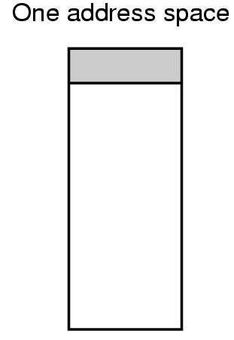
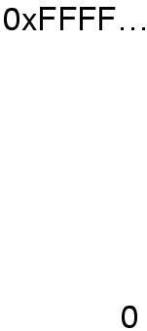
Memory-Mapped I/O
Portion that is used by control registers
Main Memory Address Space
Portion that is used by memory locations
Memory-mapped I/O (e.g. PDP-11)

Slide 15
Hybrid Scheme
Data buffers use memory-mapped addresses
Control registers use addresses from a separate address space
  Pentium use this scheme
    0~64K: I/O port address space
    640K~1M: reserved main memory address space part that is used by data buffers

Slide 16
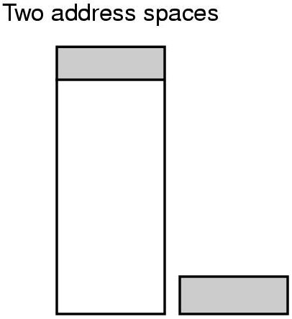
Hybrid Scheme
Hybrid scheme (e.g. Pentium)

Slide 17
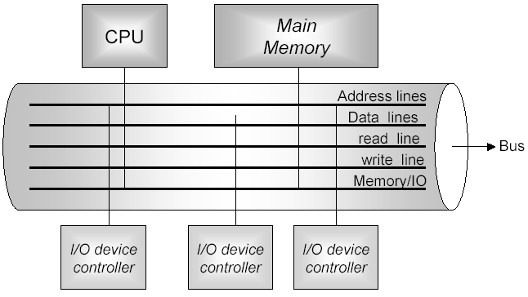
How these schemes work

Slide 18
How these schemes work
- Separate I/O and memory space
Assume we will do a read operation
CPU puts the address on the bus
CPU activates the read line
CPU asserts a signal line that says whether we will read from memory or I/O device
If we will read from memory
  Address lines contain a memory address from the memory address space
  Main Memory responds.
If we will read from I/O device
  Address lines contain an address from I/O port address space.
  Respective device controller responds

Slide 19
How these schemes work
- Memory-mapped I/O
Assume we will do a read operation
CPU puts the address on the bus
CPU activates the read line
If we will read from memory
  Address lines contain an address from part of address space for main memory
  Main Memory responds.
If we will read from I/O device
  Address lines contain an address from part of address space for device controllers
  Respective device controller responds

Slide 20
Advantages of Memory-mapped I/O
No special instructions are needed to read and write from/to control registers
No special protection mechanism is necessary to protect control registers from direct access of users
Every instruction that references memory can also reference control registers.

Slide 21
Disadvantages of Memory-mapped I/O
Caching
  If device controller register values are caches, this can be problematic.
    We don’t want to read cached soft copy, but we want to read the control register content.
    Solution: Disable caching for some virtual pages that correspond to control registers.
Because of only one address space, all main memory modules and all I/O device controllers must examine all memory references to see which one to respond to.

Slide 22
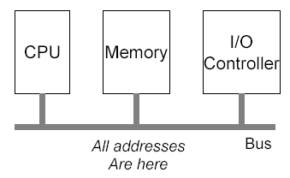
Disadvantages of Memory-mapped I/O
This can be easy or difficult depending on the architecture of the system
  No problem in this single-bus architecture

Slide 23
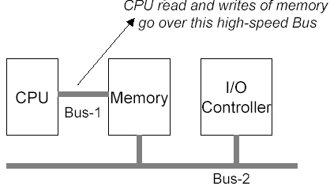
Disadvantages of Memory-mapped I/O
This can be easy or difficult depending on the architecture of the system
  In this dual-bus memory architecture, how can I/O controllers see the addresses that are used for control registers,
  as all memory
  addresses
  go by on the
  memory bus.

Slide 24
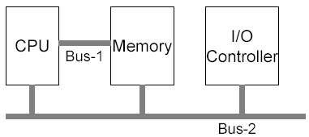
Disadvantages of Memory-mapped I/O
Solution 1
  CPU sends an address to main memory over the memory bus. If main memory does not respond (since address range is for I/O), the CPU will put the address on the other buses.

Slide 25
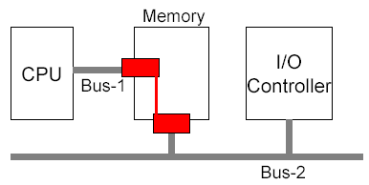
Disadvantages of Memory-mapped I/O
Solution 2
  A snooping device on the memory bus can be used to pass all addresses in I/O range to the I/O bus.

Slide 26
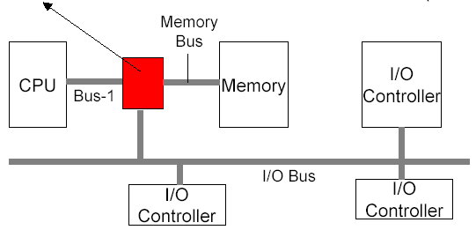
Disadvantages of Memory-mapped I/O
Solution 3
  A bridge filters all memory addresses. If addresses are in main memory address range, then it passes the addresses to the memory bus; if addresses are in I/O space then it passes the addresses to the I/O bus. (e.g. Pentium)
Bridge
(filters)

Slide 27
Principles of I/O Software
Goals of I/O Software
I/O Operations
  Programmed I/O
  Interrupt-driven I/O
  I/O using DMA

Slide 28
Goals of I/O Software (1)
Device independence
  programs can access any I/O device
  without specifying device in advance
    (USB device, hard drive, or CD-ROM)
Uniform naming
  name of a file or device a string or an integer
  not depending on which machine
Error handling
  handle as close to the hardware as possible

Slide 29
Goals of I/O Software (2)
Synchronous vs. asynchronous transfers
  blocked transfers vs. interrupt-driven
Buffering
  data coming off a device cannot be stored in final destination
Sharable vs. dedicated devices
  disks are sharable
  tape drives would not be

Slide 30
Programmed I/O (1)
CPU is always busy with I/O until I/O gets completed.
  Fine for single process systems
    MS-DOS
    Embedded systems
  But not a good approach for multi-programming and time-sharing systems

Slide 31
Programmed I/O (2)
Assume a program that wants to print a string to a printer.
Assume string is “ABCDEFGH”, 8 character long string
Assume printer has 1 byte of data buffer to put the character that needs to be printed.

Slide 32
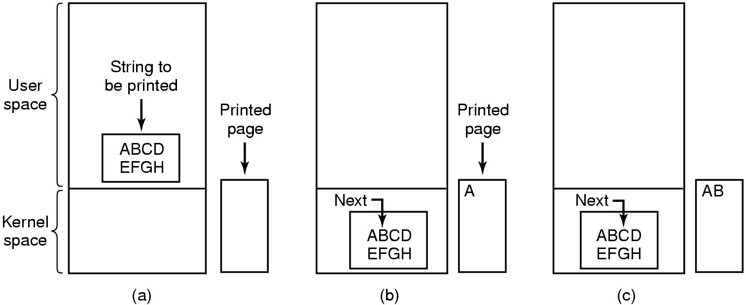
Programmed I/O (3)
Steps in printing a string

Slide 33
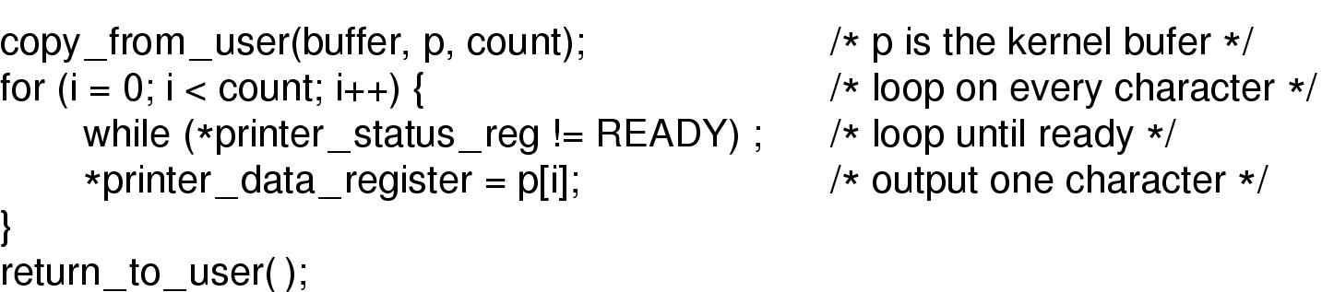
Programmed I/O (4)
/*
buffer is user buffer
p is kernel buffer
count is number of bytes to be copied
*/
Writing a string to the printer using programmed I/O

Slide 34
Programmed I/O (5)
Polling: CPU busy with checking the status register of printer to determine its state
  Ready
  Busy
  Error
Busy-wait cycle to wait for I/O from device, waste of CPU

Slide 35
Interrupt-Driven I/O (1)
After copying application buffer content into kernel buffer, and sending 1 character to printer,
  CPU does not wait until printer is READY again.
  Instead, the scheduler() is called and some other process is run.
    The current process is put into blocked state.
  Printer controller generates an hardware interrupt:
    When the character is written to the printer and the printer becomes READY again.

Slide 36
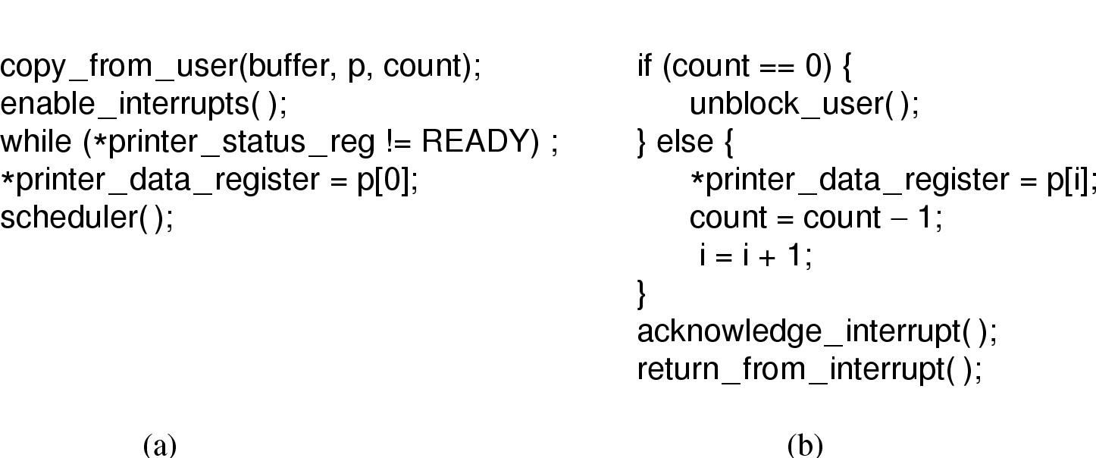
Interrupt-Driven I/O (2)
Writing a string to the printer using interrupt-driven I/O
  (a) Code executed when print system call is made
  (b) Interrupt service procedure

Slide 37

Interrupt
Bus
How interrupts happens. Connections between devices and interrupt controller actually use interrupt lines on the bus rather than dedicated wires

Slide 38
I/O using DMA (1)
Disadvantage of Interrupt-Driven I/O is that interrupt occurs on every character.
DMA controller will feed the characters from kernel buffer to the printer controller.
  CPU is not bothered during this transfer
After transfer of whole buffer (string) is completed, then the CPU is interrupted.

Slide 39
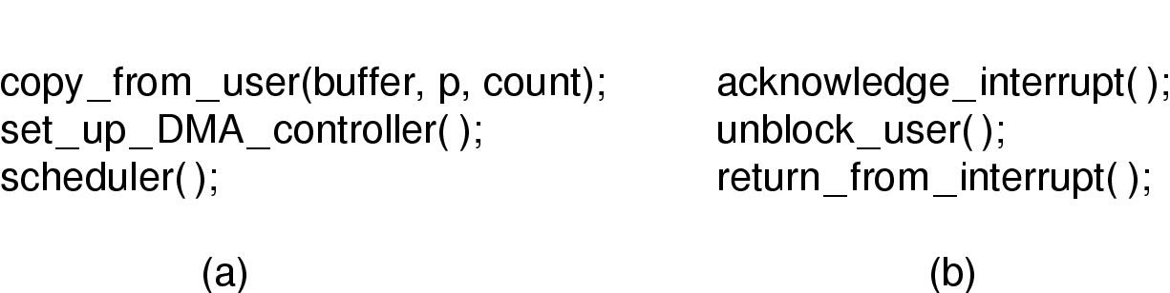
I/O using DMA (2)
Printing a string using DMA
  code executed when the print system call is made
  interrupt service procedure

Slide 40

Direct Memory Access (DMA)
Operation of a DMA transfer

Slide 41
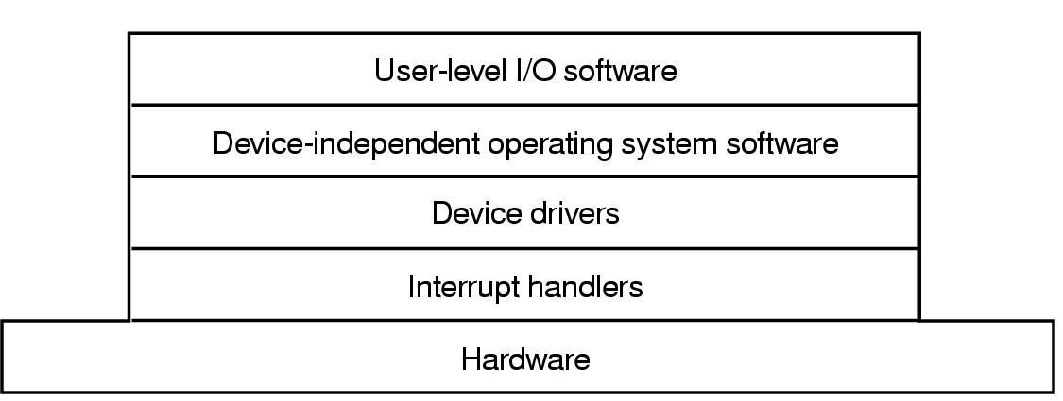
I/O Software Layers
User Space
Kernel Space
Layers of the I/O Software System

Slide 42
Interrupt Handlers (1)
Interrupt handlers are best hidden
  have driver starting an I/O operation block until interrupt notifies of completion
Interrupt procedure does its task
  then unblocks driver that started it

Slide 43
Interrupt Handlers (2)
Steps must be performed in software after interrupt completed
  Save regs not already saved by interrupt hardware
  Set up context for interrupt service procedure
  Set up stack for interrupt service procedure
  Ack interrupt controller, reenable interrupts
  Copy registers from where saved
  Run service procedure
  Choose which process to run next.
  Set up MMU context for process to run next
  Load new process' registers
  Start running the new process

Slide 44
Device Drivers (1)
Encapsulates routines that handle low-level device operations
Generally written by device manufacturers
  Not necessarily by OS writers
A driver can be written for more than one OS
Each driver can handle one type of device
We need to have a well-defined model of what a driver does and how it integrates with the rest of the OS.
  This is because, OS implementers and drivers implementers may be different.
OSs usually classify drivers into two classes
  Drivers for block devices
  Drivers for character devices

Slide 45
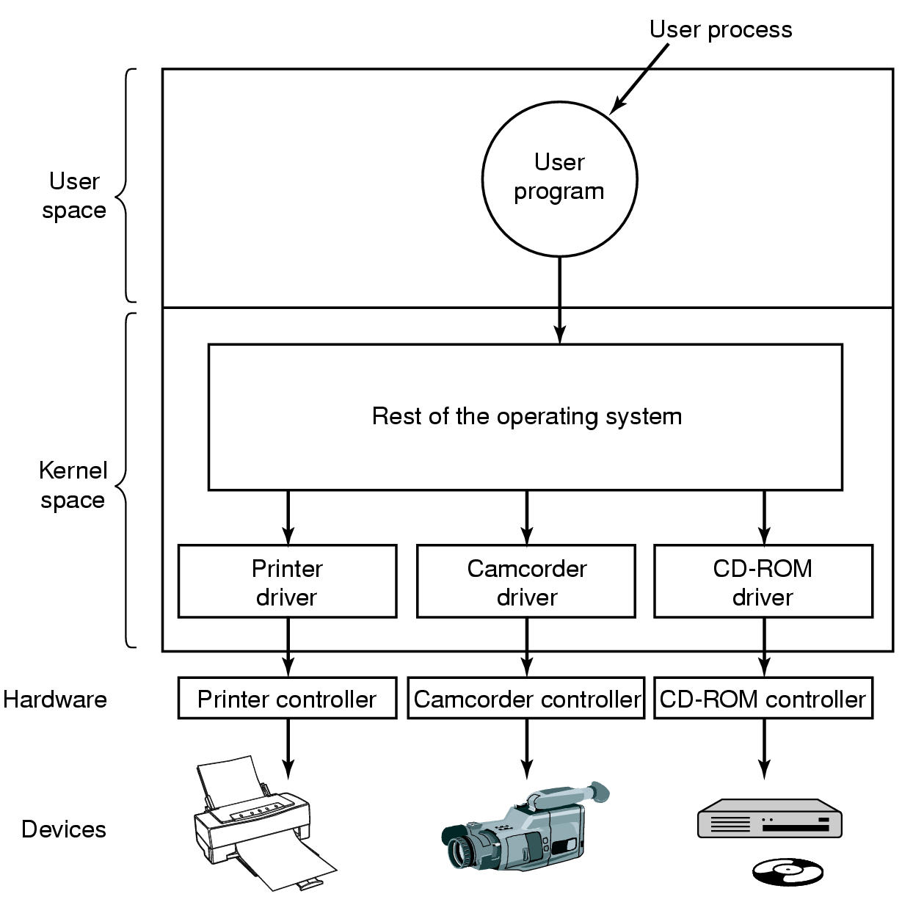
Device Drivers (2)
Logical position of device drivers is shown here
Communications between drivers and device controllers goes over the bus

Slide 46
Device Drivers (3)
Device Driver Functions
  Accept abstract read and write requests from rest of the OS (device-independent part).
    Translate from abstract terms to concrete terms.
      Example: A disk driver translates from a linear block address to a physical head, track, sector, and cylinder number.
  Initialize the devices if necessary
  Check if the device is currently in use for some other request.
    If so, enqueue the request.
  Issue sequence of commands to control the device
  Check errors

Slide 47
Device-Independent I/O Software
Functions of the device-independent I/O software
  Uniform interfacing for device drivers
  Buffering
  Error reporting
  Allocating and releasing dedicate devices
  Providing a device-independent block size

Slide 48
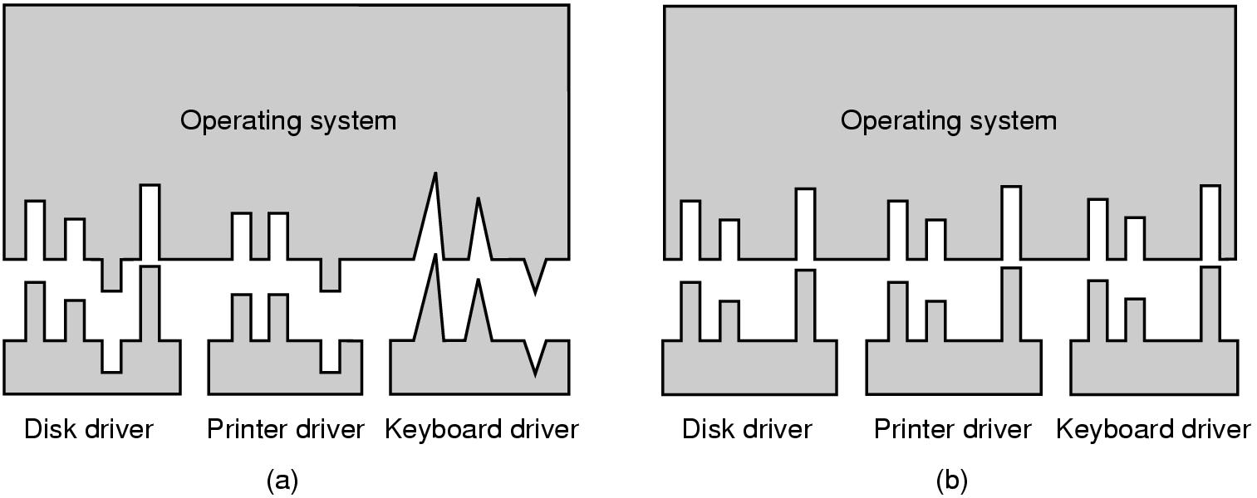
Uniform Interfacing (1)
(a) Without a standard driver interface
(b) With a standard driver interface

Slide 49
Uniform Interfacing (2)
Drivers need to have uniform interface. The benefits are:
  The driver implementers know what is expected from them
  The OS implementers can developed device-independent I/O function on top of a well-defined lower-layer driver interface.
    They know which functions each driver implements and the pro-types of these function.

Slide 50
Uniform Interfacing (3)
In Unix, devices are modeled as special files.
  They are accessed through the use of system calls such as open(), read(), write(), close(), ioctl(), etc.
  A file name is associated with each device.
Major device number locates the appropriate driver.
  Minor device number (stored in i-node) is passed as a parameter to the driver in order to specify the unit to be read or written.
The usual protection rules for files also apply to I/O devices

Slide 51
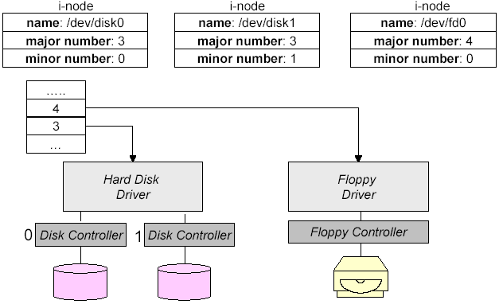
Uniform Interfacing (4)
Uniform Interfacing: Mapping symbolic I/O device names to their appropriate drivers

Slide 52
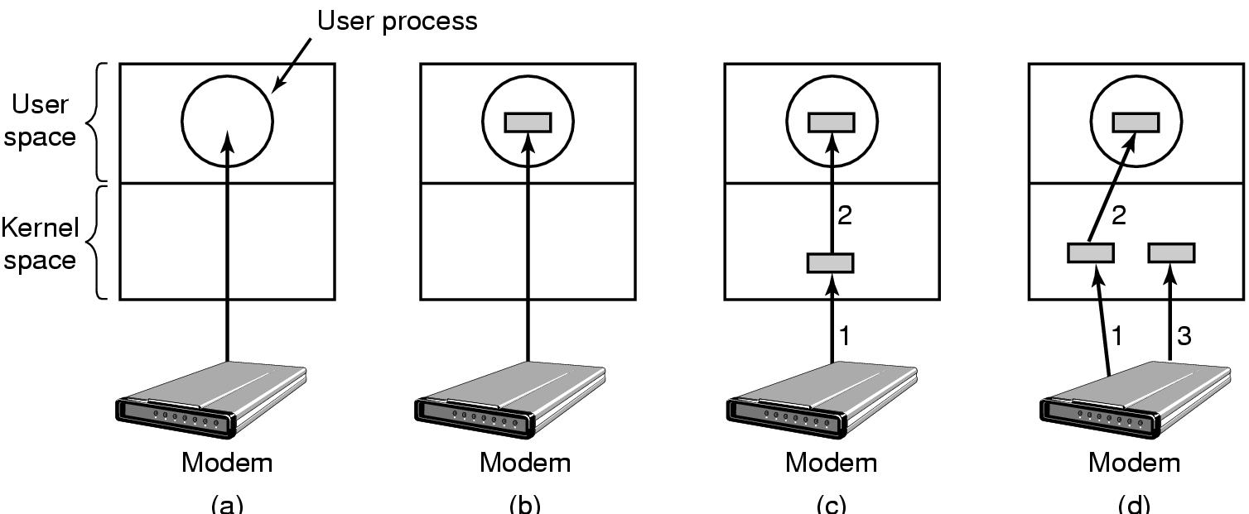
Buffering (1)
(a) Unbuffered input
(b) Buffering in user space
(c) Buffering in the kernel followed by copying to user space
(d) Double buffering in the kernel

Slide 53
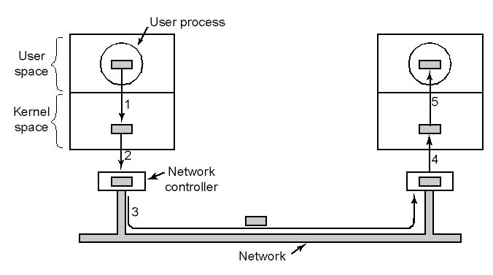
Buffering (2)
Networking may involve many copies

Slide 54
Error Reporting
Some errors are handled by device-controllers
  Example: Checksum incorrect, re-correct the block by using redundant bits
Some by device derivers
  Example: disk block could not be read, re-issue the read operation for block from disk
Some by the device-independent software layer of OS.
  Programming errors
    Example: Attempt to write to a read-only device
  Actual I/O errors
    Example: The camcorder is shut-off, therefore we could not read. Return an indication of this error to the calling application.

Slide 55
Allocating Dedicated Devices
Do not allow concurrent accesses to dedicated devices such as CD-RWs.

Slide 56
Device-independent Block Size
There are different kind of disk drives. Each may have a different physical sector size.
A file system uses a block size while mapping files into logical disk blocks.
This layer can hide the physical sector size of different disks and can provide a fixed and uniform disk block size for higher layers, like the file system
  Several sectors can be treated as a single logical block.

Slide 57
User-Space I/O Software
This includes
  The I/O libraries that provides the implementation of I/O functions which in turn call the respective I/O system calls.
    These libraries also implemented formatted I/O functions such as printf() and scanf()
  Some programs that does not directly write to the I/O device, but writes to a spooler.

Slide 58
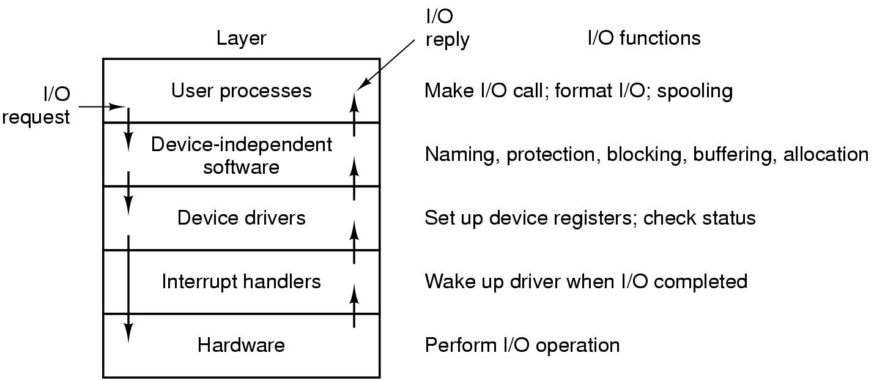
Summary of I/O Software
Layers of the I/O system and the main functions of each layer

Slide 59
Disks
Disks have many types
  Magnetic disks
    Hard disk
    Floppy disk
  Optical disks
    CD-ROM
    CD-Writable
    CD-Recordable
    DVDs

Slide 60
Magnetic Disks (1)
Organized into cylinders
  Each cylinders contains tracks
    Each track is divided into a number of sectors
      The sector size is usually 512 bytes.
There are IDE, SATA, SCSI, SAS and Fiber Channel hard disks.

Slide 61
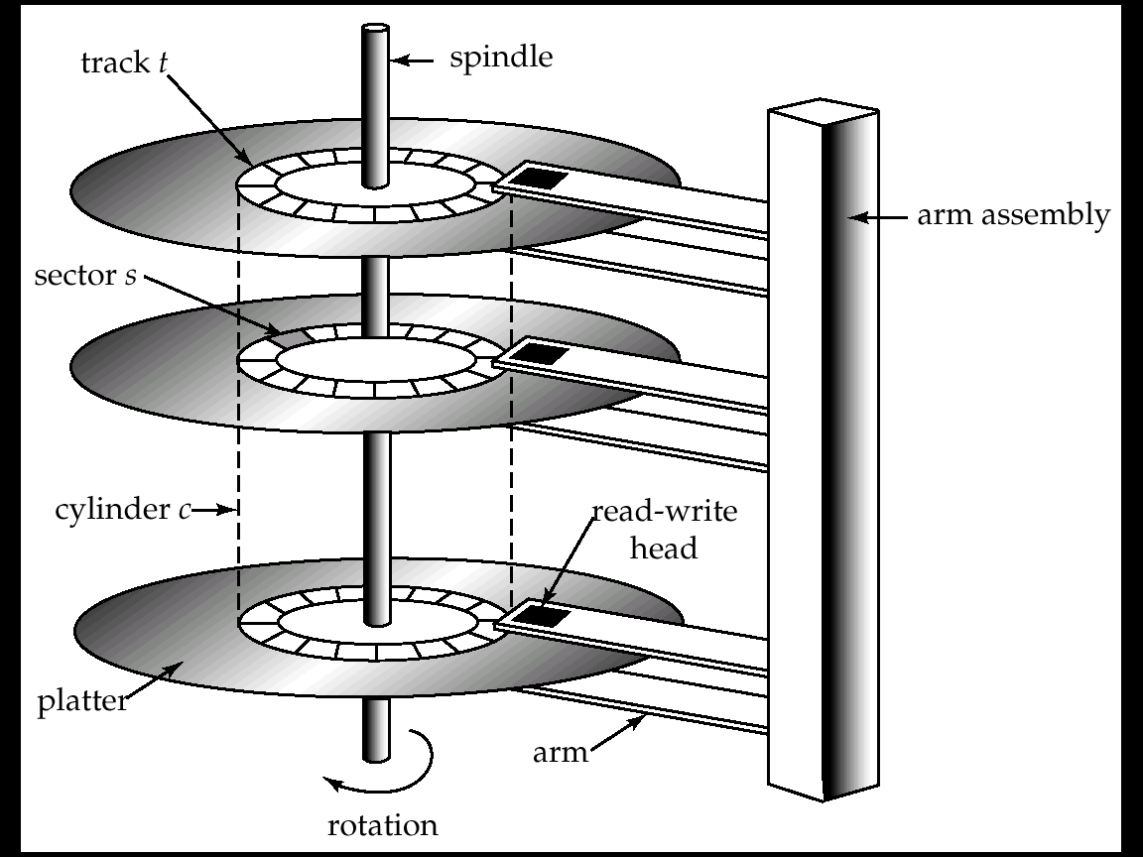
Magnetic Disks (2)

Slide 62
Disk Hardware
Read-write head
  Positioned very close to the platter surface (almost touching it)
  Reads or writes magnetically encoded information.
Surface of platter divided into circular tracks
  Over 16,000 tracks per platter on typical hard disks
Each track is divided into sectors.
  A sector is the smallest unit of data that can be read or written.
  Sector size typically 512 bytes
  Typical sectors per track: 200 (on inner tracks) to 400 (on outer tracks)
To read/write a sector
  disk arm swings to position head on right track
  platter spins continually; data is read/written as sector passes under head
Head-disk assemblies
  multiple disk platters on a single spindle (typically 2 to 4)
  one head per platter, mounted on a common arm.
Cylinder i consists of ith track of all the platters

Slide 63
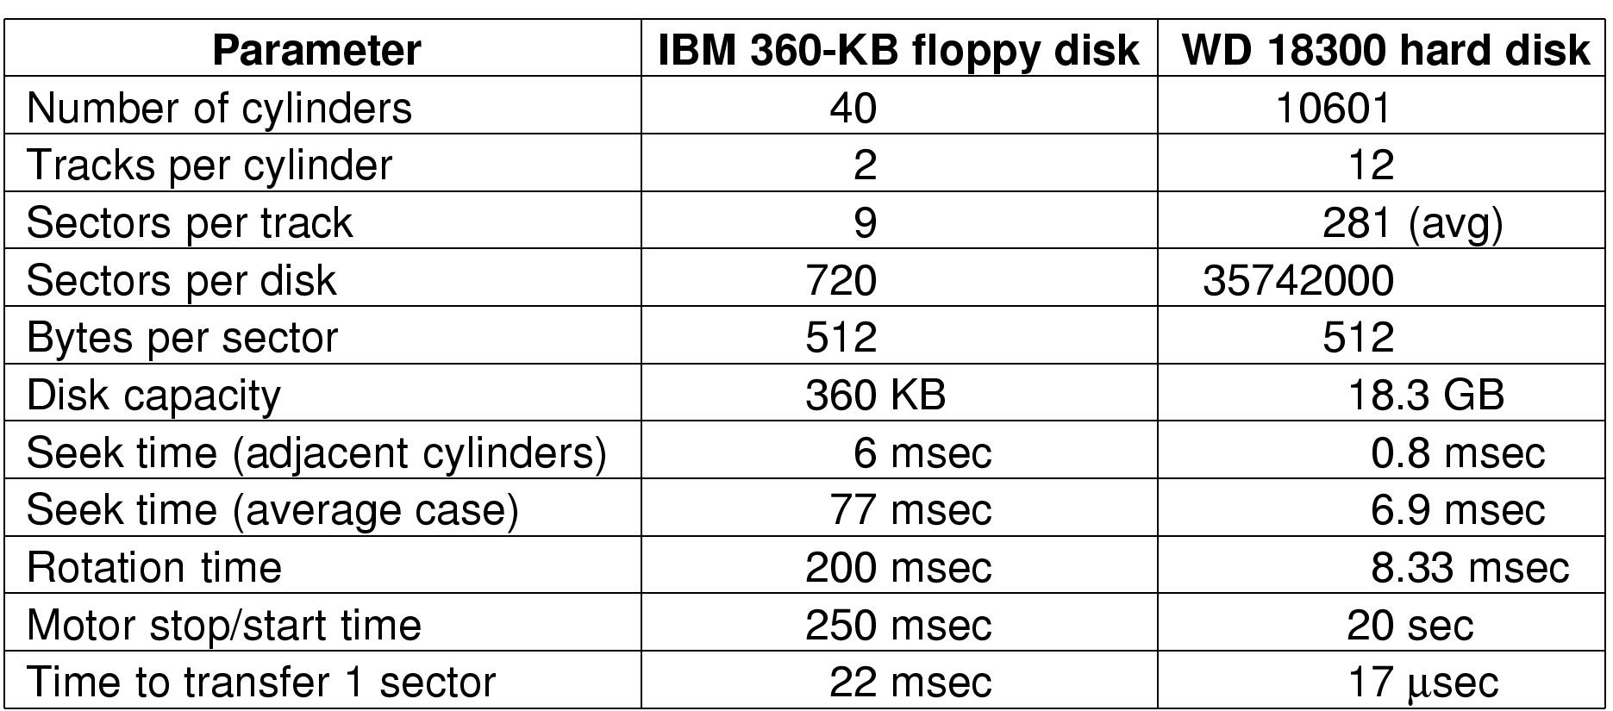
Magnetic Disks (3)
Disk parameters for the original IBM PC floppy disk and a Western Digital WD 18300 hard disk

Slide 64
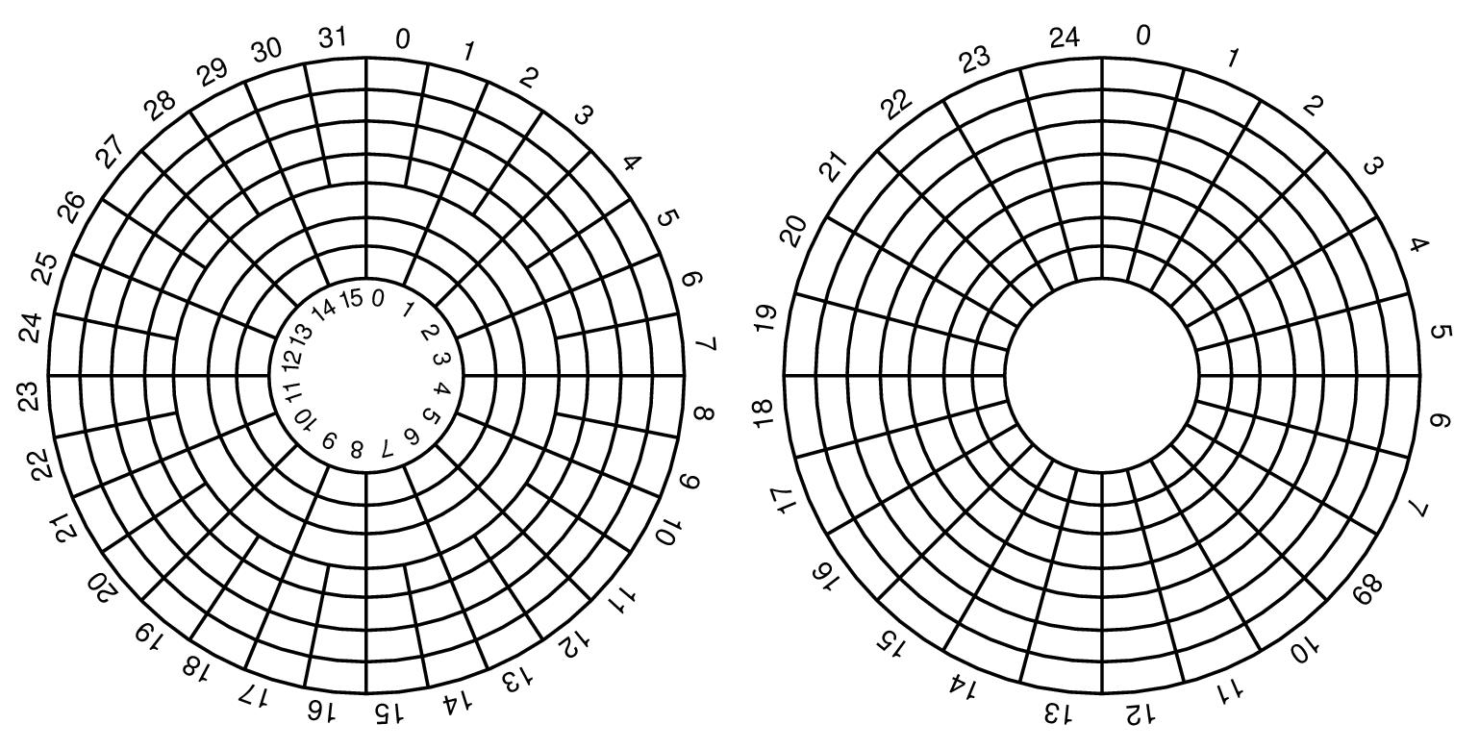
Magnetic Disks (4)
Physical geometry of a disk with two zones
A possible virtual geometry for this disk

Slide 65
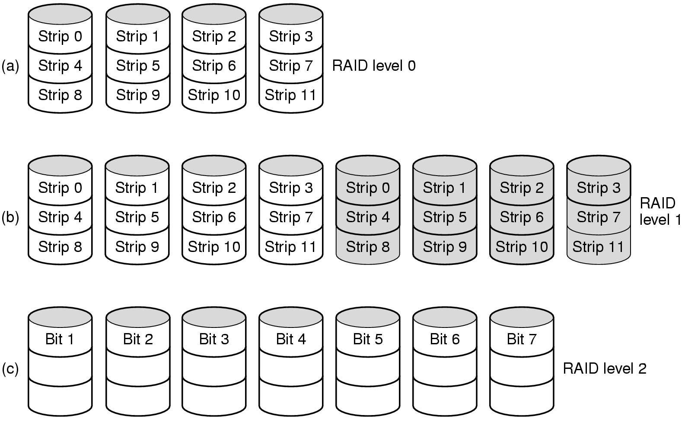
RAID (1)
RAID levels 0 through 2
(Backup and parity drives are shaded)

Slide 66
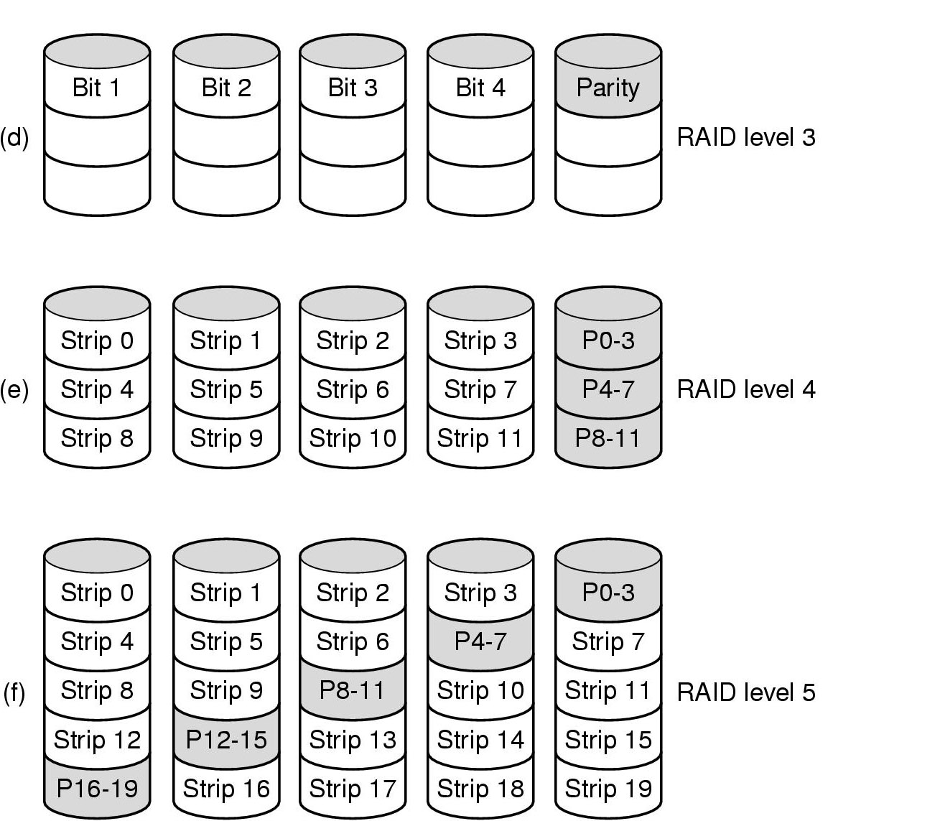
RAID (2)
RAID levels 3 through 5
(Backup and parity drives are shaded)

Slide 67
Disk Formatting (1)
After manufacturing, there is no information on the disk
  Just empty bits
Each platter need to have
  A low-level format
  A high-level format
  before disk can be used

Slide 68


Disk Formatting (2)
Each track should have formatted in the following way:
  Sectors and inter-sector-gap between them
  A sector will be have format like the following:
    Preamble – data (512 bytes) – Checksum

Slide 69
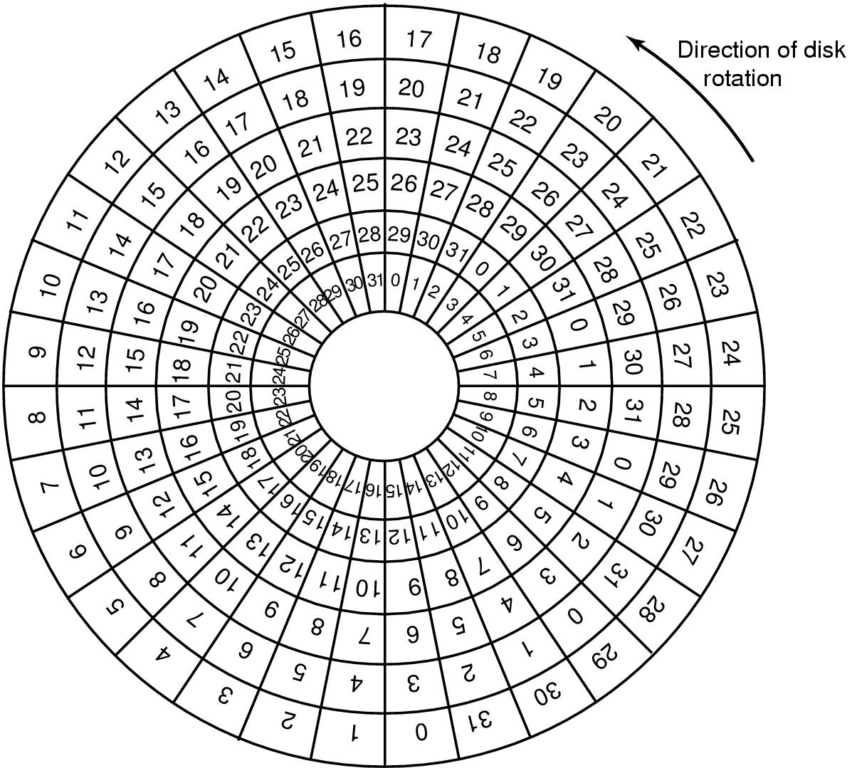
Cylinder Skew
Example
10,000rpm disk drive (6ms/round)
300 sectors per track (20 μs/sector)
Seek time: 800 μs
Cylinder skew: 40secotrs
An illustration of cylinder skew(柱面斜进)

Slide 70
Interleaving (1)
If we have ONE sector buffer in the disk controller:
  After we have transferred one sector of data from hard-disk to controller buffer:
    We will copy the controller buffer to the memory
    During this time, the disk-head will pass the start of the next sector.
    Therefore, the next logical sector, should not be the next physical sector in hard-disk.
      There should be some interleaving.

Slide 71
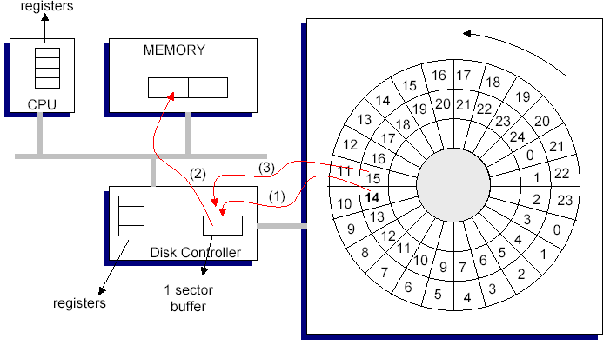
Interleaving (2)

Slide 72
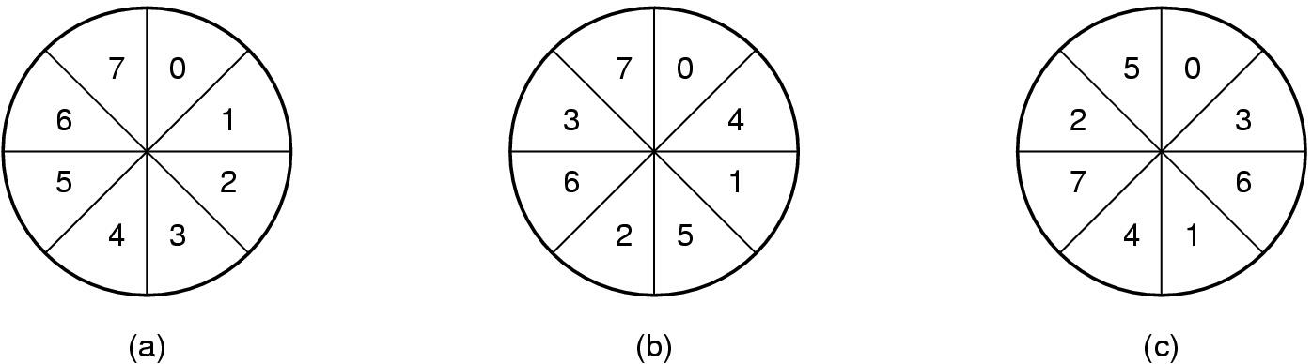
Interleaving (3)
No interleaving
Single interleaving
Double interleaving

Slide 73
Performance Measures of Disks (1)
Access time – the time it takes from when a read or write request is issued to when data transfer begins. Consists of:
  Seek time – time it takes to reposition the arm over the correct track.
    Average seek time is 1/2 the worst case seek time.
      Would be 1/3 if all tracks had the same number of sectors, and we ignore the time to start and stop arm movement
    4 to 10 milliseconds on typical disks
  Rotational latency – time it takes for the sector to be accessed to appear under the head.
    Average latency is 1/2 of the worst case latency.
    4 to 11 milliseconds on typical disks (5400 to 15000 r.p.m.)

Slide 74
Performance Measures of Disks (2)
Data-transfer rate – the rate at which data can be retrieved from or stored to the disk.
  4 to 8 MB per second is typical
Mean time to failure (MTTF) – the average time the disk is expected to run continuously without any failure.
  Typically 3 to 5 years
Notes:
MTTF：平均故障间隔时间

Slide 75
Disk Arm Scheduling Algorithms (1)
Time required to read or write a disk block determined by 3 factors
  Seek time
    Move arm to the correct cylinder
  Rotational delay
    Wait until correct sector comes under head.
  Actual data transfer time
For most systems, the seek time dominates the other two times.

Slide 76
Disk Arm Scheduling Algorithms (2)
Assume the disk is heavily loaded.
  There are a lot requests for disk blocks that are arriving to the hard disk driver.
  The drivers queues the requests.
    The driver knows for each block request, where in hard disk the block should be stored (the cylinder number).
  Since moving between cylinders (seek time) is costly, we should try to minimize these seek times.

Slide 77
Disk Arm Scheduling Algorithms (3)
Algorithms order pending accesses to tracks so that disk arm movement is minimized
  First Come First Served (FCFS)
  Shortest Seek First (SSF)
  Elevator Algorithm

Slide 78
FCFS
Serve the request in the order they arrive (don’t look to the cylinder numbers)
Example:
  Assume the current position is cylinder 11.
  The following requests arrive in the given time order: 1, 36, 16, 34, 9, 12
  The request will be served in the same order.
  The head will go to:
    Cylinder 1 first (10 cylinders motion)
    Cylinder 36 next (35 cylinders motion)
    Cylinder 16 next (20 cylinders motion)
    Cylinder 34 next (18 cylinders motion)
    Cylinder 9 next (25 cylinders motion)
    Cylinder 12 next (3 cylinders motion)
    Total of 111 cylinders are skipped. Cost = 111

Slide 79
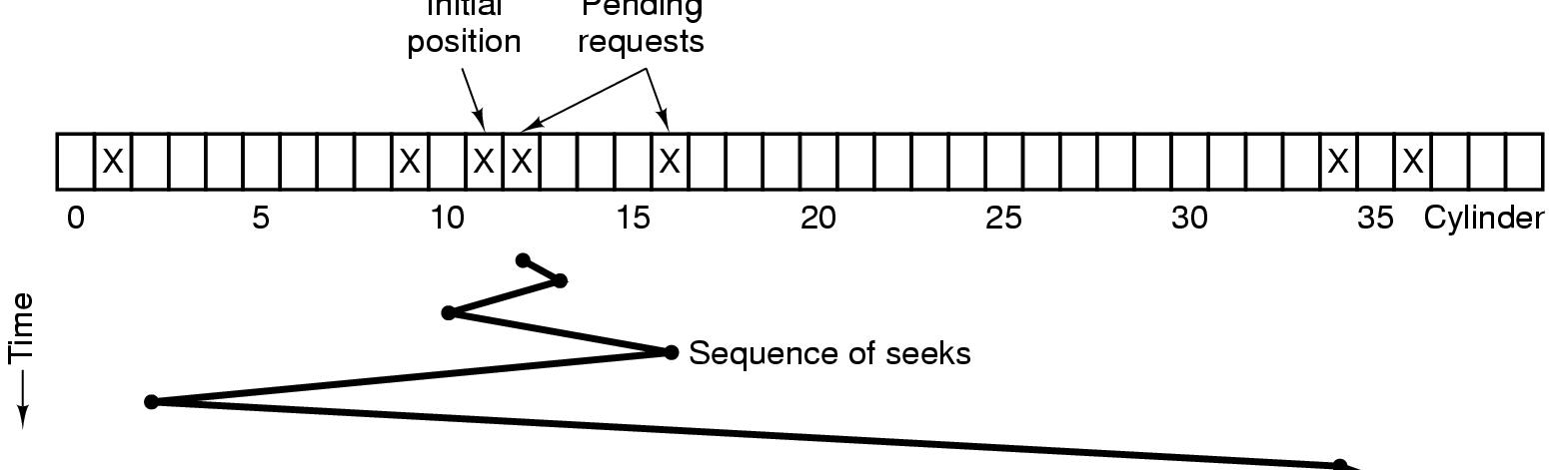
Shortest Seek First (SSF)
Satisfy the request that need shortest seek from the current position.
  Cylinder request sequence: 11、1、36、16、34、9、12
  Sequence of seeks: 11、12、9、16、1、34、36
  Moving the head to these cylinders require: 1, 3, 7, 15, 33, and 2 arm motions, total cost=61

Slide 80
Elevator algorithm (1)
Elevator algorithm: Move disk arm in one direction (from outer to inner tracks or vice versa), processing next request in that direction, till no more requests in that direction, then reverse direction and repeat
In the previous example, assume initial position was 11 and initial direction was up (going to higher numbered cylinders).

Slide 81
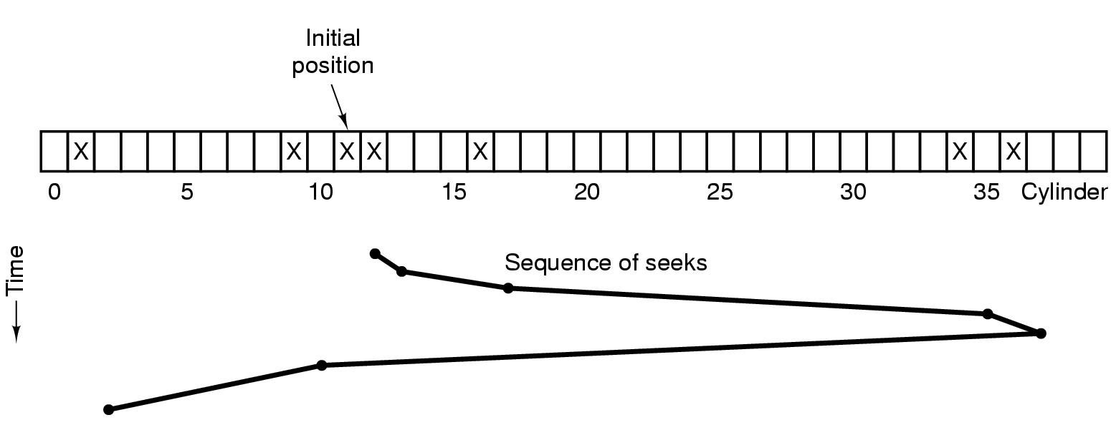
Elevator algorithm (2)
Cylinder request sequence: 11、1、36、16、34、9、12
Sequence of seeks: 11、12、16、34、36、9、1
Moving the head to these cylinders require: 1, 4, 18, 2, 27, and 8 arm motions, total cost=60

Slide 82
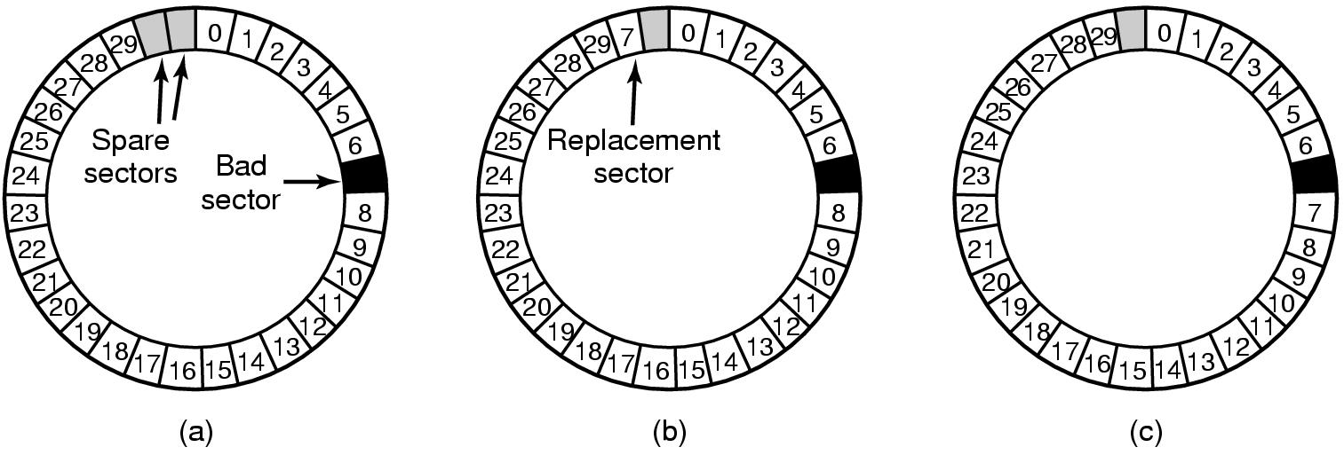
Error Handling
A disk track with a bad sector
Substituting a spare for the bad sector
Shifting all the sectors to bypass the bad one

Slide 83
Summary
Principles of I/O Hardware
  I/O Devices
  Separate I/O and memory space, Memory-mapped I/O, Hybrid
Principles of I/O Software
  Goals of I/O software
  Programmed I/O
  Interrupt driven I/O
  I/O using DMA
I/O software layers
Disks
  Disk formatting
  Disk arm scheduling algorithm

Slide 84
Homework
14、28、31

