Slide 1
Chapter 6
Deadlocks
6.1 Resource
6.2 Introduction to deadlocks
6.3 The ostrich algorithm
6.4 Deadlock detection and recovery
6.5 Deadlock avoidance
6.6 Deadlock prevention
6.7 Other issues

Slide 2
Resources
A resource is anything that can be used by a single process at any instant of time, and that must be acquired, used, and released over the course of time.
Resource types R1, R2, . . ., Rm
  CPU cycles, memory space, I/O devices ,record in a database…
Each resource type Ri has Wi instances.
Preemptable resources
  can be taken away from a process with no ill effects (e.g. memory)
Nonpreemptable resources
  will cause the process to fail if taken away (e.g. CD recorder)

Slide 3
Resources
Each process utilizes a resource as follows:
  request the resource
  use the resource
  release the resource
Must wait if request is denied
  requesting process may be blocked
  may fail with error code

Slide 4
Resources
Processes need access to resources in reasonable order
Suppose a process holds resource A (e.g. scanner) and requests resource B (e.g. CD recorder)
  at same time another process holds B and requests A
  both are blocked and remain so
Deadlocks occur when …
  processes are granted exclusive access to devices

Slide 5
Using Semaphore to Share Resource
1
Process P();
{ A.Down();
B.Down();
use both resource
B.Up();
A.Up(); }
Process Q();
{ A.Down();
B.Down();
use both resource
B.Up();
A.Up(); }
1
2
6
3
4
5
1
External Semaphore A(1), B(1);
2
External Semaphore A(0), B(1);
3
External Semaphore A(0), B(0);
4
External Semaphore A(0), B(1);
5
External Semaphore A(1), B(1);

Slide 6
But Deadlock can Happen!
1
Process P();
{ A.Down();
B.Down();
use both resources
B.Up();
A.Up(); }
Process Q();
{ B.Down();
A.Down();
use both resources
A.Up();
B.Up(); }
1
2
3
DEADLOCK
1
External Semaphore A(1), B(1);
2
External Semaphore A(0), B(1);
3
External Semaphore A(0), B(0);

Slide 7
Bridge Crossing Example
Traffic only in one direction.
Each section of a bridge can be viewed as a resource. If a deadlock occurs, it can be resolved if one car backs up (preempt resources and rollback).
Several cars may have to be backed up if a deadlock occurs.

Slide 8
Introduction to Deadlocks
Formal definition :
A set of processes is deadlocked if each process in the set is waiting for an event that only another process in the set can cause.
Usually the event is release of a currently held resource
None of the processes can …
  run
  release resources
  be awakened

Slide 9
Four Conditions for Deadlock
Deadlock can arise if four conditions hold simultaneously.
Mutual exclusion condition
  each resource assigned to 1 process or is available
Hold and wait condition
  process holding resources can request additional
No preemption condition
  previously granted resources cannot forcibly taken away
Circular wait condition
  must be a circular chain of 2 or more processes
  each is waiting for resource held by next member of the chain

Slide 10
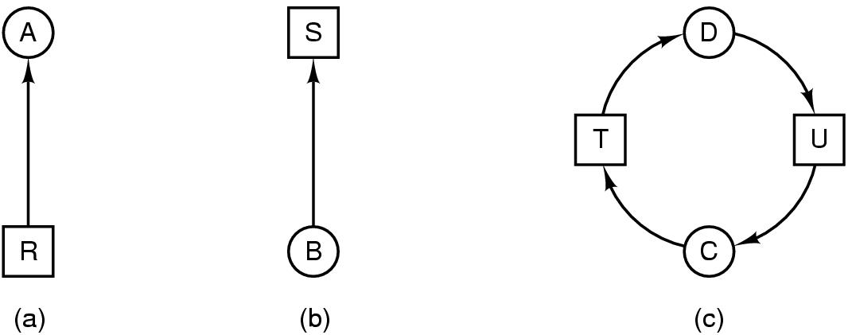
Deadlock Modeling
Modeled with directed graphs
  resource R assigned to process A
  process B is requesting/waiting for resource S
  process C and D are in deadlock over resources T and U

Slide 11
Resource-Allocation Graph
A set of vertices V and a set of edges E.
V is partitioned into two types:
  P = {P₁, P₂, …, P_{n}}, the set consisting of all the processes in the system.
  R = {R₁, R₂, …, R_{m}}, the set consisting of all resource types in the system.
request edge – directed edge P_{i} → R_{j}
assignment edge – directed edge R_{j} → P_{i}

Slide 12
Resource-Allocation Graph
Process
Resource Type with 4 instances
P_{i} requests an instance of R_{j}
P_{i} is holding an instance of R_{j}
P_{i}
R_{j}
P_{i}
R_{j}

Slide 13

Example of a Resource Allocation Graph

Slide 14

Resource Allocation Graph
With a Deadlock

Slide 15

Resource Allocation Graph
With a Cycle But No Deadlock

Slide 16
Basic Facts
If graph contains no cycles ⇒ no deadlock.
If graph contains a cycle ⇒
  if only one instance per resource type, then deadlock.
  if several instances per resource type, possibility of deadlock.

Slide 17
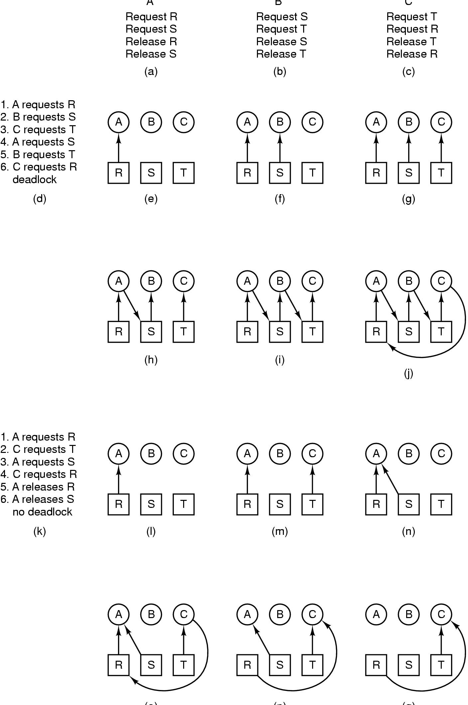
Deadlock Modeling
A B C
How deadlock occurs

Slide 18
Deadlock Modeling
(o) (p) (q)
How deadlock can be avoided

Slide 19
Methods for Handling Deadlocks
  Ignore the problem and pretend that deadlocks never occur in the system
  Allow the system to enter a deadlock state and then recover.
    detection and recovery
  Ensure that the system will never enter a deadlock state
    dynamic avoidance
      (careful resource allocation)
    prevention
    (negating one of the four necessary conditions)

Slide 20
(1) The Ostrich Algorithm
Pretend there is no problem
Reasonable if
  deadlocks occur very rarely
  cost of prevention is high
UNIX and Windows takes this approach
It is a trade off between
  convenience
  correctness

Slide 21
(2) Deadlock Detection
Allow system to enter deadlock state
Detection algorithm
Recovery scheme

Slide 22

Detection with One Resource of Each Type
Note the resource ownership and requests
A cycle can be found within the graph, denoting deadlock

Slide 23
An algorithm for detecting cycles in directed graph
Periodically invoke an algorithm that searches for a cycle in the graph.
A data structure, L, a list of nodes.
Arcs will be marked to indicate that they have already been inspected, to prevent repeated inspections.
For each node, N, in the graph, performing the following 5 steps with N as the starting node.

Slide 24
An algorithm for detecting cycles in directed graph
Initialize L to the empty list, and designate all the arcs as unmarked.
Add the current node to the end of L and check to see if the node now appears in L two times. If it does, the graph contains a cycle (listed in L) and the algorithm terminates.
From the given node, see if there are any unmarked outgoing arcs. If so, go to step 4; if not, go to step 5.
Pick an unmarked outgoing arc at random and mark it. Then follow it to the new current node and go to step 2.
We have now reached a dead end. Remove it and go back to the previous node, make it the current node, and go to step 3. If this node is the initial node, the graph does not contain any cycles and the algorithm terminates.

Slide 25
Example1
Start at R and initialize L to the empty list.
From R we go to S, giving L={R, A, S}. S has no outgoing arcs (a dead end).
Go backtrack to A.
A has no unmarked outgoing arcs, go backtrack to R.
R is the initial node, so no cycles.

Slide 26
Example2
Start at B and initialize L to the empty list.
From B, we follow outgoing arcs until we get to D, giving L={B, T, E, V, G, U, D}.
Pick S randomly and we come to a dead end, then backtrack to D.
Now pick T and update L to be {B, T, E, V, G, U, D, T}. T appears two times in L, we discover cycle.

Slide 27
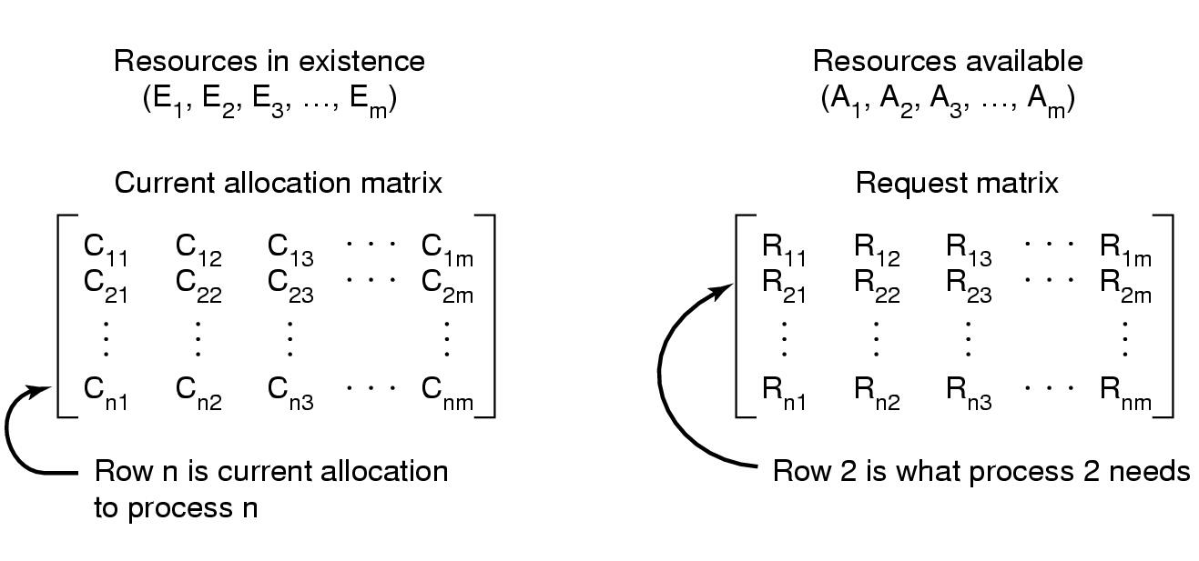
Detection with Multiple Resources of Each Type
Data structures needed by deadlock detection algorithm
Σ C_{ij} + A_{j} = E_{j}
n
i=1

Slide 28
Deadlock Detection Algorithm
Based on comparing vectors.
(A<B hold if and only if Ai < Bi for 1<=i<=m)
Each process is initially unmarked.
Look for an unmark process Pi, for which the i-th row of R is less than or equal to A. (Pi's request can be satisfied)
If such a process is found, add the i-th row of C to A, mark the process and go back to step 1. ( When Pi completes, its resources will become available).
If no such process exist, the algorithm terminates. The unmarked process, if any, are deadlock.

Slide 29
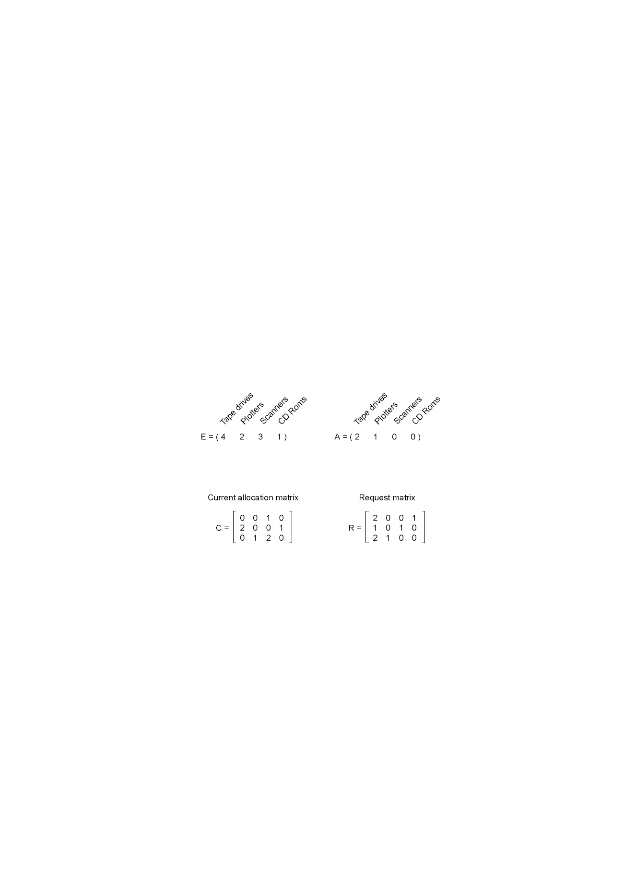
Detection with Multiple Resources of
Each Type (Example)
An example for the deadlock detection algorithm

Slide 30
Recovery from Deadlock
Recovery through preemption
  take a resource from some other process
  depends on nature of the resource
Recovery through rollback
  checkpoint a process periodically
  use this saved state
  restart the process if it is found deadlocked

Slide 31
Recovery from Deadlock
Recovery through killing processes
  crudest but simplest way to break a deadlock
  kill one of the processes in the deadlock cycle, then the other processes get its resources
  kill process that can be rerun from the beginning with no ill effects

Slide 32
(3) Deadlock Avoidance
The deadlock-avoidance algorithm dynamically examines the resource-allocation state to ensure that there can never be a circular-wait condition.
Requires that the system has some additional a priori information available.
Simplest and most useful model requires that each process declare the maximum number of resources of each type that it may need.

Slide 33
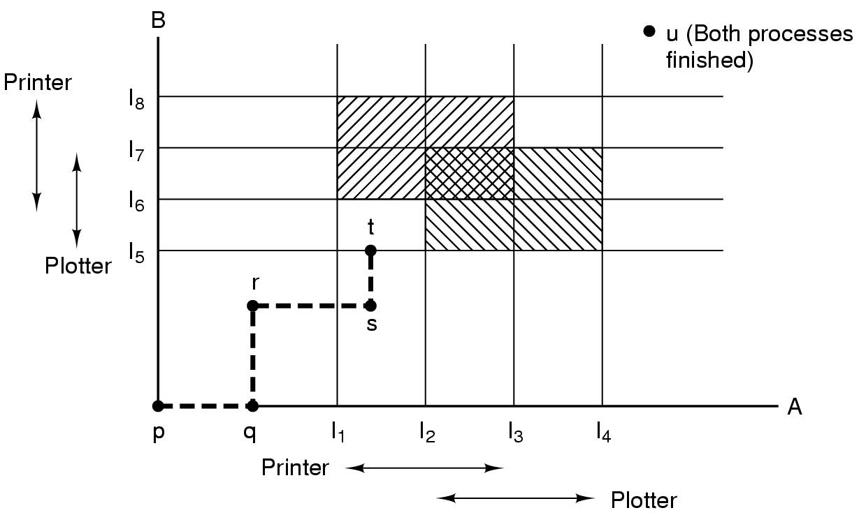
The deadlock-avoidance algorithm are based on the safe states.
Two process resource trajectories

Slide 34
Safe and Unsafe States
A state is safe if it is not deadlock and there is a way of satisfying all pending requests by running the process in some order.
System is in safe state if there exists a safe sequence of all processes.
When a process requests an available resource, system must decide if immediate allocation leaves the system in a safe state.

Slide 35
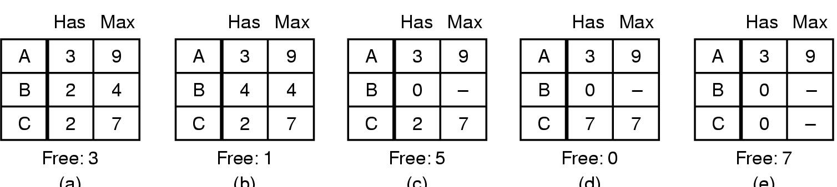
Safe and Unsafe States
(a) (b) (c) (d) (e)
Demonstration that the state in (a) is safe
(there exists a safe sequence BCA)

Slide 36
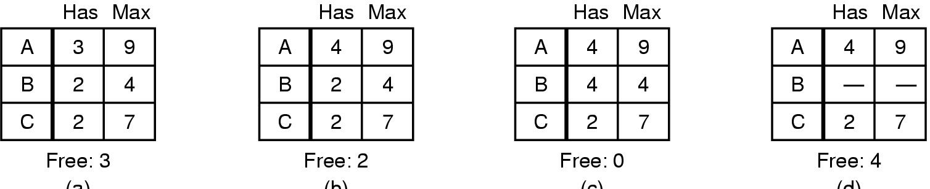
Safe and Unsafe States
A request 1
(a) (b) (c) (d)
Demonstration that the sate in b is not safe

Slide 37
Basic Facts
If a system is in safe state ⇒ no deadlocks.
If a system is in unsafe state ⇒ possibility of deadlock.
Avoidance ⇒ ensure that a system will never enter an unsafe state.

Slide 38

Safe, Unsafe, Deadlock State spaces

Slide 39
Deadlock-avoidance algorithm
Banker Algorithm (Dijkstra, 1965)
  Each customer tells banker the maximum number of resources it needs
  Customer borrows resources from banker
  Customer returns resources to banker
  Customer eventually pays back loan
  Banker only lends resources if the system will be in a safe state after the loan
Safe state - there is a lending sequence such that all customers can take out a loan
Unsafe state - there is a possibility of deadlock

Slide 40
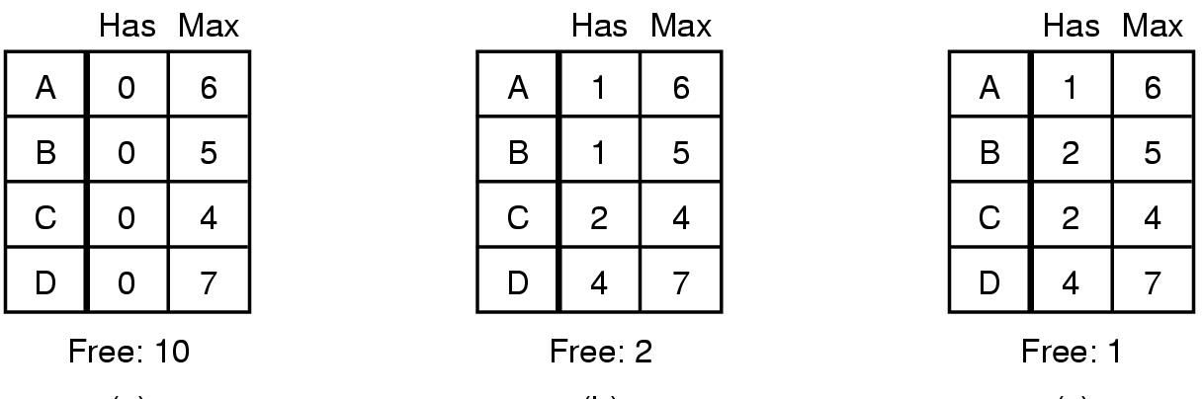
The Banker's Algorithm for a Single Resource
B request 1
(a) (b) (c)
Three resource allocation states
  (a) safe
  (b) safe
  (c) unsafe

Slide 41
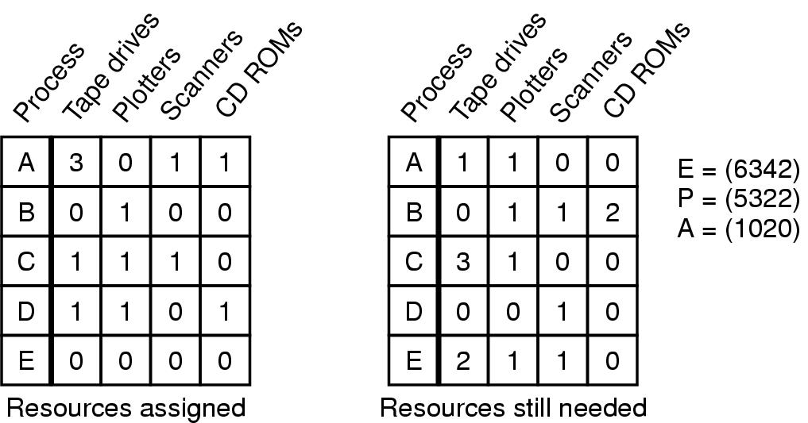
Banker's Algorithm for Multiple Resources
C R
Example of banker's algorithm with multiple resources

Slide 42
Banker’s Algorithm
Check to see if a state is safe:
Some look for a new row in R which is smaller than A. If no such row exists the system will eventually deadlock ==> not safe.
If such a row exists, the process may finish. Mark that process (row) as terminate and add all of its resources to A.
Repeat Steps 1 and 2 until all rows are marked == > safe state
or not marked == > not safe.

Slide 43
How to Compute Safety
Given:
n kinds of resources
p processes
Set P of processes
struct {resource needs[n], owns[n]} ToDo[p]
resource available[n]
while there exists a p in P such that
for all i (ToDo[p].needs[i] < available[i] )
{ do for all i
available[i] += ToDo[p].owns[i];
P = P - p;
}
If P is empty then system is safe.

Slide 44
Is Allocation (1 0 2) to P1 Safe?
Process
Alloc
Max
Need
Available
A
B
C
A
B
C
A
B
C
A
B
C
P0
0
1
0
7
5
3
7
4
3
10
5
5
P1
2
0
0
3
2
2
1
2
2
3
3
2
P2
3
0
0
9
0
2
6
0
2
P3
2
1
1
2
2
2
0
1
1
P4
0
0
2
4
3
3
4
3
1

Slide 45
And Run Safety Test: Group Discussion
Process
Alloc
Max
Need
Available
A
B
C
A
B
C
A
B
C
A
B
C
P0
0
1
0
7
5
3
7
4
3
10
5
5
P1
3
0
2
3
2
2
0
2
0
2
3
0
P2
3
0
0
9
0
2
6
0
2
P3
2
1
1
2
2
2
0
1
1
P4
0
0
2
4
3
3
4
3
1
If P1 requests max resources, can complete

Slide 46
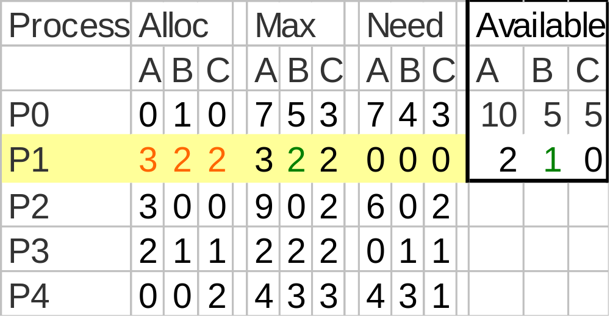
Allocate to P1, Then

Slide 47
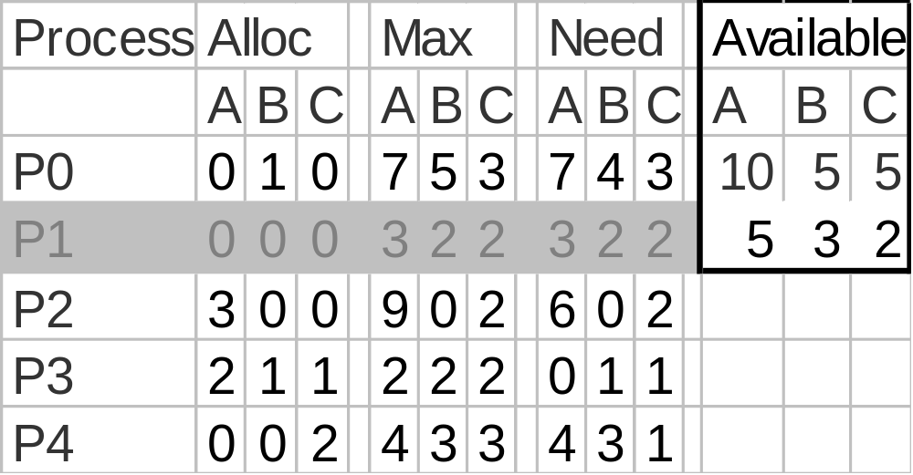
Release - P1 Finishes
Now P3 can acquire max resources and release

Slide 48
Release – P3 Finishes
Process
Alloc
Max
Need
Available
A
B
C
A
B
C
A
B
C
A
B
C
P0
0
1
0
7
5
3
7
4
3
10
5
5
P1
0
0
0
3
2
2
3
2
2
7
4
3
P2
3
0
0
9
0
2
6
0
2
P3
0
0
0
2
2
2
2
2
2
P4
0
0
2
4
3
3
4
3
1
Now P4 can acquire max resources and release

Slide 49
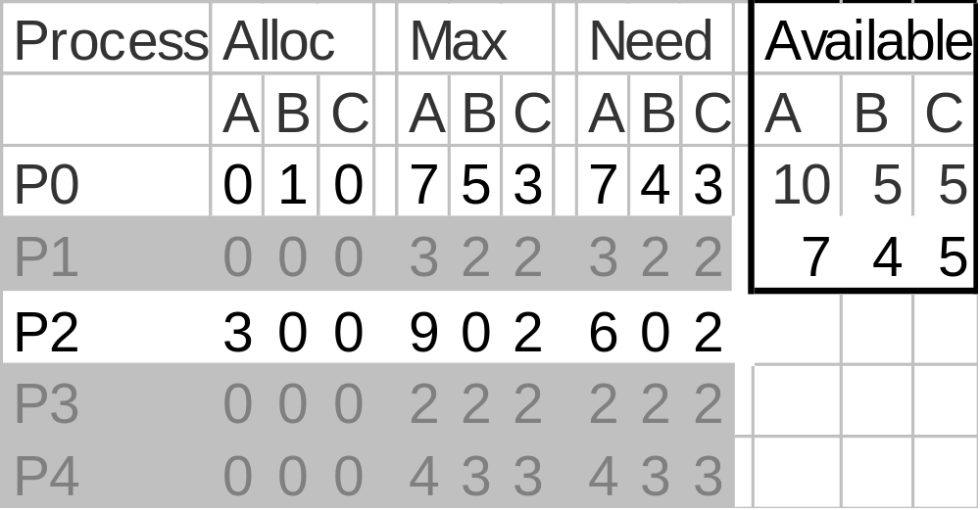
Release - P4 Finishes
Now P2 can acquire max resources and release

Slide 50
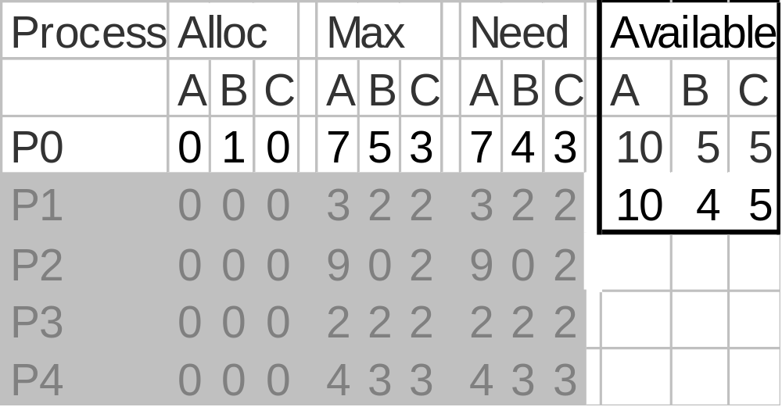
Release - P2 Finishes
Now P0 can acquire max resources and release

Slide 51
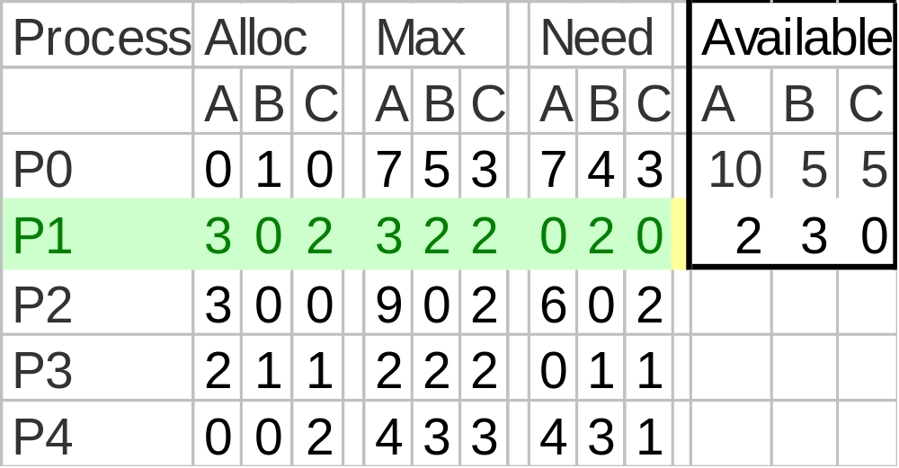
So P1 Allocation (1 0 2) Is Safe
There exists a safe sequence: P1, P3, P4, P2, P0

Slide 52
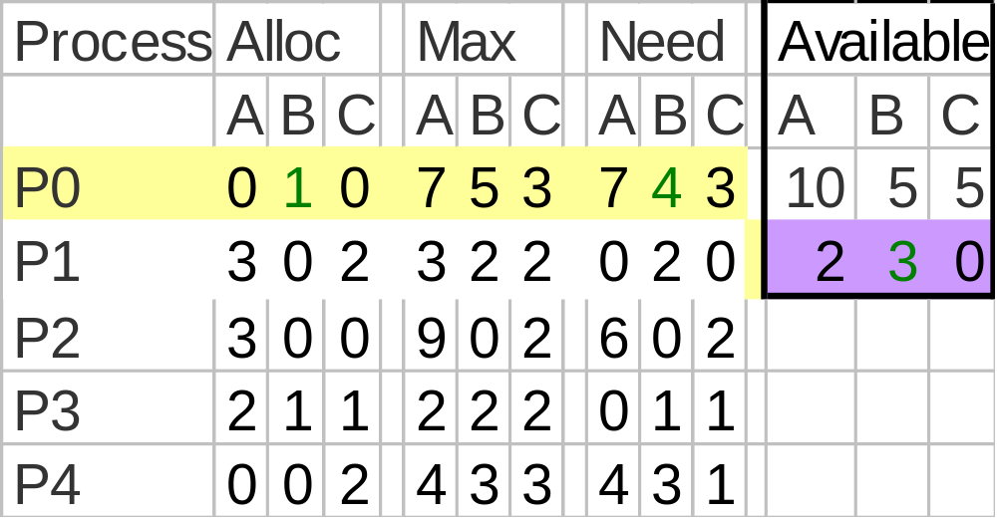
Is allocation (0 2 0) to P0 Safe?
Try to Allocate 2 B to P0

Slide 53
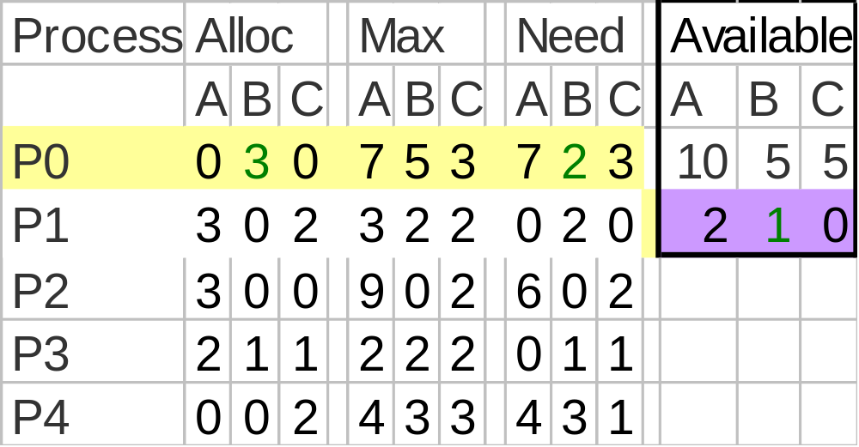
Run Safety Test
No Processes may get max resources and release

Slide 54
So Unsafe State - Do Not Enter
Process
Alloc
Max
Need
Available
A
B
C
A
B
C
A
B
C
A
B
C
P0
0
1
0
7
5
3
7
4
3
10
5
5
P1
3
0
2
3
2
2
0
2
0
2
3
0
P2
3
0
0
9
0
2
6
0
2
P3
2
1
1
2
2
2
0
1
1
P4
0
0
2
4
3
3
4
3
1
Return to Safe State and do not allocate resource

Slide 55
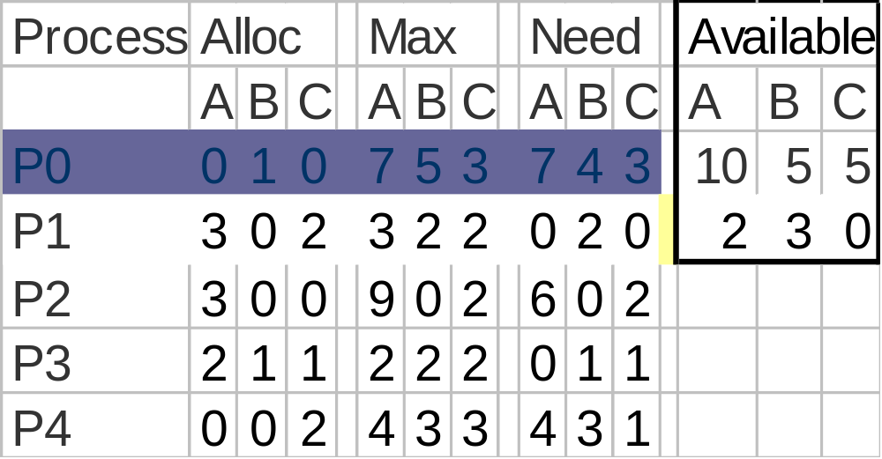
P0 Suspended Pending Request
When enough resources become available, P0 can awake

Slide 56
Results
P0’s request for 2 Bs cannot be granted because that would prevent any other process from completing if they need their maximum claim.

Slide 57
Just Because It’s Unsafe---
P0 could have been allocated 2 Bs and a deadlock might not have occurred if:
  P1 say didn’t use its maximum resources but finished using the resources it had

Slide 58
Allocate to P0(0 2 0)
P1 can finish its work using the resources it just had

Slide 59
If P1 Doesn’t Need Max---
Process
Alloc
Max
Need
Available
A
B
C
A
B
C
A
B
C
A
B
C
P0
0
3
0
7
5
3
7
2
3
10
5
5
P1
0
0
0
3
2
2
3
2
2
5
1
2
P2
3
0
0
9
0
2
6
0
2
P3
2
1
1
2
2
2
0
1
1
P4
0
0
2
4
3
3
4
3
1
Then P1 would have finished…

Slide 60
Banker Solution Issues
Trade-off: The banker’s algorithm is conservative --- it reduces parallelism for safety sake
Not very practicable
  Processes rarely know advance what their maximum resource needs will be
  The number of processes is not fixed
  Resources that were thought to be available can suddenly vanish (tape drive can break)

Slide 61
(4) Deadlock Prevention
Restrain the ways request can be made.
  Mutual Exclusion
  Hold and Wait
  No Preemption
  Circular Wait

Slide 62
Attacking the Mutual Exclusion Condition
Some devices (such as printer) can be spooled
  only the printer daemon uses printer resource
  thus deadlock for printer eliminated
Not all devices can be spooled
Principle:
  avoid assigning resource when not absolutely necessary
  as few processes as possible actually claim the resource

Slide 63
Attacking the Hold and Wait Condition
Require processes to request all resources before starting
  a process never has to wait for what it needs
Problems
  may not know required resources at start of run
  also ties up resources other processes could be using
Variation:
  process requesting a resource must give up all the resources it currently holds, then request all immediately needed

Slide 64
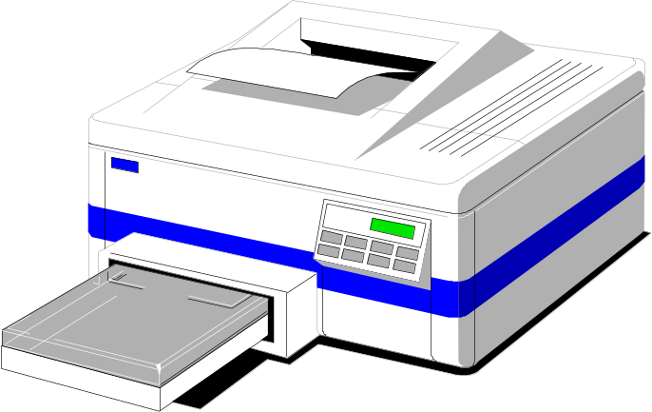
Attacking the No Preemption Condition
This is not a viable option
Consider a process given the printer
  halfway through its job
  now forcibly take away printer
  !!??

Slide 65
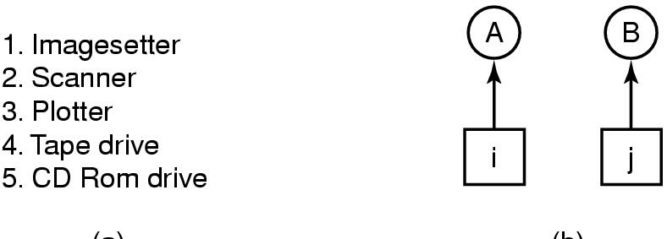
Attacking the Circular Wait Condition
(a) (b)
    Normally ordered resources
    A resource graph
Number all resources and require all requests to be made in numerical order.

Slide 66
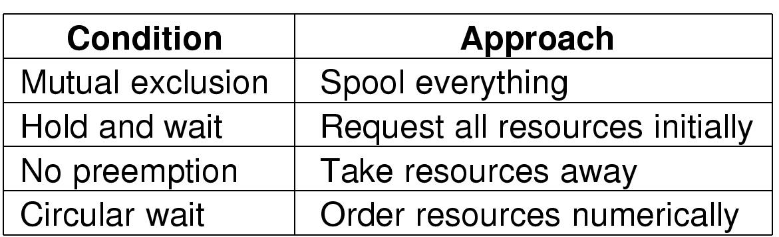
Summary of approaches to deadlock prevention

Slide 67
Other Issues
Two-Phase Locking
Phase One
  process tries to lock all records it needs, one at a time
  if needed record found locked, start over
If phase one succeeds, it starts second phase,
  performing updates
  releasing locks
Note similarity to requesting all resources at once
Algorithm works where programmer can arrange
  program can be stopped, restarted

Slide 68
Communication Deadlocks
Resource deadlocks are common, but not the only kind of deadlock.
Communication deadlocks
  A set of processes, each blocked waiting for an event only the other one can cause.
  Example
    Process A sends a request message to process B, and then blocks until B sends back a reply message.
    If the request message gets lost, B is blocked waiting for a request asking it to do something.
Solution: timeout

Slide 69
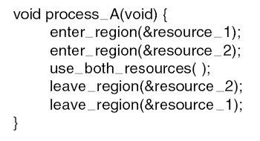
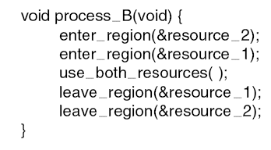
Livelock
Polling (busy waiting), used to enter a critical region or access a resource, can lead to livelock
Example
  When A acquires resource_1 and B acquires resource_2, no process can make further progress, and neither process blocks.
  →livelock

Slide 70
Starvation
Algorithm to allocate a resource
  may be to give to shortest job first
Works great for multiple short jobs in a system
May cause long job to be postponed indefinitely
  even though not blocked
Solution:
  First-come, first-serve policy

Slide 71
Deadlock Summary
In general, deadlock detection or avoidance is expensive
Must evaluate cost of deadlock against detection or avoidance costs
Deadlock avoidance and recovery may cause indefinite postponement
Unix and Windows use Ostrich Algorithm

Slide 72
Homework
23、26、31、34、41

