Slide 1
The Decoupling Paradox: Unmasking Structural Lock-in in the 2023 Carbon Footprint
Yuke Zhang Sirui Ye
Climate and atmospheric science

Slide 2
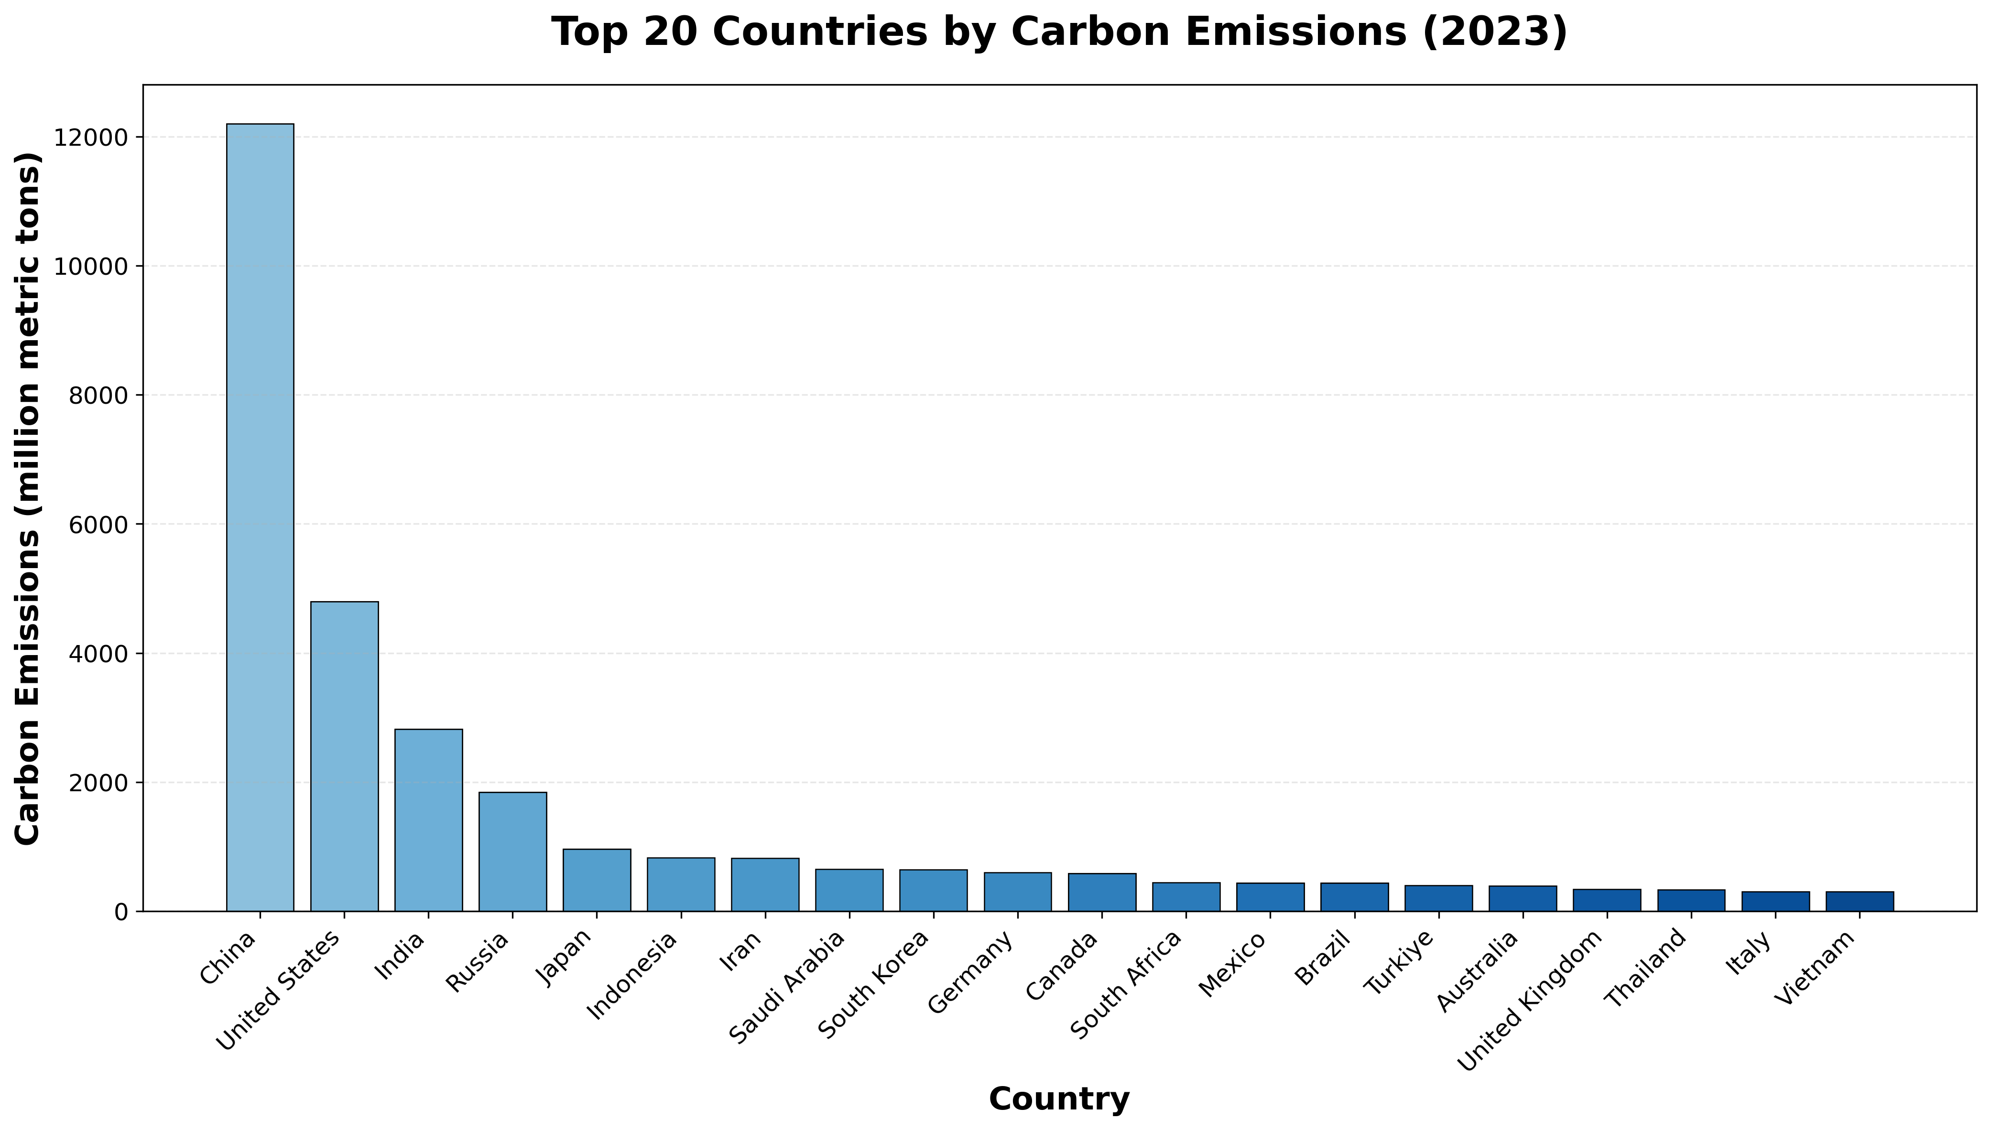
Notes:
柱状图（2023年） 根据2023年的co2排放量，对各个国家进行大小排序，展示前20个国家（文件中的地区不参与排序）

Slide 3
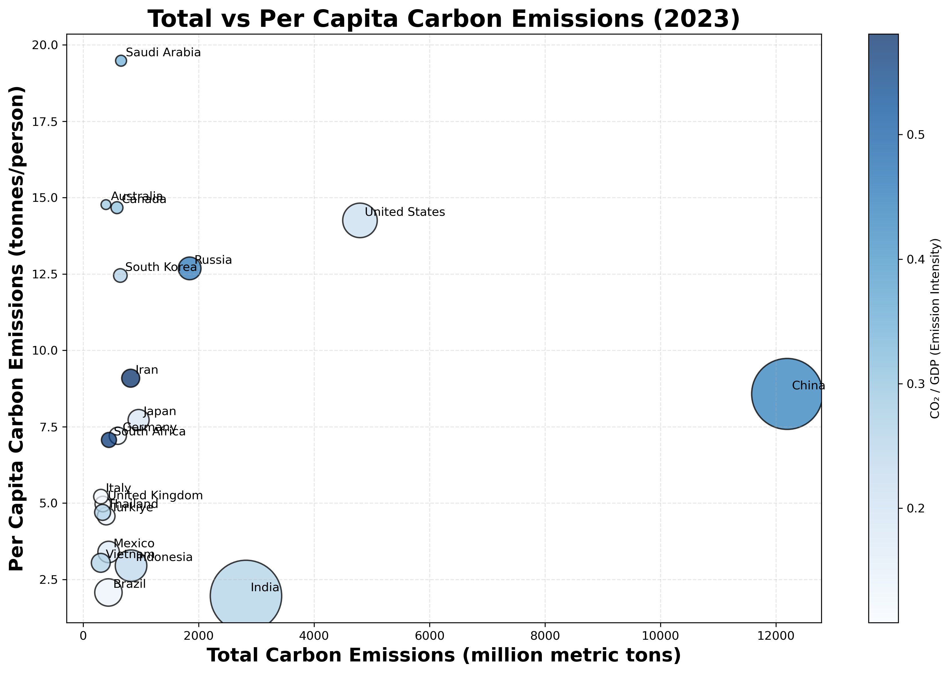
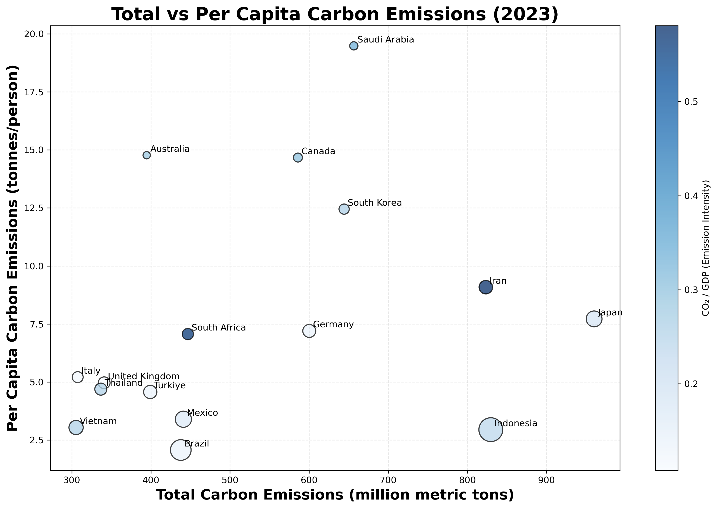
Notes:
散点图（2023年） 圆的大小代表人口，圆的颜色深浅代表co2 / GDP，横坐标为co2排放量，纵坐标为人均co2排放量
图一是P1筛出的前20的国家的散点图
图二是P1筛出的前20的国家的散点图，剔除中国，美国，印度，俄罗斯 根据图二决定研究SAU

Slide 4
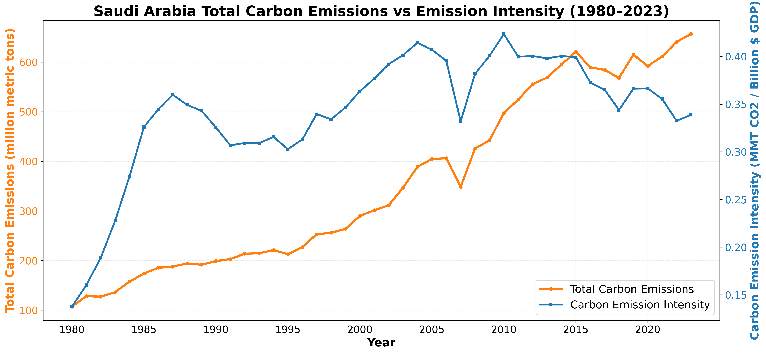
Notes:
双轴折线图 （1980-2023年）
左轴：沙特历年 CO2 总排放量
右轴：沙特历年单位 GDP 碳强度 (Carbon Intensity)

Slide 5
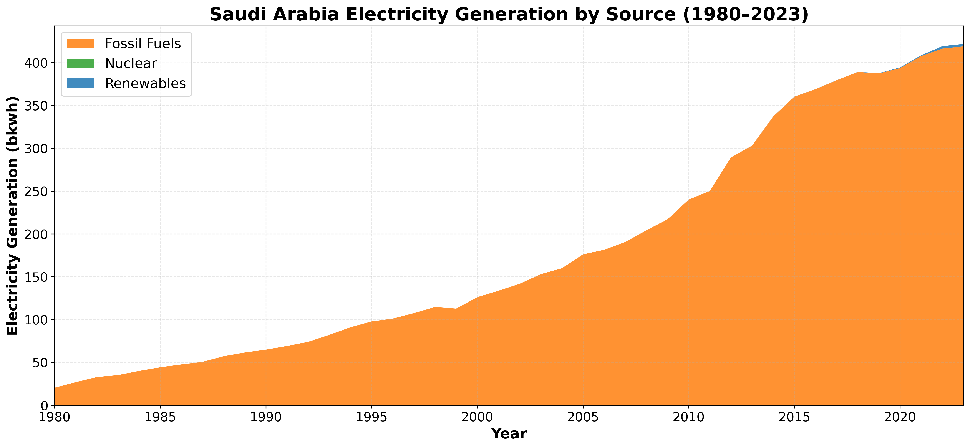
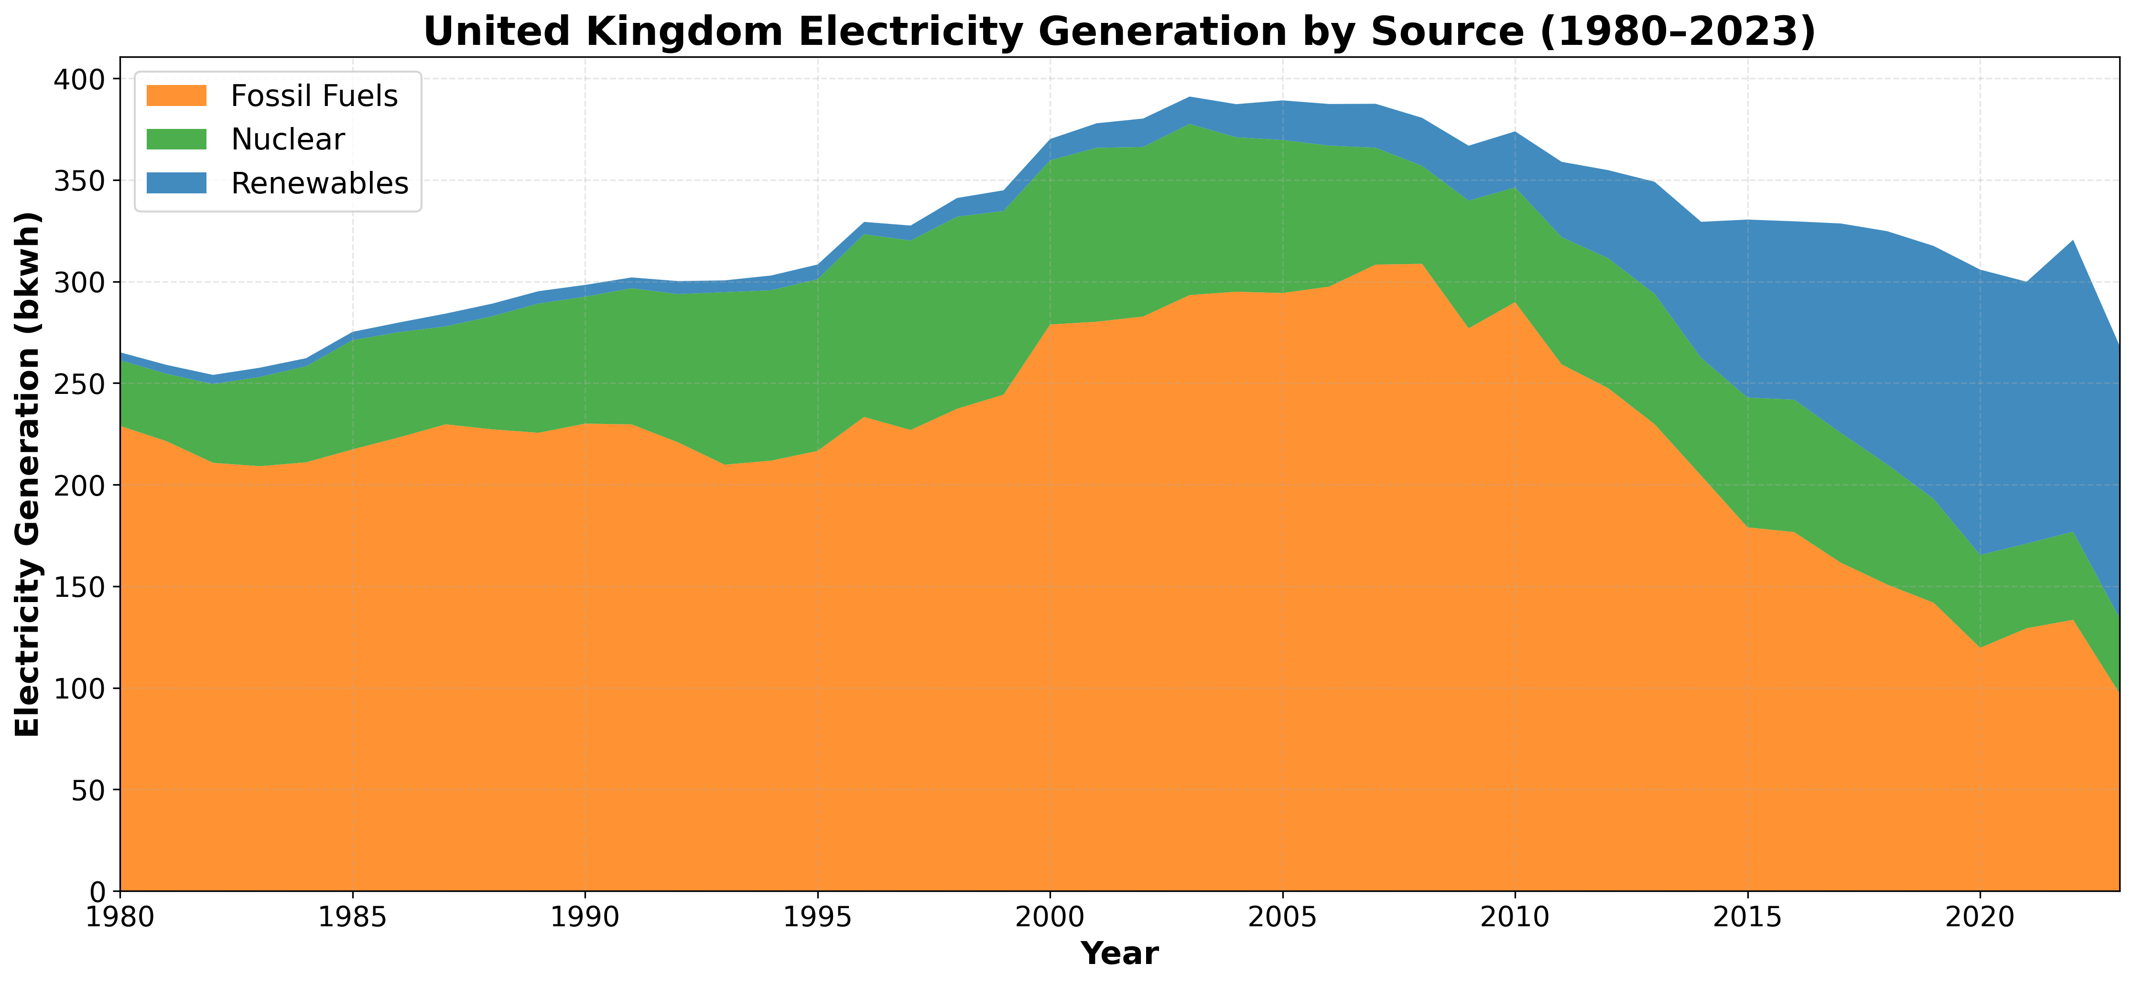
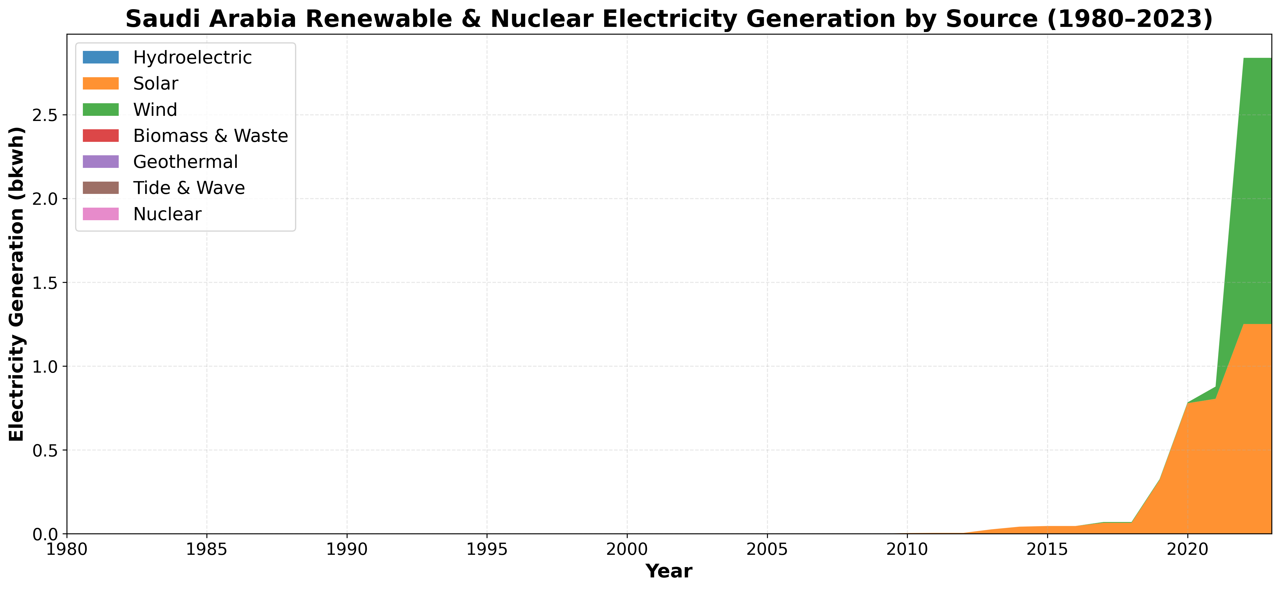
Notes:
堆叠面积图 (1980-2023年)
X 轴是年份（1980-2023），Y 轴是发电量（按来源切分）。
底部巨大色块：化石燃料发电 (Fossil)
顶部可能几乎看不见的线条：可再生能源 (Renewables: Solar + Wind)
左下图：可再生能源大类里面的小类，和核能，
由代码可知：
biomass-and-waste-generation-bkwh.csv
geothermal-generation-bkwh.csv
hydroelectric-pumped-storage-generation-bkwh.csv
hydroelectricity-generation-bkwh.csv
nuclear-generation-bkwh.csv
other-gases-generation-bkwh.csv
tide-and-wave-generation-bkwh.csv
沙特在1980-2023年的值均为0
右上图：英国的堆叠面积图 (1980-2023年)

Slide 6
conclusion
This study demonstrates that simply looking at total emissions masks the deep, structural differences between countries.
The case of Saudi Arabia clearly highlights the limits of "relative decoupling": efficiency improvements simply cannot outpace the explosive growth in overall energy demand.
By comparing Saudi Arabia with the UK, it becomes clear that the true driver of a nation's carbon footprint is its underlying energy architecture.
Saudi Arabia's high emissions are the result of a "structural carbon lock-in," with a grid relying almost 100% on fossil fuels. In contrast, the UK achieved "absolute decoupling" by systematically replacing its fossil-fuel baseload with a diverse mix of clean energy, such as wind and nuclear power.
Therefore, the ultimate solution for global emission reduction must shift from merely "controlling surface-level totals" to "breaking the underlying structural lock-in." The real path forward is fundamentally rebuilding national energy grids to be clean, diverse, and sustainable.

