Slide 1
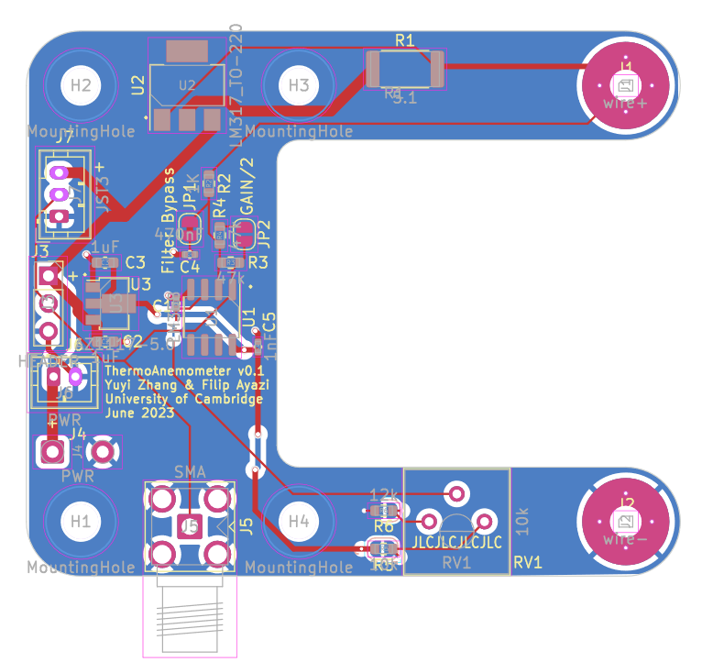
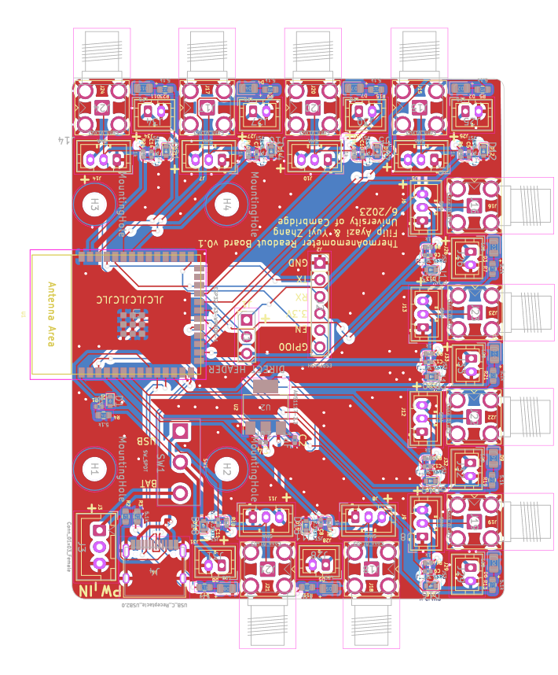
9
Anemometer | GPIO
1 | 4
2 | 2
3 | 10
4 | 3
5 | 8
6 | 5
7 | 9
8 | 1
9 | 7
8
Connection9 ADC 0 GPIO 1
Connection2 ADC 1 GPIO 2
Connection5 ADC 9 GPIO 10
Connection ADC 8 GPIO 9
7
6
Connection 1 ADC 2 GPIO 3
5
Connection 8 ADC 7 GPIO 8
4
Connection 7 ADC 6 GPIO 7
3
2
Connection 6 ADC3 GPIO4
Connection 3 ADC4 GPIO5
1

