Slide 1
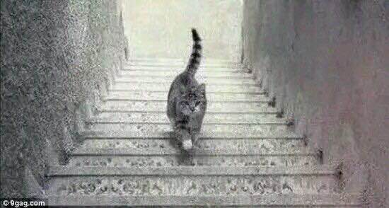
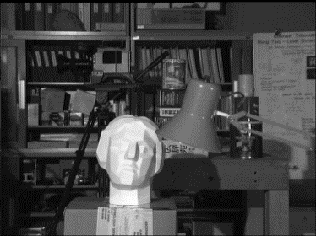
Project-1:BMP Loading and Interpolation
Using C++/VC++/.net referring to BMP IO.zip or internet
Or Using Opencv/Matlab independently
(Note: No function package is permitted but reading, writing and displaying BMP image!)
Tasks:
1) Read and display “Up or Down.bmp” file
2) Write “U” or “D” into this Bmp as your answer
3) Save 2) as an answer.bmp
For tsukuba-left.bmp(gray, 8bits/pixels, 384*288 pixels)
1)Bicubic interpolation ( into 1152*864 pixels)
2)Rotate +35 degree

