Slide 1
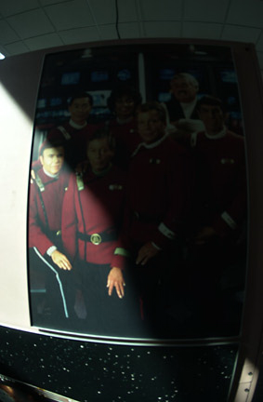
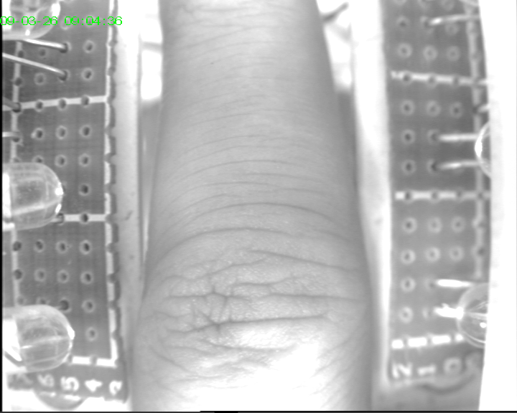
Project-3 Filtering in Frequency Domain
Using the Homomorphic Filtering(HF) remove the uneven lighting for delighting.bmp and 29_0.bmp
Compare HF with histogram equalization
Realize DFT by yourself (refer to p286)
Note: both images are 24bits

Slide 2
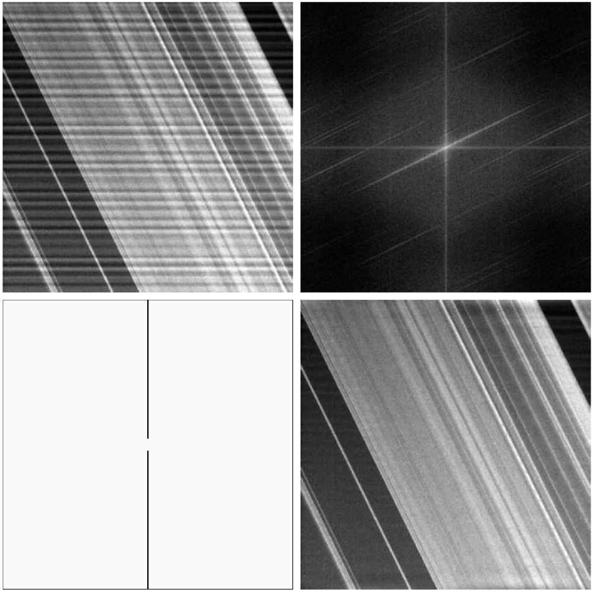
4) Realize Notch filter (example 4.24 P319)

Slide 3
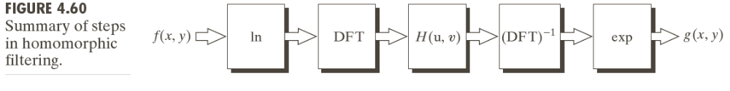
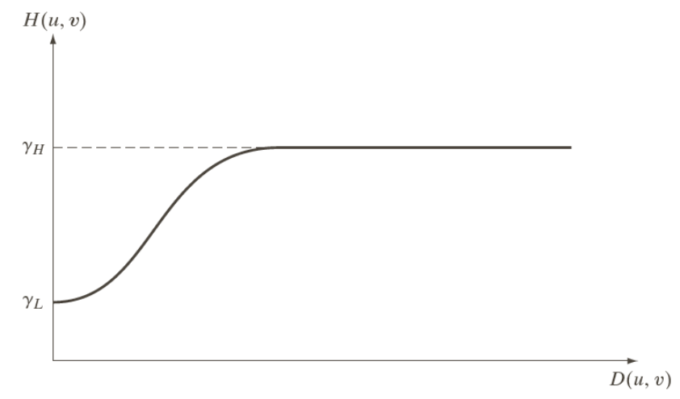
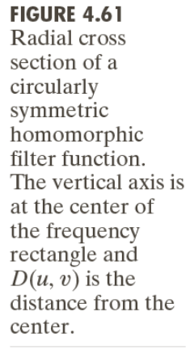
Appendix ：Homomorphic Filtering(p314)
f(x,y) = i(x,y) r(x,y) ⇒ F(u,v) ≠ I(u,v) R(u,v)
lnf(x,y) = lni(x,y) + lnr(x,y)
Attn: i – slow variation; r – fast variation.

