Slide 1
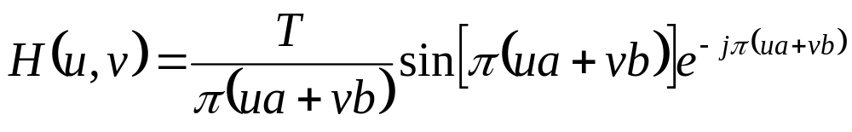
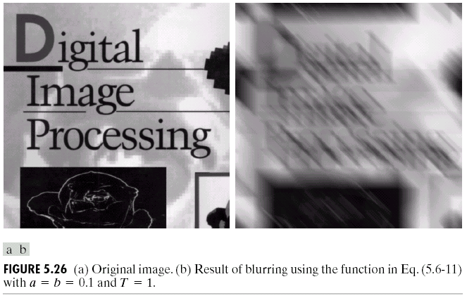
Project 4 Constrained Least Squares Filtering
1）Image blurring by Motion Model:
Input：ImageOrg & H, a=0.1, b=0.1 and T=1
Output：ImageBlur
2）Constrained Least Squares Filtering
Input：ImageBlur & H, a=0.1, b=0.1 and T=1, you may estimateσ_{n}² +μ_{n}²
Output：ImageOrg

Slide 2
2）Constrained Least Squares Filtering
Wiener: p.d.f.; CLS: μ_{n} and σ_{n}².
Vector-matrix form:
g = H f + n with: g –MNx1; H –MNxMN.
Criterion function:
min ∑∑[▽²f(x,y)]² (smoothness) see Eq(3.6-3) for ▽²
subject to the constraint ‖g - H∧f‖² = ‖n‖²
Solution in the frequency domain:
where γ –parameter to satisfy the constraint; 0 -1 0
P(u,v) –Fourier transform of p(x,y) = -1 4 -1
0 -1 0
H*(u,v)
|H(u,v)|² + γ |P(u,v)|²
^F(u,v) = G(u,v)

Slide 3
5.9 Constrained Least Squares Filtering
Computing γ by iteration:
  Principle:
    Define: ▽ = g - H ^f “residual” vector
    ^f is a function of γ, so ▽ also is a function of γ.
    ||▽||² monotonically increasing by γ
    Adjust γ => ||▽ ||² = ||n||² ± a (a-an accuracy factor)
  Procedure:
    Specify an initial value of γ.
    Compute ||▽||² = ∑ ∑ ▽ ²(x,y).
    where ▽(x,y) <= R(u,v) = G(u,v) – H(u,v) ^F(u,v)
    if ||▽ ||² < ||n||² – a, increasing γ => return to Step 2;
    if ||▽ ||² > ||n||² + a, decreasing γ => return to Step 2;
    Stop, otherwise.
    where ||n||² = M N [σ_{n}² +μ_{n}²] (5.9−13)

Slide 4
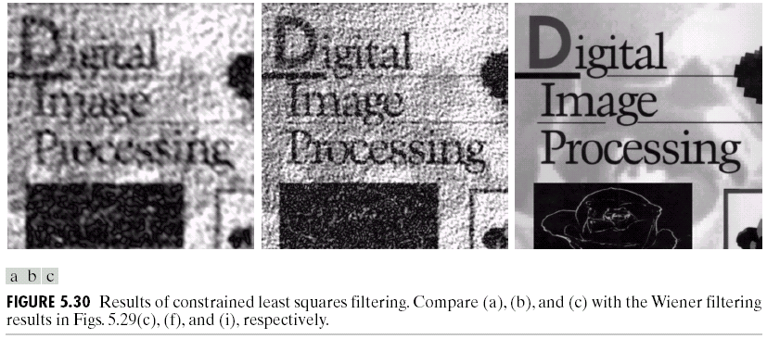
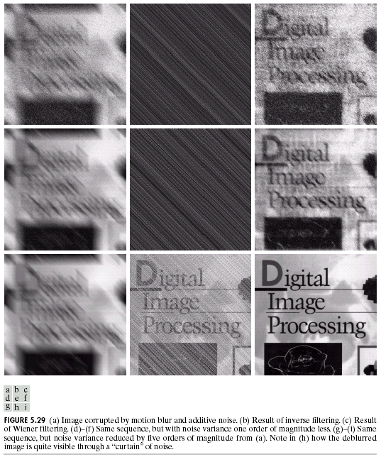
5.9 Constrained Least Squares Filtering
H*(u,v)
|H(u,v)|² + γ |P(u,v)|²
^F(u,v) = G(u,v)
FIGURE 5.29 (c) (f) (i) Results of Wiener filtering.

