Slide 1
Project-1 Noising& Filtering
DIPA
Wenming Yang

Slide 2
Adding Noise and Filtering
Preparation – adding noise to board-orig.bmp:
Noise 1: Salt&Pepper (25%)
Noise 2: Gauss(20%,m=20,viarance=400)
Methods to be developed and tested:
Alpha-trimmed mean filter
Adaptive median filter
Evaluation of results

Slide 3
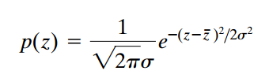
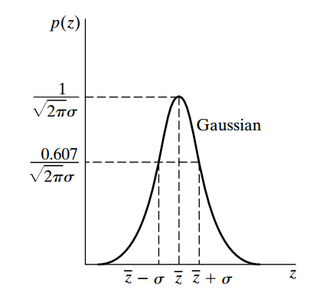
Noise
Gaussian noise(Additive)

Slide 4
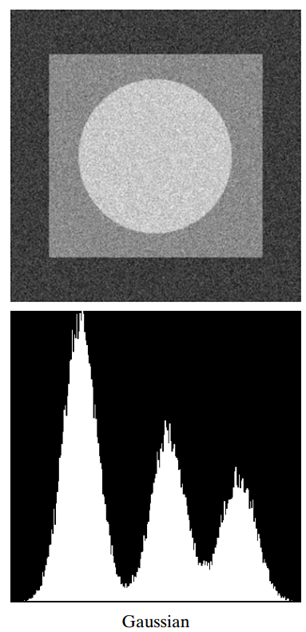
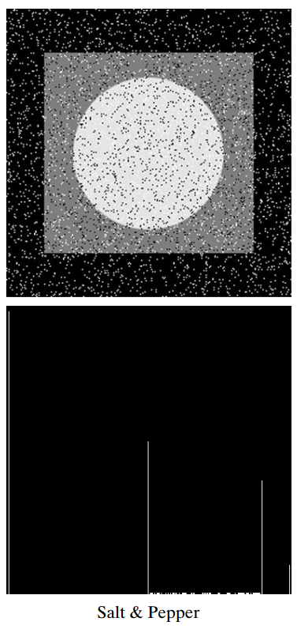
Images and histograms resulting from adding Gaussian and salt-andpepper noise to the image

Slide 5
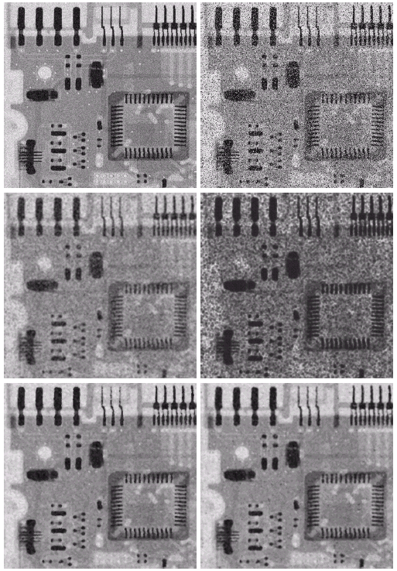

Order-Statistic Filters
Alpha-trimmed mean:
with 0 ≤ d ≤ mn-1
g_{r}(s,t):
d/2 higher levels to be removed;
d/2 lower levels to be removed.
Special cases:
d = 0
d = (mn-1).

Slide 6
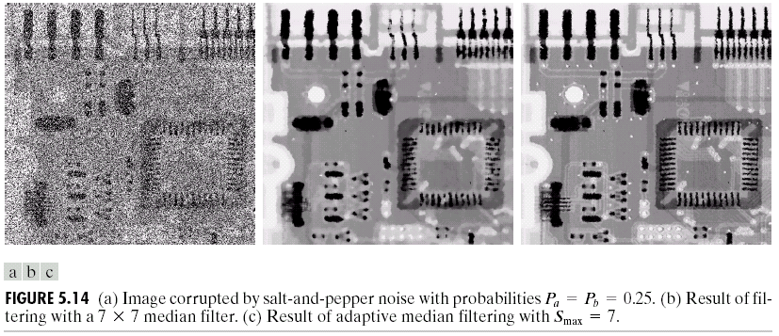
Adaptive Filters
Adaptive median filter:
Median is Min or Max? YES, subwin size↑; NO, go to 2).
The pixel is Min or Max? YES, output Median; NO, unchanged.

