Slide 1

Privacy Protection Amid Giant Components
Qingyuan Chen, David Wu, George Yu, Zhanhao Zhang

Slide 2
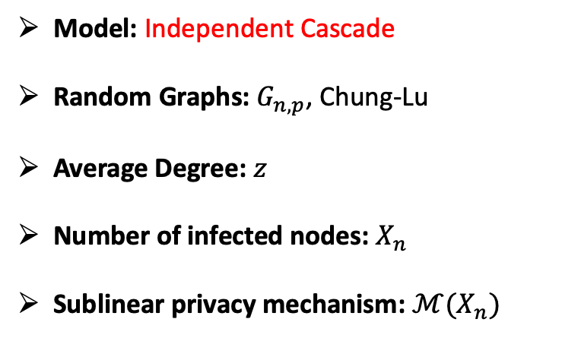
Previous Work
Goal: Infer the infection status of individual nodes given graph topology.
Setup
Takeaways
Model: Independent Cascade
Random Graphs: $G_{n,p}$, Chung-Lu
Average Degree: $z$
Number of infected nodes: $X_{n}$
Sublinear privacy mechanism: $ℳ(X_{n})$
Nodes in the largest component have the same infection status
$ℳ(X_{n})$ indicates the infection status of the largest component
ℳ(𝑋_𝑛) indicates the infection status of the largest component
$P\left(\text{Node} i \text{infecte}\text{d}\right)≥P(\text{Node} i \text{in} \text{largest} \text{infected} \text{component})$
𝑃("Node " 𝑖 "infected" )≥𝑃("Node " 𝑖 "in largest infected component")

Slide 3
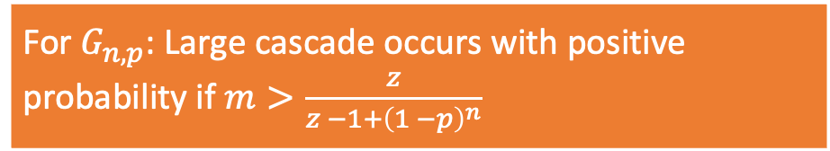
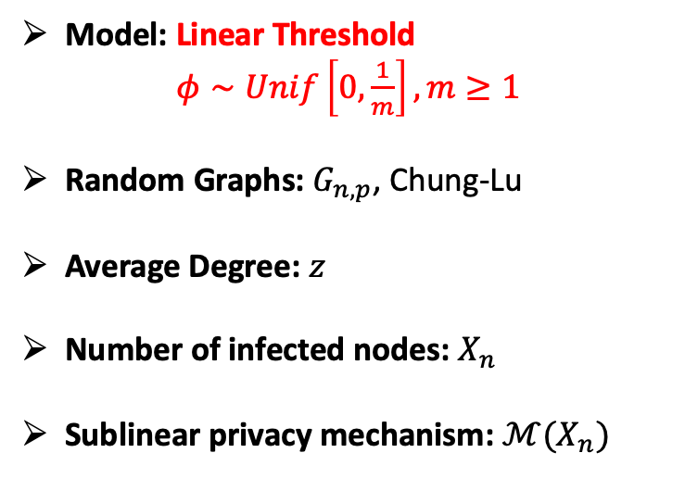
Extensions
Goal: Infer the infection status of individual nodes given graph topology.
Setup
Preliminary Results
Model: Linear Threshold
$φ∼Unif\left[0,\frac{1}{m}\right], m≥1$
Random Graphs: $G_{n,p}$, Chung-Lu
Average Degree: $z$
Number of infected nodes: $X_{n}$
Sublinear privacy mechanism: $ℳ(X_{n})$
Privacy is hard to preserve when a large cascade occurs
For $G_{n,p}$: Large cascade occurs with positive probability if $m>\frac{z}{z −1+{\left(1 −p\right)}^{n}}$

Slide 4
References
[1] Nicholas A Christakis and James H Fowler. The spread of obesity in a large social network over 32 years. New England journal of medicine, 357(4):370–379, 2007.
[2] Aria Rezaei, Jie Gao, and Anand D Sarwate. Influencers and the giant component: the funda- mental hardness in privacy protection for socially contagious attributes. In Proceedings of the 2021 SIAM International Conference on Data Mining (SDM), pages 217–225. SIAM, 2021.
[3] Daniel Kifer and Ashwin Machanavajjhala. Pufferfish: A framework for mathematical privacy definitions. ACM Transactions on Database Systems (TODS), 39(1):1–36, 2014.
[4] Duncan J Watts. A simple model of global cascades on random networks. Proceedings of the National Academy of Sciences, 99(9):5766–5771, 2002.
[5] David Easley and Jon Kleinberg. Networks, crowds, and markets: Reasoning about a highly connected world. Cambridge university press, 2010.

