Slide 1


Privacy Protection Amid Giant Components
Setup:
Independent Cascade
Number of infected nodes: $X_{n}$
Random Graphs: $G_{n,p}$, Chung-Lu
Sublinear privacy mechanism $ℳ(X_{n})$
Goal: Infer the infection status of individual nodes given graph topology
Takeaways:
Nodes in the largest component have the same infection status
$ℳ(X_{n})$ indicates the infection status of the largest component
$P\left(i infected\right)≥P(i in largest infected component)$

Slide 2
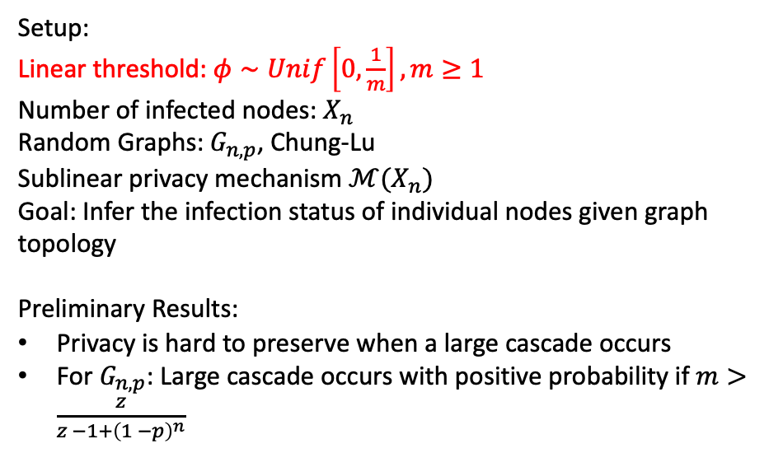
Extensions
Setup:
Linear threshold: $φ∼Unif\left[0,\frac{1}{m}\right], m≥1$
Number of infected nodes: $X_{n}$
Random Graphs: $G_{n,p}$, Chung-Lu
Sublinear privacy mechanism $ℳ(X_{n})$
Goal: Infer the infection status of individual nodes given graph topology
Preliminary Results:
Privacy is hard to preserve when a large cascade occurs
For $G_{n,p}$: Large cascade occurs with positive probability if $m>\frac{z}{z −1+{\left(1 −p\right)}^{n}}$

