Slide 1

Privacy Protection Amid Giant Components
Qingyuan Chen, David Wu, George Yu, Zhanhao Zhang

Slide 2
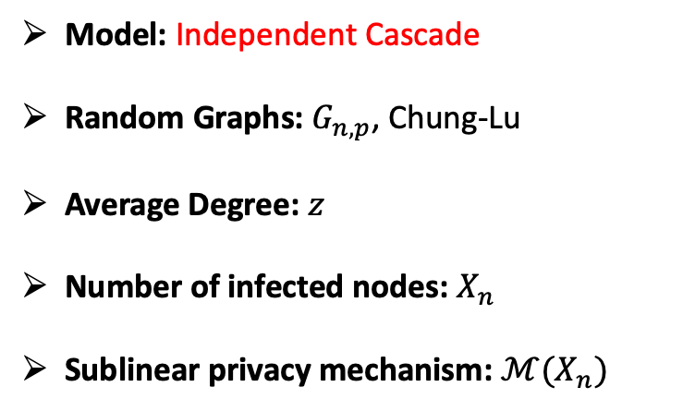
Previous Work
Goal: Infer the infection status of individual nodes given graph topology.
Setup
Takeaways
Model: Independent Cascade
Random Graphs: $G_{n,p}$, Chung-Lu
Average Degree: $z$
Number of infected nodes: $X_{n}$
Sublinear privacy mechanism: $ℳ(X_{n})$
Nodes in the largest component have the same infection status
$ℳ(X_{n})$ indicates the infection status of the largest component
ℳ(𝑋_𝑛) indicates the infection status of the largest component
$P\left(\text{Node} i \text{infecte}\text{d}\right)≥P(\text{Node} i \text{in} \text{largest} \text{infected} \text{component})$
𝑃("Node " 𝑖 "infected" )≥𝑃("Node " 𝑖 "in largest infected component")

Slide 3
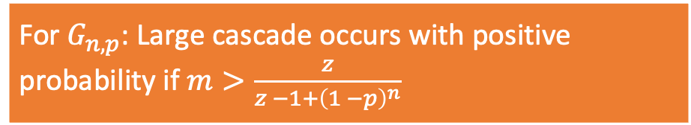
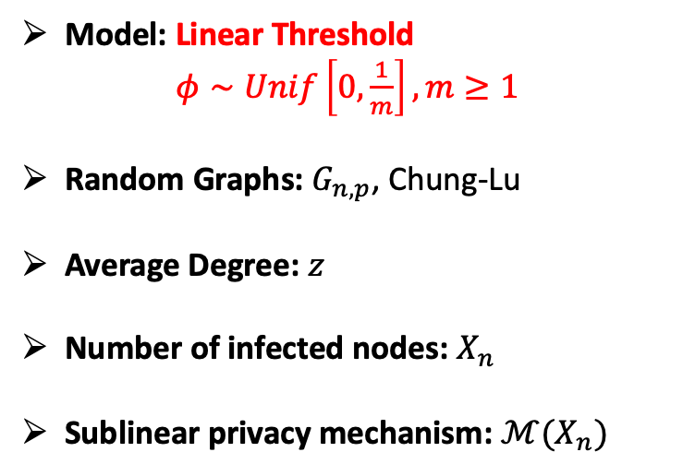
Extensions
Goal: Infer the infection status of individual nodes given graph topology.
Setup
Preliminary Results
Model: Linear Threshold
$φ∼Unif\left[0,\frac{1}{m}\right], m≥1$
Random Graphs: $G_{n,p}$, Chung-Lu
Average Degree: $z$
Number of infected nodes: $X_{n}$
Sublinear privacy mechanism: $ℳ(X_{n})$
Privacy is hard to preserve when a large cascade occurs
For $G_{n,p}$: Large cascade occurs with positive probability if $m>\frac{z}{z −1+{\left(1 −p\right)}^{n}}$

