Slide 1
The Northern Lights
Nature’s Most Spectacular Light show

Slide 2
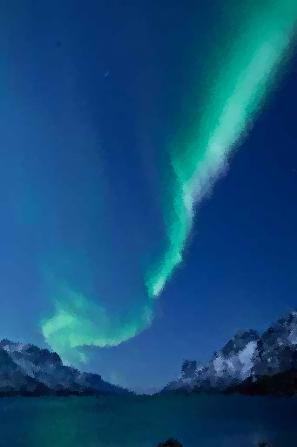
The Aurora Borealis
Ribbons of blue, green, pink, and purple luminescence that are caused by the collisions of electrically charged particles in the atmosphere.

Slide 3
Northern Lights Ideal Viewing Conditions
Best time for viewing
Late fall and early spring
Between 10 p.m. and 2 a.m.
Fairbanks
Ideal location due to distance from equator
Clear skies with little moonlight are ideal
Notes:
The lights reach their peak in September and March.

Slide 4
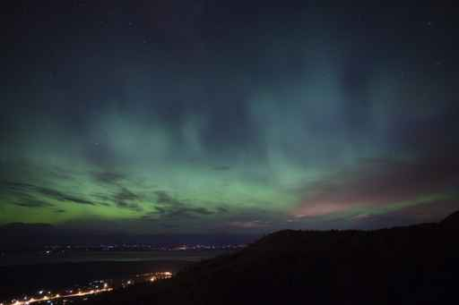
Viewing the Lights from Fairbanks
Cleary Summit
Chena Lakes Recreation Area
Steese Highway
Ester Dome

Slide 5
Visit Fairbanks and View the Northern Lights
With Kodiak West Travel

