Slide 1
Week 4 Memory Virtualization and DynamoDB
Dr Zhi Zhang

Slide 2
Overview
Virtual Memory
Memory Virtualization
DynamoDB
Mid-semester Test

Slide 3
Object lock and bucket policy
Object Lock: bucket feature that protects object versions from deletion.
Bucket policy: access control. It cannot enable object lock by itself. Enabling object lock must be performed through the AWS S3 console, CLI, or API. The policy can control who is authorised to enable object lock via s3:PutBucketObjectLockConfiguration.

Slide 4
Virtual memory
Physical memory
(active copy)
Process A (e.g., web browser)
Virtual memory
Memory map A
Disk
(original copy)
program code
variables
library code
Memory map A
Current location
Virtual memory
physical memory
disk: library file
The actual bytes may be on disk, or loaded into physical memory while a backing copy remains on disk.

Slide 5
Virtual memory
Process A virtual memory
Memory map A
Process A Browser
Process B virtual memory
Memory map B
Process B Music
Process isolation

Slide 6
Virtual memory
The OS divides virtual memory into many fixed-size blocks called virtual pages. A typical page size is 4 KiB.
Virtual memory of one process
page 0
page 1
page 2
page 3
page 4
page 5
page 6
page …
0x0
0x?
For a 4 KiB page, starting addresses of pages are multiples of 4096.

Slide 7
Virtual memory
The OS divides virtual memory into many fixed-size blocks called virtual pages. A typical page size is 4 KiB.
Virtual memory of one process
page 0
page 1
page 2
page 3
page 4
page 5
page 6
page …
Physical memory
The OS also divides physical memory into many fixed-size blocks called physical pages. A typical page size is 4 KiB.
Physical memory of the machine
page 0
page 1
page 2
page 3
page 4
page 5
page 6
page ..

Slide 8
Page-aligned address
Page 0 4 KiB
Page 1 4 KiB
Page 2 4 KiB
0x60000000
0x60001000
0x60002000
Page 0 4 KiB
Page 1 4 KiB
Page 2 4 KiB
0x70000000
0x70001000
0x70002000
For a 4 KiB page, page-aligned addresses end with 000 in hexadecimal format.

Slide 9
Virtual Address
0x60001800: page starting at 0x60001000 + offset 0x800
Virtual page base 0x60001000
Page offset 0x800
Physical Address
0x70001800: page starting at 0x70001000 + offset 0x800
Physical page base 0x70001000
Page offset 0x800

Slide 10
Memory Map: page granularity
Virtual page base: 0x60001000 size: 4 KB
Memory map 0x60001000 → 0x70001000
Physical page base: 0x70001000 size: 4 KB
The page offset for a virtual address and its mapped physical address is the same.
Inside the virtual page
Inside the physical page
offset 0x100
offset 0x100

Slide 11
Memory Map
4KiB
4KiB
Memory Map
VA = 0x60001000
PA = 0x70001000
4KiB
4KiB
Memory Map
VA1 = 0x60001800
PA1 = ?
VA = 0x60001000
PA = 0x70001000

Slide 12
Virtual memory size
The CPU and OS decide how many bits are used for a virtual address.
Virtual-address bits
supported by CPU + OS
Possible virtual addresses
Virtual memory size
i386 CPU with 32-bit: 32 address bits → ? bytes
x86-64 with 64-bit: only 48 address bits → ? bytes

Slide 13
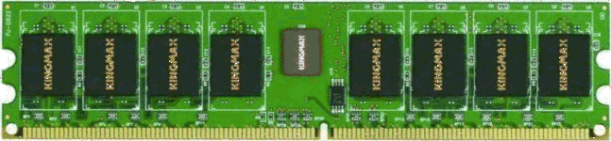
Physical memory size
Physical machine
Example
16 GiB of DRAM installed → 16 GiB physical memory
Installed DRAM (Dynamic Random-Access Memory) Capacity
Does adding DRAM change the virtual memory size?

Slide 14
Virtual memory
Virtual memory
Memory map
Current location
Virtual page 0: program code
present
physical page 5
Virtual page 1: variables
present
physical page 9
Virtual page 2: library code
not present
disk: library file
Virtual page 3: unused
map not allocated
no real storage

Slide 15
On-demand Paging
Suppose the process calls boto3.client() for the first time.
Virtual page
Meaning
Before the call
After page fault
page 0
program code
physical page 5
physical page 5
page 1
variables
physical page 9
physical page 9
page 2
boto3.client() code
not present; on disk
？
Process calls boto3.client()
page fault
Not a crash

Slide 16
Page fault
memory map
A process virtual memory
present
page-fault handler
(OS kernel)
return from the handler
CPU
detects page fault
executes the handler
not present
Unused / reserved
...
pause program execution
present
program code, data and libraries
not present
resume program execution

Slide 17
On-demand Paging
Suppose the process calls boto3.client() for the first time.
Virtual page
Meaning
Before the call
After page fault
page 0
program code
physical page 5
physical page 5
page 1
variables
physical page 9
physical page 9
page 2
boto3.client() code
not present; on disk
physical page 7
Process calls boto3.client()
page fault
load virtual page 2 from disk into physical page 7
update memory map
continue running
on-demand paging: the page is loaded only when it is actually accessed.

Slide 18
On-demand Paging
Virtual memory
Memory map
Current location
Virtual page 0: program code
present
physical page 5
Virtual page 1: variables
present
physical page 9
Virtual page 2: library code
?
?
Virtual page 3: unused
map not allocated
no real storage

Slide 19
Swapping: if memory is full
Physical page 7 occupied by another process
Physical page 7 occupied by another process
Virtual page 0 mapped to
Physical page 5
Virtual page 0 mapped to
Physical page 5
Virtual page 1 mapped to Physical page 9
Swap out inactive Virtual page 1 to disk swap slot 3
Load Virtual page 2 into freed Physical page 9
Virtual page 1 mapped to
Disk swap slot 3
inactive
Virtual page 2 mapped to
Physical page 9
Virtual page | Meaning | Memory map | Current location
page 0 | program code | present | physical page 5
page 1 | variables | ? | ?
page 2 | boto3.client() code | ? | ?
page 3 | unused | map not allocated | no real storage

Slide 20
Memory virtualization
In a normal OS
Inside a virtual machine
Process inside VM
Process
virtual address
Guest OS memory map
OS memory map
Guest physical memory
Physical memory
VMM memory map
Host (real) physical memory

Slide 21








Memory Virtualization
Bob
Virtual machine monitor
Charlie
Alice
Physical machine
Virtual machines
Daniel
Alice has a machine with 64 GiB of memory.
Bob is assigned with 32 GiB of guest physical memory.
Charlie is assigned with 32 GiB of guest physical memory.
Daniel is assigned with 8 GiB of guest physical memory.

Slide 22
Memory overcommitment
Alice’s machine
64 GiB physical memory
Bob
32 GiB
Charlie
32 GiB
Daniel
8 GiB
Total assigned guest physical memory = 72 GiB > 64 GiB host physical memory
Not every guest physical page is mapped to a host physical page.

Slide 23
VM isolation
Bob VM
32 GiB guest physical memory
Memory map for Bob
Host physical pages
Charlie VM
32 GiB guest physical memory
Memory map for Charlie
Host physical pages
Host physical pages
Daniel VM
8 GiB guest physical memory
Memory map for Charlie
Other pages
Alice’s machine
VMM Memory map
On-demand paging is still used.

Slide 24
Extended page fault
Guest physical page
Host physical page
Map not present?
VMM kernel allocates a host physical page
and updates VMM memory map

Slide 25
Page fault vs. Extended page fault
Guest Virtual page
Guest physical page
Host physical page
Map not present?
Map not present?
Guest OS kernel allocates a guest physical page and updates OS memory map
VMM kernel allocates a host physical page
and updates VMM memory map

Slide 26
What is hardware virtualization?
Hardware virtualization is the ability to run multiple operating systems on a single physical machine.
Allows one computer software (called Virtual Machine Monitor or Hypervisor) to provide the appearance of many computers (called virtual machines).

Slide 27
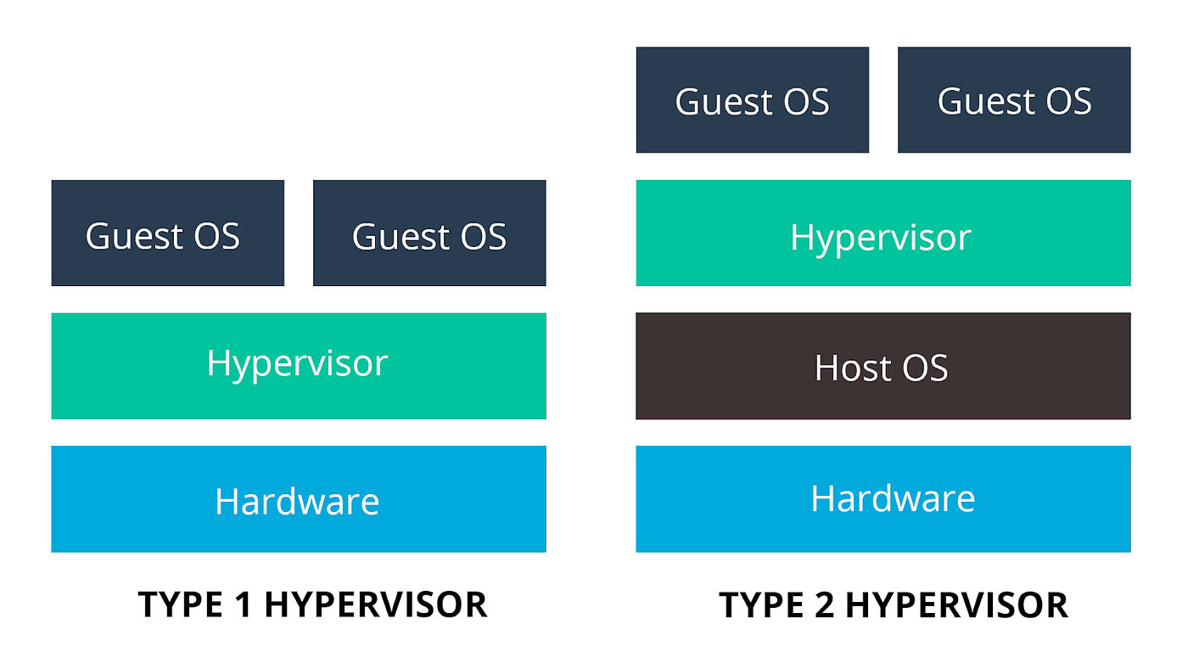
VMM Types
Bare-metal/Native Architecture
Hosted Architecture

Slide 28
VMM Types
Bare-metal/Native Architecture
Hosted Architecture
Examples: KVM, Xen, Hyper-V
Examples:?

Slide 29
VMM Types
Bare-metal/Native Architecture
Hosted Architecture
Examples: KVM, Xen, Hyper-V
Examples: VirtualBox, UTM, Vmware

Slide 30
VMM Types
Bare-Metal/Native Architecture
VMM or Hypervisor is installed directly on hardware as the most privileged software.
Acknowledged as preferred architecture for mainstream public clouds
Examples: KVM, Xen, Hyper-V
Hosted Architecture
VMM or Hypervisor is installed as an application on an existing host OS, e.g., Windows, Linux, MacOS
Examples: Virtualbox, UTM, Vmware
Which is the most privileged software? Host OS or Hosted hypervisor?

Slide 31
Practice Question
[7 marks] Q1: Describe what virtualization is. Describe three types of virtualization (Language, Operating System and Hardware) and their respective attribute.

Slide 32
Practice Question
[7 marks] Q1: Describe what virtualization is. Describe three types of virtualization (Language, Operating System and Hardware) and their respective attribute.
[1 mark] Virtualization is a technology that allows multiple virtual instances of hardware/software resources (e.g., operating systems) to run.
[2 marks] Language virtualization:
[2 marks] Operating system virtualization:
[2 marks] Hardware virtualization:

Slide 33
Practice Question
[7 marks] Q1: Describe what virtualization is. Describe three types of virtualization (Language, Operating System and Hardware) and their respective attribute.
[1 mark] Virtualization is a technology that allows multiple virtual instances of hardware/software resources (e.g., operating systems) to run.
[2 marks] Language virtualization: provides a virtual runtime environment (e.g., Python interpreter) that allows code written in a specific programming language (e.g., Python) to execute.
Cross-OS: code can be executed in a virtual runtime environment across different OSes without modification.
[2 marks] Operating system virtualization:
[2 marks] Hardware virtualization:

Slide 34
Practice Question
[7 marks] Q1: Describe what virtualization is. Describe three types of virtualization (Language, Operating System and Hardware) and their respective attribute.
[1 mark] Virtualization is a technology that allows multiple virtual instances of hardware/software resources (e.g., operating systems) to run.
[2 marks] Language virtualization: provides a virtual runtime environment (e.g., Python interpreter) that allows code written in a specific programming language (e.g., Python) to execute.
Cross-OS: code can be executed in a virtual runtime environment across different OSes without modification.
[2 marks] Operating system virtualization: allows multiple isolated user-space environments (e.g., docker containers) to run on top of a single OS kernel (e.g., Linux kernel).
Limited Isolation: while user-space environments are isolated, they share the same OS kernel, which means a vulnerability in the kernel could affect all user-space environments.
[2 marks] Hardware virtualization:

Slide 35
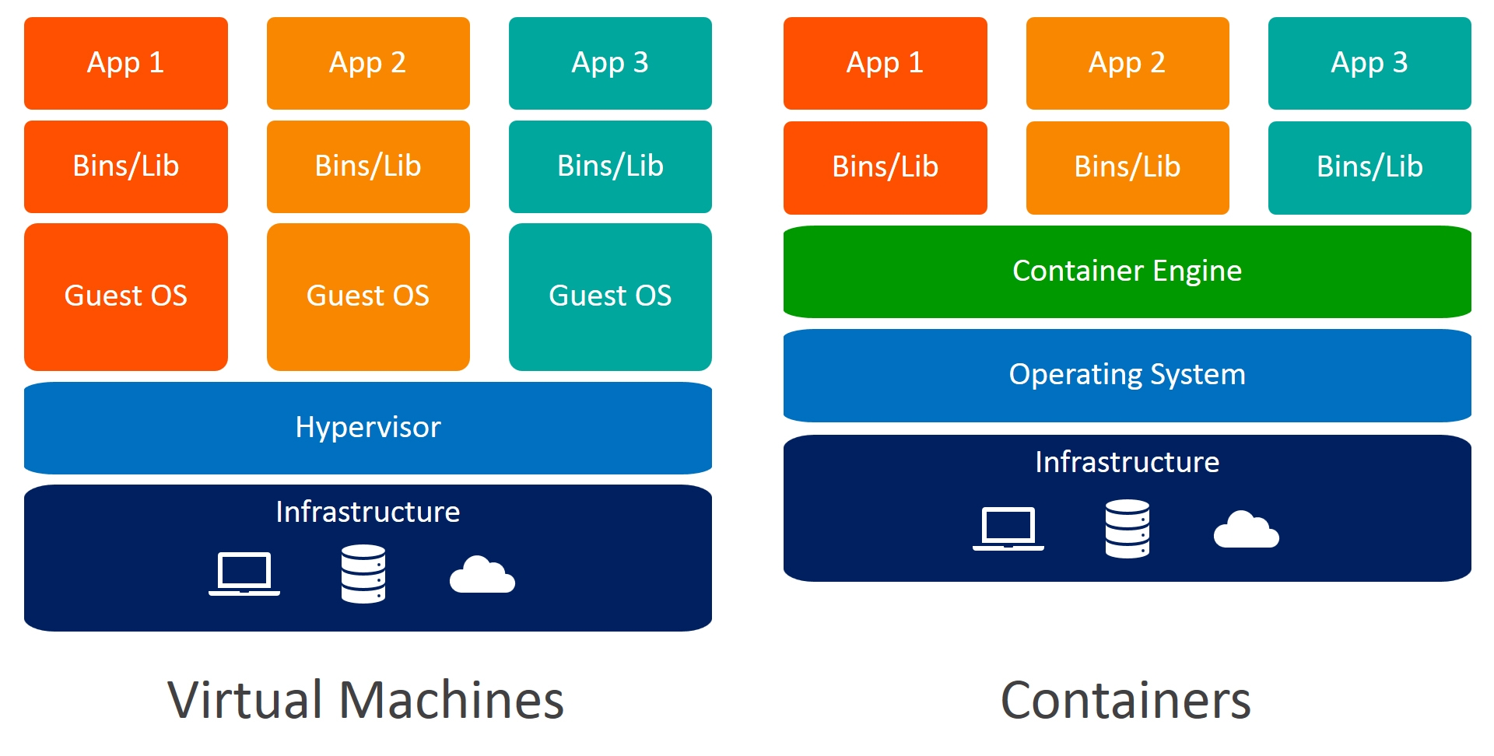
Containers
Container
VM

Slide 36
Practice Question
[7 marks] Q1: Describe what virtualization is. Describe three types of virtualization (Language, Operating System and Hardware) and their respective attribute.
[1 mark] Virtualization is a technology that allows multiple virtual instances of hardware/software resources (e.g., operating systems) to run.
[2 marks] Language virtualization: provides a virtual runtime environment (e.g., Python interpreter) that allows code written in a specific programming language (e.g., Python) to execute.
Cross-OS: code can be executed in a virtual runtime environment across different OSes without modification.
[2 marks] Operating system virtualization: allows multiple isolated user-space environments (e.g., docker containers) to run on top of a single OS kernel (e.g., Linux kernel).
Limited Isolation: while user-space environments are isolated, they share the same OS kernel, which means a vulnerability in the kernel could affect all user-space environments.
[2 marks] Hardware virtualization: creates multiple virtual machines sharing a single physical server.
VM isolation: one VM cannot access data of another VM .

Slide 37
DynamoDB
A fast and flexible non-relational database service
relational database service: MySQL, PostgreSQL, etc.

Slide 38
Set up a local DynamoDB
From a terminal:
mkdir dynamodb; cd dynamodb
install jre if not done (sudo apt-get install default-jre)
wget https://s3-ap-northeast-1.amazonaws.com/dynamodb-local-tokyo/dynamodb_local_latest.tar.gz
tar -zxvf dynamodb_local_latest.tar.gz
java -Djava.library.path=./DynamoDBLocal_lib -jar DynamoDBLocal.jar –sharedDb

Slide 39
Create Table
1
2
3
4
5
6
7
8
aws dynamodb create-table --table-name MusicAlbum
--attribute-definitions \
AttributeName=Artist,AttributeType=S \
AttributeName=Song,AttributeType=S \
--key-schema AttributeName=Artist,KeyType=HASH \
AttributeName=Song,KeyType=RANGE \
--provisioned-throughput ReadCapacityUnits=1,WriteCapacityUnits=1 \
--endpoint-url=http://localhost:8000
A composite primary key composed of hash key and range key
MusicAlbum
Artist | Song
hash key
range key

Slide 40
Create Table
1
2
3
4
5
6
7
8
aws dynamodb create-table --table-name MusicAlbum
--attribute-definitions \
AttributeName=Artist,AttributeType=S \
AttributeName=Song,AttributeType=S \
--key-schema AttributeName=Artist,KeyType=HASH \
AttributeName=Song,KeyType=RANGE \
--provisioned-throughput ReadCapacityUnits=1,WriteCapacityUnits=1 \
--endpoint-url=http://localhost:8000
Throughput capacity
1 write capacity unit (WCU) = one write per second for a table item up to 1 KiB.
1 read capacity unit (RCU) = one strongly consistent read per second for a table item up to 4 KiB.

Slide 41
Create Table
1
2
3
4
5
6
7
8
aws dynamodb create-table --table-name MusicAlbum
--attribute-definitions \
AttributeName=Artist,AttributeType=S \
AttributeName=Song,AttributeType=S \
--key-schema AttributeName=Artist,KeyType=HASH \
AttributeName=Song,KeyType=RANGE \
--provisioned-throughput ReadCapacityUnits=1,WriteCapacityUnits=1 \
--endpoint-url=http://localhost:8000
Creates a table named "MusicAlbum" with two attributes ("Artist" and "Song"),
Sets up "Artist" as the hash key and "Song" as the range key,
Assigns provisioned throughput capacity of 1 read capacity unit and 1 write capacity unit,
Connects to a DynamoDB instance running at a local OS on port 8000.

Slide 42
Create Items
1
2
3
4
5
6
7
8
9
10
aws dynamodb put-item \
--table-name MusicAlbum \
--item \ '{"Artist": {"S": “Tom"}, "Song": {"S": "Call Me Today"}}’\
--return-consumed-capacity TOTAL --endpoint-url=http://localhost:8000
aws dynamodb put-item \
--table-name MusicAlbum \
--item '{"Artist": {"S": “Jerry"}, "Song": {"S": "Happy Day"}}’ \
--return-consumed-capacity TOTAL --endpoint-url=http://localhost:8000

Slide 43
Data Types
Attributes can be:
Scalar: represent exactly one value
Number, String, Binary, Boolean, null
Set: an array of the same scalar type
["Black", "Green" ,"Red"]
[42.2, -19, 7.5, 3.14]
Document

Slide 44
Document Types
List: a collection of values, enclosed in square brackets: [ ... ]
FavoriteThings: ["Cookies", "Coffee", 3.14159]
Map: a hierarchical structure of attributes, enclosed in curly brackets: {...}
{
Day: "Monday",
UnreadEmails: 42,
ItemsOnMyDesk: [
"Coffee Cup",
"Telephone",
{
Pens: { Quantity : 3},
Pencils: { Quantity : 2}
}
]
}

Slide 45
Create Items
1
2
3
4
5
6
7
8
9
10
aws dynamodb put-item \
--table-name MusicAlbum \
--item \ '{"Artist": {"S": “Tom"}, "Song": {"S": "Call Me Today"}}’\
--return-consumed-capacity TOTAL --endpoint-url=http://localhost:8000
aws dynamodb put-item \
--table-name MusicAlbum \
--item '{"Artist": {"S": “Jerry"}, "Song": {"S": "Happy Day"}}’ \
--return-consumed-capacity TOTAL --endpoint-url=http://localhost:8000
Insert two items with values of the attributes,
Request information about the consumed capacity for the write operations,
Specify a local DynamoDB for the connection.
What if we want to add one more attribute to this table, e.g., AlbumTitle?

Slide 46
Create Entries
1
2
3
4
5
6
7
8
9
10
11
12
aws dynamodb put-item \
--table-name MusicAlbum \
--item \ '{"Artist": {"S": “Tom"}, "Song": {"S": "Call Me Today"},
"AlbumTitle": {"S": "Somewhat Famous"}}’ \
--return-consumed-capacity TOTAL --endpoint-url=http://localhost:8000
aws dynamodb put-item \
--table-name MusicAlbum \
--item '{"Artist": {"S": “Jerry"}, "Song": {"S": "Happy Day"}, \
"AlbumTitle": {"S": "Songs About Life"} }’ \
--return-consumed-capacity TOTAL --endpoint-url=http://localhost:8000

Slide 47
MusicAlbum Table
Artist | Song | AlbumTitle
Tom | Call Me Today | Somewhat Famous
Jerry | Happy Day | Songs About Life

Slide 48
Query
1
2
3
4
5
aws dynamodb query \
--table-name MusicAlbum \
--key-condition-expression "Artist = :artist" \
--expression-attribute-values '{":artist":{"S":"Tom"}}’ \
--endpoint-url=http://localhost:8000
‘artist’ works as a placeholder and can be changed by other word.

Slide 49
Query
1
2
3
4
5
aws dynamodb query \
--table-name MusicAlbum \
--key-condition-expression "Artist = :artist" \
--expression-attribute-values '{":artist":{"S":"Tom"}}’ \
--endpoint-url=http://localhost:8000
Queries the "MusicAlbum" table for items where the "Artist" is "Tom".
Table output:
Artist | Song | AlbumTitle
Tom | Call Me Today | Somewhat Famous

Slide 50
Scan
1
2
3
aws dynamodb scan \
--table-name MusicAlbum \
--endpoint-url=http://localhost:8000
Table output:
Artist | Song | AlbumTitle
Tom | Call Me Today | Somewhat Famous
Jerry | Happy Day | Songs About Life

Slide 51
Create Entries
1
2
3
4
5
6
7
8
9
10
11
aws dynamodb put-item \
--table-name MusicAlbum \
--item \ '{"Artist": {"S": "Tom"}, "Song": {"S": "Call Me Today"},
"AlbumTitle": {"S": "Somewhat Famous"}}' \
--return-consumed-capacity TOTAL --endpoint-url=http://localhost:8000
aws dynamodb put-item \
--table-name MusicAlbum \
--item '{"Artist": {"S": "Jerry"}, "Song": {"S": "Happy Day"}}' \
--return-consumed-capacity TOTAL --endpoint-url=http://localhost:8000
What will the table be like if we create the first item with 3 attributes and the second item with 2 attributes?

Slide 52
Create Entries
1
2
3
4
5
6
7
8
9
10
11
aws dynamodb put-item \
--table-name MusicAlbum \
--item \ '{"Artist": {"S": "Tom"}, "Song": {"S": "Call Me Today"},
"AlbumTitle": {"S": "Somewhat Famous"}}' \
--return-consumed-capacity TOTAL --endpoint-url=http://localhost:8000
aws dynamodb put-item \
--table-name MusicAlbum \
--item '{"Artist": {"S": "Jerry"}, "Song": {"S": "Happy Day"}}' \
--return-consumed-capacity TOTAL --endpoint-url=http://localhost:8000
Artist | Song | AlbumTitle
Tom | Call Me Today | Somewhat Famous
Jerry | Happy Day

Slide 53
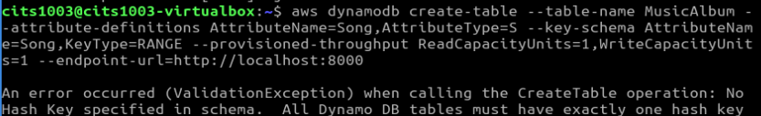
What if the hash key is NOT provided?
1
2
3
4
5
6
aws dynamodb create-table --table-name MusicAlbum
--attribute-definitions \
AttributeName=Song,AttributeType=S \
--key-schema AttributeName=Song,KeyType=RANGE \
--provisioned-throughput ReadCapacityUnits=1,WriteCapacityUnits=1 \
--endpoint-url=http://localhost:8000

Slide 54
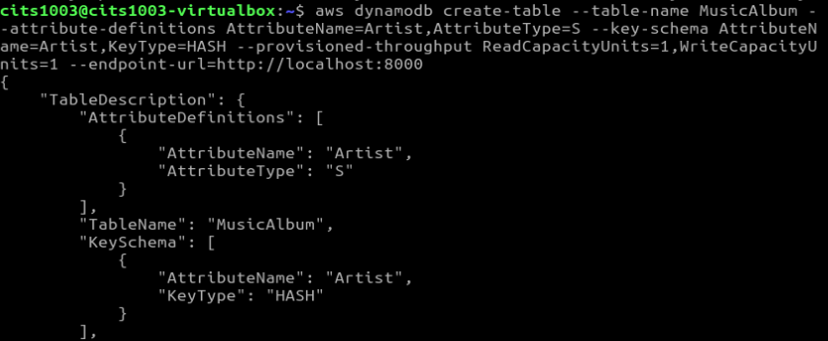
What if the range key is NOT provided?
1
2
3
4
5
6
aws dynamodb create-table --table-name MusicAlbum
--attribute-definitions \
AttributeName=Artist,AttributeType=S \
--key-schema AttributeName=Artist,KeyType=HASH \
--provisioned-throughput ReadCapacityUnits=1,WriteCapacityUnits=1 \
--endpoint-url=http://localhost:8000

Slide 55
A dynamodb table
Artist | Song
Jerry | Happy Day
What will the table be like if we create an item by adding a value of “Tom” to the “Artist” key?

Slide 56
A dynamodb table
Artist | Song
Jerry | Happy Day
Tom
What will the table be like if we create an item by adding a value of “Poker Face” to the “Song” key?

Slide 57
Practice Questions
Q2: You are asked to store data about music in a local DynamoDB table. Specifically, you need to record the artist name and their song names. Describe the AWS CLI commands you would use to create a table to store such information and write entries to that table.

Slide 58

Mid-sem test
The test has a time limit of 60 mins.
The test is at 5:15pm-6:15pm on August 24 2026.
arrive at 5:00pm with your ID such as student card, driver license, etc.
No lecture on August 24 2026 and lab sessions are still open in week 5 and week 6.
Check out your test venue from LMS.

Slide 59
Mid-sem test
The exam is close-book: NO notes are allowed.
The exam is F2F for all students.
Your name and student ID must be written on the cover page of the question booklet.
Please do NOT use a pencil or a red pen.
Please use readable handwriting. What cannot be read cannot be marked.

Slide 60
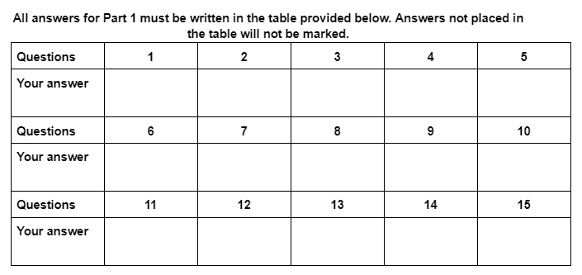
Mid-sem test
Part 1: Multi-choice questions (15 marks)
15 questions
Each question has only one correct answer and is worth 1 mark

Slide 61
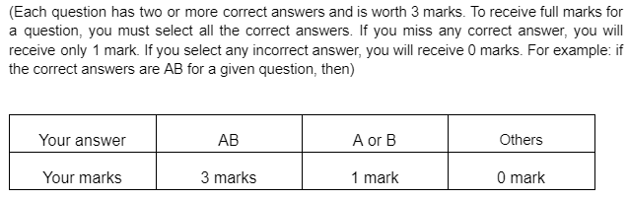
Mid-sem test
Part 1: Multi-choice questions (15 marks)
Part 2: Multi-answer questions (15 marks)
5 questions

Slide 62
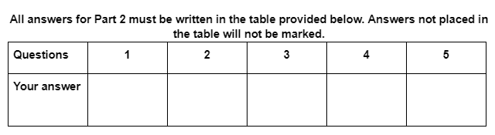
Mid-sem test
Part 1: Multi-choice questions (15 marks)
Part 2: Multi-answer questions (15 marks)
5 questions

Slide 63
Mid-sem test
Part 1: Multi-choice questions (15 marks)
All answers to Part 1 must be written in the provided table.
Part 2: Multi-answer questions (15 marks)
All answers to Part 2 must be written in the provided table.
Part 3: Short answer questions including reading code (30 marks)
5 themed questions
All answers to Part 3 must be written on the provided blank pages.

Slide 64
Mid-sem test
Part 1: Multi-choice questions (15 marks)
All answers to Part 1 must be written in the provided table.
Part 2: Multi-answer questions (15 marks)
All answers to Part 2 must be written in the provided table.
Part 3: Short answer questions including reading code (30 marks)
5 themed questions
All answers to Part 3 must be written on the provided blank pages.
Test Content:
Lectures of Weeks 1-5 and Labs 1-3 (not just checkpoints).

Slide 65
Mid-sem test
Part 1: Multi-choice questions (15 marks)
Part 2: Multi-answer questions (15 marks)
Part 3: Short answer questions including reading code (30 marks).
Test Content:
Lectures of Weeks 1-5 and Labs 1-3 (not just checkpoints).
For practice (will be provided next week)

