Slide 1
Week 7 Networking
Dr Zhi Zhang

Slide 2
    1
    2
    3
    4
    5
    6
    7
    8
    aws dynamodb create-table --table-name MusicAlbum
    --attribute-definitions \
    AttributeName=Artist,AttributeType=S \
    AttributeName=Song,AttributeType=S \
    --key-schema AttributeName=Artist,KeyType=HASH \
    AttributeName=Song,KeyType=RANGE \
    --provisioned-throughput ReadCapacityUnits=1,WriteCapacityUnits=1 \
    --endpoint-url=http://localhost:8000
Insert the first item.
    1
    2
    3
    4
    aws dynamodb put-item \
    --table-name MusicAlbum \
    --item '{"Artist": {"S": "Tom"}, "Song": {"S": "Call me today"}}'\
    --return-consumed-capacity TOTAL --endpoint-url=http://localhost:8000
Insert the second item.
    1
    2
    3
    4
    5
    aws dynamodb put-item \
    --table-name MusicAlbum \
    --item '{"Artist": {"S": “Tom"}, "Song": {"S": "Call Me Today"}, \
    "AlbumTitle": {"S": "Somewhat Famous"}}’ \
    --return-consumed-capacity TOTAL --endpoint-url=http://localhost:8000
What will the table be like?

Slide 3
    1
    2
    3
    4
    5
    6
    7
    8
    aws dynamodb create-table --table-name MusicAlbum
    --attribute-definitions \
    AttributeName=Artist,AttributeType=S \
    AttributeName=Song,AttributeType=S \
    --key-schema AttributeName=Artist,KeyType=HASH \
    AttributeName=Song,KeyType=RANGE \
    --provisioned-throughput ReadCapacityUnits=1,WriteCapacityUnits=1 \
    --endpoint-url=http://localhost:8000
Insert the first item.
    1
    2
    3
    4
    aws dynamodb put-item \
    --table-name MusicAlbum \
    --item '{"Artist": {"S": "Tom"}, "Song": {"S": "Call me today"}}'\
    --return-consumed-capacity TOTAL --endpoint-url=http://localhost:8000
Insert the second item.
    1
    2
    3
    4
    aws dynamodb put-item \
    --table-name MusicAlbum \
    --item '{"Artist": {"S": "Tom"}, "Song": {"S": “Call me today"}}'\
    --return-consumed-capacity TOTAL --endpoint-url=http://localhost:8000

Slide 4
Overview
Networking concepts
Elastic load balancing

Slide 5
Network
A network can be defined as a group of devices connected for data exchange.
Each of the devices on the network is a node and each node has at least one unique address.

Slide 6
IP Address
It is an Internet Protocol address, which is a numerical label assigned to each device connected to a network that uses the Internet Protocol for communication.
An IPv4 (Internet Protocol version 4) address has 4 bytes (32 bits) separated by periods.
  e.g., 192.168.1.10

Slide 7
IP Address
An IPv4 address has 4 bytes separated by periods.
  the first R bits correspond to the network portion.
  the remaining H bits (32 – R) are used for the host portion.
  subnet mask: determines the values for R and H.
    e.g., IPv4 address "192.168.1.10" with a subnet mask of "255.255.255.0".
    question: what are the network portion and host portion for this IP address?

Slide 8
IP Address
An IPv4 address has 4 bytes separated by periods.
  the first R bits correspond to the network portion.
  the remaining H bits are used for the host portion.
  subnet mask: determines the values for R and H.
    e.g., IPv4 address "192.168.1.10" with a subnet mask of "255.255.255.0".
    Question: what are the network portion and host portion for this IP address?
      A notation: 192.168.1.10/24
        CIDR (Classless Inter-Domain Routing) notation

Slide 9
IP Address
An IPv4 address has 4 bytes separated by periods.
  the first R bits correspond to the network portion.
  the remaining H bits are used for the host portion.
  subnet mask: determines the values for R and H.
    it is used to cluster IP addresses into different subnets.
      e.g., 130.95.141.192 with a subnet mask of 255.255.255.192
      question: how many possible IP addresses does this subnet have?

Slide 10
IP Address
An IPv4 address has 4 bytes separated by periods.
  the first R bits correspond to the network portion.
  the remaining H bits are used for the host portion.
  subnet mask: determines the values for R and H.
    it is used to cluster IP addresses into different subnets.
      e.g., 130.95.141.192 with a subnet mask of 255.255.255.192
      question: how many possible IP addresses does this subnet have?
        CIDR notation: 130.95.141.192/26
        IP address number: 2^6 or 64

Slide 11
IP Address
An IPv4 address has 4 bytes separated by periods.
  e.g.,: 192.168.1.10
  the first R bits correspond to the network portion.
  the remaining H bits are used for the host portion.
  subnet mask: determines the values for R and H.
    it is used to cluster IP addresses into different subnets.
      e.g., 130.95.141.192 with a subnet mask of 255.255.255.192
      question: how many possible hosts does this subnet have?
        CIDR notation: 130.95.141.192/26

Slide 12
IP Address
An IPv4 address has 4 bytes separated by periods.
  e.g.,: 192.168.1.10
  the first R bits correspond to the network portion.
  the remaining H bits are used for the host portion.
  subnet mask: determines the values for R and H.
    it is used to cluster IP addresses into different subnets.
      e.g., 130.95.141.192 with a subnet mask of 255.255.255.192
      question: how many possible hosts does this subnet have?
        CIDR notation: 130.95.141.192/26
        Host number: 62 (Network address and broadcast address cannot be assigned to hosts).
        Network address: 130.95.141.192
        Broadcast address: 130.95.141.255

Slide 13
CIDR Practice
A: 172.16.17.30/20
B: 172.16.28.15/20
Question: Is B in the same subnet with A? Justify your answer
Notes:
13

Slide 14
CIDR Practice
20
For A:
  IP address: 172.16.17.30: 10101100.00010000.00010001.00011110
  Subnet mask: 255.255.240.0: 11111111.11111111.11110000.00000000
  Network portion for this subnet can be done via a bitwise AND on the IP address and subnet mask
    172.16.17.30: 10101100.00010000.00010001.00011110
    255.255.240.0: 11111111.11111111.11110000.00000000
          -------------------------|AND|---------------------------
          10101100.00010000.00010000.00000000 = 172.16.16.0
For B:
  IP address: 172.16.28.15: 10101100.00010000.00011100.00001111
  Subnet mask: 255.255.240.0: 11111111.11111111.11110000.00000000
  Network portion for this subnet can be done via a bitwise AND on the IP address and subnet mask
    172.16.28.15: 10101100.00010000.00011100.00001111
    255.255.240.0: 11111111.11111111.11110000.00000000
          -------------------------|AND|---------------------------
          10101100.00010000.00010000.00000000 = 172.16.16.0
Notes:
14

Slide 15
More practice
Q: Suppose the public IPv4 address has a CIDR notation of 212.114.20.0/24, this specifies the subnet where the IPv4 address resides. How many IPv4 addresses does this subnet have?
If the Internet service provider divides the original /24 subnet using /27, how many small subnets will be created?
For each created subnet, how many IPv4 addresses does it have?
Notes:
15

Slide 16
More practice
Q: Suppose the public IPv4 address has a CIDR notation of 212.114.20.0/24, this specifies the subnet where the IPv4 address resides. How many IPv4 addresses does this subnet have?
"/24" indicates the network portion of 24 bits, leaving 8 (32-24) bits for the host portion of the IP address. Therefore, the total number of IPv4 addresses is: 2^8 = 256 addresses.
Notes:
16

Slide 17
More practice
Q: Suppose the public IPv4 address has a CIDR notation of 212.114.20.0/24, this specifies the subnet where the IPv4 address resides. How many IPv4 addresses does this subnet have?
If the Internet service provider (ISP) divides the original /24 subnet using /27, how many small subnets will be created?
Notes:
17

Slide 18
More practice
Q: Suppose the public IPv4 address has a CIDR notation of 212.114.20.0/24, this specifies the subnet where the IPv4 address resides. How many IPv4 addresses does this subnet have?
If the Internet service provider (ISP) divides the original /24 subnet using /27, how many small subnets will be created?
When dividing a /24 subnet into multiple /27 subnets, the ISP uses additional (27-24) bits to create small subnets. The number of small subnets created: 2^(27 - 24) = 8.
Notes:
18

Slide 19
More practice
Q: Suppose the public IPv4 address has a CIDR notation of 212.114.20.0/24, this specifies the subnet where the IPv4 address resides. How many IPv4 addresses does this subnet have?
If the Internet service provider (ISP) divides the original /24 subnet using /27, how many small subnets will be created?
For each created subnet, how many IPv4 addresses does it have?
Notes:
19

Slide 20
More practice
Q: Suppose the public IPv4 address has a CIDR notation of 212.114.20.0/24, this specifies the subnet where the IPv4 address resides. How many IPv4 addresses does this subnet have?
If the Internet service provider (ISP) divides the original /24 subnet using /27, how many small subnets will be created?
For each created subnet, how many IPv4 addresses does it have?
Within each of the small /27 subnets, (32 - 27) bits are available for the host portion. The total number of IPv4 Addresses is: 2^5 = 32.
Notes:
20

Slide 21
Domain Name
It uses alphanumeric characters and symbols separated by periods to create a hierarchical naming structure. This structure is organized from right to left.
  For www.javasoft.com
    ".com" is the top-level domain.
    "javasoft.com" is the registered domain.
    "www" is a subdomain of "javasoft.com".

Slide 22
Domain Name
It uses alphanumeric characters and symbols separated by periods to create a hierarchical naming structure. This structure is organized from right to left.
  For www.javasoft.com
    ".com" is the top-level domain.
    "javasoft.com" is the registered domain.
    "www" is a subdomain of "javasoft.com".
http://www.nab.com.do1n1.eu
  What website will we go to if we click the link? do1n1.eu or nab.com

Slide 23
Domain Name
It uses alphanumeric characters and symbols separated by periods to create a hierarchical naming structure. This structure is organized from right to left.
DNS (Domain Name System)
Domain names are also known as mnemonic textual Internet addresses.
DNS servers are responsible for translating mnemonic textual Internet addresses into the numeric addresses.

Slide 24
Domain Name
It uses alphanumeric characters and symbols separated by periods to create a hierarchical naming structure. This structure is organized from right to left.
DNS (Domain Name System)
Domain names are also known as mnemonic textual Internet addresses.
DNS servers are responsible for translating mnemonic textual Internet addresses into the numeric addresses.
Question: what is the difference between a domain name and a URL?

Slide 25
Domain name and URL
Domain name: a human-readable hierarchical structure, which consists of alphanumeric characters and symbols separated by periods.
URL (Uniform Resource Locator): a complete address to locate a specific resource on a given website. It consists of:
  a network protocol,
  a domain name,
  an additional path and/or query parameters.
  e.g., https://www.example.com/products/category?id=123&sort=asc
    the protocol is "https", the domain name is "www.example.com", the path is "/products/category", the query parameters are "?id=123&sort=asc"

Slide 26
Domain name and URL
Domain name: a human-readable hierarchical structure, which consists of alphanumeric characters and symbols separated by periods.
URL (Uniform Resource Locator): a complete address to locate a specific resource on a given website. It consists of:
  a network protocol,
  a domain name,
  an additional path and/or query parameters.
  e.g., https://www.example.com/products/category?id=123&sort=asc
    the protocol is "https", the domain name is "www.example.com", the path is "/products/category";
    the query parameters are "?id=123&sort=asc", which requests specific items of the category with "id=123" in an ascending order via "sort=asc".

Slide 27
Port
An IP address identifies a device on the network.
A networked device can run different application protocols
An application protocol defines rules for web applications on different devices to communicate over the network.
A network port identifies a specific application protocol running on a networked device.

Slide 28
Port
A network port is identified by a number, the port number.
There are some port numbers which are usually allocated for specific application protocols as their destination ports.
  e.g.,
Application Protocols | Default Port Numbers
HTTP | 80
HTTPS | 443
SSH | 22

Slide 29
Port
What is a destination port?
A network port number is 16 bits long, i.e., 2 bytes.
  What is the possible port range?
192.168.1.1:9000 -> 210.100.100.1:443

Slide 30
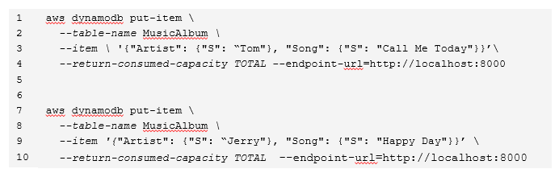
Port
What is a destination port?
A network port number is 16 bits long, i.e., 2 bytes.
  What is the possible port range?
192.168.1.1:9000 -> 210.100.100.1:443

Slide 31
Protocol
A set of rules that govern how data is transmitted over a network.
  Examples: HTTP (Hypertext Transfer Protocol), TCP (Transmission Control Protocol), IP (Internet Protocol)

Slide 32
Protocol
A set of rules that govern how data is transmitted over a network.
Each protocol is designed based on a layered model.
  A real-world model : TCP/IP.
  A conceptual model : OSI (Open Systems Interconnection)

Slide 33
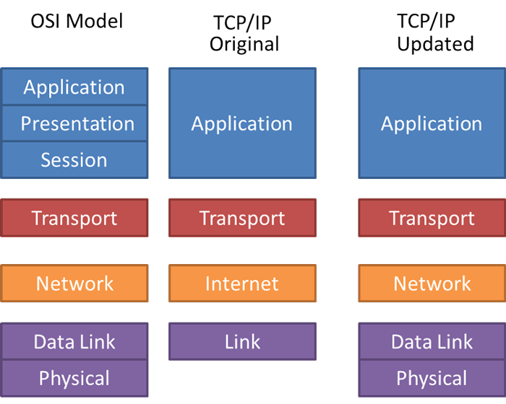

Slide 34
5-layer TCP/IP model
Application Layer provides network services directly to applications. It hosts various application-specific protocols.
  Examples of protocols for different applications: HTTP and HTTPS for web browsing, and SSH (Secure Shell) for secure remote access.

Slide 35
5-layer TCP/IP model
Transport Layer establishes and manages the end-to-end data transfer between applications running on different devices.
  Examples of protocols for network connection: TCP (Transmission Control Protocol) for reliable connection, UDP (User Datagram Protocol) for fast communication.

Slide 36
5-layer TCP/IP model
Network Layer routes packets of data to reach their destination.
  Example of protocols for packet routing: IP (Internet Protocol)

Slide 37
5-layer TCP/IP model
Data Link Layer provides node-to-node data transfer.
  Particularly, it uses MAC (Media Access Control) addresses to identify Network Interface Cards (NICs).

Slide 38
5-layer TCP/IP model
Data Link Layer provides node-to-node data transfer.
  Particularly, it uses MAC (Media Access Control) addresses to identify Network Interface Cards (NICs).
  Examples of protocols for node addressing: Ethernet, Wi-Fi

Slide 39
5-layer TCP/IP model
Physical Layer deals with data transmission over a physical medium.
  Examples of medium: Optical fibers, Wireless radio waves

Slide 40
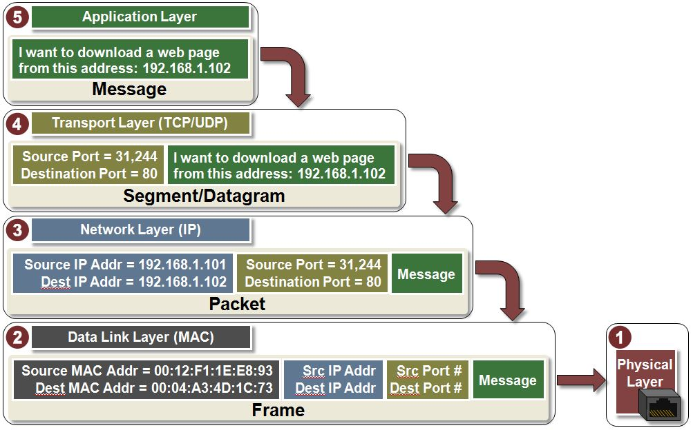
Transmit Data with TCP/IP model
Data
Segment for TCP
Datagram for UDP

Slide 41
Transmit Data with TCP/IP model
Data
data encapsulation
Segment for TCP
Datagram for UDP
Packet
Frame
Bits: 01011101…

Slide 42
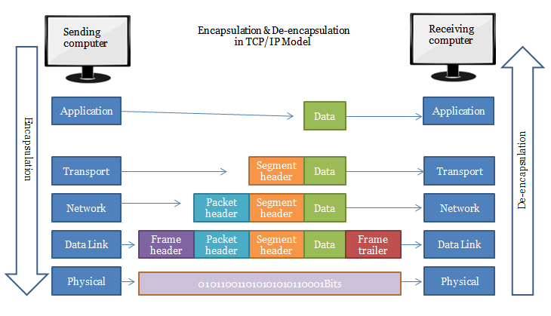
Data encapsulation/decapsulation in TCP/IP
https://nglthu.github.io/Networking/

Slide 43
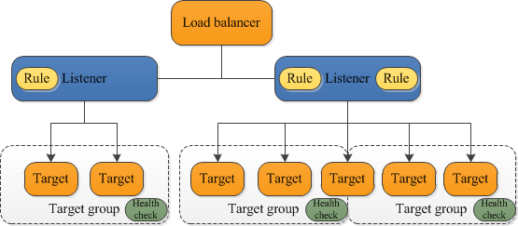
ELB (Elastic Load Balancing)
ELB serves as the single point of contact for clients, distributing incoming requests across multiple target groups of multiple targets (e.g., EC2 instances and containers).
Listener checks for incoming network requests from clients using pre-configured rules.

Slide 44
Example: Path-based routing
Rule 1: If the URL is https://example.com/public/home, the listener routes the request to a specific target group: PublicWebServer.
Rule 2: If the URL is https://example.com/admin/settings, the listener routes the request to another target group: AdminConsole.
    [ {
    "Field": "path-pattern",
    "PathPatternConfig": {
    "Values": ["/public/*"]
    }
    } ]
    [ {
    "Field": "path-pattern",
    "PathPatternConfig": {
    "Values": ["/admin/*"]
    }
    } ]

Slide 45
Benefits of ELB
Increases the scalability and fault tolerance of web applications.
  More virtual servers are registered as targets (horizontal scaling)

Slide 46
Benefits of ELB
Increases the scalability and fault tolerance of web applications.
  More virtual servers are registered as targets (horizontal scaling)
  What are horizonal scaling and vertical scaling?

Slide 47
Benefits of ELB
Increases the scalability and fault tolerance of web applications.
Enables health check of registered targets.
  Healthy: a target is responsive and functioning as expected.

Slide 48
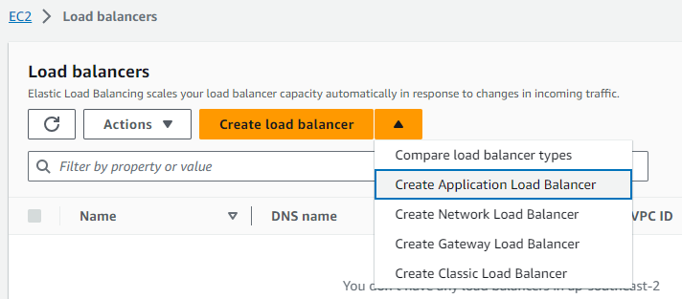
Set up an ALB (Application Load Balancer)
Navigate to EC2 Dashboard and Click “Load balancers”

Slide 49
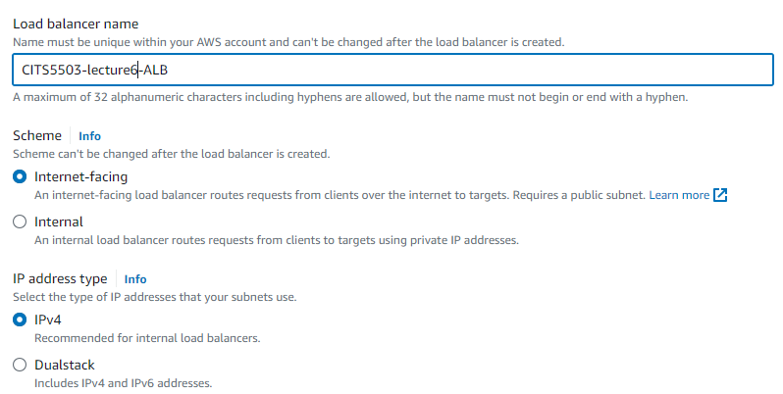
Set up an ALB
Basic configuration

Slide 50
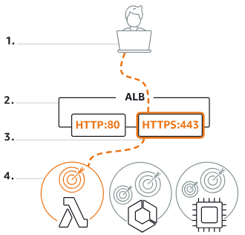
Scheme
Internet-facing indicates the ALB has a public IP address.
Internal means the ALB has a private IP address.
Both schemes route the client’s requests to targets’ private IP addresses.
Targets do not need public IP addresses to receive requests from the ALB.

Slide 51
Set up an ALB
Basic configuration

Slide 52
IP address type
IPv4 (Internet Protocol version 4)
Dualstack includes IPv4 and IPv6 (Internet Protocol version 6)
IPv4: it is widely used in real-world.
  What is the main reason why IPv6 is needed?

Slide 53
IP address type
IPv4: it is widely used in real-world.
  What is the main reason why IPv6 is needed?
    IPv4 uses an address format with 4 bytes (32 bits)
    IPv4 allows for about 4.3 billion addresses: 2^32= 2^32
    The number of internet-connected devices has been increasing all the time.
    IPv6 uses an address format with 16 bytes (128 bits)
    IPv4 allows for a much larger of number of addresses: 2^128

Slide 54
IP address type
  How to address the IPv4 exhaustion problem?
    Effective solution: IPv6.
    Mitigation: network address translation (NAT) and private IPv4 address ranges.

Slide 55
NAT and private IP address range
NAT: it is a way to map multiple private IPv4 addresses inside an internal network to a public IPv4 address before transmitting data to the internet.
  All the devices in an internal network use a single public IPv4 address.
Private IPv4 address range: it is a reserved IP address block that is not routable on the internet.
  It is used for internal communication among devices within the same internal/private network.
  Three address ranges:
Range | CIDR | Total Addresses
10.0.0.0 to 10.255.255.255 | 10.0.0.0/8 | 2^24 (24 = 32 – 8)
172.16.0.0 to 172.31.255.255 | 172.16.0.0/12 | 2^20 (20 = 32 – 12)
192.168.0.0 to 192.168.255.255 | 192.168.0.0/16 | 2^16 (16 = 32 – 16)

Slide 56
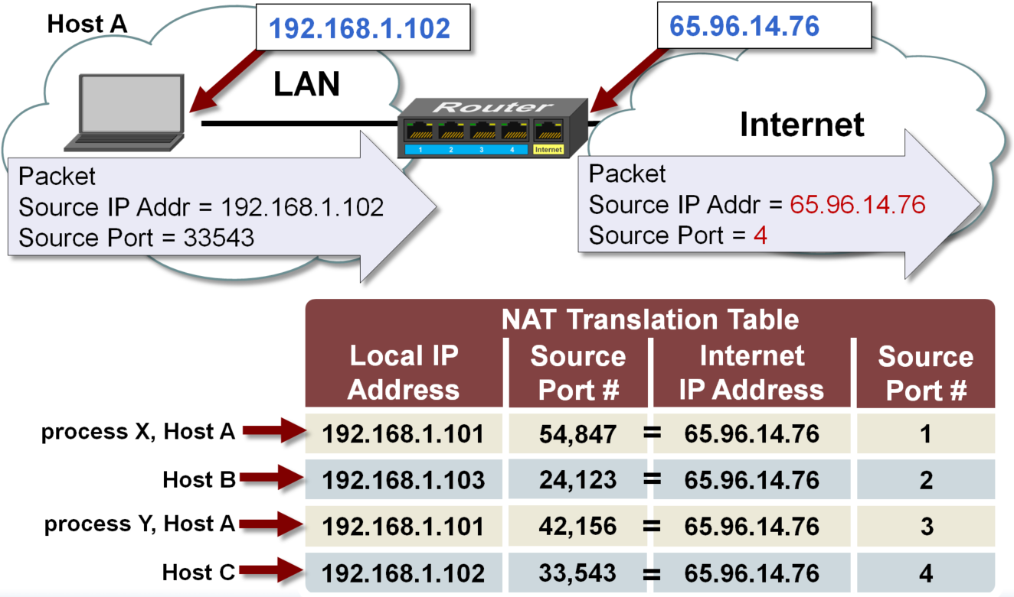
How NAT works
Notes:
56

Slide 57
Set up an ALB
Basic configuration

Slide 58
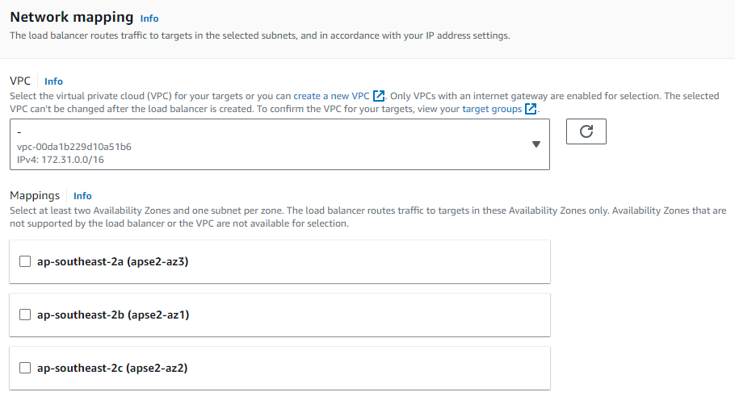
Set up an ALB
Network configuration

Slide 59
VPC
VPC (virtual private cloud): it is a virtual network dedicated to an AWS account.
  It is logically isolated from other virtual networks in the AWS Cloud.
Internet gateway: provides VPC with internet access
  Manage outbound traffic to the internet and inbound traffic to the AWS resources.
Subnet: it is a range of IP addresses in a VPC.
  It is used to divide a VPC into multiple logical sub-networks.
  It can be either public or private sub-network.
  It must reside entirely within one Availability Zone.

Slide 60
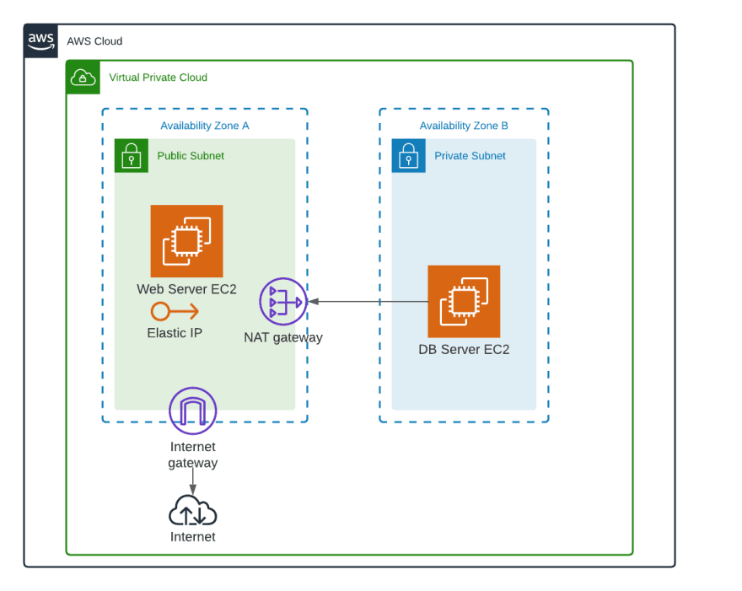
An example

Slide 61
An example
The Web Server EC2 with elastic IP accepts Internet-initiated traffic through the Internet Gateway.
Does NAT gateway also accepts Internet-initiated traffic? Why?

Slide 62
Set up an ALB
Network configuration

Slide 63
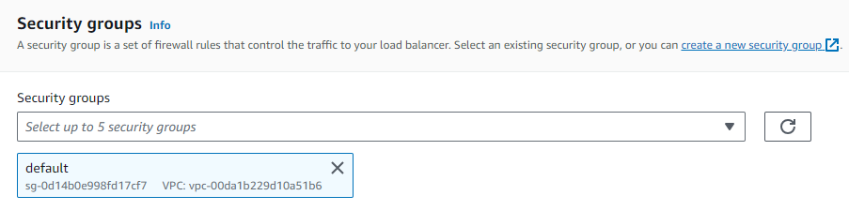
Security group

Slide 64
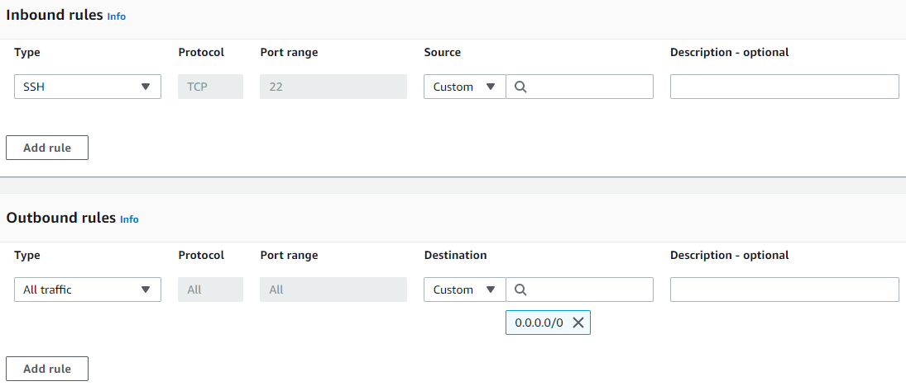
Security group

Slide 65
Security group
HTTP

Slide 66
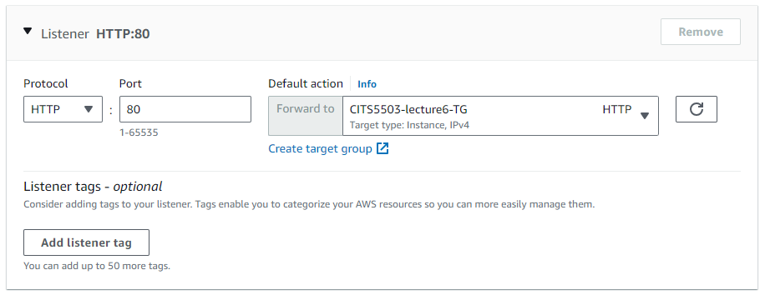
Listeners and routing
A Listener in ALB supports protocols and ports:
  Protocols: HTTP, HTTPS with Ports: 1-65535

Slide 67
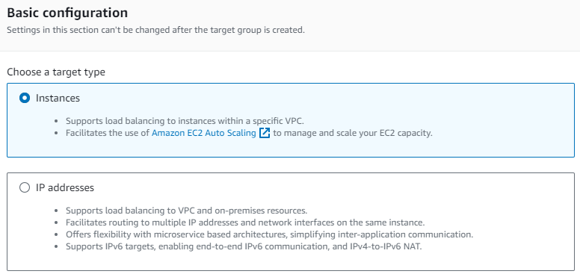
Create target group
Instance: specify targets via EC2 instance IDs.
IP Address: specify targets via IP addresses or IP address ranges.

Slide 68
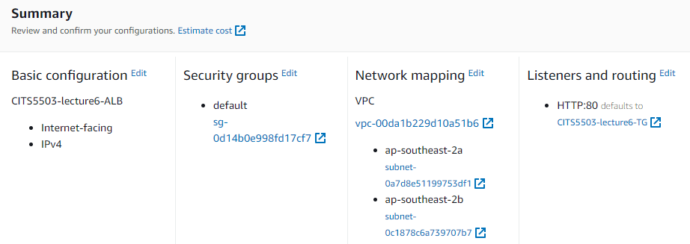
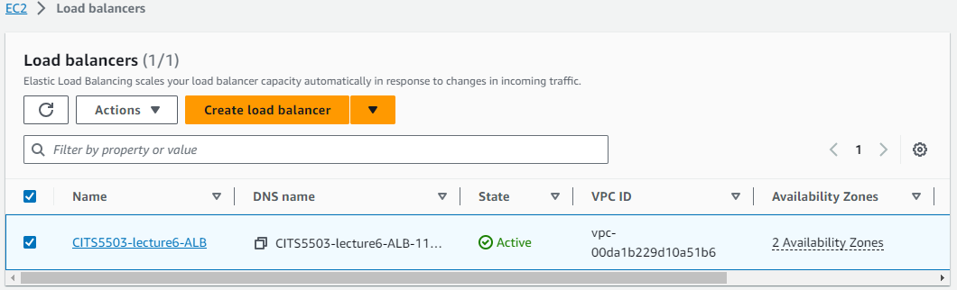

Slide 69

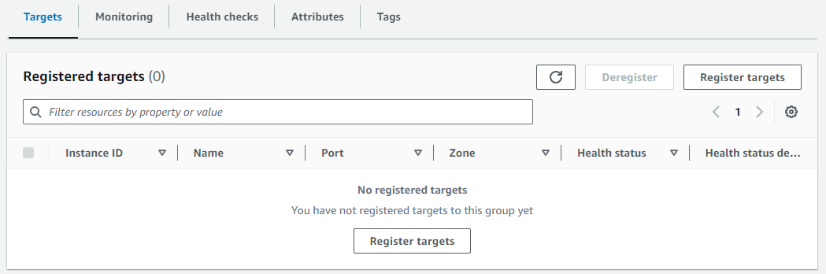

Slide 70
Practice Question
Q: Discuss 3 reasons why you would use Application Load Balancing to load balance a Python Django application.

Slide 71
Q: Discuss 3 reasons why you would use Application Load Balancing to load balance a Python Django application.
Reasons
High fault-tolerance: the ALB can distribute traffic to multiple targets in multiple groups, making the Django application healthy and improving its fault-tolerance.
High scalability: As the ALB can distribute traffic evenly, the Django application can be scaled horizontally. For example, when traffic increases, more targets can be added, and the ALB can distribute traffic to them.
Well aligned: Django is a web framework accepting http and https requests. The main responsibility of ALB is to optimize http and https traffic.

