Slide 1
Week 10 DevOps
Dr Zhi Zhang

Slide 2
Expression of Interest: Facilitating CITS5503 in Sem 2, 2027
  a google form will be available soon

Slide 3
Overview
DevOps
Fabric
AWS Lambda

Slide 4
What is DevOps?
It is a combination of cultural philosophies, practices and tools created to facilitate organizations in delivering services/applications much faster than they can through traditional software development.

Slide 5
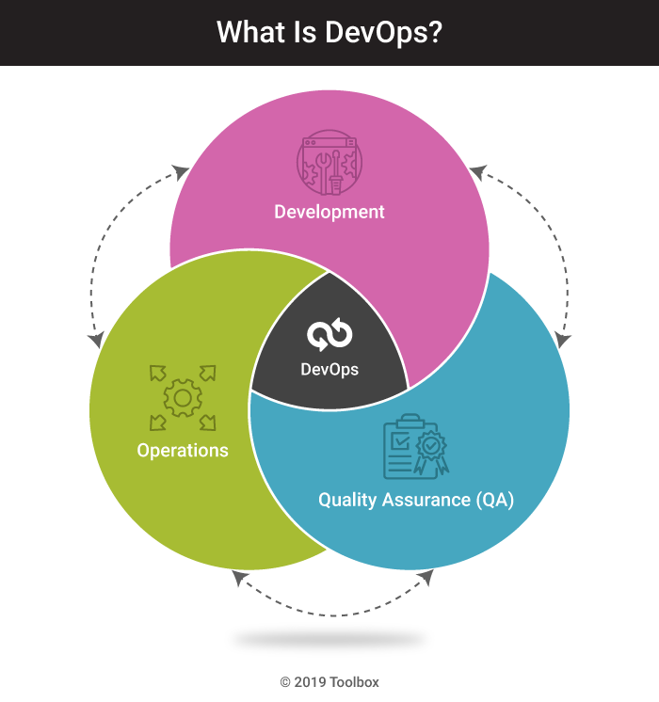

Slide 6
DevOps best practices
Microservice
Monitoring and Logging
Continuous Integration
Continuous Delivery
Continuous Deployment

Slide 7
DevOps best practices
Microservice
  Builds a single application as a set of small services. Each service runs in its own process and communicates with other services through network.
  Applications are broken into many individual microservices with each microservice scoped to a single purpose or function.

Slide 8
DevOps best practices
Microservice
  Builds a single application as a set of small services. Each service runs in its own process and communicates with other services through network.
  Applications are broken into many individual microservices with each microservice scoped to a single purpose or function.
  Benefits: makes the application flexible and enables frequent and small updates.
  Example: AWS Lambda.

Slide 9
DevOps best practices
Monitoring and Logging
  Organizations monitor metrics and logs to see how application and infrastructure performance impacts the experience of their product’s end user.
  Benefits: tracks the performance of applications and infrastructure and detects real-time problems.
  Example: AWS CloudWatch.

Slide 10
DevOps best practices
Continuous Integration
Continuous Delivery
Continuous Deployment

Slide 11
The software/application release process:
Source Control:
  Developers use a VCS (Version Control System) to manage and track changes to a code repository.
Run Build and Unit Tests:
Deploy to Test Environment:
Deploy to Production Environment:

Slide 12
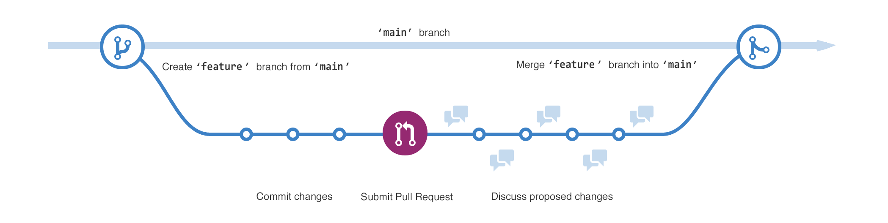
The software/application release process:
Source Control:
  Developers use a VCS (Version Control System) to manage and track changes to a code repository.

Slide 13
The software/application release process:
Source Control:
Run Build and Unit Tests:
  Build refers to automatically generating executables for the application.
  Automated unit tests are executed to ensure that individual components of the application function correctly.
  Failures in build and unit tests alert the developers.
Deploy to Test Environment:
Deploy to Production Environment:

Slide 14
The software/application release process:
Source Control:
Run Build and Unit Tests:
Deploy to Test Environment:
  Automated deployment to the test environment.
  Test Environment: a dedicated test environment mirrors the production environment but is isolated for testing purposes.
  Test includes functional testing, integration testing, workload testing, etc.
Deploy to Production Environment:

Slide 15
The software/application release process:
Source Control:
Run Build and Unit Tests:
Deploy to Test Environment:
Deploy to Production Environment:
  The application is deployed to the production environment for serving real users.

Slide 16
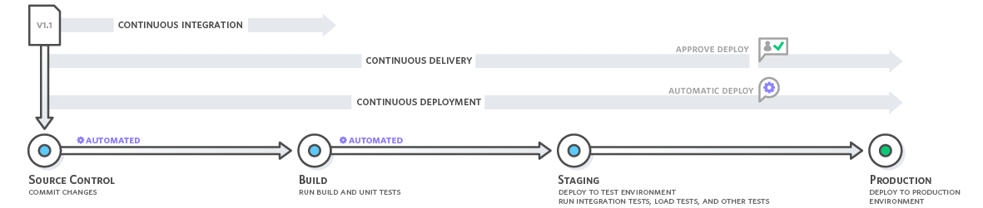
The software/application release process:
Source Control:
Run Build and Unit Tests:
Deploy to Test Environment:
Deploy to Production Environment:

Slide 17
DevOps best practices
Continuous Integration
  Every time developers merge their code changes into a central repository, automated builds and tests start: Whenever a change is committed, the automated build and test will be triggered.
  Benefits: ?

Slide 18
DevOps best practices
Continuous Integration
  Every time developers merge their code changes into a central repository, automated builds and tests start: Whenever a change is committed, the automated build and test will be triggered.
  Benefits: Improve Developer Productivity, Find and Address Bugs Quicker

Slide 19
DevOps best practices
Continuous Delivery and Continuous Deployment:
  Expand upon continuous integration by deploying all code changes to a testing environment and/or a production environment after the build stage.
  Benefits: Continuous Integration + Automate the Software Release Process

Slide 20
Fabric: automate tasks in DevOps
Fabric is a high level Python library designed to execute shell commands remotely over SSH, yielding useful Python objects in return.
OpenSSH: a widely used version of the SSH protocol, available on Mac, Linux/Unix and Windows.
Question: how is OpenSSH used for user/client authentication?

Slide 21
User/Client Authentication in SSH

Slide 22
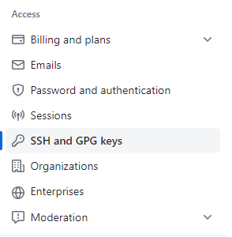
Add the public key to GitHub
Check for existing OpenSSH key pairs:
  ls ~/.ssh
Generate OpenSSH keys if no key pairs exist:
  ssh-keygen -t rsa -b 4096 -C email@example.com
  private key: id_rsa
  public key: id_rsa.pub
Add the Public Key to GitHub:

Slide 23
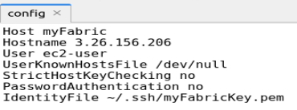
How to configure OpenSSH to support Fabric
Install fabric using: pip install fabric
Create a config file in ~/.ssh

Slide 24
How to configure OpenSSH to support Fabric
Install fabric using: pip install fabric
Create a config file in ~/.ssh
Question: Two lines in the configuration above will make the SSH connection NOT secure? What are they? Why.

Slide 25
How to configure OpenSSH to support Fabric
Install fabric using: pip install fabric
Create a config file in ~/.ssh
Question: Two lines in the configuration above will make the SSH connection NOT secure? What are they? Justify your answer.
Both “UserKnownHostsFile /dev/null” and “StrictHostKeyChecking no” disable host key checking, making the connection insecure to the client.
To explain why, we need to be aware of “server/host authentication”.

Slide 26
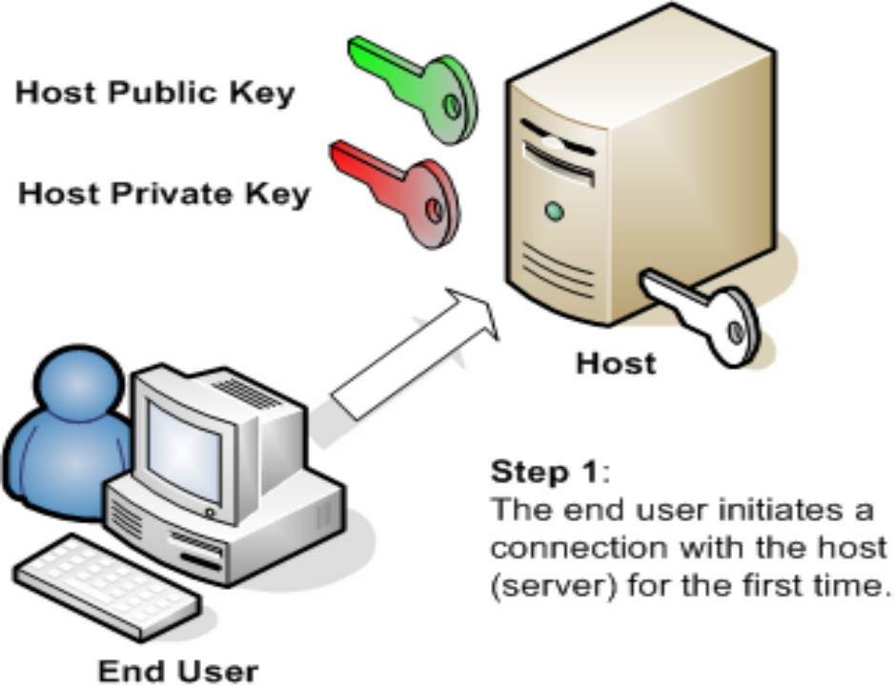
Server/Host Authentication in SSH
Key pair: host key is a key pair. Public host key is stored on and distributed to different clients, and private key is stored on the host/server.
Key Exchange: when a client attempts to connect to a server for the first time

Slide 27
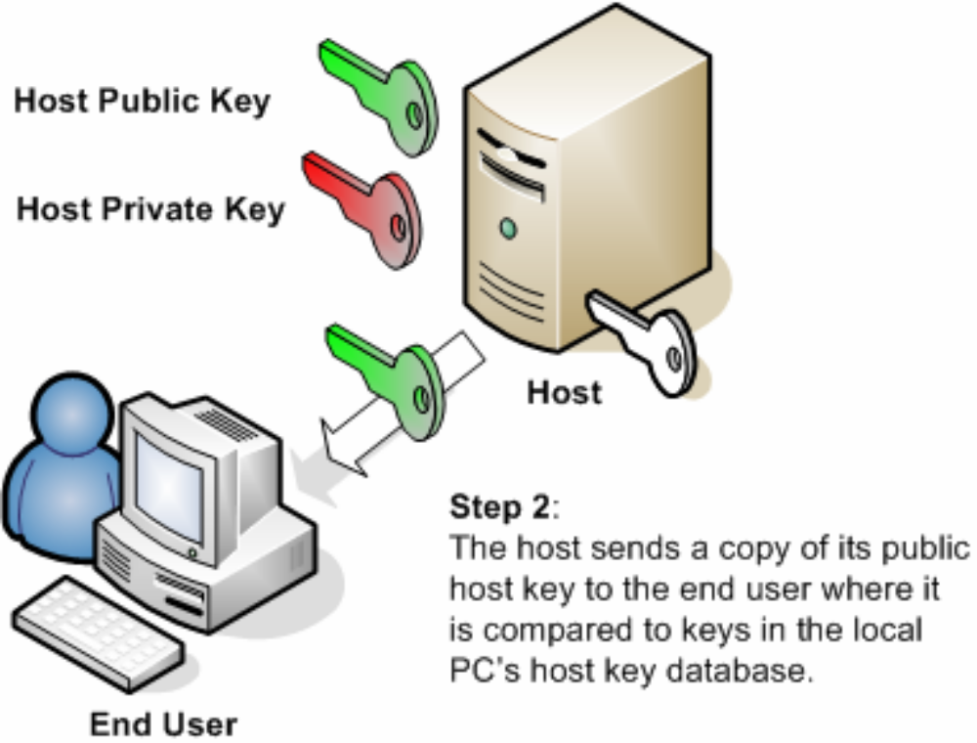
Server/Host Authentication in SSH
Key Exchange: when a client attempts to connect to a server for the first time, the server presents its host public key to the client.

Slide 28

Server/Host Authentication in SSH
The host-key database is called known_hosts in Linux and contains known host keys.

Slide 29
Server/Host Authentication in SSH
Host Key Checking: The client checks the server's host key against a copy stored in its "known_hosts" file. If the check succeeds, the server is authenticated.

Slide 30
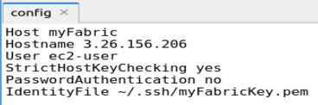
Enable Server/Host Authentication in SSH

Slide 31
Fabric: common functions
from fabric import Connection
c = Connection('myFabric')
upload a local file to the remote server
  c.put(localfile, remotefilepath)
run a remote command
  c.run(command, otherargs)
run a remote command with sudo
  c.sudo(command, otherargs)

Slide 32
Fabric: common functions
from fabric import Connection
c = Connection('myFabric')
upload a local file to the remote server
  c.put(localfile, remotefilepath)
run a remote command
  c.run(command, otherargs)
run a remote command with sudo
  c.sudo(command, otherargs)
Question: what are the differences between 'sudo' and 'su'?

Slide 33

Question: what are the differences between 'sudo' and 'su’?
sudo (Superuser Do): allows a user to execute specific commands that require superuser privileges.
Allow members of group sudo to execute any command

Slide 34
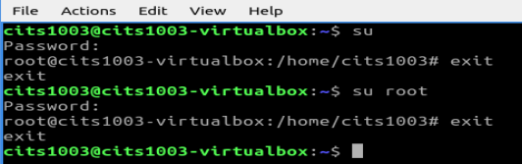
Question: what are the differences between 'sudo' and 'su'?
sudo (Superuser Do): allows a user to execute specific commands that require superuser privileges.
su (Switch User): allows a user to switch to another user account by entering that user account's password.

Slide 35
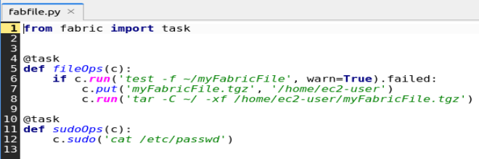
fabfile.py: a Python script that is a collection of tasks and functions
@task is a decorator from the Fabric library.

Slide 36
AWS Lambda: automate tasks in DevOps
Lambda: a microservice that lets us run code without provisioning or managing servers. With Lambda, all we need to do is supply our code in one of the language runtimes that Lambda supports.
Two main benefits:
  Automatic Scaling: Lambda automatically adjusts compute resources based on the workload, scaling up or down seamlessly without manual intervention.
  Server Management: Lambda abstracts away all server and operating system maintenance. It manages the underlying infrastructure, allowing developers to focus on their code and business logic.

Slide 37
AWS Lambda: automate tasks in DevOps
Examples:
  A toy lambda function
  A combination of lambda function and S3

Slide 38
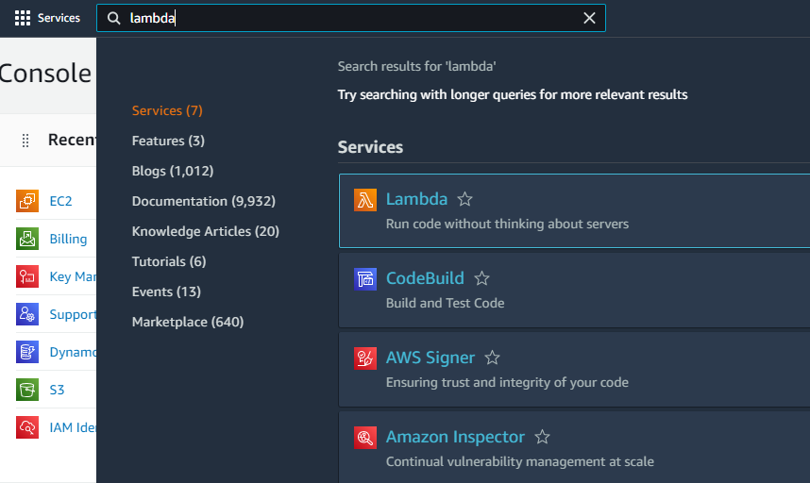
Step1: open the AWS Lambda Console

Slide 39
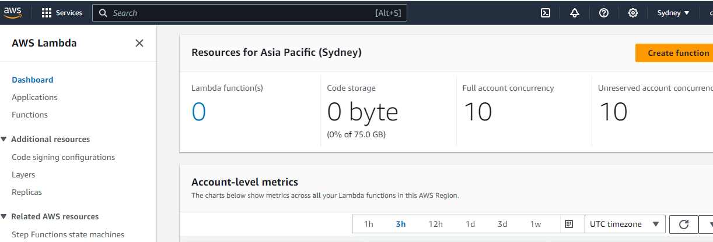
Step1: open the AWS Lambda Console

Slide 40
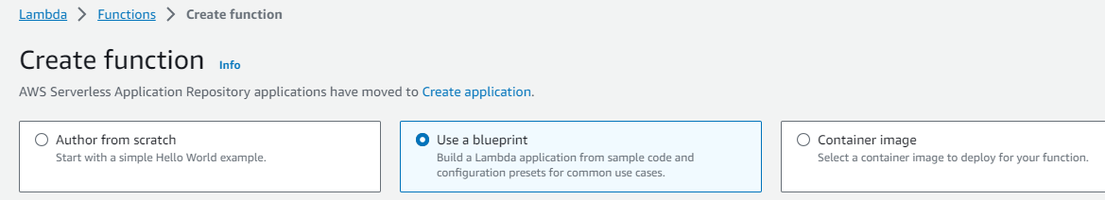
Step2: select a Lambda blueprint and configure it

Slide 41
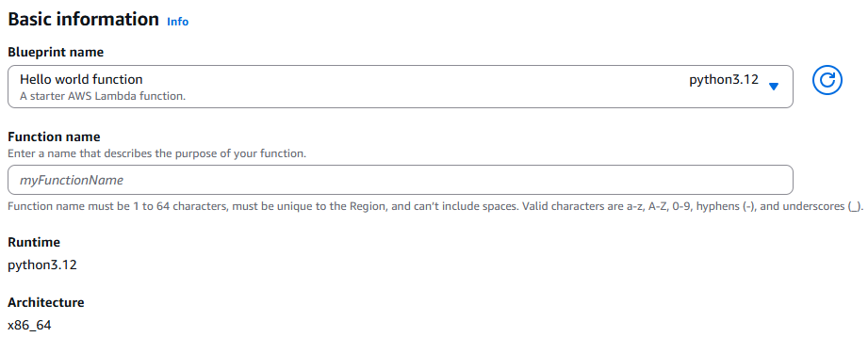
Step3: basic information configuration

Slide 42
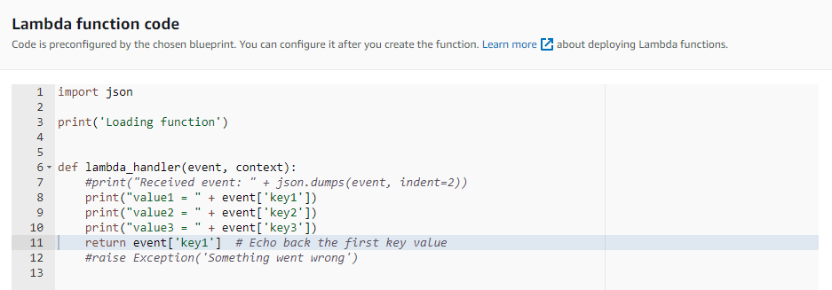
Step4: preconfigured function code

Slide 43
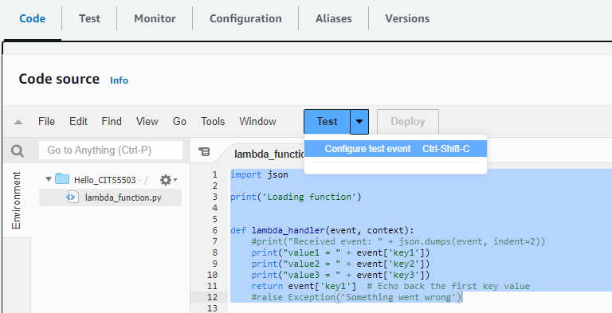
Step5: configure a test event to trigger the code

Slide 44
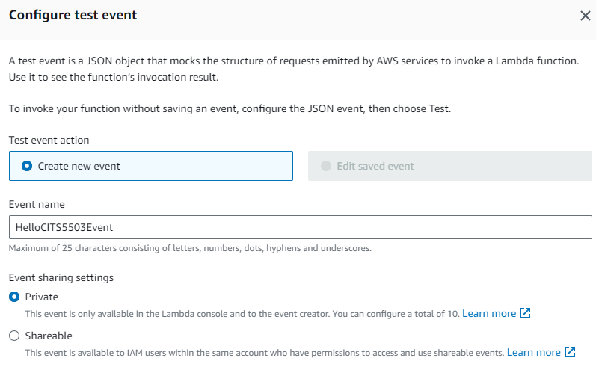
Step5.1: configure a test event

Slide 45
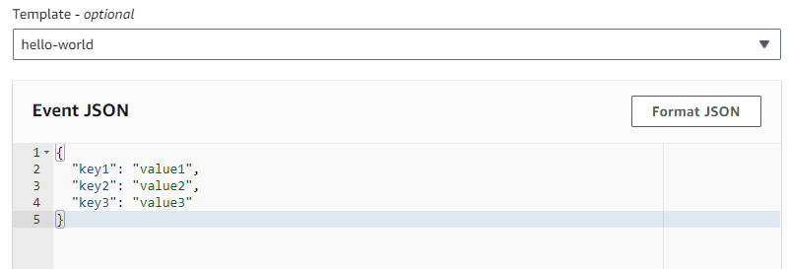
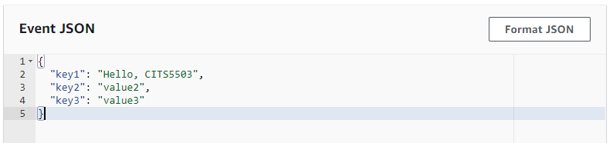
Step5.2: configure the event’s data

Slide 46
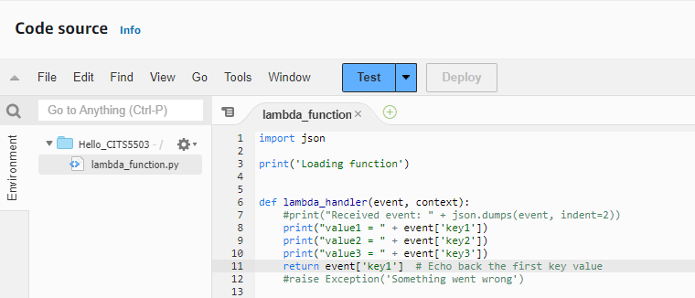
Step6: trigger the Lambda function via the event

Slide 47
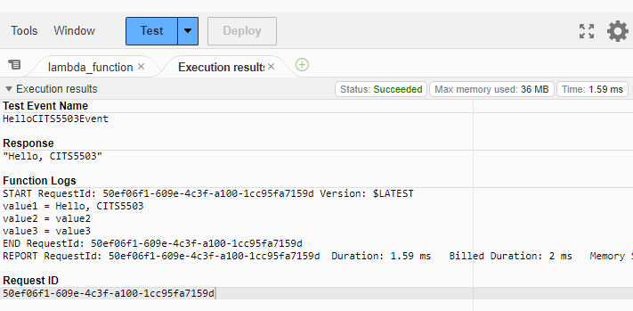
Step7: Execution results

Slide 48
AWS Lambda: automate tasks in DevOps
Example:
  A toy Lambda function
  A combination of lambda and S3

Slide 49
Combine Lambda with S3
Step 1
Step 2
Step 3
IAM
IAM
S3 BUCKET
Create policy
policy
Create BUCKET
Create role
Test with trigger
Lambda
Lambda
S3
function
role
Lamda
Create function
Add S3 trigger
CloudWatch
Step 6
Step 5
Step 4

Slide 50
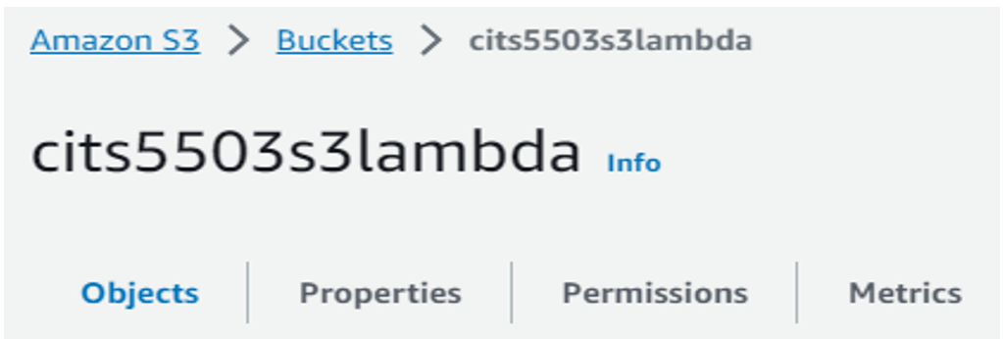
Step1: create a bucket

Slide 51
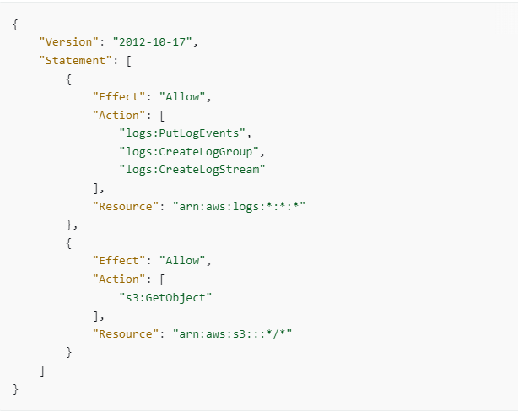
Step2: create a customer managed policy

Slide 52
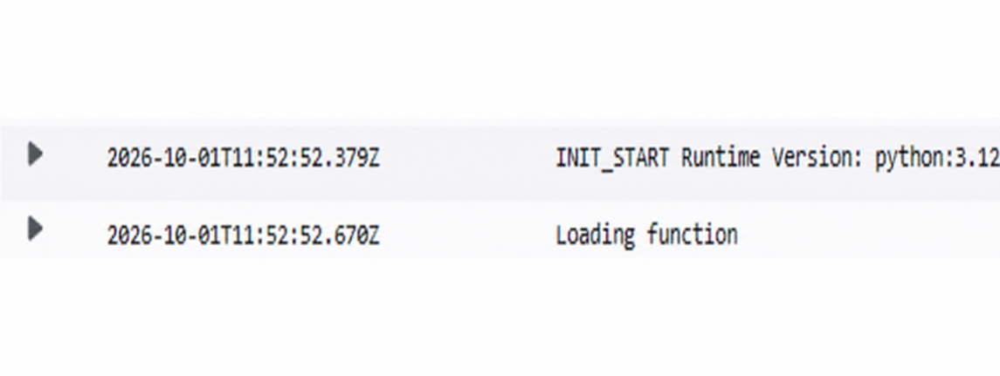
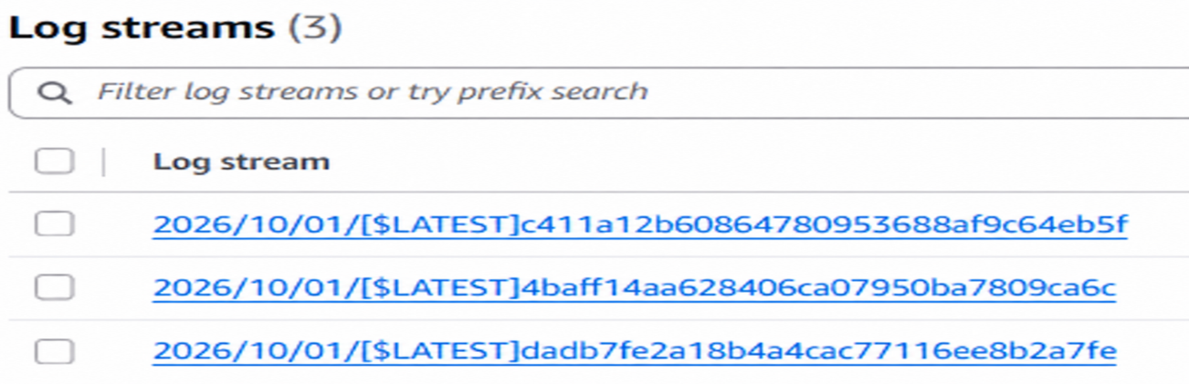
Step2: create a customer managed policy
log event: a set of log records and each record consists of a timestamp and a message.
log stream: a sequence of log events from the same runtime environment.

Slide 53
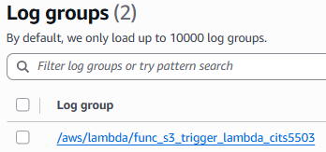
Step2: create a customer managed policy
log group: a group of log streams that share the same application/component.
Hierarchy: Log group → multiple log streams → many log events in each stream.

Slide 54
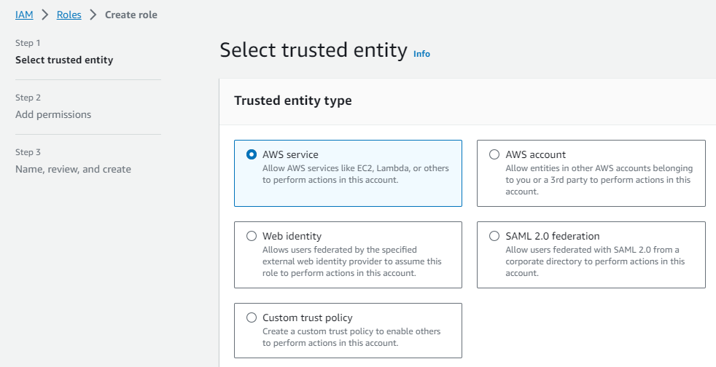
Step3: create a role

Slide 55
AWS account: another AWS account (or entities within that account) is trusted to assume a role in this account.
Web identity: users authenticated through an external web identity provider are trusted to assume a role in this account.
SAML (Security Assertion Markup Language) 2.0 Federation: users authenticated via their corporate credentials (e.g., Microsoft Active Directory) are trusted to assume a role in this account.
Custom trust policy: provides more flexibility in defining who or what is trusted to assume a role in this account.

Slide 56
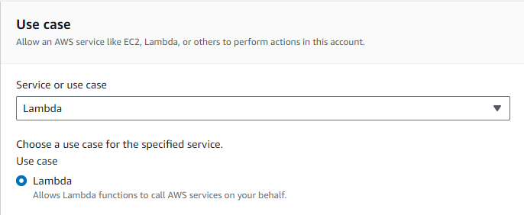
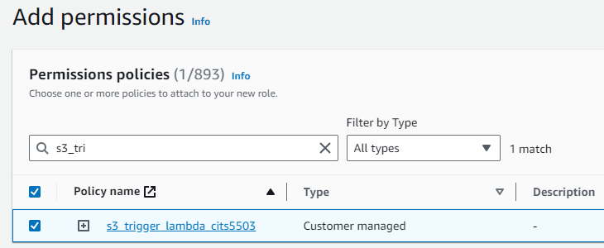
Step3.1: create a role

Slide 57
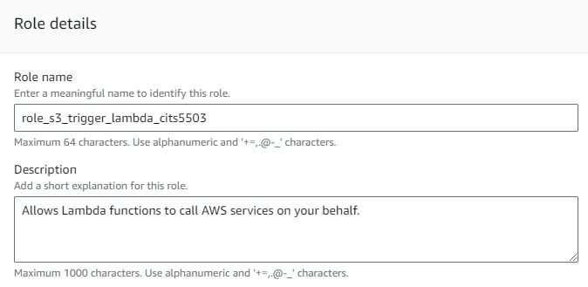
Step3.2: create a role

Slide 58
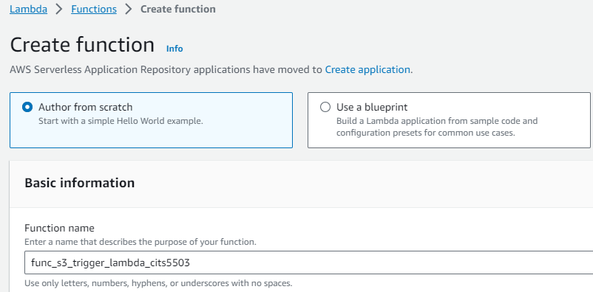
Step4: create a lambda function

Slide 59
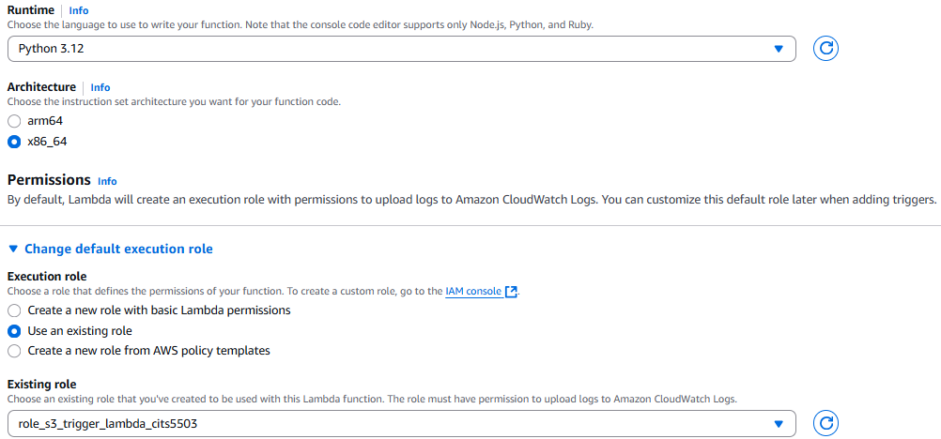
Step4.1: create a lambda function

Slide 60
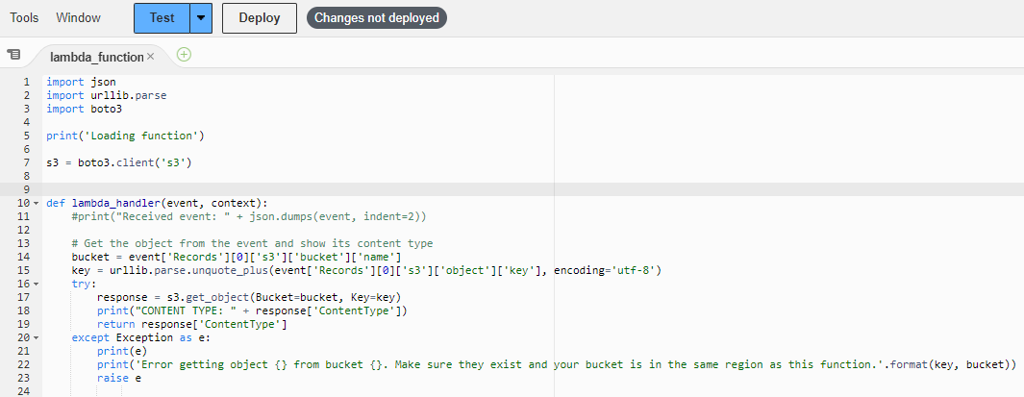
Step4.2: create a lambda function

Slide 61
Step4.3: create a lambda function
event['Records']: contains an array of records. A record corresponds to a specific event that triggered the lambda function.
event['Records'][0]: retrieves the first record in this array.
event['Records'][0]['s3']: contains information specific to an S3 event in the record.
event['Records'][0]['s3']['bucket']: contains information about the S3 bucket where the S3 event occurred.
event['Records'][0]['s3']['bucket']['name’]: retrieves the name field from the bucket.

Slide 62
Step4.4: create a lambda function
event['Records'][0]['s3']['object']['key']: retrieves the S3 object key from the S3 object, encoded by utf-8.
urllib.parse.unquote_plus(): a function call that decodes an encoded URL string.
encoding='utf-8': specifies the character encoding to be used when decoding the object key.

Slide 63
Step4.5: create a lambda function

Slide 64
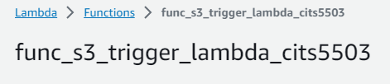
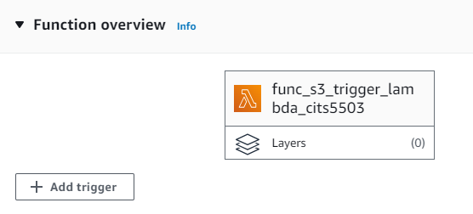
Step5: create a trigger

Slide 65
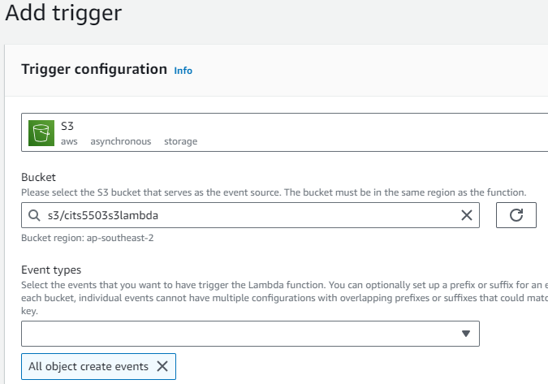
Step5.1: create a trigger

Slide 66
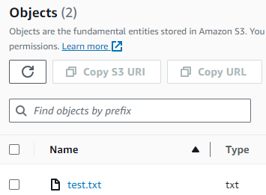
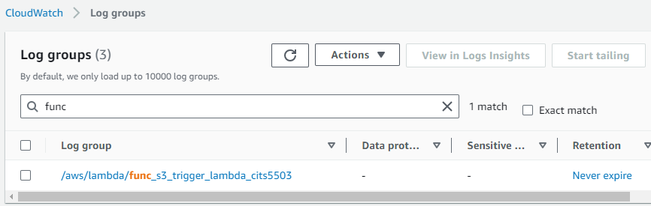
Step6: test the function via the trigger

Slide 67

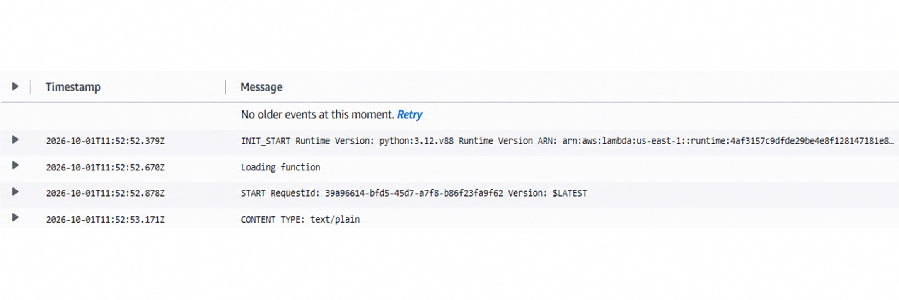
Step6.1: test the function via the trigger

