Slide 1
Week 7 Networking
Dr Zhi Zhang

Slide 2
Overview
Networking concepts
Elastic load balancing

Slide 3
Network
A network can be defined as a group of devices connected for data exchange.
Each of the devices on the network is a node and each node has at least one unique address.

Slide 4
IP Address
It is an Internet Protocol address, which is a numerical label assigned to each device connected to a network that uses the Internet Protocol for communication.
An IPv4 (Internet Protocol version 4) address has 4 bytes (32 bits) separated by periods.
e.g., 192.168.1.10

Slide 5
IP Address
An IPv4 address has 4 bytes separated by periods.
the first R bits correspond to the network portion.
the remaining H bits (32 – R) are used for the host portion.
subnet mask: determines the values for R and H.
e.g., IPv4 address "192.168.1.10" with a subnet mask of "255.255.255.0".
Question: what are the network portion and host portion for this IP address?

Slide 6
IP Address
An IPv4 address has 4 bytes separated by periods.
the first R bits correspond to the network portion.
the remaining H bits are used for the host portion.
subnet mask: determines the values for R and H.
e.g., IPv4 address "192.168.1.10" with a subnet mask of "255.255.255.0".
Question: what are the network portion and host portion for this IP address?
A notation: 192.168.1.10/24
CIDR (Classless Inter-Domain Routing) notation

Slide 7
IP Address
An IPv4 address has 4 bytes separated by periods.
the first R bits correspond to the network portion.
the remaining H bits are used for the host portion.
subnet mask: determines the values for R and H.
it is used to cluster IP addresses into different subnets.
e.g., 130.95.141.192 with a subnet mask of 255.255.255.192
question: how many possible IP addresses does this subnet have?

Slide 8
IP Address
An IPv4 address has 4 bytes separated by periods.
the first R bits correspond to the network portion.
the remaining H bits are used for the host portion.
subnet mask: determines the values for R and H.
it is used to cluster IP addresses into different subnets.
e.g., 130.95.141.192 with a subnet mask of 255.255.255.192
question: how many possible IP addresses does this subnet have?
CIDR notation: 130.95.141.192/26
IP address number: 2^6 or 64

Slide 9
IP Address
An IPv4 address has 4 bytes separated by periods.
e.g.,: 192.168.1.10
the first R bits correspond to the network portion.
the remaining H bits are used for the host portion.
subnet mask: determines the values for R and H.
it is used to cluster IP addresses into different subnets.
e.g., 130.95.141.192 with a subnet mask of 255.255.255.192
question: how many possible hosts does this subnet have?
CIDR notation: 130.95.141.192/26

Slide 10
IP Address
An IPv4 address has 4 bytes separated by periods.
e.g.,: 192.168.1.10
the first R bits correspond to the network portion.
the remaining H bits are used for the host portion.
subnet mask: determines the values for R and H.
it is used to cluster IP addresses into different subnets.
e.g., 130.95.141.192 with a subnet mask of 255.255.255.192
question: how many possible hosts does this subnet have?
CIDR notation: 130.95.141.192/26
Host number: 62 (Network address and broadcast address cannot be assigned to hosts).
Network address: 130.95.141.192
Broadcast address: 130.95.141.255

Slide 11
A short summary
IP address is divided into two parts: network portion and host portion.
Subnet mask is used for IP address management.
CIDR (Classless Inter-Domain Routing)
CIDR is a notation to represent IP addresses and their associated subnet masks.
In CIDR notation, an IP address (e.g., 130.95.141.192/26) is followed by a slash ("/") and a number. This number represents the bit length of the network portion.
Notes:
11

Slide 12
CIDR Practice
A: 172.16.17.30/20
B: 172.16.28.15/20
Question: Is B in the same subnet with A? Justify your answer
Notes:
12

Slide 13
CIDR Practice
20
For A:
IP address: 172.16.17.30: 10101100.00010000.00010001.00011110
Subnet mask: 255.255.240.0: 11111111.11111111.11110000.00000000
Network portion for this subnet can be done via a bitwise AND on the IP address and subnet mask
172.16.17.30: 10101100.00010000.00010001.00011110
255.255.240.0: 11111111.11111111.11110000.00000000
-------------------------|AND|---------------------------
10101100.00010000.00010000.00000000 = 172.16.16.0
For B:
IP address: 172.16.28.15: 10101100.00010000.00011100.00001111
Subnet mask: 255.255.240.0: 11111111.11111111.11110000.00000000
Network portion for this subnet can be done via a bitwise AND on the IP address and subnet mask
172.16.28.15: 10101100.00010000.00011100.00001111
255.255.240.0: 11111111.11111111.11110000.00000000
-------------------------|AND|---------------------------
10101100.00010000.00010000.00000000 = 172.16.16.0
Notes:
13

Slide 14
More practice
Q: Suppose the public IPv4 address has a CIDR notation of 212.114.20.0/24, this specifies the subnet where the IPv4 address resides. How many IPv4 addresses does this subnet have?
If the Internet service provider divides the original /24 subnet using /27, how many small subnets will be created?
For each created subnet, how many IPv4 addresses does it have?
Notes:
14

Slide 15
More practice
Q: Suppose the public IPv4 address has a CIDR notation of 212.114.20.0/24, this specifies the subnet where the IPv4 address resides. How many IPv4 addresses does this subnet have?
"/24" indicates the network portion of 24 bits, leaving 8 (32-24) bits for the host portion of the IP address. Therefore, the total number of IPv4 addresses is: 2^8 = 256 addresses.
Notes:
15

Slide 16
More practice
Q: Suppose the public IPv4 address has a CIDR notation of 212.114.20.0/24, this specifies the subnet where the IPv4 address resides. How many IPv4 addresses does this subnet have?
If the Internet service provider (ISP) divides the original /24 subnet using /27, how many small subnets will be created?
Notes:
16

Slide 17
More practice
Q: Suppose the public IPv4 address has a CIDR notation of 212.114.20.0/24, this specifies the subnet where the IPv4 address resides. How many IPv4 addresses does this subnet have?
If the Internet service provider (ISP) divides the original /24 subnet using /27, how many small subnets will be created?
When dividing a /24 subnet into multiple /27 subnets, the ISP uses additional (27-24) bits to create small subnets. The number of small subnets created: 2^(27 - 24) = 8.
Notes:
17

Slide 18
More practice
Q: Suppose the public IPv4 address has a CIDR notation of 212.114.20.0/24, this specifies the subnet where the IPv4 address resides. How many IPv4 addresses does this subnet have?
If the Internet service provider (ISP) divides the original /24 subnet using /27, how many small subnets will be created?
For each created subnet, how many IPv4 addresses does it have?
Notes:
18

Slide 19
More practice
Q: Suppose the public IPv4 address has a CIDR notation of 212.114.20.0/24, this specifies the subnet where the IPv4 address resides. How many IPv4 addresses does this subnet have?
If the Internet service provider (ISP) divides the original /24 subnet using /27, how many small subnets will be created?
For each created subnet, how many IPv4 addresses does it have?
Within each of the small /27 subnets, (32 - 27) bits are available for the host portion. The total number of IPv4 Addresses is: 2^5 = 32.
Notes:
19

Slide 20
Domain Name
It uses alphanumeric characters and symbols separated by periods to create a hierarchical naming structure. This structure is organized from right to left.
For www.javasoft.com
"com" is the top-level domain (TLD).
" javasoft" is the second-level domain (SLD).
"www" is a subdomain of " javasoft."
DNS (Domain Name System)
Domain names are also known as mnemonic textual Internet addresses.
DNS servers are responsible for translating mnemonic textual Internet addresses into the numeric addresses.

Slide 21
Domain Name
It uses alphanumeric characters and symbols separated by periods to create a hierarchical naming structure. This structure is organized from right to left.
For www.javasoft.com,
"com" is the top-level domain (TLD).
" javasoft" is the second-level domain (SLD).
"www" is a subdomain of " javasoft."
DNS (Domain Name System)
Domain names are also known as mnemonic textual Internet addresses.
DNS servers are responsible for translating mnemonic textual Internet addresses into the numeric addresses.
Question: what is the difference between a domain name and a URL?

Slide 22
Domain name and URL
Domain name: a human-readable hierarchical structure, which consists of alphanumeric characters and symbols separated by periods.
URL (Uniform Resource Locator): a complete address to locate a specific resource on a given website. It consists of:
a network protocol,
a domain name,
an additional path and/or query parameters.
e.g., https://www.example.com/products/category?id=123&sort=asc
the protocol is "https", the domain name is "www.example.com", the path is "/products/category", the query parameters are "?id=123&sort=asc"

Slide 23
Domain name and URL
Domain name: a human-readable hierarchical structure, which consists of alphanumeric characters and symbols separated by periods.
URL (Uniform Resource Locator): a complete address to locate a specific resource on a given website. It consists of:
a network protocol,
a domain name,
an additional path and/or query parameters.
e.g., https://www.example.com/products/category?id=123&sort=asc
the protocol is "https", the domain name is "www.example.com", the path is "/products/category";
the query parameters are "?id=123&sort=asc", which requests specific items of the category with "id=123" in an ascending order via "sort=asc".

Slide 24
Port
An IP address identifies a device on the Internet.
An IP port identifies a specific application protocol running on an Internet device.
A port is identified by a number, the port number.
There are some port numbers which are allocated for specific application protocols.
e.g.,
Application Protocols | Default Port Numbers
HTTP | 80
HTTPS | 443
SSH | 22

Slide 25
Protocol
A set of rules that govern how data is transmitted over a network.
Examples: HTTP (Hypertext Transfer Protocol), TCP (Transmission Control Protocol), IP (Internet Protocol)

Slide 26
Protocol
A set of rules that govern how data is transmitted over a network.
Each protocol is designed based on a layered model.
A real-world model : TCP/IP.
A conceptual model : OSI (Open Systems Interconnection)

Slide 27
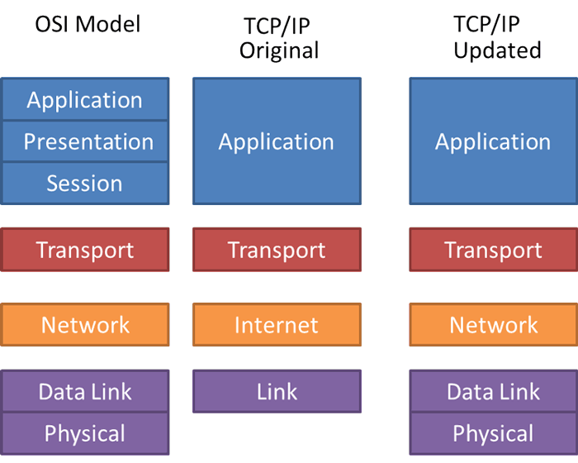
https://fiberbit.com.tw/tcpip-model-vs-osi-model/

Slide 28
5-layer TCP/IP model
Application Layer provides network services directly to applications. It hosts various application-specific protocols.
Examples of protocols for different applications: HTTP and HTTPS for web browsing, and SSH (Secure Shell) for secure remote access.

Slide 29
5-layer TCP/IP model
Transport Layer establishes and manages the end-to-end data transfer between applications running on different devices.
Examples of protocols for network connection: TCP (Transmission Control Protocol) for reliable connection, UDP (User Datagram Protocol) for fast communication.

Slide 30
5-layer TCP/IP model
Network Layer routes packets of data to reach their destination.
Examples of protocols for packet routing: IP (Internet Protocol), ICMP (Internet Control Message Protocol)

Slide 31
5-layer TCP/IP model
Data Link Layer provides node-to-node data transfer.
Particularly, it uses MAC (Media Access Control) addresses to identify Network Interface Cards (NICs).

Slide 32
5-layer TCP/IP model
Data Link Layer provides node-to-node data transfer.
Particularly, it uses MAC (Media Access Control) addresses to identify Network Interface Cards (NICs).
Examples of protocols for node addressing: Ethernet, Wi-Fi

Slide 33
5-layer TCP/IP model
Physical Layer deals with data transmission over a physical medium.
Examples of medium: Optical fibers, Wireless radio waves

Slide 34
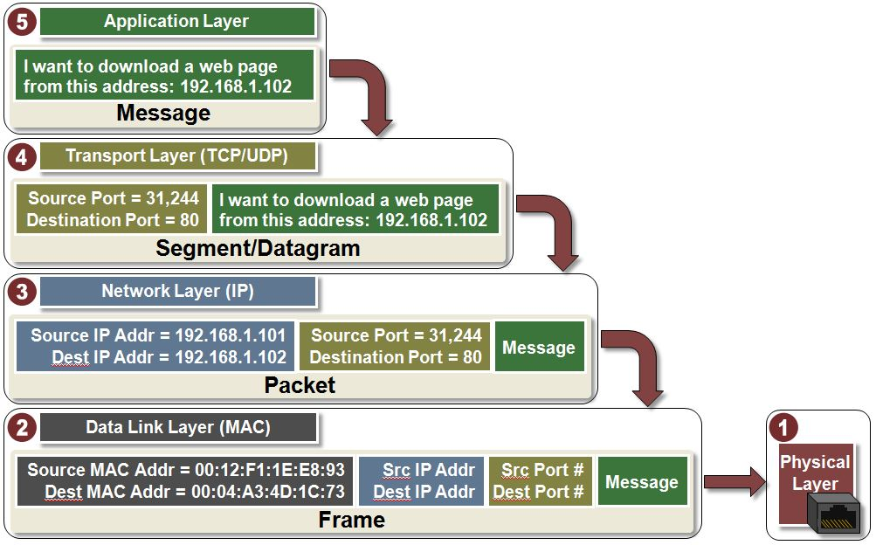
Transmit Data with TCP/IP model
Data
Segment for TCP
Datagram for UDP

Slide 35
Transmit Data with TCP/IP model
Data
data encapsulation
Segment for TCP
Datagram for UDP
Packet
Frame
Bits: 01011101…

Slide 36
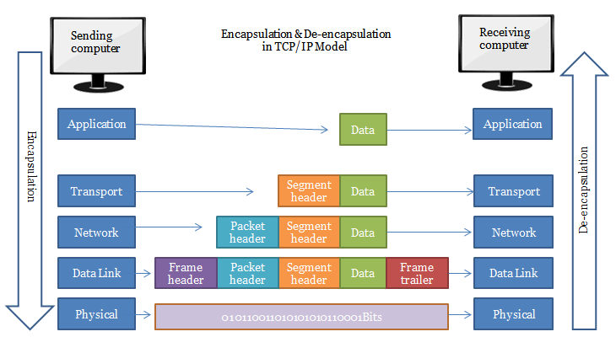
Data encapsulation/decapsulation in TCP/IP
https://nglthu.github.io/Networking/

Slide 37
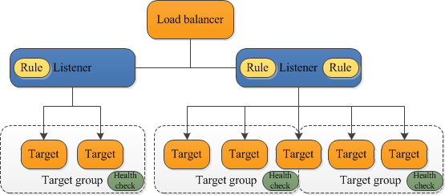
ELB (Elastic Load Balancing)
ELB serves as the single point of contact for clients, distributing incoming requests across multiple target groups of multiple targets (e.g., EC2 instances and containers).
Listener checks for incoming network requests from clients using pre-configured protocol and port.

Slide 38
Example: Path-based routing
Rule 1: If the URL is https://example.com/public/home, the listener routes the request to a specific target group: PublicWebServer.
Rule 2: If the URL is https://example.com/admin/settings, the listener routes the request to another target group: AdminConsole.
[ {
"Field": "path-pattern",
"PathPatternConfig": {
"Values": ["/public/*"]
}
} ]
[ {
"Field": "path-pattern",
"PathPatternConfig": {
"Values": ["/admin/*"]
}
} ]

Slide 39
Benefits of ELB
Increases the availability and fault tolerance of web applications.
More compute resources can be added (horizontal scaling)

Slide 40
Benefits of ELB
Increases the availability and fault tolerance of web applications.
More compute resources can be added (horizontal scaling)
What are horizonal scaling and vertical scaling?

Slide 41
Benefits of ELB
Increases the availability and fault tolerance of web applications.
Enables health check of compute resources.
Healthy: a target is responsive and functioning as expected.

Slide 42
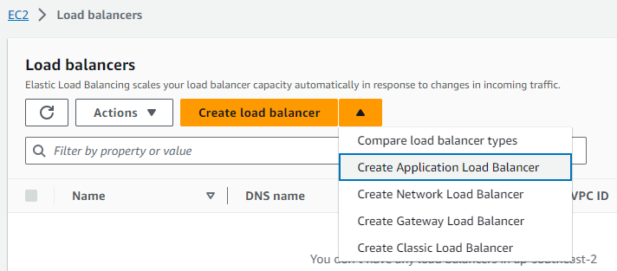
Set up an ALB (Application Load Balancer)
Navigate to EC2 Dashboard and Click “Load balancers”

Slide 43
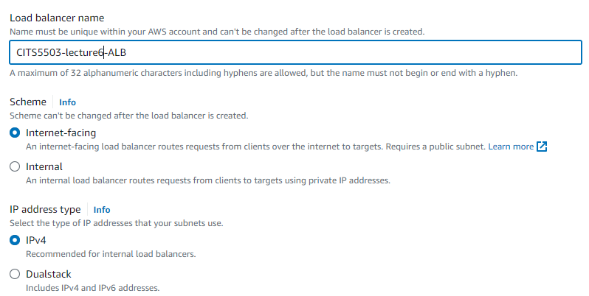
Set up an ALB
Basic configuration

Slide 44
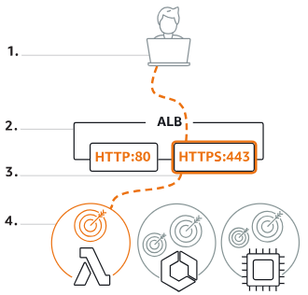
Scheme
Internet-facing indicates the ALB has a public IP address.
Internal means the ALB has a private IP address.
Both schemes route the client’s requests to targets’ private IP addresses.
Targets do NOT need public IP addresses to receive requests from the ALB.

Slide 45
Set up an ALB
Basic configuration

Slide 46
IP address type
IPv4 (Internet Protocol version 4)
Dualstack includes IPv4 and IPv6 (Internet Protocol version 6)
IPv4: it is widely used in real-world.
What is the main reason why IPv6 is needed?

Slide 47
IP address type
IPv4: it is widely used in real-world.
What is the main reason why IPv6 is needed?
IPv4 uses an address format with 4 bytes (32 bits)
IPv4 allows for about 4.3 billion addresses: 2^32= 2^32
The number of internet-connected devices has been increasing all the time.
IPv6 uses an address format with 16 bytes (128 bits)
IPv4 allows for a much larger of number of addresses: 2^128

Slide 48
IP address type
How to address the IPv4 exhaustion problem?
Fundamental solution: IPv6.
Mitigation: network address translation (NAT) and private IPv4 address ranges.

Slide 49
NAT and private IP address range
NAT: it is a way to map multiple private IPv4 addresses inside an internal network to a public IPv4 address before transmitting data to the internet.
All the devices in an internal network use a single public IPv4 address.
Private IPv4 address range: it is a reserved IP address block that is not routable on the internet.
It is used for internal communication among devices within the same internal/private network.
Three address ranges:
Range | CIDR | Total Addresses
10.0.0.0 to 10.255.255.255 | 10.0.0.0/8 | 2^24 (24 = 32 – 8)
172.16.0.0 to 172.31.255.255 | 172.16.0.0/12 | 2^20 (20 = 32 – 12)
192.168.0.0 to 192.168.255.255 | 192.168.0.0/16 | 2^16 (16 = 32 – 16)

Slide 50
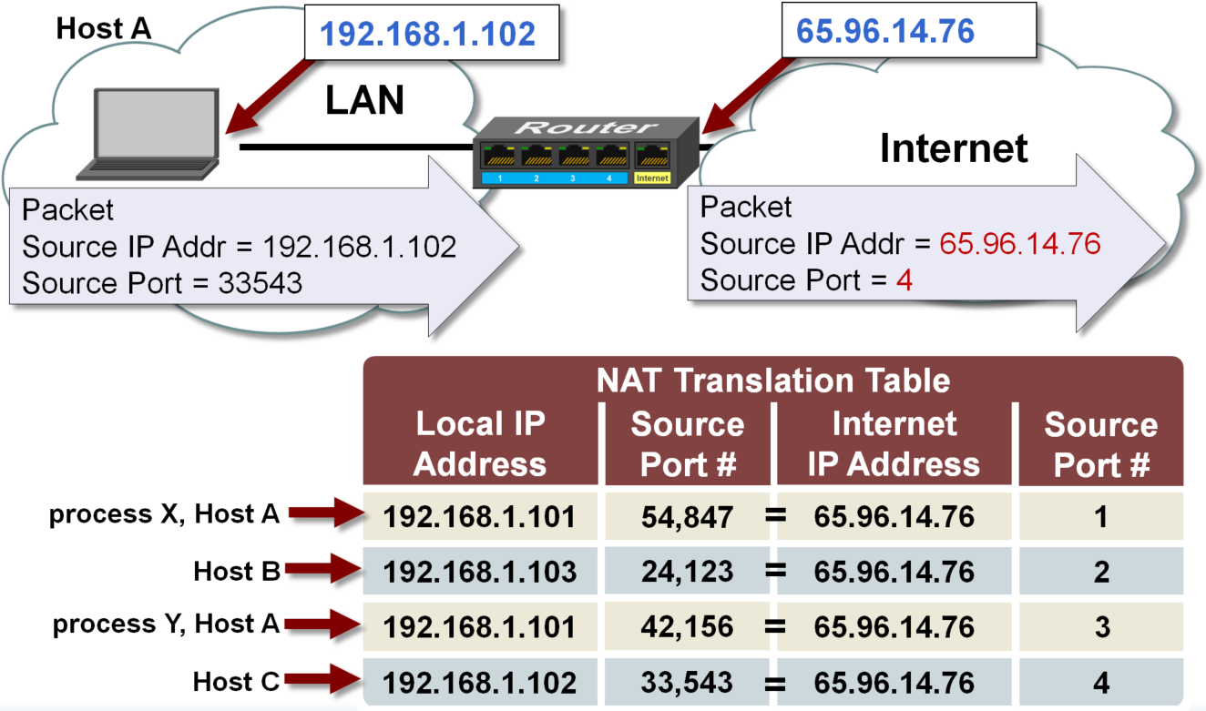
How NAT works
Notes:
50

Slide 51
How NAT works
Is the router directly accessible from the internet?
Is Host C directly accessible from the internet?
Notes:
51

Slide 52
Set up an ALB
Basic configuration

Slide 53
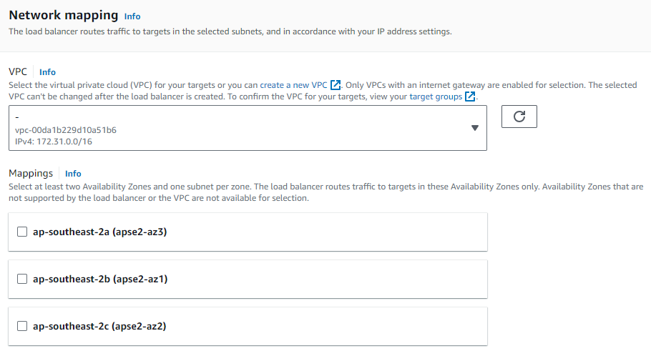
Set up an ALB
Network configuration

Slide 54
VPC
VPC (virtual private cloud): it is a virtual network dedicated to an AWS account.
It is logically isolated from other virtual networks in the AWS Cloud.
Internet gateway: provides VPC with internet access
Manage outbound traffic to the internet and inbound traffic to the AWS resources.
Subnet: it is a range of IP addresses in a VPC.
It is used to divide a VPC into multiple logical sub-networks.
It can be either public or private sub-network.
It must reside entirely within one Availability Zone.

Slide 55
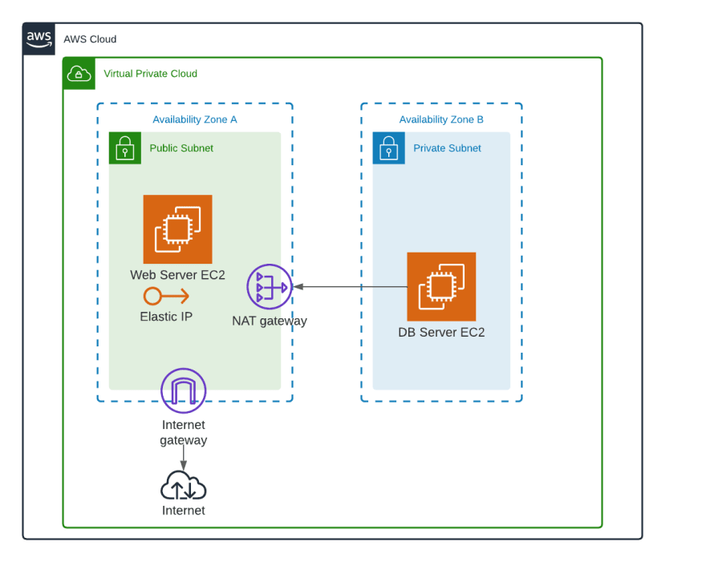
An example

Slide 56
An example
Is the Web Server EC2 directly accessible from the internet?
Is the DB Server EC2 directly accessible from the internet?
Is the NAT gateway directly accessible from the internet?

Slide 57
An example
Is the Web Server EC2 directly accessible from the internet? Yes
Is the DB Server EC2 directly accessible from the internet? No
Is the NAT gateway directly accessible from the internet? No

Slide 58
Set up an ALB
Network configuration

Slide 59
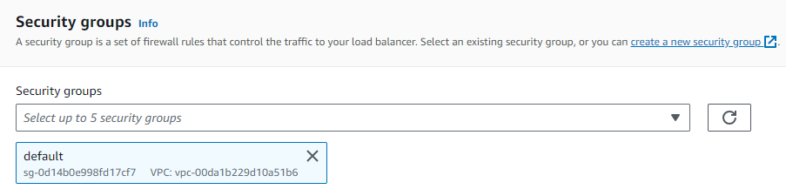
Security group

Slide 60
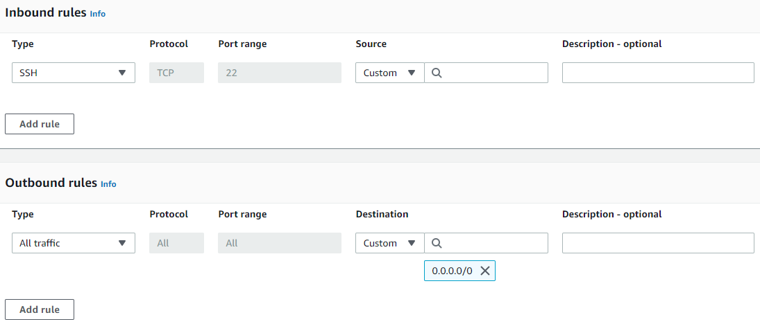
Security group

Slide 61
Security group
HTTP

Slide 62
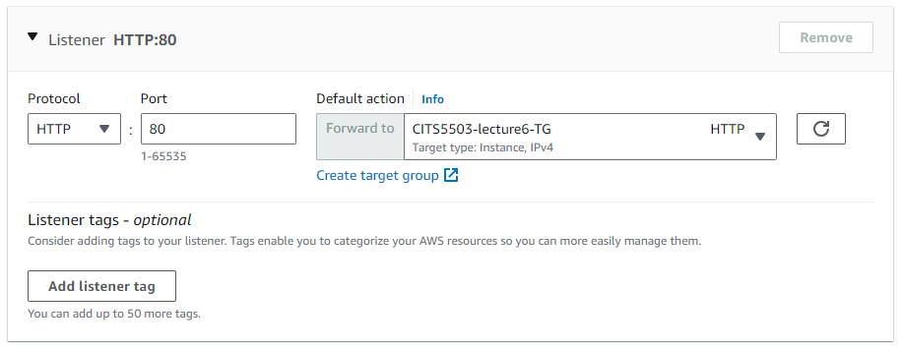
Listeners and routing
Listener: it is a process that checks network requests using the protocol and port we configure.
A Listener in ALB supports protocols and ports:
Protocols: HTTP, HTTPS with Ports: 1-65535

Slide 63
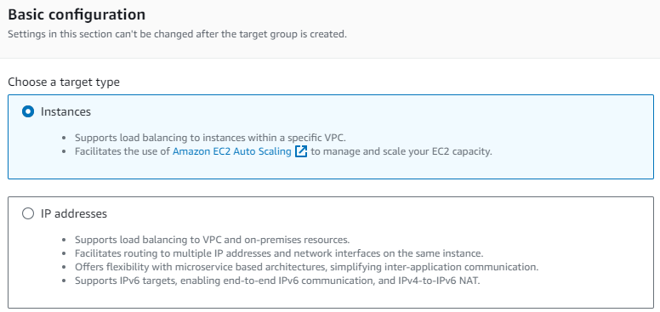
Create target group
Instance: specify targets via EC2 instance IDs.
IP Address: specify targets via IP addresses or IP address ranges.

Slide 64
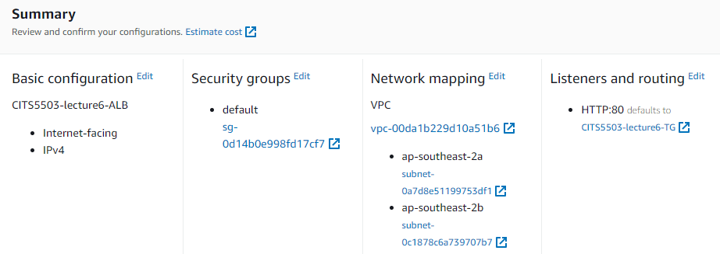
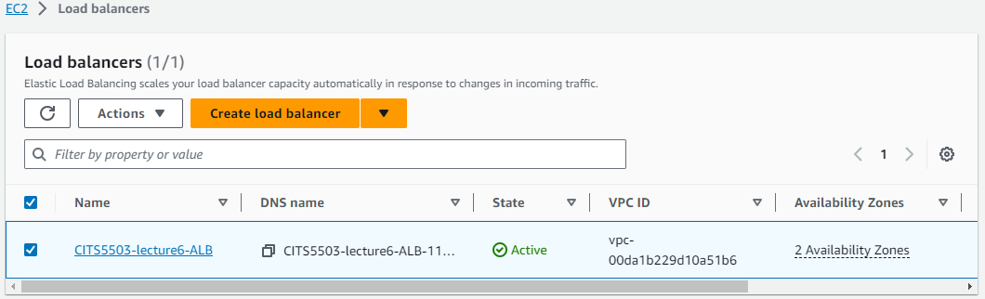

Slide 65

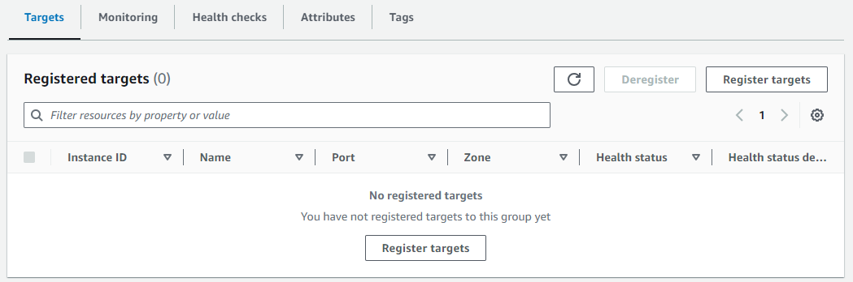

Slide 66
Practice Question
Q: Discuss 3 reasons why you would use Application Load Balancing to load balance a Python Django application.

Slide 67
Q: Discuss 3 reasons why you would use Application Load Balancing to load balance a Python Django application.
Reasons
High fault-tolerance: the ALB can distribute traffic to multiple targets in multiple groups, making the Django application healthy and improving its fault-tolerance.
High scalability: As the ALB can distribute traffic evenly, the Django application can be scaled horizontally. For example, when traffic increases, more targets can be added, and the ALB can distribute traffic to them.
Well aligned: Django is a web framework accepting http and https requests. The main responsibility of ALB is to optimize http and https traffic.

