Slide 1
CITS5503 Final Exam
Dr Zhi Zhang

Slide 2
My research on cloud security
Final exam
Practice questions

Slide 3
Research on cloud security
Introduction to some concepts in public cloud security
A Cross-VM attack

Slide 4
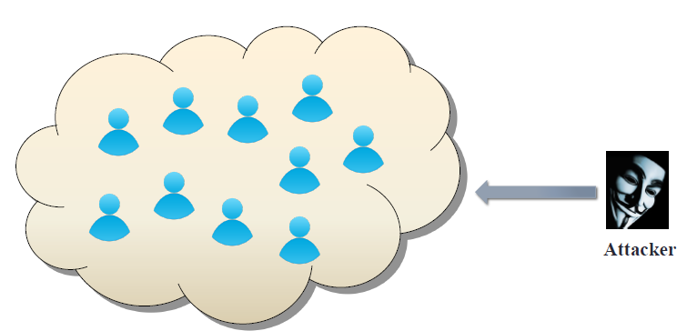
Public cloud becomes tempting target
Valuable targets:
  banking, medical information, LLM/DNN models

Slide 5
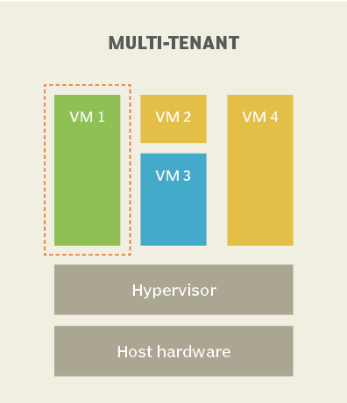
Key Terms
Multi-tenancy:
  IaaS clouds multiplex virtual machines (VMs) of disjoint customers upon the same physical machines.
Co-residency:
  A malicious VM is co-resident with a target VM upon the same physical machine.

Slide 6
Key Terms
Multi-tenancy:
Co-residency:
Placement:

Slide 7
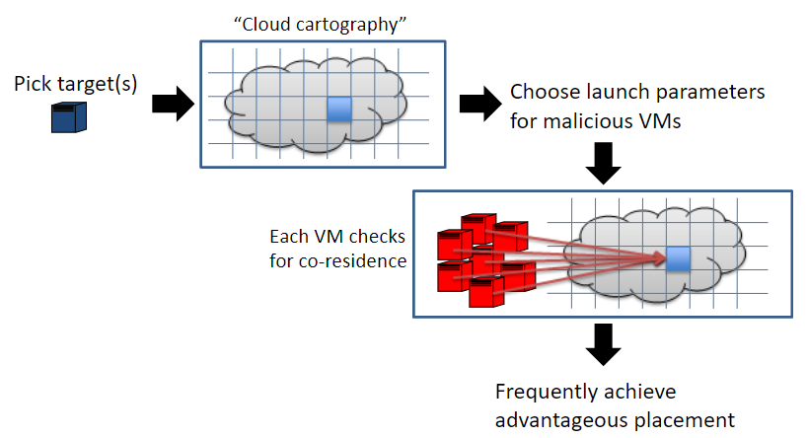
Achieve placement
2
1

Slide 8
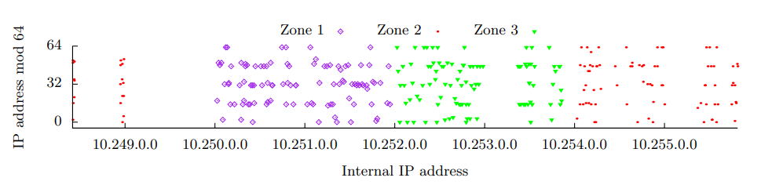
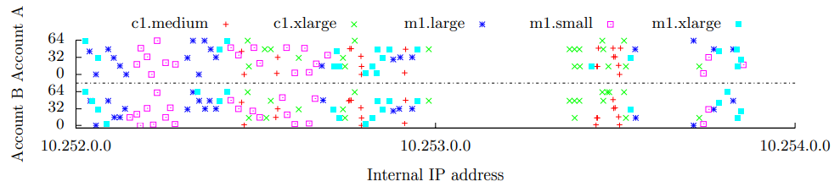
Cloud cartography
Ristenpart et al. [CCS’09]

Slide 9
Achieve placement
2
1
3
4
5

Slide 10
Key Terms
Multi-tenancy:
Co-residency:
Placement:
Cross-VM attack:
  The adversary from the malicious VM breaks data confidentiality or integrity against the target VM, so-called cross-VM attack.
    e.g., hardware fault attack
  Hardware-fault attacks: the adversary disrupts the normal operations of the computer hardware, compromising the integrity of the victim or the whole system.
    Depleting DNN Model Inference Accuracy through Rowhammer
      (Top 0.8% of submissions, Best Paper Award in USENIX SECURITY’24.)

Slide 11
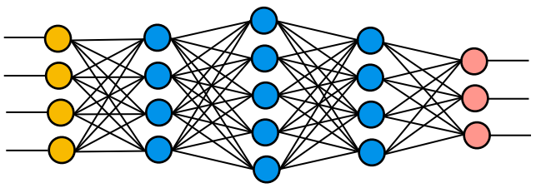

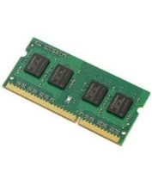
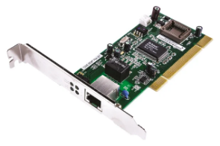
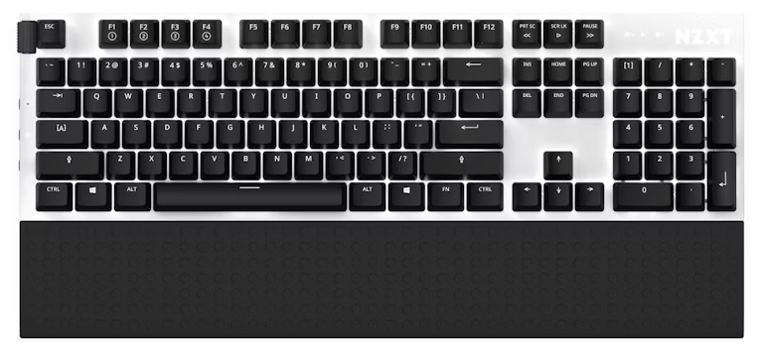

Depleting DNN Model Inference Accuracy through Rowhammer
Malicious VM
Victim VM
VMM/Hypervisor
SW
HW
DRAM memory is prone to rowhammer faults.

Slide 12
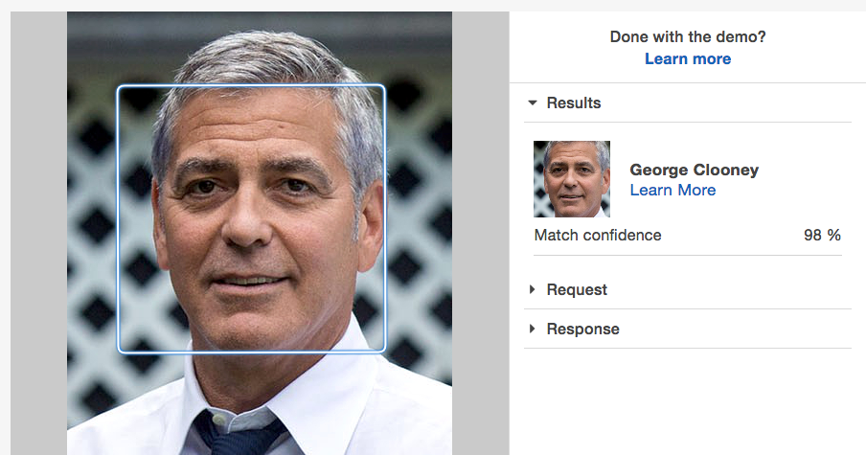
Inference: A well-trained DNN model

Slide 13


What is Rowhammer ?
Frequently accessing
Rowhammer:
DRAM rows

Slide 14
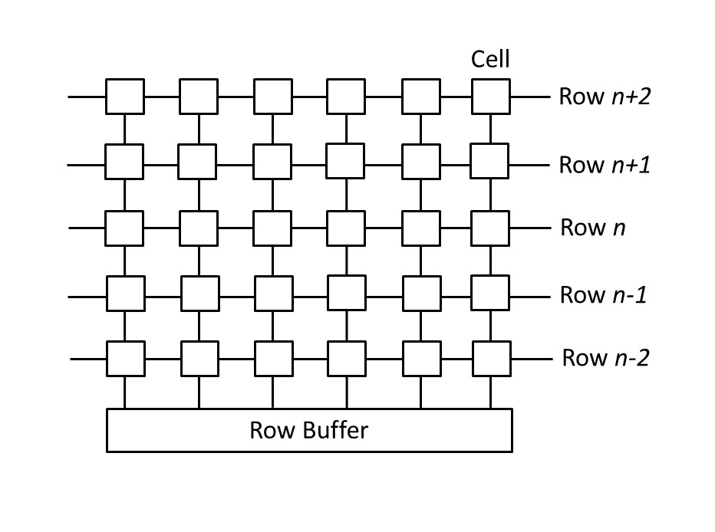
A memory access opens a DRAM bank
A bank has rows of cells
A cell is either charged or discharged to store bit 0 or 1
Row buffer facilitates memory access
Alternating row access clears row buffer

Slide 15
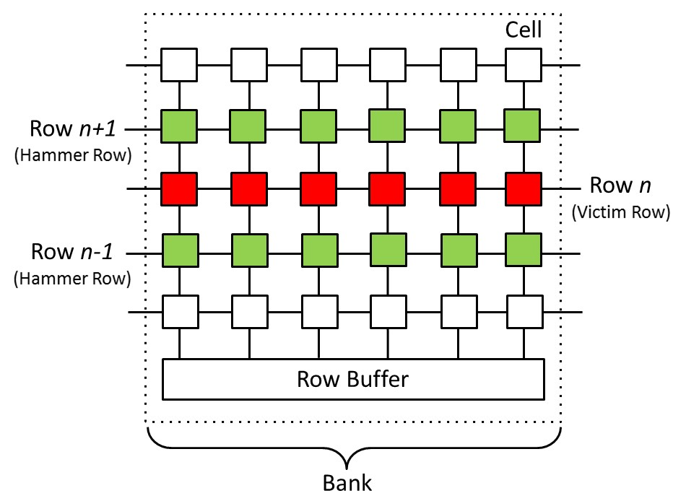
Rowhammer Fault
frequently activating rows n+1 & n-1 cause permanent charge leakage (bit flips) in row n

Slide 16
Rowhammer Fault
frequently activating rows n+1 & n-1 cause permanent charge leakage (bit flips) in row n
Not only DDR3 but also DDR4 and DDR5
are vulnerable to rowhammer fault

Slide 17
Rowhammer code on x86
1 loop:
2 mov (X), %eax
3 mov (Y), %ebx
4 clflush (X)
5 clflush (Y)
6 jmp loop
What is the purpose of lines 2-3?
Clear row buffer (e.g., alternate access)

Slide 18
Rowhammer code on x86
1 loop:
2 mov (X), %eax
3 mov (Y), %ebx
4 clflush (X)
5 clflush (Y)
6 jmp loop
What is the purpose of lines 4-5?
flush CPU cache (e.g., clflush)

Slide 19
Hammer pattern
1 loop:
2 mov (X), %eax
3 mov (Y), %ebx
4 clflush (X)
5 clflush (Y)
6 jmp loop
Double-sided hammer
  X and Y are adjacent to the target row
Single-sided hammer
  Either X or Y is adjacent to the target row
Common
  X and Y must be in the same bank to clear row buffer

Slide 20
The workflow of the attack
Search target ML library for an exploitable instruction
Trick the system into placing the instruction
onto a victim page
Trigger a rowhammer fault to flip the instruction

Slide 21

Depleting DNN Model Inference Accuracy through Rowhammer
DNN Model
Rowhammer Code
hammer page
victim page
hammer page
ML Library
Attacker VM
DRAM Memory
Victim VM

Slide 22
Search target ML library for an exploitable instruction
An exploitable instruction: is a conditional check in a matrix-computation function

Slide 23
Flipping exploitable instruction
Opcode
Operands
CMP EAX, 0
JE
target
0x74
0x05
What if a bit flip occurs to the opcode of JE?

Slide 24
Flipping exploitable instruction
Opcode
Operands
One Bit-Flip
Opcode’
Operands
JE
0x74
CMP EAX, 0
JNE
0x75

Slide 25
Exam Format
The exam is F2F and has a time limit of 2 hours
The exam is marked out of 100 points and is worth 60% of the overall unit mark.
The exam is open book: any printed or written materials are allowed (no page limit).
UWA approved calculators with stickers are optional.
  e.g., 2^5 - 2 or 32 -2 or 30.

Slide 26
Exam Instructions
  You will be provided with an answer booklet
  You should clearly state which questions of the final exam you are answering.
  Please do NOT use a pencil or a red pen.
  Please use readable handwriting. What cannot be read cannot be marked.

Slide 27
Exam Topics
5 themed questions in total. In each themed question, a few sub-questions are asked.
The format of sub questions is similar to that of part C in the mid-sem test, i.e., short answer questions.
Each themed question will assess one of the following topics from certain lectures and labs:
  Networking: Week 7+12 lectures
  AWS IAM: Week 5 lecture
  DynamoDB: Week 4 lecture (excluding virtualization) + Week 5 lecture
  Load Balancing: Weeks 5+7 lectures + Lab 5 (only ALB)
  Miscellaneous:
    Week 9 lecture (only Web Application Design Pattern + Django Framework) + Week 10 lecture (only AWS Lambda) + Lab 6 (only Ngix)
Note: the AWS management console screenshots in the step-by-step demos from the lectures above are not part of the final exam.

Slide 28
Exam Topics (Supplementary and Deferred)
5 themed questions in total. In each themed question, a few sub-questions are asked.
The format of sub questions is similar to that of part C in the mid-sem test, i.e., short answer questions.
Each themed question will assess one of the following topics from certain lectures and labs:
  Networking: Week 7+12 lectures
  AWS IAM: Week 5 lecture
  DynamoDB: Week 4 lecture (excluding virtualization) + Week 5 lecture
  Load Balancing: Weeks 5+7 lectures + Lab 5 (only ALB)
  Miscellaneous:
    Week 9 lecture (only Web Application Design Pattern + Django Framework) + Week 10 lecture (only AWS Lambda) + Lab 6 (only Ngix)
Note: the AWS management console screenshots in the step-by-step demos from the lectures above are not part of the final exam.

Slide 29
To prepare for the exam
Carefully review relevant lectures and labs.
Practice questions from past years.
  Note: Questions related to this year’s topics are selected.

Slide 30
Q1: A network can be defined as a group of computers and other devices connected for data exchange.
Part 1. Suppose a public IPv4 address has a CIDR notation of 200.100.50.0/24, this specifies the subnet where the IPv4 address resides. How many IPv4 addresses does this subnet have? Justify your answer.
Part 2. If the Internet service provider divides the original /24 subnet using /29, how many small subnets will be created? For each created subnet, How many hosts does it have? Justify your answer.
Part 3. When a message is sent from a host machine, it passes through the 5 layers of the TCP/IP model, a process called data encapsulation. For each of the following, identify which layer adds the specific information. Answer in the order listed:
1. Which layer adds the port numbers?
2. Which layer adds the IP addresses?
3. Which layer adds the MAC addresses?
Notes:
30

Slide 31
Q1: A network can be defined as a group of computers and other devices connected for data exchange.
Part 1. Suppose a public IPv4 address has a CIDR notation of 200.100.50.0/24, this specifies the subnet where the IPv4 address resides. How many IPv4 addresses does this subnet have? Justify your answer.
Notes:
31

Slide 32
Q1: A network can be defined as a group of computers and other devices connected for data exchange.
Part 1. Suppose a public IPv4 address has a CIDR notation of 200.100.50.0/24, this specifies the subnet where the IPv4 address resides. How many IPv4 addresses does this subnet have? Justify your answer.
Answer:
the notation "/24" indicates a subnet mask of 24 bits, leaving 32-24 = 8 bits for the host portion of the IP address. Total IPv4 Addresses in a /24 subnet: 2^8 = 256 addresses.
Notes:
32

Slide 33
Q1: A network can be defined as a group of computers and other devices connected for data exchange.
Part 2. If the Internet service provider divides the original /24 subnet using /29, how many small subnets will be created? For each created subnet, How many hosts does it have? Justify your answer.
Notes:
33

Slide 34
Q1: A network can be defined as a group of computers and other devices connected for data exchange.
Part 2. If the Internet service provider divides the original /24 subnet using /29, how many small subnets will be created? For each created subnet, How many hosts does it have? Justify your answer.
Answer:
when dividing a /24 subnet into /29 subnets, the ISP is using additional 5 bits to create small subnets (29 - 24 = 5). The number of subnets created: 2^(29 - 24) = 2^5 = 32 subnets.
Within each of the small /29 subnets, 3 (32 - 29) bits are available for host addresses. Total host addresses per /29 Subnet: 2^3 -2 = 6.
Notes:
34

Slide 35
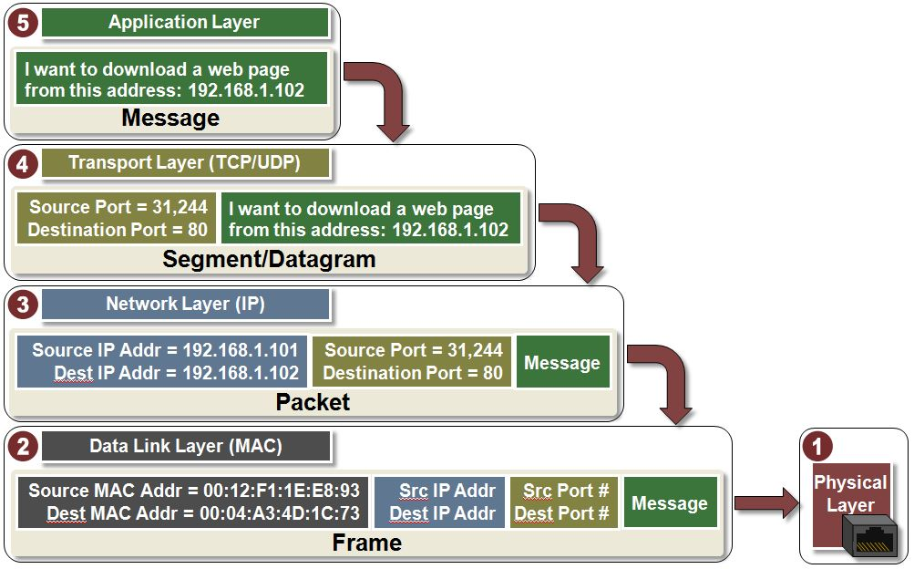
Part 3. When a message is sent from a host machine, it passes through the 5 layers of the TCP/IP model, a process called data encapsulation. For each of the following, identify which layer adds the specific information. Answer in the order listed:
1. Which layer adds the port numbers?
2. Which layer adds the IP addresses?
3. Which layer adds the MAC addresses?
Notes:
35

Slide 36
Part 3. When a message is sent from a host machine, it passes through the 5 layers of the TCP/IP model, a process called data encapsulation. For each of the following, identify which layer adds the specific information. Answer in the order listed:
1. Which layer adds the port numbers?
2. Which layer adds the IP addresses?
3. Which layer adds the MAC addresses?
Answer: Transport Layer, Network Layer, Data Link Layer
Notes:
36

Slide 37
Q2: IAM
Bob is a system engineer at an internet company. One of his main jobs is to maintain their e-commerce applications that are hosted by AWS cloud. He is responsible for managing AWS resources including the AWS accounts in his company.
Part 1. His boss doesn't have much knowledge about cloud computing and is concerned about the security of AWS. Help Bob list and describe 3 critical security measures implemented by AWS.
Part 2. Suppose only AWS managed policies are available to Bob, what policy should Bob have? Justify your answer.
Part 3. Alice is a new employee at Bob's company, responsible for developing a component of their e-commerce application. She needs access to AWS resources for updates but is not allowed to manage IAM, organizations, or account services (i.e., limited access to these three services). Still, only AWS-managed policies are available, so what policy should Alice have? Justify your answer.
Notes:
37

Slide 38
Q2: IAM
Bob is a system engineer at an internet company. One of his main jobs is to maintain their e-commerce applications that are hosted by AWS cloud. He is responsible for managing AWS resources including the AWS accounts in his company.
Part 1. His boss doesn't have much knowledge about cloud computing and is concerned about the security of AWS. Help Bob list and describe 3 critical security measures implemented by AWS.
Notes:
38

Slide 39
Q2: IAM
Bob is a system engineer at an internet company. One of his main jobs is to maintain their e-commerce applications that are hosted by AWS cloud. He is responsible for managing AWS resources including the AWS accounts in his company.
Part 1. His boss doesn't have much knowledge about cloud computing and is concerned about the security of AWS. Help Bob list and describe 3 critical security measures implemented by AWS.
Answer:
Data Encryption: AWS uses various encryption algorithms such as AES and RSA to encrypt data, ensuring the confidentiality of data during transmission and storage.
Instance Isolation. AWS allows virtual machines to run in their isolated and secure environments, mitigating mutual interference among them.
User Authorization: AWS uses policies to determine what actions or resources authenticated users are allowed to access or perform, preventing damage due to the unauthorized actions.
Notes:
39

Slide 40
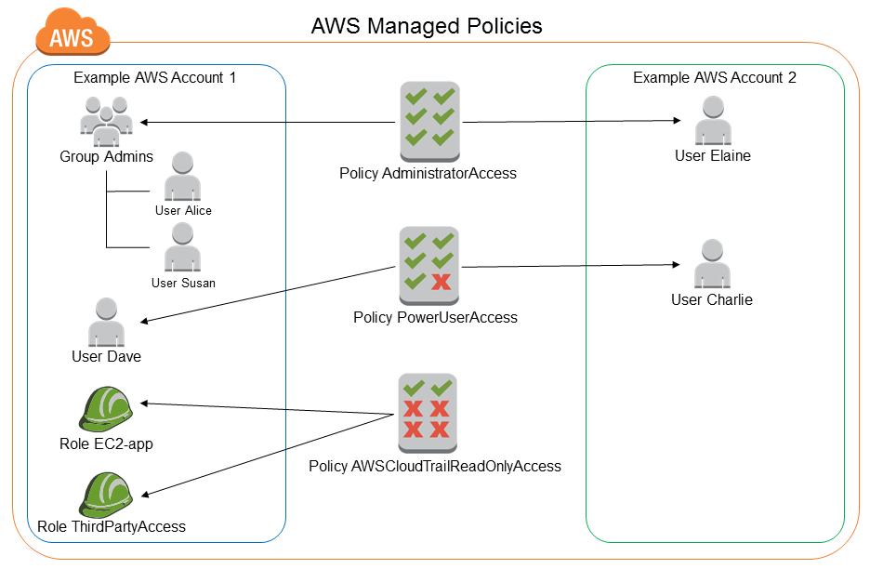
Q2: IAM
Bob is a system engineer at an internet company. One of his main jobs is to maintain their e-commerce applications that are hosted by AWS cloud. He is responsible for managing AWS resources including the AWS accounts in his company.
Part 2: Suppose only AWS managed policies are available to Bob, what policy should Bob have? Justify your answer.
Notes:
40

Slide 41
Q2: IAM
Bob is a system engineer at an internet company. One of his main jobs is to maintain their e-commerce applications that are hosted by AWS cloud. He is responsible for managing AWS resources including the AWS accounts in his company.
Part 2: Suppose only AWS managed policies are available to Bob, what policy should Bob have? Justify your answer.
Answer:
Bob should have AdministratorAccess.
Reason: AdministratorAccess grants full access to any AWS service and resource, which should be attached to Bob, as he is a maintainer and has complete management control over accounts, services, and policies to configure appropriate permissions for users in his company.
Notes:
41

Slide 42
Q2: IAM
Bob is a system engineer at an internet company. One of his main jobs is to maintain their e-commerce applications that are hosted by AWS cloud. He is responsible for managing AWS resources including the AWS accounts in his company.
Part 3: Alice is a new employee at Bob's company, responsible for developing a component of their e-commerce application. She needs access to AWS resources for updates but is not allowed to manage IAM, organizations, or account services (i.e., limited access to these three services). Still, only AWS-managed policies are available, so what policy should Alice have? Justify your answer.
Notes:
42

Slide 43
Q2: IAM
Bob is a system engineer at an internet company. One of his main jobs is to maintain their e-commerce applications that are hosted by AWS cloud. He is responsible for managing AWS resources including the AWS accounts in his company.
Part 3: Alice is a new employee at Bob's company, responsible for developing a component of their e-commerce application. She needs access to AWS resources for updates but is not allowed to manage IAM, organizations, or account services (i.e., limited access to these three services). Still, only AWS-managed policies are available, so what policy should Alice have? Justify your answer.
Answer:
Alice should have PowerUserAccess
Reasons: PowerUserAccess provides Alice with broad access to AWS resources, such as EC2 instances and S3 buckets, but except the management permission of IAM, organizations and account. It is aligned with the role of Alice.
Notes:
43

Slide 44
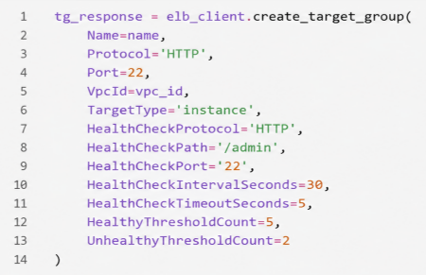
Q3: Load Balancing
The following code creates a target group for an Application Load Balancer. The target group forwards HTTP requests to EC2 instances listening on port 80. One EC2 instance has a private IPv4 address 10.0.1.25. It also performs periodic health checks to determine whether the instances are healthy. The web server is configured to use the root path / for health checks.
Part 1. Based on the background information above, construct the HTTP URL that the load balancer would send to the EC2 instance with IP address 10.0.1.25 for a health check, and explain what this request is used to determine.
Part 2. The code above contains three logical errors. Identify the line number of each error, and describe how it should be corrected.
Part 3. What happens if an EC2 instance fails the health check?
Notes:
44

Slide 45
Q3: Load Balancing
The following code creates a target group for an Application Load Balancer. The target group forwards HTTP requests to EC2 instances listening on port 80. One EC2 instance has a private IPv4 address 10.0.1.25. It also performs periodic health checks to determine whether the instances are healthy. The web server is configured to use the root path / for health checks.
Part 1. Based on the background information above, construct the HTTP URL that the load balancer would send to the EC2 instance with IP address 10.0.1.25 for a health check, and explain what this request is used to determine.
Notes:
45

Slide 46
Q3: Load Balancing
The following code creates a target group for an Application Load Balancer. The target group forwards HTTP requests to EC2 instances listening on port 80. One EC2 instance has a private IPv4 address 10.0.1.25. It also performs periodic health checks to determine whether the instances are healthy. The web server is configured to use the root path / for health checks.
Part 1. Based on the background information above, construct the HTTP URL that the load balancer would send to the EC2 instance with IP address 10.0.1.25 for a health check, and explain what this request is used to determine.
Answer:
The URL is: http://10.0.1.25:80/
The load balancer periodically sends a request to the URL to check whether the instance is responding.
Notes:
46

Slide 47
Q3: Load Balancing
Part 2. The code contains three logical errors. Identify the line number of each error, and describe how it should be corrected.
Notes:
47

Slide 48
Q3: Load Balancing
Part 2. The code contains three logical errors. Identify the line number of each error, and describe how it should be corrected.
Answer:
Lines 4 and 9 are incorrect because both port numbers should be 80 instead of 22.
Line 8 is incorrect. ‘/admin’ should be corrected to ‘/’.
Notes:
48

Slide 49
Q3: Load Balancing
Part 3. What happens if an EC2 instance fails the health check?
Notes:
49

Slide 50
Q3: Load Balancing
Part 3. What happens if an EC2 instance fails the health check?
Answer:
The load balancer stops forwarding new requests to the unhealthy instance.
Notes:
50

Slide 51
Q4: IAM and Django
Tom is a web developer and tasked with setting up a Django web application for music sharing. To host the application, Tom rents an EC2 instance. For the first month, the website works properly. However, as the website becomes increasingly popular, the website response is getting slower and sometimes it even crashes.
Part 1. Which aspect of the CIA triad has been compromised with regard to the crash? Justify your answer.
Part 2. To address the issue above, both vertical and horizontal scale are effective solutions. First, describe each of the two concepts. Then, explain how vertical scaling with AWS and horizontal scaling with AWS can help Tom scale the website.
Notes:
51

Slide 52
Q4: IAM and Django
Tom is a web developer and tasked with setting up a Django web application for music sharing. To host the application, Tom rents an EC2 instance. For the first month, the website works properly. However, as the website becomes increasingly popular, the website response is getting slower and sometimes it even crashes.
Part 1. Which aspect of the CIA triad has been compromised with regard to the crash? Justify your answer.
Notes:
52

Slide 53
Q4: IAM and Django
Tom is a web developer and tasked with setting up a Django web application for music sharing. To host the application, Tom rents an EC2 instance. For the first month, the website works properly. However, as the website becomes increasingly popular, the website response is getting slower and sometimes it even crashes.
Part 1. Which aspect of the CIA triad has been compromised with regard to the crash? Justify your answer.
Answer:
Availability
because the website is inaccessible to users
Notes:
53

Slide 54
Q4: IAM and Django
Part 2. To address the issue above, both vertical and horizontal scale are effective solutions. First, describe each of the two concepts. Then, explain how vertical scaling with AWS and horizontal scaling with AWS can help Tom scale the website.
Notes:
54

Slide 55
Q4: IAM and Django
Part 2. To address the issue above, both vertical and horizontal scale are effective solutions. First, describe each of the two concepts. Then, explain how vertical scaling with AWS and horizontal scaling with AWS can help Tom scale the website.
Answer:
Vertical scaling involves increasing the resources of a single instance to handle increased load.
Vertical Scaling using AWS can be EC2 Instance Upgrade. Tom can vertically scale by upgrading the EC2 instance to a more powerful instance type.
Horizontal scaling involves adding more instances or resources to distribute the load and improve application performance.
Horizontal Scaling using AWS can be ALB. Tom can set up an Application Load Balancer to distribute incoming traffic across newly added instances.
Notes:
55

Slide 56
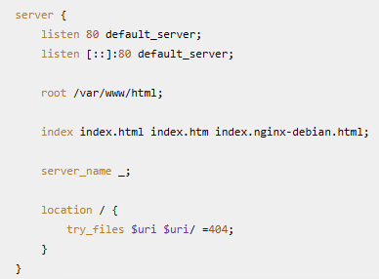
Q5: Nginx
Alex is a web developer who has deployed a Django-based music sharing web application on an Ubuntu EC2 instance. Nginx is also installed on the instance to handle web requests. After installing Nginx on the instance, Alex examines the default /etc/nginx/sites-enabled/default configuration.
Part 1. What type of web content does this Nginx configuration serve: dynamic or static? Justify your answer.
Part 2. Where in the local filesystem is the web content stored?
Part 3. What happens if the requested file or directory does not exist?
Notes:
56

Slide 57
Q5: Nginx
Part 1. What type of web content does this Nginx configuration serve: dynamic or static? Justify your answer.
Notes:
57

Slide 58
Q5: Nginx
Part 1. What type of web content does this Nginx configuration serve: dynamic or static? Justify your answer.
Answer:
Static. Because the directive root /var/www/html tells Nginx to serve files directly from the directory.
Notes:
58

Slide 59
Q5: Nginx
Part 2. Where in the local filesystem is the web content stored?
Notes:
59

Slide 60
Q5: Nginx
Part 2. Where in the local filesystem is the web content stored?
Answer:
/var/www/html
Notes:
60

Slide 61
Q5: Nginx
Part 3. What happens if the requested file or directory does not exist?
Notes:
61

Slide 62
Q5: Nginx
Part 3. What happens if the requested file or directory does not exist?
Answer:
404 Not Found (or 404).
Notes:
62

Slide 63
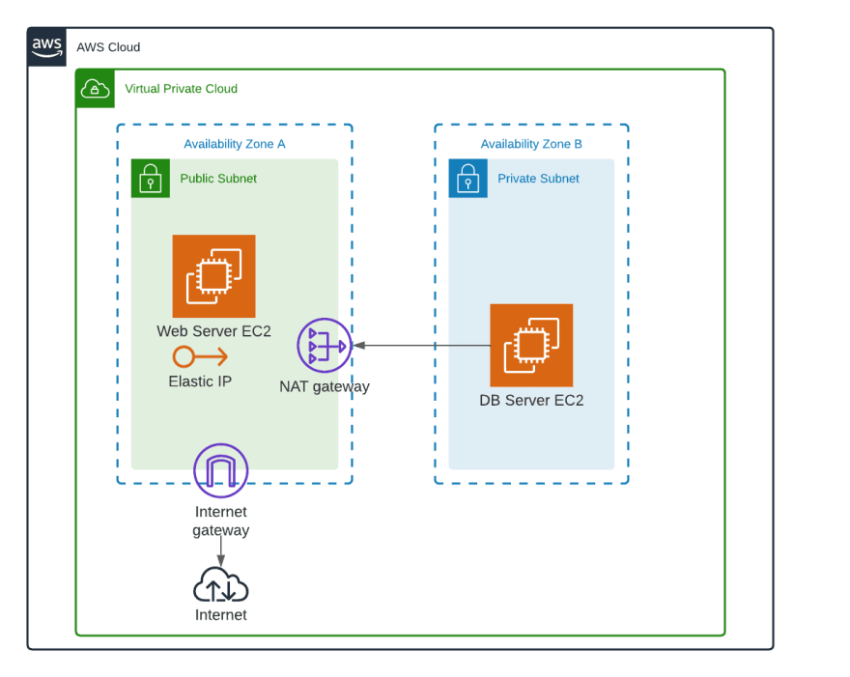
Q6: Web application deployment in AWS
A company deploys a Web Server and a DB Server in the same VPC with CIDR block 10.0.0.0/16. As shown in the diagram below, the Web Server is in a public subnet, and the DB Server is in a private subnet. The public subnet’s route table is shown below.
Part 1. The Web Server sends a packet to the DB Server at 10.0.2.10. Which route will AWS use to forward this packet. Justify your answer.
Part 2. Does traffic from the Web Server in the public subnet to the DB Server in the private subnet need to pass through the NAT Gateway? Justify your answer.
Part 3. Introduce an additional AWS service that improves the diagram so that end users can still access the web application without directly exposing the Web Server EC2 instance to end users?
Destination | Target
10.0.0.0/16 | local
0.0.0.0/0 | Internet gateway

Slide 64
Q6: Web application deployment in AWS
A company deploys a Web Server and a DB Server in the same VPC with CIDR block 10.0.0.0/16. As shown in the diagram below, the Web Server is in a public subnet, and the DB Server is in a private subnet. The public subnet’s route table is shown below.
Part 1. The Web Server sends a packet to the DB Server at 10.0.2.10. Which route will AWS use to forward this packet? Justify your answer.
Destination | Target
10.0.0.0/16 | local
0.0.0.0/0 | Internet gateway

Slide 65
Q6: Web application deployment in AWS
A company deploys a Web Server and a DB Server in the same VPC with CIDR block 10.0.0.0/16. As shown in the diagram below, the Web Server is in a public subnet, and the DB Server is in a private subnet. The public subnet’s route table is shown below.
Part 1. The Web Server sends a packet to the DB Server at 10.0.2.10. Which route will AWS use to forward this packet? Justify your answer.
Answer: the first route. because IP 10.0.2.10 matches the destination 10.0.0.0/16. Although 0.0.0.0/0 also matches the destination, AWS uses longest-prefix matching, so /16 is more specific than /0.
Destination | Target
10.0.0.0/16 | local
0.0.0.0/0 | Internet gateway

Slide 66
Q6: Web application deployment in AWS
A company deploys a Web Server and a DB Server in the same VPC with CIDR block 10.0.0.0/16. As shown in the diagram below, the Web Server is in a public subnet, and the DB Server is in a private subnet. The public subnet’s route table is shown below.
Part 2. Does traffic from the Web Server in the public subnet to the DB Server in the private subnet need to pass through the NAT Gateway? Justify your answer.
Destination | Target
10.0.0.0/16 | local
0.0.0.0/0 | Internet gateway

Slide 67
Q6: Web application deployment in AWS
A company deploys a Web Server and a DB Server in the same VPC with CIDR block 10.0.0.0/16. As shown in the diagram below, the Web Server is in a public subnet, and the DB Server is in a private subnet. The public subnet’s route table is shown below.
Part 2. Does traffic from the Web Server in the public subnet to the DB Server in the private subnet need to pass through the NAT Gateway? Justify your answer.
Answer: No. Because both public and private subnets share the CIDR block 10.0.0.0/16, the traffic from the web server to the DB server always uses the first route. The target is local, meaning that the traffic is routed directly within the VPC. So the NAT Gateway is not used for communication between the two subnets.
Destination | Target
10.0.0.0/16 | local
0.0.0.0/0 | Internet gateway

Slide 68
Q6: Web application deployment in AWS
A company deploys a Web Server and a DB Server in the same VPC with CIDR block 10.0.0.0/16. As shown in the diagram below, the Web Server is in a public subnet, and the DB Server is in a private subnet. The public subnet’s route table is shown below.
Part 3. Introduce an additional AWS service that improves the diagram so that end users can still access the web application without directly exposing the Web Server EC2 instance to end users?
Destination | Target
10.0.0.0/16 | local
0.0.0.0/0 | Internet gateway

Slide 69
Q6: Web application deployment in AWS
A company deploys a Web Server and a DB Server in the same VPC with CIDR block 10.0.0.0/16. As shown in the diagram below, the Web Server is in a public subnet, and the DB Server is in a private subnet. The public subnet’s route table is shown below.
Part 3. Introduce an additional AWS service that improves the diagram so that end users can still access the web application without directly exposing the Web Server EC2 instance to end users?
Answer: Application Load Balancer
Destination | Target
10.0.0.0/16 | local
0.0.0.0/0 | Internet gateway

