Slide 1
Week 9 Web Application Architecture and Design Pattern
Dr Zhi Zhang

Slide 2
Guest Lecture by Vaibhav Agrawal on 30 September
Practical AI Governance – A Practitioner’s Playbook
Deploy narrow AI for maximum impact
Harness generative AI as an orchestrator
Build governance that drives results, not red tape

Slide 3
Mid-sem test
Over 88% passed the test
36% achieved D/HD
The average score is over 39

Slide 4
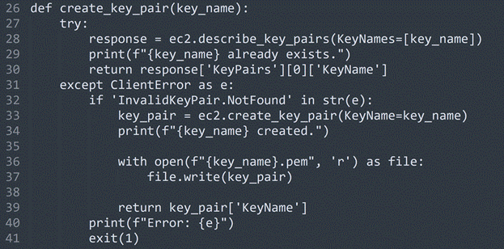
Q2.c
There are TWO programming errors within the create_key_pair function. Describe what the two errors are. Note the two errors are in two different lines and you should specify the line number when explaining an error.

Slide 5
Q2.c
Answer:
Line 36: 'r' should be 'w'.

Slide 6
Q2.c
Answer:
Line 36: 'r' should be 'w'.
Line 37: key_pair should be key_pair['KeyMaterial'].

Slide 7
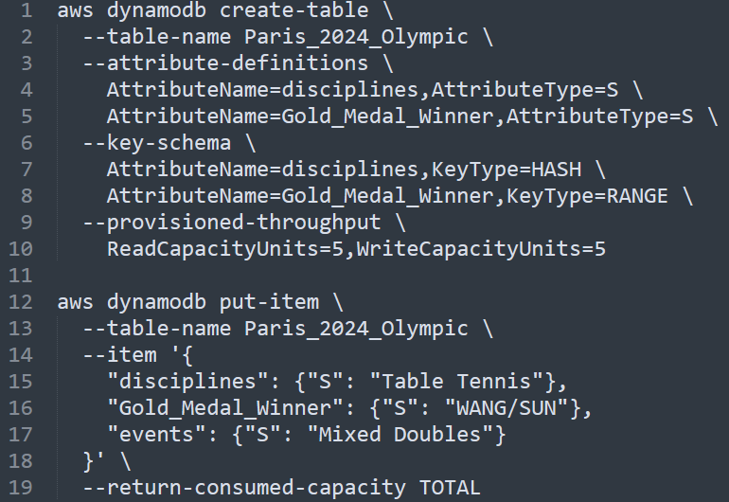
Q4.b

Slide 8
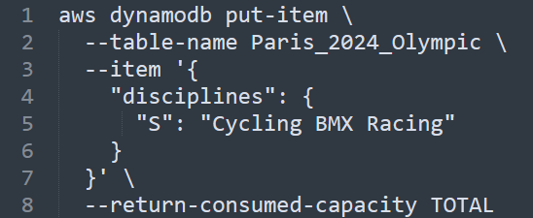
Q4.b
Read the code snippet above. If the code were executed, what would the resulting table look like?

Slide 9
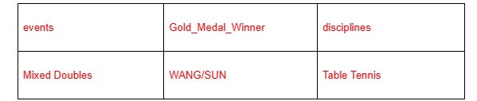
Q4.b
Answer:

Slide 10
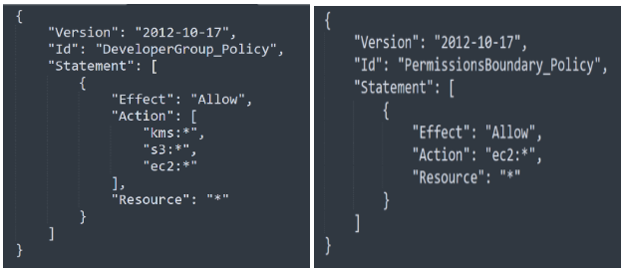
Q5
To manage AWS user accounts, Bob implements a policy below called DeveloperGroup_Policy for a group of developers within his company. Then, Bob adds Alice to the group. To set the maximum permissions that DeveloperGroup_Policy can grant to Alice, Bob also attaches another policy to her. The policy is called PermissionsBoundary_Policy.
What are the effective permissions that Alice can perform? Justify your answer by explaining what the two policies primarily do and determining the final effective permissions.

Slide 11
Q5
To manage AWS user accounts, Bob implements a policy below called DeveloperGroup_Policy for a group of developers within his company. Then, Bob adds Alice to the group. To set the maximum permissions that DeveloperGroup_Policy can grant to Alice, Bob also attaches another policy to her. The policy is called PermissionsBoundary_Policy.
What are the effective permissions that Alice can perform? Justify your answer by explaining what the two policies primarily do and determining the final effective permissions.
Answer
As a member of DeveloperGroup, according to the DeveloperGroup _Policy, Alice can perform all actions to kms, s3 and ec2.
However, Alice is attached with a permissions boundary policy that restricts her to all ec2-related actions.
Considering that effective permissions are determined by the intersection of Identity-based policy and permissions boundary, Alice is limited to performing actions to ec2 only.

Slide 12
Overview
Web Application Architecture
Web Application Design Pattern
Django Framework

Slide 13
What is a web application architecture
A web application architecture is a layout that displays the interactions between different software components, such as frontend, and backend.

Slide 14
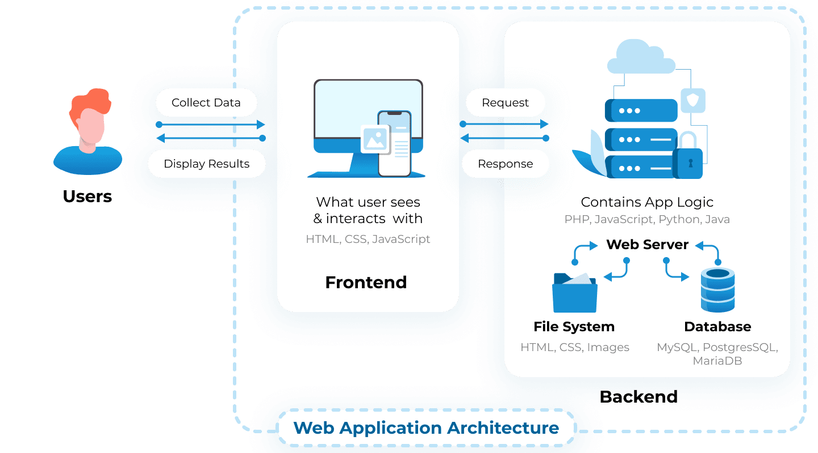
What is a web application architecture
A web application architecture is a layout that displays the interactions between different software components, such as frontend, and backend.
https://litslink.com/blog/web-application-architecture#types-of-web-application-architecture

Slide 15
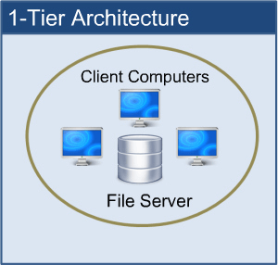
1-Tier web application architecture
1-Tier Architecture: all the software components are available on the same machine.
https://www.perfmatrix.com/software-architecture-and-its-types/

Slide 16
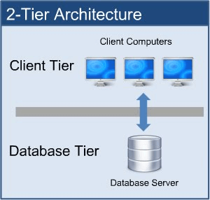
2-Tier web application architecture
2-Tier Architecture: The client sends the request to the server and the server processes the request and sends the response back to the client.
https://www.perfmatrix.com/software-architecture-and-its-types/

Slide 17
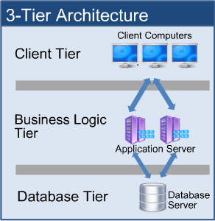
3-Tier web application architecture
Client Tier/Presentation Layer: displays the user interface and manages user interaction.
Business Logic Tier/Application server: has all the business logic that dictates how data is handled, and routed between the Client and Database Tiers.
Database Tier/Database server: stores data and handles data queries and updates.
https://www.perfmatrix.com/software-architecture-and-its-types/

Slide 18
Complex web application architecture
Presentation Layer.
Application Layer.
Database Layer.
More layers of services: serve specific tasks or provide additional functionality to the web application.

Slide 19
Complex web application architecture
More layers of services:
Examples: Caching service, and datawarehouse.

Slide 20
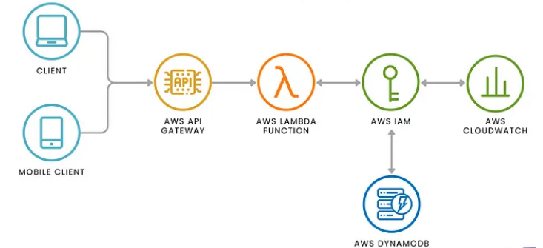
Serverless architecture
Example: AWS
https://www.skiplevel.co/blog/cloud-and-serverless-computing-101

Slide 21
Web application architecture
It is the skeleton: a high-level structure that outlines how different software components are organized and interact.
Web application design pattern
It is a reusable solution regarding how to structure the components and their interaction such as how to organize the business logic, how to handle user requests, or how to separate different services.

Slide 22
A popular design pattern
Model—View—Controller (MVC):
Model: Maintains the application’s data. It interacts with the database to retrieve, update, and store data.
View: Provides templates for presenting the data to the user. It handles the layout and visual presentation of the data.
Controller: Acts as an intermediary between the Model and the View. It processes user inputs, makes calls to the Model to retrieve data, and then selects the appropriate View to display the data. The Controller manages the flow of data and controls the application logic.

Slide 23
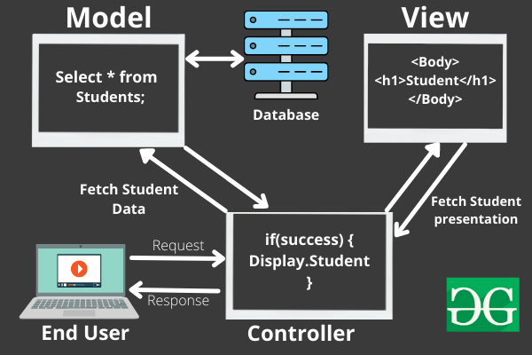
Model—View—Controller (MVC)
An example:
2
1
https://www.geeksforgeeks.org/mvc-framework-introduction/

Slide 24
Model—View—Controller (MVC)
An example:
3
2
4
1
https://www.geeksforgeeks.org/mvc-framework-introduction/

Slide 25
Model—View—Controller (MVC)
An example:
3
2
4
5
6
1
7
https://www.geeksforgeeks.org/mvc-framework-introduction/

Slide 26
MVC
Django is an open-source web application framework written in Python.
Django customizes the MVC design pattern.

Slide 27
Django customizes MVC as MTV (Model—Template—View)
M — — — ->For data interaction— — — — — ->M V — — — -> For data visualization— — — — — ->T C — — — -> For component interaction— — — —>V
Real-world Django-based web application
Instagram, Spotify, Youtube

Slide 28
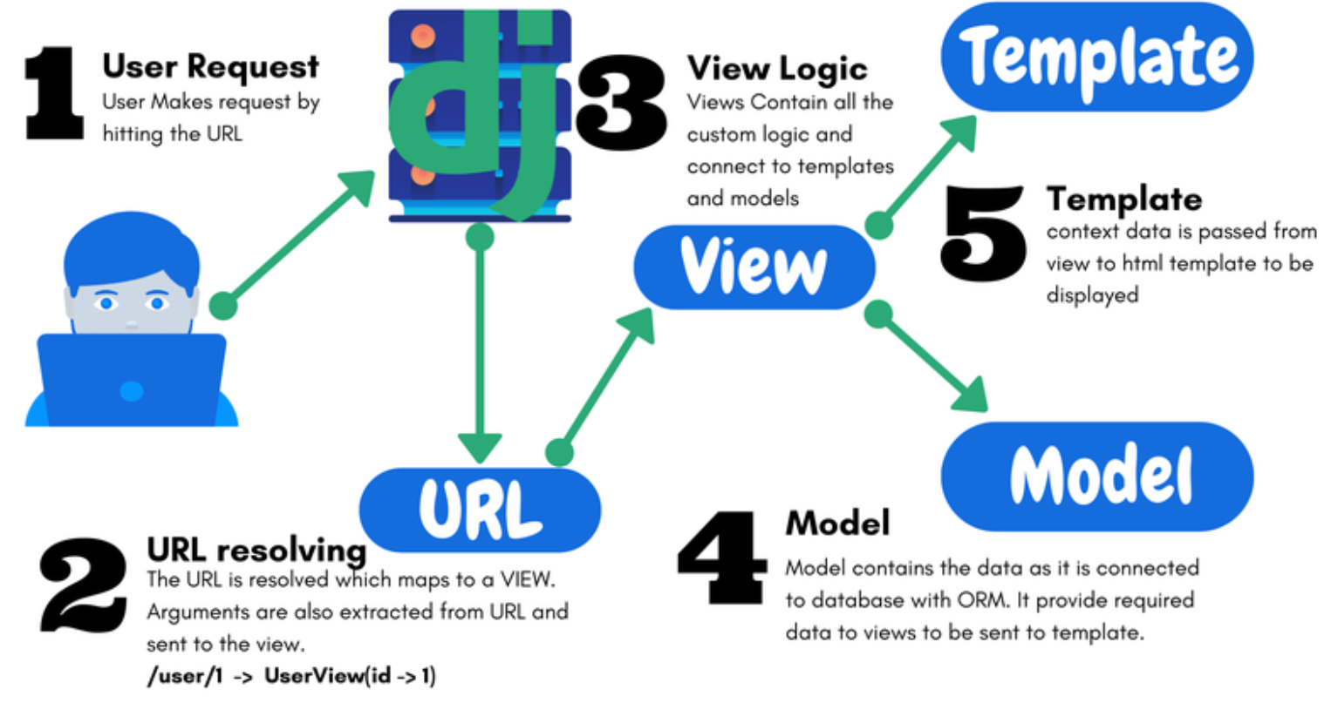
A Django-based web application:
URL resolving: maps an incoming request to an appropriate view function.
Extracts specific strings and/or digits in the URL and sends them to the VIEW function.

Slide 29
A Django-based web application:
View: uses the resolved arguments to interacts with templates and models as needed.

Slide 30
A Django-based web application:
Model: interacts with the database.

Slide 31
A Django-based web application:
Template: takes the data passed from the view logic for rendering the HTML template (or other XML templates)

Slide 32
Demo: set up a Django web app called music
Create a Django project and a music app
Setup the music app
Enable template rendering
Render templates with retrieved data

Slide 33
Step 1: create a virtual environment
mkdir ~/cits5503_django
cd cits5503_django
python3 -m venv cits5503venv
source cits5503venv/bin/activate
Question: /opt/wwc/ is not a good path for deploying a Django application from the security perspective. Why?

Slide 34
Step 1: create a virtual environment
mkdir ~/cits5503_django
cd cits5503_django
python3 -m venv cits5503venv
source cits5503venv/bin/activate
Question: /opt/wwc/ is not a good path for deploying a Django application:
While this path requires the root privilege, the application itself does not require it.

Slide 35
Step 1: create a virtual environment
mkdir ~/cits5503_django
cd cits5503_django
python3 -m venv cits5503venv
source cits5503venv/bin/activate
Question: Why do we need to setup a virtual environment in python?

Slide 36
Step 1: create a virtual environment
Question: Why do we need to setup a virtual environment in python?
Isolation: Virtual environments isolate Python packages and dependencies between different projects. This prevents conflicts where different projects require different versions of the same package.
Ease of Deployment: All the installed packages in a virtual environment can be copied onto another machine or virtual environment
pip freeze > requirements.txt
pip install -r requirements.txt

Slide 37
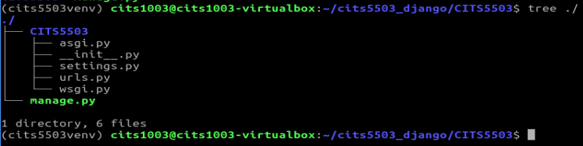
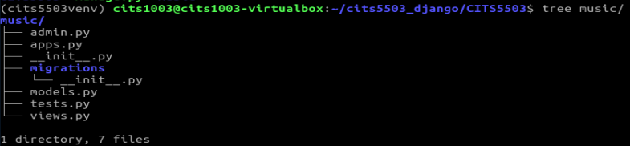
Step 2: create a Django project and app
pip install django
django-admin startproject CITS5503
cd CITS5503
python3 manage.py startapp music

Slide 38
Step 2: create a Django project and app
pip install django
django-admin startproject CITS5503
cd CITS5503
python3 manage.py startapp music
Question: What's the difference between the outputs of
django-admin startproject CITS5503
django-admin startproject CITS5503 .

Slide 39
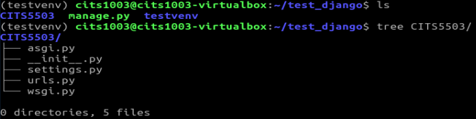
django-admin startproject CITS5503 (under cits5503_django)
django-admin startproject CITS5503 . (under test_django)

Slide 40
Step 2: create a Django project and app
pip install django
django-admin startproject CITS5503
cd CITS5503
python3 manage.py startapp music
Question: What's the difference between the outputs of
django-admin startproject CITS5503: Django creates a new directory named "CITS5503" , a working directory of the project, inside which another subdirectory named "CITS5503" is created.
django-admin startproject CITS5503 . : Django uses the current directory as the working directory of the project, inside which a new directory named "CITS5503" is created.

Slide 41
Step 3: start the Django application server
python manage.py check
python manage.py runserver
Question: Which default port is the Django application server is listening on?

Slide 42
Step 3: start the Django application server
python manage.py check
python manage.py runserver
Question: What if the default port is taken by another process in our system?

Slide 43
Step 3: start the Django application server
Question: What if the default port is taken by another process in our system?
python manage.py runserver 9000
#ngnix
proxy_pass http://127.0.0.1:8000;

Slide 44
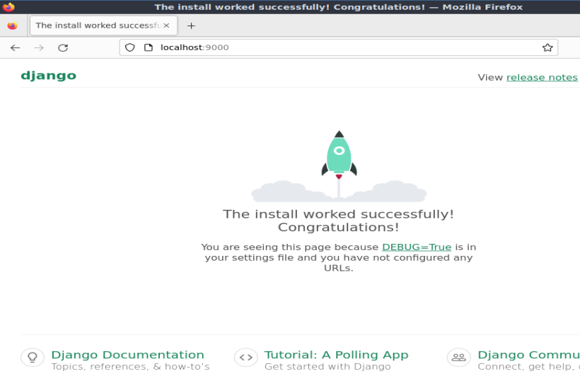
Step 4: Access the server
Open a browser and go to: http://localhost:9000

Slide 45
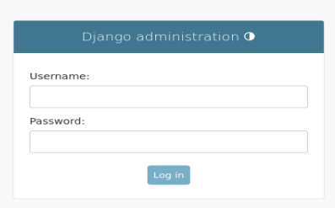
Step 4: Access the server
If we go to: http://localhost:9000/admin/

Slide 46
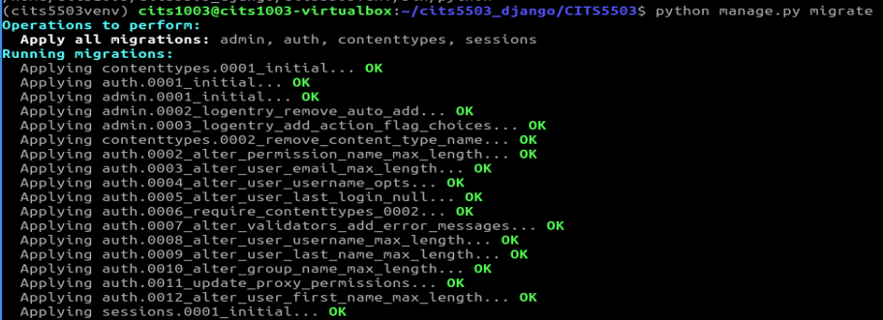
Step 5: create an admin
python manage.py migrate

Slide 47
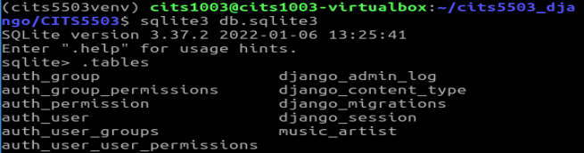
Step 5: create an admin
python manage.py migrate

Slide 48
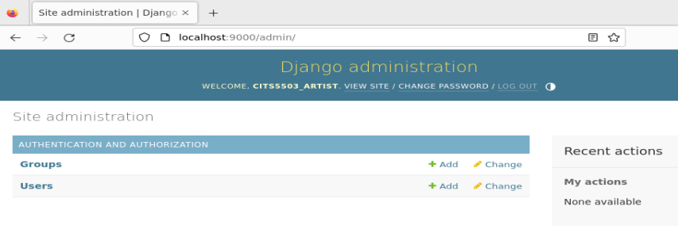
Step 5: create an admin
python manage.py createsuperuser
restart the server

Slide 49
Demo: set up a Django web app called music
Create a Django project and a music app
Setup the music app
Enable template rendering
Render templates with retrieved data

Slide 50
Step 1: register the app
# inside CITS5503/settings.py
INSTALLED_APPS = [
'django.contrib.admin’, #The admin site 'django.contrib.auth’, #Authentication 'django.contrib.contenttypes’, #A framework for content types 'django.contrib.sessions’, #A session framework 'django.contrib.messages’, #A messaging framework 'django.contrib.staticfiles’, #A framework for managing static files
#new app below: ‘music.apps.MusicConfig', ]

Slide 51
Step 2: update the url component in the project
# inside CITS5503/urls.py
from django.contrib import admin from django.urls import path from music import views # added
urlpatterns = [ path('', views.home, name='home'), # added path('admin/', admin.site.urls),
]

Slide 52
Step 3: update the view component in the app
# inside music/views.py
from django.shortcuts import render from django.http import HttpResponse #added
#added
def home(request): return HttpResponse('This is the home page.')

Slide 53
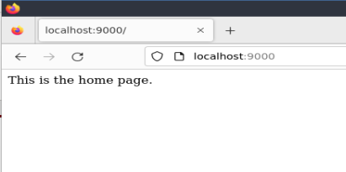
Step 4: access the app
restart the server and go to: http://localhost:9000

Slide 54
Demo: set up a Django web app called music
Create a Django project and a music app
Setup the music app
Enable template rendering
Render templates with retrieved data

Slide 55
Step 1: create html templates in the project and the app
Inside the current working directory of the project
mkdir templates mkdir music/templates mkdir music/templates/music
touch templates/home.html touch music/templates/music/main.html touch music/templates/music/artist.html

Slide 56
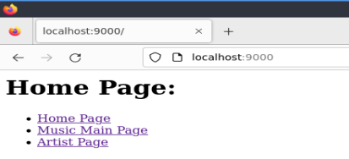
templates/home.html
<h1>Home Page:</h1> <ul> <li><a href="{% url 'home' %}">Home Page</a></li> <li><a href="{% url 'music:main' %}">Music Main Page</a></li> <li><a href="{% url 'music:artist' %}">Artist Page</a></li> </ul>

Slide 57
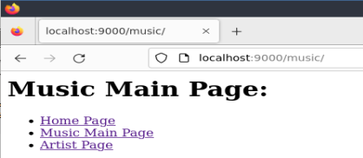
music/templates/music/main.html
<h1>Music Main Page:</h1> <ul> <li><a href="{% url 'home' %}">Home Page</a></li> <li><a href="{% url 'music:main' %}">Music Main Page</a></li> <li><a href="{% url 'music:artist' %}"> Artist Page </a></li> </ul>

Slide 58
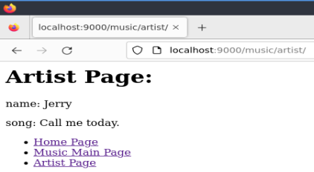
music/templates/music/artist.html
<h1>Artist Page:</h1> <p>name: Jerry</p>
<p>song: Call me today</p> <ul> <li><a href="{% url 'home' %}">Home Page</a></li> <li><a href="{% url 'music:main' %}">Music Main Page</a></li> <li><a href="{% url 'music:artist' %}"> Artist Page </a></li> </ul>

Slide 59
Step 2: update the url component in the project
# inside CITS5503/urls.py
from django.contrib import admin from django.urls import path from music import views
urlpatterns = [ path('', views.home, name='home'), path('admin/', admin.site.urls),
path('music/', include('music.urls')), # added
]

Slide 60
Step 3: create the url component in the app
touch music/urls.py
# inside music/urls.py
from django.urls import path from . import views app_name = 'music'
urlpatterns = [ path('', views.main, name='main'), path('artist/', views.artist, name='artist'), ]
Question: What kind of URL requests will be processed by the first URL pattern?

Slide 61
Step 3: create the url component in the app
touch music/urls.py
# inside music/urls.py
from django.urls import path from . import views app_name = 'music'
urlpatterns = [ path('', views.main, name='main'), path('artist/', views.artist, name='artist'), ]

Slide 62
Step 4: update the view component in the app
# inside music/views.py
from django.shortcuts import render
def home(request): return render(request, 'home.html’)
#added
def main(request): return render(request, 'music/main.html')
def artist(request): return render(request, 'music/artist.html')

Slide 63
Step 5: register the home template in the project
# inside CITS5503/settings.py
import os #added
TEMPLATES = [ {
(...)
'DIRS': [os.path.join(BASE_DIR, 'templates')], #added
(...)
} ]

Slide 64
Step 6: restart the server and access the app
Go to the home page
Go to the music main page
Go to the artist page

Slide 65
Demo: set up a Django web app called music
Setup a Django project
Setup a web app called music
Enable template rendering
Render templates with retrieved data

Slide 66
Step 1: add a model in the app
# inside music/models.py
from django.db import models
class Artist(models.Model):
name = models.CharField(max_length=200)
song = models.CharField(max_length=200)
def __str__(self):
return self.name

Slide 67
Step 2: create the Artist table and register it into the admin interface
# inside music/admin.py
from django.contrib import admin from .models import Artist
admin.site.register(Artist)

Slide 68
Step 3: make changes and apply changes to the database
python manage.py makemigrations
python manage.py migrate

Slide 69
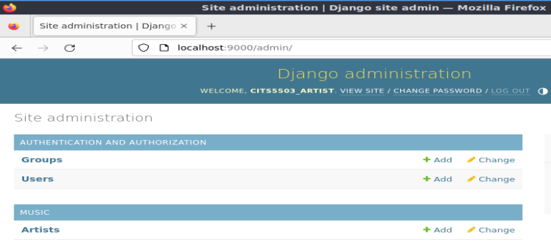
Step 4: restart the server and access the app
Go to the admin interface

Slide 70
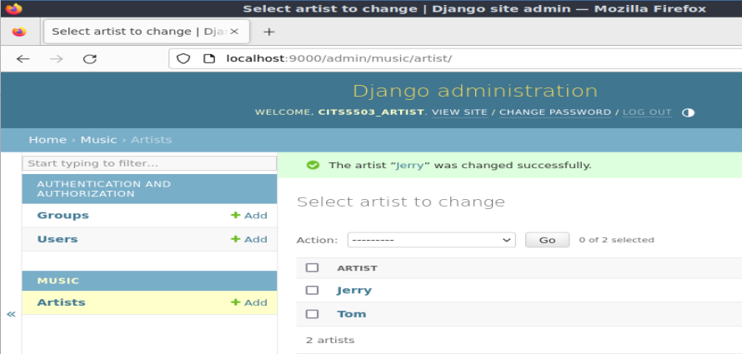
Step 5: populate the artist table
def __str__(self):
return self.name

Slide 71
Step 6: update the view component in the app
# inside music/views.py
from django.shortcuts import render
from .models import Artist
def home(request): return render(request, 'home.html')
def main(request): return render(request, 'music/main.html')
#updated
def artist(request): title = 'Artist Page'
artist_list = Artist.objects.all()
context = {'title': title, 'artist_list': artist_list}
return render(request, 'music/artist.html', context)

Slide 72
Step 7: update music/templates/music/artist.html
<h1>{{title}}</h1> <ul> <li><a href="{% url 'home' %}">Home Page</a></li> <li><a href="{% url 'music:main' %}">Music Main Page</a></li> </ul>
<ul>
{% for artist in artist_list %} <li> {{artist.name}}: {{artist.song}}</li>
{% endfor %} </ul>

Slide 73
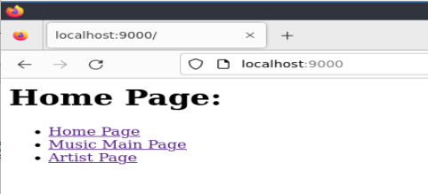
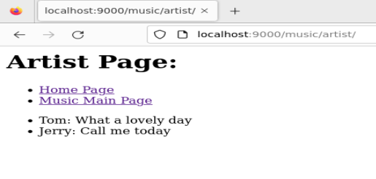
Step 8: restart the server and access the app

Slide 74
Question: What if 'title' in context is replaced by 'titlectx'?
def artist(request): title = 'Artist Page'
artist_list = Artist.objects.all()
context = {'title': title, 'artist_list': artist_list}
return render(request, 'music/artist.html', context)
def artist(request): title = 'Artist Page'
artist_list = Artist.objects.all()
context = {'titlectx': title, 'artist_list': artist_list}
return render(request, 'music/artist.html', context)

Slide 75
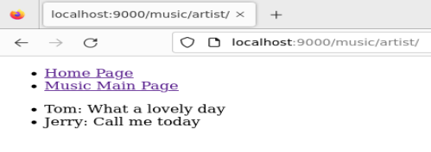
<h1>{{titlectx}}</h1> <ul> <li><a href="{% url 'home' %}">Home Page</a></li> <li><a href="{% url 'music:main' %}">Music Main Page</a></li> </ul>
<ul>
{% for artist in artist_list %} <li> {{artist.name}}: {{artist.song}}</li>
{% endfor %} </ul>
Otherwise

