Slide 1
CITS5503 Exam Exercises
Dr Zhi Zhang

Slide 2
My research on cloud security
Final exam
Practice questions

Slide 3
Research on cloud security
Introduction to important terms in public cloud security
A Cross-VM attack

Slide 4
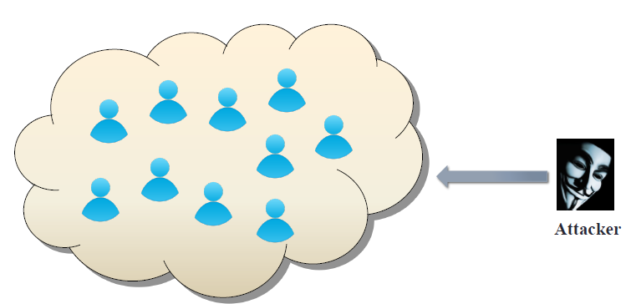
Public cloud becomes tempting target
Valuable targets:
banking, medical information, DNN models

Slide 5
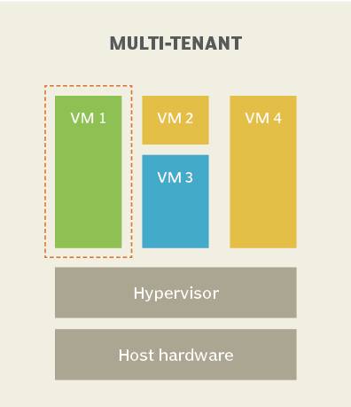
Key Terms
Multi-tenancy:
IaaS clouds multiplex virtual machines (VMs) of disjoint customers upon the same physical machines.
Co-residency:
A malicious VM is co-resident with a target VM upon the same physical machine.
https://www.techtarget.com/whatis/definition/multi-tenancy

Slide 6
Key Terms
Multi-tenancy:
Co-residency:
Placement:

Slide 7
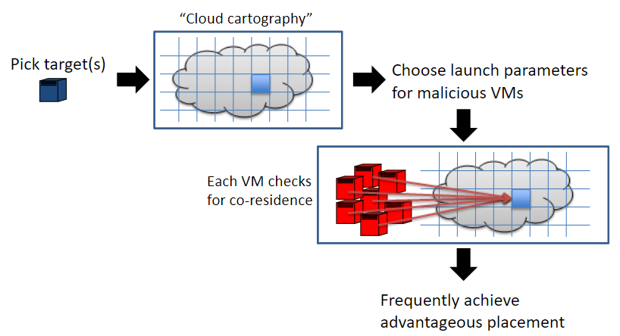
Achieve placement
2
1
Ristenpart et al. [CCS’09]

Slide 8
Achieve placement
2
1
3
4
5
Ristenpart et al. [CCS’09]

Slide 9
Key Terms
Multi-tenancy:
Co-residency:
Placement:
Cross-VM attack:
The adversary from the malicious VM breaks data confidentiality or integrity against the target VM, so-called cross-VM attack.
e.g., hardware fault attack
Hardware-fault attacks: the adversary disrupts the normal operations of the computer hardware, compromising the integrity of the victim or the whole system.
Depleting DNN Model Inference Accuracy through Rowhammer
(Top 0.8% of submissions, Best Paper Award in USENIX SECURITY’24.)

Slide 10
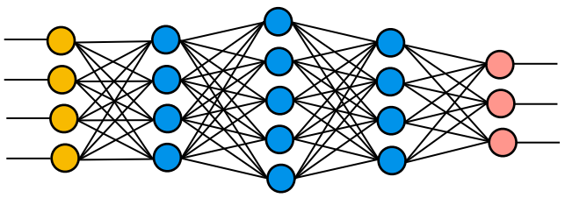

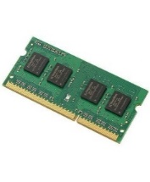
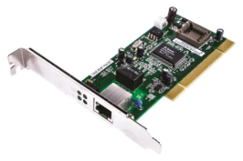
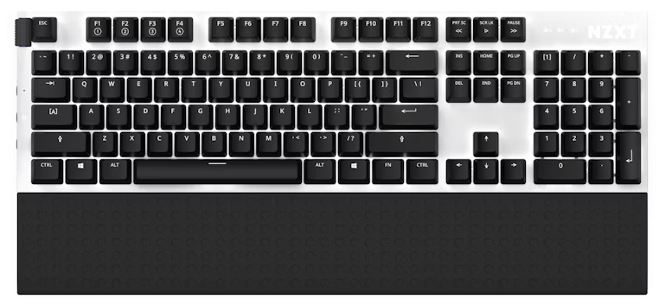

Depleting DNN Model Inference Accuracy through Rowhammer
Malicious VM
Victim VM
VMM/Hypervisor
SW
HW
DRAM memory is prone to rowhammer faults.

Slide 11
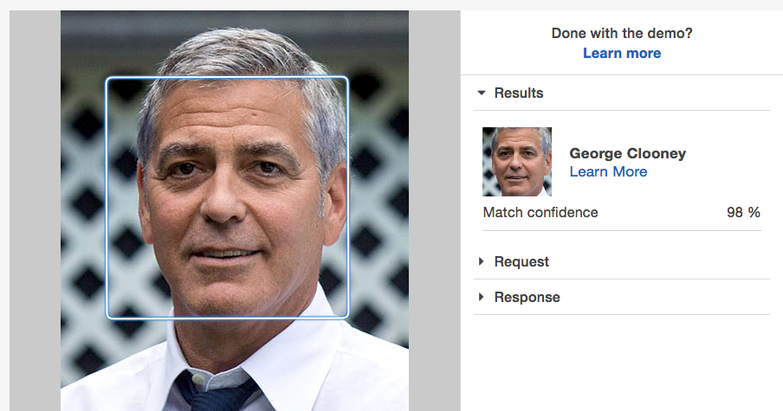
Inference: A well-trained DNN model

Slide 12

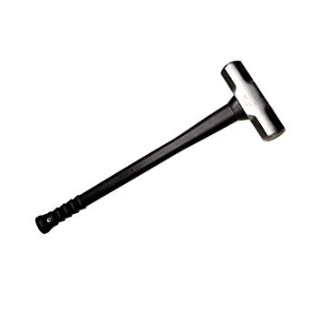
What is Rowhammer ?
Frequently accessing
Rowhammer:
DRAM rows

Slide 13
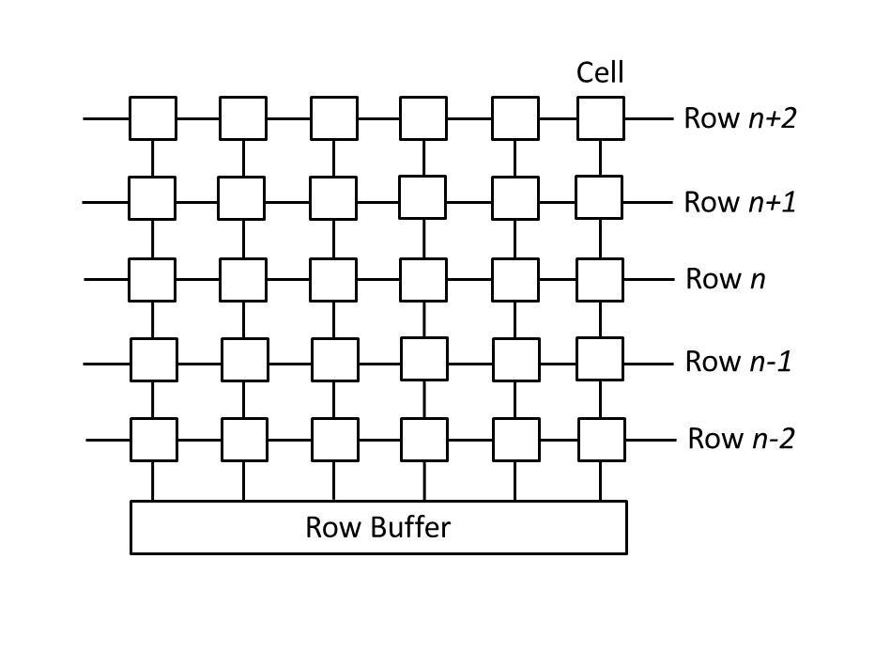
A memory access opens a DRAM bank
A bank has rows of cells
A cell is either charged or discharged to store bit 0 or 1
Row buffer facilitates memory access
Alternating row access clears row buffer

Slide 14
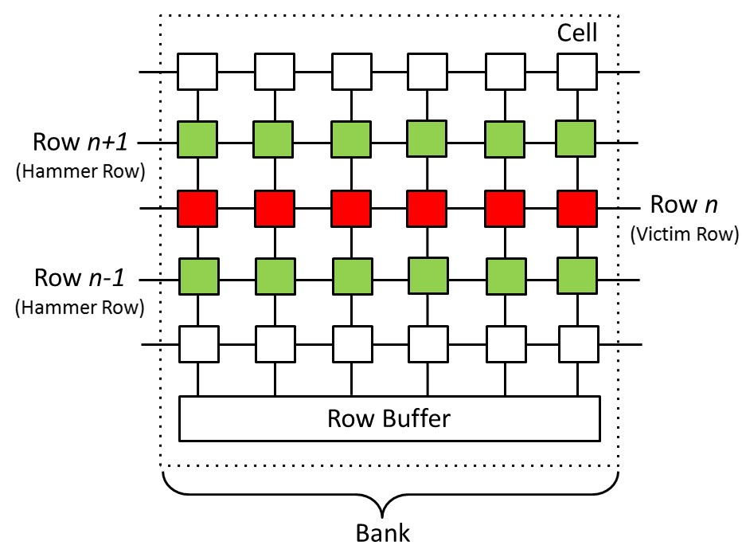
Rowhammer Fault
frequently activating rows n+1 & n-1 cause permanent charge leakage (bit flips) in row n

Slide 15
Rowhammer Fault
frequently activating rows n+1 & n-1 cause permanent charge leakage (bit flips) in row n
Not only DDR3 but also DDR4 and DDR5
are vulnerable to rowhammer fault

Slide 16
Rowhammer code on x86
1 loop:
2 mov (X), %eax
3 mov (Y), %ebx
4 clflush (X)
5 clflush (Y)
6 jmp loop
What is the purpose of lines 2-3?
Clear row buffer (e.g., alternate access)

Slide 17
Rowhammer code x86
1 loop:
2 mov (X), %eax
3 mov (Y), %ebx
4 clflush (X)
5 clflush (Y)
6 jmp loop
What is the purpose of lines 4-5?
flush CPU cache (e.g., clflush)

Slide 18
Hammer pattern
1 loop:
2 mov (X), %eax
3 mov (Y), %ebx
4 clflush (X)
5 clflush (Y)
6 jmp loop
Double-sided hammer
X and Y are adjacent to the target row
Single-sided hammer
Either X or Y is adjacent to the target row
Common
X and Y must be in the same bank to clear row buffer

Slide 19
The workflow of the attack
Search target ML library for an exploitable instruction
Trick the system into placing the instruction
onto a victim page
Trigger a rowhammer fault to flip the instruction

Slide 20

Depleting DNN Model Inference Accuracy through Rowhammer
DNN Model
Rowhammer Code
hammer page
victim page
hammer page
ML Library
Attacker VM
DRAM Memory
Victim VM
https://github.com/FrameFlip/SGXBLAS

Slide 21
Search target ML library for an exploitable instruction
An exploitable instruction: is a conditional check in a matrix-computation function

Slide 22
Flipping exploitable instruction
Opcode
Operands
CMP EAX, 0
JE
target
0x74
0x05
What if a bit flip occurs to the opcode of JE?

Slide 23
Flipping exploitable instruction
Opcode
Operands
One Bit-Flip
Opcode’
Operands
JE
0x74
CMP EAX, 0
JNE
0x75

Slide 24
Exam Format
The exam is F2F and has a time limit of 2 hours
The exam is marked out of 100 points and is worth 50% of the overall unit mark.
The exam is open book: any printed or written materials are allowed (no page limit).
UWA approved calculators with stickers are optional.
e.g., 2^5 - 2 or 32 -2 or 30.

Slide 25
Exam Instructions
You will be provided with an answer booklet
You should clearly state which questions of the final exam you are answering.
Please do NOT use a pencil or a red pen.
Please use readable handwriting. What cannot be read cannot be marked.

Slide 26
Exam Topics
5 themed questions in total and each themed question describes a scenario, based on which, some sub-questions are asked.
The format of sub questions is similar to that of part C in the mid-sem test, i.e., short answer questions.
Each themed question will assess one of the following topics from certain lectures and labs:
Networking: Week 7 lecture
AWS IAM: Week 5 lecture
AI and AWS: Week 8 lecture + Labs 8&9 (code excluded)
Miscellaneous: Weeks 5+7 lectures + Lab 5 (only ALB)
Miscellaneous:
Week 9 lecture (only Web Application Design Pattern + Django Framework) + Week 11 lecture (only AWS Lambda) + Lab 6 (only ngix)
Note: Screenshots from the step-by-step demos and AWS examples in the lectures above are not part of the final exam. There is only one question related to code and it will be Lab 5.

Slide 27
Exam Topics (Supplementary and Deferred)
5 themed questions in total and each themed question describes a scenario, based on which, some sub-questions are asked.
The format of sub questions is similar to that of part C in the mid-sem test, i.e., short answer questions.
Each themed question will assess one of the following topics from certain lectures and labs:
TBA
Note: Screenshots from the step-by-step demos and toy examples in the lectures above are not part of the exams.

Slide 28
To prepare for the exam
Carefully review relevant lectures and labs.
Practice questions from past years.
Note: Questions related to this year’s topics are selected.

Slide 29
Q1: A network can be defined as a group of computers and other devices connected for data exchange.
Part 1. Suppose a public IPv4 address has a CIDR notation of 200.100.50.0/24, this specifies the subnet where the IPv4 address resides. How many IPv4 addresses does this subnet have? Justify your answer.
Part 2. If the Internet service provider divides the original /24 subnet using /29, how many small subnets will be created? For each created subnet, How many hosts does it have? Justify your answer.
Part 3. When a message is sent from a host machine, it passes through the 5 layers of the TCP/IP model, a process called data encapsulation. For each of the following, identify which layer adds the specific information. Answer in the order listed:
1. Which layer adds the port numbers?
2. Which layer adds the IP addresses?
3. Which layer adds the MAC addresses?
Notes:
29

Slide 30
Q1: A network can be defined as a group of computers and other devices connected for data exchange.
Part 1. Suppose a public IPv4 address has a CIDR notation of 200.100.50.0/24, this specifies the subnet where the IPv4 address resides. How many IPv4 addresses does this subnet have? Justify your answer.
Notes:
30

Slide 31
Q1: A network can be defined as a group of computers and other devices connected for data exchange.
Part 1. Suppose a public IPv4 address has a CIDR notation of 200.100.50.0/24, this specifies the subnet where the IPv4 address resides. How many IPv4 addresses does this subnet have? Justify your answer.
Answer:
the notation "/24" indicates a subnet mask of 24 bits, leaving 32-24 = 8 bits for the host portion of the IP address. Total IPv4 Addresses in a /24 subnet: 2^8 = 256 addresses.
Notes:
31

Slide 32
Q1: A network can be defined as a group of computers and other devices connected for data exchange.
Part 2. If the Internet service provider divides the original /24 subnet using /29, how many small subnets will be created? For each created subnet, How many hosts does it have? Justify your answer.
Notes:
32

Slide 33
Q1: A network can be defined as a group of computers and other devices connected for data exchange.
Part 2. If the Internet service provider divides the original /24 subnet using /29, how many small subnets will be created? For each created subnet, How many hosts does it have? Justify your answer.
Answer:
when dividing a /24 subnet into /29 subnets, the ISP is using additional 5 bits to create small subnets (29 - 24 = 5). The number of subnets created: 2^(29 - 24) = 2^5 = 32 subnets.
Within each of the small /29 subnets, 3 (32 - 29) bits are available for host addresses. Total host addresses per /29 Subnet: 2^3 -2 = 6.
Notes:
33

Slide 34
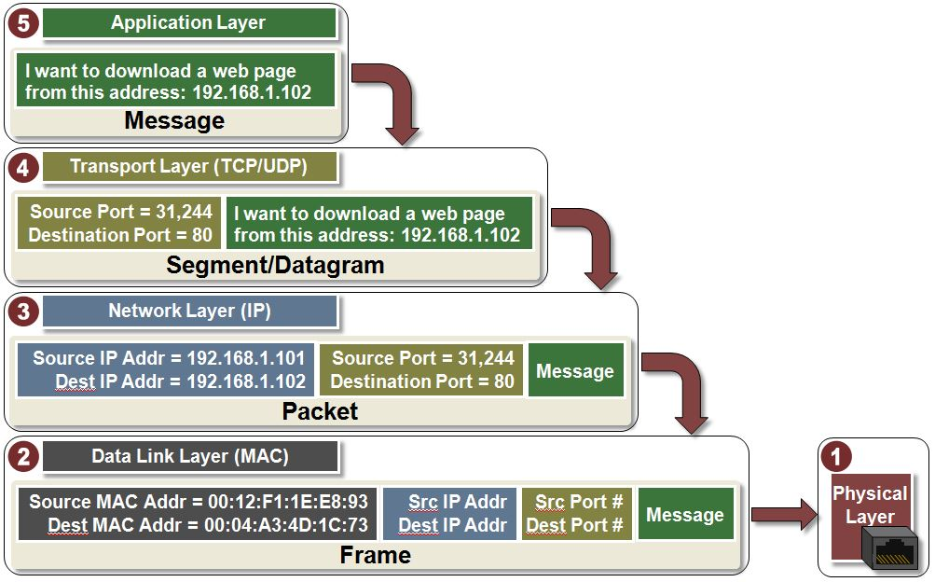
Part 3. When a message is sent from a host machine, it passes through the 5 layers of the TCP/IP model, a process called data encapsulation. For each of the following, identify which layer adds the specific information. Answer in the order listed:
1. Which layer adds the port numbers?
2. Which layer adds the IP addresses?
3. Which layer adds the MAC addresses?
Notes:
34

Slide 35
Part 3. When a message is sent from a host machine, it passes through the 5 layers of the TCP/IP model, a process called data encapsulation. For each of the following, identify which layer adds the specific information. Answer in the order listed:
1. Which layer adds the port numbers?
2. Which layer adds the IP addresses?
3. Which layer adds the MAC addresses?
Answer: Transport Layer, Network Layer, Data Link Layer
Notes:
35

Slide 36
Q2: IAM
Bob is a system engineer at an internet company. One of his main jobs is to maintain their e-commerce applications that are hosted by AWS cloud. He is responsible for managing AWS resources including the AWS accounts in his company.
Part 1. His boss doesn't have much knowledge about cloud computing and is concerned about the security of AWS. Help Bob list and describe 3 critical security measures implemented by AWS.
Part 2. Suppose only AWS managed policies are available to Bob, what policy should Bob have? Justify your answer.
Part 3. Explain the two concepts: Root user and IAM user.
Notes:
36

Slide 37
Q2: IAM
Bob is a system engineer at an internet company. One of his main jobs is to maintain their e-commerce applications that are hosted by AWS cloud. He is responsible for managing AWS resources including the AWS accounts in his company.
Part 1. His boss doesn't have much knowledge about cloud computing and is concerned about the security of AWS. Help Bob list and describe 3 critical security measures implemented by AWS.
Notes:
37

Slide 38
Q2: IAM
Bob is a system engineer at an internet company. One of his main jobs is to maintain their e-commerce applications that are hosted by AWS cloud. He is responsible for managing AWS resources including the AWS accounts in his company.
Part 1. His boss doesn't have much knowledge about cloud computing and is concerned about the security of AWS. Help Bob list and describe 3 critical security measures implemented by AWS.
Answer:
Data Encryption: AWS uses various encryption algorithms such as AES and RSA to encrypt data, ensuring the confidentiality of data during transmission and storage.
Instance Isolation. AWS allows virtual machines to run in their isolated and secure environments, mitigating mutual interference among them and reducing security risks from attacks by unauthorized users.
Authorization: AWS uses policies to determine what actions or resources authenticated users are allowed to access or perform, preventing damage due to the unauthorized actions.
Notes:
38

Slide 39
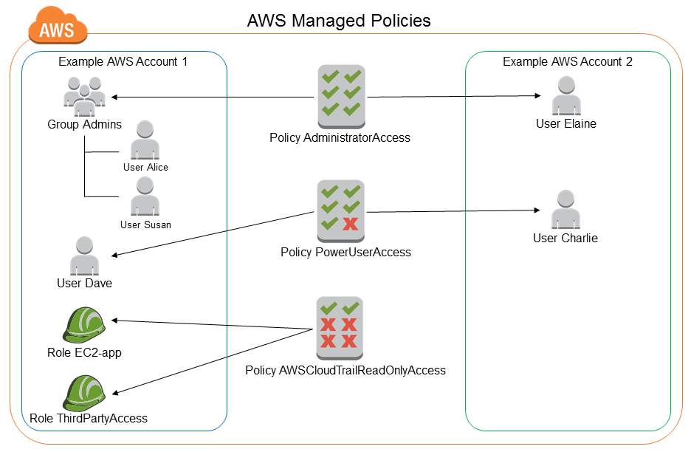
Q2: IAM
Bob is a system engineer at an internet company. One of his main jobs is to maintain their e-commerce applications that are hosted by AWS cloud. He is responsible for managing AWS resources including the AWS accounts in his company.
Part 2: Suppose only AWS managed policies are available to Bob, what policy should Bob have? Justify your answer.
Notes:
39

Slide 40
Q2: IAM
Bob is a system engineer at an internet company. One of his main jobs is to maintain their e-commerce applications that are hosted by AWS cloud. He is responsible for managing AWS resources including the AWS accounts in his company.
Part 2: Suppose only AWS managed policies are available to Bob, what policy should Bob have? Justify your answer.
Answer:
Bob should have AdministratorAccess.
AdministratorAccess grants full access to any AWS service and resource, which should be attached to Bob, as he is a maintainer and has complete management control over accounts, services, and policies to configure appropriate permissions for users in his company.
Notes:
40

Slide 41
Q2: IAM
Bob is a system engineer at an internet company. One of his main jobs is to maintain their e-commerce applications that are hosted by AWS cloud. He is responsible for managing AWS resources including the AWS accounts in his company.
Part 3: Explain the two concepts: Root user and IAM user.
Answer:
Root user has complete access to all AWS services and resources in the account.
IAM user is an identity within a root user account that has specific permissions for a single person or application.
Notes:
41

Slide 42
Q3: AI
Part 1. Hyperparameters are important in (re)training a model. To fine-tune a pre-trained model, you should retrieve its default hyperparameters and then update them based on your specific task and dataset. List 2 hyperparameters and explain their role in model training.
Part 2. List 2 AWS resources that are beneficial to the pre-trained model fine-tuning and explain why.
Part 3. Given a csv file as your dataset, how will you divide it so as to fine-tune the pretrained model and evaluate its performance? Justify your answer.
Notes:
42

Slide 43
Q3: AI
Part 1. Hyperparameters are important in (re)training a model. To fine-tune a pre-trained model, you should retrieve its default hyperparameters and then update them based on your specific task and dataset. List 2 hyperparameters and explain their role in model training.
Answer:
Learning rate: it controls the step size or rate at which a machine learning model updates its internal parameters (e.g., weights and biases) during training.
Batch size: it decides the number of training samples used to compute one gradient update (one forward pass + one backward pass).
Notes:
43

Slide 44
Q3: AI
Part 2. List 2 AWS resources that are beneficial to the pre-trained model fine-tuning and explain why.
Notes:
44

Slide 45
Q3: AI
Part 2. List 2 AWS resources that are beneficial to the pre-trained model fine-tuning and explain why.
Answer:
Amazon SageMaker, because it can provide a machine-learning environment for setting up, training, and deploying models in the cloud.
Amazon S3, because it can store dataset for fine-tuning.
Notes:
45

Slide 46
Q3: AI
Part 3. Given a csv file as your dataset, how will you divide it so as to fine-tune the pretrained model and evaluate its performance? Justify your answer.
Notes:
46

Slide 47
Q3: AI
Part 3. Given a csv file as your dataset, how will you divide it so as to fine-tune the pretrained model and evaluate its performance? Justify your answer.
Answer:
The dataset should be divided into three parts: training, validation and test sets.
A training set is used to update model weights.
A validation set is needed to tune hyperparameters during retraining
A test set is required once to evaluate the final retrained model to estimate its real-world performance.
Notes:
47

Slide 48
Q4: IAM and Django
Tom is a web developer and tasked with setting up a Django web application for music sharing. To host the application, Tom rents an EC2 instance. For the first month, the website works properly. However, as the website becomes increasingly popular, the website response is getting slower and sometimes it even crashes.
Part 1. Which aspect of the CIA triad has been compromised with regard to the crash? Justify your answer.
Part 2. To address the issue above, both vertical and horizontal scale are effective solutions. First, describe each of the two concepts. Then, explain how vertical scaling with AWS and horizontal scaling with AWS can help Tom scale the website.
Notes:
48

Slide 49
Q4: IAM and Django
Tom is a web developer and tasked with setting up a Django web application for music sharing. To host the application, Tom rents an EC2 instance. For the first month, the website works properly. However, as the website becomes increasingly popular, the website response is getting slower and sometimes it even crashes.
Part 1. Which aspect of the CIA triad has been compromised with regard to the crash? Justify your answer.
Notes:
49

Slide 50
Q4: IAM and Django
Tom is a web developer and tasked with setting up a Django web application for music sharing. To host the application, Tom rents an EC2 instance. For the first month, the website works properly. However, as the website becomes increasingly popular, the website response is getting slower and sometimes it even crashes.
Part 1. Which aspect of the CIA triad has been compromised with regard to the crash? Justify your answer.
Answer:
Availability
because the website is inaccessible to users
Notes:
50

Slide 51
Q4: IAM and Django
Part 2. To address the issue above, both vertical and horizontal scale are effective solutions. First, describe each of the two concepts. Then, explain how vertical scaling with AWS and horizontal scaling with AWS can help Tom scale the website.
Notes:
51

Slide 52
Q4: IAM and Django
Part 2. To address the issue above, both vertical and horizontal scale are effective solutions. First, describe each of the two concepts. Then, explain how vertical scaling with AWS and horizontal scaling with AWS can help Tom scale the website.
Answer:
Vertical scaling involves increasing the resources of a single instance to handle increased load.
Vertical Scaling using AWS can be EC2 Instance Upgrade. Tom can vertically scale by upgrading the EC2 instance to a more powerful instance type.
Horizontal scaling involves adding more instances or resources to distribute the load and improve application performance.
Horizontal Scaling using AWS can be ALB. Tom can set up an Application Load Balancer to distribute incoming traffic across newly added instances.
Notes:
52

Slide 53
Good Luck!

