Slide 1
Week 3 CPU Virtualization and AWS S3
Dr Zhi Zhang

Slide 2
Overview
process scheduling
CPU Virtualization
Amazon S3

Slide 3
What is a process?
A process is a program that is executed.
It is a basic unit of execution in an OS.

Slide 4
What is a process?
A process is a program that is executed
It is a basic unit of execution in an OS.
Process scheduling (time-sharing)
Each process is scheduled and executed within their time share.
The number of processes can be much larger than that of the CPUs.

Slide 5
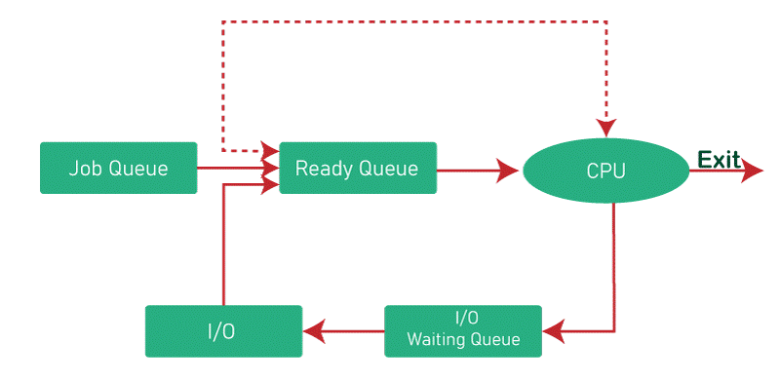
Process scheduling

Slide 6







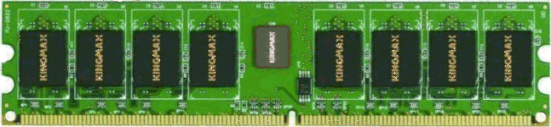

CPU Virtualization
Bob
Virtual machine monitor
Charlie
Alice
Physical machine
Virtual machines
Daniel
Alice has a machine with 16 CPUs.
Bob is assigned with 8 vCPUs.
Charlie is assigned with 8 vCPUs.
Daniel is assigned with 4 vCPUs.

Slide 7
What is a virtual CPU (vCPU)?
Bob's VM
Charlie’s VM
Daniel’s VM
Guest OS sees 8 CPUs
Guest OS sees 8 CPUs
Guest OS sees 4 CPUs
vCPU 1
vCPU 2
vCPU 3
...
vCPU 8
VMM schedules vCPUs
16 Physical CPUs on Alice’s machine

Slide 8
CPU virtualization: two scheduling layers
Inside each VM: guest OS scheduling
Under all VMs: VMM scheduling
Process queue
Guest OS scheduler
vCPU
vCPU queue
VMM scheduler
pCPU
P1
P2
P3
P4
B1
C1
D1
B2
The guest OS schedules processes onto vCPUs. It thinks these vCPUs are physical CPUs.
The VMM schedules vCPUs onto real physical CPUs.

Slide 9
Example: Bob's program runs through two schedulers
Bob starts a web server process inside his VM.
Process ready inside Bob VM
Guest OS puts it on Bob vCPU 1
VMM maps Bob vCPU 1 to a pCPU
Guest OS decision
Guest OS decision
VMM decision
Considering that the web server process is already put onto Bob vCPU 1 but Bob vCPU 1 is waiting for a physical CPU, can the process make progress? Why?

Slide 10
Example: Bob's program runs through two schedulers
Inside Bob VM
Time slice 1
Time slice 2
Time slice 3
Guest OS view
Web server → Bob vCPU 1
Web server → Bob vCPU 1
Web server → Bob vCPU 1
VMM on Alice machine
VMM view
Bob vCPU 1 runs on pCPU
Charlie vCPU 1 runs on pCPU
Bob vCPU 1 runs on pCPU

Slide 11
CPU overcommitment
Bob 8 vCPUs
Charlie 8 vCPUs
Daniel 4 vCPUs
Total = 20 vCPUs Physical CPUs = 16
Running now on 16 physical CPUs
Waiting for next time slice
B1
B2
B3
B4
B5
C1
C2
C3
B8
C8
D3
D4
C4
C5
D1
D2
B6
B7
C6
C7
16 physical CPU slots are occupied
4 vCPUs wait in the queue
Do Bob and Charlie get more time of running on pCPU than Daniel?

Slide 12
CPU overcommitment
Each vCPU becomes one scheduling ticket. Total = 20 scheduling tickets
Bob
B1
B2
B3
B4
B5
B6
B7
B8
Bob
8/20 = 40%
Charlie
C1
C2
C3
C4
C5
C6
C7
C8
Charlie
8/20 = 40%
Daniel
D1
D2
D3
D4
Daniel
4/20 = 20%

Slide 13
CPU virtualization: same idea as process scheduling
OS
Virtualization
Many processes P1 P2 P3 P4 ...
Many vCPUs B1 B2 C1 D1 ...
OS scheduler chooses one process
VMM scheduler chooses vCPUs
Physical CPU
Physical CPU
Processes take turns on CPUs.
vCPUs take turns on physical CPUs.

Slide 14
Amazon S3 (Simple Storage Service)
It is a popular and widely used cloud storage service provided by AWS
It allows users to store and retrieve any amount of data at any time over the internet

Slide 15
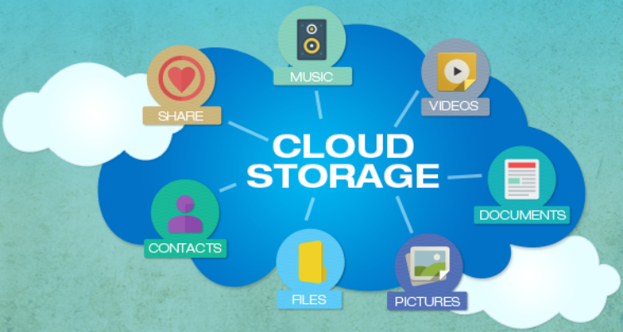
Cloud storage
Cloud storage, provided by a third-party cloud provider allows customers to store and access data over the internet.
Examples: Dropbox, Google drive, iCloud, Amazon S3

Slide 16
Amazon S3 (Simple Storage Service)
It is a popular and widely used cloud storage service provided by AWS
It allows users to store and retrieve any amount of data at any time over the internet
Bucket
Object

Slide 17
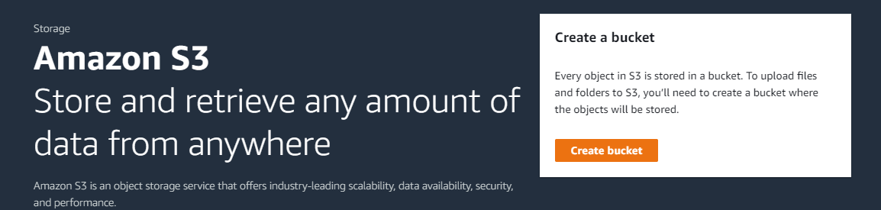
Create bucket

Slide 18
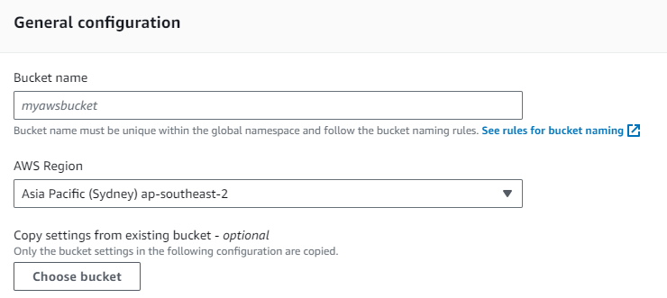
Create Bucket
Bucket name must be unique within the global namespace.
Bucket names must be unique across all AWS accounts in an AWS partition. A partition is a group of AWS Regions.
three partitions: AWS (Standard Regions), AWS-CN (China Regions), and AWS-US-Gov (US Gov Regions).
It must follow the bucket naming rules.

Slide 19
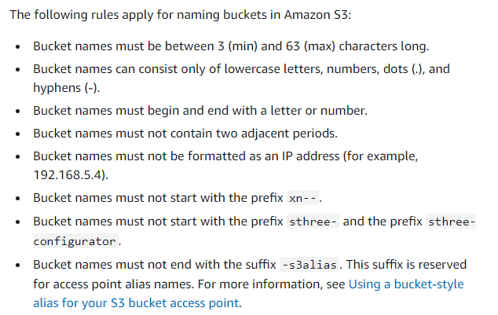
Rules for bucket naming

Slide 20
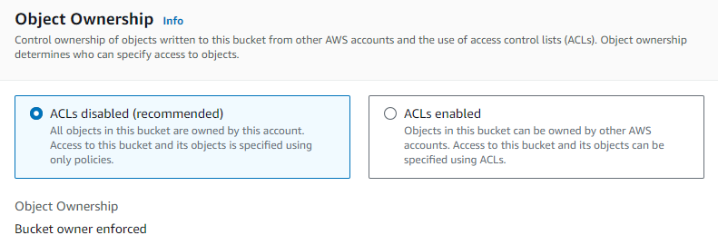
Object ownership
What is an object?

Slide 21
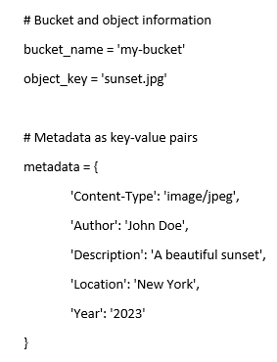
Object
It is an individual unit of data stored in a bucket
Can be a file of any type:
documents, images, videos, etc
It contains both data and metadata:
Data refers to file contents. Metadata include file attributes.
e.g., a file called sunset.jpg is uploaded into a bucket.

Slide 22
Object
How to identify an object? object key + version ID (if enabled)
Object key is a string specifying the object’s location and name, e.g., cits5503-123456-lecture/subdir/sunset.jpg
Version ID: denotes a specific version of an object, e.g., v1AbCdEfGhIjKlMnOpQrStUvWxYz1234567890
A combination of an object key and version ID uniquely identifies a specific version of an object in a bucket.

Slide 23
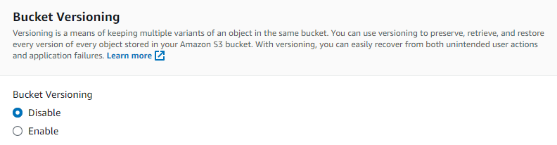
Bucket versioning

Slide 24
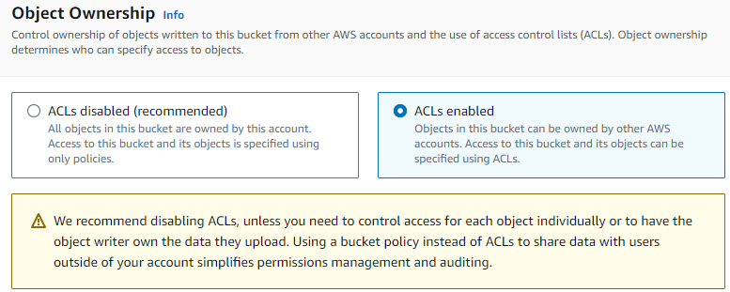
Object ownership
Bucket ACLs are access-control mechanism for buckets.

Slide 25
Bucket policy
Secure access to buckets and their objects
For unauthenticated users, access is denied
For authenticated users, access is dependent on their permissions

Slide 26
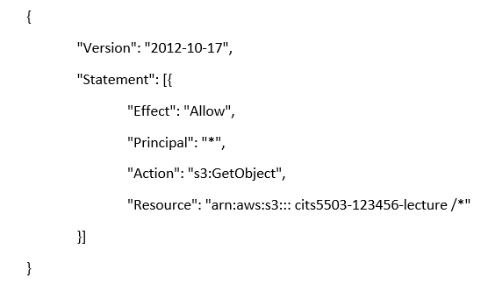
Bucket policy
Secure access to buckets and their objects
Version: indicates the language version of the policy language.
Statement: represents a permission rule.
Effect: what the effect will be when a user requests a specific action—this can be either ’Allow’ or ’Deny’.
Principal: refers to a set of users/applications that have allowed (or denied) access to the actions and resources below.
Action: defines a set of resource operations a principal is allowed (or denied) to perform.
Resource: specifies AWS resources for which a principal is allowed (or denied) to take actions. ARN identifies the bucket.

Slide 27
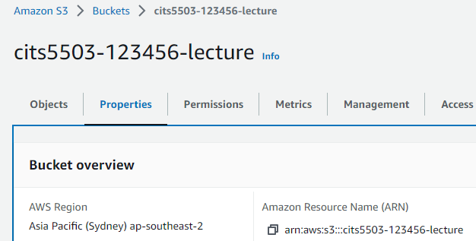
ARN
ARN: a unique ID for any AWS resources, such as S3 buckets, EC2 instances and IAM users.

Slide 28
Bucket policy
Secure access to buckets and their objects
Version: indicates the language version of the policy language.
Statement: represents a permission rule.
Effect: what the effect will be when a user requests a specific action—this can be either ’Allow’ or ’Deny’.
Principal: refers to a set of users/applications that have allowed (or denied) access to the actions and resources below.
Action: defines a set of resource operations a principal is allowed (or denied) to perform.
Resource: specifies AWS resources for which a principal is allowed (or denied) to take actions. ARN identifies the bucket.

Slide 29
Common S3 actions
s3:GetObject: Allow users to read objects from the bucket.
s3:PutObject: Allow users to upload new objects to the bucket.
s3:DeleteObject: Allow users to delete objects from the bucket.
s3:ListBucket: Allow users to list the objects in the bucket.
s3:GetBucketLocation: Allow users to retrieve the bucket’s AWS region.
A complete list of actions (https://docs.aws.amazon.com/AmazonS3/latest/API/API_Operations.html)

Slide 30
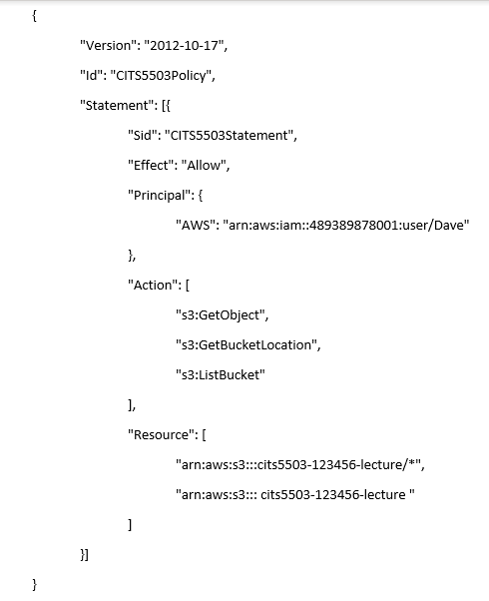
Bucket policy
Id: An optional identifier for the policy, denoting a unique name for the policy.
Sid: An optional identifier for the statement, denoting a unique name for the statement.
s3:GetObject: Allows users to read objects in the bucket.
s3:GetBucketLocation: Allow users to retrieve the bucket's region.
s3:ListBucket: Allows users to list the objects in the bucket.
What is the difference between the two ARNs in the Resource field?

Slide 31
Bucket policy
Id: An optional identifier for the policy, denoting a unique name for the policy.
Sid: An optional identifier for the statement, denoting a unique name for the statement.
s3:GetObject: Allows users to read objects in the bucket.
s3:GetBucketLocation: Allow users to retrieve the bucket's region.
s3:ListBucket: Allows users to list the objects in the bucket.
What is the difference between the two ARNs in the Resource field?
First ARN: refers to all the objects within the bucket.
Second ARN: refers to the bucket itself.

Slide 32
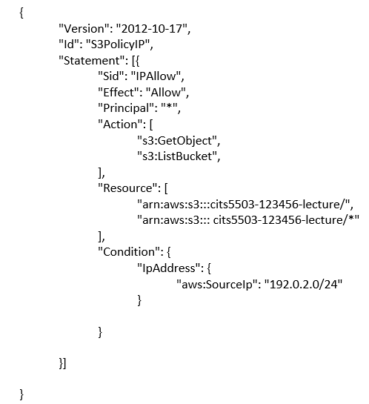
Bucket policy: practice
What does this policy do?
192.0.2.0 is an Internet Protocol Version 4 address.
An IPv4 (Internet Protocol version 4) address has 4 bytes (32 bits) separated by periods.
What is the value range of each byte in an IPv4 address?

Slide 33
Bucket policy: practice
What does this policy do?
192.0.2.0 is an Internet Protocol Version 4 address.
An IPv4 (Internet Protocol version 4) address has 4 bytes (32 bits) separated by periods.
What is the value range of each byte in an IPv4 address?
0-255

Slide 34
CIDR (Classless Inter-Domain Routing)
CIDR is a notation to represent IP addresses and their associated subnet masks.
In CIDR notation, an IPv4 address (e.g., 192.0.2.0/24) is followed by a slash ("/") and a number. This number represents the bit length of the network portion of the IP address.
Notes:
34

Slide 35
Bucket policy: practice
This policy allows any users or applications to read objects and list objects from the bucket named "cits5503-123456-lecture" and its contents from IP addresses within the "192.0.2.0/24" range. This range covers all IP addresses from 192.0.2.0 to 192.0.2.255, inclusive.
What is the ip address range of 192.0.2.0/16?

Slide 36
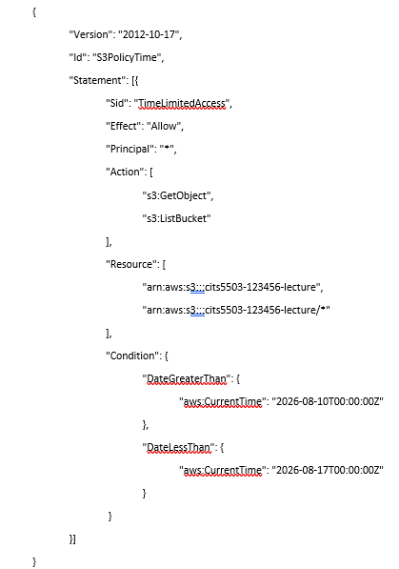
Bucket policy: practice

Slide 37
Bucket policy: practice
This policy allows any users or applications to read objects and list objects from the bucket named “cits5503-123456-lecture” and its contents during a pre-defined period: after 10 August 2026, 00:00 UTC, and before 17 August 2026, 00:00 UTC.
2026-08-10T00:00:00Z: is an AWS-standard timestamp. 2026-08-17 is in YYYY-MM-DD format. 00:00:00 is in 24-hour clock. Z means UTC (Coordinated Universal Time) time, also called Zulu time

Slide 38
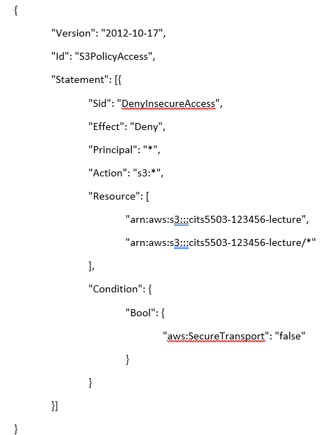
Bucket policy: practice
Can a user access the bucket through HTTPS?

Slide 39
Bucket policy: practice
This policy denies any users or applications from performing any S3 operations on the bucket named “cits5503-123456-lecture” and its contents when the request is made through an insecure http connection.

Slide 40
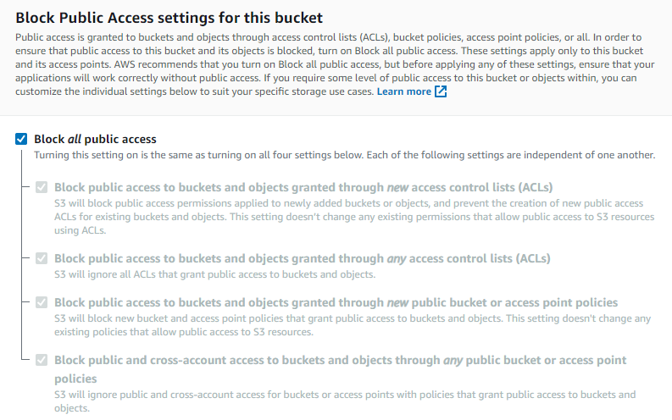
Block Public Access settings for this bucket

Slide 41
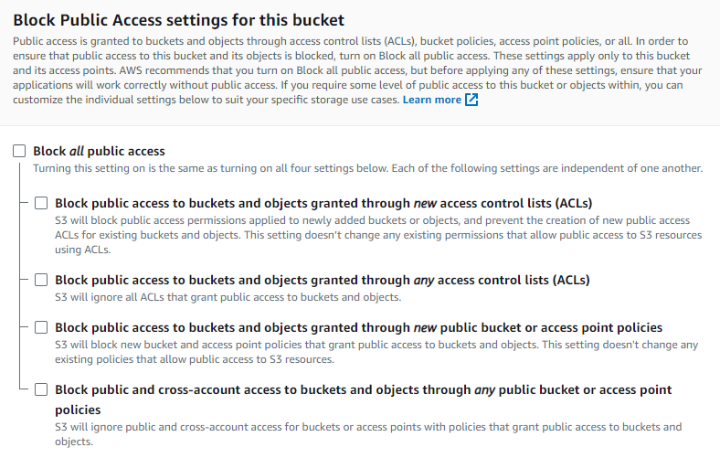
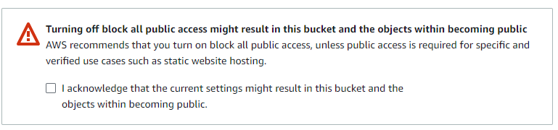
Block Public Access settings for this bucket

Slide 42
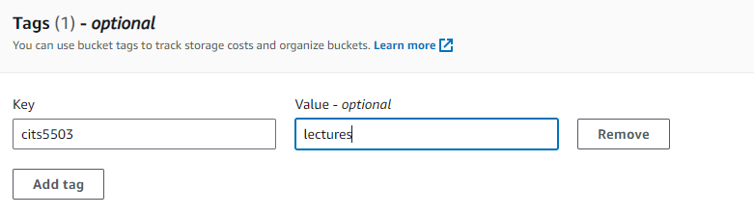

Tags
Tags are key-value pairs that provide customized label to track costs from buckets, e.g.,
If a bucket is tagged as cits5503/lectures, ‘cits5503’ is a key and ‘lectures’ is a value.
If another bucket is tagged as cits5503/labs, ‘cits5503’ is a key and ‘labs’ is a value.

Slide 43
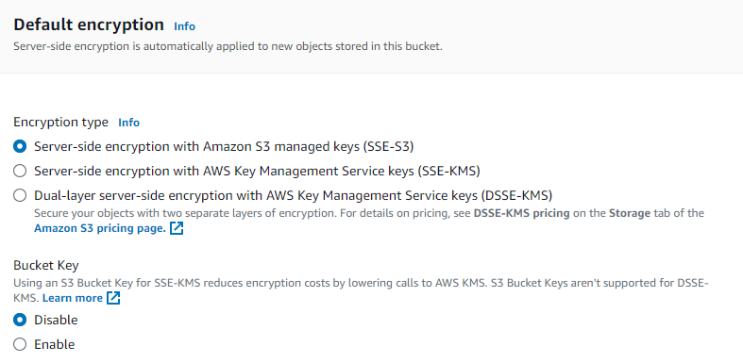
Default encryption

Slide 44
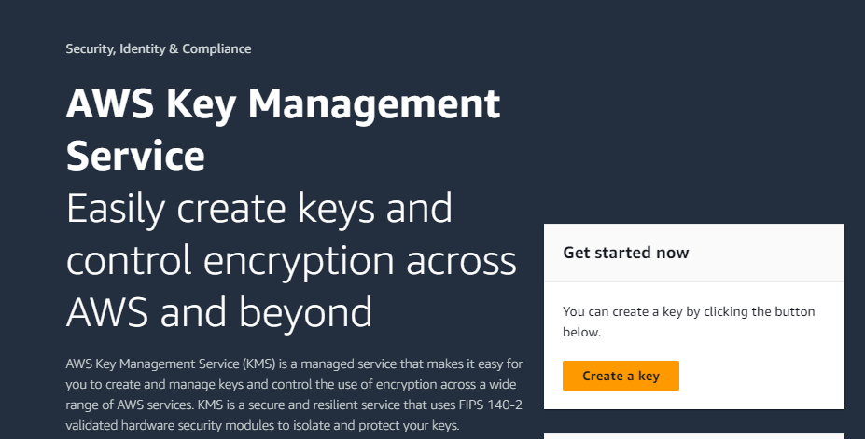
Default encryption
Server-side encryption with S3 managed keys (SSE-S3): The S3 service manages the encryption keys (AES-256 encryption) used to encrypt and decrypt objects.
Server-side encryption with AWS Key Management Service keys (SSE-KMS): It uses KMS to manage the encryption keys for each object stored in the bucket.

Slide 45
Default encryption
Server-side encryption with S3 managed keys (SSE-S3): S3 manages the encryption keys (AES-256 encryption) used to encrypt and decrypt objects.
Server-side encryption with AWS Key Management Service keys (SSE-KMS): It uses KMS to manage the encryption keys for each object stored in the bucket.
Dual-layer server-side encryption with AWS KMS (DSSE-KMS): It is a combination of SSE-S3 and SSE-KMS.

Slide 46
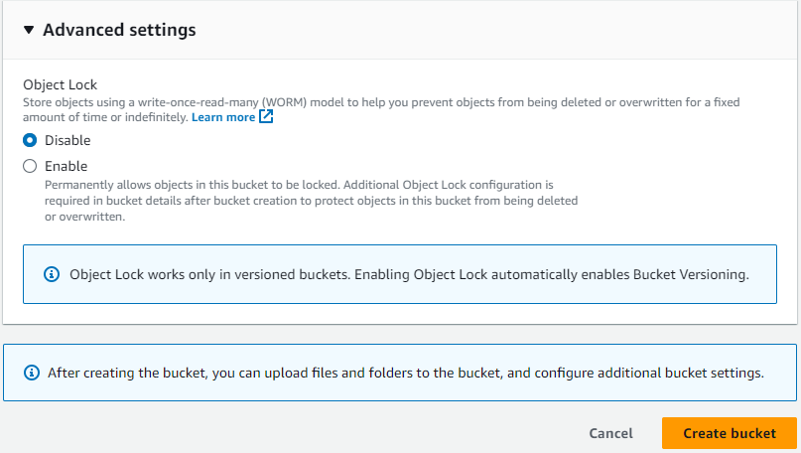
Object lock

Slide 47
Configure a bucket

Slide 48
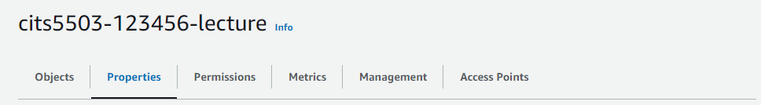
Configure a bucket
Properties
Bucket versioning
Tags
Default encryption
Object Lock
Server access logging
Provides records for the requests that are made to a bucket.

Slide 49
Practice Questions
[5 marks] Q1: When a bucket is created, AWS provides features that can be managed. List and describe 5 key features?

Slide 50
Practice Questions
[5 marks] Q1: When a bucket is created, AWS provides features that can be managed. List and describe 5 key features?
[1 mark] Bucket versioning: keeps multiple versions of an object in the same bucket.
[1 mark] Tags: are key-value pairs that provide customized label to track costs from buckets.
[1 mark] Default Encryption: All objects uploaded to the bucket will be automatically encrypted using one server-side encryption.
[1 mark] Object Lock: prevent objects in a bucket from being deleted or overwritten for a fixed amount of time or indefinitely.
[1 mark] Server access logging: provides records for the requests that are made to a bucket.

Slide 51
Practice Questions
[5 marks] Q2: Describe how S3 handles consistency of objects and how this approach affects the state of objects when they are read using a GET.

Slide 52
Practice Questions
[5 marks] Q2: Describe how S3 handles consistency of objects and how this approach affects the state of objects when they are read using a GET.
[4 marks] S3 delivers strong read-after-write and list (i.e., GET, PUT and LIST operations) consistency automatically. Specifically, what a user write is what they will read, and the results of a LIST will be an accurate reflection of what’s in the bucket.
[1 mark] When GET is used to read an object, the read request immediately receives the latest content of the object.

