Slide 1
CITS5503 Cloud Computing 2026 Introduction
Dr Zhi Zhang

Slide 2
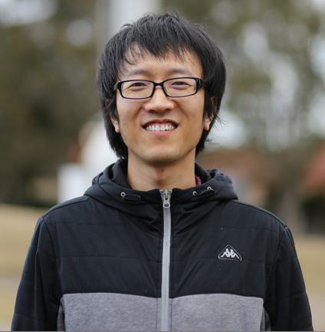
Senior Lecturer
Office: G10@CSSE
https://zhangzhics.github.io‬
Email: zhi.zhang@uwa.edu.au
queries related to CITS5503: cits5503-pmc@uwa.edu.au

Slide 3
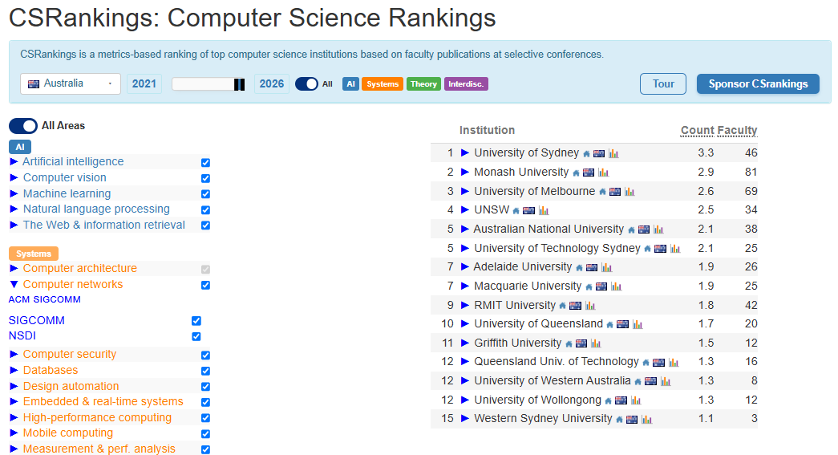
csrankings.org

Slide 4
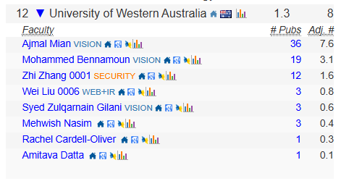

Slide 5
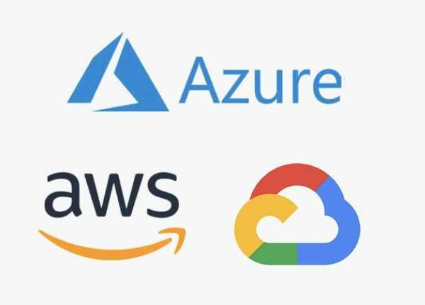
Three main cloud providers

Slide 6
Three main virtual machine monitors (VMM)
?
?
?

Slide 7
Three main virtual machine monitors (VMM)
Hyper-V
Closed-source
Windows kernel module
Xen and KVM
KVM
Open-source
Build from scratch
Open-source
Linux kernel module

Slide 8
Three main virtual machine monitors (VMM) What do they have in common?
Hyper-V
Xen and KVM
KVM

Slide 9
KVM, Xen, Hyper-V are bare-metal/type 1 VMM.
Type-1 VMM: VMM is installed directly on hardware.
VM
VM
Hypervisor
Hardware
Type-1 VMM

Slide 10
Three main virtual machine monitors (VMM)
Hyper-V
Xen and KVM
KVM

Slide 11
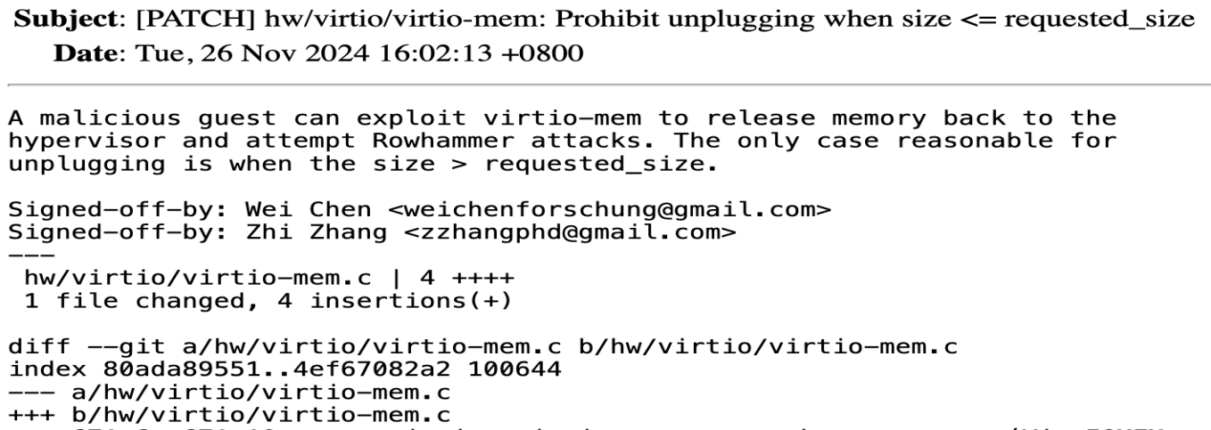
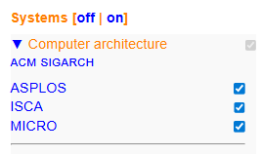
KVM: https://linux-kvm.org

Slide 12
To Get Started
People
Emergency
Lectures
Items of assessment
Use of AI
What is Cloud Computing?
Learning outcomes

Slide 13
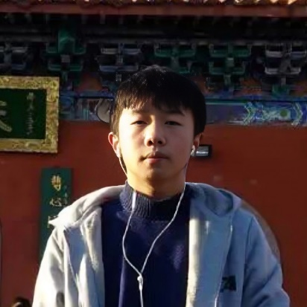
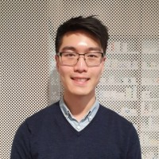
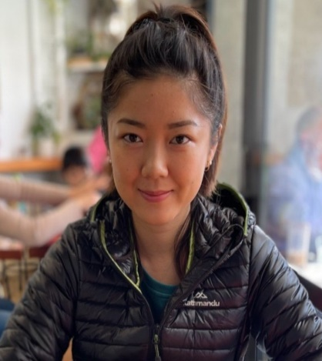
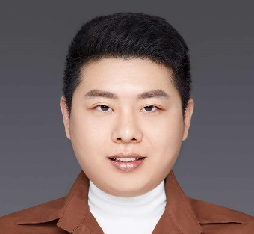
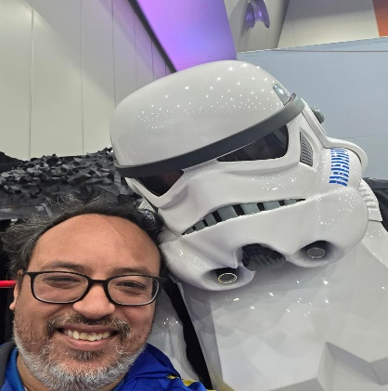
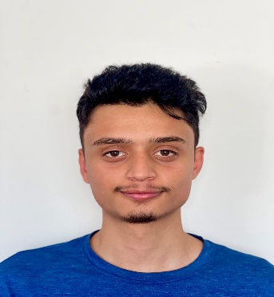
People
Zhi Zhang
Unit coordinator
Room G.10
cits5503-pmc@uwa.edu.au
Wenxiao Zhang
Lab facilitator
Larry Huynh
Assistant Lecturer
Fiona Wei
Lab facilitator
Jichunyang Li
Assistant Coordinator
Sarwesh Kattel
Lab facilitator
Rodney Paul
Lab facilitator

Slide 14
Emergency
General emergency: call campus security at 6488 2222
In super emergency: call emergency at 000
For other student services:
https://www.uwa.edu.au/students/Support-services
UniAccess: https://www.uwa.edu.au/students/Support-services/Disability-and-accessibility (send me your Uniaccess letters ☺)

Slide 15
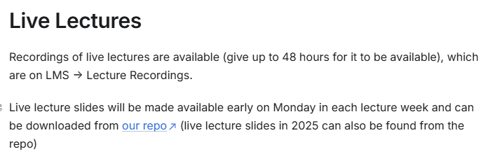
Lectures
For lectures, they will be recorded and uploaded into LMS.
Lectures are about different aspects of cloud computing with exam-style questions included.
Lectures slides are available:
https://zhangzhics.gitbook.io/cits5503

Slide 16
Assessments
Labs
Mid-semester Test
Final Exam

Slide 17
Labs start in week 2
Lab materials
Lab location
Lab computer
Lab assessment
Lab due dates
Lab help
Lab setup

Slide 18
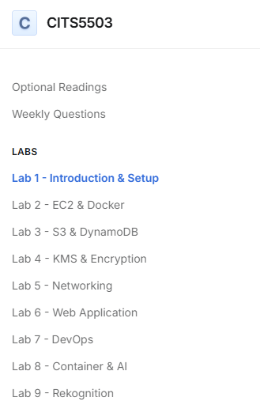
Lab materials
https://zhangzhics.gitbook.io/cits5503/labs/lab1introsetup
Read through each lab before starting it.

Slide 19
AWS
Labs focus on AWS resources
AWS login credentials will be sent by the end of this week.
Each AWS user account sent to you is unprivileged and created by the only root user.
The login portal is:
https://489389878001.signin.aws.amazon.com/console
where 489389878001 is an AWS account’s root user id.
Lab 1 provides the portal.
Lab 4 needs the root user id.

Slide 20
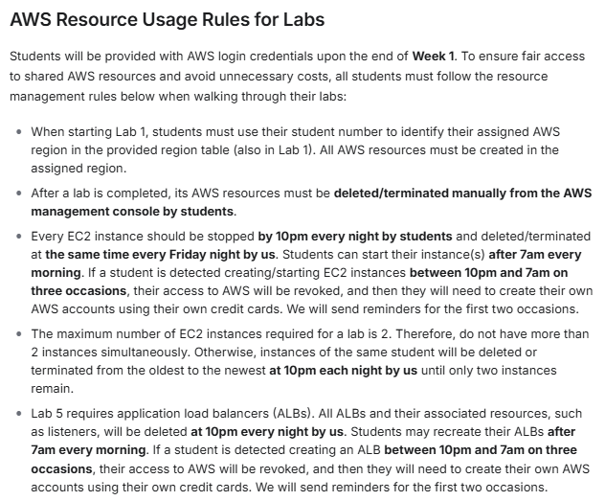
https://zhangzhics.gitbook.io/cits5503#use-of-aws

Slide 21
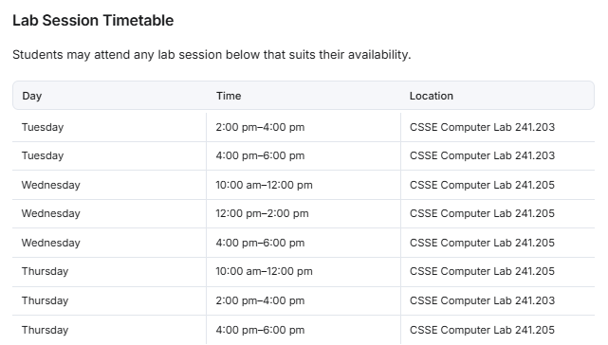
Lab Location
Labs
Check your timetable for your lab allocation
You can go to another scheduled lab.
https://zhangzhics.gitbook.io/cits5503#live-lab-assessment

Slide 22
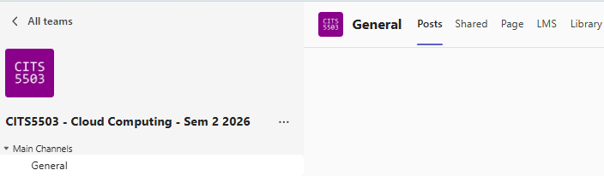
MS Teams

Slide 23
Lab Computer
The labs are related to Unix-like OS.
If you do not have a laptop that is capable of running the labs, you can arrange to borrow one from the university.
Else – invest in a decent laptop.
If none of these options are available to you, please come and chat with me.

Slide 24
Lab Assessment
Labs are worth 20% of the unit grade (i.e., 20 marks in total).
9 labs in total: Each lab in labs 1-7 is worth 2 marks and each lab in labs 8-9 is worth 3 marks.

Slide 25
Lab Assessment
Lab facilitator will mark each lab in person during a lab session, known as live lab assessment:
Each lab contains a few checkpoints.
Each checkpoint has an assigned value and is assessed on a binary basis.

Slide 26
Lab Assessment
Lab facilitator will mark each lab in person during a lab session, known as live lab assessment:
Each lab contains a few checkpoints.
Each checkpoint has an assigned value and is assessed on a binary basis.
Demonstrate each checkpoint of a lab live to a lab facilitator.
For each demonstration, one student covers the checkpoints for one lab ONLY. So this should take no more than a few minutes.
More details about lab due dates and live lab assessment will come in Week 2.

Slide 27
Other Assessments
Mid-semester test is scheduled in Week 6.
Mid-semester test is worth 30% of the unit grade (more details later)
Final Exam: 50% of the unit grade.
Exam overview will be done in Week 11 or 12.

Slide 28
Use of AI
AI tools are allowed in a limited way (UWA Tier 2: AI assistance)
https://www.uwa.edu.au/students/-/media/project/uwa/uwa/students/academic-support/using-artificial-intelligence-tools-at-uwa---a-guide-for-students-%282026%29.pdf
Do not use AI tools during live lab assessment, mid-semester test and final exam.
Do not enter your personal data into AI tools.
Do not upload copyrighted materials (e.g., lecture slides) into AI tools.
Do not use DeepSeek, which has been banned by The Department of Home Affairs.

Slide 29
Enquiries
Office hours
Maybe Friday 12 – 2pm (F2F and virtual) -> this is just an arbitrary slot
Other times can be arranged too (email cits5503-pmc@uwa.edu.au)
Lab Enquiries
Ask on Teams (but remember not to share code/commands/answers)
Ask during the lab session
If all fails, email us

Slide 30
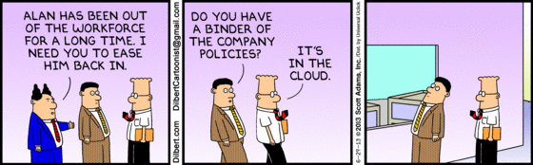
What is cloud computing?
http://www.dilbert.com/fast/2013-06-29/

Slide 31
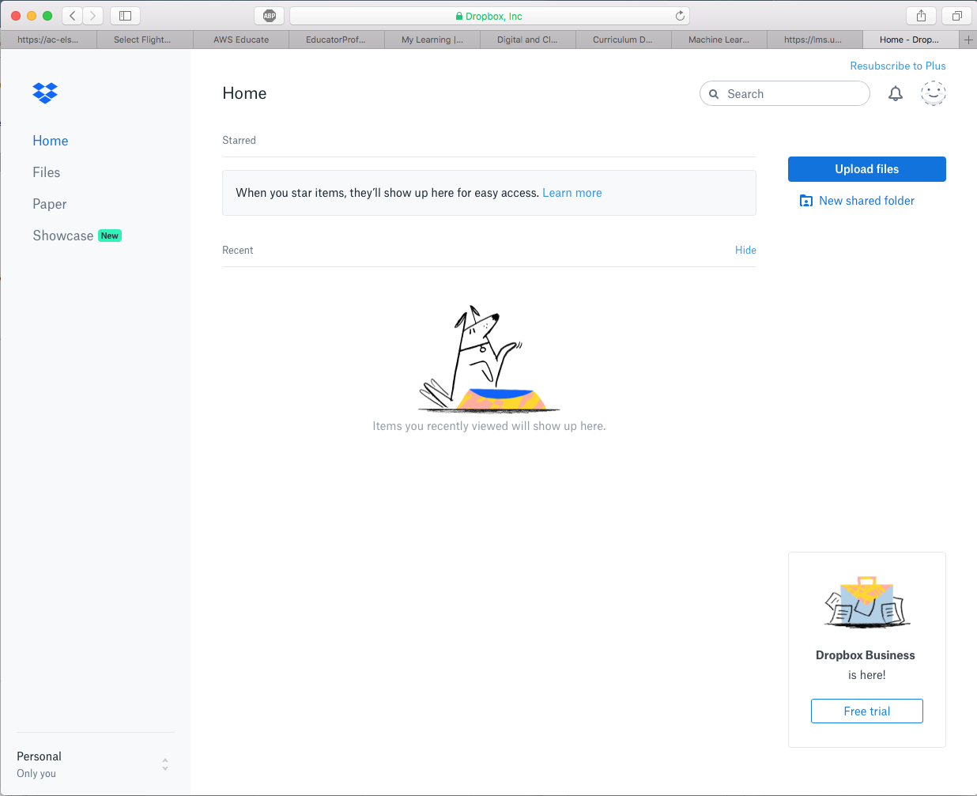
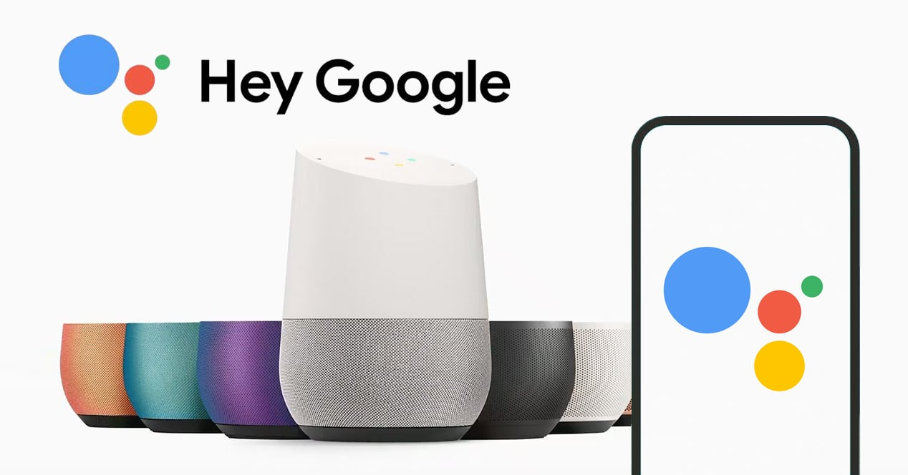
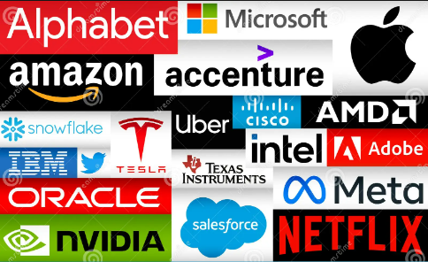
Cloud Services

Slide 32
Formal definition
According to NIST (USA’s National Institute of Standards and Technology):
Cloud computing is a model for enabling convenient, on-demand network access to a shared pool of configurable computing resources (e.g., processors, networks, storage) that can be rapidly provisioned and released with minimal management effort or service provider interaction.

Slide 33
Formal definition
According to NIST (USA’s National Institute of Standards and Technology):
Essential characteristics/benefits:
On-demand self service
Cloud providers allow us to provision computing resources, such as virtual machines, without interacting with them.
Broad network access
cloud services are accessible over a network in various ways.
Cloud computing is a model for enabling convenient, on-demand network access to a shared pool of configurable computing resources (e.g., processors, networks, storage) that can be rapidly provisioned and released with minimal management effort or service provider interaction.

Slide 34
Formal definition
According to NIST (USA’s National Institute of Standards and Technology):
Essential characteristics/benefits:
On-demand self service
Broad network access
Resource pooling
Cloud providers consolidate and share computing resources among many users.
Rapid elasticity
Cloud providers enables the quick and automatic scaling of underlying hardware resources based on workload demands
Cloud computing is a model for enabling convenient, on-demand network access to a shared pool of configurable computing resources (e.g., processors, networks, storage) that can be rapidly provisioned and released with minimal management effort or service provider interaction.

Slide 35
Formal definition
According to NIST (USA’s National Institute of Standards and Technology):
Essential characteristics/benefits:
On-demand self service
Broad network access
Resource pooling
Rapid elasticity
Measured service
Cloud providers allow users to pay as they go
Cloud computing is a model for enabling convenient, on-demand network access to a shared pool of configurable computing resources (e.g., processors, networks, storage) that can be rapidly provisioned and released with minimal management effort or service provider interaction.

Slide 36
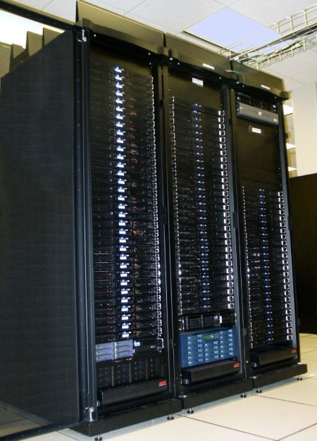
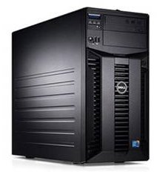
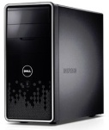
Motivating Cloud Computing
PC
Server
Cluster
What if one computer is not enough?
Buy a better (server-class) computer
What if the best server is not enough?
Buy many servers

Slide 37
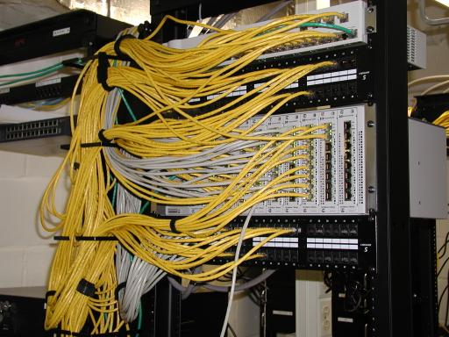
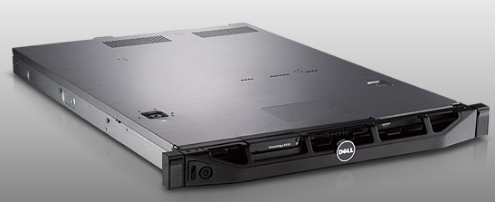
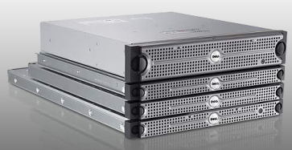
Cluster
Network switch (connects nodes with each other and with other racks)
Rack
Many nodes/blades (often identical)
Storage device(s)
Characteristics of a cluster:
Many similar machines with close interconnection
Special and standardized hardware (racks, blades, etc)

Slide 38
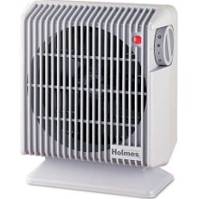
Power and cooling
Clusters need lots of power
Most of power is converted into heat
Large clusters need massive cooling

Slide 39
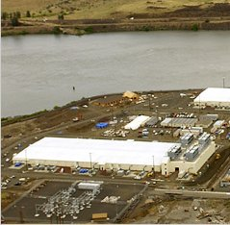
Scaling up
PC
Server
Cluster
Data center
What if a cluster is not enough?
Buy many clusters

Slide 40
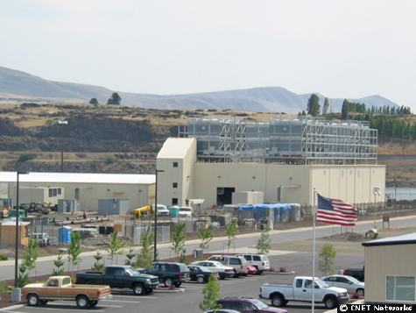
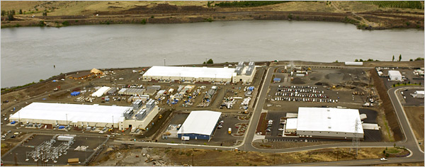
Data center
Cooling plant
Data centers (size of a football field)
Google data center in The Dalles, Oregon

Slide 41
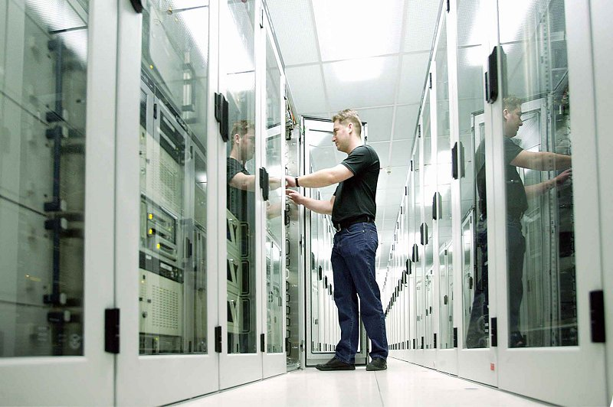

What's inside a data center?
Source: 1&1
Hundreds or thousands of racks

Slide 42
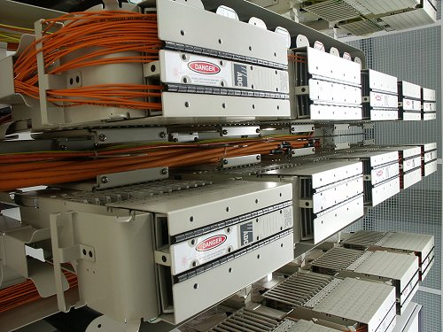
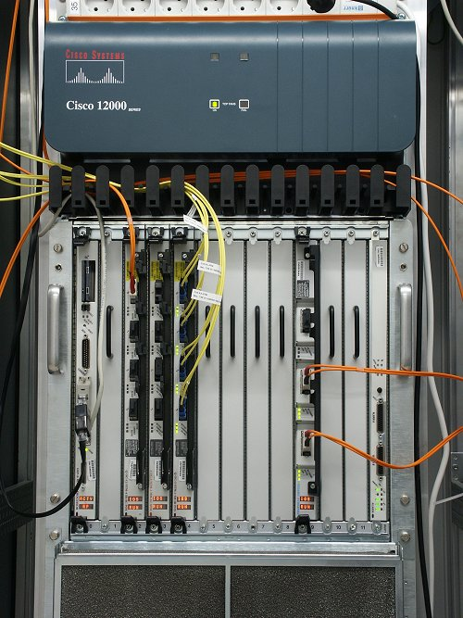
What's inside a data center?
Source: 1&1
Massive networking

Slide 43

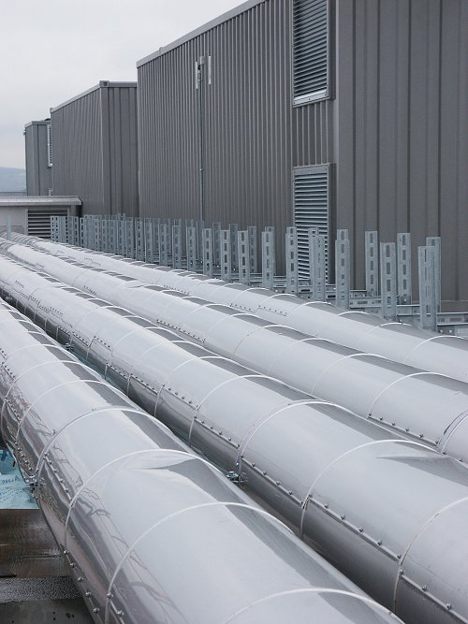
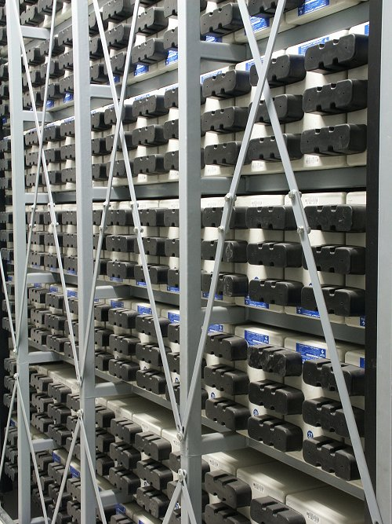
What's inside a data center?
Source: 1&1
Redundant and scalable power supplies

Slide 44
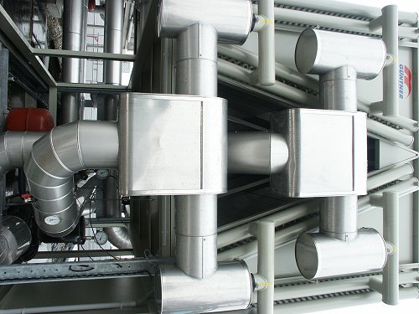
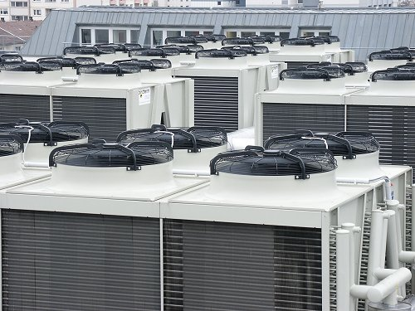
What's inside a data center?
Source: 1&1
Massive cooling

Slide 45
Data Center
Hundreds or thousands of racks
High-capacity networking infrastructure
Redundant and scalable power supplies
Large-scale cooling infrastructure

Slide 46
Scaling up
PC
Server
Cluster
Data center
Network of data centers
What if a data center is not big enough?
Build many data centers

Slide 47
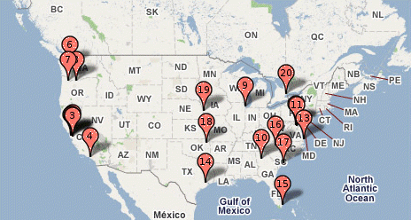
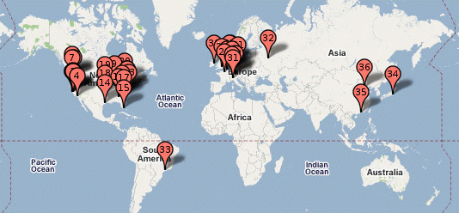
Global distribution
Google data centers
Data centers are globally distributed and networked
Why do we need to distribute the data centers globally?

Slide 48
Global distribution
Google data center in The Dalles, Oregon
Data centers are often globally distributed and networked
Why do we need to distribute the data centers globally?
Reduced Latency
We can bring our cloud services closer to users.
Regional Markets
We can deliver our cloud services that are optimized for specific regional markets.
Disaster Recovery
When a data center goes down, other data centers can replicate the data.

Slide 49

Data center has enabled cloud computing
Big tech companies use existing data centers to provide cloud computing
Benefits:
Economies of scale
Cheaper to run big data centers than many small ones
Statistical resource multiplexing
High utilization of hardware resources
Scalability
Thousands of servers available on demand
Add more within seconds
No up-front commitment
No investment in data centers, enabling pay-as-you-go

Slide 50
Other terms
Utility computing
Services being provided by a cloud
Focuses on the business model (pay-as-you-go), similar to classical utility companies
The Web
The Internet's information sharing model
Most web services run on clouds
The Internet
A network of networks.
Used by the web; connects (most) clouds to their customers

Slide 51
Cloud applications
Application hosting
Backup and Storage
Content delivery
E-commerce
High-performance computing
Media hosting
On-demand workforce
Search engines
Web hosting
…

Slide 52
Some Examples
Woolworths hosts Woolworths Online on Microsoft Azure
UniSuper hosts core systems on Google Cloud
Virgin atlantic hosts their travel portal on Amazon AWS

Slide 53
Practice Questions
Some questions in mid-semester test will be picked from the link below:
https://zhangzhics.gitbook.io/cits5503/weekly_questions
Some practice questions will also be picked from the link.
Answers to practice questions will be discussed in the live lecture.
Answers to other questions in the link need your own work.

Slide 54
Practice Questions
[6 marks] Q1: The evolution of Cloud Computing has been compared to the evolution of electricity supply as a utility. Describe 3 specific problems that cloud computing solves as compared to businesses running their local data centers.

Slide 55
Practice Questions
[6 marks] Q1: The evolution of Cloud Computing has been compared to the evolution of electricity supply as a utility. Describe 3 specific problems that cloud computing solves as compared to businesses running their local data centers.
[2 marks] Operational expenses: Cloud computing enables businesses to apply a subscription policy without investing in building and maintaining their data centers.

Slide 56
Practice Questions
[6 marks] Q1: The evolution of Cloud Computing has been compared to the evolution of electricity supply as a utility. Describe 3 specific problems that cloud computing solves as compared to businesses running their local data centers.
[2 marks] Operational expenses: Cloud computing enables businesses to apply a subscription policy without investing in building and maintaining their data centers.
[2 marks] Scalability: Cloud computing enables on-demand computing resources by providing virtual machines as instances.

Slide 57
Practice Questions
[6 marks] Q1: The evolution of Cloud Computing has been compared to the evolution of electricity supply as a utility. Describe 3 specific problems that cloud computing solves as compared to businesses running their local data centers.
[2 marks] Operational expenses: Cloud computing enables businesses to apply a subscription policy without investing in building and maintaining their data centers.
[2 marks] Scalability: Cloud computing enables on-demand computing resources by providing virtual machines as instances.
[2 marks] Resource utilization: Cloud computing provides multi-tenant environments by allocating resources efficiently for different users, e.g., some tasks are computing intensive while some others are memory intensive.

Slide 58
Practice Questions
[6 marks] Q2: An established financial company is about to launch their new banking application. Give 3 reasons why the company should use their own data center rather than cloud computing.

Slide 59
Practice Questions
[6 marks] Q2: An established financial company is about to launch their new banking application. Give 3 reasons why the company should use their own data center rather than cloud computing.
[2 marks] Data Security: Financial institutions must ensure user data security. By hosting their application in their own data center, the company can better protect their data security.

Slide 60
Practice Questions
[6 marks] Q2: An established financial company is about to launch their new banking application. Give 3 reasons why the company should use their own data center rather than cloud computing.
[2 marks] Data Security: Financial institutions must ensure user data security. By hosting their application in their own data center, the company can better protect their data security.
[2 marks] Data Sovereignty: For financial institutions, data sovereignty is critical because user data will be stored and processed in compliance with local laws and regulations.

Slide 61
Practice Questions
[6 marks] Q2: An established financial company is about to launch their new banking application. Give 3 reasons why the company should use their own data center rather than cloud computing.
[2 marks] Data Security: Financial institutions must ensure user data security. By hosting their application in their own data center, the company can better protect their data security.
[2 marks] Data Sovereignty: For financial institutions, data sovereignty is critical because user data will be stored and processed in compliance with local laws and regulations.
[2 marks] Optimized Performance: With their own data center, the company can have consistent performance for their application. Besides, they can fine-tune the infrastructure to optimize the application’s performance.

Slide 62
Learning Outcomes
Understandings
Understand cloud services, their motivation, design and implementation
Understand the basics of virtualization of hardware, networks and security
Understand cloud-based web architectures and their applications
Understand how to achieve scalability and security in a cloud
Hands-on skills
Use DevOps to deploy and manage the creation and update of software environments
Use cloud services to carry out specific use cases such as machine learning

Slide 63
Copyright notice
Commonwealth of Australia
Copyright Regulations 1969
WARNING
Materials in this unit have been reproduced and communicated to you by or on behalf of The University of Western Australia pursuant to Part VB of the Copyright Act1968 (the Act).
The material in this communication may be subject to copyright under the Act. Any further reproduction or communication of this material by you may be the subject of copyright protection under the Act.

