Slide 1
Week 12 Web Application
Deployment Architecture
Dr Zhi Zhang

Slide 2
Overview
AWS Web Application Deployment Architecture
  A traditional web application deployment
  A serverless web application deployment
2

Slide 3
Start from a web application architecture
Client
Application Server
Database

Slide 4
Web application Architecture and design pattern
Web application architecture
Design pattern
What major software components exist and how do they interact?
Example: Client -> App -> Database
How are software responsibilities organised internally?
Example: MVC

Slide 5
Web application deployment architecture
Web application architecture
Design pattern
Deployment architecture
What major software components exist and how do they interact?
Example: Client -> App -> Database
How are software responsibilities organised internally?
Example: MVC
Where and how do components run?
Example: ALB -> EC2 -> DB

Slide 6
Requirements drive the architecture
Reachability
Security
Availability
Public users must reach the service over HTTPS, but private tiers do not need unsolicited Internet access.
Only intended communication paths should be possible: user -> entry point -> app -> database.
The application should survive common instance failures and reduce dependence on one AZ.

Slide 7
A traditional web application deployment
Internet
VPC
AZ-A
IGW
AZ-B
Public subnet A
Public subnet B
ALB + NAT GW
ALB
ALB + NAT GW
Private web app subnet A
App
Private web app subnet B
EC2 targets
EC2 targets
Private DB subnet A
DB
Private DB subnet B
RDS placement
RDS placement

Slide 8
AWS geography: Region and Availability Zone
AWS Region
Availability Zone A
Availability Zone B
Public subnet
Private app subnet
Private DB subnet
Public subnet
Private app subnet
Private DB subnet

Slide 9
Region: the physical boundary
One AWS Region
• VPC belongs to one Region
• Multiple Availability Zones inside
• Region choice affects latency, service availability and cost

Slide 10
VPC: the network boundary
VPC 10.0.0.0/16
Subnet in AZ-A
Subnet in AZ-B
Private IP addresses
Route table association
Security boundary options
Private IP addresses
Route table association
Security boundary options

Slide 11
VPC address space
VPC address space
10.0.0.0/16
Subnet A
Subnet B
10.0.1.0/24
10.0.2.0/24
Both subnet CIDRs are inside the VPC CIDR and do not overlap.
Why do we need to divide a VPC into multiple subnets?

Slide 12
Why divide a VPC into subnets?
Different routing : public-facing AWS resources can use IGW while private resources can use NAT, or no Internet.
Availability: create corresponding subnets in multiple AZs to distribute network traffic.
Security: Network access control apply at subnet boundaries.

Slide 13
Route tables: destination -> target
Example subnet route table
Destination | Target
10.0.0.0/16 | local
0.0.0.0/0 | igw-...

Slide 14
Route 1: 10.0.0.0/16 → local
VPC 10.0.0.0/16
Subnet A
Subnet B
10.0.1.0/24
10.0.2.0/24
destination IP = 10.0.2.10
Web Server
DB Server
10.0.1.10
10.0.2.10
Packet walk
1 Destination is 10.0.2.10
2 10.0.2.10 matches the first route. Why not the second route?
3 Target = local
4 AWS delivers the packet inside the VPC

Slide 15
Route 1: 10.0.0.0/16 → local
VPC 10.0.0.0/16
Subnet A
Subnet B
10.0.1.0/24
10.0.2.0/24
destination IP = 10.0.2.10
Web Server
DB Server
10.0.1.10
10.0.2.10
AWS uses longest-prefix match:
10.0.2.10
matches /16 and /0 → /16 is more specific → local

Slide 16
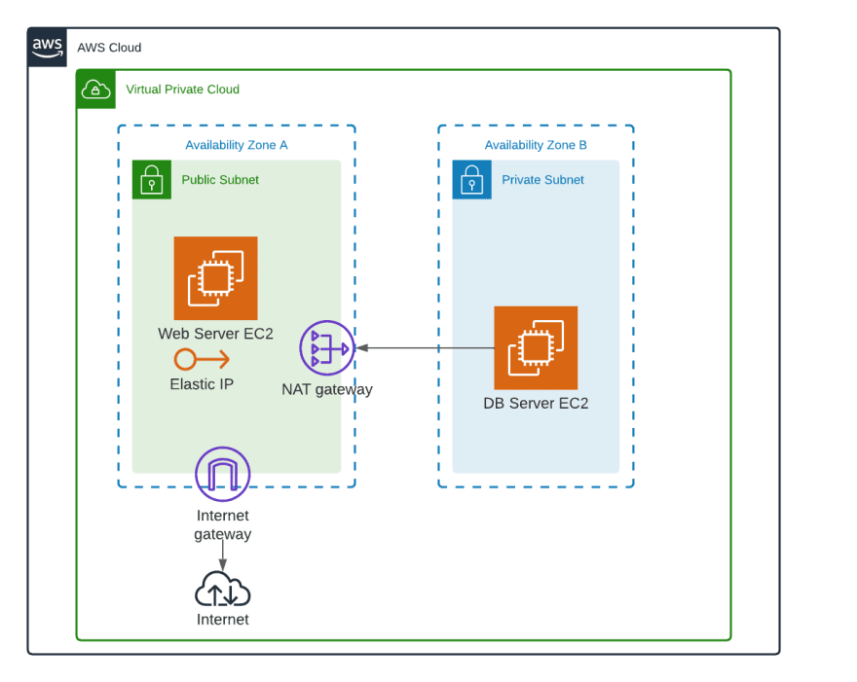
Route 1: 10.0.0.0/16 → local

Slide 17
Route 2: 0.0.0.0/0 → Internet Gateway
Subnet A
10.0.1.0/24
Internet Gateway
destination IP = 8.8.8.8
Internet
Web Server
igw-…
10.0.1.10
Public IPv4 / EIP

Slide 18
Public/Private subnet
VPC
IGW
VPC attachment
Public subnet
Private subnet
route -> IGW
no direct IGW route
Is everything (e.g., the web server EC2) in public subnet reachable from the internet? Why?

Slide 19
Not everything in public subnet is reachable from the internet
1 Routing
2 Addressing
3 Security
4 Service
Subnet has 0.0.0.0/0 -> IGW
Web server EC2 has public IPv4
SG allow protocol + port
Web server is listening

Slide 20
Internet -> web server EC2
Destination: The Internet user sends to the EC2’s public IPv4 address.
1
VPC edge: The Internet gateway maps the EC2's public IPv4 to its private IPv4 address.
2
Why does AWS perform the mapping?
3
Routing + security: The public subnet has an IGW route; Security group allows the inbound traffic.
Service: The EC2 must be running and listening on the requested port.
4

Slide 21
Internet -> web server EC2
Internet Gateway
EC2 instance uses
10.0.1.10
54.240.10.20
Internet user
203.0.113.5
Internet packet
dst = 54.240.10.20
IPv4 destination translation
54.240.10.20 → 10.0.1.10
public IPv4
private IPv4
The instance is addressed internally by its private IPv4.
21

Slide 22
Internet -> web server EC2
Destination: The Internet user sends to the EC2’s public IPv4 address.
1
VPC edge: At the Internet gateway, AWS maps the EC2's public IPv4 to its private IPv4 address.
2
3
Routing + security: The public subnet has an IGW route; Security group allows the inbound traffic.
Service: The EC2 must be running and listening on the requested port.
4
Is web server EC2 reachable from the internet a common deployment practice? Why?

Slide 23
Why keep web server EC2 private?
Saving public IPv4 addresses: Users need access to the web service, not direct access to every web server instance. If placing the web server instances in private subnets, this can save public IPv4 addresses and accept inbound traffic from ALB.
Enabling scaling and fault tolerance: with ALB in use, more instances can be added dynamically to accept increased traffic and unhealthy instances can be replaced without affecting public access.

Slide 24
Keep the web server EC2 private
Web server EC2
10.0.2.10
NAT Gateway
54.240.10.20
10.0.1.50
Internet
Gateway
Internet
private subnet
public subnet
attached to the VPC
Public subnet route table
Private subnet route table
Destination
Target
Destination
Target
10.0.0.0/16
local
10.0.0.0/16
local
0.0.0.0/0
igw-...
0.0.0.0/0
nat-...
How do the route tables above route the outbound traffic from the web server to 8.8.8.8 from the internet?
25

Slide 25
IGW vs. NAT Gateway
Internet Gateway
NAT Gateway
• Attached to the VPC as an Internet edge
• Route target for Internet-routable traffic
• Part of internet inbound/outbound paths
• It normally sits in the public subnet with an associated public ipv4 address
• Private resource → NAT
• No arbitrary inbound traffic

Slide 26
A traditional web application deployment w/ DynamoDB
Internet
VPC
AZ-A
IGW
AZ-B
VPC local
Public subnet A
Public subnet B
ALB + NAT GW
ALB
ALB + NAT GW
VPC local
Private web app subnet A
App
Private web app subnet B
EC2 targets
EC2 targets
VPC local
DynamoDB gateway
VPC endpoint
VPC-level route target
AWS private path
Amazon DynamoDB
regional managed service

Slide 27
DynamoDB gateway VPC endpoint
Destination
Target
10.0.0.0/16
local
pl-0d123456789abcde0 (DynamoDB)
vpce-0a1b2c3d4e5f67890
0.0.0.0/0
nat-0123456789abcdef0
28

Slide 28
Two different “endpoints”
endpoint
What is it?
Concrete example
Main role
DynamoDB service endpoint
Regional AWS API address used by AWS SDK
dynamodb.ap-southeast-2.amazonaws.com
Names the service destination
DynamoDB gateway VPC endpoint
VPC networking resource used as a gateway route-table target
vpce-0a1b2c3d4e5f67890
Provides the private route
29

Slide 29
Two different “endpoints”
APPLICATION VIEW
Web application
EC2
dynamodb.ap-southeast-2.amazonaws.com
NETWORK VIEW
Web application EC2
10.0.2.10
Route table
pl-0d123456789abcde0 → vpce-0a1b2c3d4e5f67890
DynamoDB gateway
VPC endpoint
DynamoDB
30

Slide 30
Deployment architecture is a design choice
Client
Application logic
Data
traditional web application deployment
ALB -> EC2 -> RDS/DynamoDB
serverless web application deployment
API Gateway -> Lambda -> RDS/DynamoDB

Slide 31
serverless web application deployment
AWS manages the compute infrastructure and service networking.
Web developers design APIs, functions, data access permissions and data analysis.

Slide 32
A serverless web application deployment
IAM role
authorizes Lambda actions
Client
API Gateway
Lambda
DynamoDB
web / mobile
public API
business logic
data
CloudWatch
observes the services

Slide 33
What is an API?
Client
browser
API
communication contract
Application
business logic
33

Slide 34
A common Web API model: HTTP(s) request
HTTP-based Web API
request / response contract
Web client
initiates request
Application
processes request
34

Slide 35
HTTP request: method + resource path + message
HTTP method
GET
POST
PUT
DELETE
Resource path
/movies
/movies/123
/movies/123/reviews
Message
query string
header
optional request body
Method = intended operation
Path = target resource
Message = additional input/context
GET /movies/123?include=reviews
Host: api.example.com
Accept: application/json
35

Slide 36
A serverless-based HTTP request
HTTP 200 + JSON body
API Gateway
API endpoint
API management
route + integration
Lambda
getMovie() on DynamoDB service endpoint
Client
web
DynamoDB
Movies table
GET /movies/123?include=reviews
invoke getMovie
GetItem(movieId=123)
36

Slide 37
HTTP API route
Method
GET
Resource path
/movies/{id}
Route
GET /movies/{id}
{id} is a path parameter
In our movie example, do the following two requests belong to two different routes? Why?
GET /movies/123
GET /movies/123?include=reviews
37

Slide 38
Integration
GET /movies/{id}
→ getMovie
Integration
Lambda: getMovie
path parameter: id = 123
query parameter: include = reviews
Matched pattern
Incoming request
GET /movies/123
?include=reviews
POST /movies
→ createMovie
DELETE /movies/{id}
→ deleteMovie
38

Slide 39
DynamoDB
Returned item
{
"movieId": "123",
"title": "Arrival",
"year": 2016
}
Lambda: getMovie
path parameter: id = 123
query parameter: include = reviews
DynamoDB
DynamoDB API
GetItem with:
TableName = Movies
Key = { movieId: "123" }
39

Slide 40
IAM
IAM role
authorises
Lambda
getMovie()
DynamoDB
Movies table
dynamodb:GetItem
Does an http request travel Lambda → IAM → DynamoDB?
40

Slide 41
CloudWatch
API Gateway
requests / latency
Lambda
logs / errors
DynamoDB
service metrics
CloudWatch
logs / metrics / alarms
41

Slide 42
Putting all together
IAM role
authorises
Client
GET /movies/123
API Gateway
match route
Lambda
getMovie()
DynamoDB
GetItem(123)
CloudWatch
observe
42

Slide 43
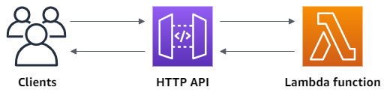
AWS example: HTTP API
43

Slide 44
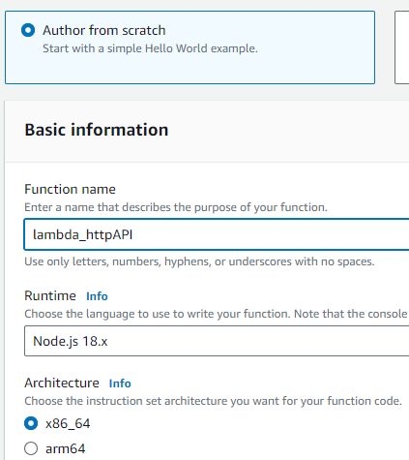
Step1: create a Lambda function
44

Slide 45
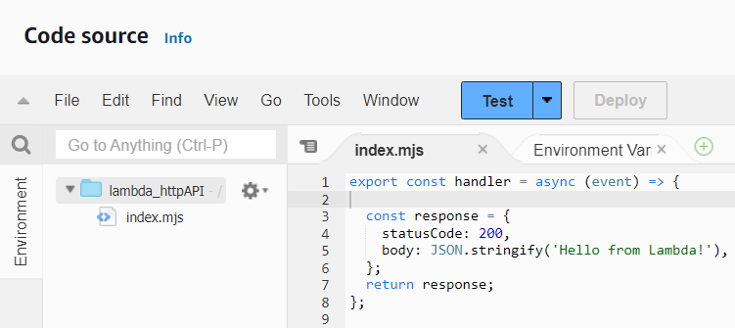
Step1: create a Lambda function
45

Slide 46
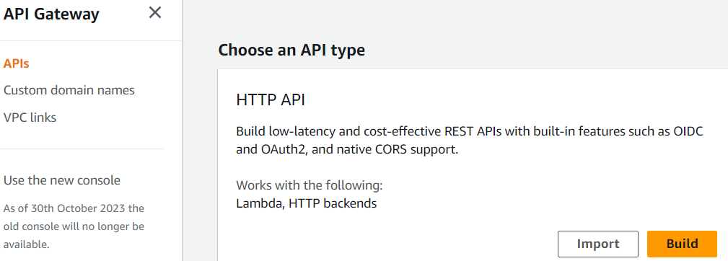
Step2: create an HTTP API
46

Slide 47
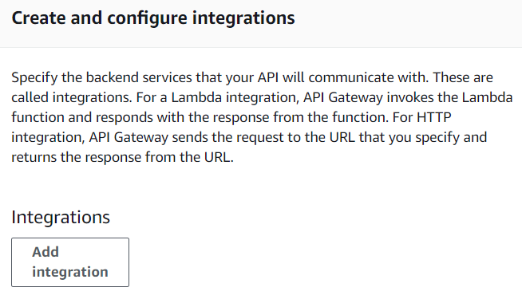
Step2.1: create and configure integrations
47

Slide 48
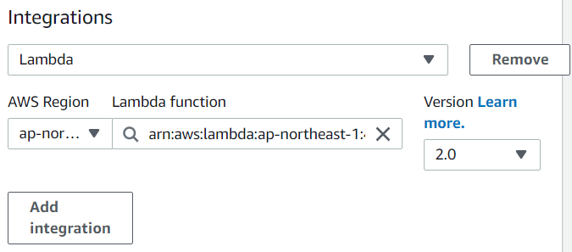
Step2.1: create and configure integrations
48

Slide 49
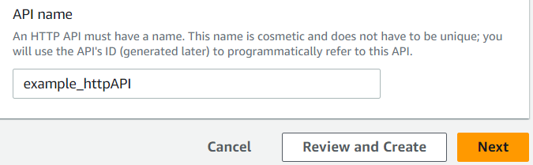
Step2.2: name the HTTP API
49

Slide 50
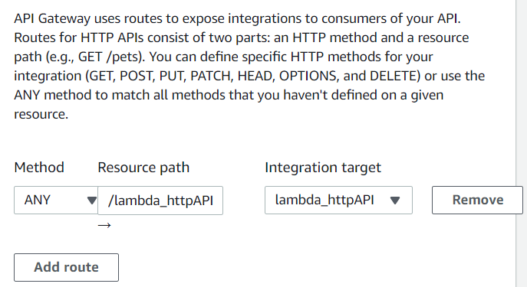
Step2.3: create routes
50

Slide 51
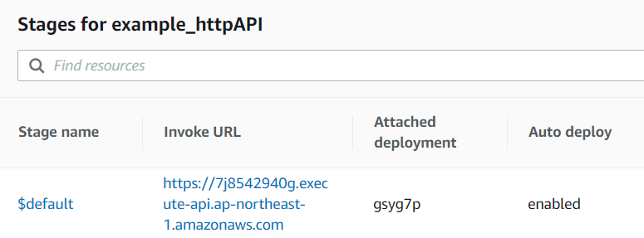
Step3: view the HTTP API
Full URL:
  https://7j8542940g.execute-api.ap-northeast-1.amazonaws.com/lambda_httpAPI
51

Slide 52
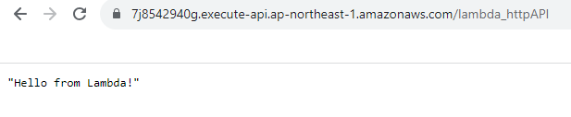
Step4: test the HTTP API
52

Slide 53
Good Luck!
53

