Slide 1
Week 9 Web Application
Architecture and Design Pattern
Dr Zhi Zhang

Slide 2
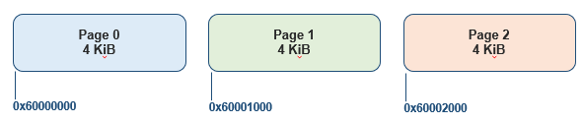
A typical page size is 4 KiB. Which of the following addresses is page-aligned?
A. 0x60001800.
B. 0x60001000.
C. 0x50001100.
D. 0x50001200.

Slide 3
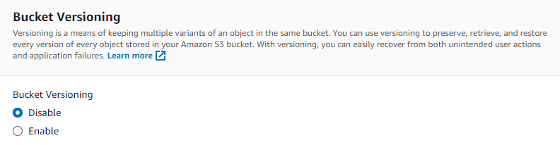
Which of the following statements about Amazon S3 are correct? (Select all that apply)?
A. An S3 bucket is used to store objects.
B. An S3 object can contain both data and metadata.
C. Object Lock prevents objects in a bucket from being deleted or overwritten for a fixed amount of time or indefinitely.
D. Bucket versioning enables multiple versions of a single bucket.

Slide 4
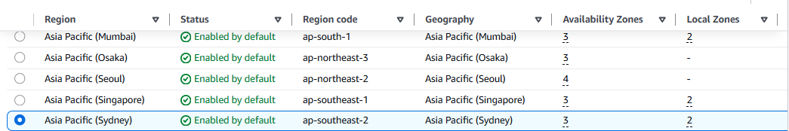
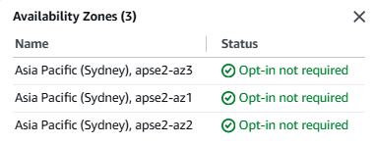
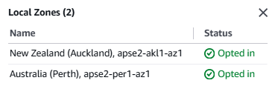
Which of the following statements about AWS are correct?
A. An AWS region represents a geographical location where AWS has data centers.
B. A region can contain multiple availability zones.
C. A local zone extends a region to a location closer to users in a particular city.
D. A local zone extends an availability zone to a location closer to users in a particular city.

Slide 5
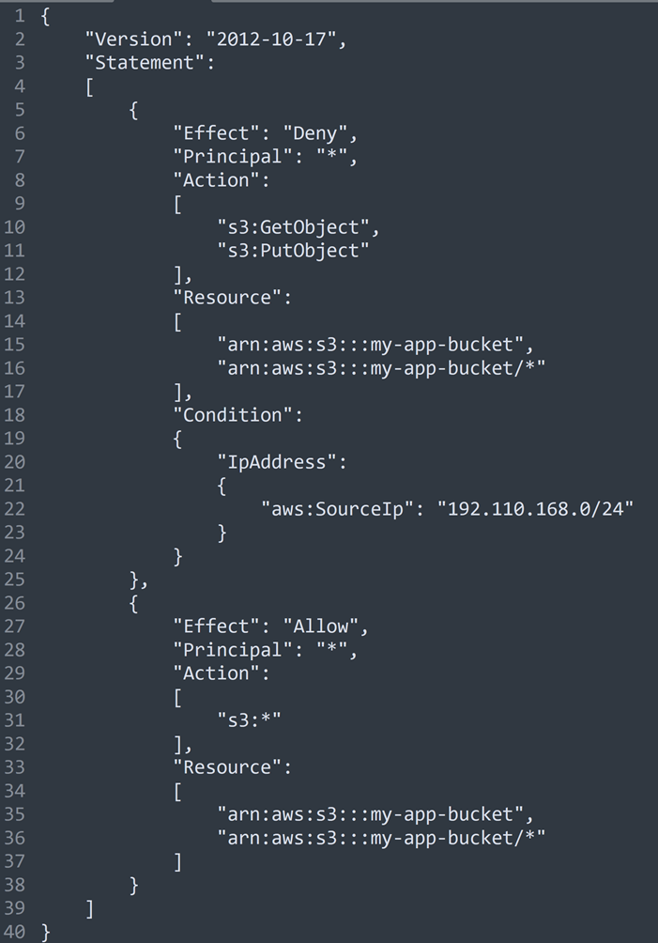
First, describe what the first statement (Effect:Deny) does based on Effect, Principal, Action, Resource and Condition.

Slide 6
Second, explain the final effective permissions for:
a) a user connecting from 192.110.168.200.
b) a user connecting from 10.0.0.5.

Slide 7
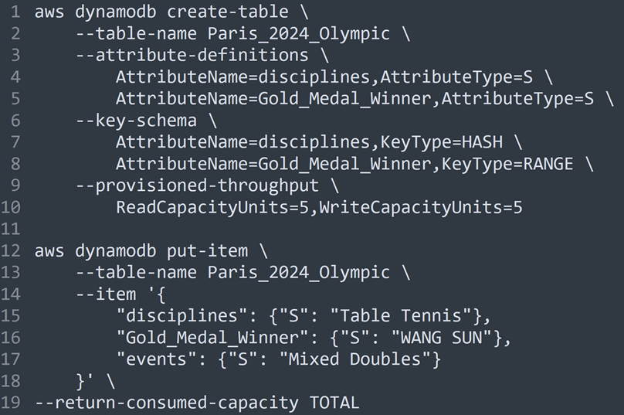
Draw a resulting DynamoDB table assuming the code above were executed.

Slide 8
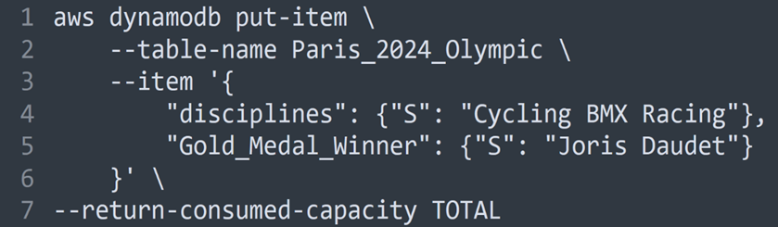
Based on the table created, read the code snippet above. If the code were executed, draw the resulting DynamoDB table.

Slide 9
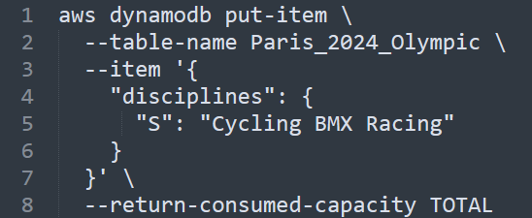
Based on the existing table, read the code snippet above. If the code below were executed, what would the resulting table look like?

Slide 10
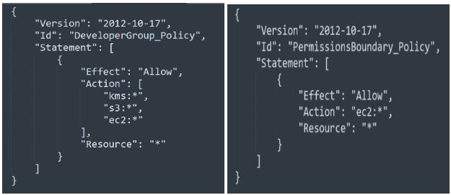
To manage AWS user accounts, Bob implements a policy below called DeveloperGroup_Policy for a group of developers within his company. Then, Bob adds Alice to the group. To set the maximum permissions that DeveloperGroup_Policy can grant to Alice, Bob also attaches another policy to her. The policy is called PermissionsBoundary_Policy.
What are the effective permissions that Alice can perform? Justify your answer by explaining what the two policies primarily do and determining the final effective permissions.

Slide 11
Overview
Web Application Architecture
Web Application Design Pattern
Django Framework

Slide 12
What is a web application architecture
A web application architecture is a layout that displays the interactions between different software components, such as frontend, and backend.

Slide 13
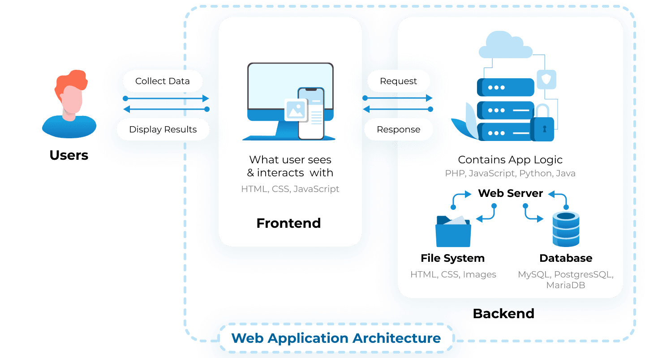
What is a web application architecture
A web application architecture is a layout that displays the interactions between different software components, such as frontend, and backend.

Slide 14
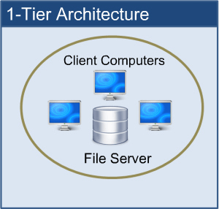
1-Tier web application architecture
  1-Tier Architecture: all the software components are available on the same machine.

Slide 15
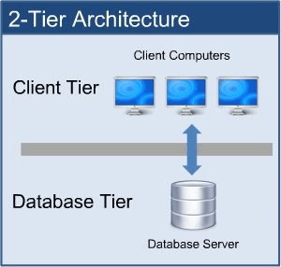
2-Tier web application architecture
  2-Tier Architecture: The client sends the request to the server and the server processes the request and sends the response back to the client.

Slide 16
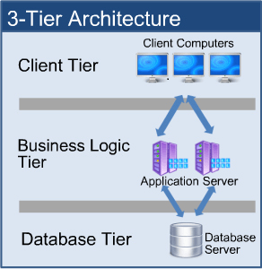
3-Tier web application architecture
Client Tier/Presentation Layer: displays the user interface and manages user interaction.
Business Logic Tier/Application server: has all the business logic that dictates how data is handled, and routed between the Client and Database Tiers.
Database Tier/Database server: stores data and handles data queries and updates.

Slide 17
Complex web application architecture
Presentation Layer.
Application Layer.
Database Layer.
More layers of services: perform optimization and/or provide additional functionality to the web application.

Slide 18
Complex web application architecture
More layers of services:
Examples: Caching service, and datawarehouse.

Slide 19
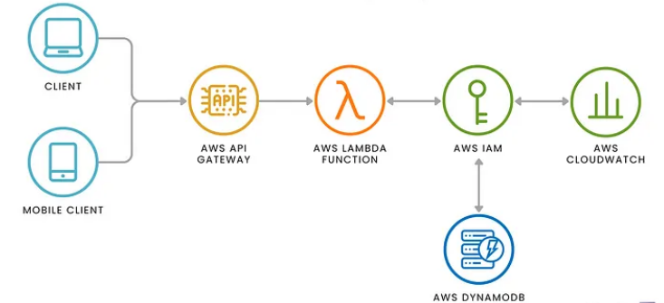
Serverless architecture
Example: AWS

Slide 20
Web application architecture
It is the skeleton: a high-level structure that outlines how different application components are organized and interact.
Web application design pattern
It is a reusable solution regarding how to organizing software responsibilities and interactions within an application.

Slide 21
A popular design pattern
Model—View—Controller (MVC):
  Model: Maintains the application’s data. It interacts with the database to retrieve, update, and store data.
  View: Provides templates for presenting the data to the user. It handles the layout and visual presentation of the data.
  Controller: Acts as an intermediary between the Model and the View. It processes user inputs, makes calls to the Model to retrieve data, and then selects the appropriate View to display the data. The Controller manages the flow of data and controls the application logic.

Slide 22
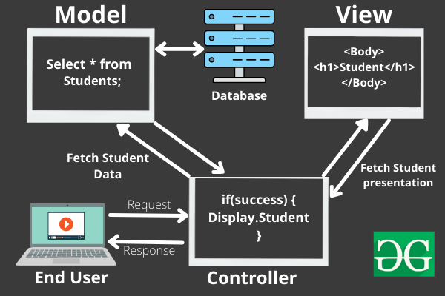
Model—View—Controller (MVC)
An example:
2
1

Slide 23
Model—View—Controller (MVC)
An example:
3
2
4
1

Slide 24
Model—View—Controller (MVC)
An example:
3
2
4
5
6
1
7

Slide 25
MVC
Django is an open-source web application framework written in Python.
  Django customizes the MVC design pattern.

Slide 26
Django customizes MVC as MTV (Model—Template—View)
  M — — — ->For data interaction— — — — — ->M
  V — — — -> For data visualization— — — — — ->T
  C — — — -> For component interaction— — — —>V
Real-world Django-based web application
  Instagram, Spotify, Youtube

Slide 27
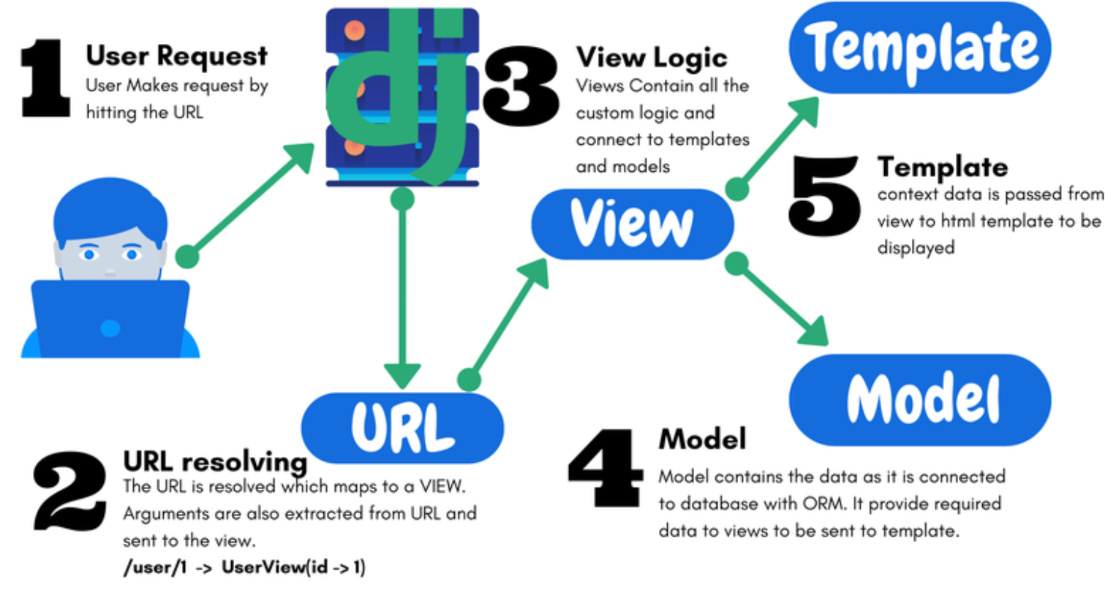
A Django-based web application:
URL resolving: maps an incoming request to an appropriate view function.
  Extracts specific strings and/or digits in the URL and sends them to the VIEW function.

Slide 28
A Django-based web application:
View: uses the resolved arguments to interacts with templates and models as needed.

Slide 29
A Django-based web application:
Model: interacts with the database.

Slide 30
A Django-based web application:
Template: takes the data passed from the view logic for rendering the HTML template (or other XML templates)

Slide 31
urls.py: implements the component of URL resolving
    1
    2
    3
    4
    5
    6
    from django.urls import path
from music import views
    urlpatterns = [
    path('', views.home, name='home'),
    ]

Slide 32
views.py: implements the View component
    1
    2
    3
    4
    5
from django.shortcuts import render
# Create our views here.
def home(request):
return render(request, 'home.html')

Slide 33
    1
    2
    3
    4
    5
    6
    7
    8
    9
    10
<h1>Main Page:</h1>
<ul>
<li><a href="{% url 'home' %}">Home Page</a></li>
</ul>
<p>MVT means:</p>
<ul>
<li>Model</li>
<li>View</li>
<li>Template</li>
</ul>

Slide 34
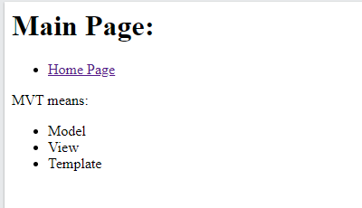

Slide 35
models.py: implements the Model component
    1
    2
    3
    4
    5
    6
from django.db import models
# Define your models here.
class Artist(models.Model):
name = models.CharField(max_length=100)
song = models.CharField(max_length=25)

Slide 36
Demo: set up a Django web app called music
Create a Django project and a music app
Setup the music app
Enable template rendering
Render templates with retrieved data

Slide 37
Step 1: create a virtual environment
mkdir ~/cits5503_django
cd cits5503_django
python3 -m venv cits5503venv
source cits5503venv/bin/activate
Question: /opt/wwc/ is not a sufficiently safe path for deploying a Django application. Why?

Slide 38
Step 1: create a virtual environment
mkdir ~/cits5503_django
cd cits5503_django
python3 -m venv cits5503venv
source cits5503venv/bin/activate
Question: /opt/wwc/ is not a sufficiently safe path for deploying a Django application:
While this path requires the root privilege, the application itself does not require it.

Slide 39
Step 1: create a virtual environment
mkdir ~/cits5503_django
cd cits5503_django
python3 -m venv cits5503venv
source cits5503venv/bin/activate
Question: Why do we need to setup a virtual environment in python? List and describe two reasons.
Isolation.
Ease of Deployment

Slide 40
Step 1: create a virtual environment
Question: Why do we need to setup a virtual environment in python?
Isolation: Virtual environments isolate Python packages and dependencies between different projects. This prevents conflicts where different projects require different versions of the same package.
Ease of Deployment: All the installed packages in a virtual environment can be copied onto another machine or virtual environment
pip freeze > requirements.txt
pip install -r requirements.txt

Slide 41
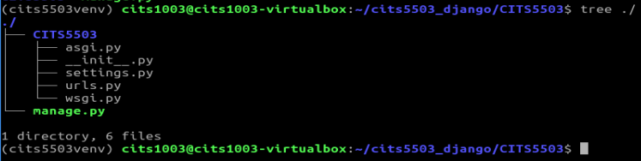
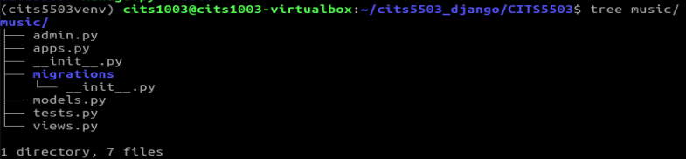
Step 2: create a Django project and app
pip install django
django-admin startproject CITS5503
cd CITS5503
python3 manage.py startapp music

Slide 42
Step 3: start the Django application server
python manage.py check
python manage.py runserver
Question: Which default port is the Django application server is listening on?

Slide 43
Step 3: start the Django application server
python manage.py check
python manage.py runserver
Question: What if the default port is taken by another process in our system?

Slide 44
Step 3: start the Django application server
Question: What if the default port is taken by another process in our system?
python manage.py runserver 9000
#ngnix
proxy_pass http://127.0.0.1:8000;

Slide 45
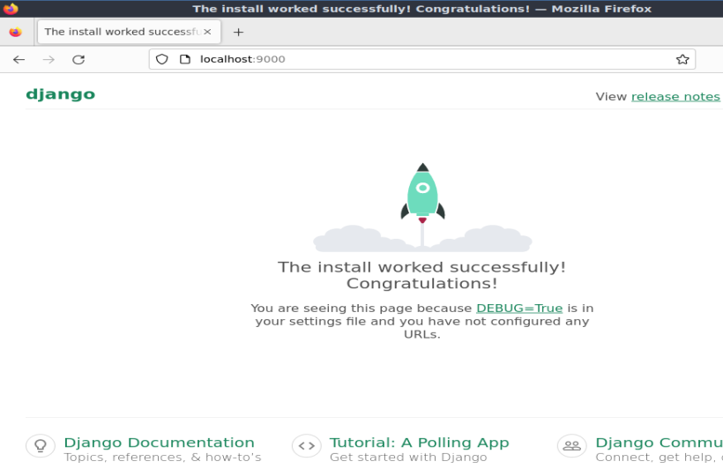
Step 4: Access the server
Open a browser and go to: http://localhost:9000

Slide 46
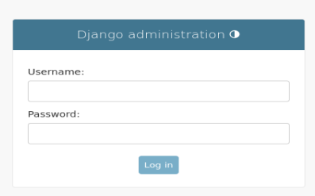
Step 4: Access the server
If we go to: http://localhost:9000/admin/

Slide 47
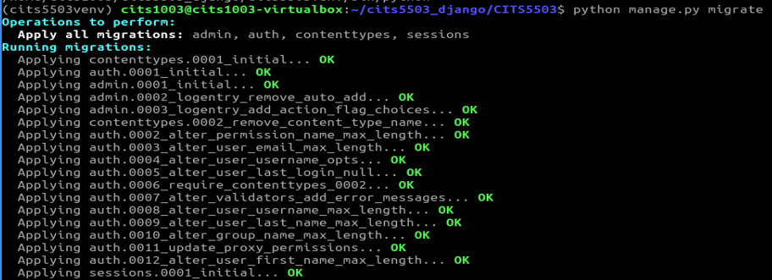
Step 5: create an admin
python manage.py migrate

Slide 48
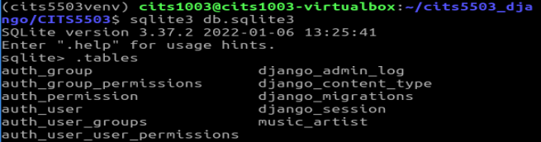
Step 5: create an admin
python manage.py migrate

Slide 49
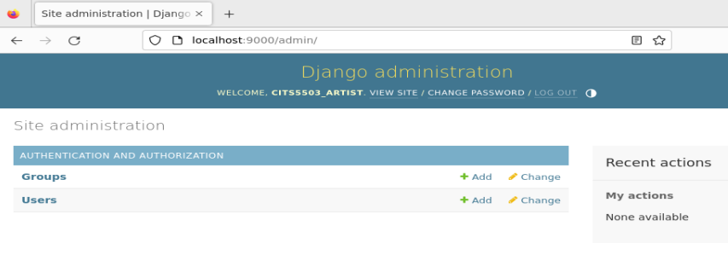
Step 5: create an admin
python manage.py createsuperuser
restart the server

Slide 50
Demo: set up a Django web app called music
Create a Django project and a music app
Setup the music app
Enable template rendering
Render templates with retrieved data

Slide 51
Step 1: register the app
# inside CITS5503/settings.py
INSTALLED_APPS = [
'django.contrib.admin’, #The admin site
'django.contrib.auth’, #Authentication
'django.contrib.contenttypes’, #A framework for content types
'django.contrib.sessions’, #A session framework
'django.contrib.messages’, #A messaging framework
'django.contrib.staticfiles’, #A framework for managing static files
#new app below:
‘music.apps.MusicConfig',
]

Slide 52
Step 2: update the url component in the project
# inside CITS5503/urls.py
from django.contrib import admin
from django.urls import path
from music import views # added
urlpatterns = [
path('', views.home, name='home'), # added
path('admin/', admin.site.urls),
]

Slide 53
Step 3: update the view component in the app
# inside music/views.py
from django.shortcuts import render
from django.http import HttpResponse #added
#added
def home(request):
return HttpResponse('This is the home page.')

Slide 54
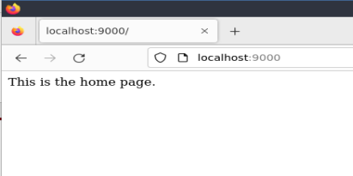
Step 4: access the app
restart the server and go to: http://localhost:9000

Slide 55
Demo: set up a Django web app called music
Create a Django project and a music app
Setup the music app
Enable template rendering
Render templates with retrieved data

Slide 56
Step 1: create html templates in the project and the app
Inside the current working directory of the project
mkdir templates
mkdir music/templates
mkdir music/templates/music
touch templates/home.html
touch music/templates/music/main.html
touch music/templates/music/artist.html

Slide 57
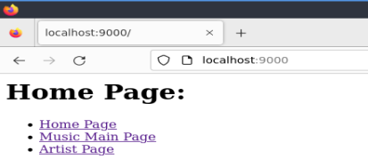
templates/home.html
<h1>Home Page:</h1>
<ul>
<li><a href="{% url 'home' %}">Home Page</a></li>
<li><a href="{% url 'music:main' %}">Music Main Page</a></li>
<li><a href="{% url 'music:artist' %}">Artist Page</a></li>
</ul>

Slide 58
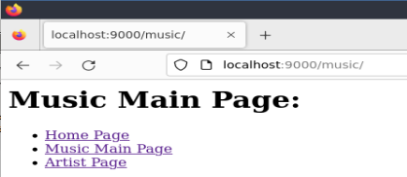
music/templates/music/main.html
<h1>Music Main Page:</h1>
<ul>
<li><a href="{% url 'home' %}">Home Page</a></li>
<li><a href="{% url 'music:main' %}">Music Main Page</a></li>
<li><a href="{% url 'music:artist' %}"> Artist Page </a></li>
</ul>

Slide 59
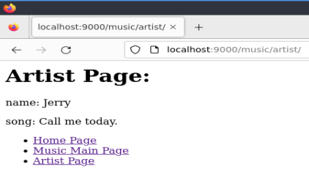
music/templates/music/artist.html
<h1>Artist Page:</h1>
<p>name: Jerry</p>
<p>song: Call me today</p>
<ul>
<li><a href="{% url 'home' %}">Home Page</a></li>
<li><a href="{% url 'music:main' %}">Music Main Page</a></li>
<li><a href="{% url 'music:artist' %}"> Artist Page </a></li>
</ul>

Slide 60
Step 2: update the url component in the project
# inside CITS5503/urls.py
from django.contrib import admin
from django.urls import path
from music import views
urlpatterns = [
path('', views.home, name='home'),
path('admin/', admin.site.urls),
path('music/', include('music.urls')), # added
]

Slide 61
Step 3: create the url component in the app
touch music/urls.py
# inside music/urls.py
from django.urls import path
from . import views
app_name = 'music'
urlpatterns = [
path('', views.main, name='main'),
path('artist/', views.artist, name='artist'),
]
Question: What kind of URL requests will be processed by the first URL pattern?

Slide 62
Step 3: create the url component in the app
touch music/urls.py
# inside music/urls.py
from django.urls import path
from . import views
app_name = 'music'
urlpatterns = [
path('', views.main, name='main'),
path('artist/', views.artist, name='artist'),
]

Slide 63
Step 4: update the view component in the app
# inside music/views.py
from django.shortcuts import render
def home(request):
return render(request, 'home.html’)
#added
def main(request):
return render(request, 'music/main.html')
def artist(request):
return render(request, 'music/artist.html')

Slide 64
Step 5: register the home template in the project
# inside CITS5503/settings.py
import os #added
TEMPLATES = [
{
(...)
'DIRS': [os.path.join(BASE_DIR, 'templates')], #added
'APP_DIRS': True,
(...)
}
]

Slide 65
Step 6: restart the server and access the app
Go to the home page
Go to the main page
Go to the artist page

Slide 66
Demo: set up a Django web app called music
Setup a Django project
Setup a web app called music
Enable template rendering
Render templates with retrieved data

Slide 67
Step 1: add a model in the app
# inside music/models.py
from django.db import models
class Artist(models.Model):
name = models.CharField(max_length=200)
song = models.CharField(max_length=200)
def __str__(self):
return self.name

Slide 68
Step 2: create the Artist table and register it into the admin interface
# inside music/admin.py
from django.contrib import admin
from .models import Artist
admin.site.register(Artist)

Slide 69
Step 3: make changes and apply changes to the database
python manage.py makemigrations
python manage.py migrate

Slide 70
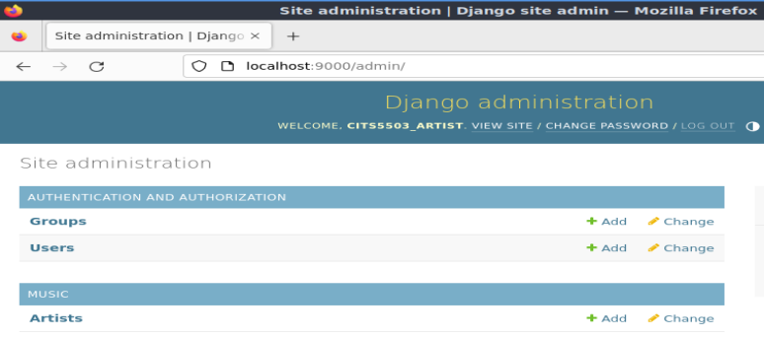
Step 4: restart the server and access the app
Go to the admin interface

Slide 71
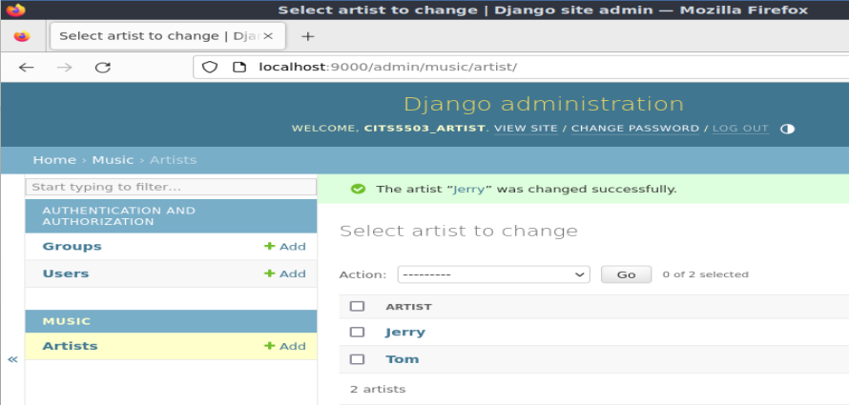
Step 5: populate the artist table
def __str__(self):
return self.name

Slide 72
Step 6: update the view component in the app
# inside music/views.py
from django.shortcuts import render
from .models import Artist
def home(request):
return render(request, 'home.html')
def main(request):
return render(request, 'music/main.html')
#updated
def artist(request):
title = 'Artist Page'
artist_list = Artist.objects.all()
context = {'title': title, 'artist_list': artist_list}
return render(request, 'music/artist.html', context)

Slide 73
Step 7: update music/templates/music/artist.html
<h1>{{title}}</h1>
<ul>
<li><a href="{% url 'home' %}">Home Page</a></li>
<li><a href="{% url 'music:main' %}">Music Main Page</a></li>
</ul>
<ul>
{% for artist in artist_list %}
<li> {{artist.name}}: {{artist.song}}</li>
{% endfor %}
</ul>

Slide 74
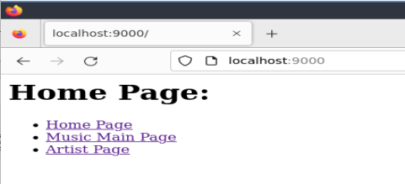
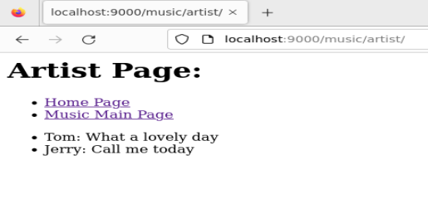
Step 8: restart the server and access the app

Slide 75
Question: What if 'title' in context is replaced by 'titlectx'?
def artist(request):
title = 'Artist Page'
artist_list = Artist.objects.all()
context = {'title': title, 'artist_list': artist_list}
return render(request, 'music/artist.html', context)
def artist(request):
title = 'Artist Page'
artist_list = Artist.objects.all()
context = {'titlectx': title, 'artist_list': artist_list}
return render(request, 'music/artist.html', context)

Slide 76
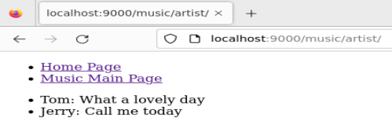
<h1>{{titlectx}}</h1>
<ul>
<li><a href="{% url 'home' %}">Home Page</a></li>
<li><a href="{% url 'music:main' %}">Music Main Page</a></li>
</ul>
<ul>
{% for artist in artist_list %}
<li> {{artist.name}}: {{artist.song}}</li>
{% endfor %}
</ul>
Otherwise

